Slide 1
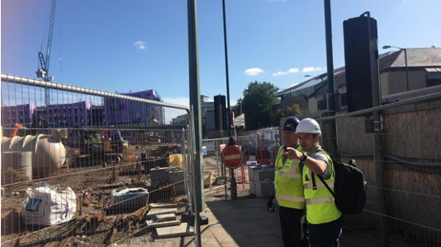

ENVIRONMENTAL MONITORING
What goes wrong, what works, how to stay compliant
NOISE | VIBRATION | DUST

Slide 2
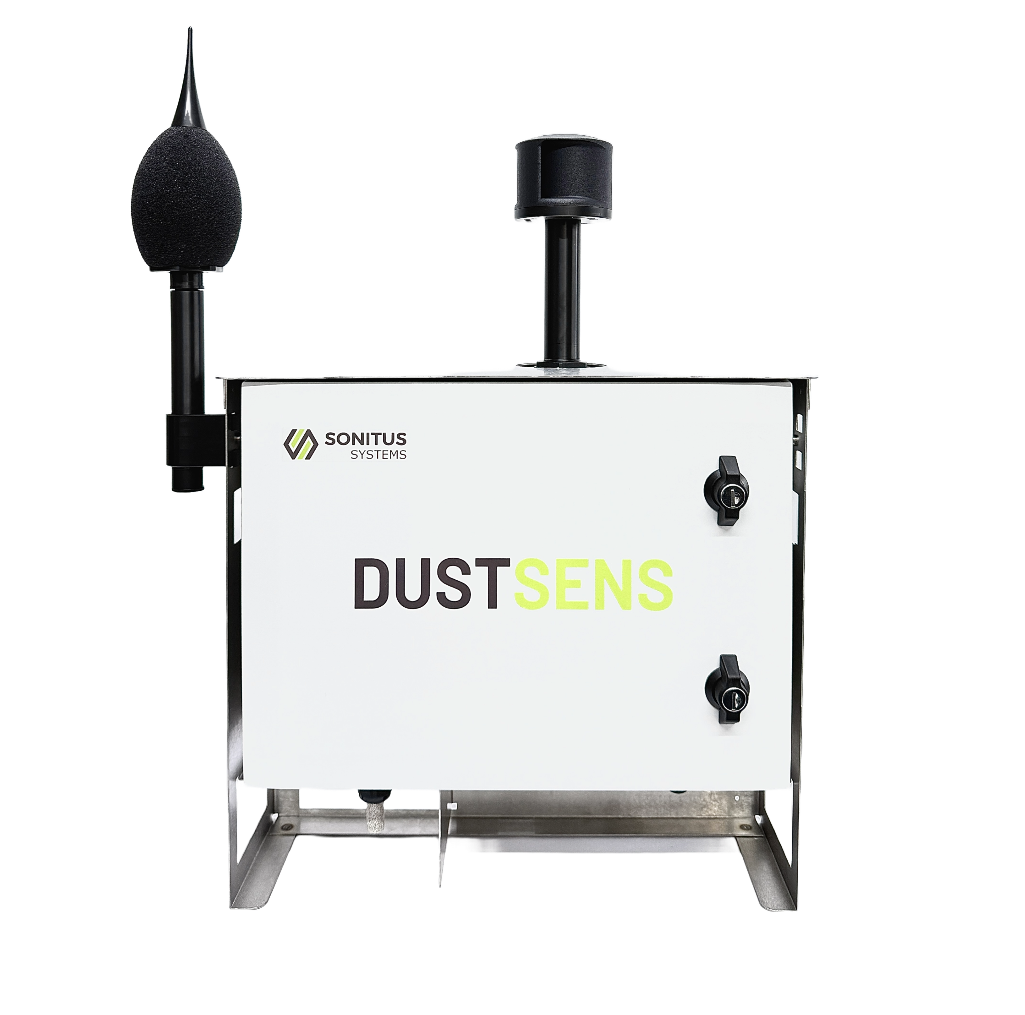

Campbell Associates – Who are we?
We are an equipment and monitoring supply of ‘environmental’ monitoring equipment.
Notes:
There is a key difference between ‘environmental’ and ‘occupational’.

Slide 3
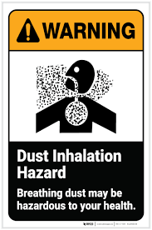
Our Responsibility
We need to control environmental impact on site
We need to protect workers and the public
We need ensure compliance
We must evidence your decisions
We should or must collect measurement data to prove conformance or provide reliance

Slide 4
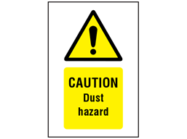
Real Consequences
Complaints from neighbours
EHO visits and enforcement
Site shutdowns
Legal claims and reputational damage

Slide 5
The difference between
Environmental
Impacts OUTSIDE the site
Affects:
Public
Neighbours
Commercial, Hospitals, Schools, Universities
Driven by:
Planning Conditions
Local authorities
Complaints
Measured as:
What leaves your site
Occupational
Impact inside the site
Affects:
Workers
Contractors
Operatives
Driven by:
HSE
COSHH Regulations
Complaints
Measured as:
What workers are exposed to

Slide 6
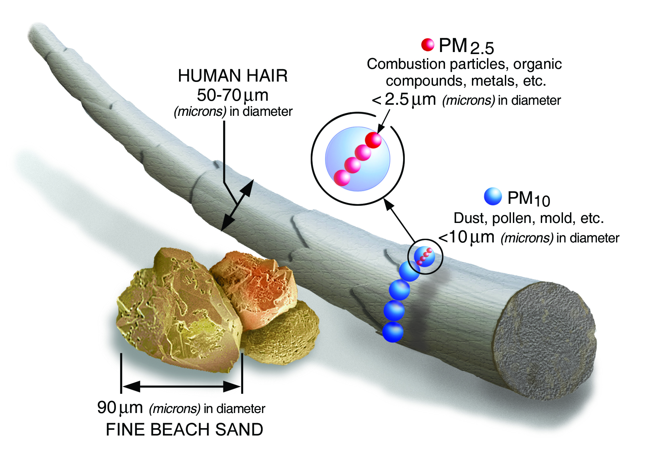
What is dust?
Dust is airborne solid particles generated by activities that can be transported through the air and inhaled or deposited.

Slide 7
Dust Particles
µm = micrometre (1/1000 of a millimetre)
The smaller the particle, the more dangerous and less visible it becomes
Dust particles are classified by size because this determines:
How they behave in air
How far they travel
Where they deposit in the body
Acronym | Description | Size (Range) | Visibility
TSP | Total Suspended Particles | ~10–100 µm | Often visible (dust clouds)
PM10 | Inhalable particles | ≤10 µm | Not usually visible individually
PM4 | Respirable particles (for occupational measurement) | ≤4 µm | Detectable with instruments
PM2.5 | Fine respirable particles | ≤2.5 µm | Invisible, may appear as haze at high levels
PM1 | Very fine particles | ≤1 µm | Completely invisible

Slide 8
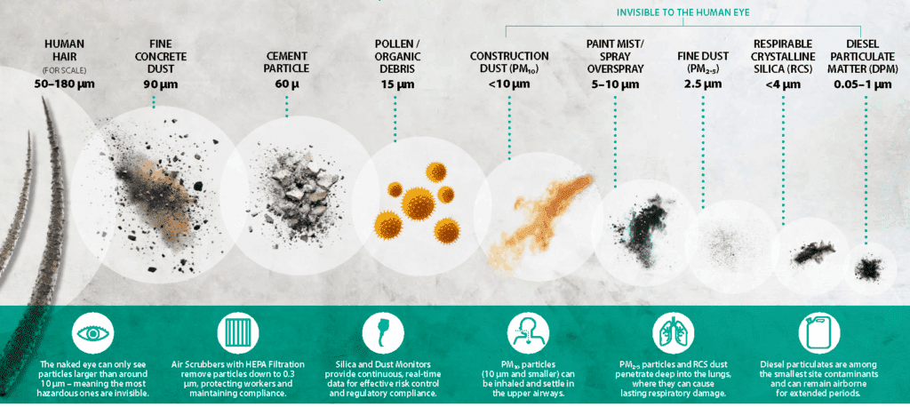

Slide 9
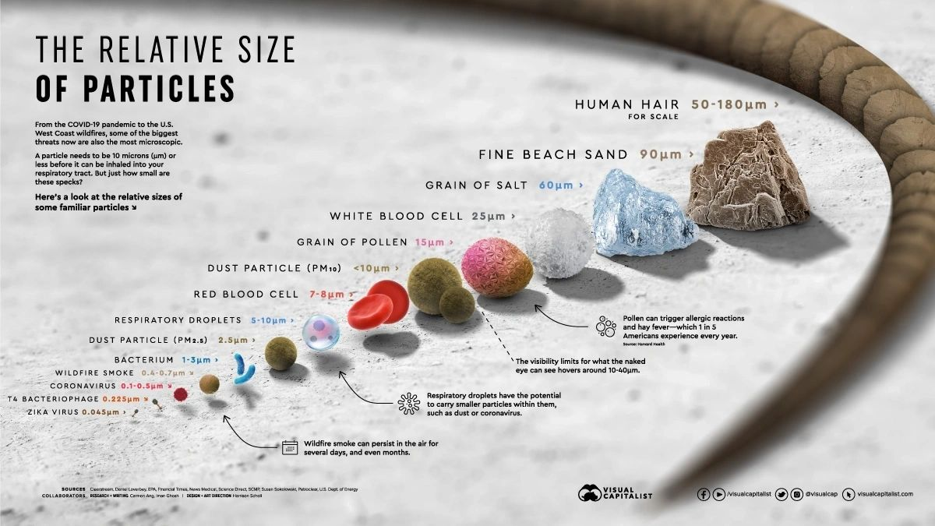

Slide 10
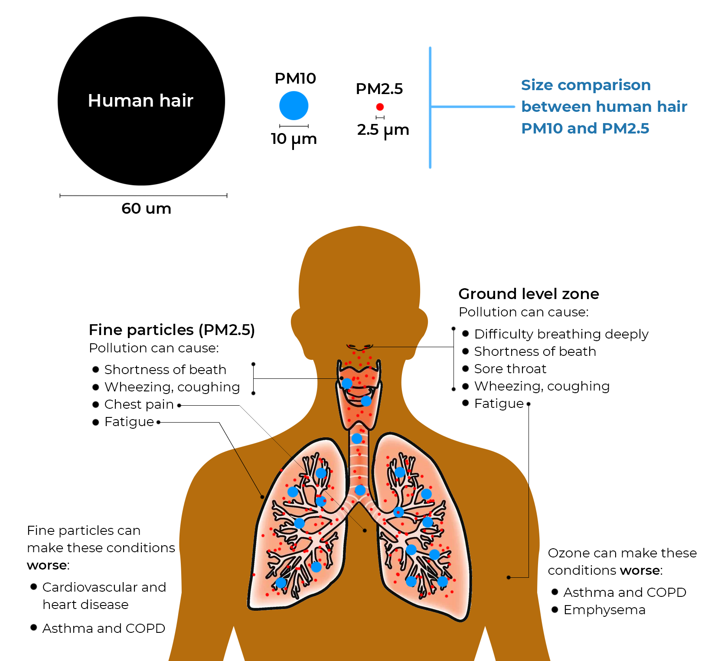

Slide 11
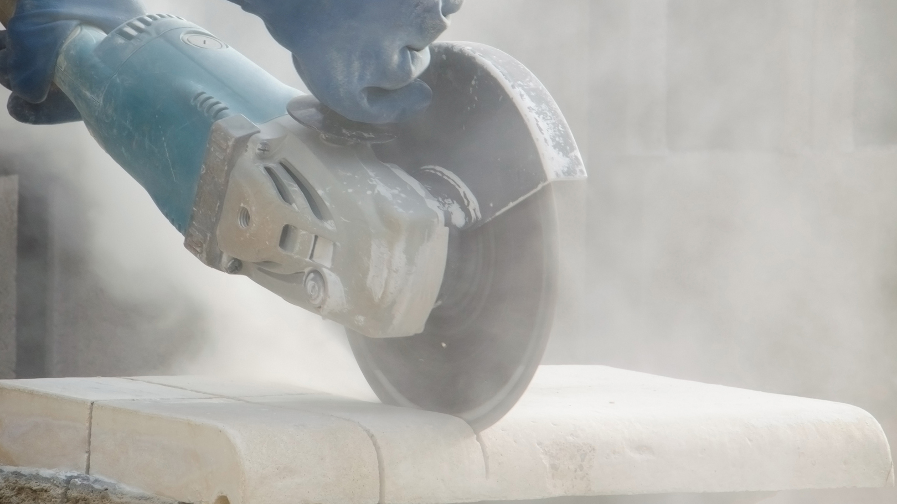
Dusty Activities
On your sites, dust is created by:
Cutting and grinding
Breaking concrete
Crushing
Vehicle movement
Wind picking up settled material
Dust can be re-generated hours after work stops

Slide 12
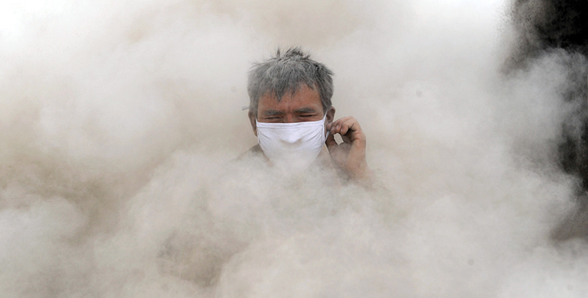
Dust Behavior
How dust behaves
Moves with wind direction
Builds up in certain areas
Escapes site boundaries
Settles and then becomes airborne again

Slide 13
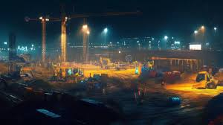
Weather & Night-Time Dust
Dust Doesn’t Stop When You Do
Work may stop, but wind continues to move dust
Settled dust becomes airborne again overnight
Changing wind direction can carry dust off-site
Night-time = no supervision, no response
Complaints often occur outside working hours

Slide 14
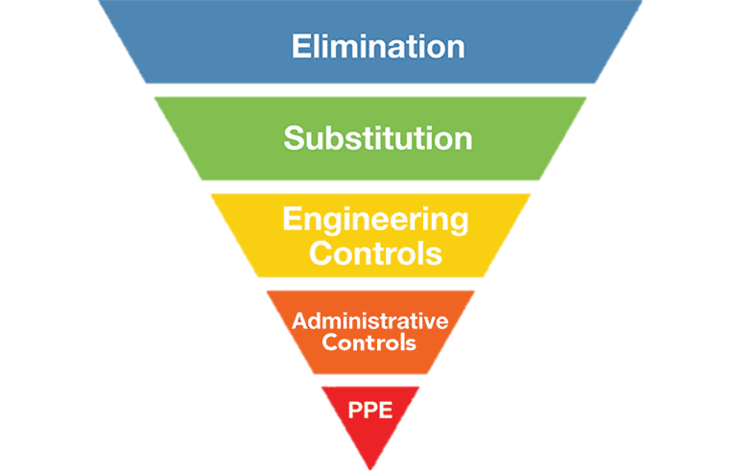
The hierarchy control is well known for Occupational
Occupational (HSE)
Strict hierarchy:
Eliminate
Substitute
Engineer
Admin
PPE

Slide 15
Should we treat both the same?
“Environmental is what leaves your site. Occupational is what your workers breathe. You are responsible for both.”

Slide 16
Environmental Hierarchy Control
🔵 Eliminate | “Best but rarely done”
🟢 Reduce | “Planning stage decisions
🟡 Control | “Where most of your effort should be”
🟠 Contain | “Stops complaints”
🔴 Monitor | “Proves whether any of this actually worked”

Slide 17
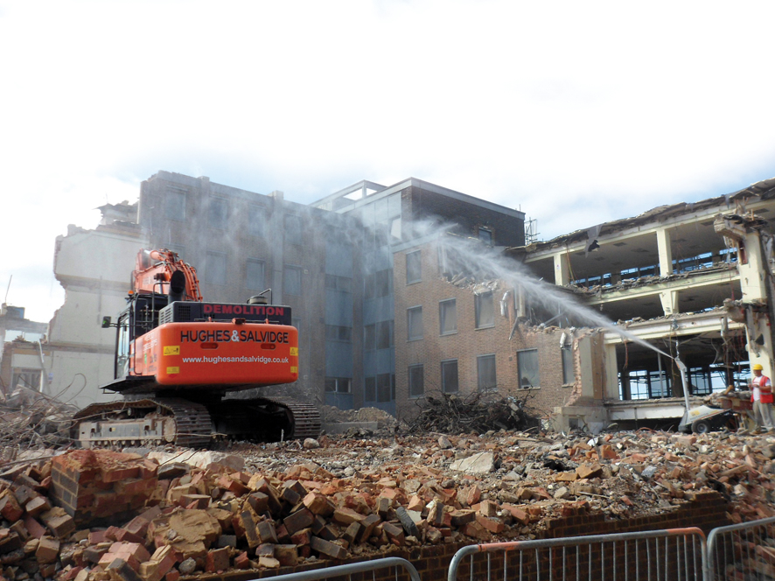
Controls – Being Compliant
Good occupational, bad environmental
Workings wearing mask
Dust extraction in place
BUT dust blowing of site
Result:
Complaints, enforcement
Good environmental, bad occupational
Boundary dust levels low
BUT high exposure at source
Result:
Long term health risk, HSE issue

Slide 18
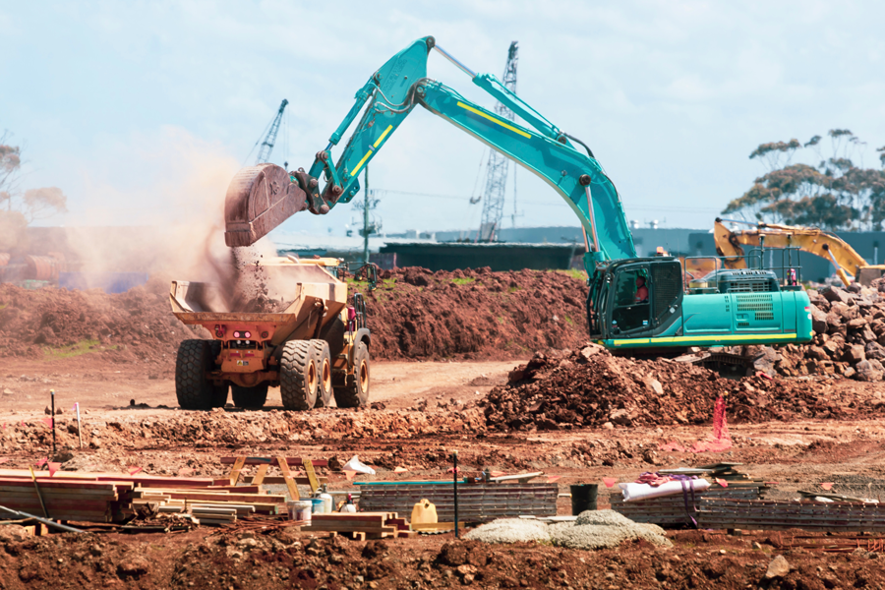
Air Quality Management
Eliminate / Avoid
Can the activity be removed or resigned
Reduce at the source
Low dust methods
Pre-cut materials
Reduce drop heights

Slide 19
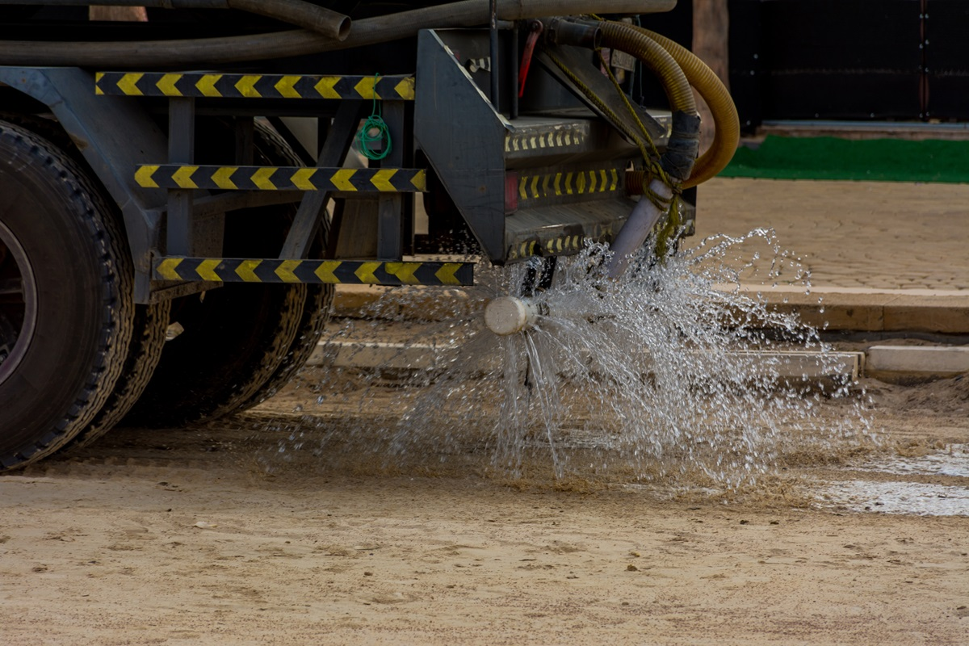
Air Quality Management
Control at source
Water suppression
Dust extraction
Enclosed processes
Contain/ Prevent Escape
Hoarding
Sheetings
Covered skips
Wheel washing

Slide 20
Environmental Air Quality Controls
Control at source
Water suppression
Dust extraction
Low dust methods
Containment
Hoarding and barriers
Covered materials
Wheel washing
Planning
Manage high-risk activities
Consider weather conditions
Monitoring (verification)
Real-time PM10 monitoring
Boundary monitoring
Used to prove control

Slide 21
Occupational Controls (Worker exposure)
Hierarchy of control
Eliminate
Substitute
Engineering controls
Engineering controls
Local exhaust ventilation
On-tool extraction
Wet cutting
Administrative controls
Training and procedures
Task rotation
PPE (last line of defence)
RPE (face masks)
Protective clothing

Slide 22
Dust Limits
Some councils define trigger levels such as:
PM10 (15 min average): 190 µg/m³
PM10 (1 hour average): 250
From UK legislation:
PM10 annual mean: 40 µg/m³
PM10 daily mean: 50 µg/m³ (not to be exceeded >35 times/year)

Slide 23
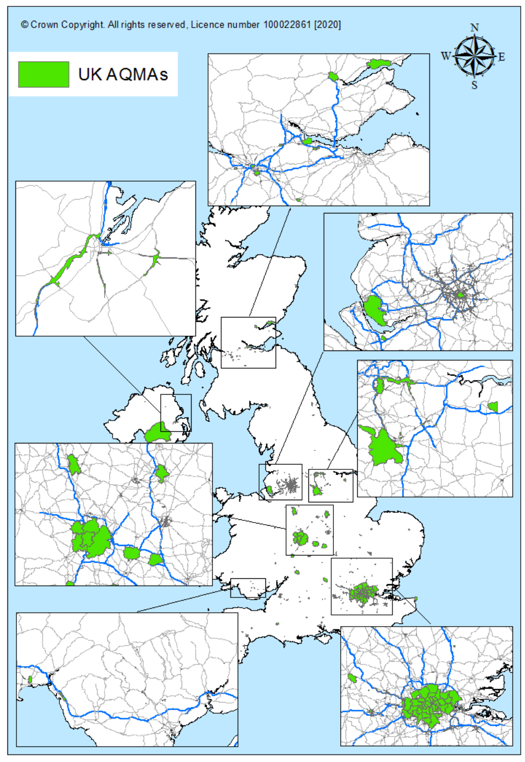

Does your site require environmental dust monitoring?

Slide 24
Codes of Practice (Borough Requirements)
Many boroughs (e.g. London) have their own dust control requirements
Often based on:
IAQM guidance
Local planning conditions
You must know what applies to your site
PG11 (Process Guidance)
Applies to specific activities (e.g. crushing, screening)
Defines emission limits and control requirements
May require monitoring and permits

Slide 25
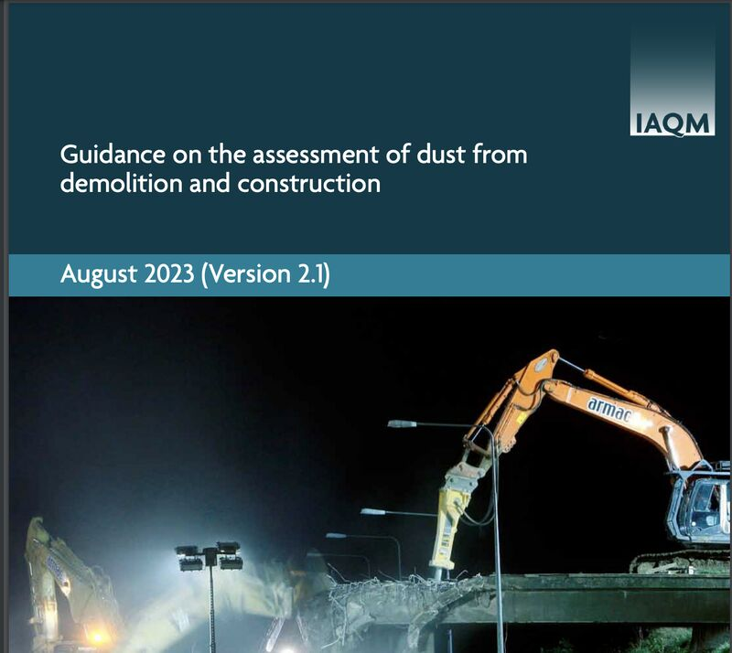

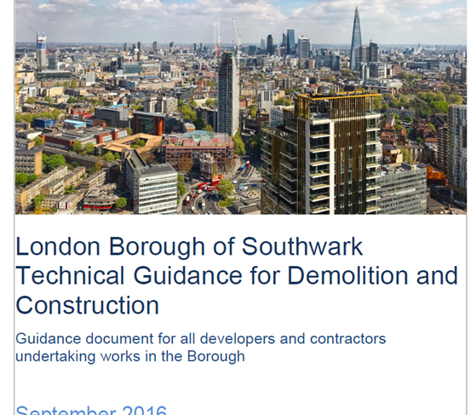

Is your site in compliance to legal standards or guidelines?

Slide 26
Section 61 – Why it matters
Provides agreed working methods with the local authority
Demonstrates proactive control of noise, vibration, and dust
Can protect against enforcement if followed correctly

Slide 27
Dust Management Plans
Why use them:
Required by planning conditions
Demonstrates control strategy
Helps manage risk proactively
What they include:
Risk assessment
Control measures
Monitoring strategy
Site layout considerations

Slide 28
Environmental Hierarchy Control
🔵 Eliminate | “Best but rarely done”
🟢 Reduce | “Planning stage decisions
🟡 Control | “Where most of your effort should be”
🟠 Contain | “Stops complaints”
🔴 Monitor | “Proves whether any of this actually worked”

Slide 29
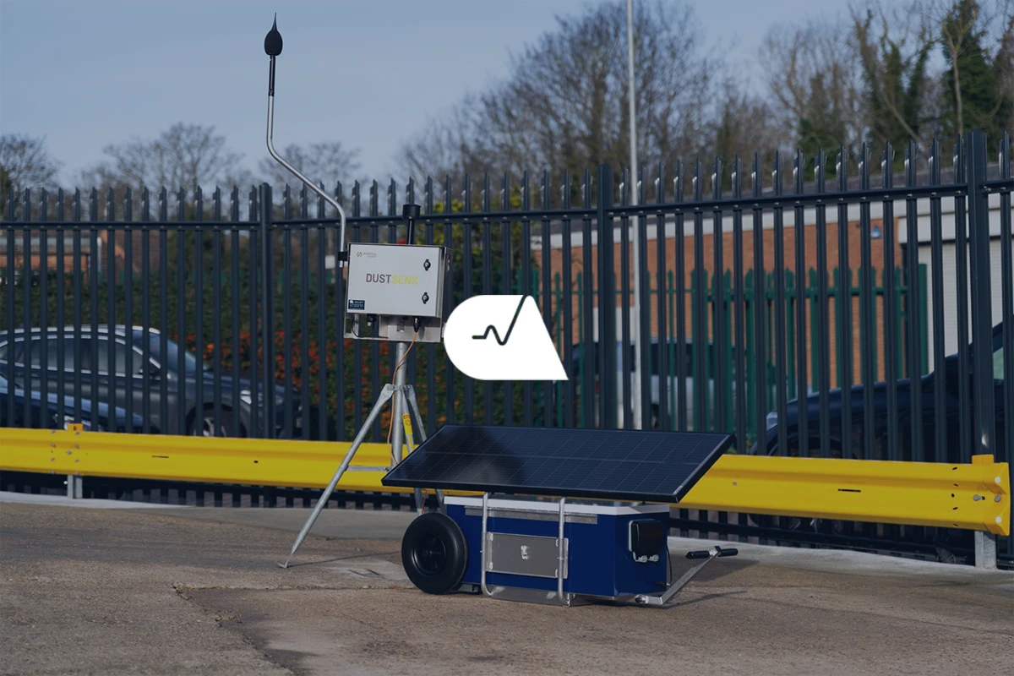
Monitor & Verify
Real-time dust monitoring
Boundary monitoring
Alerts and response
Environmental control is about stopping dust leaving the site. Monitoring proves whether you’ve achieved it.

Slide 30
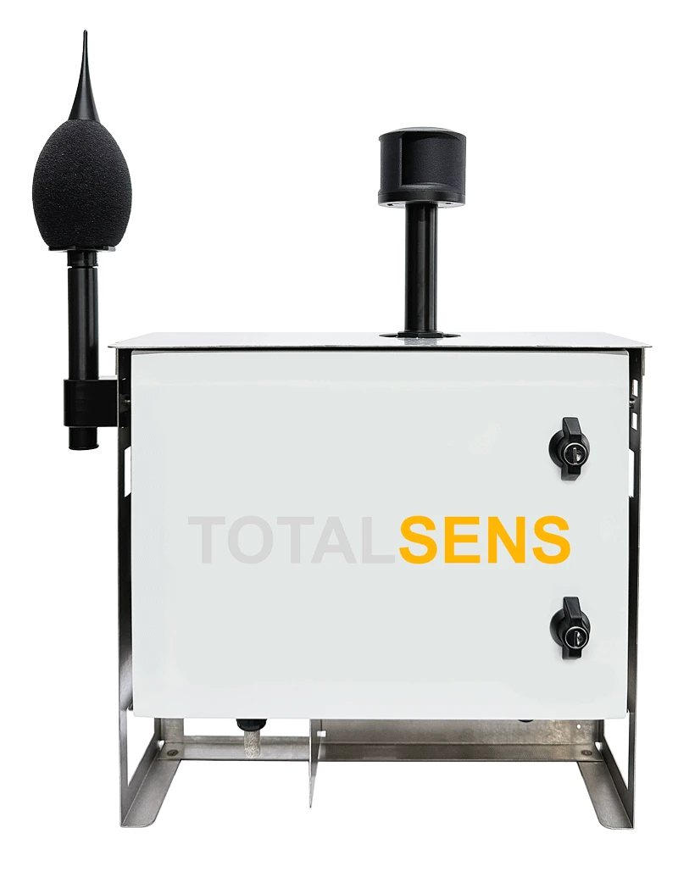
Choosing the correct monitor
UK certification scheme run by the Environment Agency
Ensures monitors are accurate
Repeatable
Fit for purpose
What people THINK MCERTS means:
It’s approved so they can be used anywhere
We’re legally covered if we use it
All MCERTS equipment is equal

Slide 31
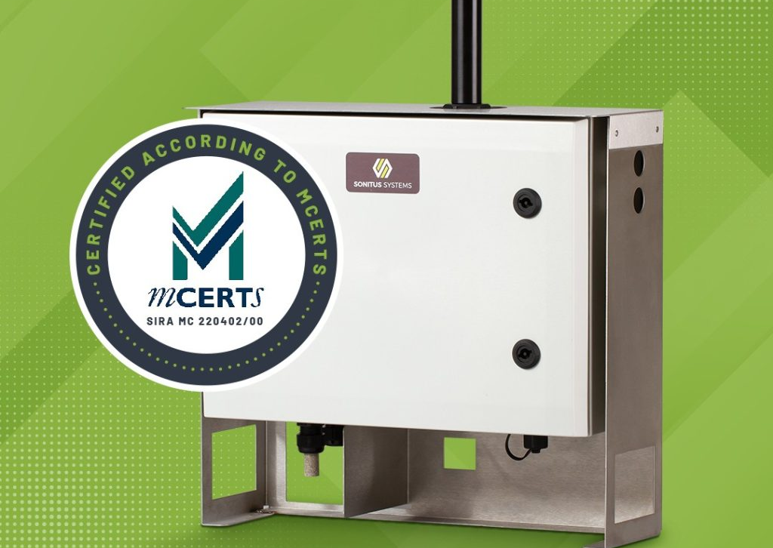
Reality of MCERTS
It means the equipment met a test standard under specific conditions
It does NOT guarantee performance in your site conditions
It does NOT replace correct setup, positioning, or interpretation
They may struggle with:
Moisture
Particle composition
Site variability

Slide 32
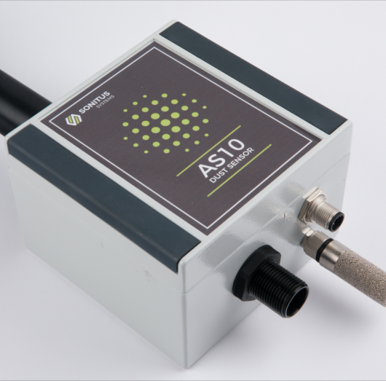
Choosing the correct sensor
Is this sensor suitable for my site conditions?
Was it tested in conditions similar to construction?
Can it handle high dust concentrations?
🌫️ How will high dust levels affect accuracy?
Will the sensor saturate or under-read?
Does performance change at peak events?
💧 What happens when water suppression is used?
Will moisture affect readings?
Does it have a heated inlet?
Can it distinguish water droplets from dust?
📍 Where will the monitor be placed?
Is it measuring source or boundary?
Is it affected by:
Wind
Obstructions
Site layout

Slide 33

IAQM Position on Air Quality Sensors
IAQM members have raised concerns about whether these systems are fit-for-purpose, and compatible with the aims of IAQM Guidance(i) and the Code of Practice(ii), when used to monitor PM10 concentrations around construction sites, particularly during elevated PM events. This position statement only relates to PM10. The recent MCERTS updates and this guidance do not currently apply to PM2.5 measurements. The indicative nature of LCS systems means they are not currently fit-for-purpose for reporting against air quality objectives, limit values or PM2.5 targets.

Slide 34
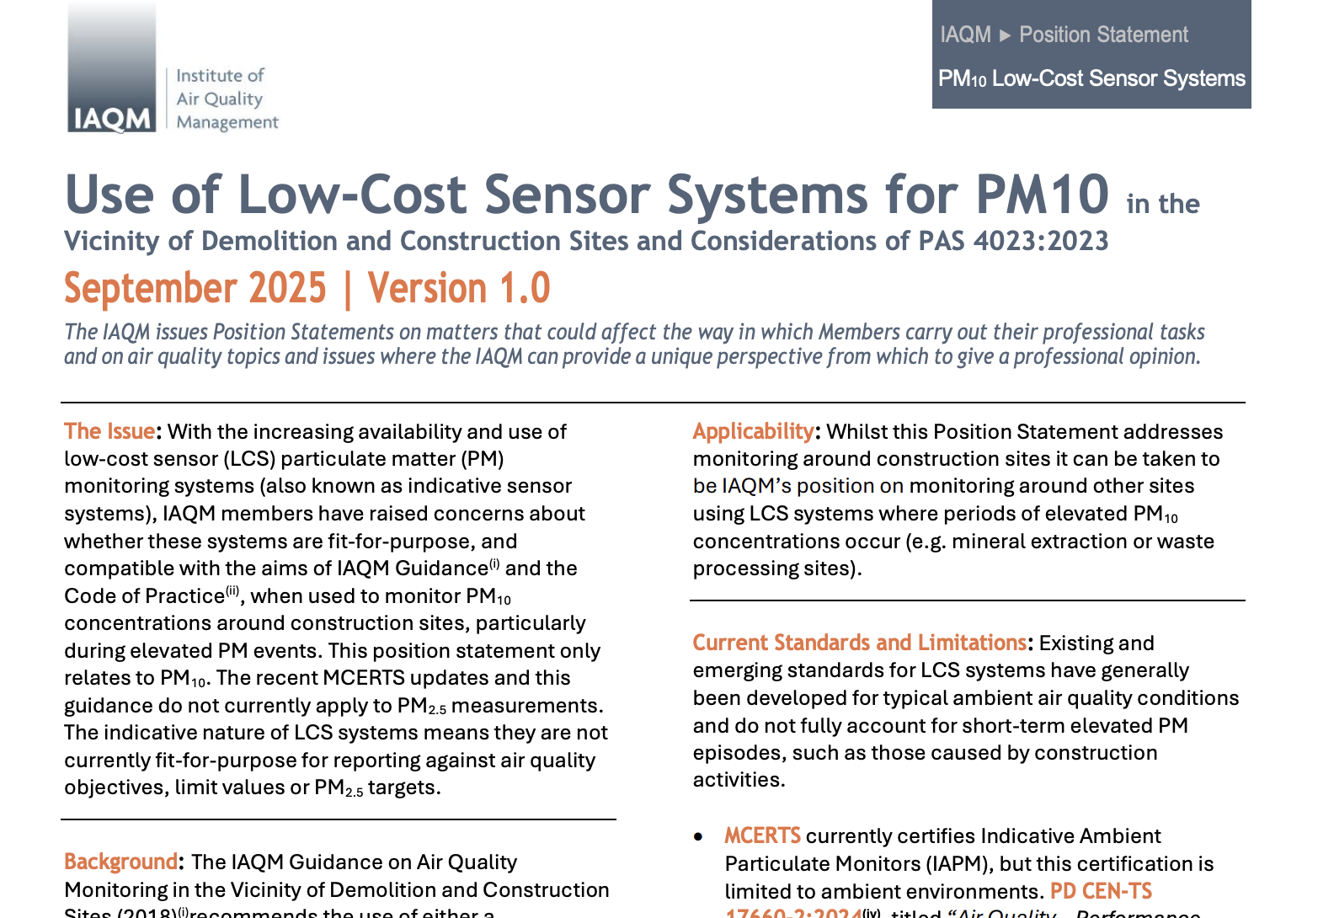

Scan to Download Article

Slide 35
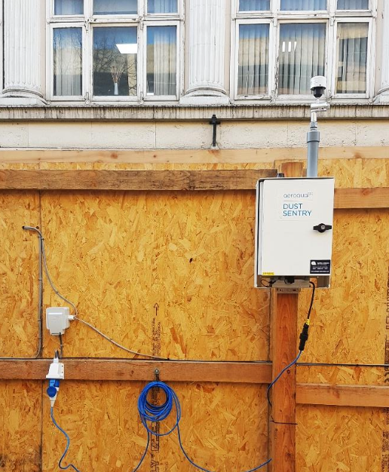
Monitor Placement - What Should Happen vs Reality
Monitors installed in free-field conditions
Clear, designated monitoring locations agreed in advance
Safe and suitable mounting arrangements in place
Power and access planned before installation
Installation risk assessed and planned (no surprises)
What ACTUALLY happens on site
“We’ll sort it when you get here”
No designated monitoring location
No power available
No proper mounting solution
Last-minute decisions under pressure

Slide 36
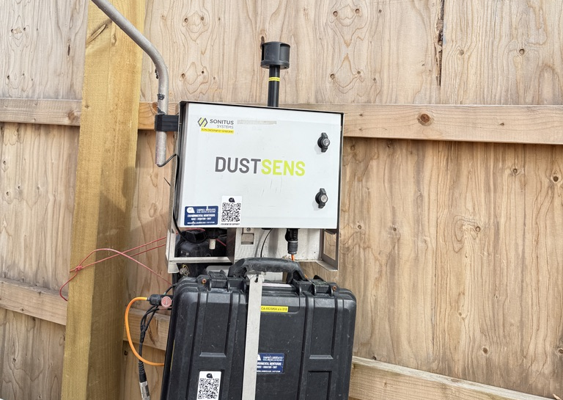
Monitoring Locations
Position away from the hoarding at least 1 metre

Slide 37
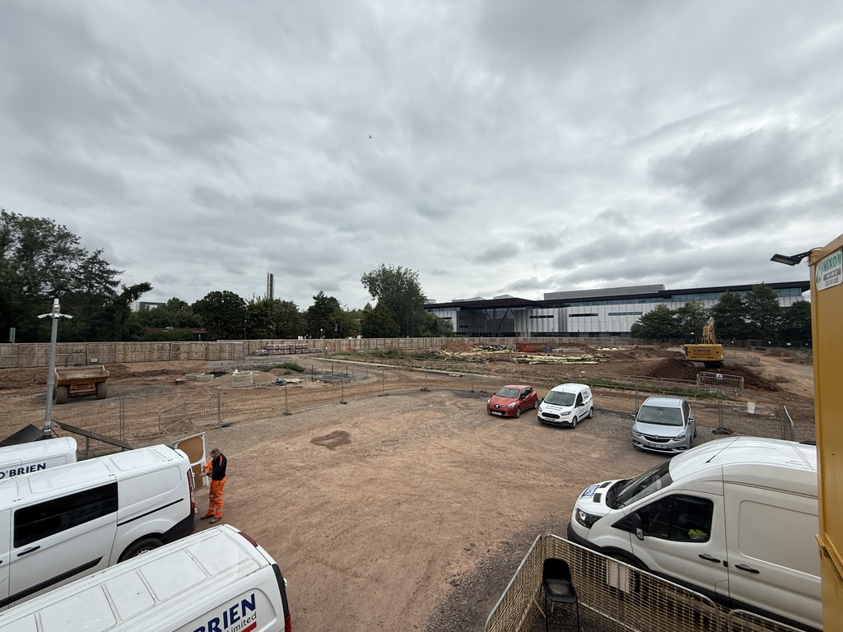
Open sites Rubble Crushed hardcore Sand All becomes airbourne when dry and windy
Your site might stop working at night — but the wind doesn’t.

Slide 38
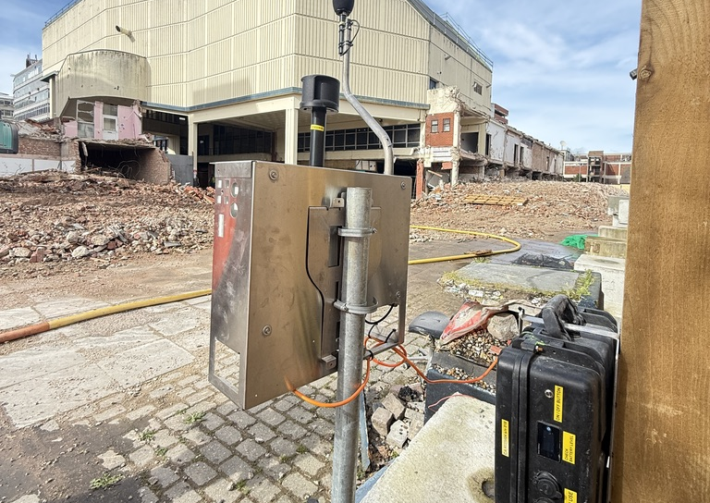
Sensible Positioning according to guidelines

Slide 39
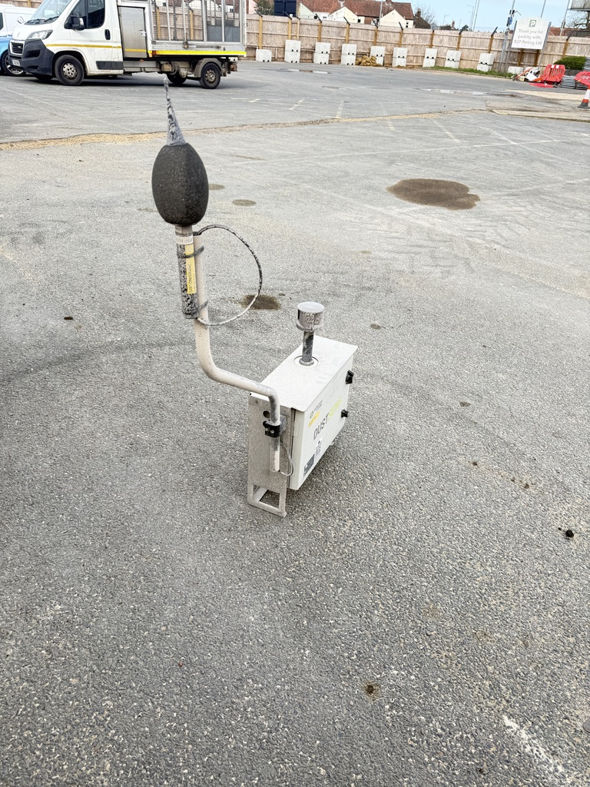
Monitors are reading high – there is no dust on site

Slide 40
One side of the microphone is covered in dust, the other is not

Slide 41
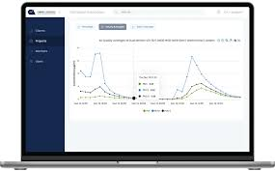
The Result
Monitors installed in poor locations
Data becomes unreliable or misleading
Increased health & safety risks (working at height, unsafe installs)
Time wasted and rework required

Slide 42
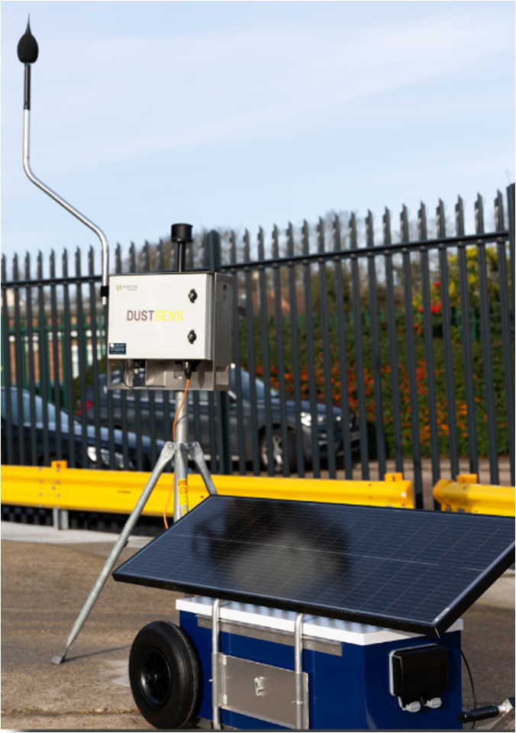
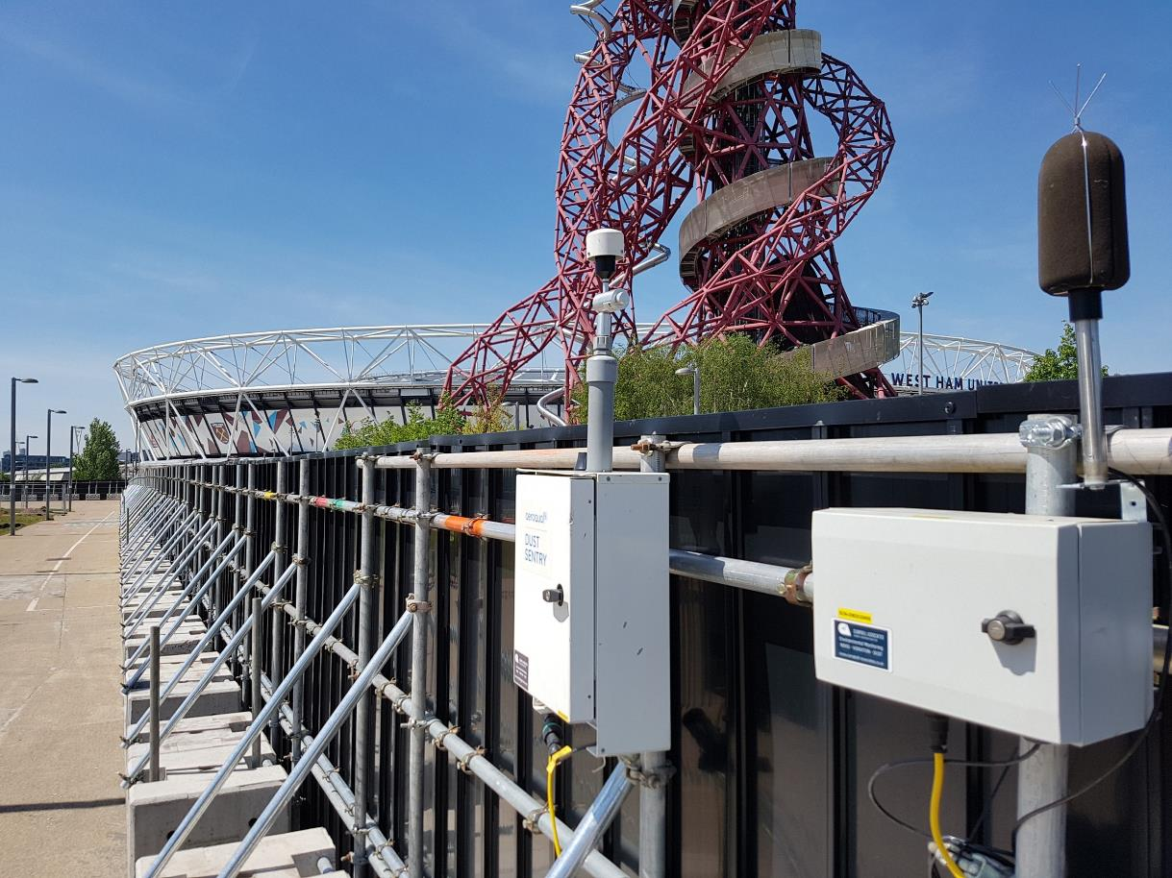
WE CREATE SOLUTIONS TO PROBLEMS
PLUG AND PLAY
NOISE & DUST

Slide 43


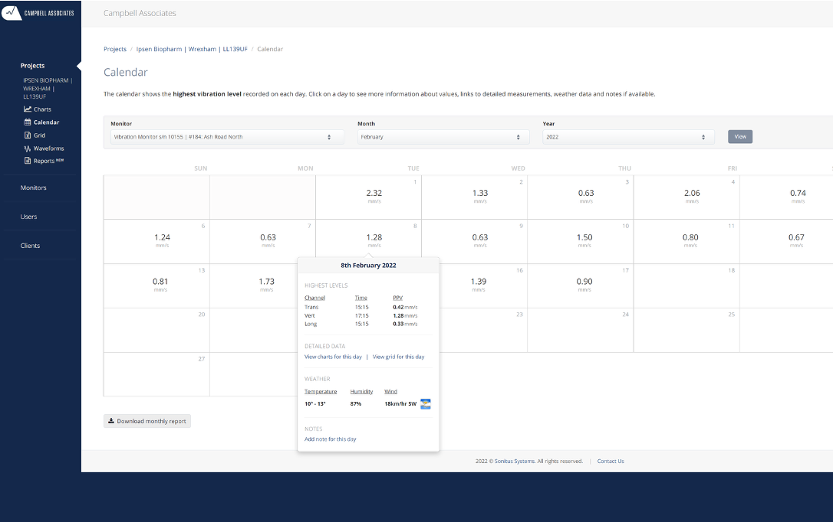

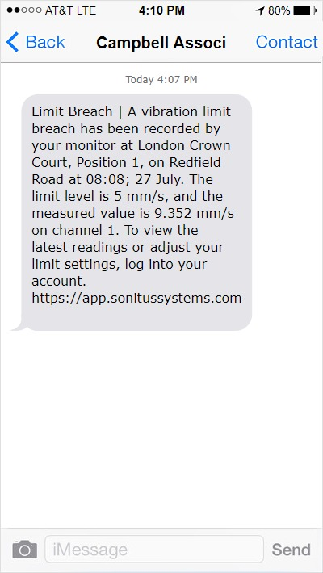

ALERTING
CLOUD SYSTEM

Slide 44
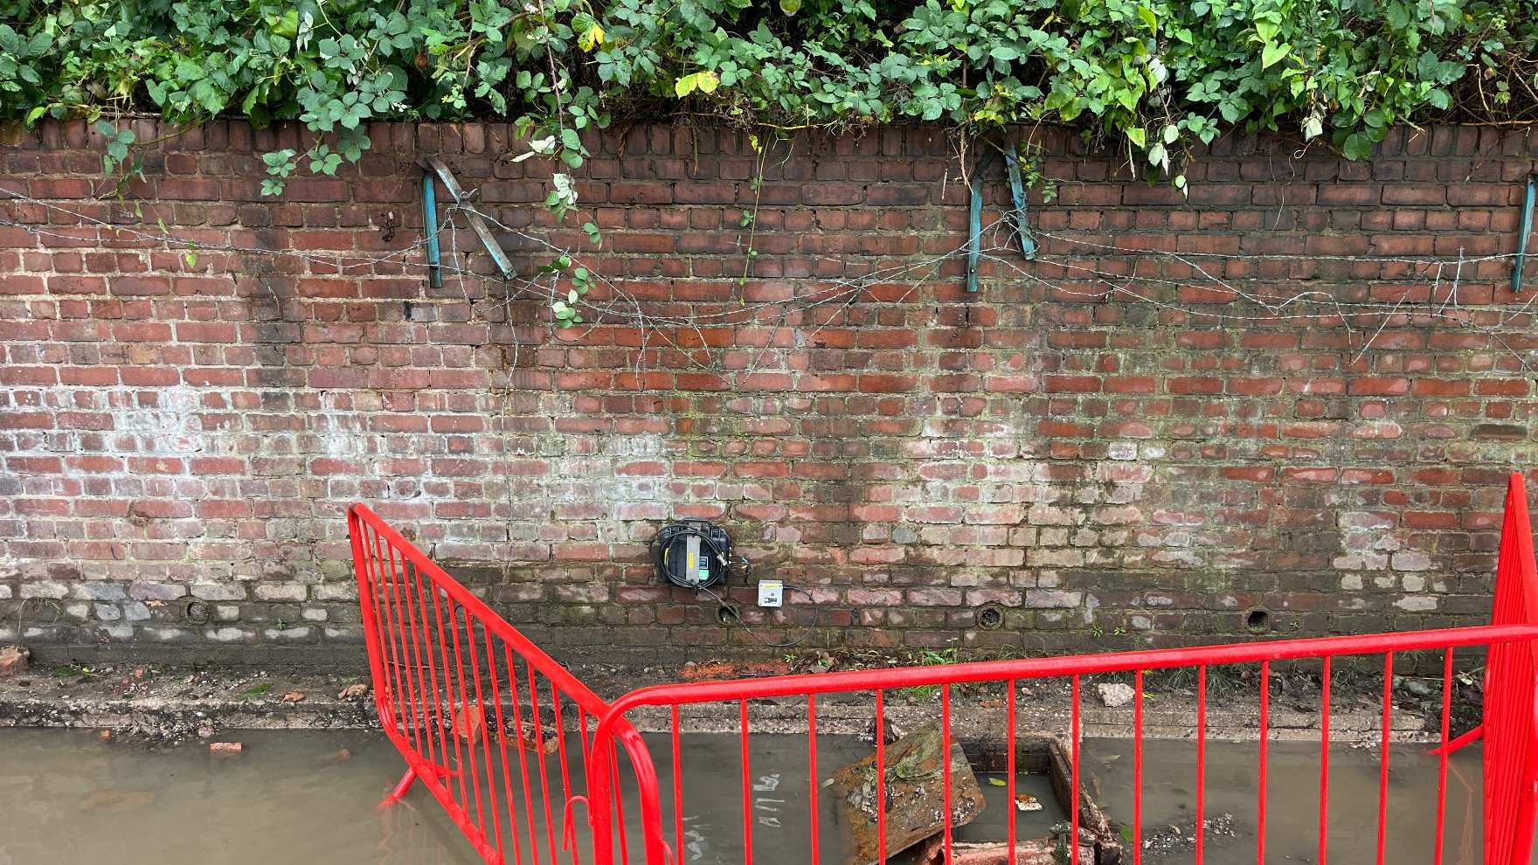
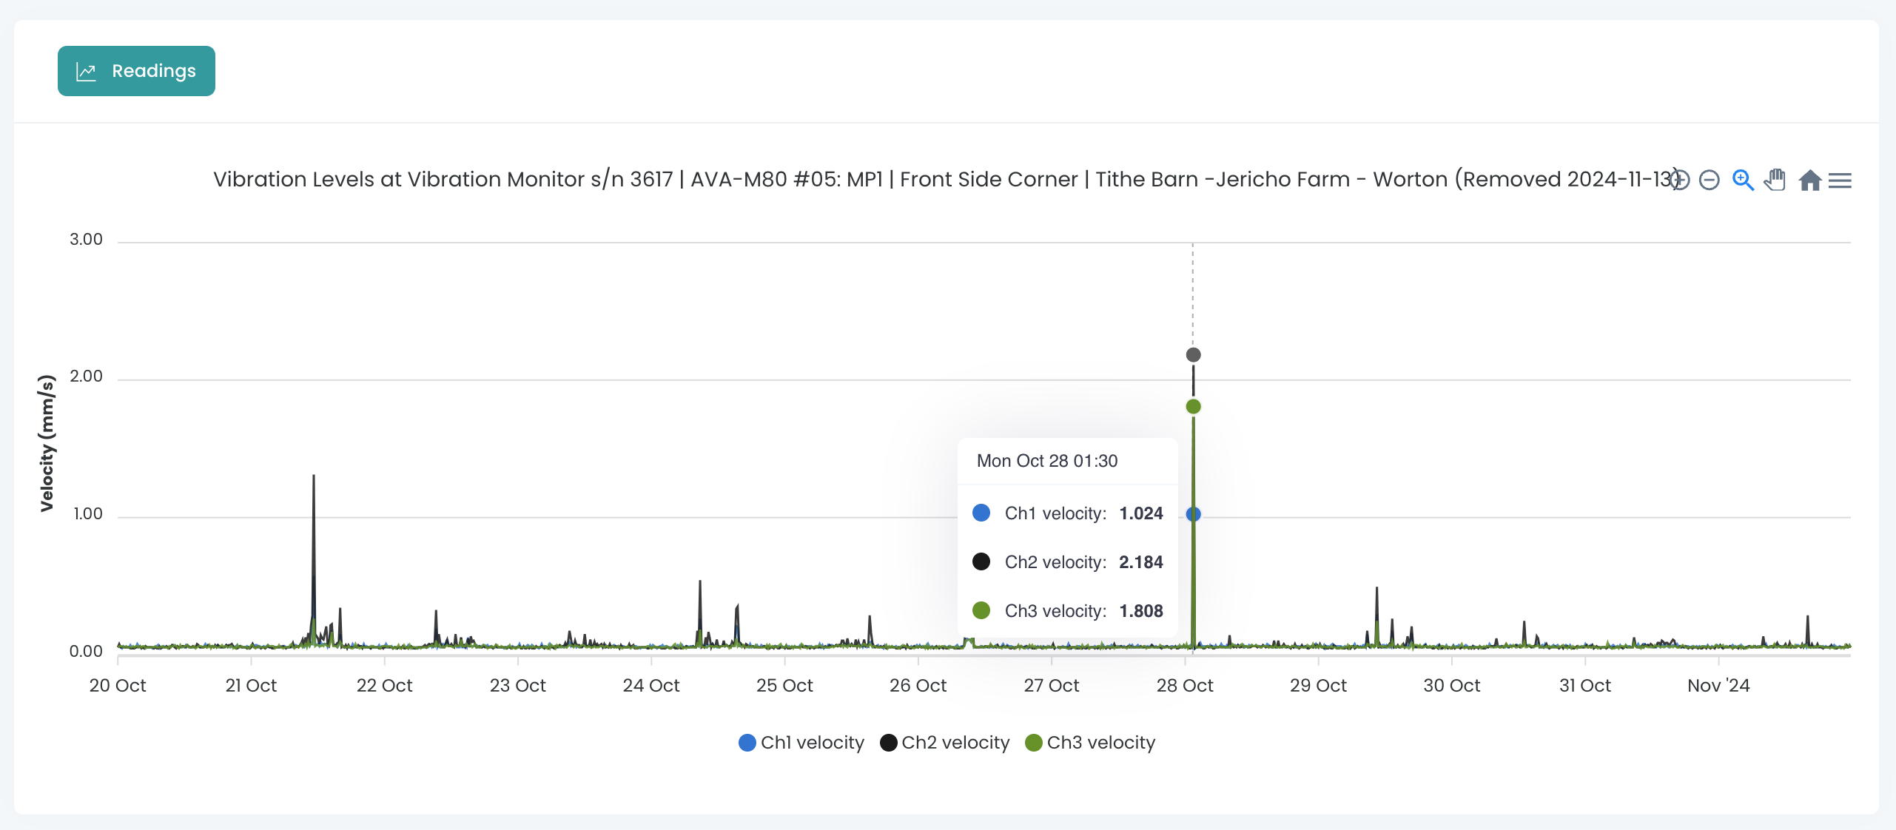

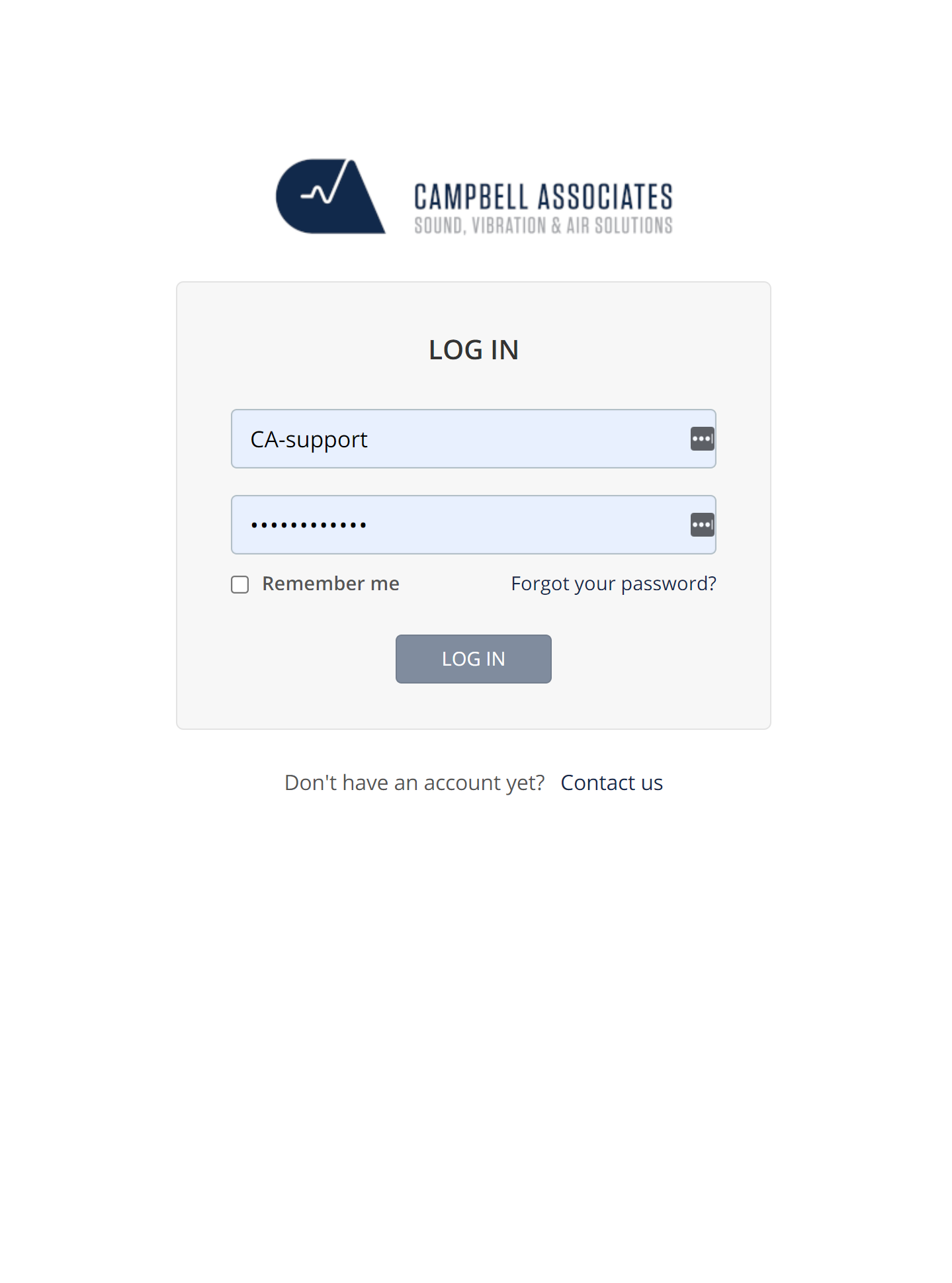

SONITUS CLOUD

Slide 45
Environmental dust is NOT harmless
Can still contain silica and harmful materials
Contributes to long-term health effects
Increasing regulatory and public scrutiny
Emerging legal direction (air pollution cases)
Silica and asbestos will harm you if exposed. Environmental dust may not harm you immediately, but it will harm your project if not controlled.
Environmental PM (PM10/PM2.5) → increasing scrutiny
Air pollution already linked to death (coroner case)

Slide 46
Respirable dust
Health implications of dust
HSE’s Dust Kill’s campaign
Hierarchy of controls

Slide 47
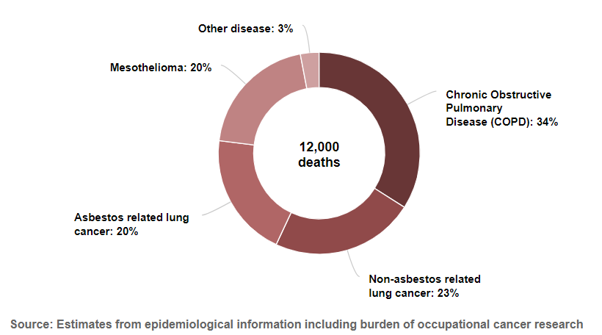
Occupational Lung Diseases Contributing to an Estimated Annual Current Deaths

Slide 48
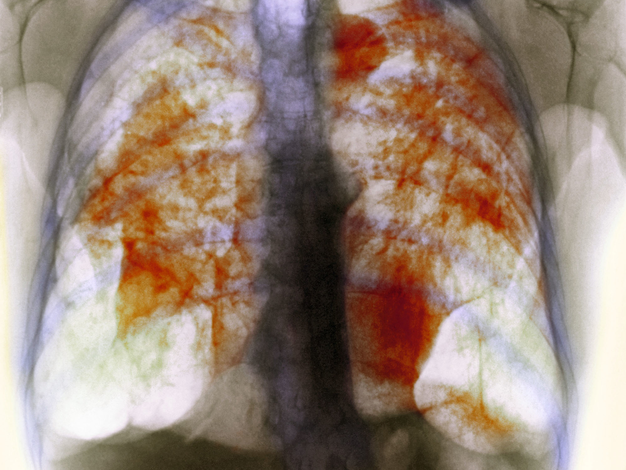
Occupational Lung Diseases contribute to 12,000 current deaths/yr in UK, compared to 123 work-related fatal injuries in 2021/22
7,200 of these deaths are related to dusts/fumes/ chemicals other than asbestos
Major causes: respirable crystalline silica (RCS) from ‘fracturing’ crystalline silica in minerals and construction industries.
DUST

Slide 49
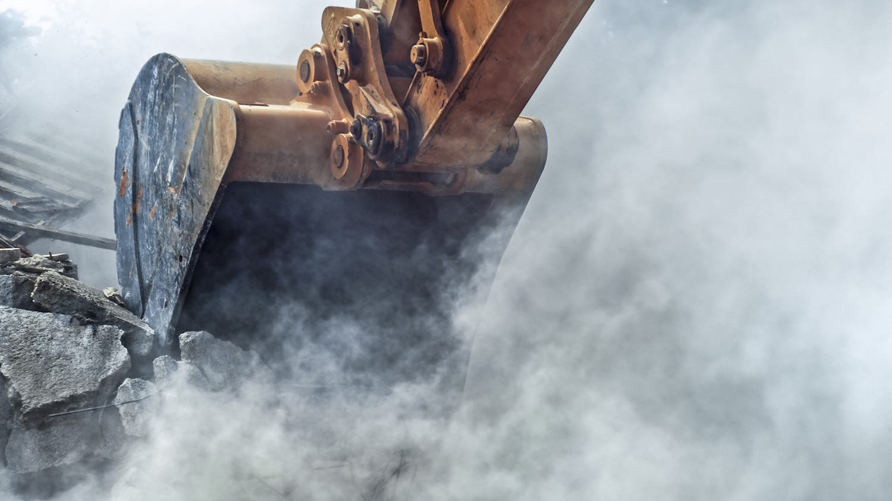
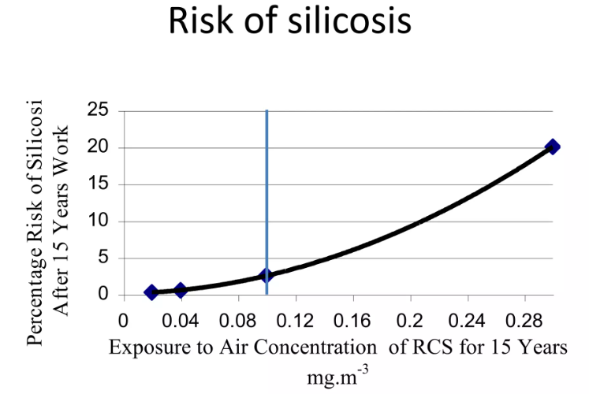
RCS was classified carcinogenic
Low exposure limits for RCS
UK limits (STEL of 0.1 mg/m3 and 8 hr limit of 0.3mg/m3)

Slide 50

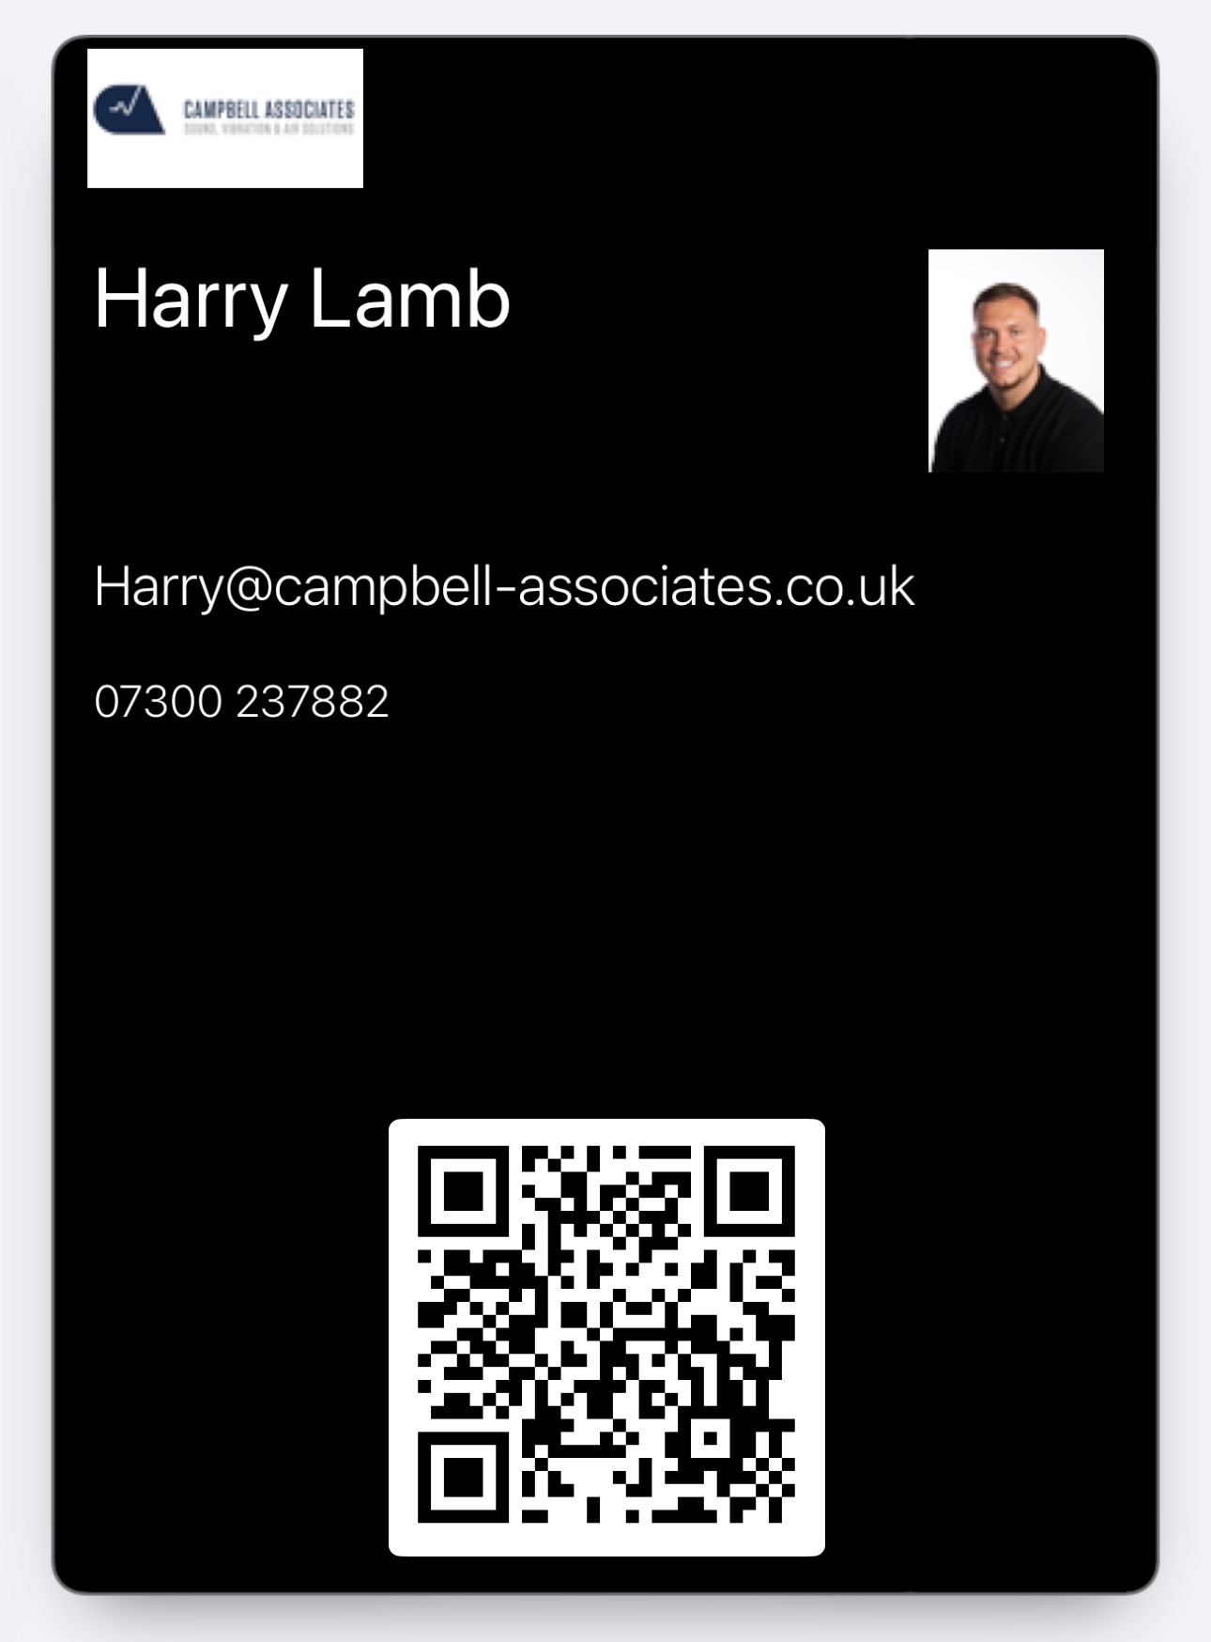
07300 237 882
Harry Lamb
Anthony@campbell-associates.co.uk
Campbell Associates Limited
At the forefront of delivering new & exciting technologies

