Slide 1
What is good health and safety?
Some reflections after a lifetime in OS&H
Roger Bibbings MBE BA CFIOSH (rtd)

Slide 2
So what is (are) H&S?
Depends who you ask
Audrey Pittom: First coined the term
David Cameron: “..a burden on business”
Sir Frank Davies: “If you think safety’s expensive, try having an accident!”
Severn Trent: ‘H&S is no accident’
Lord Young: “Common sense”
RoSPA: ‘Accidents don’t have to happen’
Google: “..the practices, policies, and regulations designed to protect the physical and mental well-being of individuals by preventing injuries and illnesses, especially in workplaces and public areas.”

Slide 3
Two more quotes..
“They spend a a lot of time here worrying about health safety’. I don’t know why. They never have any accidents” - Young trainee manager
“Safety is not an intellectual exercise to keep us in work. It is a matter of life and death. It is the sum of our contributions to safety management that determines whether the people we work with live or die.” – Sir Brian Appleton, Technical Adviser to the Enquiry on Piper Alpha Accident

Slide 4
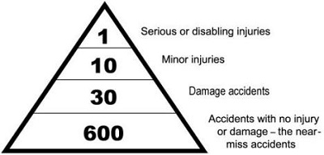
Health and safety failures
The ‘Bird triangle’ (Frank E, Bird Jnr. 1921 -2001)

Slide 5
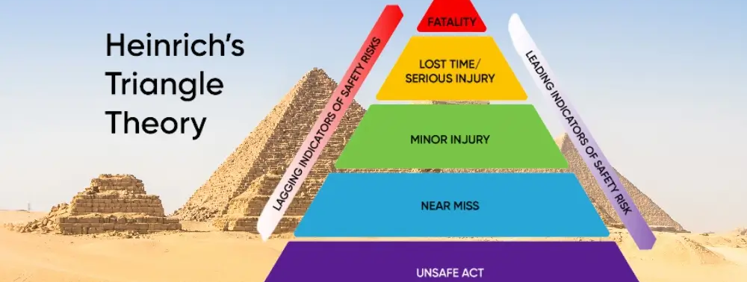
Heinrich’s triangle
(Herbert William Heinrich 1886 1962)

Slide 6
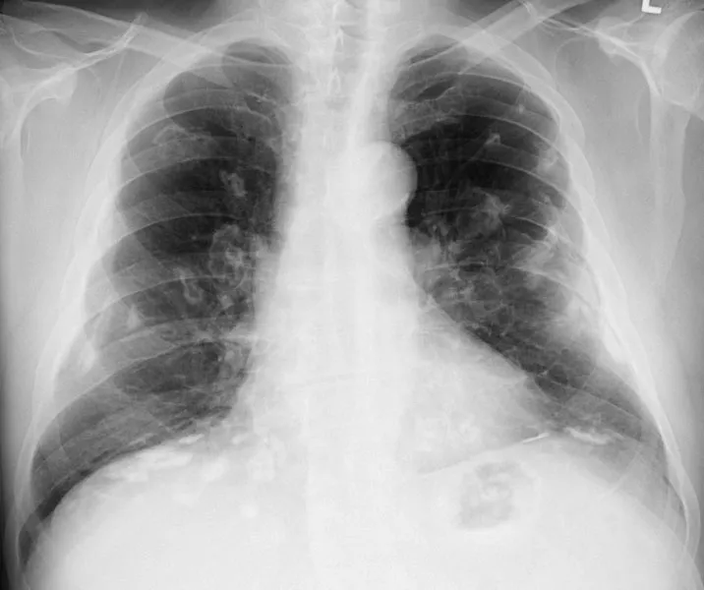
Useful.. but..
Does not address:
  system/technology risks
  ‘latent pathogens’
  major hazards
  health risks
  harmful exposures
  health damage

Slide 7
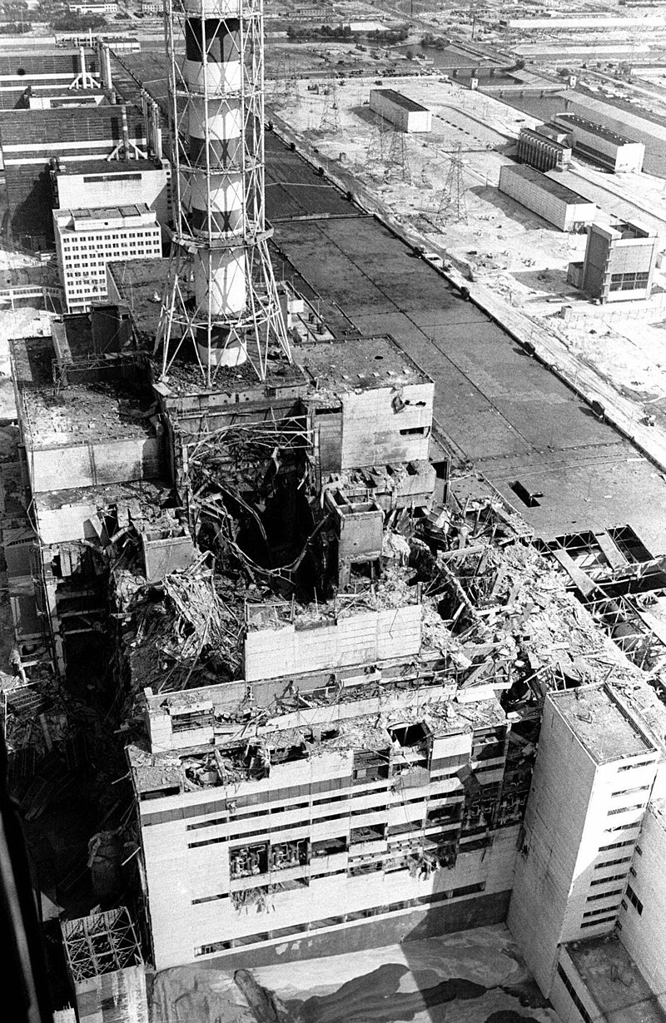
Some major disasters
Flixborough 1/6/74
Bhopal 3/12/84
Chernobyl 26/4/86
Zeebrugge 6/3/87
Piper Alpha 8/7/88
Grenfell 14/7/17

Slide 8
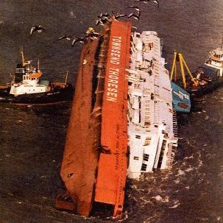
Failures of..
Behaviour?
Control measures?
Systems?
Culture?
Regulation?
Enforcement?
OR LEADERSHIP?

Slide 9
Thinking more deeply about accidents
Random?
Inevitable?
Cause or causes?
Events and conditional factors?
Necessary and sufficient?
Predictable?
Preventable?
“Accidents don’t have to happen!”

Slide 10
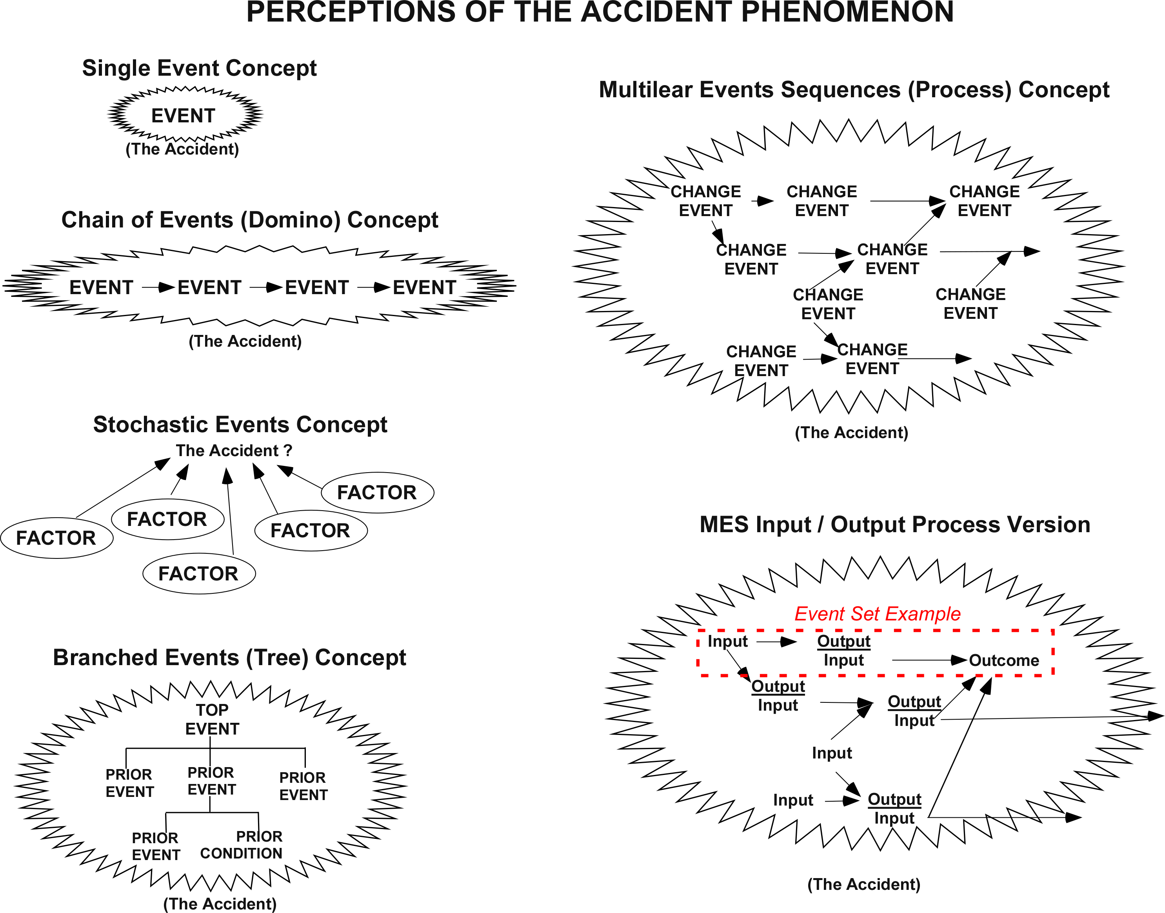
Accidents are rarely simple

Slide 11
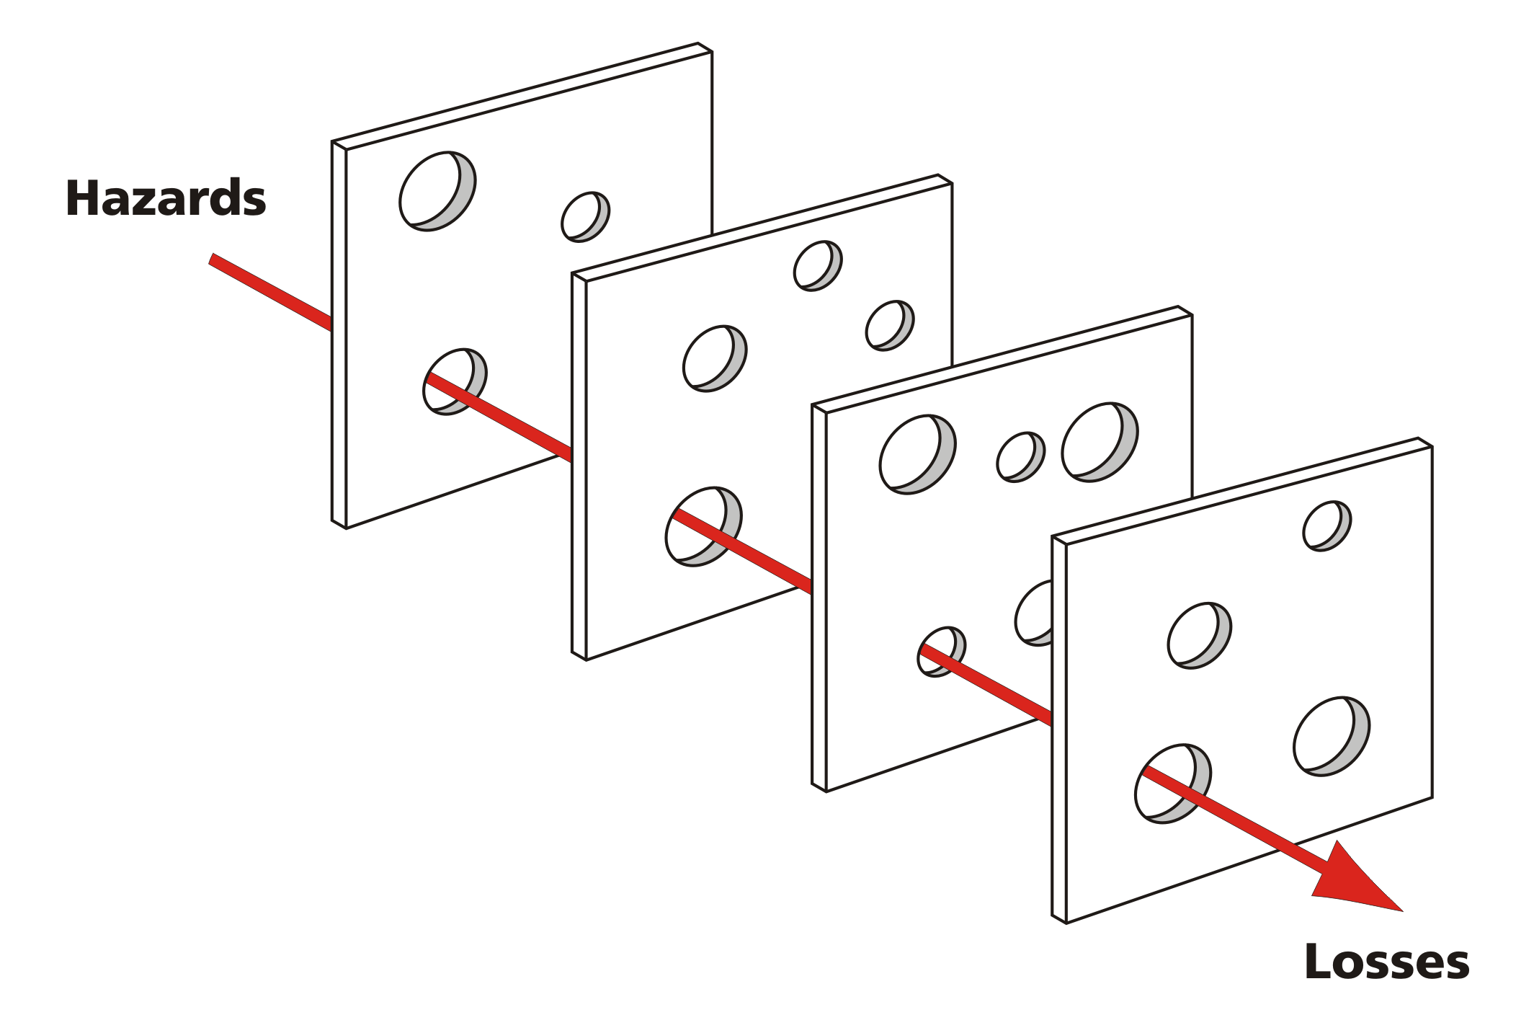
Swiss cheese
Rasmussen,
Reason et al

Slide 12
Human error? Types
“To say most accidents are caused by human error is about as useful as saying most falls are caused by gravity!” Prof Richard Booth
Error types:
  Slips and lapses
  Mistakes (skill and/or rule based)
  Violations (exceptional, situational and routine)
Error types combine!

Slide 13
Behavioural safety?
Behavioural safety is a health and safety approach focused on understanding and modifying human behaviour to reduce accidents and promote safer work practices. It involves observing behaviours, providing feedback, and creating a positive safety culture where individuals take responsibility for their actions and safety, working alongside traditional safety measures like policies and technical controls. The goal is to proactively identify and change unsafe habits to prevent incidents before they occur, rather than just relying on rules and equipment.

Slide 14
Preventability?
Hazard foreseeable?
Risks assessable?
Primary control(s) available?
Barriers to implementation?
Secondary and tertiary measures available?
On a scale of 1 (easy to prevent) to 5 (hard to prevent? how many in category 5?)

Slide 15
Health and Safety Culture?
HSE say..
“A Health and Safety Culture refers to the shared attitudes, values, and behaviours within an organisation that influence the commitment to, and the way health and safety management is performed.”

Slide 16
H&S management systems approach
Minimum ‘tick box’ compliance?
‘Fly, crash, fix, fly’?
HSG 65 (POPIMaR)?
PDCA (‘Plan, Do, Check, Act’)?
(From ‘Successful Health and Safety Management’ – HSE 1991 - to ‘Managing for Health and Safety’ 2013 to ISO 450001 - 2018)
Alignment with business management systems, standards and plans?

Slide 17
Learning to learn from H&S failures
‘Windows on reality’
Agreeing ToR
Evidence gathering
Events and conditional factors
Barriers (fears, biases, ‘stop rules’)
Hypothesising
Looking for further evidence
Reaching/testing conclusions
Reporting
Implementing change

Slide 18
Team based investigation
Senior manager led
Diverse skill/role membership
H&S professional as ‘process doctor’
Confidentiality protocol
In-service H&S learning
Team building and trust
Ambassadors for change
H&S culture building

Slide 19
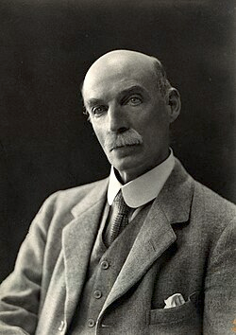
Health protection
“Is the job fit for the worker? Is the worker fit for the job?”
“Until the employer has done everything, the worker can do nothing” Sir Thomas Legge (1863 – 1932)

Slide 20

Health promotion
Dame Carol Black
(1939 -)
"There's very good research evidence that if you invest in the health and wellbeing of your workforce, they're more productive".
“The right work is good for health and well-being”
“Worklessness is harmful".

Slide 21
Risk and proportionality
Probability v. consequence
“If it can happen it must not matter: but if it can matter it must not happen!” - Edward A. Murphy Jnr. (1918-1990)
‘Goldilocks’ principle
‘Justification, optimisation, risk limits’ -(Ionising Radiations Regulations – 1961)

Slide 22
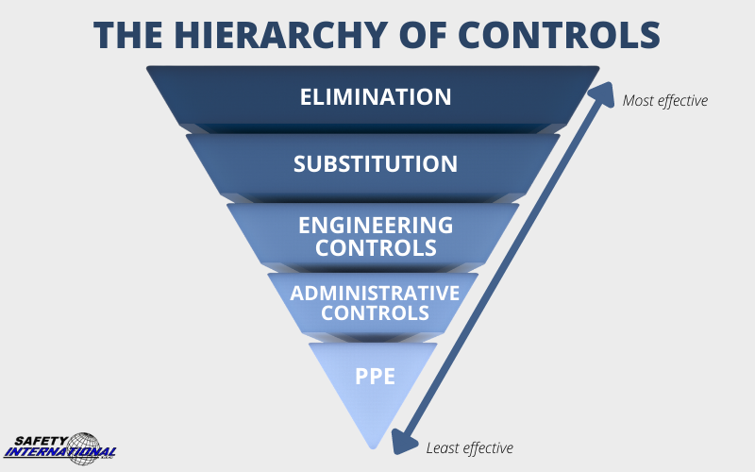
The hierarchy of controls

Slide 23
Has H&S ‘gorn mad’?
Jamie Lindsay ‘Risk, Responsibility and Regulation: ‘Who’s risk is it anyway?’ October 2006 – Tony Blair
Lord Young – ‘Common sense, common safety’) October 2010 - David Cameron
Ragnar Lofstedt – ‘Reclaiming health and safety for all’- November 2011 – Chris Grayling
Martin Temple – ‘Review of health and safety…’ - November 2014 – David Cameron

Slide 24
Measuring performance?
“What gets measured gets managed” Peter Drucker
“We tend to afford false significance to things which we can measure because what is truly significant often defies meaningful measurement” Robert MacNamara
“Accident rates are an unreliable measure of failure” RoSPA
‘Inputs/outputs/outcomes’ HSE guidance

Slide 25
Three essentials for success
Leadership
(‘Visible, felt leadership’)
Involvement
(“You can only do H&S with people not to them”)
Competence
(Skills, experience and underpinning knowledge)

Slide 26
Evidencing OS&H excellence
Why?
How?
To whom?
Costs and benefits?

Slide 27

Some options
Awards (RoSPA, BSC, IOSH, trade associations,
Certification (ISO etc.)
Pre-qual schemes
- SSIP (CHAS, SMAS), CAS, PAS 91…

Slide 28
RoSPA Achievement Awards
Evidence supported answers to ten ‘key performance questions’ to demonstrate a robust health and safety management system:
  1) leadership commitment, 2) competent advice, 3) workforce involvement, 4) competency assurance, 5) risk assessment integration, 6) effective communications, 7) active monitoring, 8) incident investigation, 9) performance review, and 10) a significant learning point from the past year
Assessment of leadership, resource provision, worker engagement, competency management, risk control, information flow, performance measurement, and continuous improvement

Slide 29
British Safety Council
Five Star outcome in a relevant British Safety Council audit (Occupational Health and Safety, Environmental, or Integrated Health, Safety & Environment).
Following the audit, successful applicants for the Sword of Honour or Globe of Honour must demonstrate excellence through a separate, independently judged application that details their commitment to health, safety, and wellbeing through best practice, effective management systems, and a strong safety culture.

Slide 30
Selling the benefits of good OS&H
Protecting people
Loss avoidance
Morale
Reputation management
Commercial profile
Systems thinking
Team building

Slide 31
Moving forward
Where are you now?
Where do you want to be?
Just ‘lift and shift’; or
‘upshift!’
Priorities?
  Fire?
  MORR?
  Mental health?
  24/7 safety?

Slide 32
HSE priorities
Work-related stress, depression, and anxiety
Asbestos exposure and risks from dust, including welding fumes, flour, and silica
Manual handling, ergonomic practices, and repetitive tasks in high-risk sectors
Noise control measures and use of hearing protection

Slide 33
HSE ‘watch’ trends
AI for predictive analytics to identify hazards and risks before they cause incidents.
Wearable technology: devices that monitor fatigue, heat stress, and lone-worker safety in real time
Virtual and augmented reality (VR/AR): immersive technology for realistic and effective safety training simulations

Slide 34
HSE ‘watch’ trends
Safety implications of new green technologies
Holistic employee well-being
Better alignment between health and safety and HR
Addressing psychological safety and mental health proactively
Changing expectations of younger generations (Gen Z)
Remote and flexible working arrangements

Slide 35

Safety never stops..

Slide 36
Study the history of OS&H
Useful reading
History of OS&H website https://www.historyofosh.org.uk
See - ‘Two steps forward, one step back’ by David Eves: A brief history of the origins, development and implementation of health and safety law in the United Kingdom, 1802–2014
Also - 'Celebrating 50 years of the Health and Safety at Work Act 1974 - How Great Britain's approach to health and safety at work was transformed. David Ashton, David Eves, Kevin Myers, David Snowball

Slide 37
Study the history of OS&H

Slide 38
Study the history of OS&H
Thank you
Any questions?

