Slide 1

Building Safety Act 2022
David Jenkins – April 2025

Slide 2
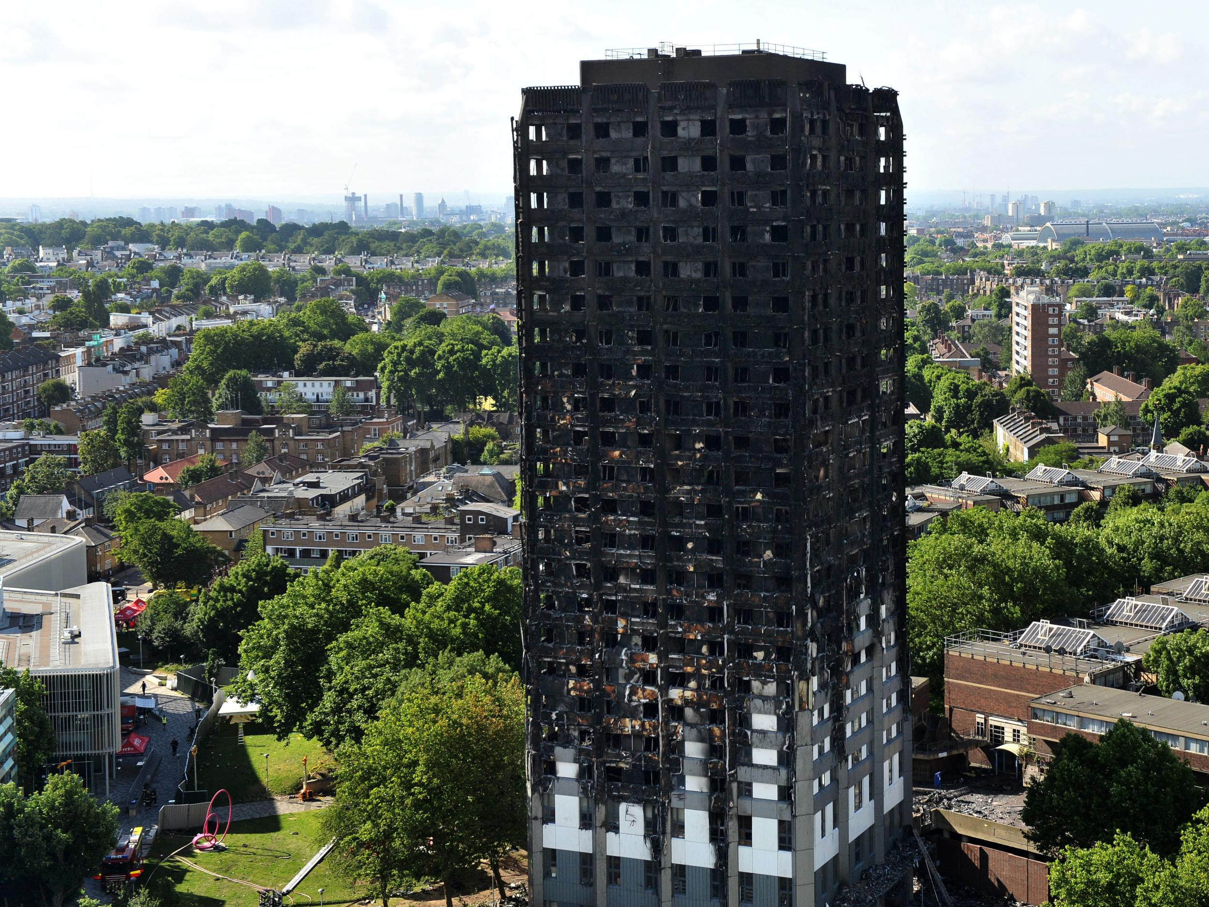
Building Safety Act 2022
A comprehensive piece of legislation aimed at overhauling the building safety regime in the UK
Established a new regulatory framework for high rise buildings and other specified premises, ensuring they are designed, constructed and maintained to meet stringent safety standards
Applies to all stages of a building’s lifecycle from design and construction to occupation and maintenance
The act came into being as a response to Grenfell Tower where 72 people lost their lives. The public enquiry identified flaws in the building safety regulations which prompted the government to take action
This led to an independent review by Dame Judith Hackett which recommended the need to overhaul the building regulatory system

Slide 3
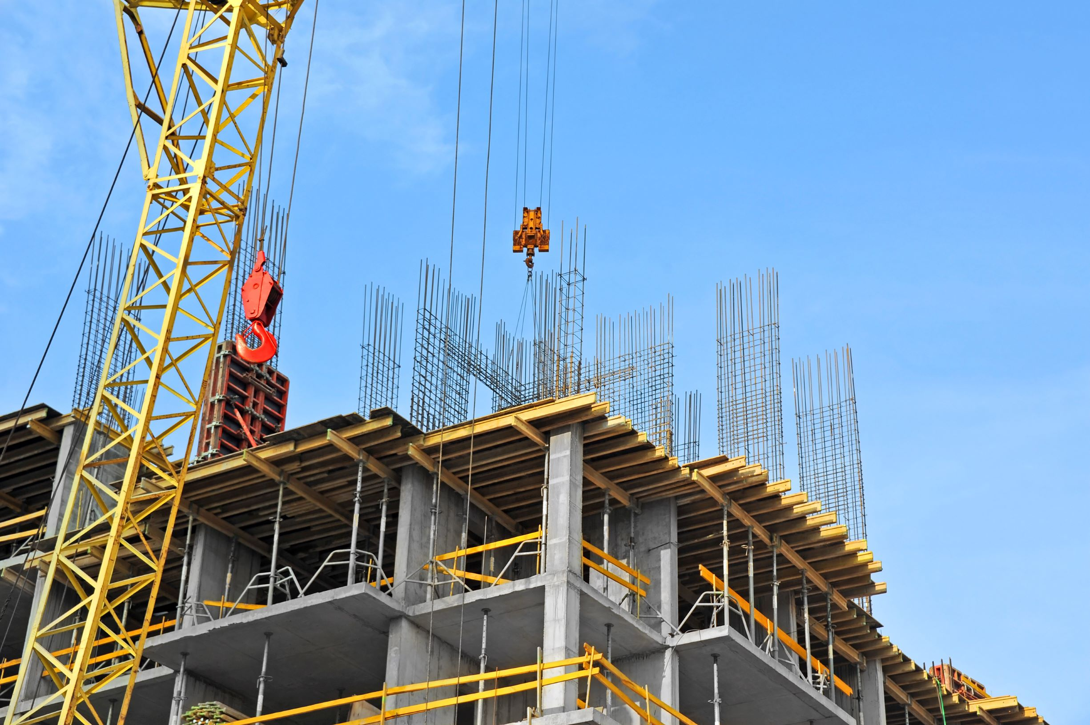
Why important:
Enhanced Safety Standards – The act introduces stricter safety standards to protect residents & building users, it means those who design, construct and manage buildings have stricter guidelines they must adhere to
Accountability – The act establishes clear lines of accountability, making it clear who is responsible for building safety at each stage of a building’s life-cycle
Transparency – Promotes greater transparency in building safety information to ensure all parties have access to the information they need to maintain safety
Scope of the Act – Prime jurisdiction is England, some measures may be reflected in building practices in Scotland, Wales & Northern Ireland

Slide 4
Applies to:
All Buildings:
The Building Safety Act establishes a new framework for building safety, applying to all buildings and building work. This includes new and existing buildings, renovations, and alterations.
Higher-Risk Buildings (HRBs):
HRBs, as defined by the act, are buildings that are: At least 18 meters high or have at least seven storeys. Contain at least two residential units.
Inclusion of Hospitals and Care Homes:
The act includes hospitals and care homes that meet the height and residential unit criteria within the definition of HRBs.
Exclusions:
  While the act generally applies to all buildings, certain buildings are excluded from the "in-occupation" part of the higher-risk regime. These include buildings that are: Used entirely as a hospital, care home, secure residential institution, hotel, or military barracks. Contain any living accommodation provided by the Ministry of Defence for military personnel.
To accurately measure an 18m building, determine the height from the lowest ground level adjacent to the structure to the top of the floor surface of the highest occupied storey.
Exclude any storeys dedicated solely to roof-top machinery or plant rooms. If the ground is sloped, measure from the lowest point on the ground directly adjacent to the building.

Slide 5
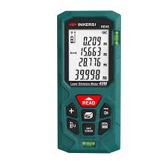
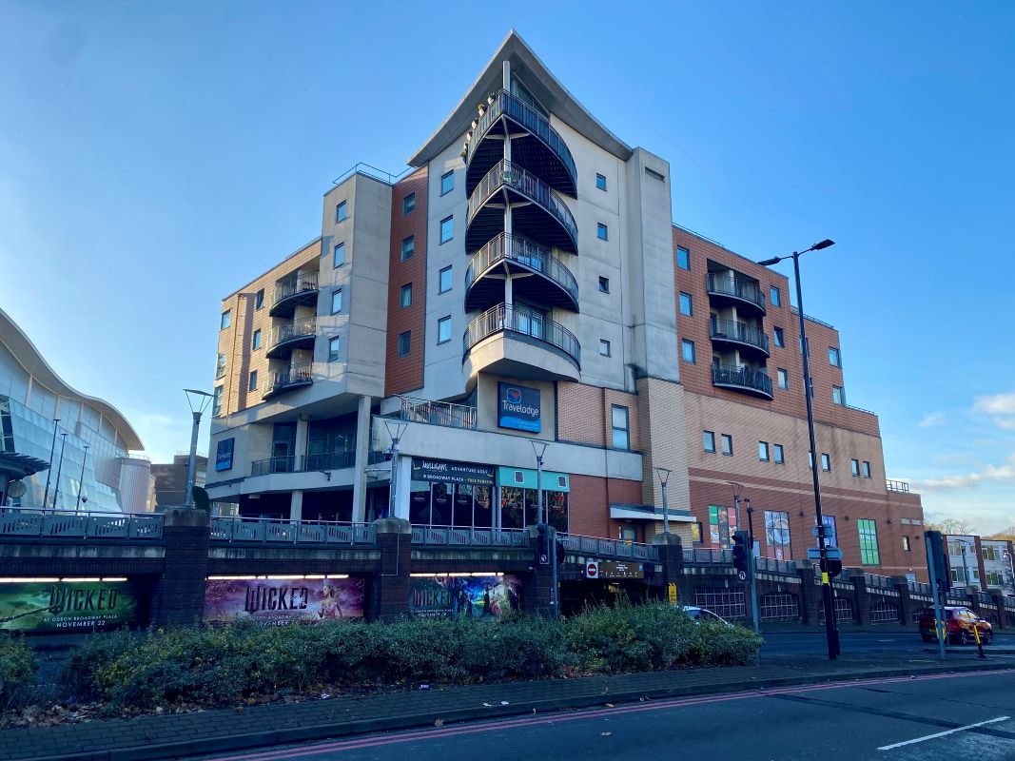
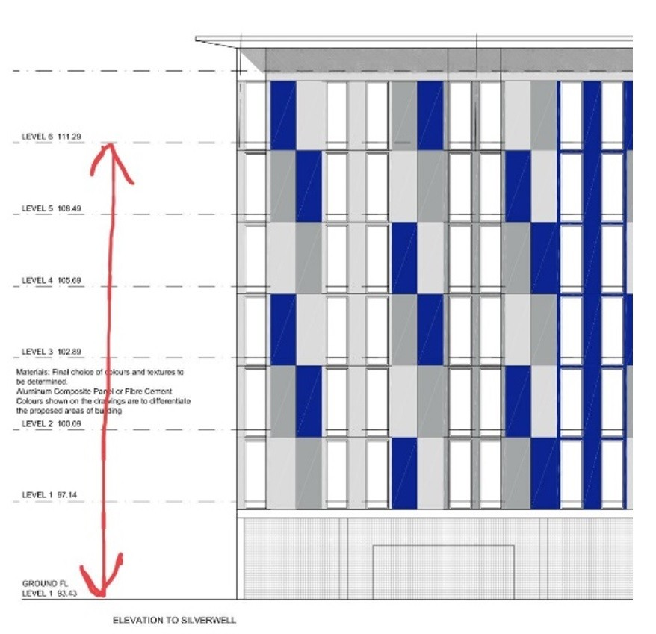
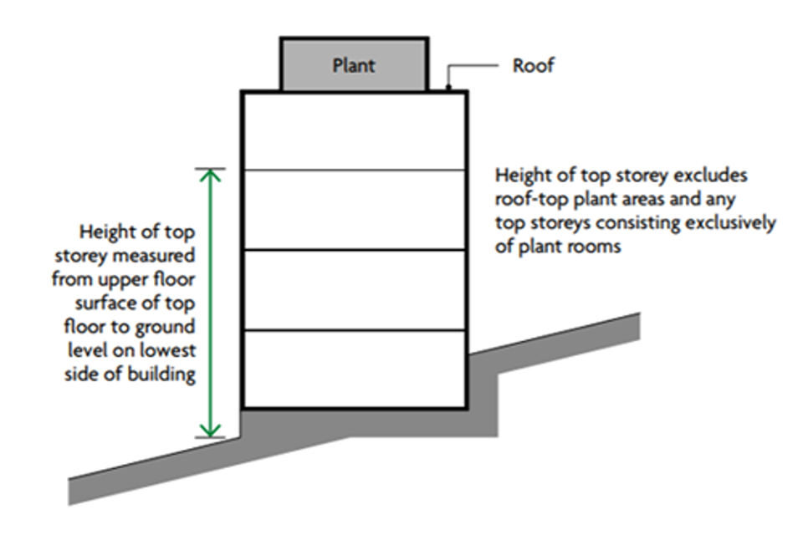
Broadway Plaza, Birmingham - Higher-risk buildings - At least two residential units which are at least 18 metres in height or have at least 7 storeys.

Slide 6

Key Components of the Act
New regulatory framework – Establishes the ‘Building Safety Regulator’ (BSR)
Duties & responsibilities – Establishes & enhances existing duties for those accountable for building safety
The Golden Thread – Refers to the process of providing accurate & up-to-date building safety information – ensuring building information is maintained throughout a building’s lifecycle
Establishing Gateways – Specific stages in the construction process that must be passed to ensure compliance with building safety regulations
Safety Case Regime – Requires duty holders to develop & maintain a ‘safety case’ for high risk residential building demonstrating how safety risks are managed in a building and on-going safety management including residential engagement & systems to identify safety concerns

Slide 7
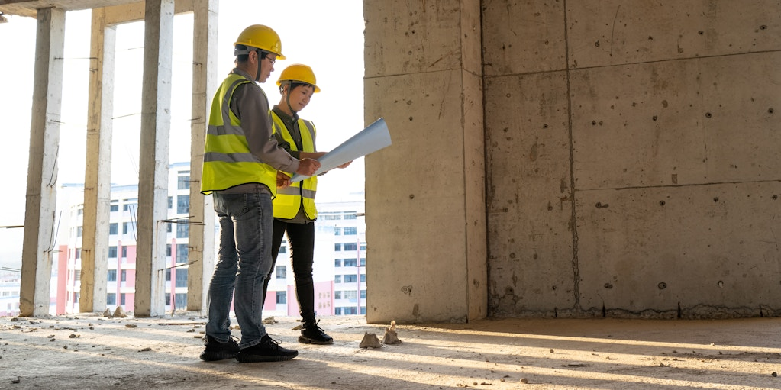
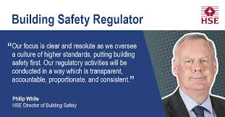
Duties of the BSR
Monitor Compliance
Ensure buildings meet safety standards
Oversee building registration
Issue building certificates
Provide guidance & support
Offer training & best practices
Develop & update policies
Create & up-date safety standards
Respond to incidents
Investigate safety issues
Conduct inspections
Issue fines
Mandate corrective actions

Slide 8
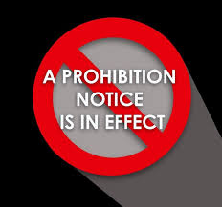
BSR – Enforcement Measures
Inspections by the BSR to ensure compliance with safety standards
Issue enforcement notices to address non-compliance which will require corrective actions to be undertaken within a specified time-frame
Issue prohibition notices which can holt construction or the occupation of a building until compliance is achieved
Penalties
Penalties for non-compliance can be severe and may include:
Fines - For failing to meet safety standards or comply with enforcement notices – can be unlimited
Imprisonment - In some cases where there is significant non-compliance

Slide 9

Amendments to the Architects Act 1987
Stricter requirements for architects to prove ‘competence’ monitored by the Architects Registration Board.
A ‘new’ Regulator for Construction Products
To ensure enhanced oversight
Mandatory safety certification
Improved tracking of defects and performance of building products to
‘prevent’ the use of unsafe materials in building construction
Amendments to the Housing Act 1996
Enhancing the housing ombudsman role in handling safety complaints
and increasing residential involvement in safety decisions

Slide 10
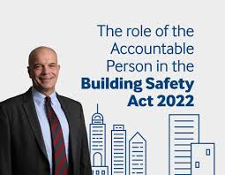
Key Roles & Responsibilities in the BSA:
The Accountable Person (AP) & Principle Accountable Person (PAP)
The Accountable Person (AP)
The individual or entity responsible for ownership or control of High-Risk buildings – an individual or corporation or partnership
Assess and manage the building safety risks
Keep information about the building management (The Golden Thread)
Provide detailed building safety information to the BSR when required
Maintain safety case reports
If a building has a single accountable person , that person is also the PAP
The Principle Accountable Person (PAP)
All duties of the AP as well as
Register the building
Provide key building information
Apply for the building assessment certificate (BAC)
Display the most recent BAC
Prepare a Safety Case Report
Notify the report if the report is revised
Establish a mandatory occurrence reporting system
Prepare a residents engagement strategy
Establish a residents complaints system

Slide 11

A strong emphasis on Resident Engagement
Ensure residents are involved in reporting issues & participate in decision making regarding building safety
Ensure they participate in safety discussions as will affect their living environment and building compliance
Have concerns addressed promptly
Able to access safety information & be informed about safety measures in place
Barriers to Resident Engagement
Anti-social activities – drugs, alcohol, sub-letting, gang activity, bed & breakfast etc.
Distrust of authority – non-engagement
Language barriers - English not first language
Numeracy & literacy issues – average reading age in UK – 9 to 11 years
Never in/time – holding down several jobs
Disabilities – physical & mental
Access to technology – Smart phones, iPads & computers etc
Distrust of QR Codes
Isolation/loneliness – barriers to engagement
Hoarding issues, Untidy, Marginalised
Poverty, Racism, Vulnerability, Cultural barriers
Staff Engagement, Time & Training (Not based on site)
Vulnerable Customer Training & Resources | Helen Pettifer Training

Slide 12

Overlap with CDM 2015 – Introducing additional responsibilities & reinforcing existing ones
Principle Designer
Enhanced focus on building safety throughout the building life-cycle – Planning & Management
BSR – An increased focus on long-term safety management
More comprehensive risk assessments, documentation and integration into the ‘Golden Thread
Demonstrating effective communication of safety considerations to ensure all parties are informed
Principle Contractor
On-going compliance with safety including safety management & maintaining safety documentation throughout the building’s lifecycle, monitoring and reporting within the ‘Golden Thread’
Client
Ensure the PD & PC comply with the BSR
Ensure the ‘Golden Thread’ is maintained throughout the building lifecycle
Designers
Comply with safety standards and ensure the ‘Golden Thread’ is maintained
Requirement for more detailed documentation & continuous up-dates to
the ‘Golden Thread’

Slide 13

Overlap with CDM 2015 – Introducing additional responsibilities & reinforcing existing ones
Contractors
Must adhere to stricter safety practices & maintain comprehensive safety records
Workers
Must be made aware of enhanced safety standards & reporting requirements
The Golden Thread
Reporting requirements are centred around the Golden Thread
The continuous & unbroken flow of information that is accurate, up-to-date and easily accessible about a building throughout its life cycle
Includes details about the buildings design, construction and on-going maintenance
UK Gov ‘The purpose of the Golden Thread is to have the right information to understand the building and the steps needed to keep both the building and people living in it safe’

Slide 14
Golden Thread – Key Information
Good Information – Ensuring comprehensive records are kept covering key safety measures and maintenance activities, accurate, reflecting the true state of the building and up-to-date.
All information should be easily accessible to all relevant stakeholders including construction professionals, facilities managers and regulatory bodies
All changes to a building design and materials must be documented and assessed, known as Change Control, this will ensure every modification is evaluated for its safety impact and is properly integrated into the building records
The Act introduced a ‘Structural Change Control’ process, categorising changes into three main types:
Major Changes – Significant alterations, such as increasing the buildings height, which requires prior approval from the BSR
Notifiable Changes – Includes modifications, such as altering a flats layout, which must be reported to the BSR with the required documentation
Recordable Changes – This involves minor adjustments, which do not fall into the above categories, should be documented and included in the final safety review
Introduced Reporting Standards that include regular reporting to the BSR , updates on safety measures, any incidents that occur, regular safety and auditsto ensure site compliance

Slide 15

Critical Control Plan (CCP)
A document designed to ensure High Risk Buildings comply with safety requirements upon completion
Provides a structured approach to managing construction work
Serves as a practical tool to controlling a project and communicating safety strategies to all team members
The CCP will include:
The Scope of the Work – A clear outline of the construction tasks to be completed with ‘specific’ attention to fire & structural safety standards
Roles & Responsibilities – Clarification of each duty holders responsibilities from those who are responsible and accountable to those who need to be kept informed throughout the project
Co-operation Strategies – Methods to foster collaboration among prejoct team leaders, supported by effective communication channels to enhance team work and comply with safety requirements

Slide 16
Purpose:
The BAC demonstrates that a building is safe for occupancy and that the Principal Accountable Person (PAP) is effectively managing building safety risks, including fire safety and structural integrity.
Who needs one?
The PAP for a high-risk residential building (at least 7 storeys or 18 metres high with at least 2 residential units) must apply for a BAC when directed to do so by the BSR, according to GOV.UK.
How it's obtained:
The PAP submits a BAC application, which includes a Building Safety Case report, to the BSR. The BSR assesses this application and may inspect the building to verify the PAP's arrangements for managing building safety risks. If satisfied, the BSR issues the BAC.
What it covers:
The BAC confirms that the building has been assessed for safety risks, that the PAP is managing those risks effectively, and that the building is in compliance with relevant regulations. It may also include details of identified risks, recommended mitigation measures, and ongoing monitoring requirements.
Importance:
The BAC is a crucial document for building owners and managers, as it demonstrates compliance with the Building Safety Act and ensures occupant safety.
The Building Assessment Certificate (BAC)

Slide 17

Gateways
Building Safety Act Gateways are checkpoints in the building process for higher-risk buildings, ensuring safety at various stages. There are three gateways: one at the planning stage, one before construction starts, and one upon completion before occupation. These gateways involve a pause in the project to allow the Building Safety Regulator (BSR) to review and approve critical aspects of the building, ensuring compliance with safety regulations.
Here's a more detailed breakdown of each gateway:
Gateway 1 (Planning):
At this stage, developers must demonstrate that fire safety and structural considerations have been addressed in the planning application.
Gateway 2 (Pre-construction):
Before any construction work begins, the BSR must review the design and ensure it meets building regulations, including fire safety, structural integrity, and other relevant requirements.
Gateway 3 (Completion):
Before a building can be occupied, the BSR must verify that the construction has been completed according to the approved plans and meets all building regulations.

Slide 18
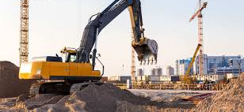
Safety Cases
The Principal Accountable Pperson (PAP), should prepare a safety case report as soon as possible when:
the building is already occupied or becomes occupied
They become the PAP
They must send BSR a copy of your safety case report:
when BSR tells you to apply for a building assessment certificate
at any time when BSR asks you for it
To help identify the latest version of your report, include a date, or version number, or both.

Slide 19

Safety Cases
Basic building information
Safety case reports shall include the building’s:
name, if it has one, full postal address
registration number, this begins with ‘HRB’ and is quoted when BSR contacts you
build date, height, number of storeys above ground level
floorplans for each type of storey layout, location, using a map or photo, or both
You should also describe the:
number and type of residential units, like flats or maisonettes
common parts, for example community room, bin store, underground parking
resident profile, for example if any residents need help to evacuate or have additional needs, this should be the same as in your resident engagement strategy
other building uses which are not residential
surrounding area, services and utilities provided to the building, including isolation points
if the building is supplied with gas, include whether gas is supplied to individual flats and, if so, piping routes

Slide 20
Summary / Practical Implications
Applies to all buildings and specifically new or existing occupied buildings over 18 metres high or seven storeys or more, which contain at least two residential units. The design, refurbishment, and construction requirements also apply to care homes and hospitals meeting the same height threshold. In February 2025, the government published its response to the Grenfell Tower Inquiry Phase2 Report, committing to urgently review the definition of higher-risk buildings.
Creates a universal change in responsibility and culture within the building industry.
Through the Building Safety Regulator (BSR), it establishes a more effective regulatory and responsibility framework for the construction industry and introduces clearer standards and guidance.
Clarifies who has responsibility for fire and building safety throughout the life cycle of a higher-risk building.

Slide 21
Summary / Practical Implications
The Act establishes a more rigorous system for building safety, including new planning and building control gateways, accountable persons, safety cases, and a statutory "golden thread" of information,
Accountable Persons:
The Act introduces the role of the Accountable Person (AP) for high-risk buildings, who is responsible for ensuring the building's safety and maintaining a safety case report, according to Property Inspect.
Competence:
The Act emphasizes the importance of competence for all individuals and organizations involved in building work, ensuring that they are qualified and capable of carrying out their duties
Construction Products:
The Act strengthens the construction products regulatory regime, with new requirements to ensure that construction products are safe for their intended use, according to GOV.UK.
Leaseholder Protections:
The Act provides additional protections for leaseholders in relation to remediation costs, aiming to reduce their liability for the costs of rectifying unsafe cladding and other defects, according to CIBSE.

Slide 22
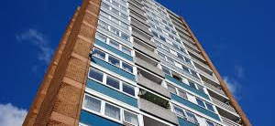
Summary / Practical Implications
Building Safety Regulator:
The Act establishes a Building Safety Regulator (BSR), who will oversee the safety and performance of all buildings
Industry Levy and Developer Tax:
The Act introduces a Building Safety Levy, which will be charged on all new residential buildings in England that require building control approval
Golden Thread of Information:
The Act mandates that a "golden thread" of information, a live electronic safety information record, be maintained for high-risk buildings throughout their lifecycle, according to Build UK.
Any Questions?

