Slide 1

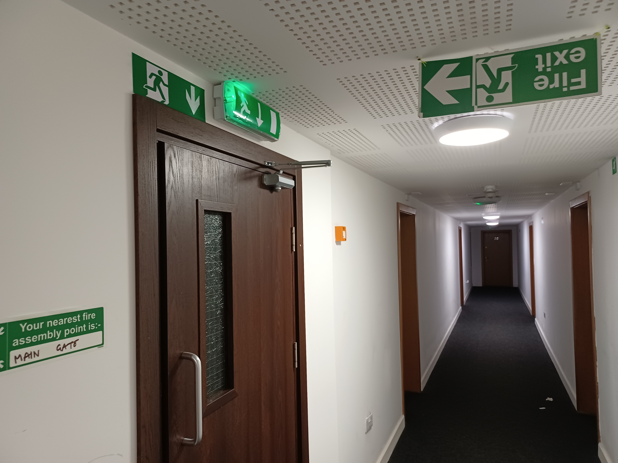
Fire Risk Assessments
David Jenkins

Slide 2
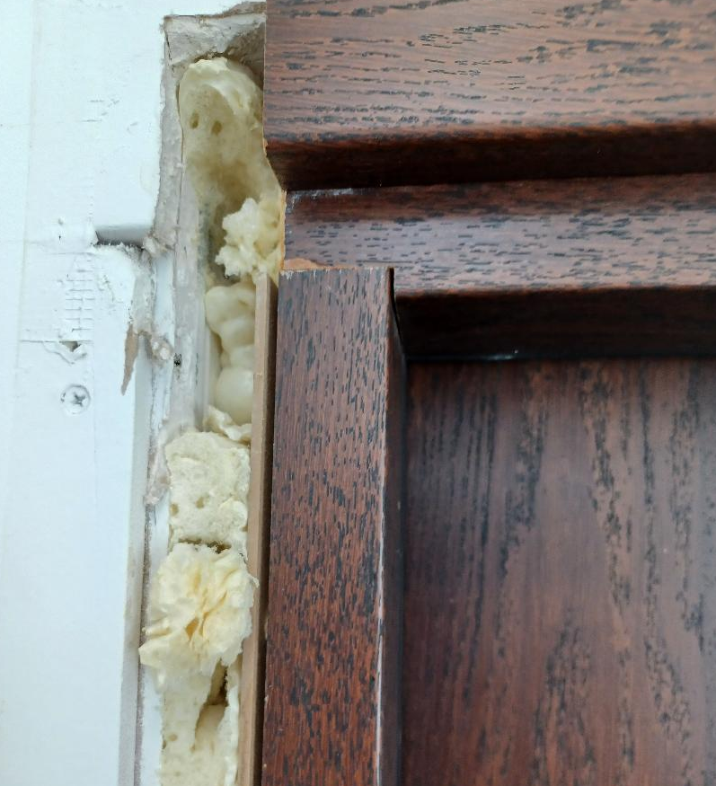
Contents
Aim of an FRA
Guidance Documents
Identifying Fire Hazards
Identifying People at Risk
Evaluating & Acting on Risks
Recording Findings
Reviewing the Assessment
Passive & Active Fire Protection
Advice on Layout
‘Suitable & Sufficient’
Training & Competency!

Slide 3
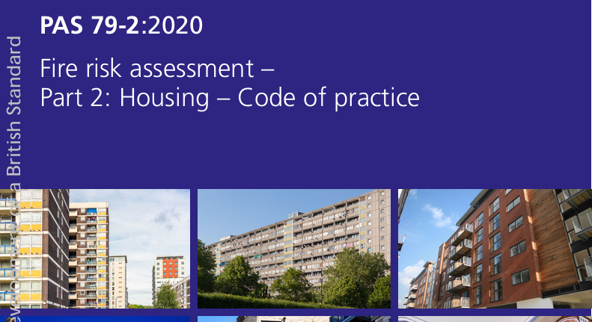
The Regulatory Reform Fire Safety Order 2005
Aim – To identify significant fire issues in the workplace and work activities that could cause harm to people and property
Guidance Documents - PAS 79-1 – Fire Risk Assessment Part 1: 2020 - Premises Other Than Housing Code of Practice
PAS 79-2 - Fire Risk Assessment Part 2 : 2020 - Housing Code of Practice

Slide 4
Approved Document B
Fire safety: Approved Document B - GOV.UK
- Approved Document B (fire safety) volume 1: Dwellings 2019 edition incorporating 2020, 2022 & 2025 amendments
- Approved Document B (fire safety) volume 2: Buildings Other Than Dwellings 2019 edition incorporating 2020, 2022 & 2025 amendments
Approved Document B is the practical guidance document for meeting fire safety requirements within the Building Regulations in England. It provides detailed guidance on how to comply with Part B of the regulations, which covers fire safety within and around buildings. The document is crucial for ensuring buildings are safe for occupants and firefighters in the event of a fire.

Slide 5
BS 9999: 2017
BS 9999 - Fire safety in the design, management, and use of buildings – Code of practice is a British Standard that provides recommendations for fire safety in building design, management, and use.
It complements BS 9991:2015 which pertains to fire safety in the design, management, and use of residential buildings, functioning as a code of practice to meet the functional requirements of the Building Regulations.
It elaborates on how a more adaptable design approach can achieve adherence to fire safety legislation. BS 9999 offers more flexibility and detailed advice than the prescriptive approach of Approved Document B, allowing for innovative solutions and tailored fire safety strategies. Adopts a holistic approach to fire safety, permitting compensatory measures to address factors like travel distances or escape door widths. This standard adopts a risk-based framework that considers diverse human factors and incorporates principles of inclusive design.

Slide 6
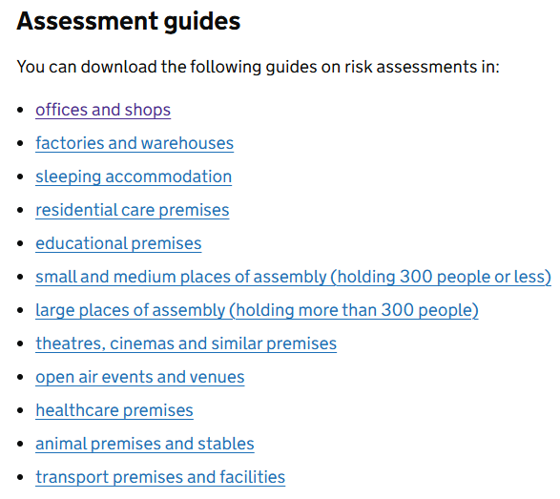
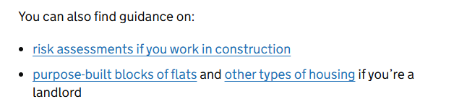
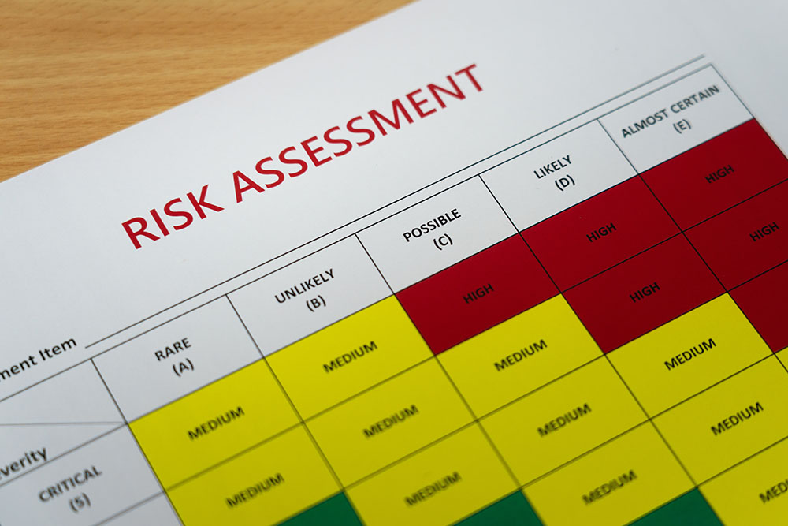
Home Office Guidance
Fire safety in the workplace: Fire risk assessments - GOV.UK

Slide 7
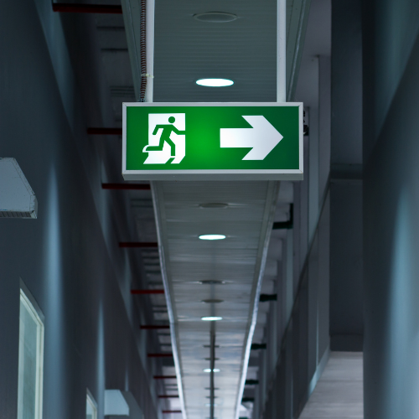
Home Office Guidance – Fire Risk Assessments
Consider:
emergency routes and exits
fire detection and warning systems
fire fighting equipment
the removal or safe storage of dangerous substances
an emergency fire evacuation plan
the needs of vulnerable people, for example the elderly, young children or those with disabilities
providing information to employees and other people on the premises
staff fire safety training & fire drills
co-operation, co-ordination and communication

Slide 8
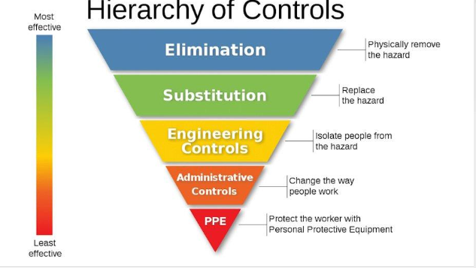
Hierarchy of Controls
The hierarch of Controls helps to prioritise fire safety actions from the most critical to the least.
In addition, they rank fire safety risks from the most to the least severe. By following the Hierarchy of Controls, fire safety management can effectively and safely control fire hazards.

Slide 9
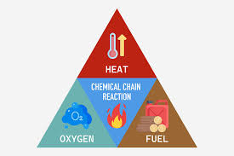
Step 1 –Identify the Hazards
The Fire Triangle – Sources of Ignition, Fuel & Oxygen
Identify the sources of ignition, fuel & oxygen in the workplace and use the hierarchy of risk control to manage the hazards
Elimination – The Smoke-free (Premises and Enforcement) Regulations – 1st July 2007
Substitution – Replacing an identified risk with an alternative that poses less of a fire risk, for example, replacing an identified flammable cleaning product with an alternative that poses less of a risk

Slide 10
Step 2 – Identify person exposed to risk
When deciding who might be harmed all occupants should be considered with particular focus given to those that are more likely to be at increased risk of harm in the event of a building fire. In a workplace setting this could be:
Visitors who are less familiar with the layout of the premises and likewise contractors for the same reason, but also due to the potential high fire risk nature of their work activities (hot works);
Lone workers in making sure others are aware of their presence in the workplace and they know of the need to evacuate in a building fire;
Young persons who’s perception of fire risk maybe very different; and
Those with disabilities that may affect their ability to evacuate a property.
When applying the next hierarchy of risk control there are some ‘engineering controls’ that can be implemented to assist occupants in safely evacuating, for example:
Engineering controls – providing engineering solution to reduce the risk or eliminate the chance of human error, such as the installation of magnetic self-closure devices on fire doors that automatically activate and close the fire doors upon the fire alarm activation. Closed fire doors will help to reduce the spread of smoke and flames in a building fire giving occupants more time to escape.

Slide 11
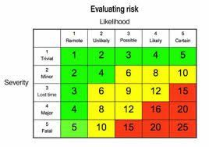
Step 3 – Evaluating the risk
As documented in HM Government ‘Fire safety risk assessment for offices and shops’ evaluation is required on ‘the risk of a fire occurring, the risk to people from fire, detection and warning, firefighting, escape routes, lighting, signs and notices and maintenance’. Arguably the most involved step with sufficient knowledge and experience essential to competently evaluate and decide whether action is required to remove the hazard, if practicable, or to use an ‘administrative control’ to reduce and manage the risks more effectively.
4. Administrative controls – by educating to reduce the risk helps make people be more aware of fire hazards. One such example is to train staff to check electrical equipment for any signs of damage before use. This will help to reduce the chance of an electrical malfunction igniting a fire.

Slide 12
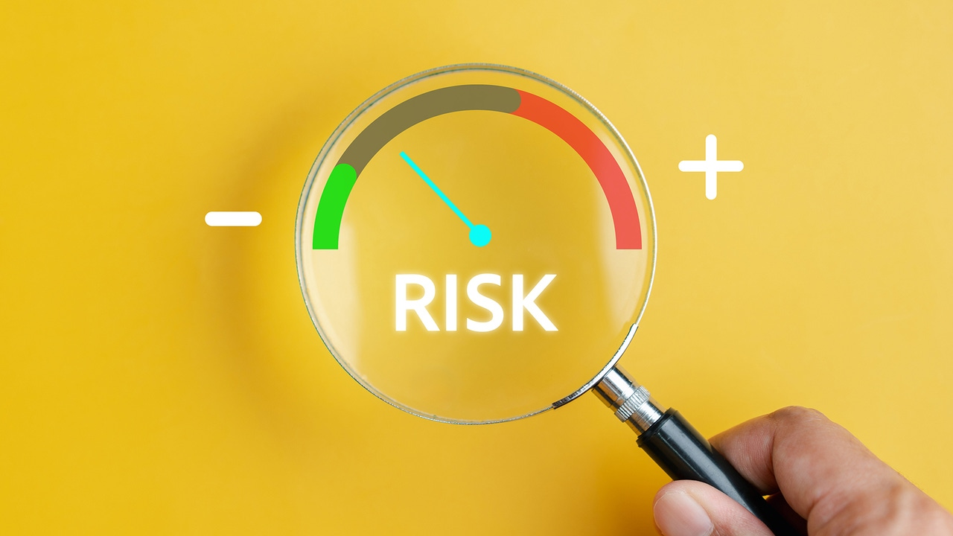
Step 4 - Record the findings and actions taken
If your organisation employs five or more people, your premises are licensed, or an alterations notice requiring you to do so, you must record the significant findings of your Fire Risk Assessment according to The Regulator Reform (Fire Safety) Order 2005.
Equally as important you must also formulate an action plan to further reduce the risk of fire and actively manage it.
An electronic copy of your report that can be managed via an online portal is the most effective and reliable method.

Slide 13
Step 5: Review the assessment
There is no set frequency on regular intervals to review a Fire Risk Assessment. The risk assessor should provide guidance on this based on their observations and conclusions. It is also important to remember a risk assessment is a snapshot in time that can easily change. There are several trigger points that would warrant the need for a review, including when:
Any fires or near misses have occurred;
There has been a visit by the Fire and Rescue Authority where an enforcement/prohibition/improvement notice has been issued;
Any significant alterations have been made to the building, such as structural changes or new installations;
Any significant changes in the use (or work activity) have been made to the building;
Any significant changes in the occupation of the building have been made, such as introducing a children’s nursery for office staff;
There have been findings from a fire evacuation drill that identify the need for a change; and
There have been changes made to the Responsible Persons.
Using the five-step risk assessment process and applying the hierarchy of risk control will evidence that it is not possible to remove all fire hazards, but it is essential to formulate an action plan for improvements, to help reduce the risk of fire in your workplace to ‘as low as reasonably practicable’ (ALARP).

Slide 14
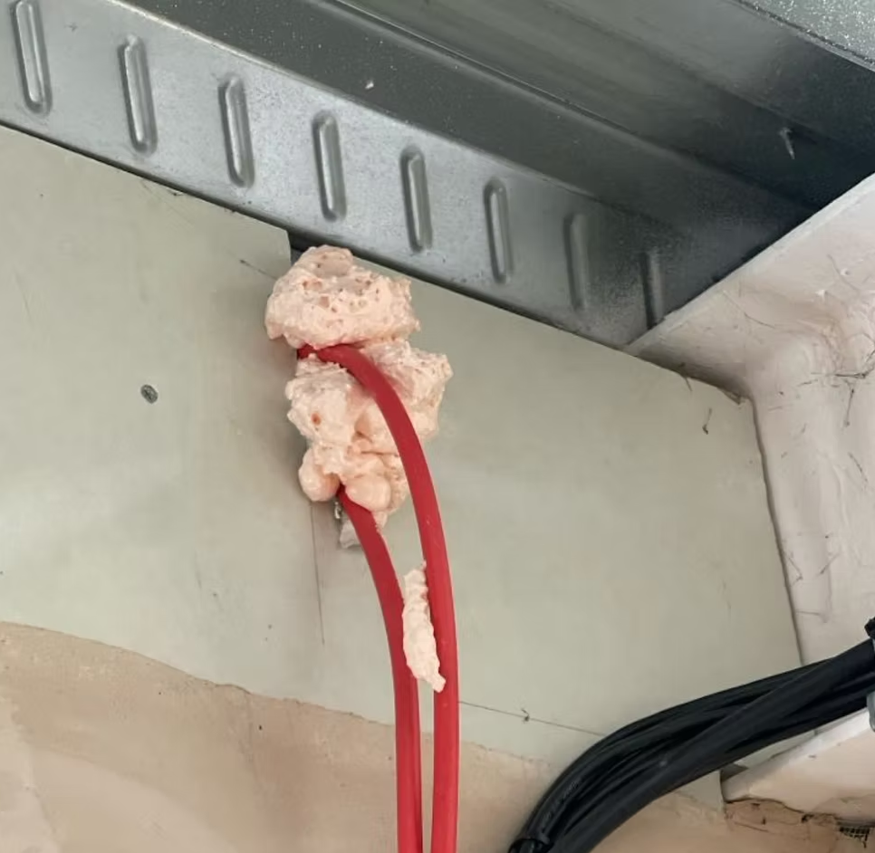
Passive Fire Protection:
Compartmentalisation
Passive fire protection divides a building into compartments to isolate fires, preventing them from spreading to other areas.
Fire-rated materials
Buildings utilise fire-rated materials like walls, floors, and doors to resist the spread of fire and smoke.
Penetration seals – fire stopping
These seals prevent fire from traveling through penetrations in walls and floors, like pipes or cables, maintaining compartmentation.
Intumescent coatings
These coatings protect structural steel from heat exposure, providing fire resistance.

Slide 15
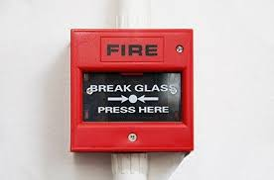
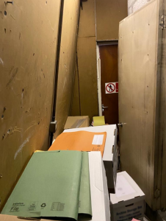
Active Fire Protection:
Detection Systems:
Fire alarm systems and smoke/heat detectors are crucial for early fire detection, alerting occupants and emergency services.
Fire Suppression Systems:
Sprinkler systems and fire extinguishers help extinguish fires or prevent them from growing.
Alarm Systems:
These systems alert occupants to evacuate and communicate the fire's location.
Escape Routes:
Ensuring clear and safe evacuation routes is a vital part of active fire protection, allowing people to safely leave the building.

Slide 16
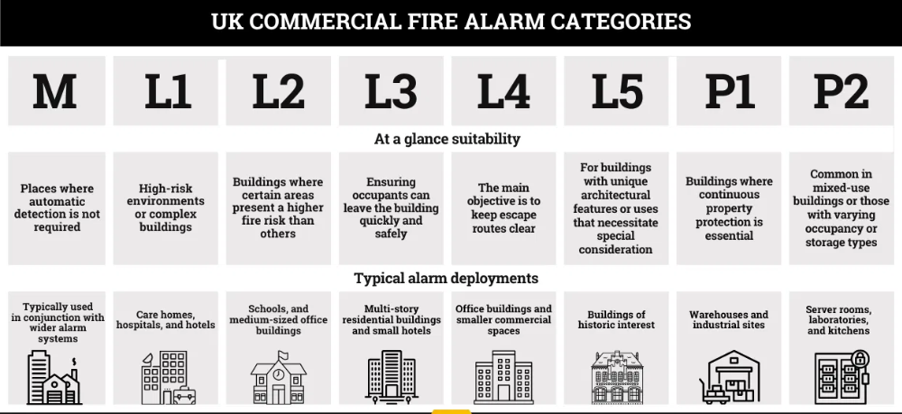
Commercial Fire Alarm Categories

Slide 17
‘Suitable & Sufficient’ & Layout
The front page to show an outside photograph of the building being risk assessed
Significant findings should be identified at the beginning of the FRA, in the form of a table which is colour coded green/amber/red matrix, colour coded with an appropriate risk rating (Likelihood v Severity numbering system), which is referenced to the photograph(s) in the FRA
This would also be cross referenced with the more detailed explanation in the main body of the report – Fire Risk Assessment in Full (Sections A to ?)
The name and address of the person responsible for fire safety at the premises and overall for the company
Ensure the correct fire alarm system is identified for the building
Identify your compartmentation lines if possible, in regard to routes of escape, riser shafts, electrical cupboards/comms rooms and kitchens
Try and include at least 10% of your accommodation within the FRA, if possible
State any records of relevant fire safety information being used to inform the current FRA including previous FRA’s
The name and address of any person(s) assisting the fire risk assessor undertaking the assessment (site manager/personnel etc.)
Details of the risk-based guidance being used for the assessment (as stated - PAS 79-1or PAS-79-2 and relevant Home Office Guidance being used – sleeping accommodation etc?
The names and addresses or any other persons/companies who have fire risk management duties or responsibilities in relation to the premises

Slide 18
‘Suitable & Sufficient’ & Layout
Include details of Co-operation, Co-ordination and Communication between different building occupants on site.
How the relevant fire information raised by the FRA is being passed to any building tenants
Undertake an inspection of any external cladding (visual only) and comment upon the cladding and position in the building in regard to fire escapes in the event of a fire
The number of photographs need to be kept to a minimum as large amounts can potentially be confusing and they need to be referenced to the relevant actions raised
Consider the amount of red items being identified in your FRAs, for example, what can be done to mitigate those risks, additional controls, for example, additional staff training/fire drills etc, this should warrant consideration for reducing the risk to amber
Ensure you have a policy in place for e-bikes/e-scooters & electric vehicle charging – charging and storage, as this risk is increasing year on year!

Slide 19
‘Suitable & Sufficient’ & Layout
Contents
Electrical sources of ignition
Portable heaters
Management of arson
Cooking & catering
Building fixed lightning protection
Combustible storage
Waste management/general housekeeping
Control of external contractors – Hor Works Permits
Dangerous/flammable substances
Potential spontaneous combustion
Means of escape
Compartmentation and building separation
Fire detection and warning arrangements
Emergency escape lighting
Fire safety signs & notices
Fire fighting equipment
Fire Safety Procedure and arrangements
Fire safety training
Fire safety testing and maintenance/record keeping

Slide 20
Competency
‘You wouldn’t believe it, its like the Wild West out there’
Competency – Shadowing an experienced practitioner & practice
FRA Review – Positive feedback & support
Qualifications – NEBOSH Fire Level 3, ABBE FRA Level 4, ProQual Fire Level 5!
FPA - Fire Door Inspection Course

Slide 21
When is a Fire Door Not A Fire Door
Fire Door Set - Fully tested, certificated and holds a fire rating of FD30, FD60 or in some cases FD120, to give a fire door its full integrity it needs the correct fire-rated ironmongery, seals and signage
Components – Door leaf, intumescent strips/cold smoke seals, threshold seal, hinges, self closing devices, ironmongery , glazed vision panel and air transfer grille
A ‘nominal’ fire door is a timber-based fire door that, in the opinion of the fire door inspector, can provide fire resistance performance for a specified period of time.
A 'notional' fire door, according to advice by the Gov, is a fire door that satisfied the standard applicable to fire-resisting doors at the time of the building's construction. This type of door may not have been fitted with intumescent strips and smoke seals.
An ‘upgraded’ fire door is a notional door that has been upgraded by fitting, for example, intumescent strips, smoke seals and a protected letter box.

Slide 22
DSEAR (Dangerous Substances and Explosive Atmospheres Regulations)
An assessment is required in the UK whenever there is work being carried out by an employer or self-employed person, and a dangerous substance is present or liable to be present at the workplace. This assessment is crucial for workplaces where dangerous substances are stored, handled, or used, or where processes may generate explosive atmospheres.
Key scenarios requiring a DSEAR assessment:
Presence of Dangerous Substances:
If dangerous substances like flammable liquids, gases, or dusts are present, used, or stored in the workplace
Potential for Explosive Atmospheres:
If there's a risk of an explosive atmosphere forming, for example, due to flammable substances, dusts, or certain processes
Work with Flammable Materials:
Activities involving flammable materials like welding, soldering, or the use of flammable liquids or gases
Handling and Storage of Dangerous Substances:
Workplaces that handle, store, or use dangerous substances, including petrol, chemicals, and dust wastage
Industries with Flammable Processes:
Industries like petrochemical sites and those dealing with the manufacturing, processing, and storage of chemicals
In essence, a DSEAR assessment is required whenever there is a risk of fire, explosion, or damage to metal from a dangerous substance in the workplace.

Slide 23
Summary
Be prepared before visiting any site visit – Obtain and read the previous FRA, obtain the maintenance and training records – Do you ask for this information beforehand?
If possible, ensure someone escorts/is at hand, who knows the building and has all the ‘keys’, record rooms you can’t access
Talk to staff regarding fire arrangements
How do you record any serious high-risk issues? Do you have a docket system
Tools - Torch, ladders, tape measure, distance metre, access keys for hatches, digital camera etc
Be careful accessing fixed ladders and climbing on rooves
Ask others to open fire escape doors!
Only undertake an FRA on a building your confident & ‘competent’ to inspect
Write up the FRA as soon as possible after the inspection as you forget!
If in doubt, ask for advice

Slide 24
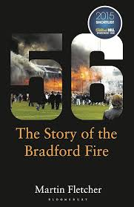
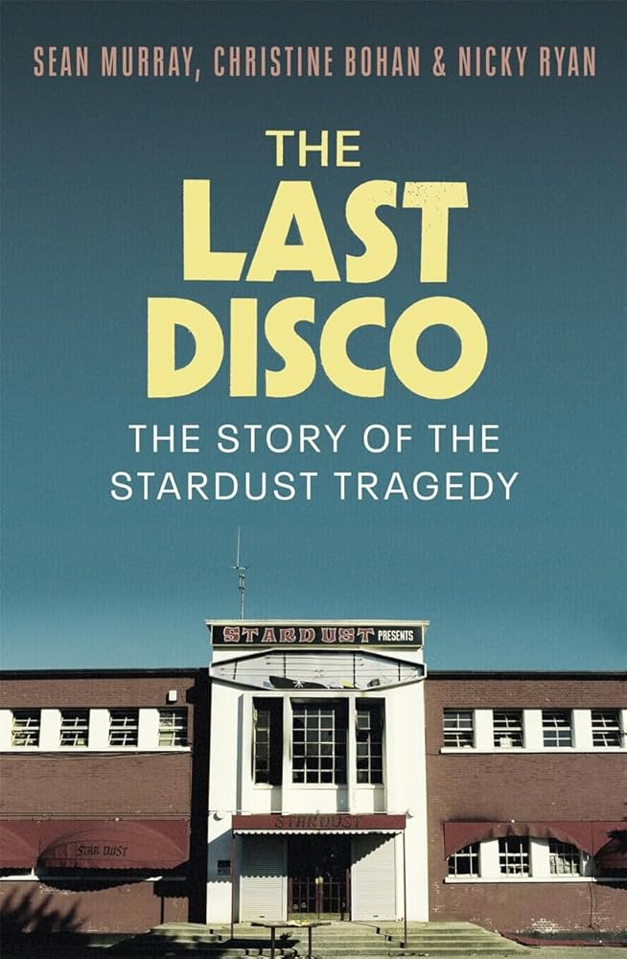
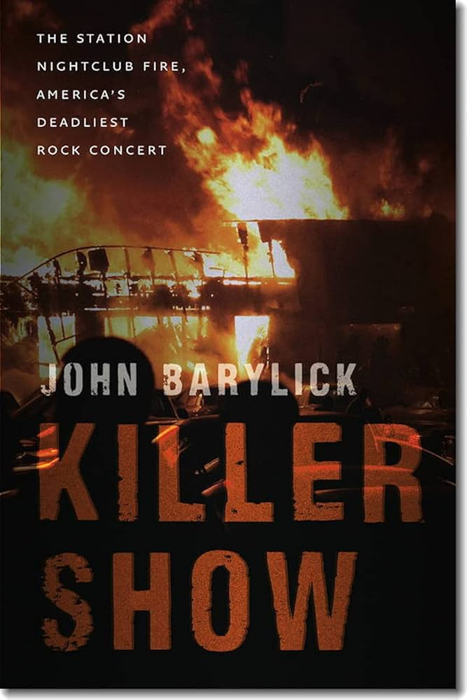

Books

