Slide 1



EVOLUTION OF
WELFARE
WWW.PALHIRE.COM

Slide 2

OVERVEIW
PAL HIRE’S OBJECTIVE IS ALWAYS TO FIND THE RIGHT SOLUTION, WE UNDERSTAND EACH SITE IS DIFFERENT, BECAUSE EACH JOB IS DIFFERENT - HOWEVER OUR STANDARDS SHOULD NOT CHANGE.
01
HIGHLIGHT THE SIGNIFICANCE OF PROVIDING THE MOST SUITABLE WELFARE FACILITIES ON SITE
02
HELP BUILD UNDERSTANDING ON HOW CHOOSING THE CORRECT SOLUTIONS CAN IMPROVE PRODUCTIVITY AND PREVENT ISSUES ON SITE
03
HELP YOU UNDERSTAND THE OPTIONS AVAILABLE TO YOU

Slide 3

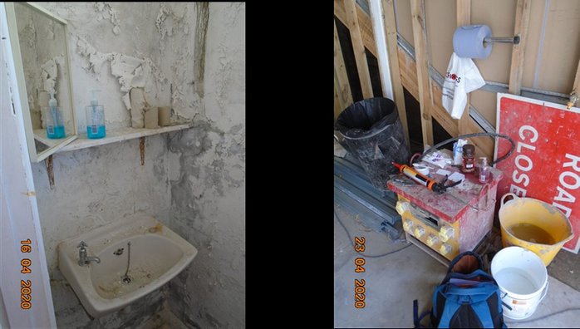
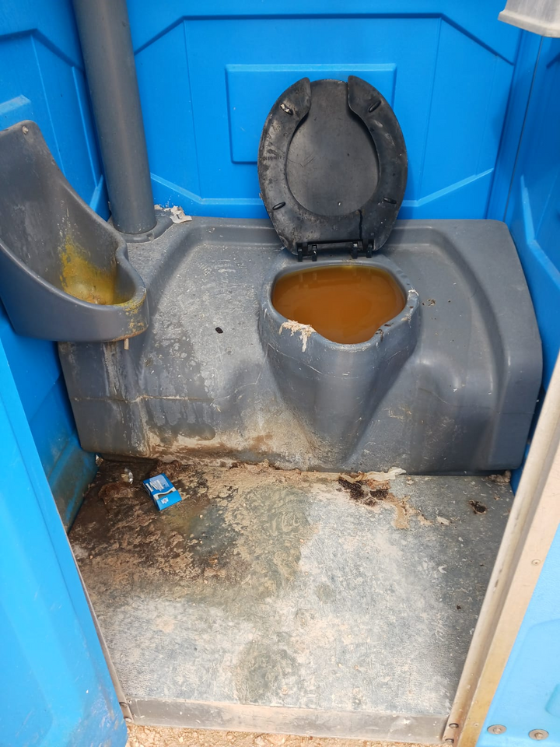
GUILTY
Company Based in Sheffield in 2023 found to provide inadequite welfare facilities fined £3500
  Failed to provide basic requirements
  Wash facilities for its workers
  Failure to provide appropriate sanitation conveniences
  No hot or clean water

Slide 4



WHY CHOOSE QUALITY WELFARE
Legal & Compliance
  Complies with legislation
  Prevents unwanted attention
  Prevent fines and enforcment actions
Employee Welfare
  Promotes Hygiene, Comfort & Health
  Improves employee Morale and Productivity
  Reduce disruption on site.

Slide 5

WORKPLACE (HEALTH, SAFETY AND WELFARE) REGULATIONS 1992
01
DRINKING WATER
02
TOILET FACILITIES (LADIES & GENTS)
03
CHANGING FACILITIES
04
REST AREAS
05
CLEANING FACILITIES

Slide 6





UNDERSTAND YOUR SITES
Site Size and Layout
Number of People
Working Hours
Assess the available space, provide supplier with plans.
How many workers will be on site at anyone point, are there any spikes during the project.
What are the working hours of the site.

Slide 7
PRODUCT SELECTION
Picking the right solution or level of service will improve the efficiency of your sites.

Slide 8


01
02
03
MOBILE
STATIC
MODULE
Mobile units that ensure you meet all obligation in one unit. Compact and mobile allowing flexibility on your site while maintaining welfare standards
Static Welfare units require more space but on long term projects can offer a cost effective solution. Multiple unit or all in one units available depending on the size of site and space available.
Offering a scalable solution to welfare modular units can be installed in tight and inaccessable sites. Flexible units to create welfare facilities to meet specific needs. .

Slide 9

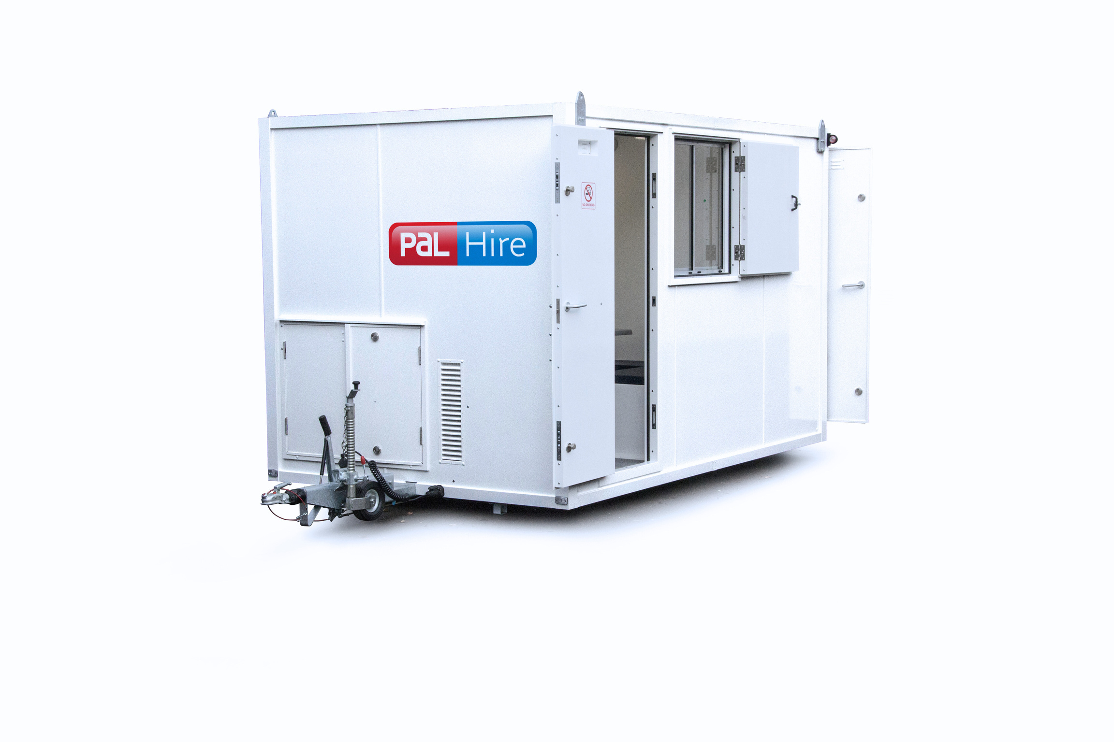
MOBILE
Available for 6, 10, 12 or 16 people

Slide 10
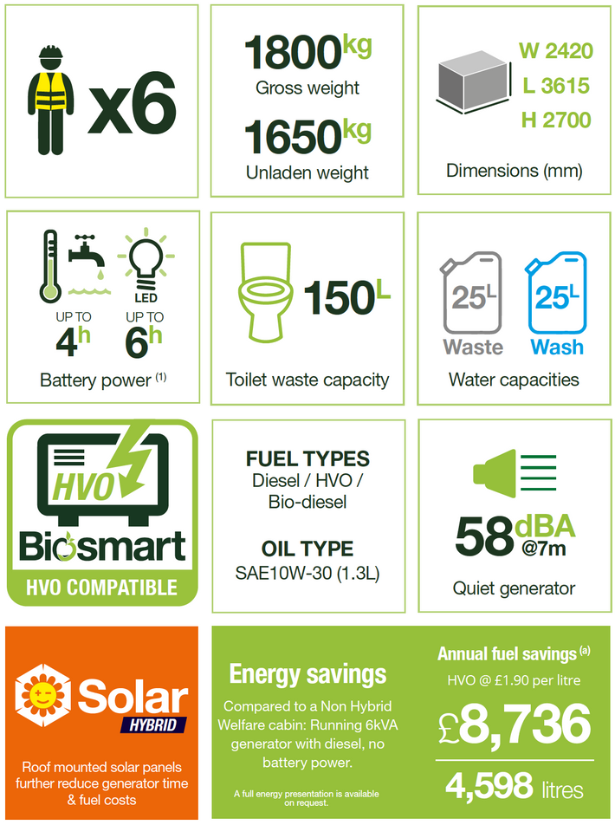
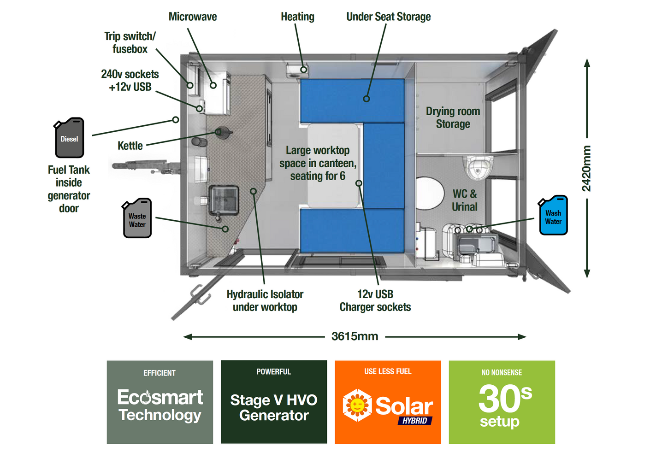
6 Person Mobile Welfare Unit

Slide 11
6 Person Mobile Welfare Unit

Slide 12
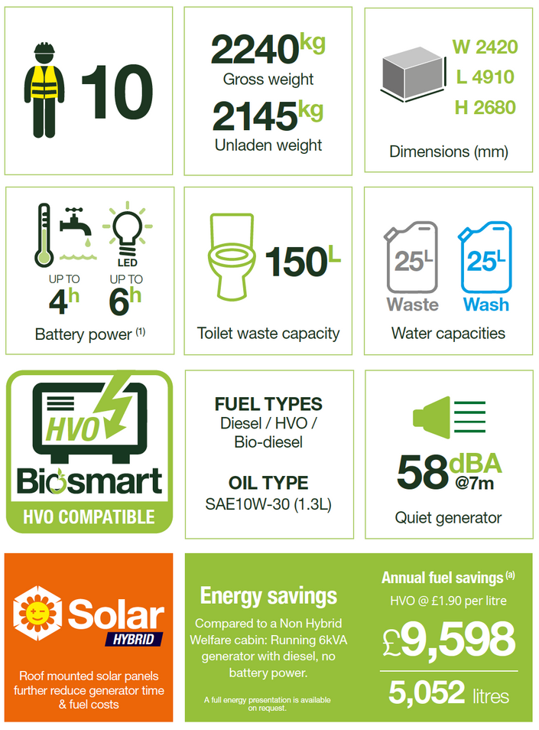
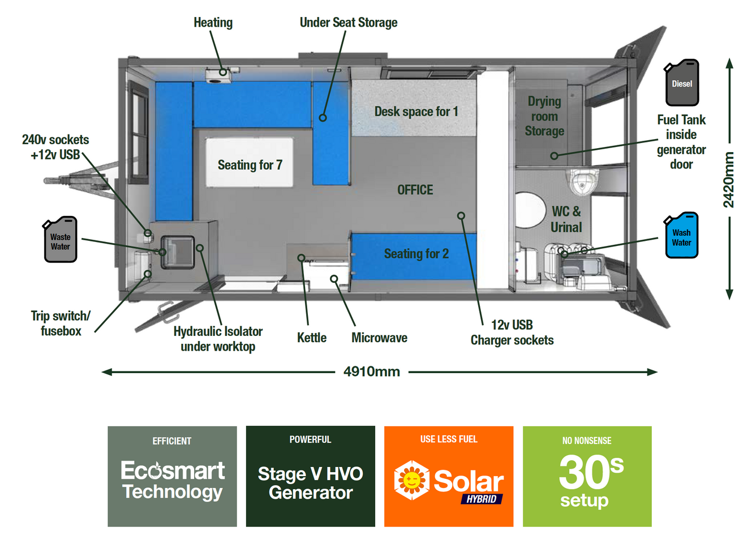
10 Person Mobile Welfare Unit

Slide 13
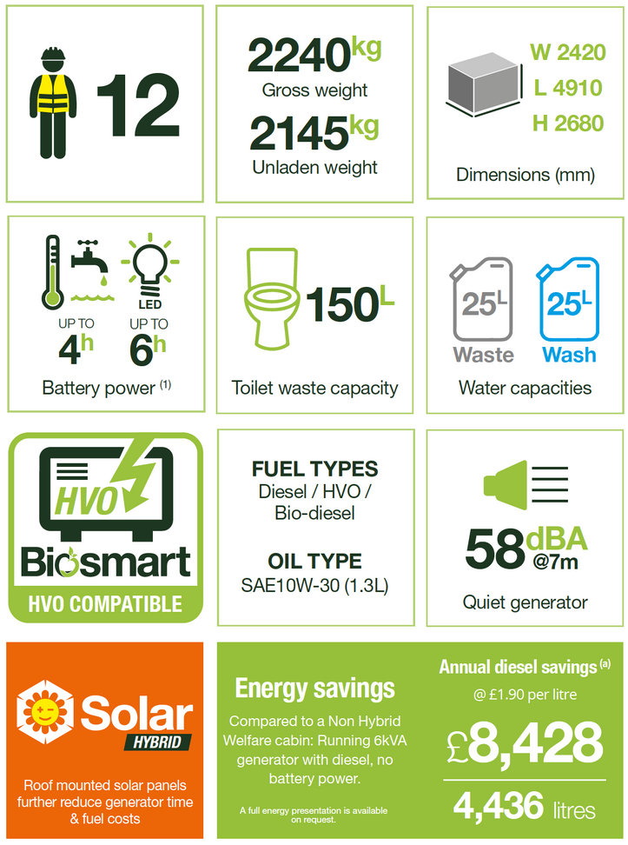
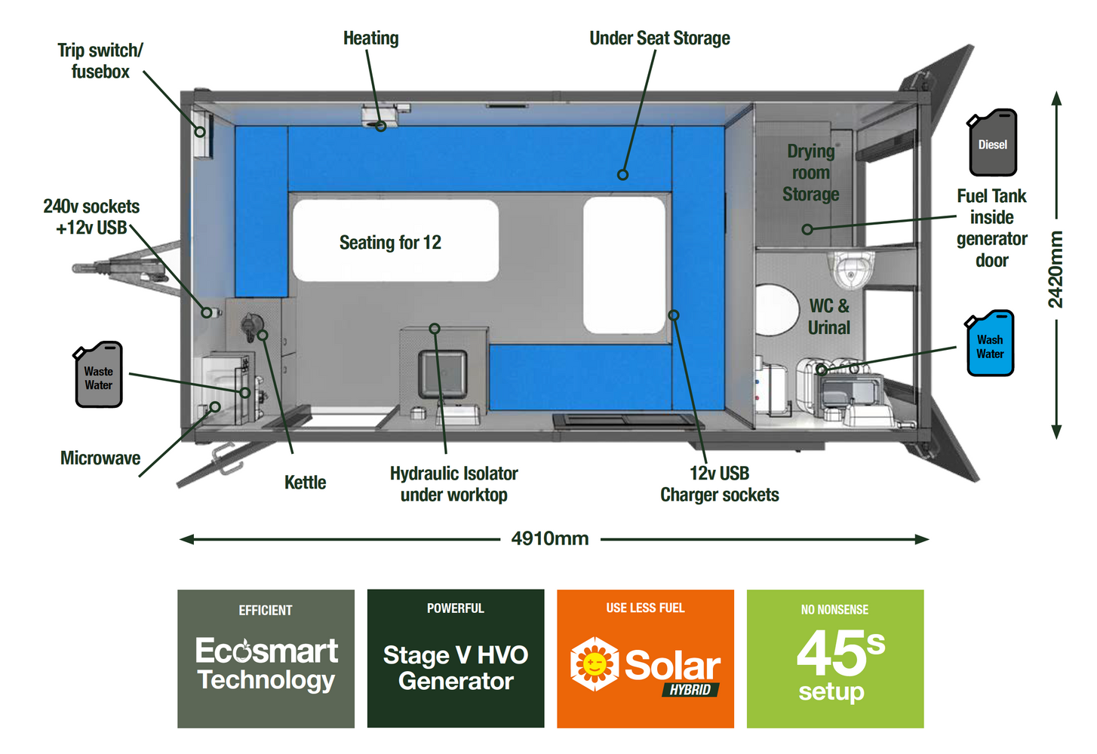
12 Person Mobile Welfare Unit

Slide 14
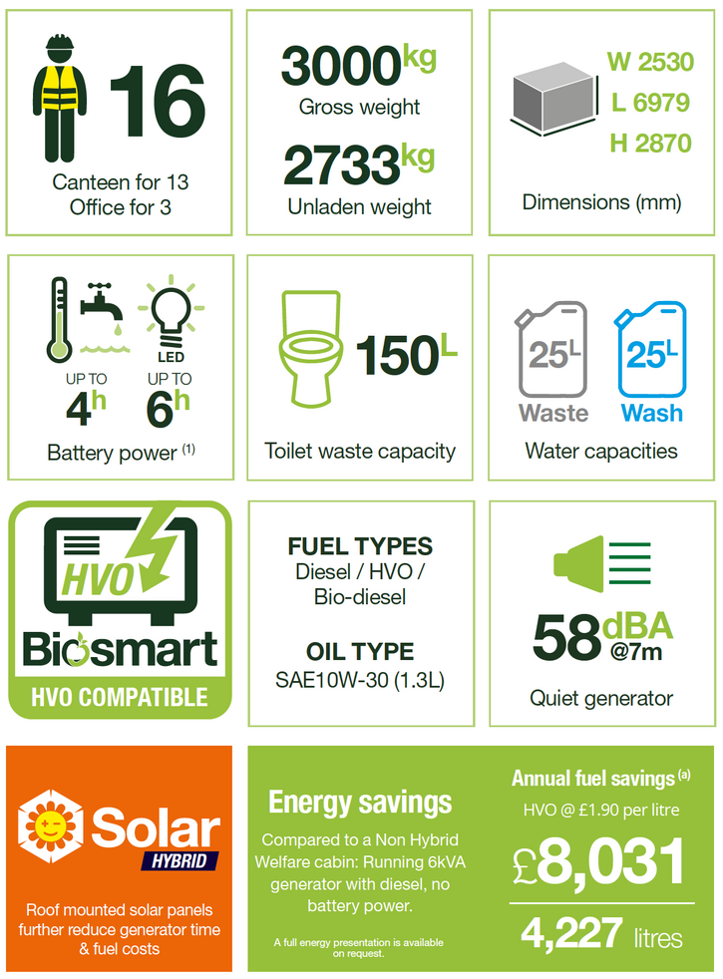
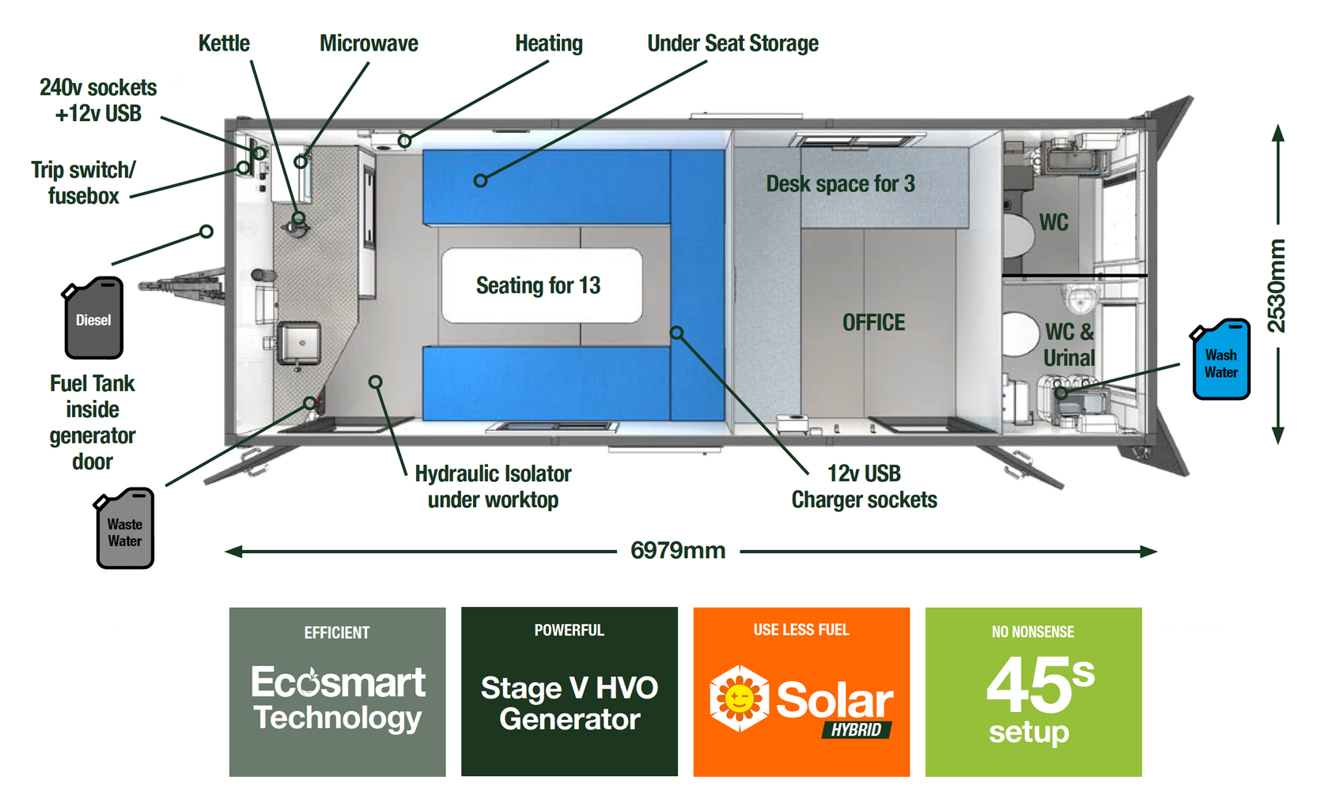
16 Person Mobile Welfare Unit

Slide 15
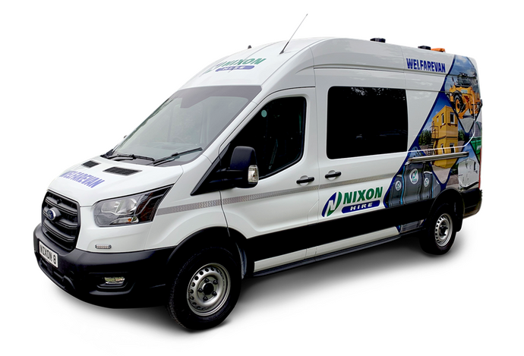
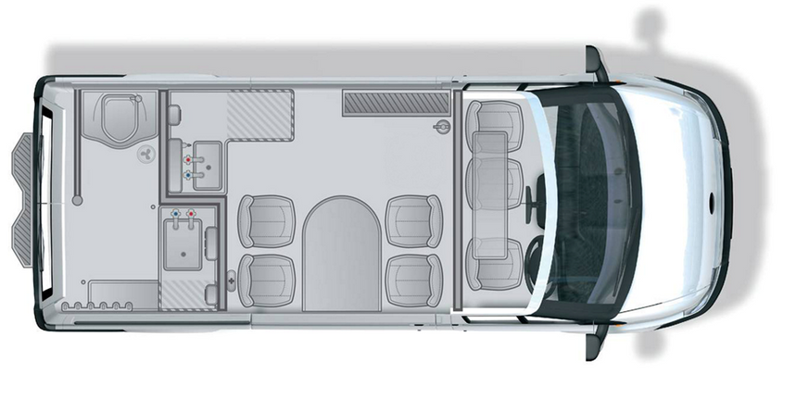
Welfarevans & Solar Welfarevans
Key Features
  Fresh Flush Toilet and Wash Basin
  Minimum 7 x Crash tested M1 Seats
  Unisex toilets
  Microwave
  Hot water
  Central Heating
  Hot & Cold handwash
  Split Batteries
  Wet Clohes storage and Drying room

Slide 16
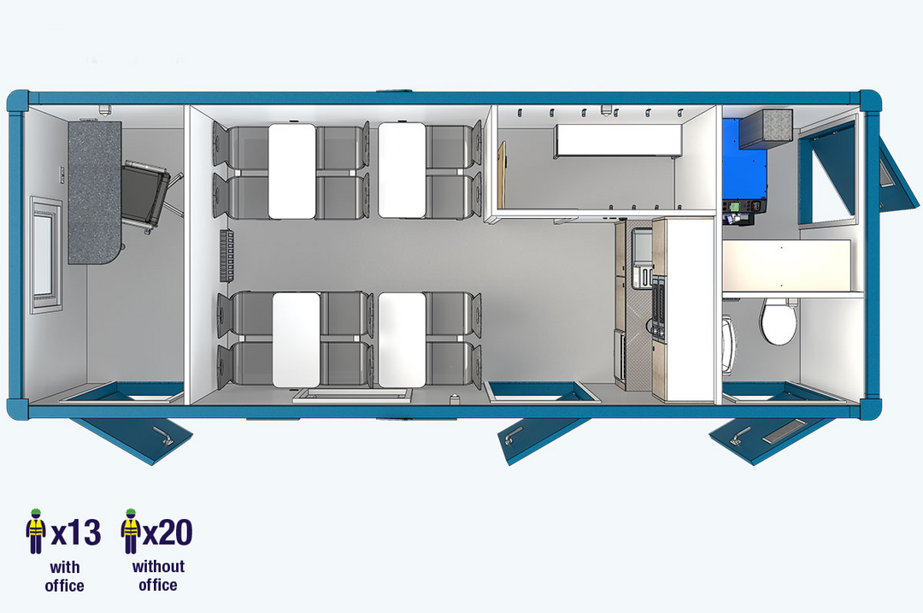
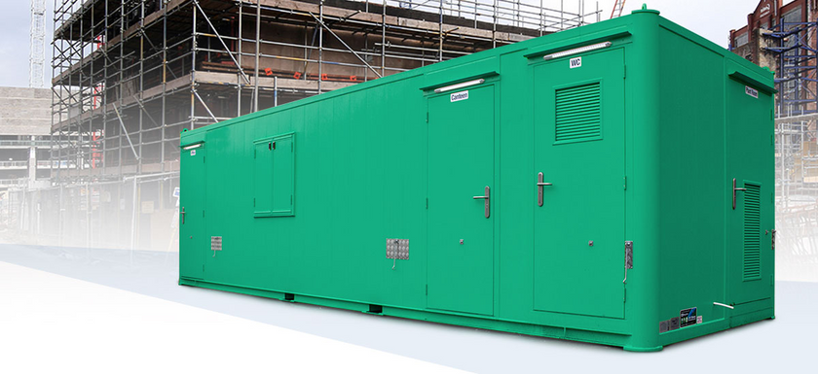
Static Welfare -Ecostatic 24/28
Facilities
Easy to use canteen facilities; 2x kettles OR 2x microwaves
Built-in refrigerator
Comfortable spacious seating area
Separate office area
Easy-to-use cabin controls
USB device charging points
Warm water washing facilities
Recirculating toilet
Forearm wash basin
All interior and exterior surfaces are tough, durable and wipe-clean
Spacious drying room with hanging clothes facility
Security / Safety
Dual heavy-duty locking system per door
Robust galvanised exterior with high impact resistance
Carbon monoxide detectors
Sustainability
Fully-insulated wall and roof system with no cold bridging
Low noise pollution
Low fuel consumption
Low CO2 emissions
Timer heating controls
Automatic generator stop/start technology for economical fuel usage
LED lighting without the generator operating
Heating usage without the generator operating

Slide 17
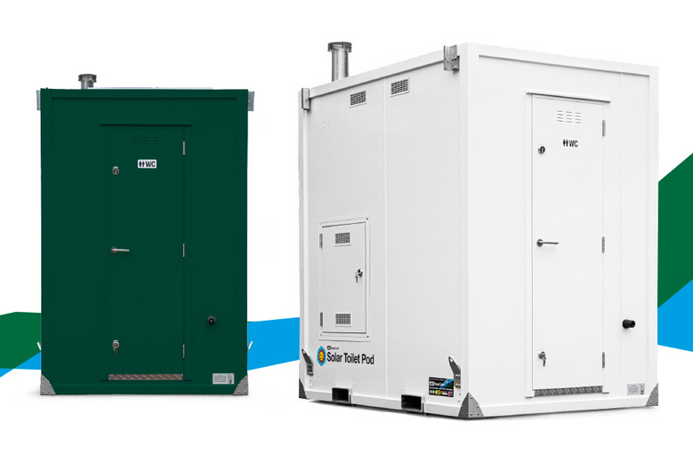
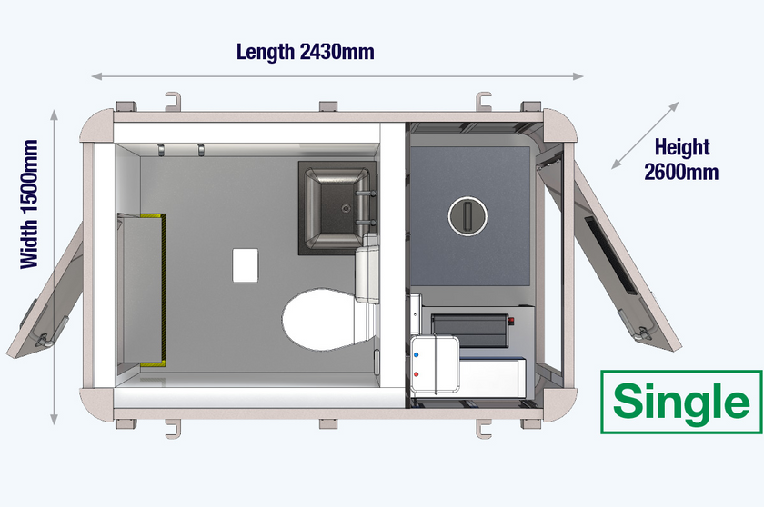
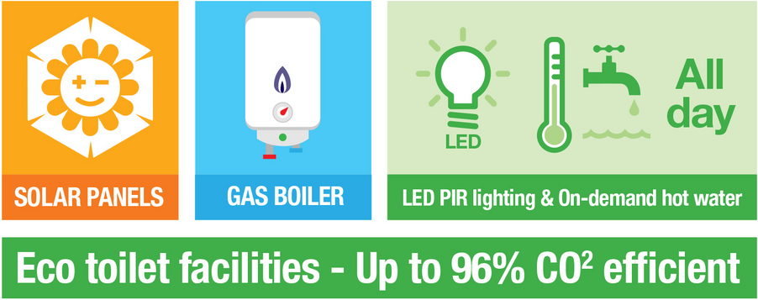
Sustainability
Solar hybrid technology for sustainable free energy
Efficient water LPG boiler
Lower fuel consumption
Low CO2 emissions
Cubicle
Fresh-flush toilet
Mirror
LED downlight
Ventilation
Coat hooks
Security
Dual heavy-duty locking system per door
Solid steel exterior with high impact resistance
Facilities
1+1 =
450 litre water tank
950 litre waste tank
Single =
210 litre water tank
520 litre waste tank
External waste tank access
Gas boiler
Solar Toilet POD

Slide 18
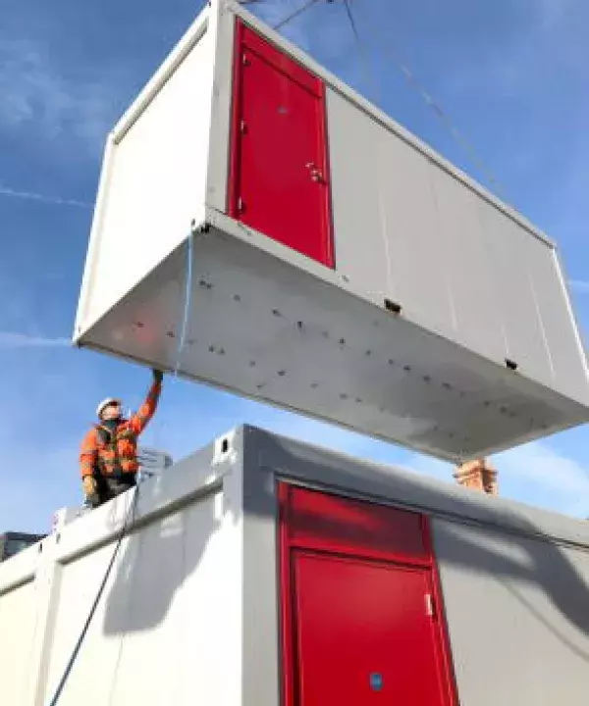
Portable Buildings - Fire Rated JCoP 10.1
  Fireflex is available with 30 minutes fire-rating or a minimum of 60 minutes (from inside to out),
  Fire curtain barriers, which automatically deploy when temperatures reach 135 degrees Fahrenheit or 57 degrees Celsius
  Fire Safety Equipment Available
  First Aid & Defribillators
  Further Guide of needs can be provided
Notes:
Our fire-rated site cabins are designed to meet the requirements of the Joint Code of Practice for Fire Prevention on Construction Sites. Fireflex is available with 30 minutes fire-rating or a minimum of 60 minutes (from inside to out), offering protection to building occupants and adjacent properties. Opening windows are fitted with active fire curtain barriers, which automatically deploy when temperatures reach 135 degrees Fahrenheit or 57 degrees Celsius
JCoP Version 10.1
The 10th edition of the code was published in August 2022 and replaced the long-established
9th edition.
However, the 10th edition has now been withdrawn and replaced with the JCoP 10.1 edition.
All new construction projects covered by the guidance must now refer to the 10.1 edition.
JCoP and HSG168
Some references within JCoP 10.1 are also made to the Health & Safety Guidance - Fire Safety
in Construction (HSG168).
HSG 168 and JCoP requires that where the temporary building/site accommodation is vertically
stacked, the lower roof/floor assembly must achieve 30 minutes fire resistance for loadbearing,
integrity and insulation (REI).
This applies for all temporary buildings/site accommodation, even when located at more than
6m from a permanent structure / building under construction/refurbishment.

Slide 19

STATISTICS
90%
Upto 90% of issues reported on site could have been prevented.

Slide 20
WORKING TOGETHER
To reduce project costs on site
Notes:
Selecting Insufficient Welfare, can impact the sites productivity.
Reducing the number or toilets on site will lead to more breakdowns with over use.
How many hours are wased in working hours with people being unproductive with insufficent space to have a break.
Paying for better standards of equipment, can provide a reducion in fuel costs, savign energy which impacts the qualty of welfare and improves morale

Slide 21
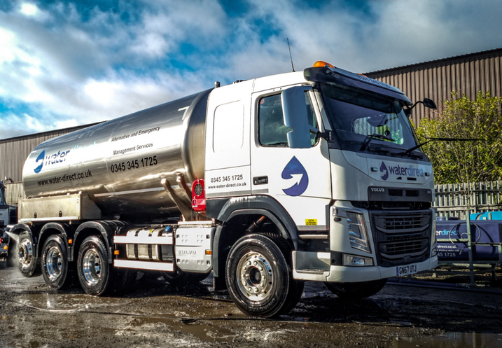
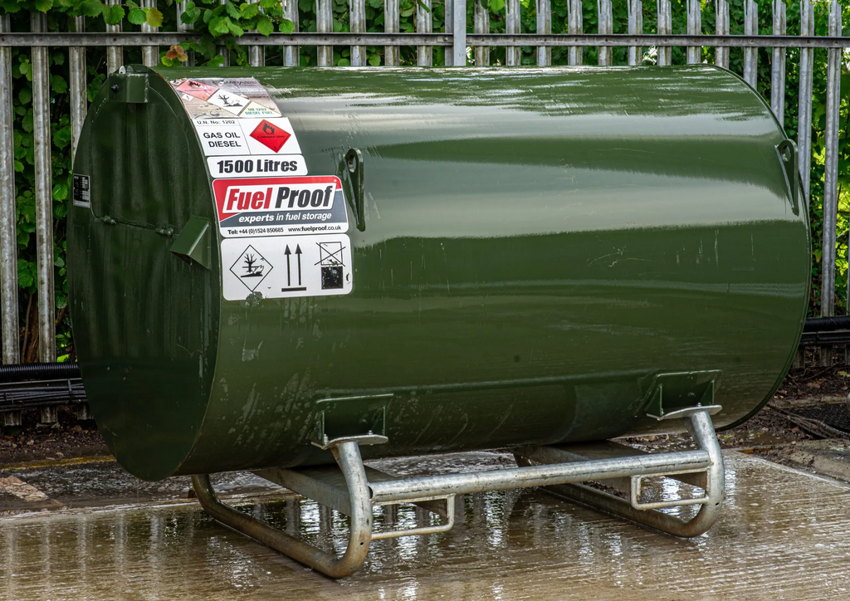
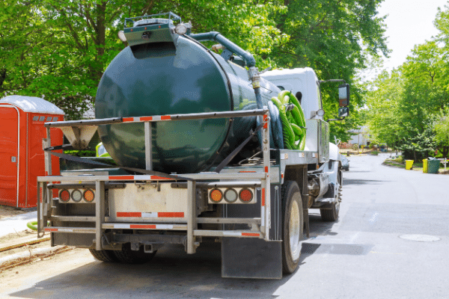
ADDITONAL SITE SERVICES
Improves site productivity
Water Delivery
Fuel Delivery
Effluent Removal
Notes:
Selecting Insufficient Welfare, can impact the sites productivity.
Reducing the number or toilets on site will lead to more breakdowns with over use.
How many hours are wased in working hours with people being unproductive with insufficent space to have a break.
Paying for better standards of equipment, can provide a reducion in fuel costs, savign energy which impacts the qualty of welfare and improves morale

