Slide 1
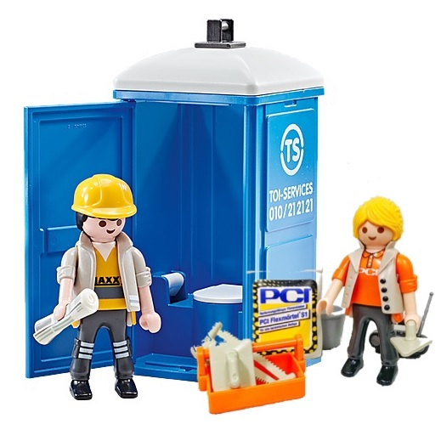
Welfare in Construction, child’s play, isn’t it? An introduction to the new operational guidance (OG)
Matt Greenly – RSU Construction welfare portfolio lead
WWT – September 2024
Notes:
Welcome to this short seminar to introduce the published Construction welfare Operational Guidance document, or OG.
This session aims to explain why the OG was needed, how it came about and how the clearer standards should help inspectors regulate welfare on construction sites more effectively as well as helping industry better understand the standards required.

Slide 2
Why is welfare important?
Good welfare is a basic requirement for anyone at work
Good welfare is a barometer for the rest of the site and how the project is managed
Construction and demolition workers are not second class workers, they deserve decent facilities
Good welfare is a vital control measure against many ill health issues
Notes:
Welfare is a fundamental and basic necessity for workers. It is also required by law. Providing the right welfare standard sets the tone for a project and demonstrates a commitment to meeting workers' needs. The provision of toilets, a supply of hot and cold (or warm) water for washing, changing facilities, drinking water and somewhere to eat and rest is a basic expectation. Workers on a demolition site should not have to accept conditions that they would not accept at home.
Welfare facilities form an important control measure in their own right as well. They help protect workers against the risks from hazardous substances such as cement, lead or micro-organisms. Having recently suffered a global health pandemic, the importance of good personal hygiene should be paramount in everyone's minds

Slide 3
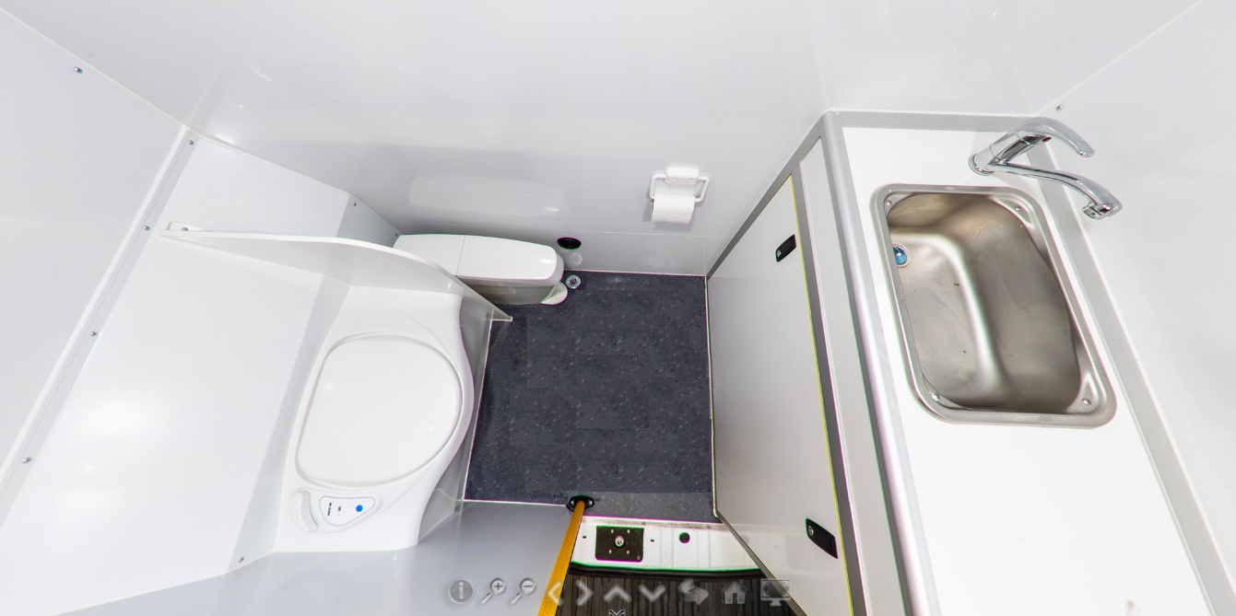
What’s does good look like? https://www.hse.gov.uk/foi/internalops/og/og-00002.pdf
Good welfare includes:
Toilet(s), clean and flushable
Sanitary waste bins in toilets
Washing facilities with hot/warm water
Facilities to heat food and make hot drinks
Somewhere warm and dry to rest, eat etc
Sufficient consumables (soap, means of drying, toilet paper etc)
Toilets should be within 150 linear metres of the work area or up/down one floor to minimise travel time
Welfare must be available at ALL times
All welfare must be maintained in a clean and working condition
Notes:
The standards required for compliant welfare are not complex and essentially match the facilities you no doubt have at home, the workplace should not be any different to what you expect away from work.
Welfare should be one of the first things on site, and the last thing to leave. It must be available at all times throughout the construction phase and good design will ensure that welfare will remain and sufficient throughout the works.

Slide 4
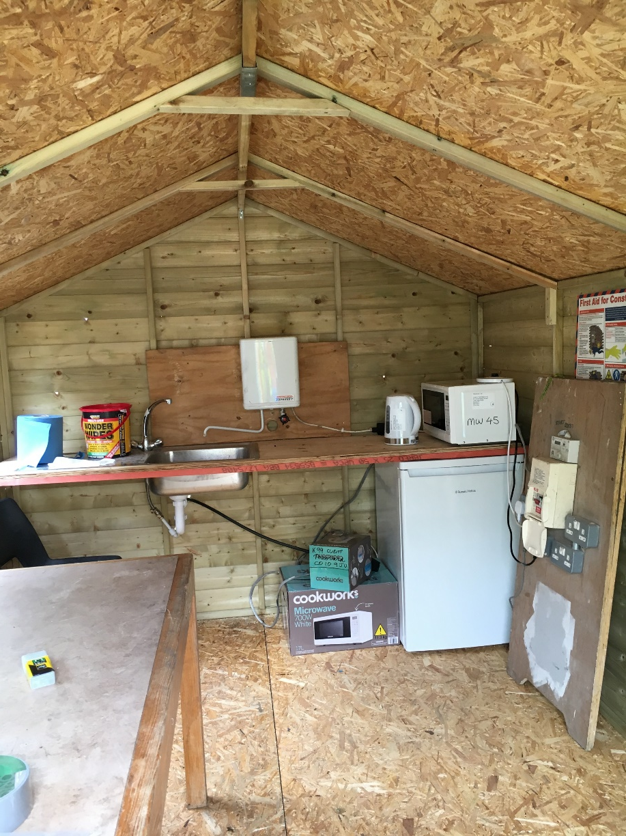
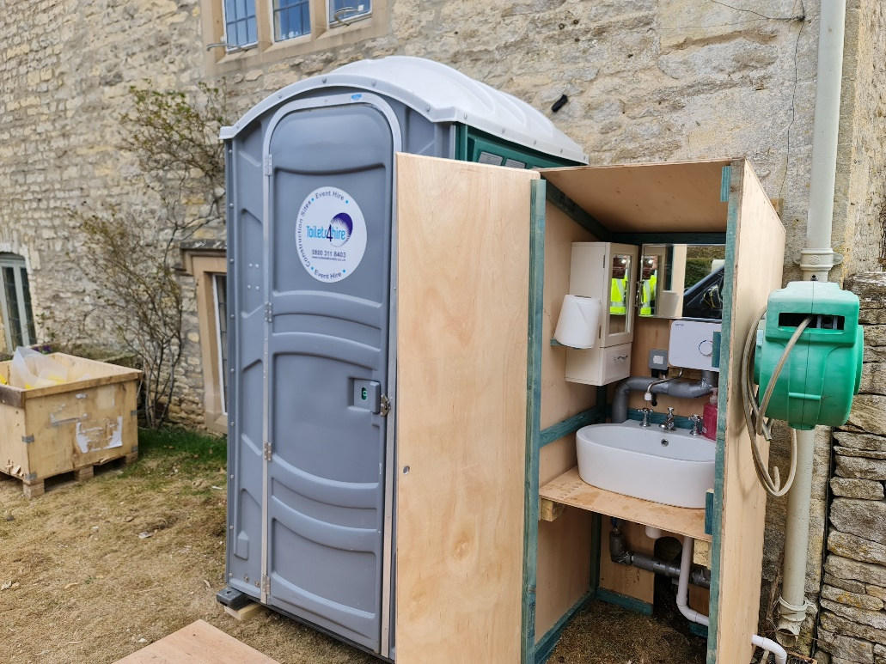
Good doesn’t have to be fancy https://www.hse.gov.uk/foi/internalops/og/og-00002.pdf
On smaller sites, ‘home-made’ solutions are perfectly acceptable, so long as they comply with CDM Schedule 2
Notes:
It’s worth remembering that compliant does not need to be fancy or expensive. HSE has seen many examples of homemade facilities which are compliant and suitable for the site.
On this site, a cold water portaloo was matched with a warm water washing station which brought it into compliance. Similarly, a shed was used to create a small rest area and canteen to provide food and drink prep, as well as somewhere away from the workface and weather to take a break.

Slide 5
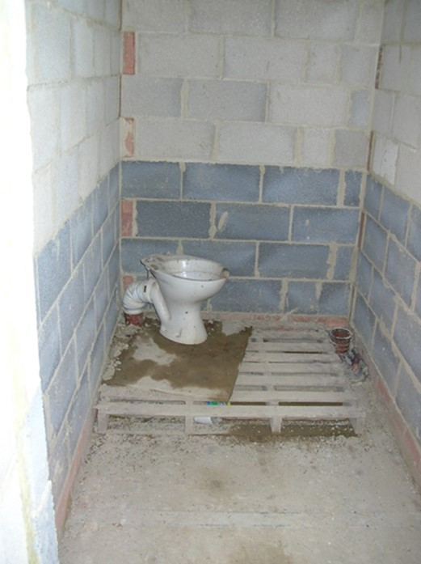
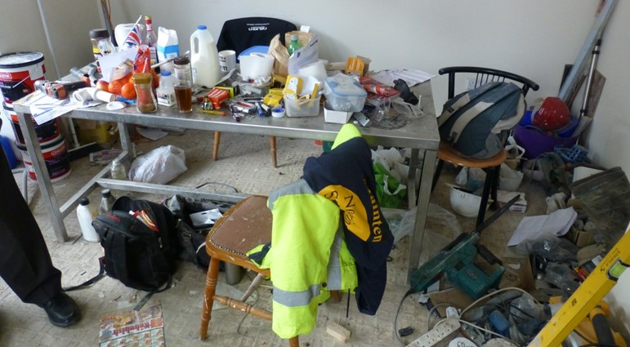
What’s does bad look like? https://www.hse.gov.uk/foi/internalops/og/og-00002.pdf
Poor welfare includes:
Cold water ‘thunderbox’ portable toilet only
Unclean facilities or toilets etc used as stores
No rest area or area unfit for preparing & consuming food and drink
Use of ‘local’ facilities only such as café’s or McDonalds without very strong justification
Notes:
We cannot accept that warm water is not possible to supply on any site, in recent years the availability of washing facilities has improved massively, you can even get warm water fed sinks to fit to the bulkhead of a van as a truly mobile solution.
Some people feel that popping to Tesco’s or McDonalds is providing suitable welfare, HSE will challenge this very strongly as you have no control over whether that public facility will be open, in good order, well stocked etc or even if dirty or contaminated workers will be allowed in. HSE will only accept this where there is no other possible solution and that formal conclusion and thought process can be clearly demonstrated.

Slide 6
Why do we need a new OG?
The previous OG was published in 2013 and was due for review in 2015
This new OG addresses the briefness and vagaries of the previous OG
Industry have driven and contributed to this update and are welcoming of clearer standards
The new OG gives HSE far clearer parameters for regulating this topic
Notes:
You will all be aware that Schedule 2 of CDM lays down the basic parameters for what good welfare looks like but it is very interpretive. HSE policy makers have spent a lot of time in working groups with key industry players and they developed a draft welfare document detailing clearer standards that they can commit to. We are very grateful for industries input into this initial piece of work.
This draft document has been reviewed by me, amended and converted to an OG, or operational guidance document to allow publication for HSE staff.
Although HSE OG’s are written as internal documents, due to FOI, HSE allows free access to these internal documents so external stakeholders can use the information to either develop their own guidance or simply understand how HSE will regulate so they can manage themselves accordingly.
This detailed revision to the OG will give Inspectors and Visiting Officer’s very clear parameters when inspecting and regulating welfare on demolition sites and can also be used by other areas of HSE to set standards for more permanent welfare facilities in factories for example.

Slide 7
Major changes?
In reality, there are very few notable changes to the standards required, in general the standards are now just far better defined
For example, distances are now given for toilet proximity which should prevent people having to drive for miles to use the bathroom
The ratios for toilets per person have changed due to the British Standard being updated, it used to be 1 toilet for 7 people, now it is 1 for 5
Clear consideration is given to the provision of sanitary waste disposal facilities (more on this later)
The detail given for each requirement listed in CDM Schedule 2 will give contractors a clear framework to achieve as well as allowing the regulator to measure site conditions to a written standard
Rest areas, canteen and drink/food prep areas are still required as before
Notes:
Despite the high levels of detail in the new OG, there are only a few changes to the standards required on site. The new OG simply gives clear interpretation of what is required.
For example, the previous OG said toilets should be readily accessible but what does that really mean? The new OG states that any worker should be within 150m of a toilet on site. For remote sites it is accepted that they may need to drive to a central welfare hub but makes it clear that the time taken to drive should be similar to that needed to walk 150m. So, if it takes the average person around 2 minutes to walk 150m then any drive should be no more than 2 minutes under normal conditions. This may mean for larger sites that satellite toilets may be needed of course.
One notable change is that the ratio for toilets per number of workers has changed due to the British Standard changing, where once you needed 1 toilet for 7 people, that number has now changed to 1 per 5 so I would encourage you to look at the ratio tables to appreciate the increase in toilet numbers required.
HSE will also be making the provision of sanitary waste disposal facilities a point to assess. With the changing face of a more inclusive industry, suitable provision must be made for female workers on site. This is nothing new but has often been overlooked by contractors over the years. I’ll discuss this in more detail later.
As with all enforcement, a certain level of pragmatism will be expected as this is only guidance, if a toilet is 155m away then it is unlikely that enforcement will be needed but these new guidelines will hopefully ensure that toilets etc are far more readily available than they have been to date.
There is no real change to the requirements for rest room and food prep arrangements

Slide 8
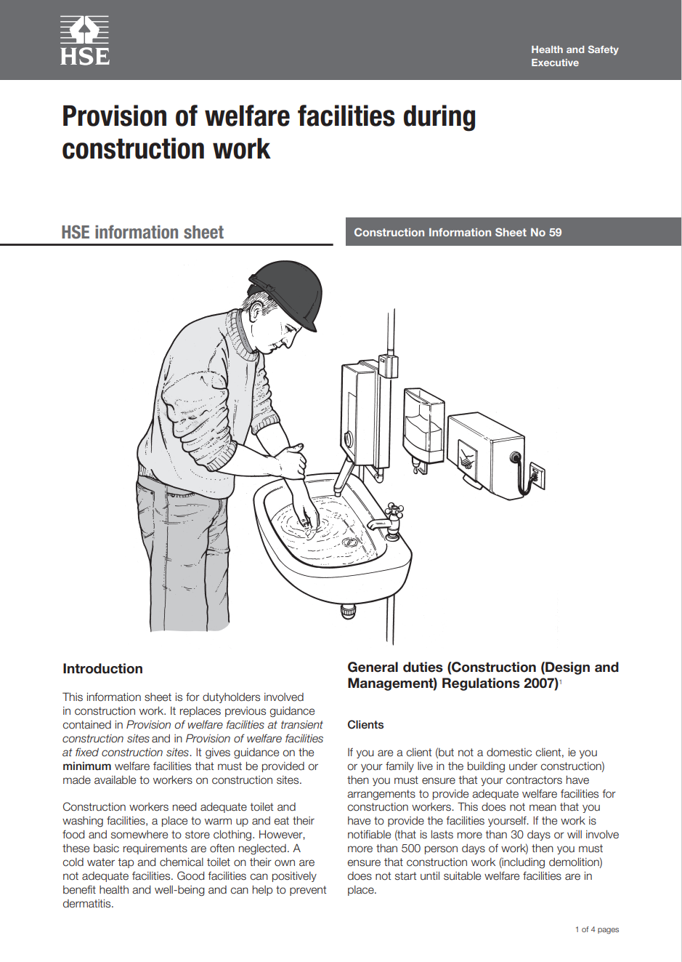
What about CIS59?
CIS59 – Welfare in Construction is now a little dated (nearly 13 years old) so should be used with this in mind
CIS59 allowed cafes etc to act as welfare, this is to be a very last option, not a cheap solution
The key principals within CIS59 are still relevant today, welfare should be planned and managed and meet the standards laid down in Schedule 2 of CDM
Investigations will be made into whether CIS59 can be updated to reflect the new OG and welfare available to the industry
Notes:
It must be remembered that any OG is primarily for HSE’s internal use, rather than acting as external public guidance such as CIS59. That said, they are available under FOI so savvy contractors will use it to understand the standards we will be measuring against.
CIS59 is currently available as a public information sheet but it is now getting quite old as it was written and first published in 2010. Much of its contents are still relevant but I would urge you to use it with some caution and be mindful that standards have changed, as has the availability and standard of compliant welfare facilities throughout the industry.
It is also worth noting that CIS59 advocates the use of public toilets and cafes etc. This should be a very last resort as with proper planning (as required by CDM), welfare facilities should be made available throughout the entire project and be under the control of the PC, not a local café owner. Contractors using this as a control measure will be asked to justify why it was the only available option and should expect robust challenge from HSE.

Slide 9
Showers?
The OG states - Suitable and sufficient washing facilities, including showers if required by the nature of the work or for health reasons, must, so far as is reasonably practicable, be provided or made available at readily accessible places.
Industries such as demolition can be dirty work and showers will be needed to remove contaminants such as lead, bacteriological matter, dust etc
Duty holders will be expected to provide suitable consumables for use in these showers including soap (shower gel/shampoo etc) and a means of drying effectively (suitably sized towels)
Normal hierarchy of controls must still prevent or reduce exposure to such contaminants so far as is reasonably practicable.
If showering is part of your control measures, then time must be allocated in the working day to allow showers to be taken before leaving site, for example, asbestos workers don’t just not shower as they want to get home more quickly, time is allowed within the shift for thorough decontamination
Notes:
The minimum provision that we are all used to (toilets, sinks etc) should be expanded to include showers where relevant to the work. However, it is important to draw a distinction between washing for health and washing for general social norms. While providing a shower for all workers for ‘freshening up’ after work may be desirable for social and community reasons, is not required by the law unless needed on the basis of risk. Determination of this will be site dependent but is likely to be for situations such as:
− Specific hazardous substances like lead;
− Specific hazardous work such as contaminated ground or refurbishing sewage works;
− Work that is particularly strenuous or dirty;
− Heat Stress where work is taking place in very hot conditions
In reality, this means that for the majority of demolition sites, showers should be provided as part of the minimum standards.
If showers are provided then we would require the provision of additional consumables such as soap and suitable means for drying, i.e. bath towels.
If showering is part of your control measures then you should build time into the working shift to allow worker to shower, rather than rushing off site dirty.

Slide 10
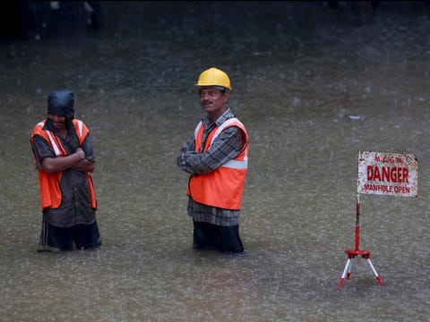
Drying rooms
The OG states - where necessary, (you must provide) facilities to enable a person to dry any special clothing and any personal clothing or effects. Temperature: this needs to be sufficient to dry clothes within the time period before they are next required – i.e. by the beginning of the following work period – unless other dry clothing is provided.
Any drying room must be large enough to accommodate the clothes of workers in such a way that they have sufficient space to dry and air circulation and ventilation is maintained
Drying rooms must be able to be used out of normal working hours so that clothing can dry before the next shift.
Power supply will need to be maintained to allow heaters to complete drying, often this is overnight, so fire risks need to be well managed.
Notes:
Drying rooms are commonly neglected but they play a vital role in demonstrating respect for the workers and giving them decent working conditions, no-one wants to start work in clothing that remains wet from the last shift.
Many drying rooms are turned off outside of normal working hours to save energy, prevent noise etc but this does not allow for proper drying to occur while the site is not working, contractors need to plan for out of hours drying so that the room can function as designed.
It is vital that adequate planning and controls are in place to manage any additional fire risk from using a drying room on site.

Slide 11
Urinary incontinence, the BIG taboo
Why bother providing sanitary waste bins for men to use, surely this is just a female issue? It’s a waste of money, men don’t need them!
20% of men aged 18 to 25 suffer from symptoms of urinary incontinence (UI)
51% of all men surveyed had suffered from symptoms of UI
25% of men globally will suffer from UI over the age of 40, in the UK 1 in 25 men will suffer over 40 which rises to 1 in 3 for those over 65 years old
Of the UK men identified as suffering from UI:
78% said they were anxious about leaving home for work due to the lack of places to dispose of sanitary pads etc
38% said they left the house less regularly
44% said they feel anxious about using public toilets
Source - 98431-phs-group-male-incontinence-whitepaper_final.pdf
Notes:
For years HSE has been advocating a more equal and diverse workforce throughout demolition and construction, this incudes the provision of sanitary waste bins in toilets used by women. Studies show that in recent years, 16% of workers within UK construction are female which is still too low a number and is probably why a lot of the old school attitudes persist.
However, while working on this project I have had my eyes well and truly opened to the needs of men for discrete and sensitive handling of a very common problem, urinary incontinence.
I’m sure the figures on the slide come as a bit of a surprise to you all, they certainly did to me when I began learning more about this issue
I fit nicely into the category to be a sufferer, as do lots of you in this room. If it happens to you I imagine it can be embarrassing and a great concern but is it just an issue of embarrassment?

Slide 12
Urinary incontinence, the BIG taboo
How can UI affect my business?
Accidents at work are often contributed to by an act of inattention or distraction
A worker who’s preoccupied with where they may be able to dispose of a full sanitary pad without being caught, teased, embarrassed etc will not have their mind fully on the job
Workers may call in sick if they have a flare up and are too worried to come to work, this results in a loss of productivity, failure to adhere to deadlines etc
In a highly skilled industry such as construction and demolition, the loss of a key worker can have huge knock on effects to the business which almost always brings with it increased costs or lost profitability.
The simple truth is, good welfare is good business!
Notes:
Some may wonder why a personal health issue such as UI should impact on the days work, you are probably the lucky ones who have never had that worry for themselves.
If anyone at work is under pressure from outside influences, it will affect their work. It is likely to make them less attentive and this can lead to accidents occurring or errors which impact on productivity
It is simply good business to look after all workers so that they can concentrate on their jobs and fulfil their role to the best of their ability. Good welfare and sanitary waste provision can help achieve this by bringing much needed self respect back to workers who do a tough job in often arduous conditions.
It’s no secret that a valued and happy worker will work harder and better by default, if this can be achieved by a reasonable canteen, clean toilet and a sanitary bin then why would you not do it? If you’re worried about cost, a sanitary bin can be supplied and serviced for between £2 and £2.50 per week, not a figure which should act as a barrier in my opinion.
The time has come to have these conversations and remove the stigma around this very common issue

Slide 13
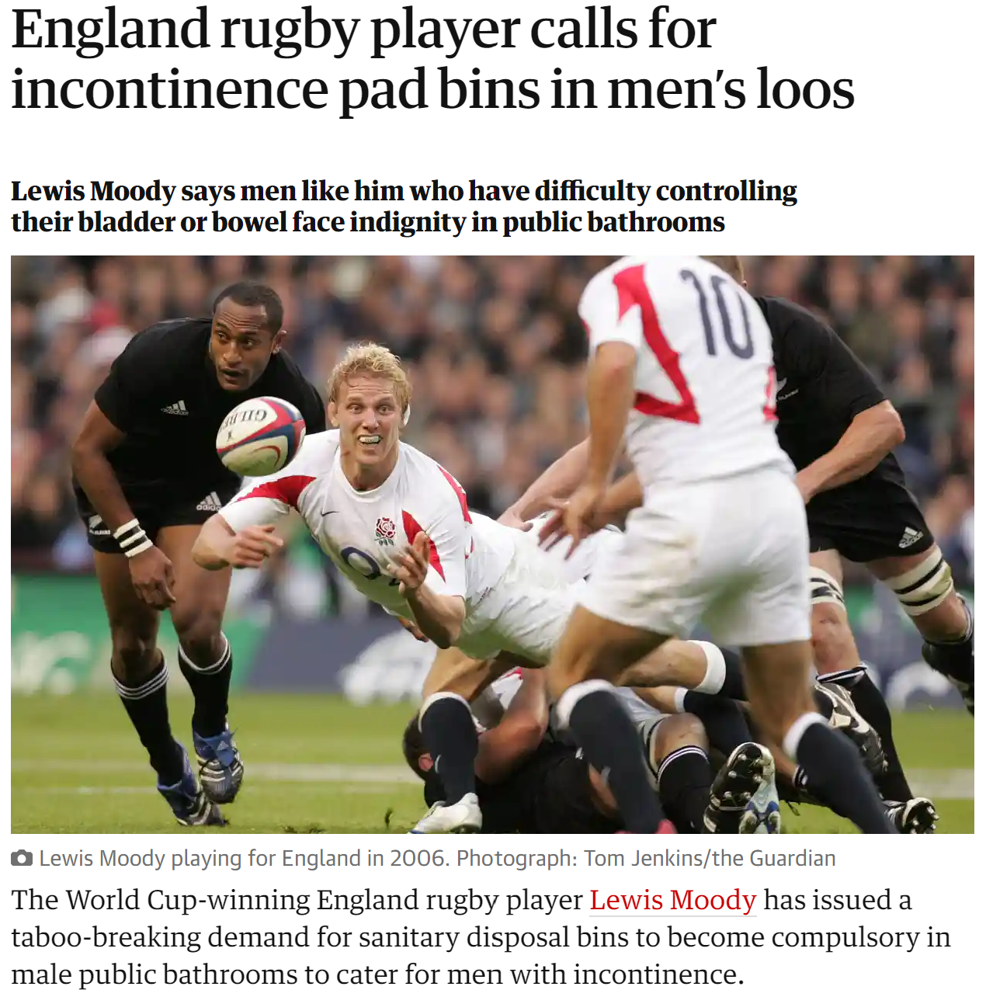
Source - England rugby player calls for incontinence pad bins in men’s loos | Men's health | The Guardian
Notes:
There is a growing public movement to bring male sanitary needs out of the darkness, with a huge working population within the UK demolition and construction industries there is no reason why you cannot make these changes to aid your workers and make them feel valued.

Slide 14
Other relevant health issues
In order to be an inclusive employer, other common health issues must also be considered, for example:
Ostomates – people who have a stoma bag to collect bodily waste following surgery for bowel issues such as cancer and Crohns Approx. 170,000 to 200,000 in the UK in 2021, with an estimated 21,000 people undergoing stoma surgery each year so a growing and more common issue. The equates to approx. 1 in 335 people in the UK
Coeliac Disease – 1 in 100 people in the UK are known to suffer from Coeliac disease and it is still vastly under reported. Sufferers can experience increased need to reach a toilet quickly and side effects of the disease can include diarrhoea and vomiting.
Common health issues can be greatly assisted by providing good, clean, accessible welfare with waste disposal bins
Notes:
When we consider welfare in general, it’s also important to think about other relevant health issues such as Coeliac disease or users of stoma bags.
These and similar conditions are more common than many think and good welfare can keep people in work, comfortable, clean and healthy

Slide 15
What you should expect Inspectors and Visiting Officers to do
Consider welfare provision at all construction/demolition inspection visits
Assess the welfare provision early on in the visit to establish the general attitude to compliance on site
Refer to the HSE website (https://www.hse.gov.uk/construction/faq-welfare.htm) for details of types and standards of welfare facilities expected and take appropriate enforcement action to secure compliance where on-site standards are poor
Apply the standard in the new OG on all sites
Enforce where required, applying the EMM and the standards in the OG
Notes:
It is important that HSE is consistent in its approach to welfare on sites and so it is vital that welfare is assessed on every visit. As we said earlier, it is a fundamental part of any site, it should be one of the first things established and the last thing to leave site.
With all HSE inspections or site visits, a progressive approach is needed to maintain their own safety, this usually includes asking about an asbestos survey or any structural issues etc but welfare should also be amongst the first topics asked about. If a site has poor or no welfare then it is likely that there will be other issues on site which require our time and attention.
If there is any doubt over the standards encountered, we will refer to the new OG and the published standards on our website, the emm or enforcement management model will be used to support the enforcement decision.
We do urge all of our field staff to refresh or familiarise themselves with the welfare guidance and apply it to raise standards throughout the industry

Slide 16
Enforcement
Unless local factors point to a different outcome, then where toilets, hand basins, drying room, etc. have not been provided or are inadequate, the Enforcement Management Model (EMM) enforcement expectations are to:
Issue an Improvement Notice (IN) to secure compliance (a Prohibition Notice (PN) is generally not appropriate unless imminent health risks are present);
Consider prosecution for repeated offences (prosecution as a first offence for welfare breaches may be appropriate depending on the level of breach).
It is anticipated that enforcement in welfare matters should increase now there is clearer information on the standards expected
Notes:
We will not hesitate to enforce on welfare issues where necessary. We often face the argument that there are more important things to worry about and no-one has ever died from a grotty toilet but why should demolition workers have to endure poor conditions while at work? Why are they often treated as being less worthy?
We can argue that workers who cannot rest in warm and dry conditions, or prepare food etc could have their performance reduced and thus be at greater risk of accidents. Good welfare has significant knock on effects on the general well being of the workforce and in turn, their ability to function safely.
Where standards on site fall below the required level, the EMM states that an Improvement Notice would be appropriate and so we should be serving notices wherever this happens. With the increase in mobile welfare vans and trailers, there is no reasonable excuse for not having good welfare available on any site.

Slide 17
Enforcement continued..
For larger clients tracking back is appropriate where problems are found, for example:
no welfare;
only portable toilets on site (e.g. ‘thunderboxes’);
clients not making space or funds for welfare available.
Welfare is effectively a shared responsibility with clients having a legal duty to ensure it is provided and the users ensuring it is present and in good order
This may result in further enforcement action being taken.
Notes:
We often think that welfare is the responsibility of the user, this is not really the case. Any large project must have welfare planned and managed from everyone from client to sub contractor.
Where there is a issue with welfare on large projects, HSE will track back up the management chain to the client to determine where the failing has occurred and enforce at that point.

Slide 18
How can you help?
Trade bodies, contractors and working groups are vital in this drive to improve standards
By setting good standards on every job, you will reinforce the message that welfare is an important part of any safe & compliant site
Users will be ‘encouraged’ by HSE to improve their provision and demand will drive change, are your supply chain and hire companies ready for it?
By providing welfare with male and female facilities and sanitary bins for both men and women, you will remove barriers and help create a more diverse and inclusive workforce, as well as helping ease the stigma of health issues
Notes:
HSE will drive change at site level (and above) by persuasion where possible and enforcement where necessary, the NWHSG can greatly assist by using the welfare OG to develop its own internal guidance and standards for all members to adhere to. This assistance can also include applying pressure to suppliers to ensure the correct standard of kit is available.
By creating internal standards for members, NWHSG can raise standards and do away with poor quality facilities, for example, hopefully this will mean the gradual death of the cold water portaloo as HSE will enforce where these are found as warm water is a non-negotiable basic on a construction site.
As a very rough average, a simple site visit where a welfare breach is found will result in a fee for intervention of around £700 – 800, wouldn’t this be far better spent on warm water, a sanitary bin and a decent sized sink?

Slide 19
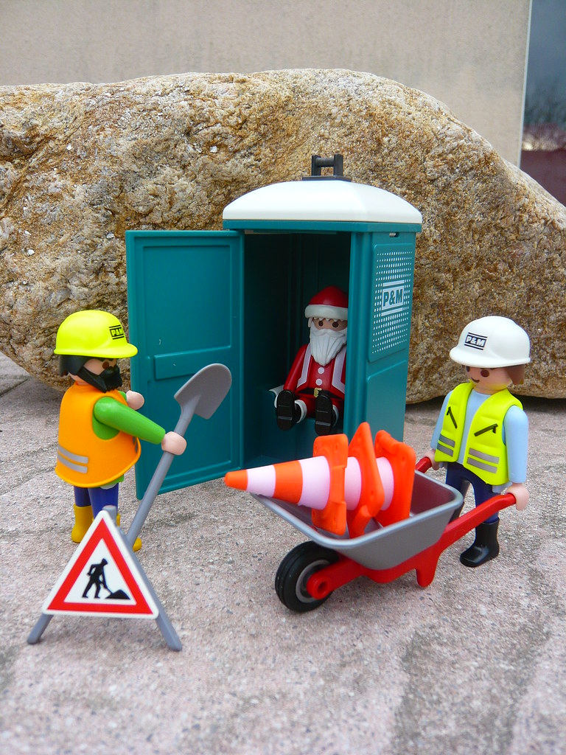
Thanks for your attention
Summary
Welfare is a vital part of site health and safety
The new guidance merely supports existing legislation and makes interpretation easier for enforcing body and contractors alike
Good welfare is a shared duty from client to end user
Remember, your welfare reflects your business both to site staff and visitors, no matter how infrequent
Good and compliant welfare should be child’s play, but we still have a reasonable way to go in embedding it as a core part of any construction or demolition project, large or small
Notes:
To sum up, the new welfare OG gives a series of detailed parameters that we, as the enforcing body, can measure any dutyholder against. Similarly, any dutyholder can access this information and determine whether they are in compliance or not.
It is not a rewriting of the rules, although there are some minor improvements, but more of a formal interpretation of CDM Schedule 2 which should remove some of the debates on site.
Our key take away message is that welfare is a very important barometer for the rest of the project, it should be in place first, maintained well and be the last thing off site. In the 21st century we should expect decent facilities for everyone to use. To answer my opening question, good welfare should be childs play if planned properly from the outset.
Thanks for your time

Slide 20
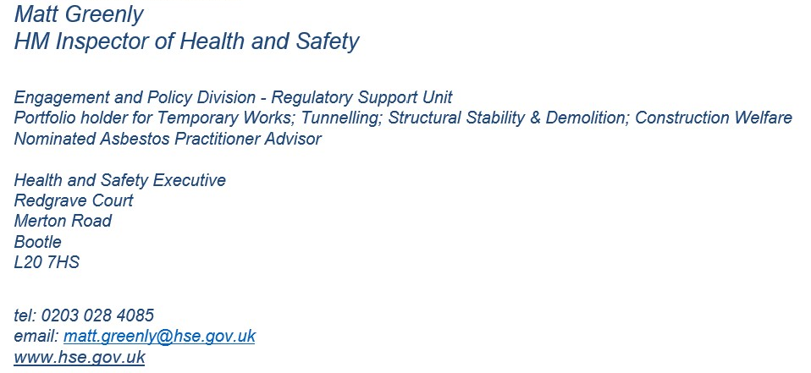
Contact details
Please contact Matt Greenly with any questions or feedback
Your feedback will help us assess the impact of the OG and the presentation

