Slide 1
jon.steele@andysmanclub.co.uk
#ANDYSMANCLUB

Slide 2
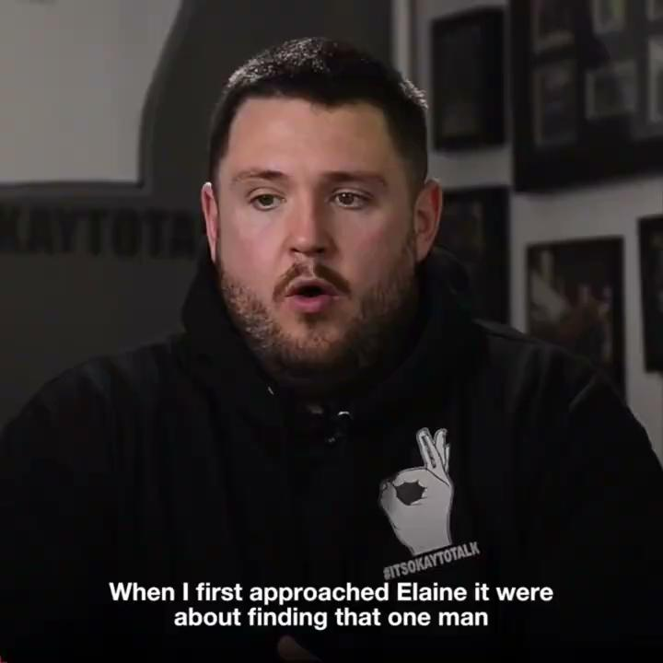

Slide 3
OVER 4900 MEN TAKE THEIR OWN LIVES EVERY YEAR!

Slide 4
THAT’S 12 MEN EVERY DAY…
ONE MAN EVERY
2 HOURS

Slide 5
SUICIDE IS THE BIGGEST KILLER OF MEN UNDER 54

Slide 6
Following Andrews suicide, Luke decided to start a coffee club for men to be able come and talk to other like minded men before emotions got out of control.
On 30th June 2016 the first ANDYSMANCLUB post was put on facebook.
Due to the response, the very first group was held on 4th July 2016.
9 men attended and
ANDYSMANCLUB was born.

Slide 7
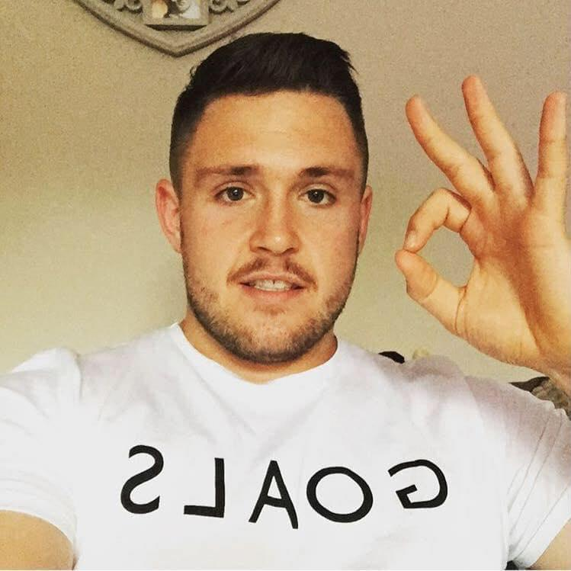
2 weeks after that first session Luke came up with the #ITSOKAYTOTALK campaign.
It has been recognised as the biggest mental health campaign on the planet with over 100 million taking part.
Including Hollywood stars, and professional sports persons.
Here’s just a few of the photos we have.

Slide 8
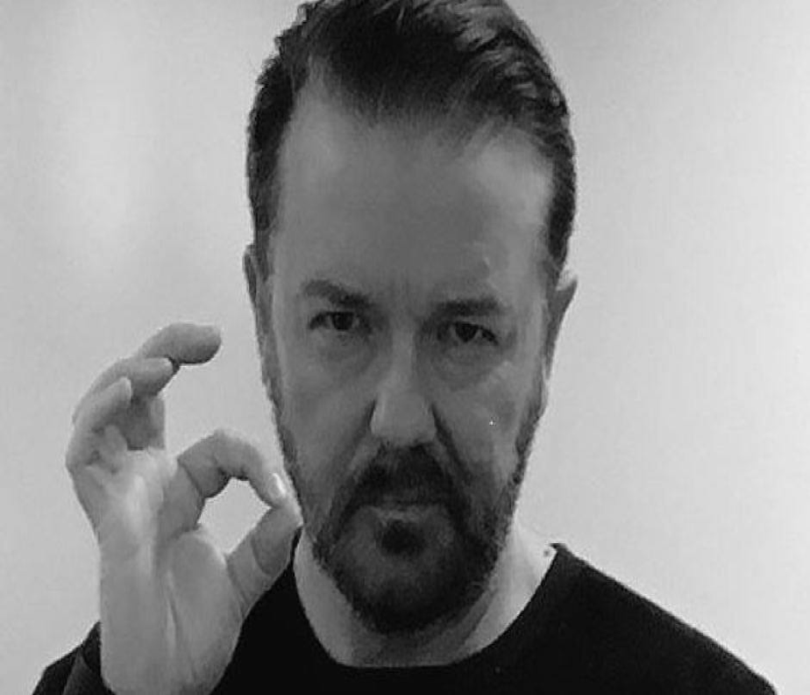

Slide 9
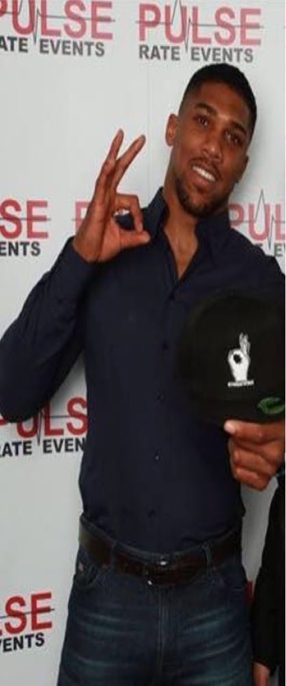
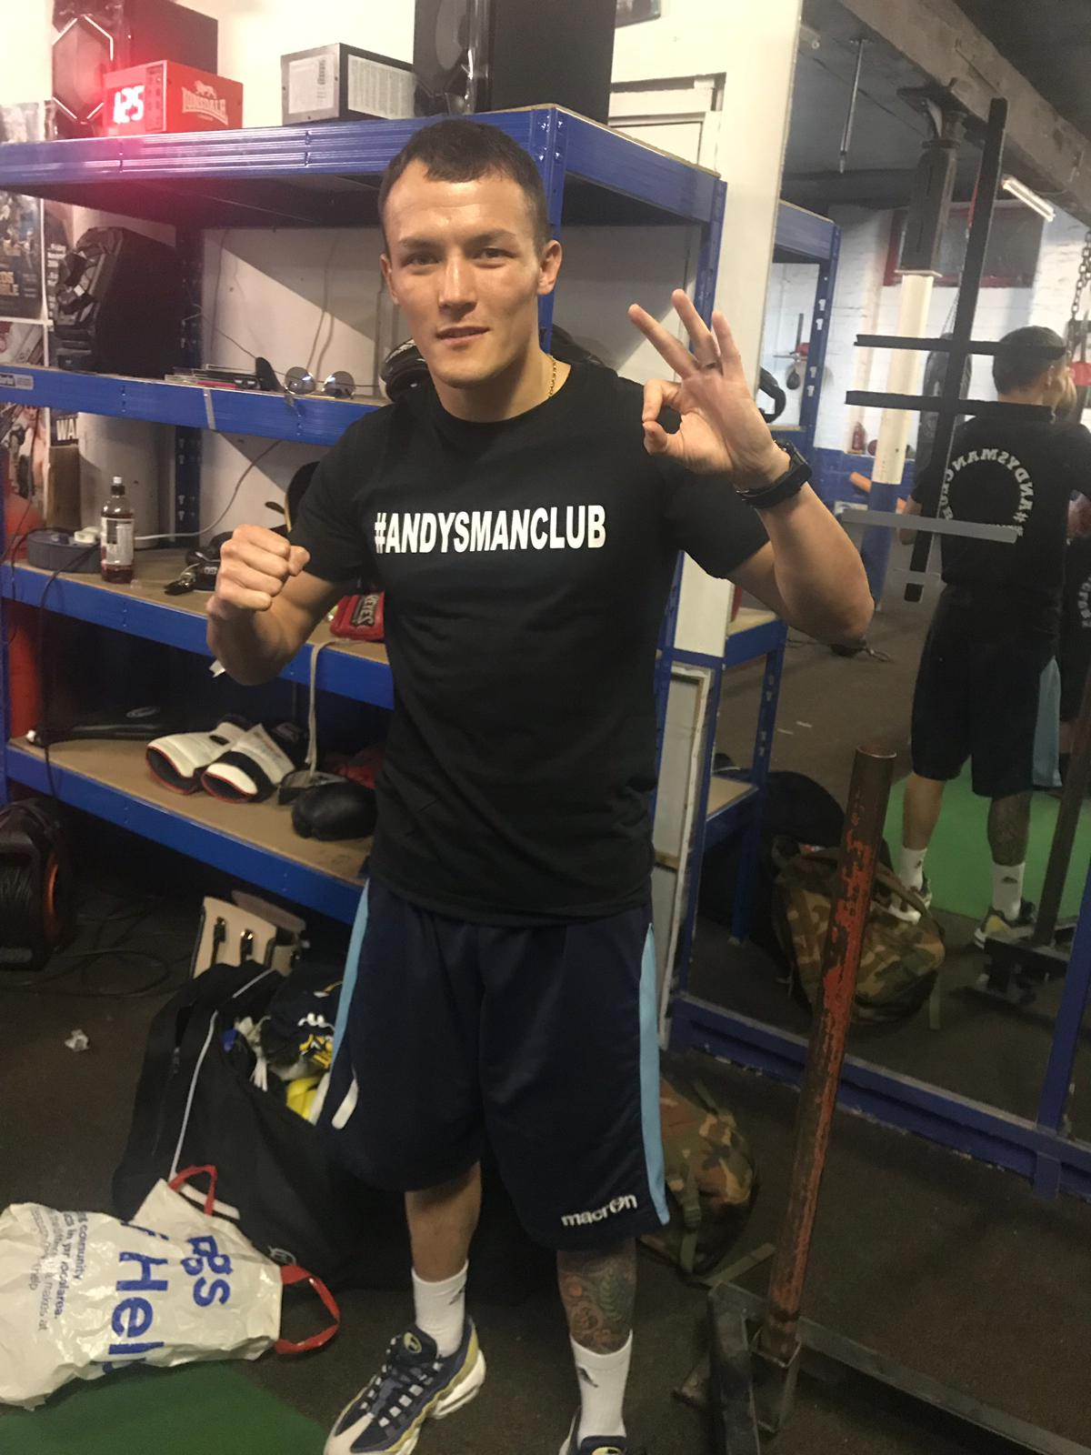
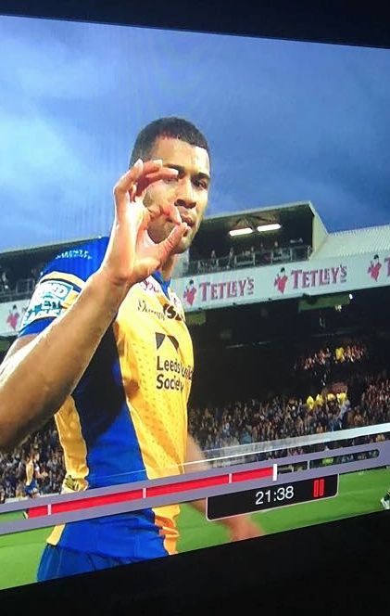

Slide 10
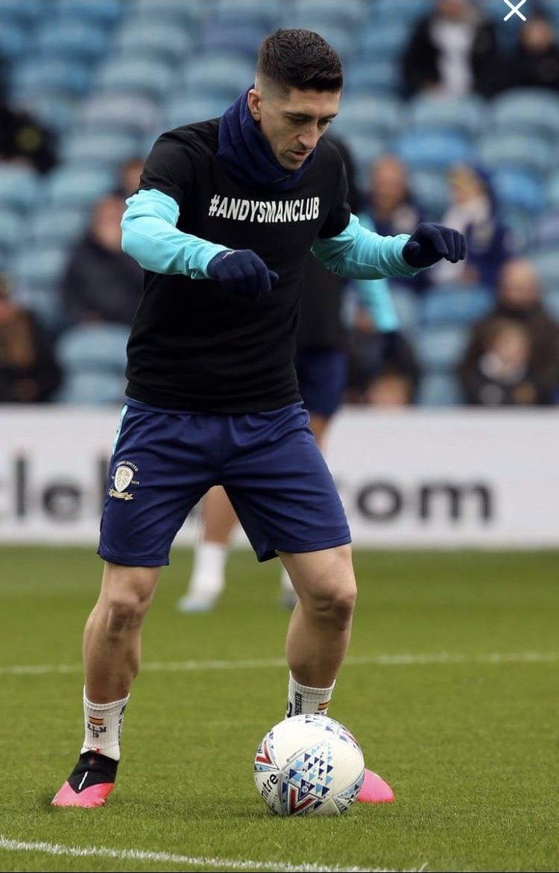

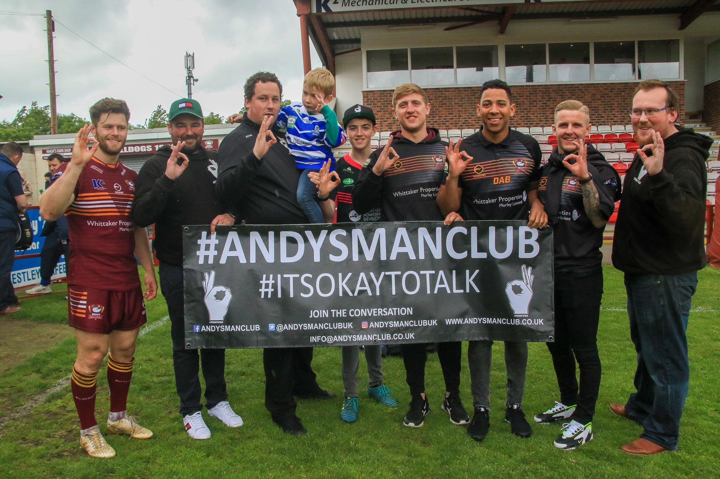
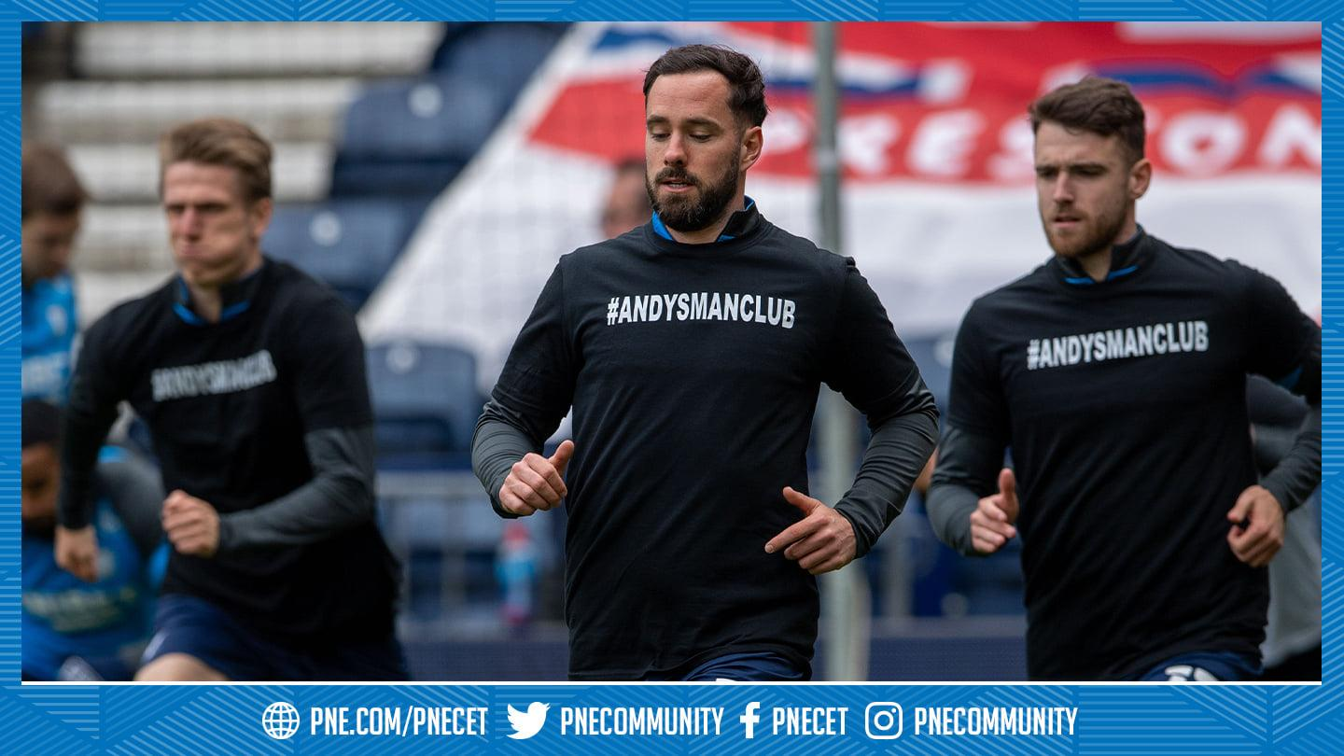
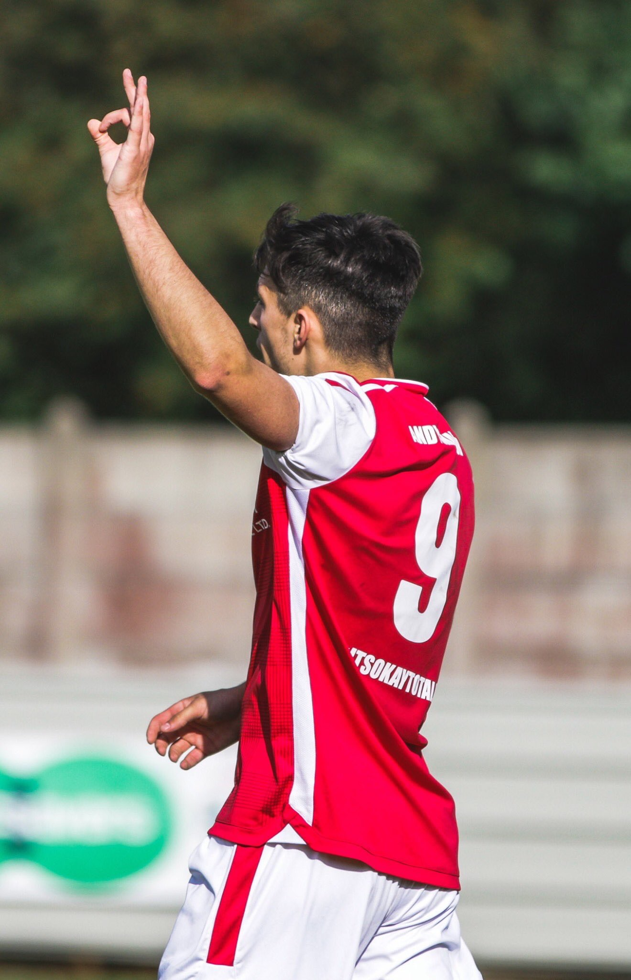
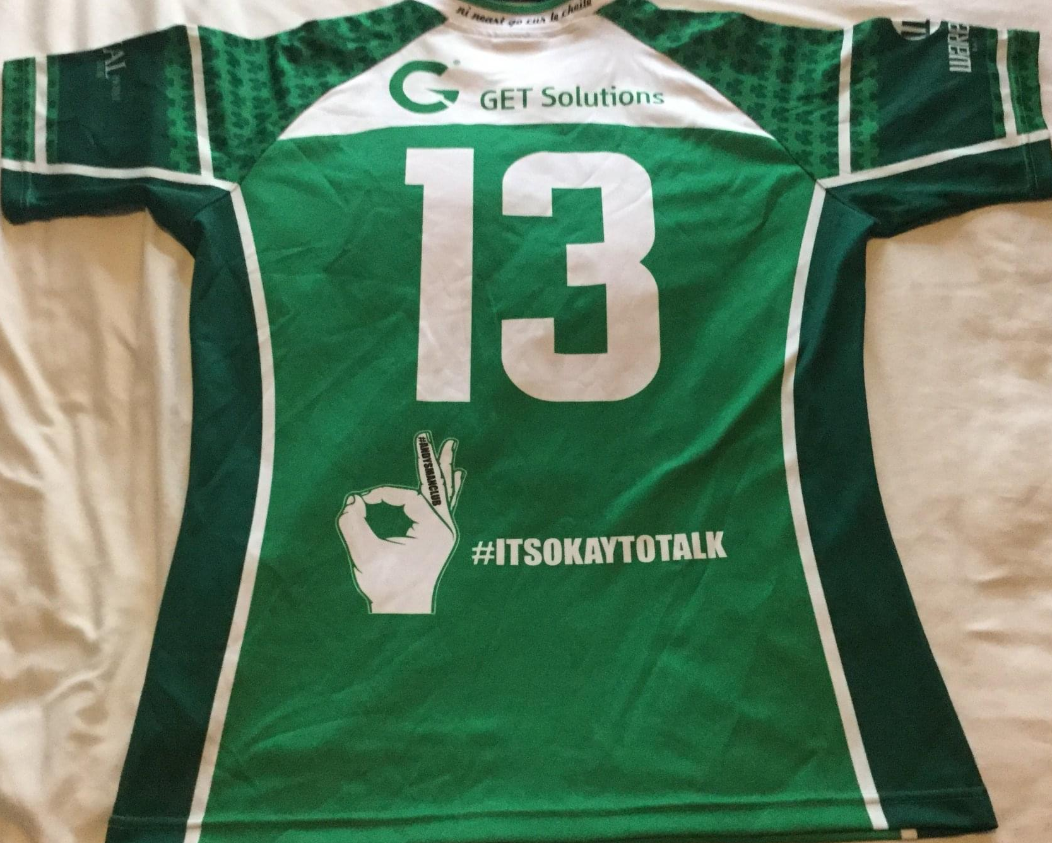
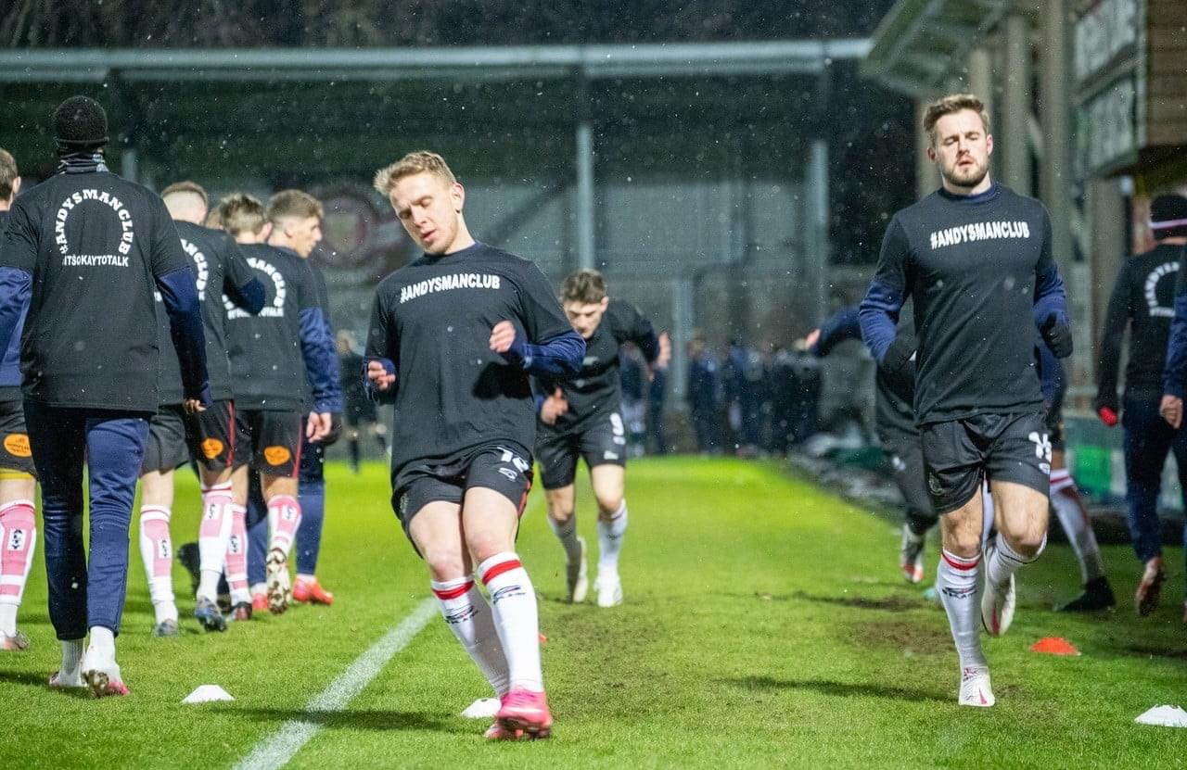
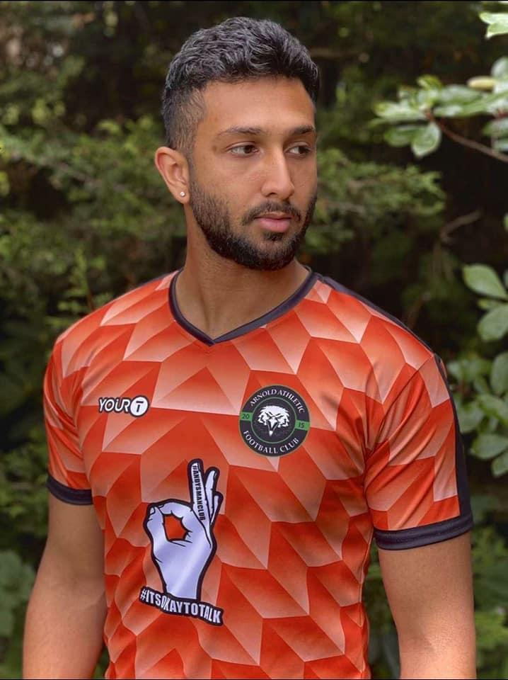
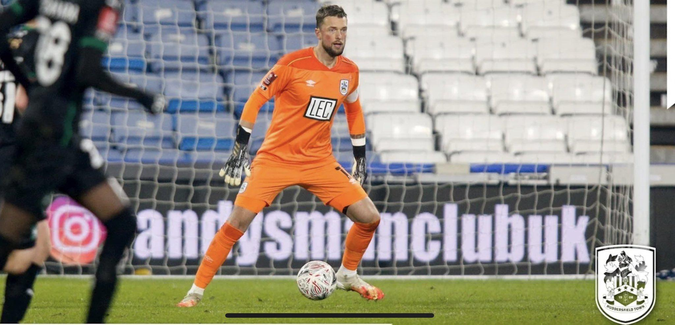
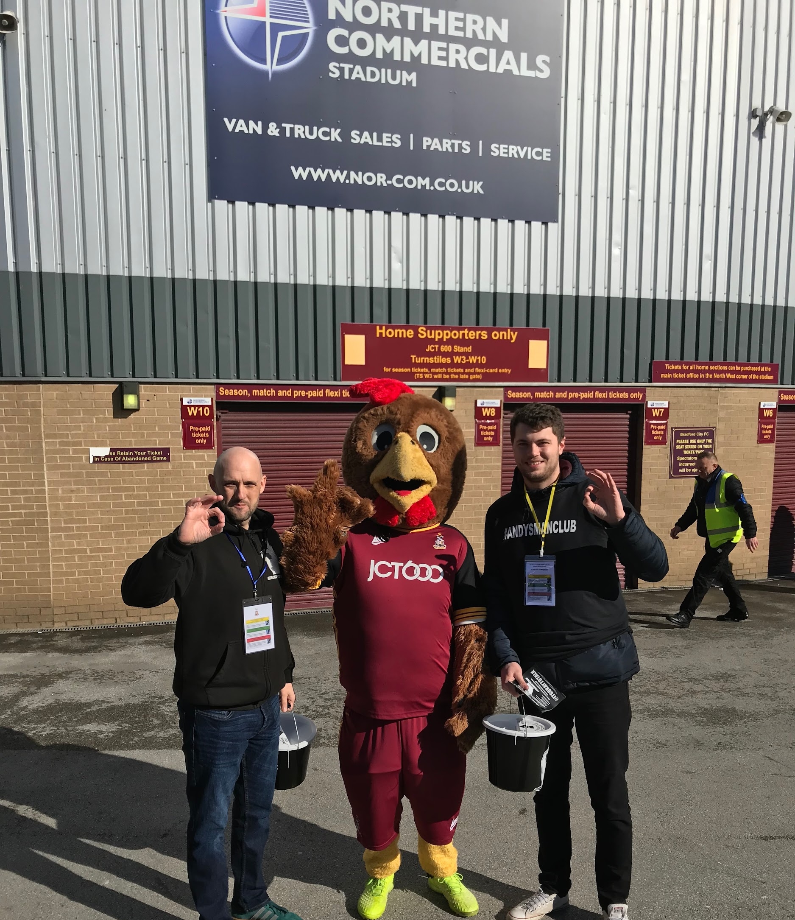
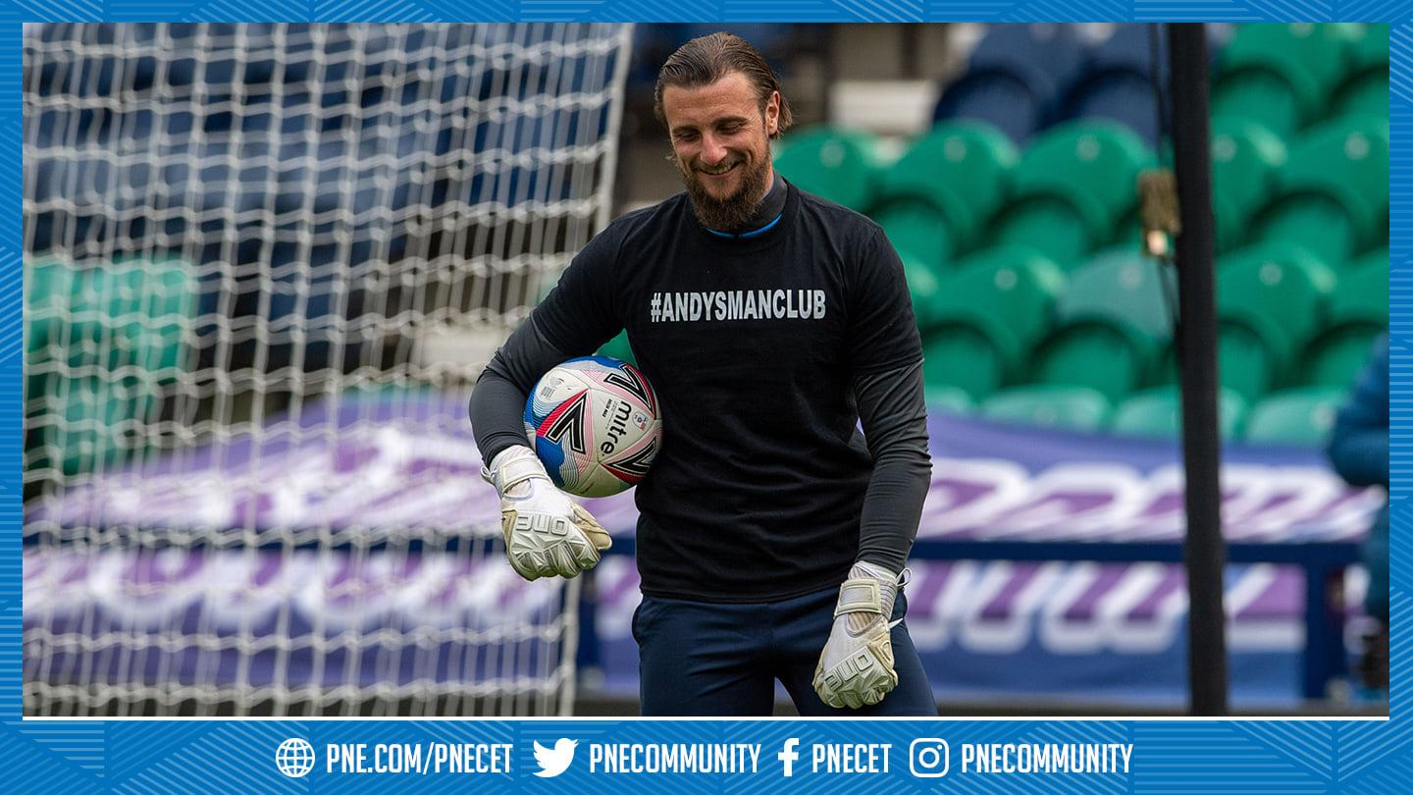

Slide 11
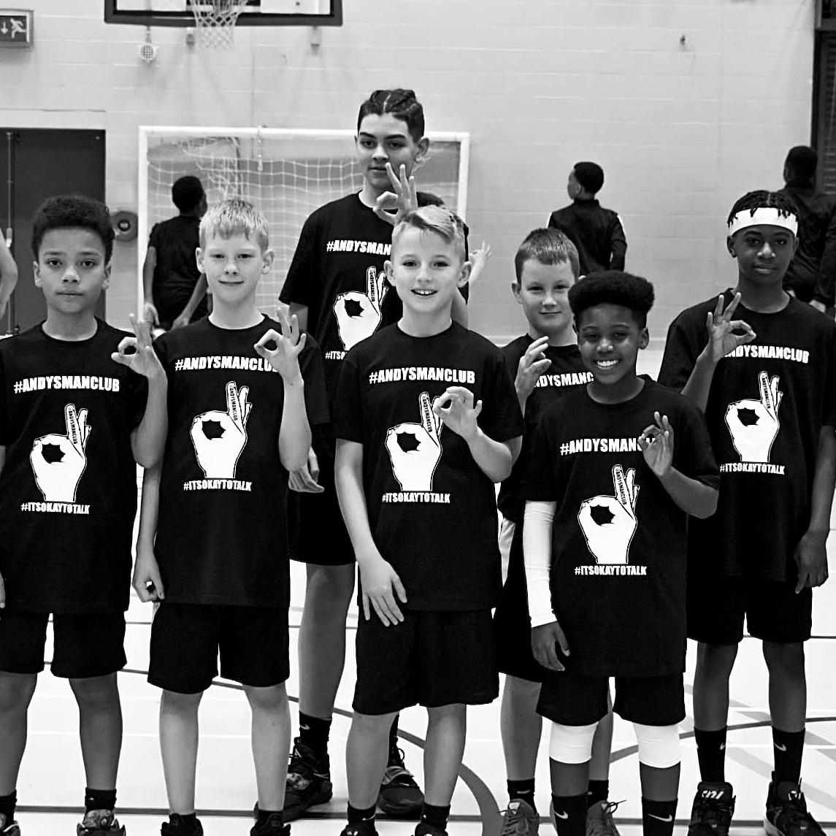
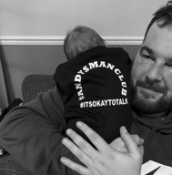
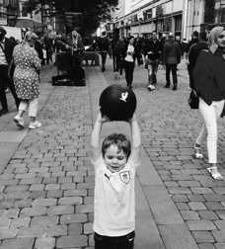
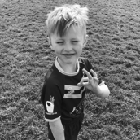
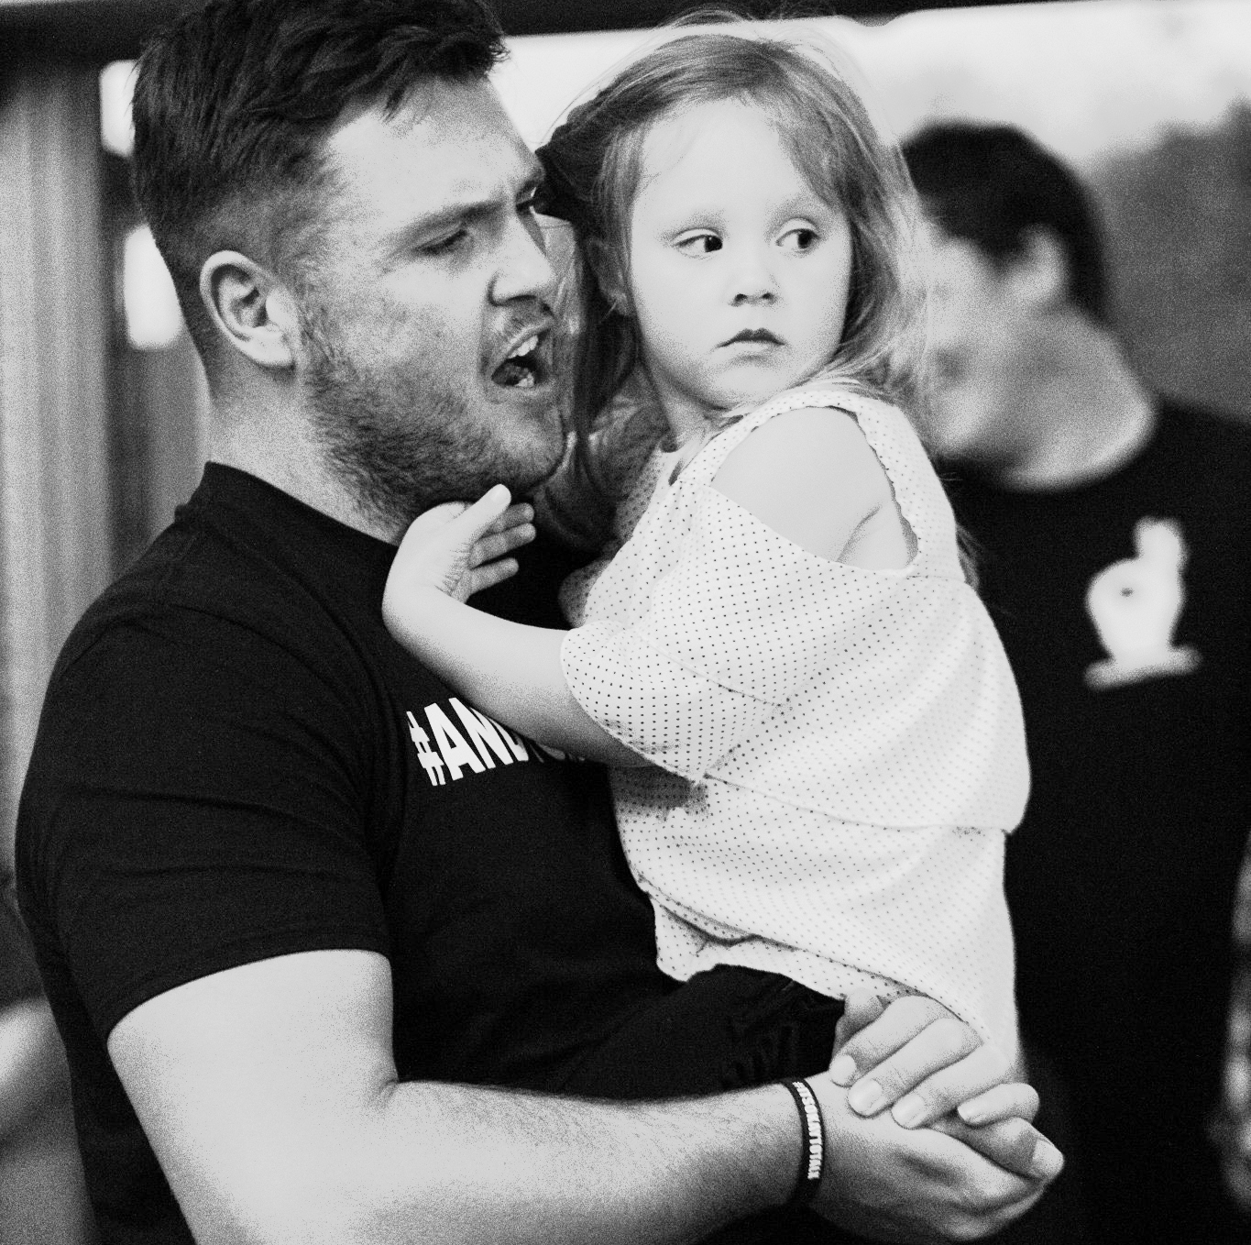
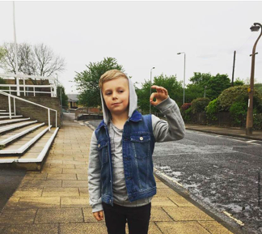
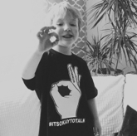
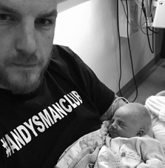

Slide 12
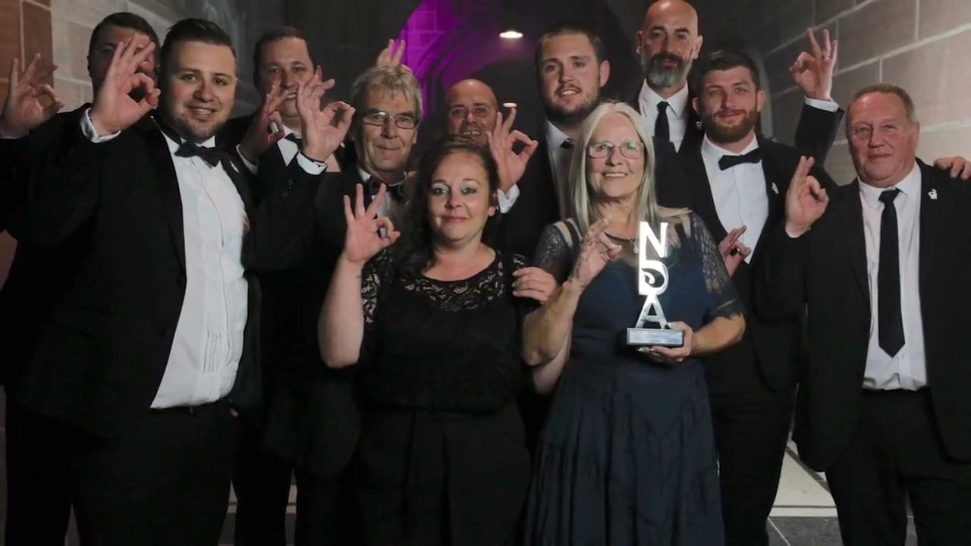

Slide 13
200+ COMMUNITY GROUPS ACROSS ENGLAND, SCOTLAND & WALES

Slide 14
OPEN TO ANY MAN OVER 18 WANTING TO TALK TO OTHER LIKE MINDED MEN

Slide 15
EVERY MONDAY 7PM
(EXCEPT BANK HOLIDAYS)

Slide 16
NO BOOKINGS,
NO CHARGES,
NO REFERRAL NECESSARY.

Slide 17
OVER 4900 MEN USE OUR GROUPS EVERY WEEK!

Slide 18
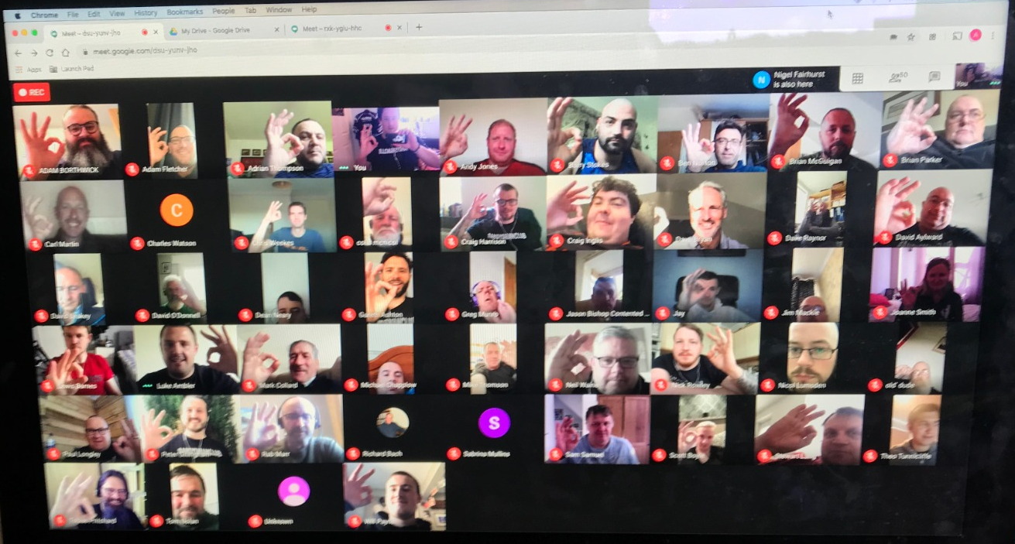
ONLINE GROUPS AVAILABLE
We are also running sessions weekly online
Around 100 men attending on a weekly basis
Also available to those living too far away from physical meets
For details on how to join email info@andysmanclub.co.uk

Slide 19
WHAT TO EXPECT AT AMC?

Slide 20
I AM
#THATONEMAN

Slide 21
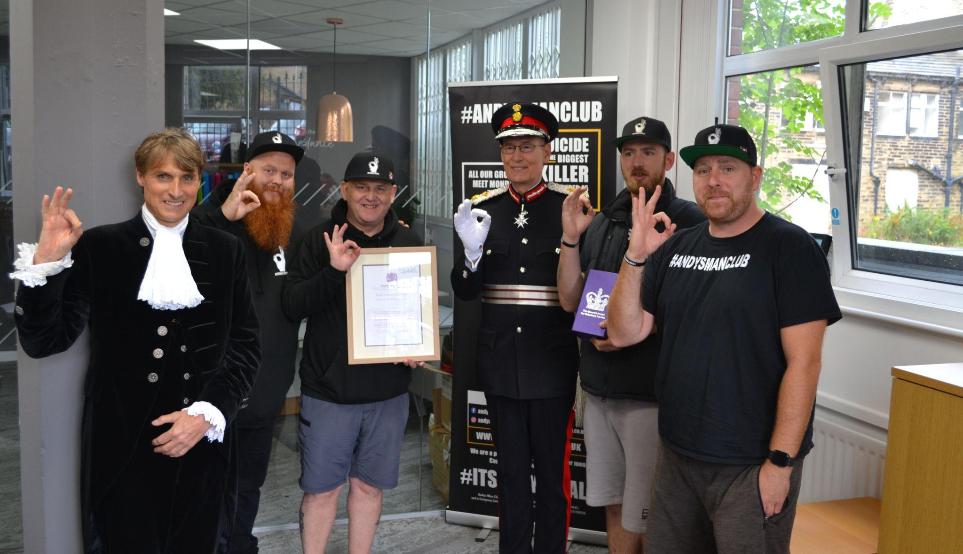
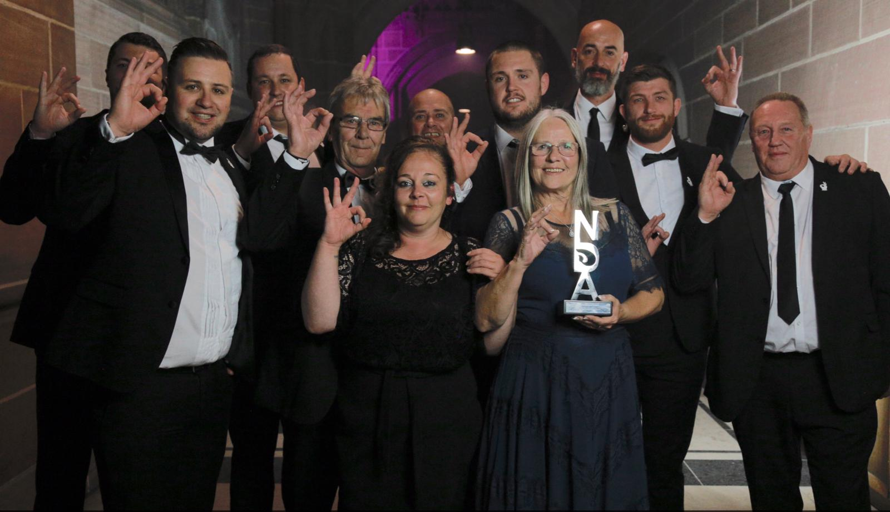
THE BEST AWARD IS, AND ALWAYS WILL BE, WHEN #THATONEMAN WALKS THROUGH THAT DOOR!

Slide 22
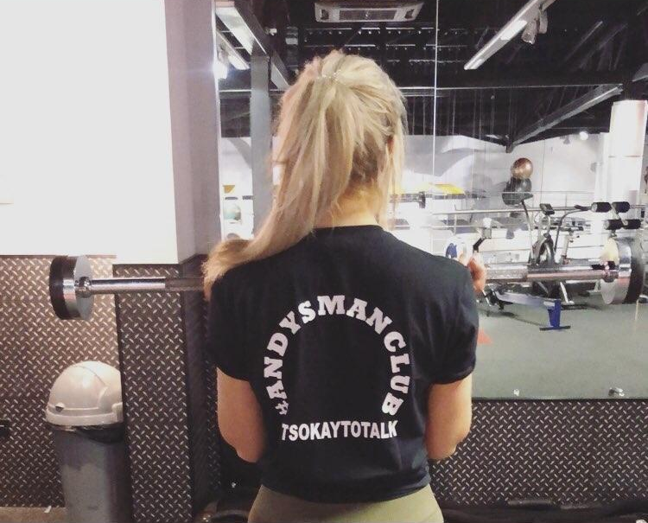
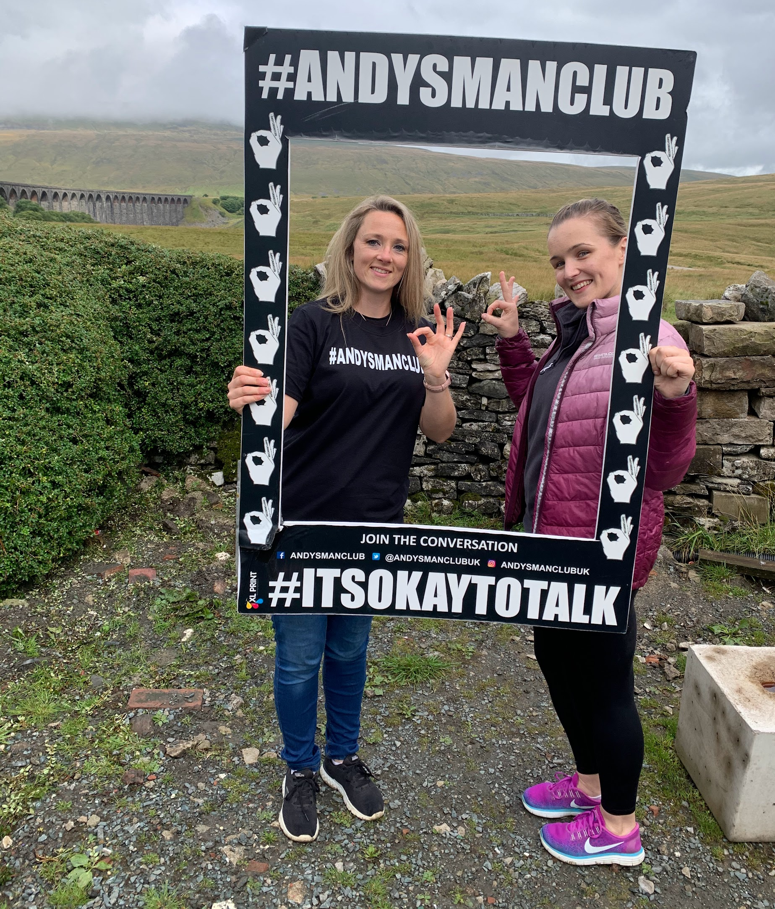
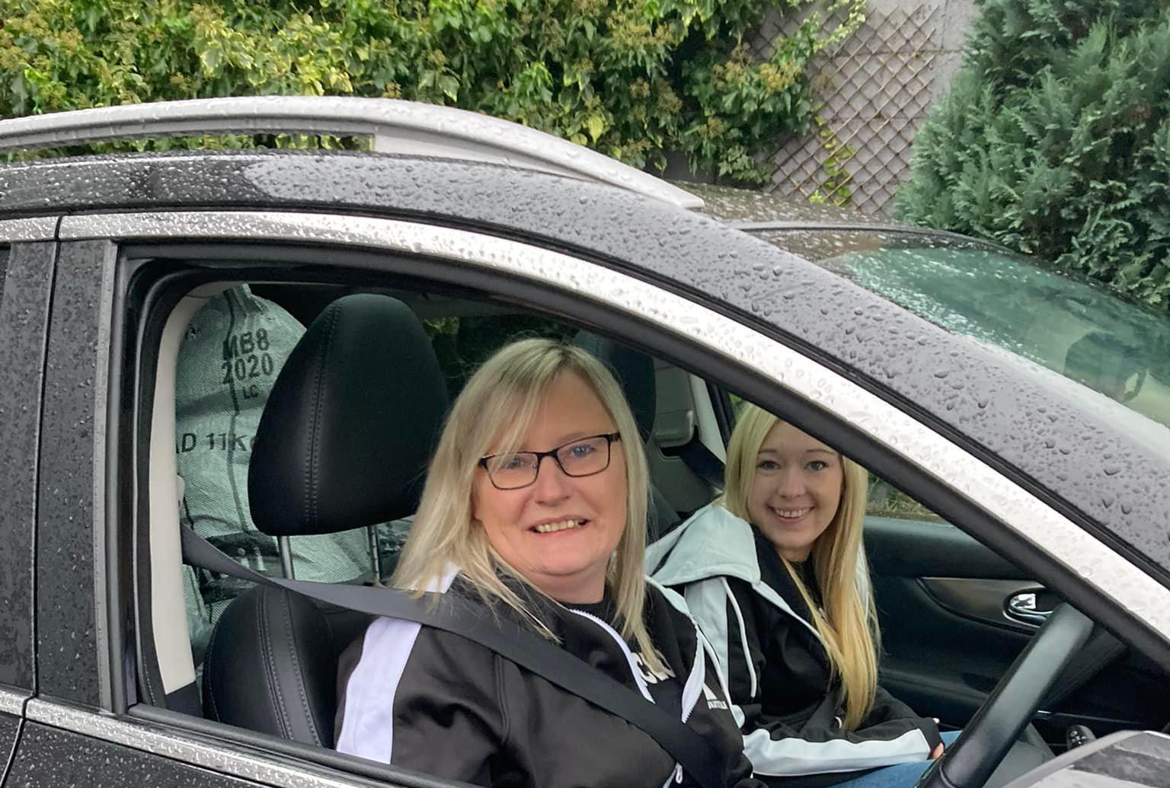
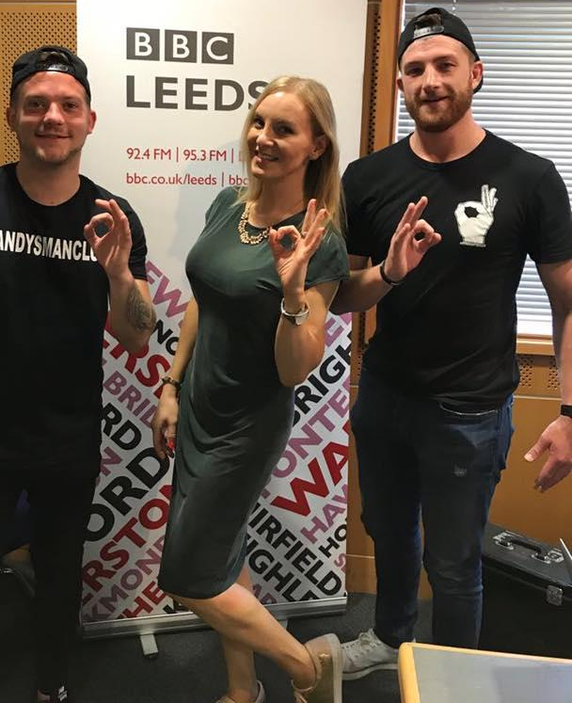
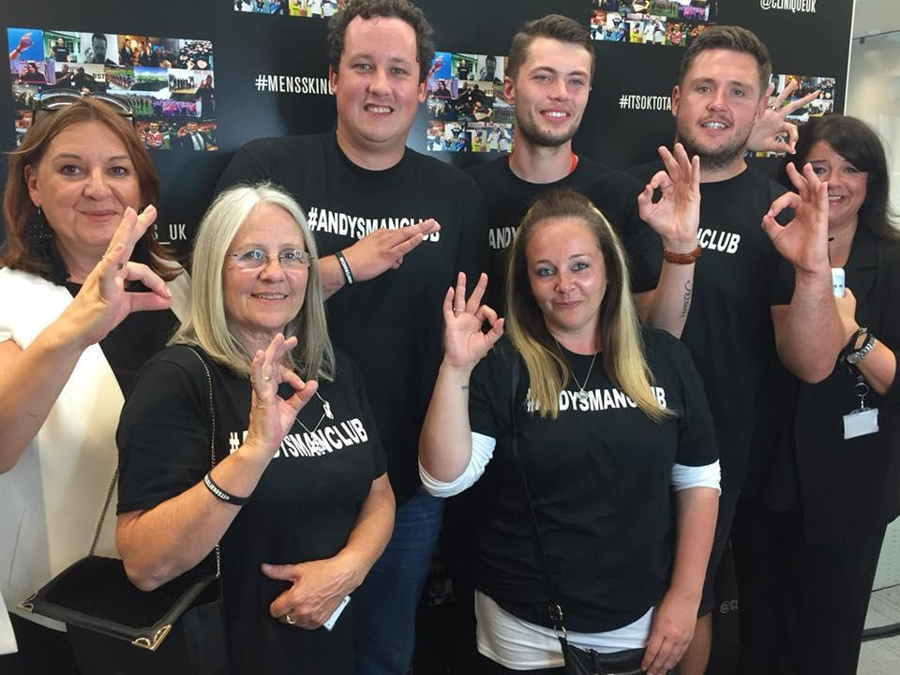
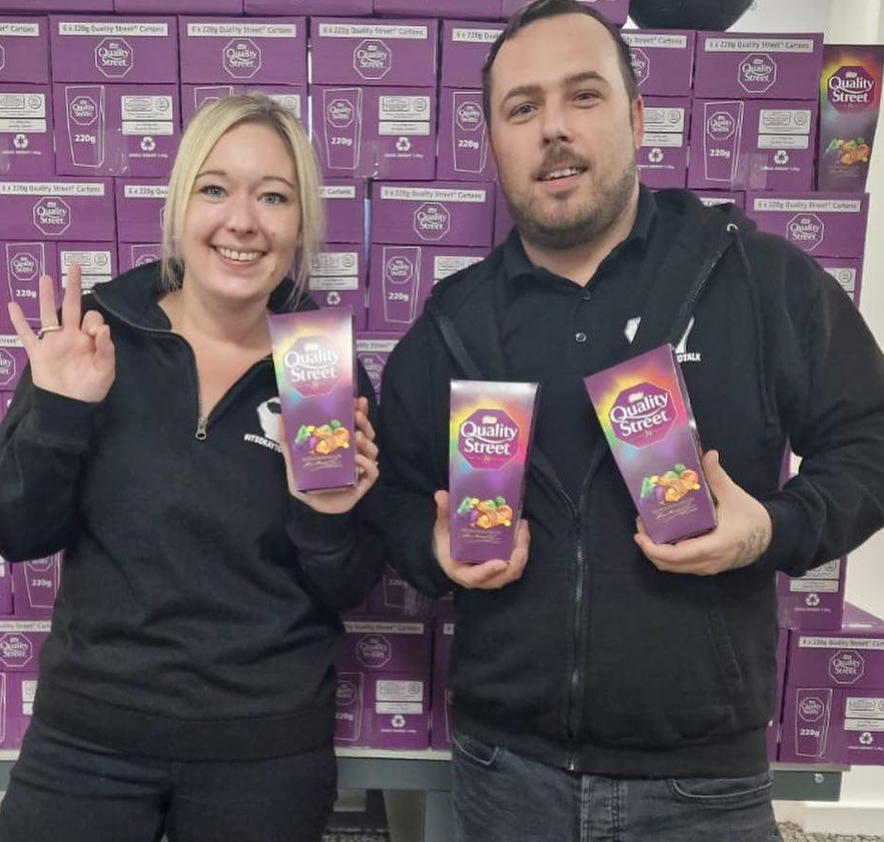
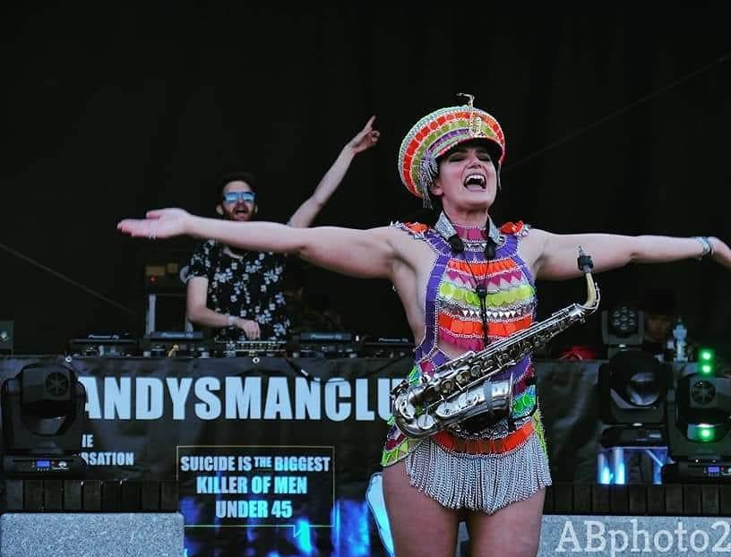

Slide 23
