Slide 1
Environmental update
Herefordshire H&S Group
Craig Wood MIEMA CEnv
20 March 2024

Slide 2
Environmental update
Global megatrends and the Environmental Improvement Plan
2023 regulatory changes
MCPs and Specified Generators
Horizon scanning: UK CBAM
Horizon scanning: UK ETS (Energy from Waste)
Horizon scanning: Persistent Organic Pollutants & PFAS
Upcoming changes to waste regulations

Slide 3
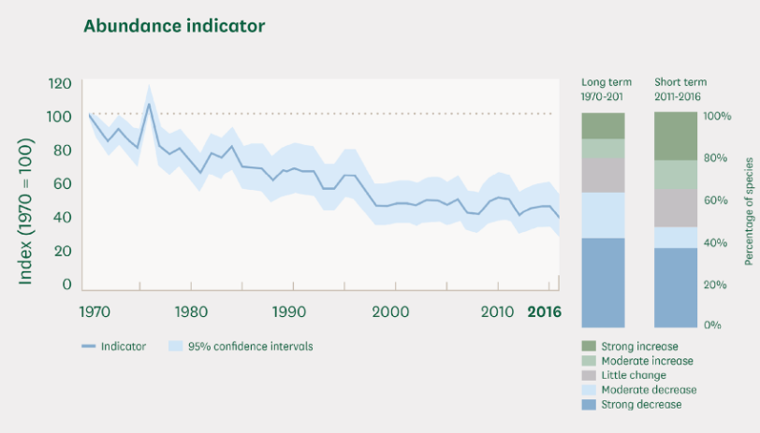
Global megatrends
Growing population
Increasing consumer demand
Increased water use
Increased fossil fuel emissions
Deforestation
Biodiversity loss
Climate change
UK regs based on global agreements and local actions
Notes:
Growing population
Global increase from 4 billion in 1974 to 8 billion in 2024. Expected to level off around 10 billion in 2050s
Increasing demand and competition for resources
Increasing use of fossil fuels to power the Asian economies which are becoming wealthier and have increasing environmental footprints
Deforestation
Trees are effective at sequesting carbon dioxide from the atmosphere
Land clearance for agriculture and increasing urbanisation
12% decrease in tree cover between 2001-2022, releasing estimated 195 gigatonnes of CO2 into the atmosphere.
Biodiversity loss
UK - 68% decrease in animal populations since 1970. Loss of habitats. Nutrient loading in watercourses disrupting natural food chains. Pesticides.
1 million animal and plant species threatened with extinction
UK worst in G7 for biodiversity
Climate change
Atmospheric carbon dioxide has increased by 50% since the Industrial Revolution and global temperature averages are rising, leading to habitat loss, more frequent extreme weather events, and increased global migration. Risk of leaving safe space if we do not keep these to 1.5 degrees, but there is increasing evidence we will fail to achieve this. UK committed to reducing emissions by 68% by 2030 compared to 1990 levels, and to delivering Net Zero carbon emissions by 2050.

Slide 4
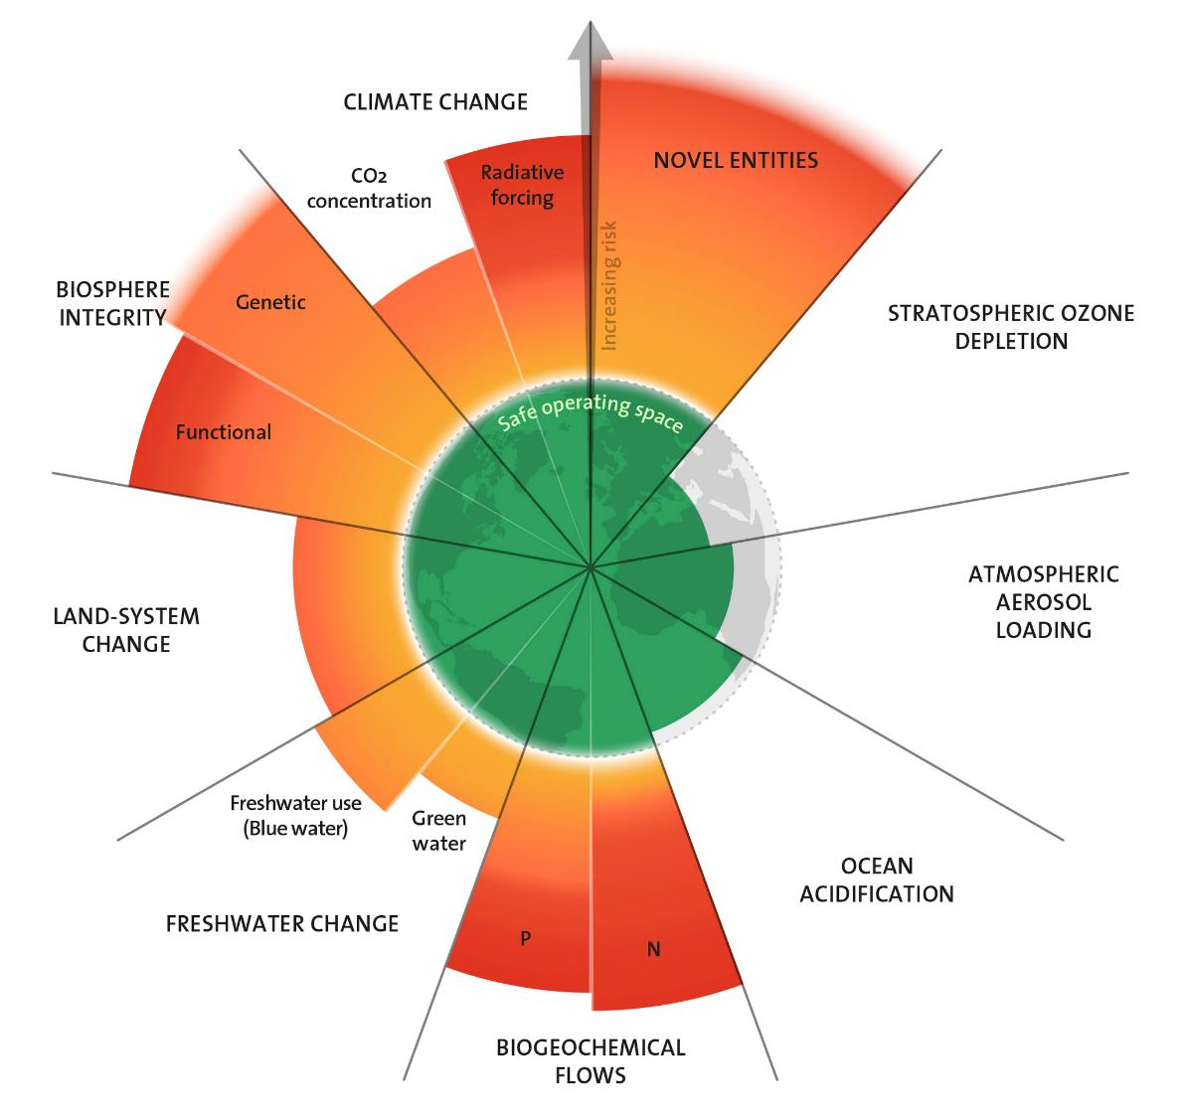
Planetary limits
6 of 9 indicators of planetary stability have been crossed in 2023
Global actions necessary to return the environment to a sustainable condition
Notes:
The Stockholm Research Centre Planetary Boundaries model
First in 2009

Slide 5
2023 changes (1)
Environmental Improvement Plan (EIP 23) published
Extended Producer Responsibility (EPR) for packaging
Plastic Packaging Tax (PPT)
SuDs for all new developments in England
Biodiversity Net Gain (BNG)
RPS 250 (waste wood) withdrawn

Slide 6
2023 changes (2)
Civil sanctions for environmental permitting offences
New air quality regulations
Consignor-only organisations and ADR
Food and drink waste hierarchy: new statutory guidance
Climate change adaptation in management systems
ESOS Phase 3
Single use plastics

Slide 7
Environmental Improvement Plan (EIP 23) (England only)
Nature
Create/restore >500,000 ha of new wildlife habitats by 2042
Species Survival Fund to protect rare species prior to 2030
Schemes to incentivize 65-80% of landowners/farmers to adopt nature friendly farming practices on 10-15% of their land by 2030
Support farmers to create/restore 30,000 miles of hedgerow by 2037, 45,000 miles by 2050

Slide 8
Environmental Improvement Plan (EIP 23) (England only)
Water
Tackle water supply leaks and roadmap to improve household water efficiency
Restore 400 miles of river through Landscape Recovery Projects
Establish 3,000 ha of new woodland along rivers
Reform of regulatory framework for catchment protection

Slide 9
Environmental Improvement Plan (EIP 23) (England only)
Air
Challenge councils to improve air quality via existing powers
Reduce ammonia emissions by incentivising farmers
Considering extending environmental permitting to dairy and intensive beef farms

Slide 10
Environmental Improvement Plan (EIP 23) (England only)
Waste
Eliminate avoidable waste by 2050
Explore banning biodegradable waste from landfill by 2028
Eliminate avoidable plastic waste by 2042
Halve residual (black bag) waste per person by 2042

Slide 11
Extended Producer Responsibility (Packaging)
Introduced 1 January 2023
Six-monthly EPR reporting will replace annual packaging waste returns for businesses
Large packaging producers: >£2m T/O & 50 tpa packaging
Small packaging producers: >£1m T/O & 25 tpa packaging
Parallel reporting in 2023
New EPR fees to be introduced from 2025 for household packaging waste producers
“Brand owners” to pick up 100% of fee obligation
Now to include online marketplaces

Slide 12
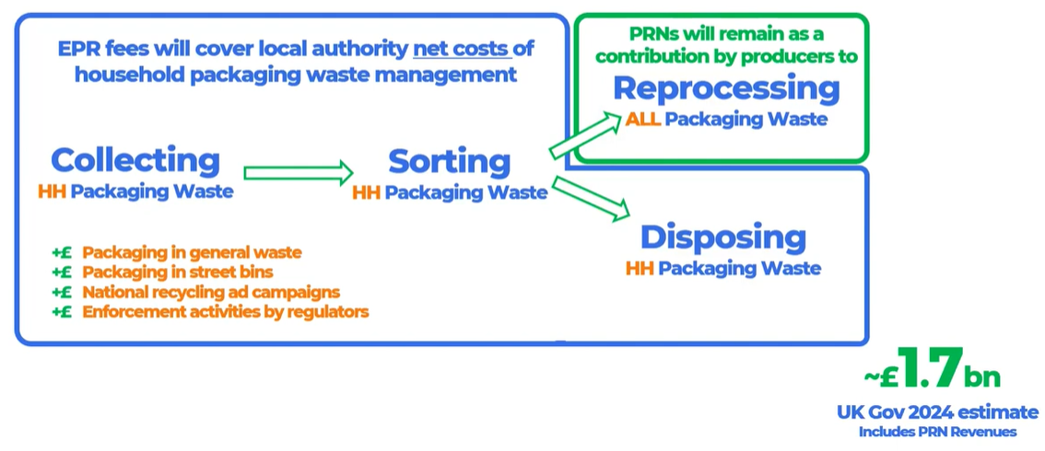
Extended Producer Responsibility (Packaging)
Government to recover “full net cost” of packaging waste from industry from 2025
PRNs and PERNs are not recovering sufficient revenue to fund the recycling and collection of packaging waste
PRNs raised:
2022: £489m
2021: £139m

Slide 13
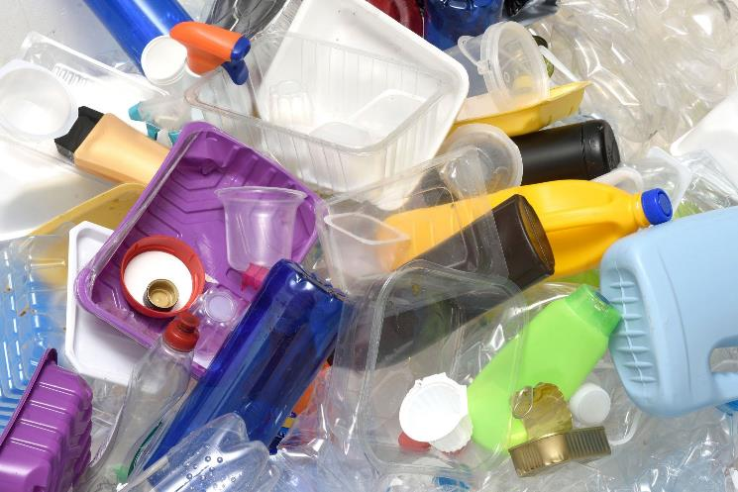
Plastic Packaging Tax
Increased from £200 to £210.82 on 1 April 2023
Increasing to £217.85 per tonne on 1 April 2024 (CPI increase)
Payable by businesses who manufacture or import >10 tonnes of plastic packaging with less than 30% recycled content into the UK.

Slide 14
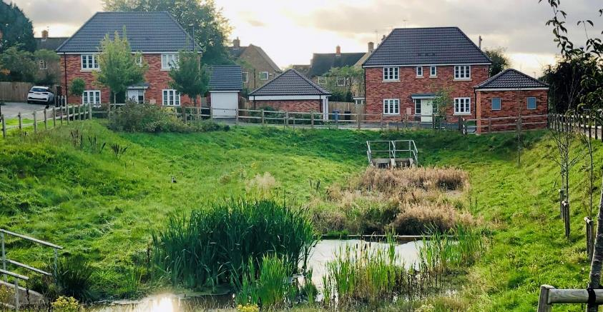
SuDs for all new developments in England
Sustainable urban drainage systems
Reduces risk of surface water flooding and pollution resulting from new developments
Councils must approve new SuDs prior to commencement against new national standards
Can require developers to lodge a “non-performance bond” to cover costs if the system fails to meet the requirements
Single-property and road developments are exempt
Commenced start of 2024

Slide 15
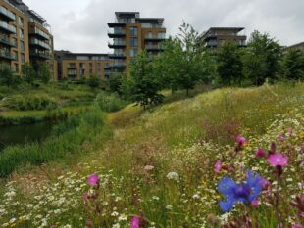
Biodiversity Net Gain (BNG)
Mandatory from 12 February 2024 through the Town & Country Planning Act 1990
All developers must deliver a BNG of 10% through their development
Biodiversity value is measured in standardised biodiversity units. Consult an ecologist to determine the score at your development site
Exemptions for small developments, householders.
Opportunities for land managers to “sell” habitat benefits
Notes:
Developments below the threshold
A development that does not impact a priority habitat and impacts less than:
25 square metres (5m by 5m) of on-site habitat
5 metres of on-site linear habitats such as hedgerows
A development ‘impacts’ a habitat if it decreases the biodiversity value.
Find out more about this exemption.
15,000 hectares of woodlands, heath, grasslands, and wetlands and absorb 650,000 tonnes of carbon each year if the government meets its housing targets

Slide 16
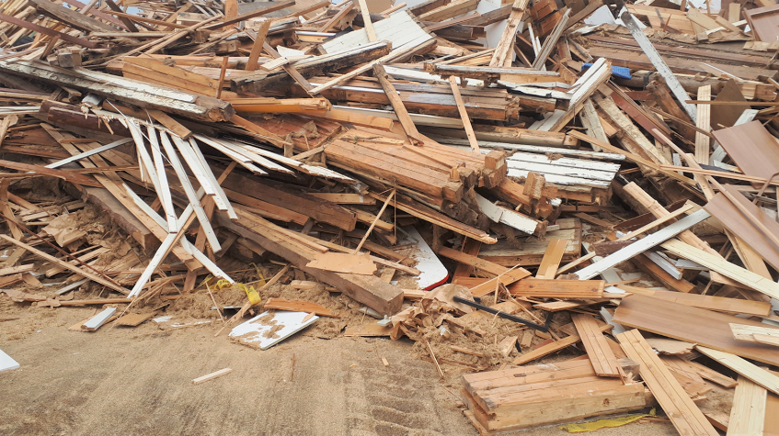
RPS 250 (hazardous waste wood) withdrawn
Waste wood, particularly from construction & demolition involving pre-2007 buildings, can be hazardous waste. RPS 250 allowed this to be managed alongside non-haz wood
RPS 250 withdrawn 1 September 2023
“Amber” items of wood must be classified as hazardous waste unless testing shows it to be non-hazardous
WRA Wood Classification toolkit includes quick guides for affected businesses
Notes:
Amber items of waste wood are from buildings built between 1950 and 2006 and are:
roof timbers
tiling and cladding battens
timber frames and joists
Amber items of waste wood are also from buildings built between 1950 and 1995 and are:
barge boards, fascias and soffits
external timber cladding
external doors
external windows

Slide 17
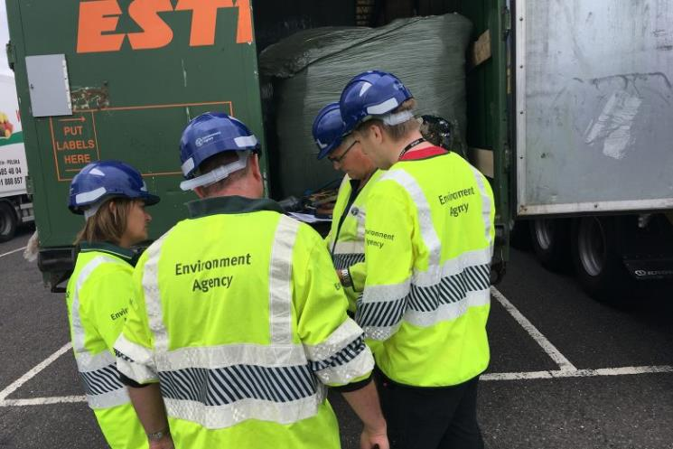
Civil sanctions for environmental permitting offences (England)
Regulators no longer need to take prosecutions to court
Able to issue unlimited monetary penalties for EPR offences from 1 December 2023
Previous £250,000 cap for VMPs has been removed
Most serious cases will continue to be prosecuted
Covers water pollutions and breaches of industrial and waste permits etc.

Slide 18
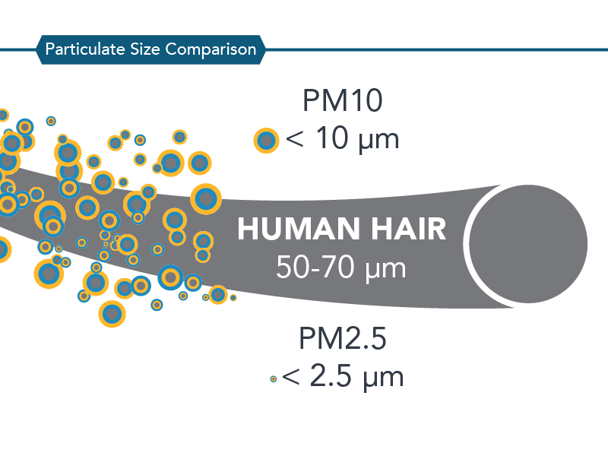
New air quality regulations (England)
The Environmental Targets (Fine Particulate Matter) (England) Regulations 2023
Fine particulate matter (PM_{2.5}) to be below 10 μg/m³ by 2040 (current target 25 μg/m³)
Population exposure to PM_{2.5} to be reduced by 35% by 2040 compared to 2018 levels
Legally binding targets to reduce human health impacts
Adds to existing Air Quality Standards Regs 2010
Notes:
Currently 13.9 microgrammes per cubic metre in urban areas,
17 at the roadside
AQS Regs cover heavy metals like nickel, lead, cadmium and arsenic, organic compounds, oxides of nitrogen and sulphur, and PM10

Slide 19
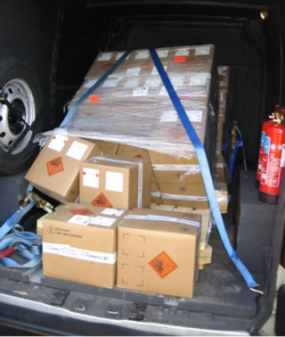
Consignor-only requirements under ADR
Under ADR, a consignor is any enterprise which consigns DGs either on its own behalf, or for a third party.
From 1 January 2023 consignor-only companies have been required to employ a qualified Dangerous Goods Safety Adviser.
Undertakings carrying, packing, loading, filling or unloading DGs continue to need a DGSA, unless exempt

Slide 20
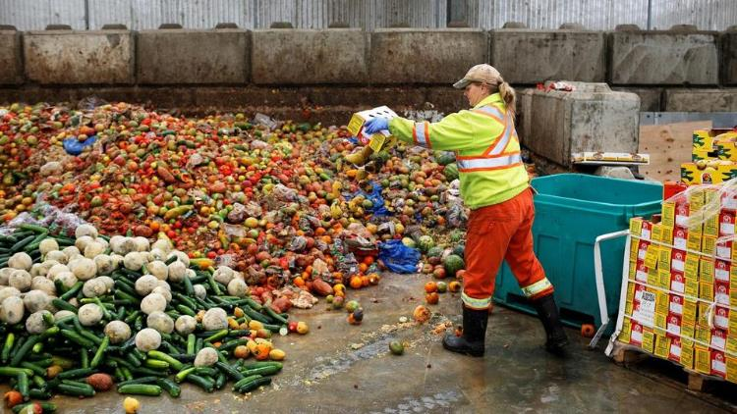
Food & drink waste hierarchy
New statutory guidance
Applies to any organisation which produces, handles, treats, or disposes of surplus or waste food and drink, including:
farmers and producers
manufacturers
retailers
hospitality and food service providers
local authorities
Anaerobic digestion is preferable management option if you can’t reduce or reuse through a redistribution scheme

Slide 21
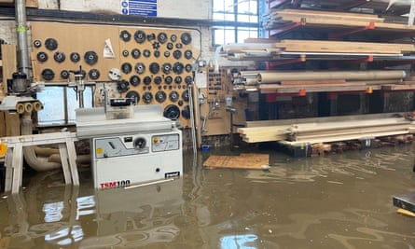
Climate change adaptation in management systems
Holders of environmental permits are required to integrate climate change adaptation risks into their business management systems by April 2024
extreme rainfall, leading to more frequent and severe floods
heat waves
drought
rise in sea levels and tidal surges
storms
wildfires
International standards ISO14090:2019 and ISO14091:2021 published to assist any company to manage climate adaptation risks

Slide 22
ESOS Phase 3
Revised reporting and notification requirements under the Energy Savings Opportunities Scheme
Deadline for notification delayed until 5 June 2024
ESOS action plans must be produced that record:
Measures to improve energy performance over the next phase period
Timescales for the measures
Estimates of total energy savings for each measure
Action plans to be notified to the EA by 5 December 2024
Notes:
For the qualification date for the third compliance period of ESOS (31 December 2022) a large undertaking is any UK company that either:
employs 250 or more people, or
has an annual turnover in excess of £44 million, and an annual balance sheet total in excess of £38 million
large UK undertakings and their corporate groups. It mainly affects businesses but can also apply to not-for-profit bodies and any other non-public sector undertakings that are large enough to meet the qualification criteria

Slide 23
Single use plastics
Online and over-the-counter sales and supply of the following single-use plastic items are banned since October 2023:
polystyrene food and drink containers
drinks stirrers
balloon sticks
cutlery
Online and over-the-counter sales and supply of the following single-use plastic items have restrictions:
plates, bowls and trays
straws
cotton buds
This includes all types of single-use plastic, including biodegradable, compostable and recycled plastic items wholly or partly made from plastic, including coating or lining
Notes:
Some medical exemptions for plates, straws, cotton buds

Slide 24
MCPs and Specified Generators
Boilers, furnaces or generators with capacity 1-50MW thermal input
Permitting controls introduced 2017
Pre-2018 MCPs (5-50MW) needed permits in place by January 2024, and compliance with the permit by 1 January 2025
1-5 MW MCPs must be permitted by 2029 and complied with by 2030
Specified generators >5MWh must have permits and comply by 1 January 2025

Slide 25
UK CBAM: Carbon Border Adjustment Mechanism
Aims to protect UK manufacturers from cheap, imported, high-carbon products from outside the EU.
Will be implemented by 2027. EU CBAM in force from 2026.
Initially to apply to aluminium, cement, ceramics, fertiliser, glass, hydrogen, iron and steel products.
Charges a UK manufacturer would incur associated with UK ETS are to be applied to imported products
Notes:
Data collection will commence from earlier. UK exporters to the EU may already start to be asked questions about the embedded carbon within their products

Slide 26
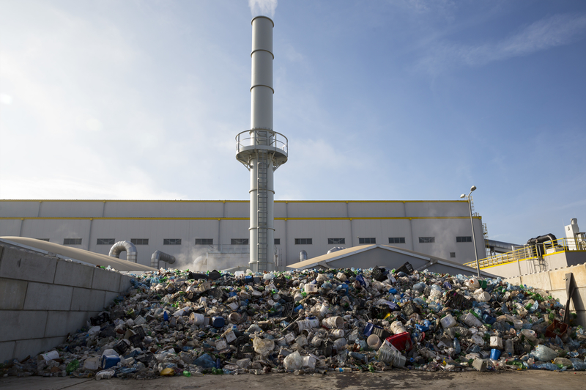
UK ETS (Energy from Waste)
Large CO₂ emitters in many sectors are required to participate in the Emissions Trading Scheme
EfW / incineration plants to enter the scheme in 2028
Estimated cost to incineration sector ca. £800m per year
Residual waste to EfW will become more expensive
Seek to move your waste to recycling operations (up the waste hierarchy)
Technical details not yet available, e.g. POPs waste, clinical waste must be incinerated by law
Notes:
Maritime sector also being included

Slide 27
Persistent Organic Pollutants
Stockholm Convention on Persistent Organic Pollutants
Three substances currently listed for proposed restriction:
Medium-chain chlorinated paraffins
LC-PFCAs (long-chain perfluorocarboxylic acids)
Chlorpyrifos (organo-phosphate fertiliser)
Notes:
MCCPS
adhesives, sealants,
paints and coatings;
a flame retardant in PVC and rubber compounds,
an extreme pressure lubricant and anti-adhesive for metal working fluids
a waterproofing agent for paints, coatings and textiles; and
a carrier solvent for colour formers in paper manufacture.
LC-PFCAs
surfactant applications, polymer manufacture, coatings, textile impregnators, carpet protectors, firefighting foams)

Slide 28
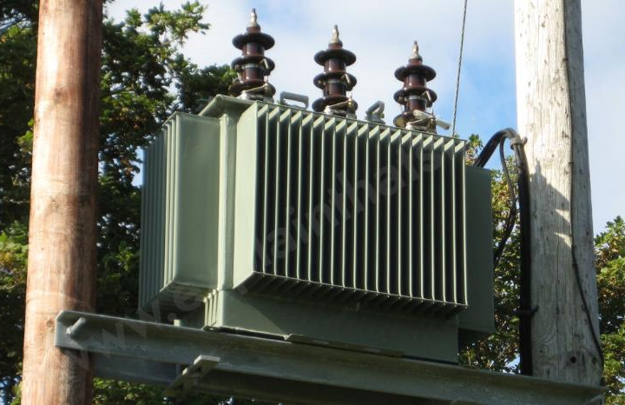
Persistent Organic Pollutants
PCBs: Banned since 1987.
You can continue to hold a transformer until 31 December 2025 if you can reasonably assume two things about its fluid.
It contains 0.005% - 0.05% by weight of PCBs.
There is a total volume of more than 0.05dm³ (0.05 litres).
After 31 December 2025 you can no longer use the transformers. You must decontaminate and dispose of them as soon as possible.

Slide 29
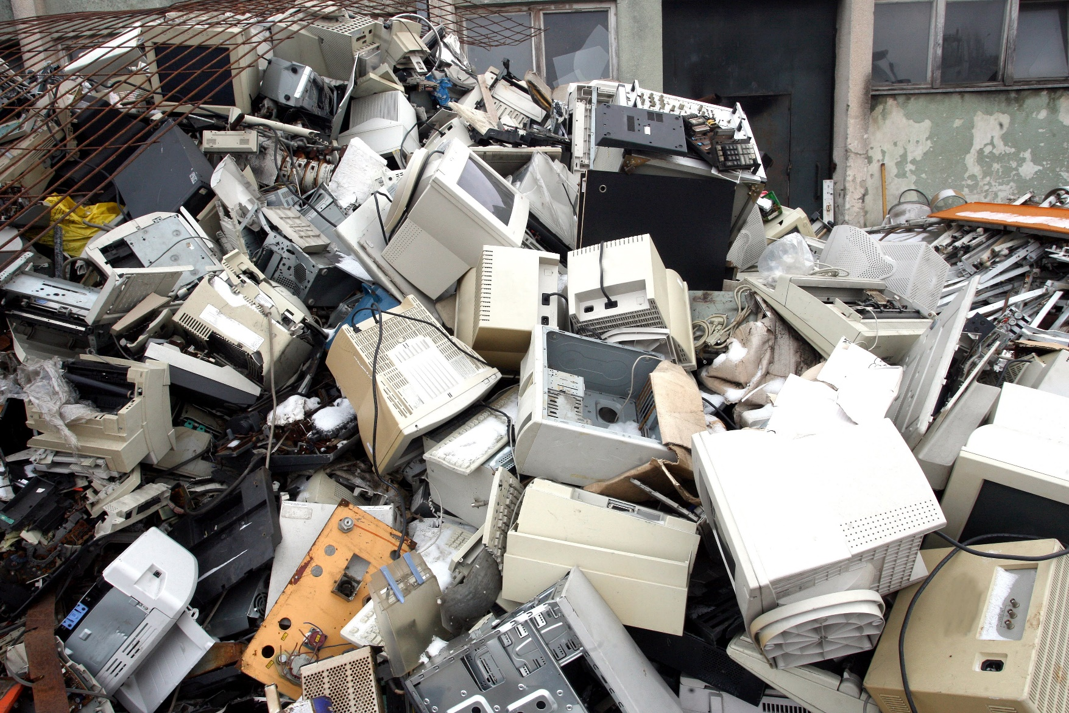
Persistent Organic Pollutants
POPS waste cannot be recycled
Small mixed WEEE
Upholstered domestic seating
Must be segregated from waste stream and sent for high-temperature incineration
See Environment Agency guidance on “POPS waste” and RPS 265
Notes:
Pesticides, dioxins & furans, complex organic compounds containing halogens

Slide 30
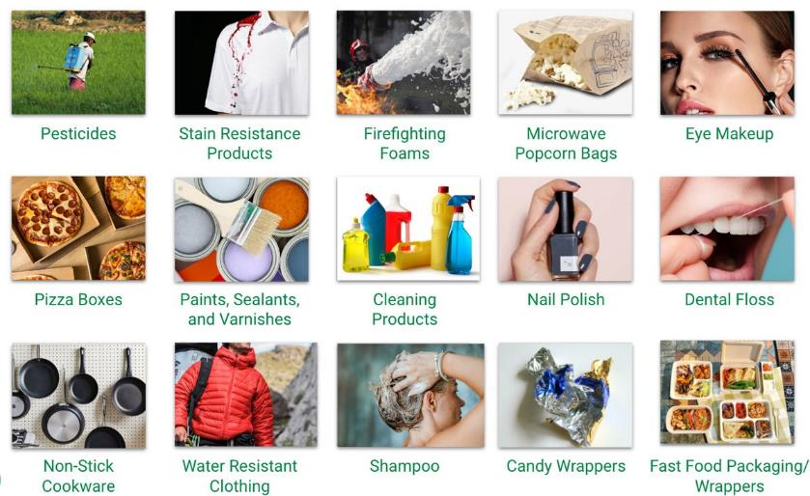
PFAS – Perfluoroalkyl substances
“Forever chemicals”
Bioaccumulative
Linked to numerous health impacts; cancers, fertility, thyroid problems, obesity, liver/immune diseases
Increasing legal scrutiny on their use globally
EU proposal to ban all PFAS through REACH Regulation
Used in a wide range of manufacturing applications and consumer products
Understand where they are in your supply chain

Slide 31
Break

Slide 32
Upcoming changes to waste regulations
All currently planned for late 2024/2025
1. New waste carrier, broker and dealer system
2. Mandatory digital waste tracking
3. Waste Exemption Review
4. ‘Simpler Recycling’

Slide 33
1. New carrier, broker and dealer system
Current system: Upper & Lower Tier Registrations
Businesses carrying waste for commercial purposes hold upper tier registrations
Charities, healthcare organisations and businesses carrying their own waste hold lower tier registrations
No technical competence requirements
Anyone registered can carry any kind of waste
Registration costs £154 (UT) or is free (LT)

Slide 34
New carrier, broker and dealer system
Transporters
Those instructed by a controller to move waste between locations without input on the end destination and classification (e.g. hauliers, contractors, delivery drivers)
Controllers
Those who organise waste collection, or its classification, transportation, end destination, or arrange the recovery or disposal of waste on behalf of others, and those who buy or sell waste.
(e.g. brokers, dealers, consultants, waste sites)

Slide 35
New carrier, broker and dealer system
Controller-transporters:
Those who organise waste collection, or its classification, transportation, end destination or arrange the recovery or disposal of waste on behalf of others, those who buy or sell waste and also collect and transport it
Waste sites with their own transporter
Skip companies
Waste collection companies

Slide 36
New carrier, broker and dealer system
England only
Amendments to be made to the Environmental Permitting Regulations to include waste transporters and controllers
Upper-tier registrants required to apply for permit at the end of their 3-year registration
Lower-tier registrants will have 12 months to apply for a new exemption or permit
Permit charges will increase above the current registration level
Waste exporters to be brought into permitting in the future

Slide 37
New carrier, broker and dealer system
Standard rules permit | Registered exemptions | Non-registered exemptions
Waste controller only | Transporting animal by-products | Householder taking waste to HWRC
Waste transporter only | Non-chargeable collection services not for commercial profit (charities/voluntary groups) | Waste at place of production with minimal sorting to be collected by another company
Waste controller-transporter | Tradesperson or business transporting their own waste produced in course of that business (non-C&D, haz waste below a certain weight) | Local authority waste collections
 | Transporting mines or quarries waste

Slide 38
New carrier, broker and dealer system
Waste producers will not need do anything to hand their waste to a controller or controller-transporter
Producers handing waste to a ‘waste transporter only’ will need to be permitted as a controller.
Mandatory technical competence requirements for permit holders; competent persons must be employed by the company. 12-month transitional period.

Slide 39
2. Mandatory digital waste tracking
UK-wide initiative
Target start date for new legislation April 2025
Voluntary use from 2024
All types of controlled waste to be included
Will replace waste transfer notes and hazardous waste consignment notes
Household waste collected from domestic premises will require a digital record (except council collections)

Slide 40
Mandatory digital waste tracking
Required for:
waste passing to a different organisation or person
waste moving between sites operated by the same organisation
waste passing from the control of one organisation to another organisation within the same site
waste moving between authorisations operated by the same entity on the same site
Exemptions not yet confirmed

Slide 41
Mandatory digital waste tracking
Likely that ADR information will be removed from the hazardous waste transfer entries, meaning a separate ADR transport document will be required for DGs
Transitioning over 3 years to the real time entry of data
Initially, records of collection and receipt to be entered within 2 working days
Government open digital software. Annual user fee likely (£20).
Season tickets should be available, but not confirmed

Slide 42
3. Waste Exemption Review (England & Wales)
Exempt waste operations – “low risk” waste activities that do not require an environmental permit
Not routinely inspected by EA or NRW officers
Problems with associated waste crime, fires and pollution
Changes to exemption thresholds from Autumn 2024
Some exemptions to be removed altogether
Operators will have to apply for environmental permits or change their on-site practices
Waste producers need to review their Duty of Care

Slide 43
Waste Exemption Review (England & Wales)
Exemptions being removed (3-month transitional period)
U16 – Use of depolluted ELVs for parts Using depolluted ELVs for parts – 2 cars or 5m³ of parts T8 – Mechanically treating end-of-life tyres Baling/processing up to 60T/40T of truck/car tyres T9 – Recovering scrap metal Processing up to 1000T of scrap metal at any one time

Slide 44
Waste Exemption Review (England & Wales)
Exemptions being revised (6-month transitional period)
T4 – Preparatory treatments, such as, baling, sorting, shredding
e.g. sorting and baling recyclables
reduced storage limits
new requirement for all waste to be indoors
annual waste limit reduced from 806,000T to 5,000T
reduced number of acceptable wastes

Slide 45
Waste Exemption Review (England & Wales)
Exemptions being revised (6-month transitional period)
T6 – Treating waste wood and waste plant matter by chipping, shredding, cutting or pulverising
No longer available for wood from wood processing/furniture industry or treated wood
Permitted tonnage reduced from 26,000 to 5,000 T per year

Slide 46
Waste Exemption Review (England & Wales)
Exemptions being revised (6-month transitional period)
T12 – Manually treating waste
Sorting, refurbishing, dismantling was for recovery, e.g. bicycles, homewares, clothing, telegraph poles
New limit of 500T per year (was unlimited)
New storage requirements (e.g. must be indoors)

Slide 47
Waste Exemption Review (England & Wales)
Exemptions being revised (6-month transitional period)
D7 – Burning waste in the open
Burning up to 10T per day of plant or clean waste wood in the open at the place of production
Only vegetation from land clearance and maintenance allowed going forward
New pile size limits and change to 20m³ limit instead of 10T

Slide 48
Waste Exemption Review (England & Wales)
Exemptions being revised (12-month transitional period)
U1 – Use of waste in construction
Using construction waste, road planings, woodchip or soils for roadways, landscaping etc.
Much stricter tonnage limits and defined uses
No more than 500m³ stored, was previously 1,000-50,000 T
Can’t be near water sources
Many wastes require haz waste assessment first

Slide 49
Waste Exemption Review (England & Wales)
Exemptions being revised (12-month transitional period)
S1 – Storing waste in secure containers
Store segregated waste in containers
Limit reduced from 80m³ in 20 containers to 15m³
New infrastructure requirements for liquids/waste oils
New or lower annual storage limits

Slide 50
Waste Exemption Review (England & Wales)
Exemptions being revised (12-month transitional period)
S2 – Storing waste in a secure place
Storing segregated waste pending recovery elsewhere
Limit reduced from 8,000m³ in 20 containers to 500m³
New infrastructure requirements
New or significantly lower annual storage limits
Changes to acceptable wastes

Slide 51
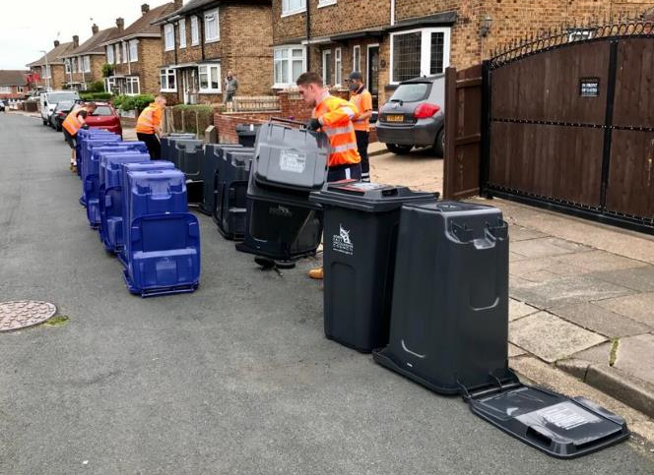
4. “Simpler Recycling” (England only)
New requirements from central government on local authorities and business
Aims to increase stagnating recycling rates
All councils/businesses will be required to collect six recyclable waste streams:
glass
metal
plastic
paper and card
food waste and
garden waste (businesses exempt).
Notes:
People should be able to recycle in the same way at work as at home, regardless of where they live
Dry recyclables can be collected together

Slide 52
“Simpler Recycling”
All businesses > 10 FTEs by 31 March 2025 (excl. garden)
All businesses and households by 31 March 2026
Plastic film to be recycled by 31 March 2027
Household residual waste collections not less than fortnightly

Slide 53
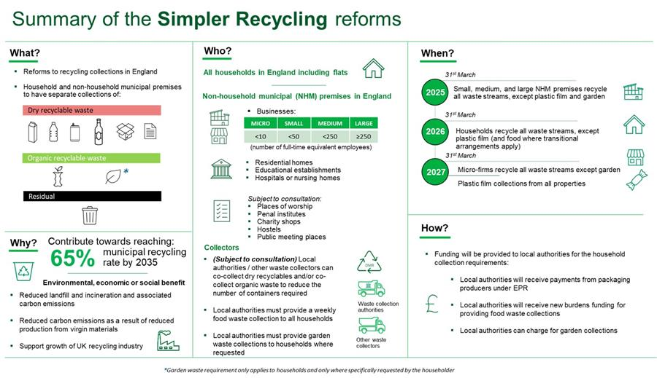

Slide 54
Questions?

