Slide 1
Guide to working from home
General guidance, tips, and resources

Slide 2
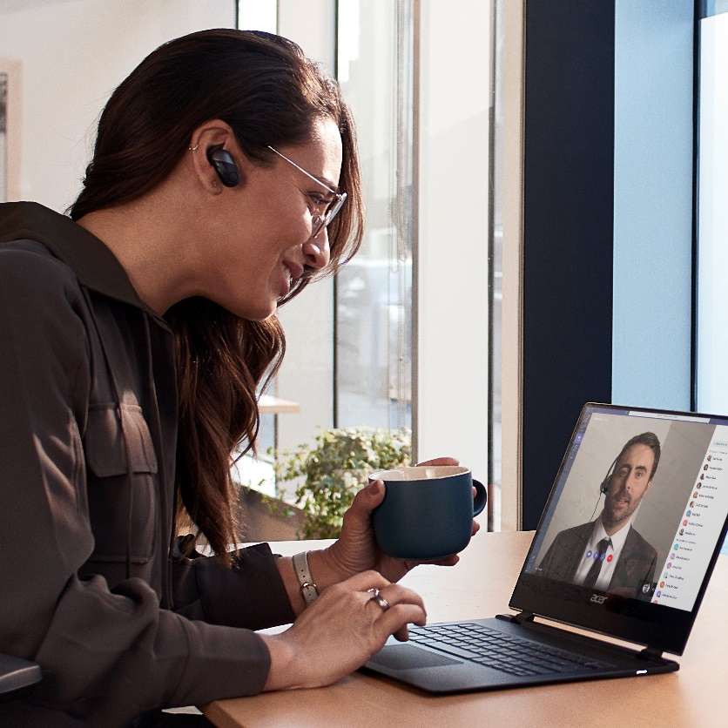
Guide to working from home
Set up your workspace
Stay connected to each other
Manage your time and well-being

Slide 3
Simple steps to prevent back pain, upper limb disorders, etc.
Human bodies have evolved to move almost constantly and many modern health problems are directly related to static posture and sedentary lifestyles.
Regular activity is good for your physical health:
It gets blood and oxygen to your brain to help concentration and performance
It helps prevent back pain, headaches, sore shoulders, painful wrists, and so on
There is no maximum time you are permitted to use DSE but the longer you work without a change of activity or position the more likely you are to develop health problems.

Slide 4
Set up your (physical and virtual) workspace

Slide 5
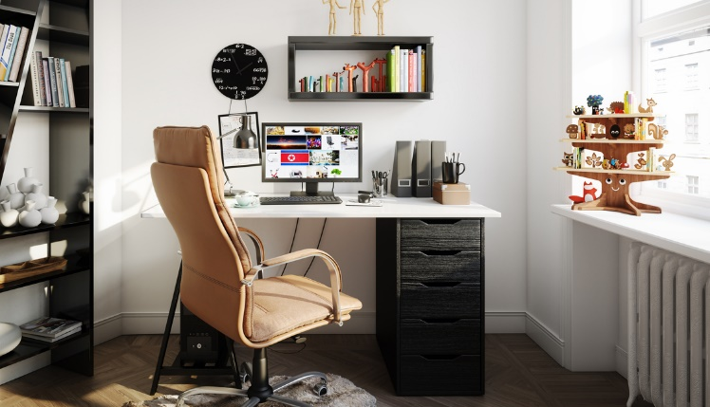
Set up your physical workspace
Take the time to set up a workspace that is safe, comfortable, and where you can work effectively.
A safe and secure space
Find a safe space to work—good ventilation, proper lighting, good ergonomics, and comfortable furniture are just a few things to consider.
Minimize distraction and disruption
If possible, aim for a space with minimal distractions (noise or clutter) and disruptions. We realize this can be challenging with others home as well during this time.
A place for equipment and materials
Identify a ‘work base’ where your equipment and materials can remain undisturbed, even if you shift locations during the day.
Notes:
Throughout this deck, you can use the blue bar to surface links and tips specific to your organization. Additional information that can be added to this page:
- Internal policy or guidance on equipment during COVID-19

Slide 6
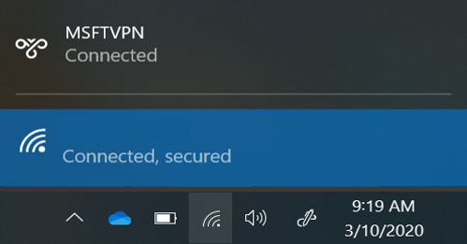
Set up your virtual workspace (Including the right equipment)
Continue to collaborate and be productive from wherever you might be working.
Use your best connection
A wired network connection is best, if possible. When using a wireless connection, consider your distance from the router and obstacles in between that can affect your connection quality.
Think secure, be secure
You can use many apps and sites with a standard internet connection. To securely access internal resources and work with confidential data, you might need to connect via VPN or remote desktop.
Mobile when you need it
Installing the apps you need on your phone is a great alternative when your local internet is experiencing high usage that affects your connectivity.
Notes:
Additional information that can be added to this page:
How to get technical help and/ or open a support ticket
How to set up VPN and remote access
How to access internal resources from home

Slide 7
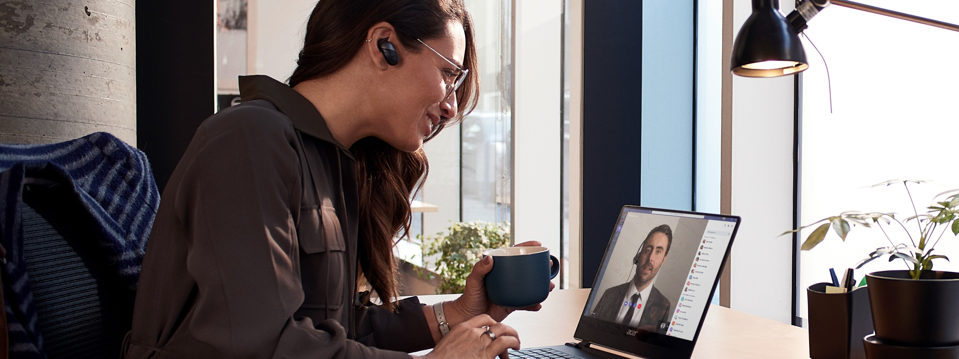
Stay connected to each other

Slide 8
Communicate
There are many ways to stay connected while working from home.
Communicate often
Make it a habit to connect frequently with your colleagues and stakeholders. Open a Teams channel for ongoing conversations or start a shared document to share progress updates.
Make space for fun
Use a Teams channel dedicated to fun—share news, pictures, and stories. Try a GIF, sticker or emoji to express yourself.
Virtual ‘water cooler’
Make up for missing hallway talk or connecting in the kitchenette or café by using chat messages or calling. Set yourself a reminder to check in with people regularly.
Channel conversations in Teams are a great way to keep the whole team in the know.
Watch the Quick Start Videos for a walk-through of Teams and use the Quick Start Guide to learn the Teams basics.

Slide 9
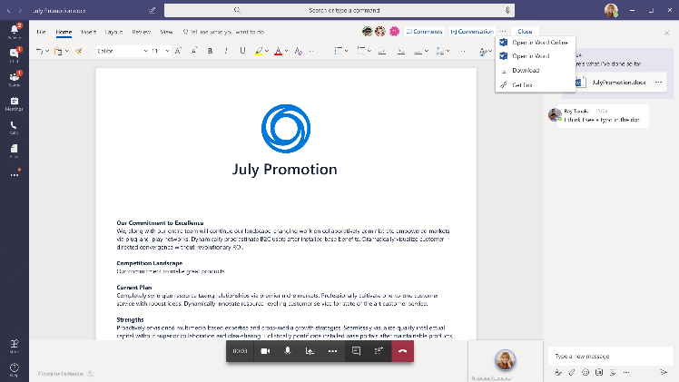
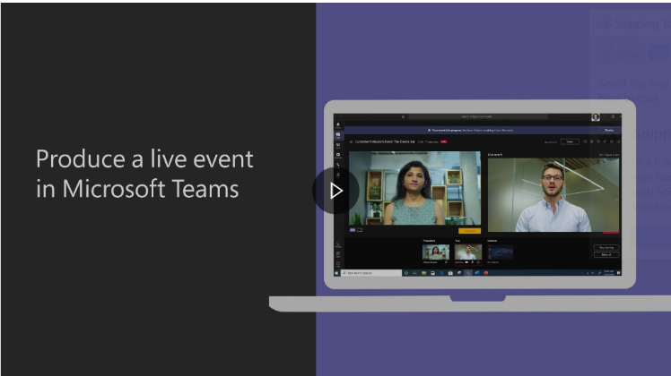
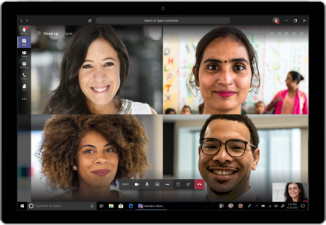
Collaborate
Don’t miss a beat by using technology to connect and collaborate regardless of location.
Real time
Share the content your audience/team needs to see with screen sharing, and work to edit in real time with coauthoring in Teams. If you need to brainstorm, use Whiteboard in Teams as a digital canvas for your ideas to come to life.
Switch to digital events
Keep your events on the books with Teams live events that allow you to broadcast video and meeting content to large online audiences. This can be used for anything from a team all-hands to external forums.
Virtual ‘huddle’
Quick meetings are effective at getting everyone on the same page quickly. Schedule a quick call with your collaborators to get the same impact of a quick in-person connection.
Use the Microsoft Whiteboard app in Teams. Watch a training on how to produce a Teams live event.

Slide 10
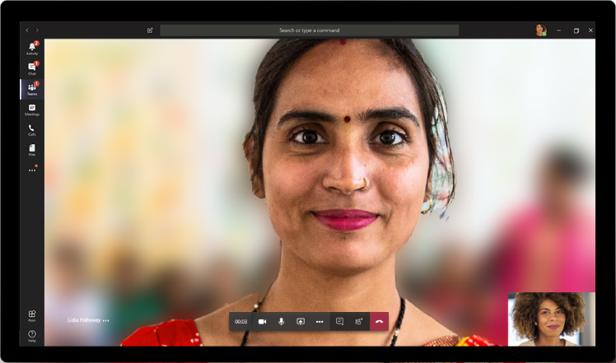
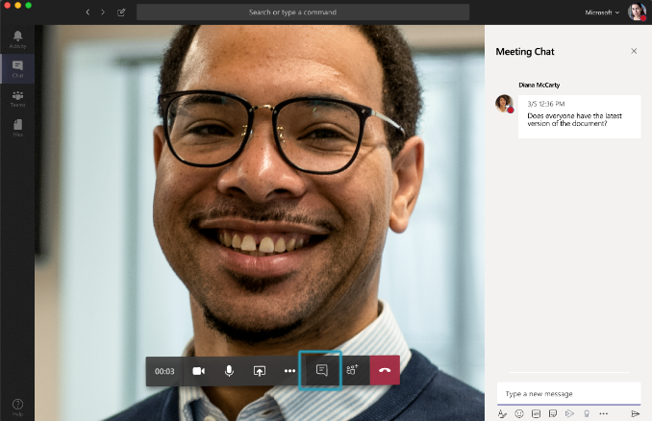
Lead inclusive online meetings
As you move your meetings online, take these steps to make them productive and welcoming for everyone.
Be present and respectful
Limit multitasking during meetings. Turning on your video can show that you are paying attention and allow you to focus on the person or people on your call. Blur your background to reduce distractions.
Pause for others to speak
It can be hard to find space to speak in a meeting, and even harder when everyone is virtual. Make sure there’s time and opportunity for all voices to be heard.
Monitor meeting chat
People may not feel comfortable breaking into the conversation or may be having technical difficulties. Check the Teams meeting chat often for comments.
Make sure all meetings have a virtual “join” option to create an online conference room.
Record meetings in Teams and share the recording link in chat so people can catch up later.

Slide 11
Manage your time and well-being

Slide 12
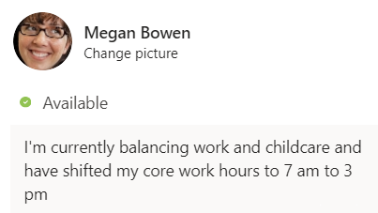
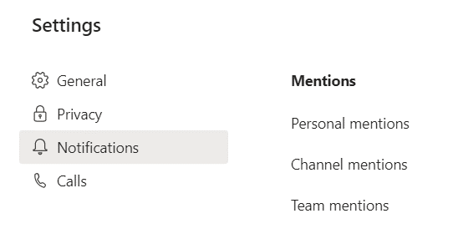
Share your schedule and signal availability
Setting healthy boundaries, managing interruptions, and being clear about when you are available is an important part of managing your time when working from home.
Set expectations for availability
Your daily schedule or even the hours that you work may change while working from home. Set expectations with your team (and those you live with) around your availability during the day.
See what is important
With everybody working from home, you might see an increase in messages. Use the settings available in Teams and Outlook to customize notifications and prioritize conversations.
Set boundaries
It can be a challenge to switch ‘off’ from work when you don’t leave the office—or switch ‘on’ your workday when you don’t leave the house. If needed, set clear intentions about work time and home time to avoid burnout or being ‘always on’.
Manage notifications for Teams activities, channels, and on mobile.
Set a status message in Teams and update your calendar to indicate if you are free or busy.
Set quiet hours in Teams mobile to limit notifications to your work hours and turn Focus Assist on in Windows 10.

Slide 13
Take care and be mindful
In challenging circumstances, we need to remember to take a step back and focus on our health, wellness, and mindset.
Don’t forget to take breaks
It can be difficult to remember to take breaks. Use your calendar to turn meals and breaks into appointments so you get regular reminders. Block time on your calendar for exercise and fresh air—or just time to step away from your workspace.
Work-life harmony
We recognize that while working from home you may need to occasionally redirect your time and energy to your loved ones. Continue to access available support options, caregiver benefits, and leave, as needed, to find the balance you need.
Check-in with team and others)
It’s important to look after yourself and be mindful of how you are feeling. Anxiety, loneliness, and other feelings are perfectly normal, and there are resources to help you take care. Be sure to check in on others within your team.
Notes:
Additional information that can be added to this page:
How access wellness resources and benefits offered by your company

Slide 14
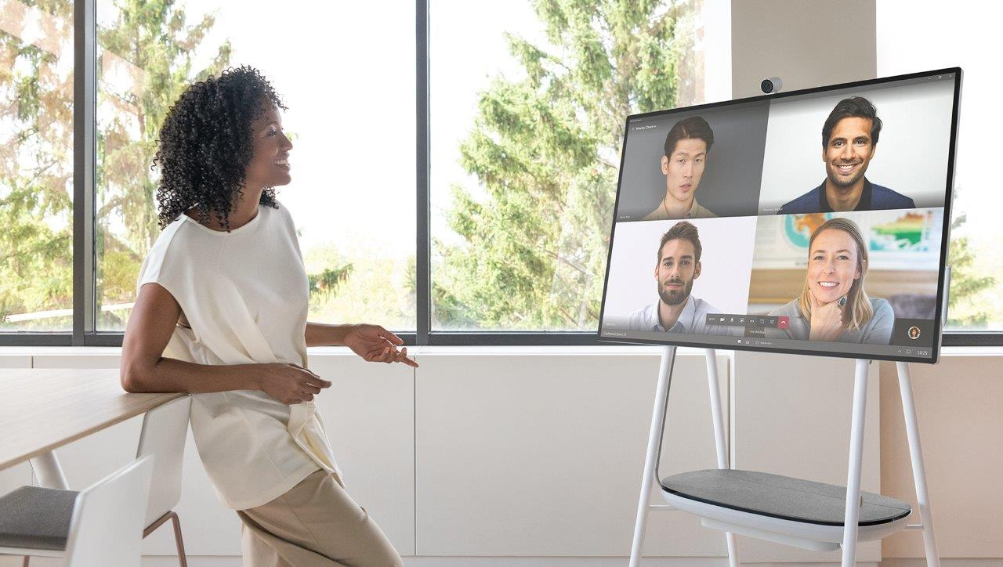
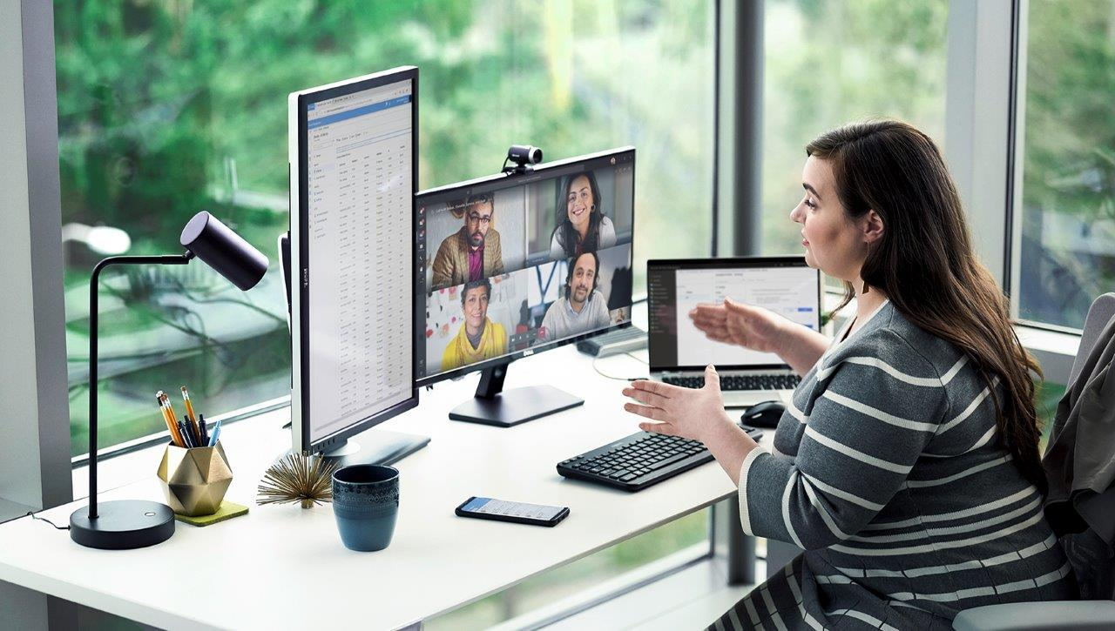
Role of the manager
Managers play a key role in the success of their teams, especially during times of uncertainty and change.
Lead by example
Model the work from home use on good habits. Be a positive example of the guidance, and make sure to reinforce inclusion. Check in with your team, ask for perspectives, and identify any areas for improvement.
Support in new ways
Help each person create their best and most productive work from home environment. Understand any business continuity concerns of your team and support their efforts at working in new ways. Be curious and ask questions that empower employees to find their own solutions.
Frequent check-ins
These are unusual times with unanticipated challenges and may require more frequent check-ins.
Be sure to manage expectations, offer support, and take time to understand the unique needs of every team member.
Notes:
Additional information that can be added to this page:
Learning resources for managers

Slide 16
Questions?

