Slide 1
Driving safely for work:
Our biggest occupational safety challenge
Roger Bibbings MBE BA CFIOSH
Partnership Consultant RoSPA

Slide 2
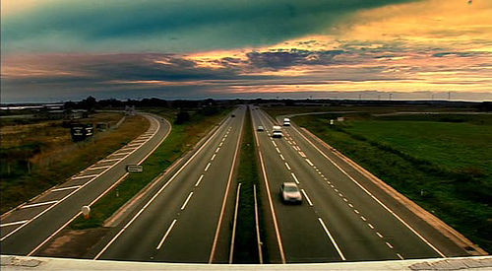
The road as a workplace?

Slide 3
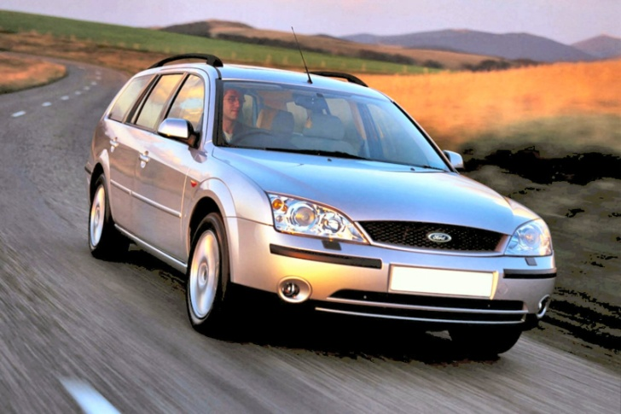

Driving for work
Commuting
Delivering goods and services
Visiting clients
Emergency services
Attending meetings
Collecting/delivering vehicles
Driving as your job?
Driving to do your job?

Slide 4

Consider who is at risk
NOT JUST
Commercial vehicle drivers
Bus and coach drivers
Taxi drivers
Motorcycle couriers
Dot com delivery drivers
Pizza delivery riders
BUT

Slide 5
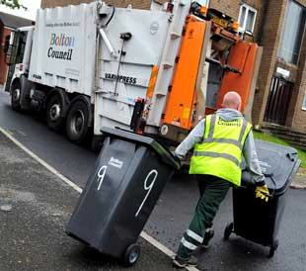
Anyone on the road as part of their job
Sales staff/service engineers
Social workers
Emergency services
Local authority staff
Voluntary workers
Police
Government officials
Teachers
Vehicle recovery staff
Health workers
Postal workers
Fund raisers
At-work pedestrians

Slide 6
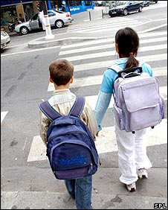
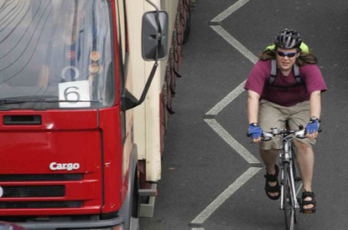
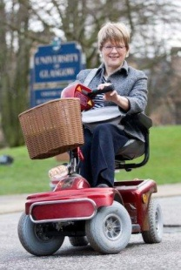
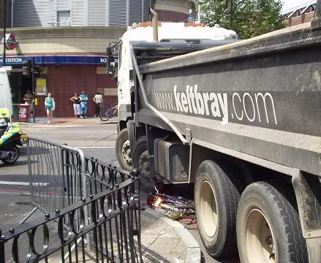
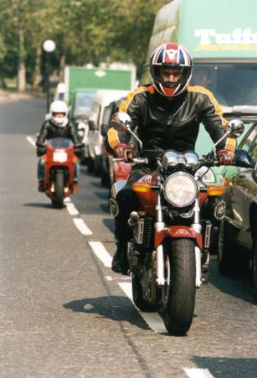
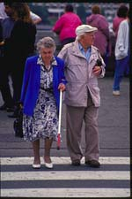
……..and vulnerable road users
Pedestrians
Cyclists
Motorcyclists
Children
Elderly
Disabled

Slide 7
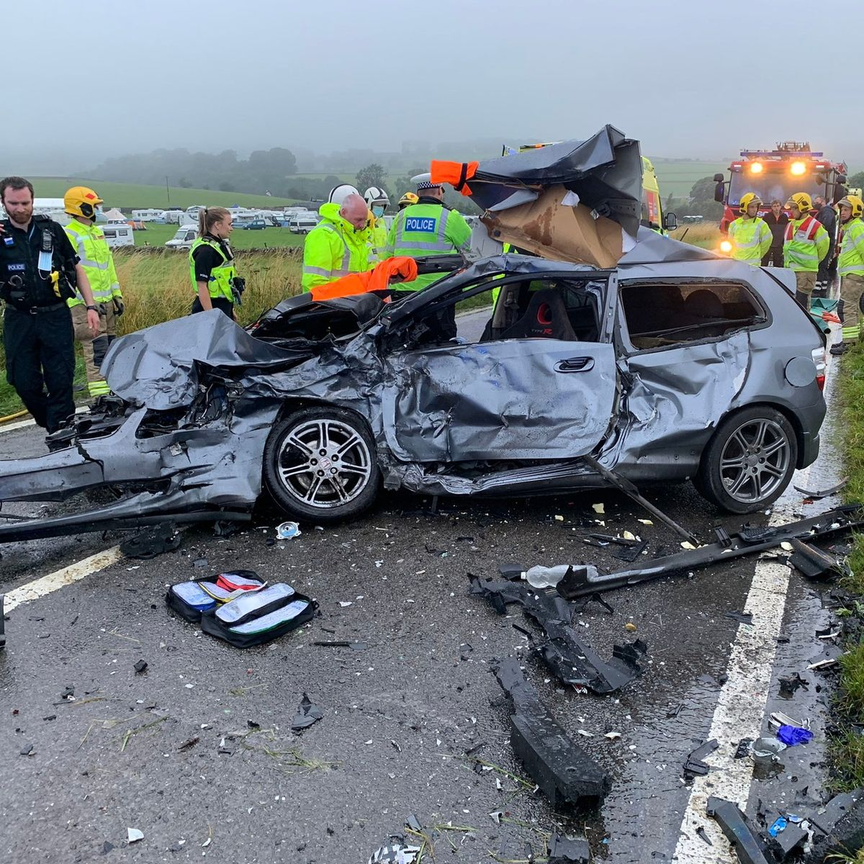
Road casualties GB
Road collisions in the year ending June 2022:
29,804 KSI casualties, of which
1,760 fatalities (415 pedestrians, 99 cyclists)
137,013 casualties of all severities
CAUSES?
COSTS?
PREVENTABILITY?

Slide 8
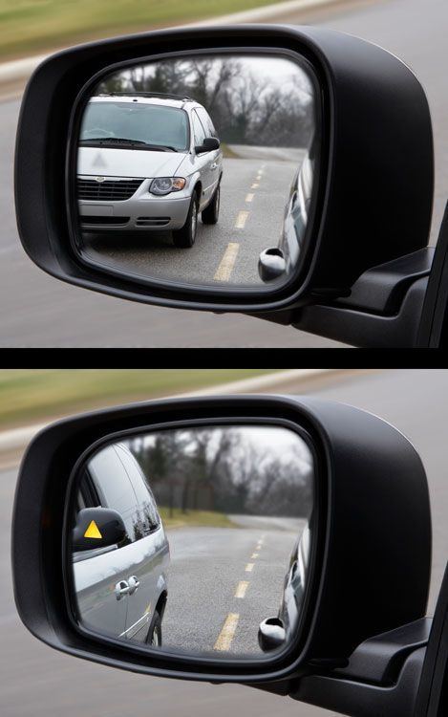
Is work related road safety still a blind spot?
Not reportable to HSE
HSE focused on site transport
Few questions asked at crashes about on road at-work driving
Police focus on ‘driver error’
Car/van driving not an occupational skill
Drivers regarded as solely responsible
H&S practice too law led?
Vehicles regarded as commonplace
“Insurance will pay”

Slide 9
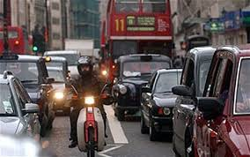
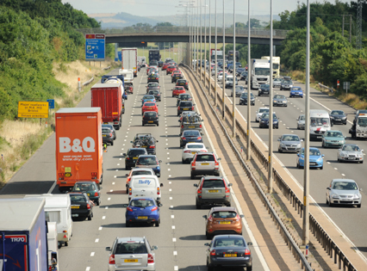
The UK’s biggest occupational safety issue
Between 1/4 and 1/3 casualties work related
Risks higher than construction
More workers killed than in RIDDOR accidents
More members of the public killed and injured BUT
Not seen as part of workplace H&S
Not really addressed by HSE/LAs AND YET
Huge potential to save lives and reduce injuries

Slide 10

RoSPA’s strategic objective since 1997
“To ensure that the risks which people face and the risks which they they create for others while on the road as part of their job are managed and regulated as part of mainstream occupational health and safety.”

Slide 11
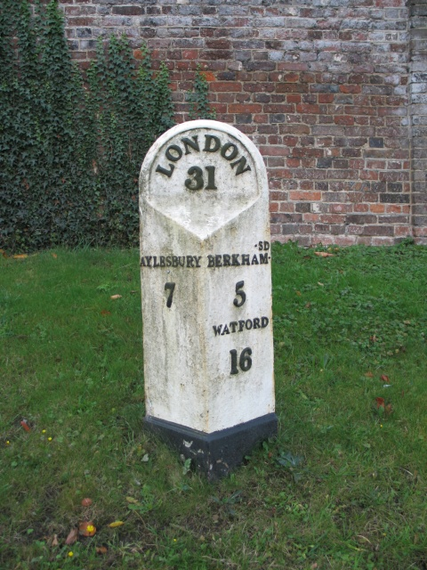
Some important milestones
1996/7: Esso/EEF RoSPA seminars
1998: The Stoke Court Declaration
1999: DfT’s ‘Tomorrow’s Roads’
2000/1: WRRSTG – Dykes Report
2002: ORSA
2003: INDG 382
2004: HoC Select Committee/Motorists’ Forum
2007: Driving for Better Business
2008: SCoRSA
2009: PRAISE, Washington conference
2014: RoSPA BNFL Review published
2015 New ORSA website

Slide 12

HSE/DfT guidance 09/03 ‘Driving at Work’
Confirmed that H&S law does apply on the road
Suggested approaches to risk assessment
Suggested control measures/performance review
Signposted further information
Highlighted the ‘business case’ for action
Revised version accessible at http://www.hse.gov.uk/pubns/indg382.pdf
HSE guidance ‘Driving and riding safely for work’ - https://www.hse.gov.uk/roadsafety/index.htm

Slide 13
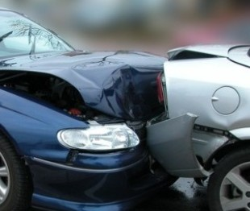
Causes of road crashes?
IMMEDIATE:
inappropriate speed
inattention
falling asleep
travelling too close
drink/drugs
adverse weather
vehicle defects
highway conditions

Slide 14
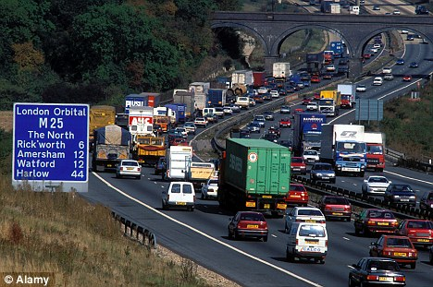
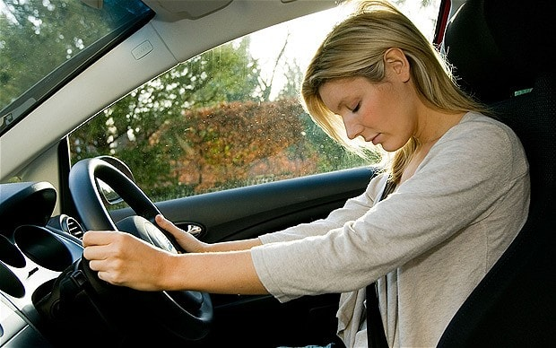
Causes of road crashes?
UNDERLYING:
pressure/attitudes
distractions
inadequate sleep
congestion
stress
poor journey planning
poor maintenance
poor routeing

Slide 15
Employer impact on crash risk
Increasing it
Too far; too fast (incentives to speed etc); unsafe routes/conditions; unsafe vehicles; stressed, tired, untrained drivers; poor work/life balance; mobiles; poor H&S culture (Out of sight, out of mind)
Reducing it
Reducing speed; journey planning; safer vehicles; driver assessment and training; action to combat fatigue; ‘No mobile while mobile’; clear MORR policies; leadership by example; strong road safety culture; monitoring and review

Slide 16
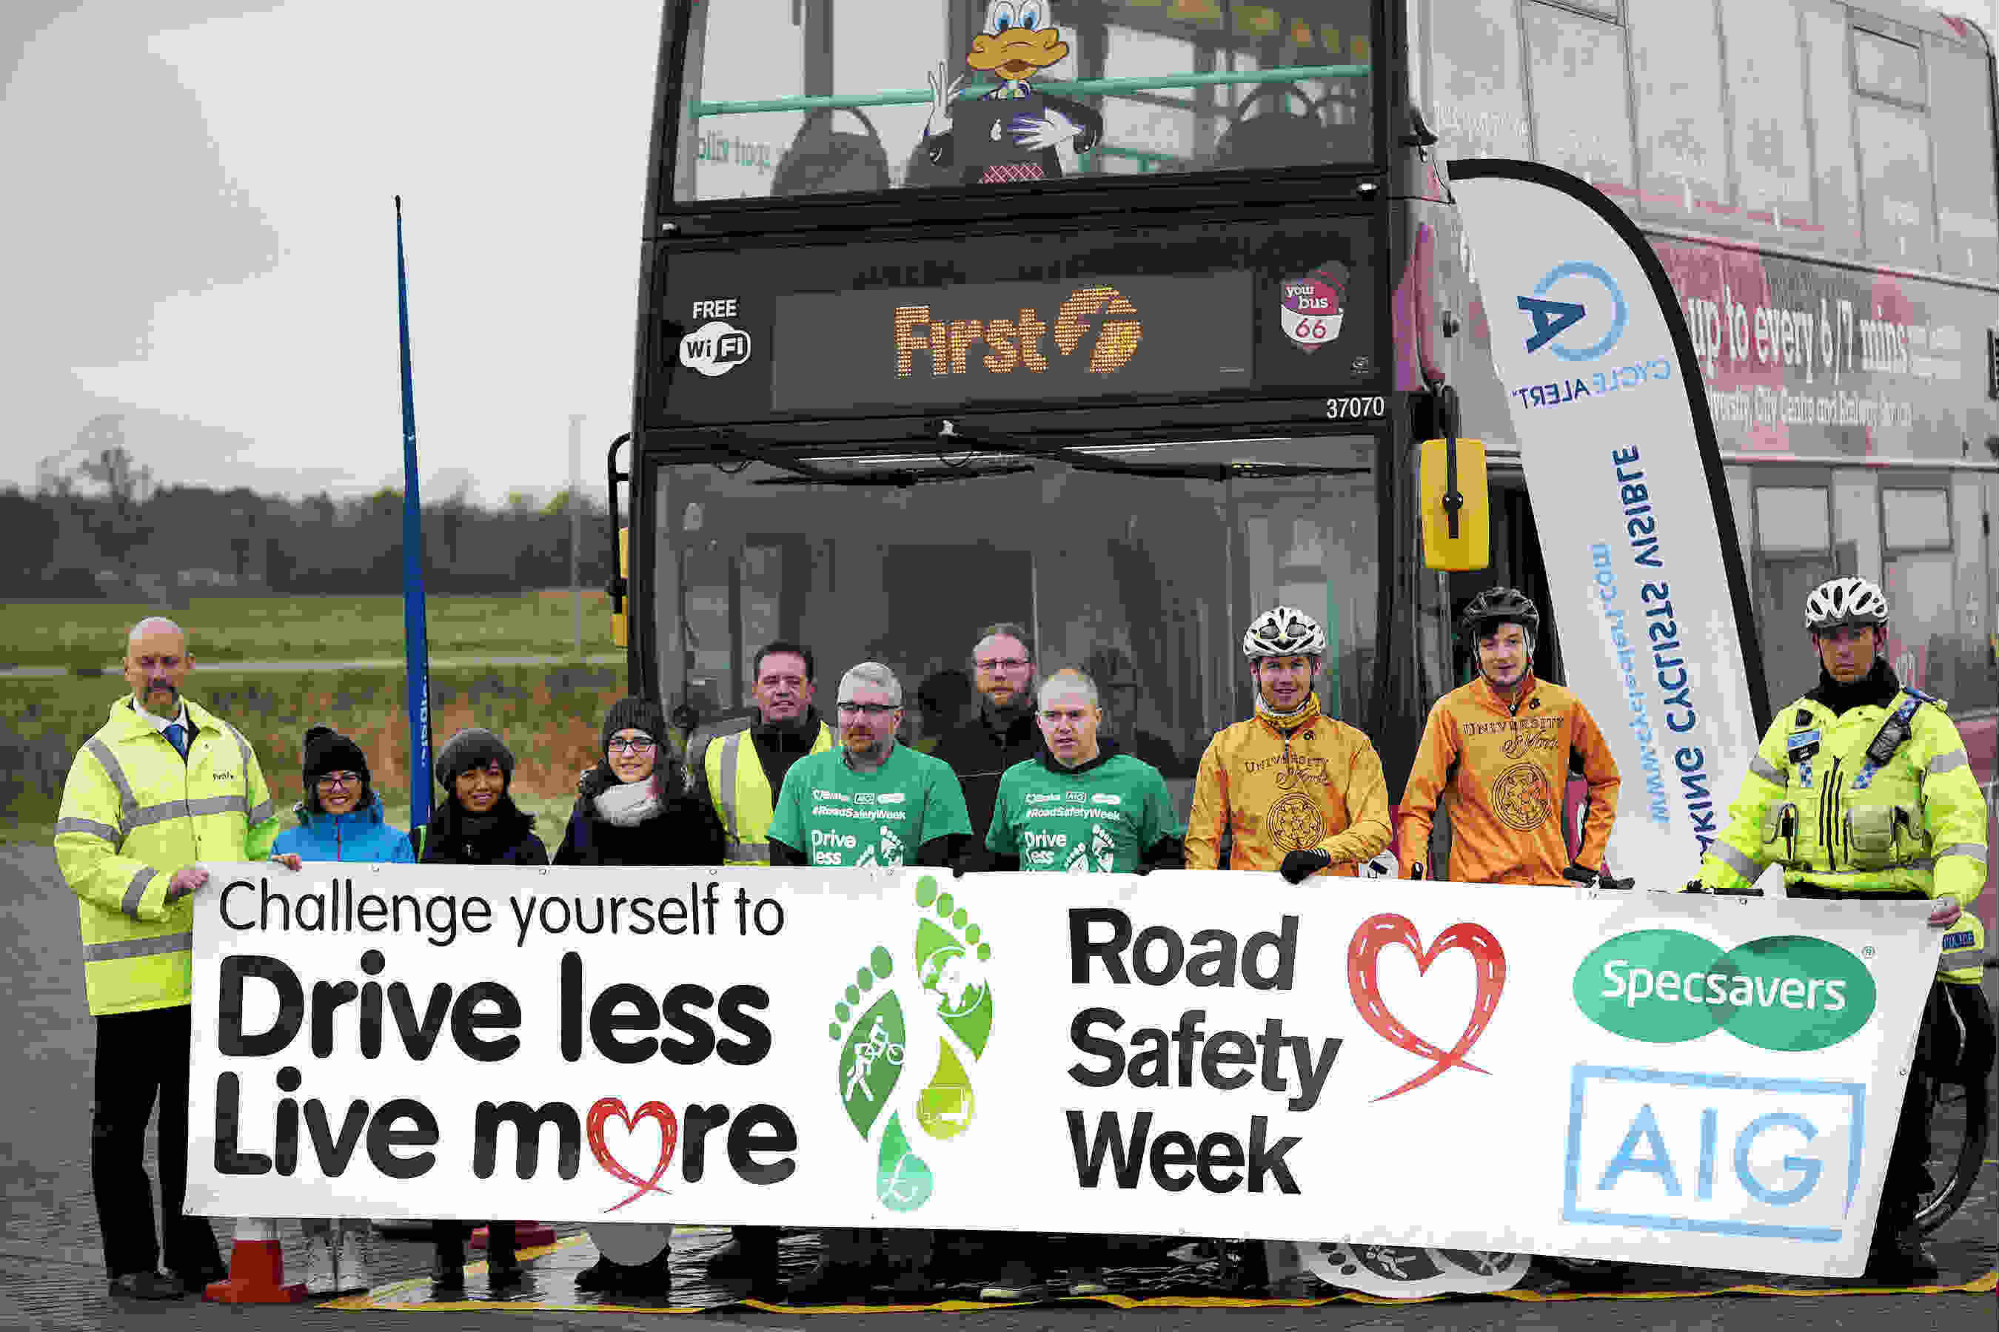
Three reasons for corporate action
Ethics: (CSR, environment etc.)
Legal compliance (HSW, RT law, CM, civil claims etc.)
The ‘business case’ (cost reduction, efficiencies, reputation, culture)

Slide 17

Real threats to your business
Hidden accident costs
Lost business opportunities
Lost staff time
Higher fleet premia
Loss of morale
Threat to corporate reputation
Notices and/or prosecutions
Common law claims
Prosecution (corporate manslaughter?)

Slide 18

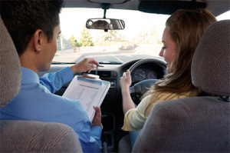
What are most businesses doing?
MANY STILL VERY LITTLE !!!!
but some….
driver handbooks
licence checking
driver feed back schemes
negative penalties
crash data analysis
technology
driver assessment and
DRIVER TRAINING…

Slide 19
Good BUT …
managing occupational road risk is not just driver training….

Slide 20
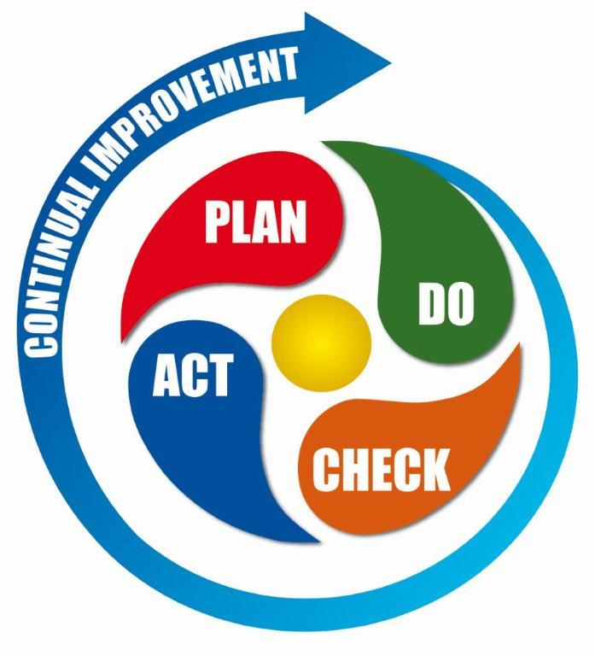
Managing occupational road risk means…
developing a risk management approach, i.e. putting in place
the
policies, people, procedures
to
‘work the problem’ !

Slide 21

Embed MORR in your 45001 framework
  define RS policy objectives
  organise and train for MORR
  plan and implement controls
  measure performance
  review and feedback
  Periodic sample audit

Slide 22

Using risk assessment sensibly to help managers and/or drivers understand:-
1. ‘How, when, who, how bad etc?’
2. Whether existing control measures adequate or more needed?
3. Which risks to tackle first?

Slide 23

Risk assessment at three levels
Generic
Specific
Dynamic
Review risk enhancing features:
journey tasks
vehicles
drivers

Slide 24
Some key risk factors
Journey task (speed? fatigue? routeing? distance? timing?distractions, weather? night/day?)
Vehicle (fit for purpose? properly maintained? additional safety features?)
Driver (age/experience? crashes/points? attitudes? competence? fitness? eyesight? stress? sleep quality?)

Slide 25
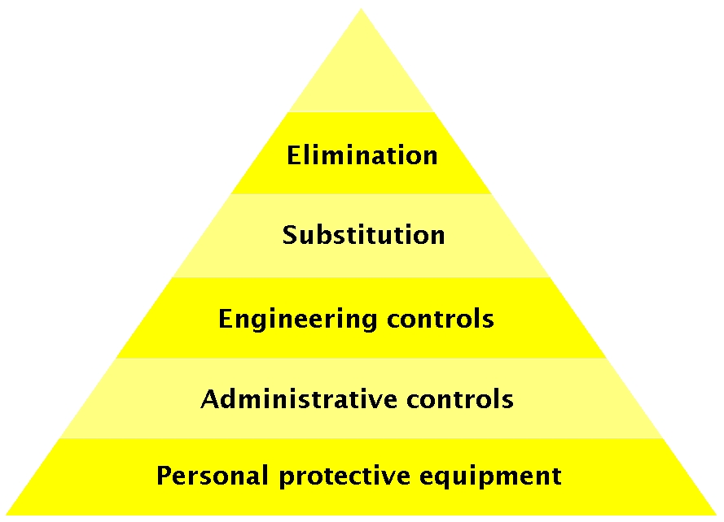
Preferred approaches to risk control
meeting without moving (Zoom, Teams etc.)
change/mix mode
reduce journeys/mileage
reduce hours/distances
optimise schedules
plan ‘safer’ routes
avoid adverse conditions
specify ‘safer’ vehicles
ensure maintenance
assess driver fitness
reduce distractions
alcohol/drugs policies
assess driver competence
prioritised driver training

Slide 26
Supported by..
Training for line-managers
Information, guidance and supervision for drivers
Performance targets/timescales (individual, department, corporate)
Monitoring (from licence/vehicle checks to ‘telematics’)
Reporting/investigating crashes/’near-hits’
Emergency procedures/personal safety
Awards/incentives? etc.
GOOD COMMUNICATIONS

Slide 27
And in-house policies on issues such as..
Speed (all staff to comply with limits)
Fatigue (preparation for driving, mileage limits, rest periods, caff/napping etc)
Night/adverse weather driving (avoidance)
Vehicle selection/maintenance (fit-for-person/purpose etc.)
Own vehicle use – ‘grey fleet’ (minimum conditions)
Driver fitness (stress, ill health, eye sight)
Drugs/alcohol (including non-prescription medicines)
Mobile phones etc etc (‘no mobile when mobile!’)
Driver competence (higher grades for higher risk drivers?)

Slide 28

So where to start?

Slide 29
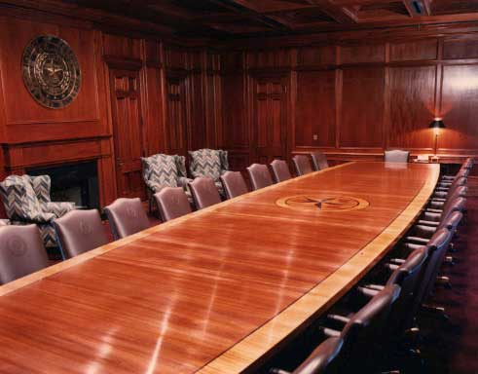
Board level leadership is key

Slide 30

Key H&S benchmarks for directors
Joint guidance, not statutory
But may be cited in prosecution evidence
Sets out core actions
  (Planning, Delivery, Monitoring, Reviewing)
Good practice and case studies
Signposts further information

Slide 31


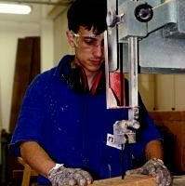

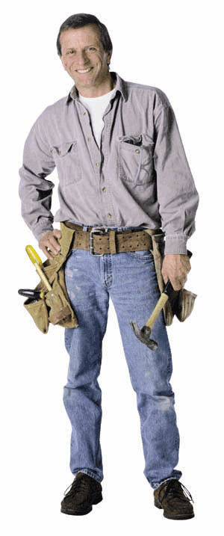
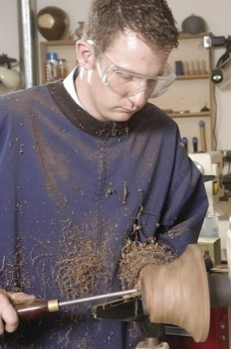



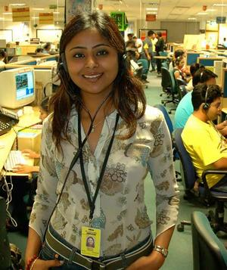
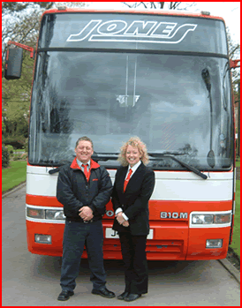
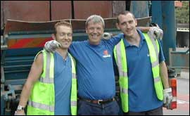

Engage with your workforce

Slide 32
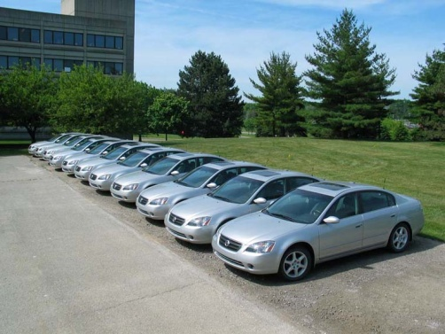

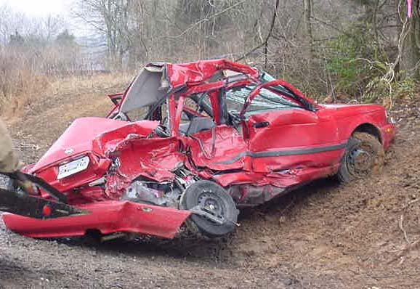
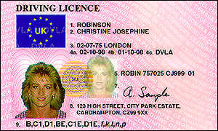

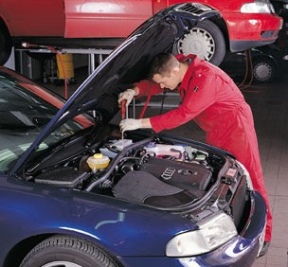
Data, data, data…

Slide 33
Three key steps..
1) Where are we now?
  Vehicles, drivers, miles, crashes, causes, costs?
  Management system (policy, organisation, planning, monitoring, review)?
2) Set up a joint team (H&S, HR, Fleet, SRs etc)
  develop ‘management system’,
  Seek external partners
3) Develop an ‘action plan’ to:
  assess risks, prioritise interventions
  set standards, targets, timescales etc
  implement
  monitor, review and feed back lessons learned

Slide 34


Evaluate, evaluate
Are your fleet safety interventions evidence based?
Impact?
Efficacy?
Cost effectiveness?

Slide 35

Are you benchmarking?
Which indicators?
Which partners?
Quantitative?
Qualitative?
Group?
One-to-one?

Slide 36

Are you sharing?
Accident/near-miss experiences?
Best practices?
Solutions?
Alerts?
Results?
Research costs/findings?

Slide 37

Are you investigating on-road incidents?
Encouraging reporting
Scaling response
Collecting all the data
Team based investigation?
Avoiding
  Unconscious biases/stopping the investigation too early
  Automatically blaming the victim
  Not sharing findings
  Not closing out actions

Slide 38

Are you reporting on performance?
To:
Employees
Investors
Insurers
Clients
Public authorities
Political representatives
The media
Local communities

Slide 39
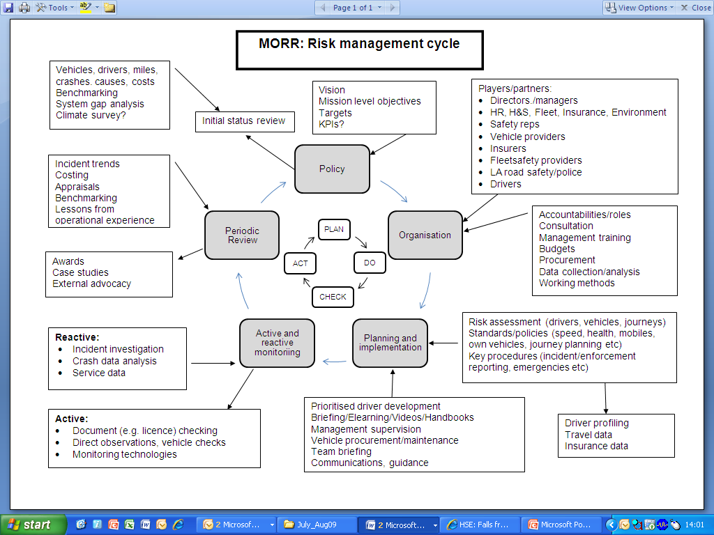
Have you created a cycle of continuous improvement?

Slide 40
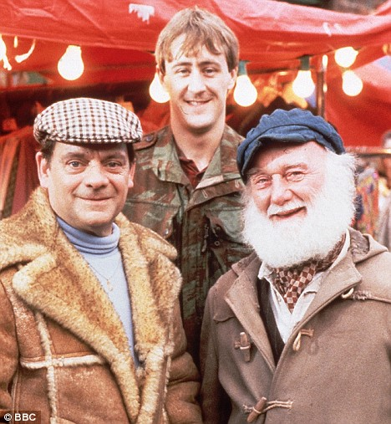
Barriers to SMEs
Lack of expertise
No formal systems
Dilute accident experience
Attitudes to risk
Fear of authority
Time poverty!

Slide 41

Simple SME MORR guidance from RoSPA
Problem
Law
Business case
PLAN
DO
CHECK
ACT

Slide 42

Plan
Review number of vehicles, mileages, incidents, causes costs
Consult workers
Develop short policy statement
Simple risk assessments

Slide 43

Do …
Reduce road travel
Assess drivers
Deliver training
Ensure journey planning
Control speeding
Ensure driver fitness
Right vehicle for job
Maintenance and servicing
Taxed and insured
Safe parking manoeuvring
Emergency plans
Prohibit mobile phone use
Managers to lead by example

Slide 44

Check
Licences/points
Road traffic offences
Accidents/incidents
Daily weekly vehicle checks
Insurance claims

Slide 45

Act
Review progress
Share lessons learned
Develop simple action plan
Celebrate/reward safe driving
Keep the topic live

Slide 46




RoSPA MORR advice. https://www.rospa.com/road-safety/advice
Investigation
Telematics
Young drivers
Fitness to drive
Driver assessment and training
Own vehicles
Safe journey planning
Safer speeds
Drink and drugs
Young drivers
Volunteers drivers
Safer motorcycling
MORR in SMES, the voluntary sector
How to evaluate managing occupational road risk

Slide 47

RoSPA Fleet support (https://www.rospa.com/safety-training/on-road)
Consultancy
Management
Evaluation
Training
Managers
Drivers
Trainers
Assessors
Motorcycling
Awards
Fleet Awards

Slide 48

MORR, where next?
Legislation?
Better guidance/tools/services (for small firms)?
Coverage in management training/auditing?
Stronger links to environment?
Business-to-business learning/benchmarking?
Research?
Exemplary enforcement?
ISO 39001?

Slide 49
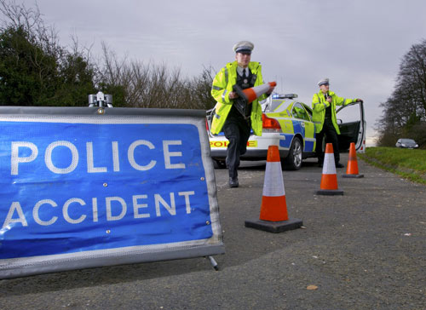
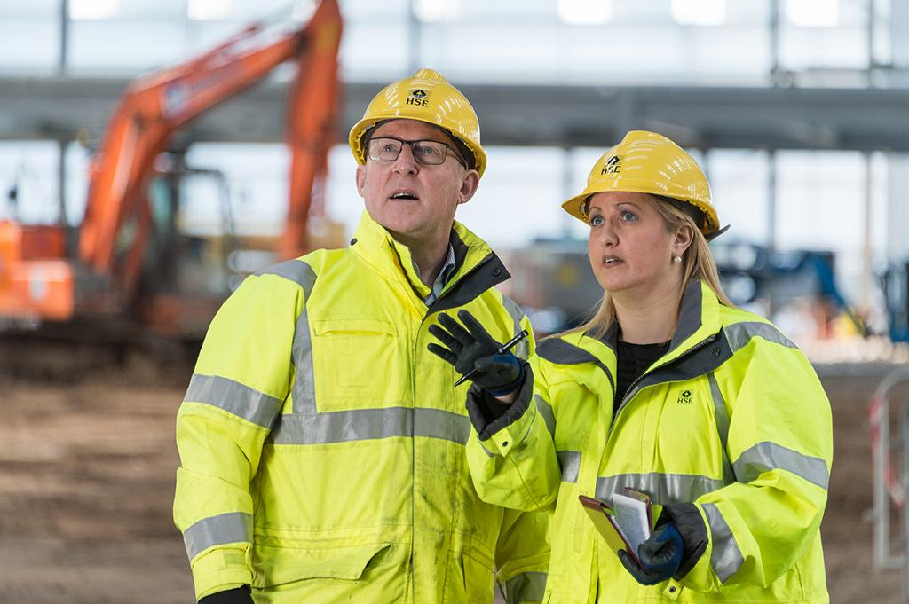
HSE and work related road safety (https://www.hse.gov.uk/roadsafety)
Police and DVSA enforce road traffic law.
vehicle condition
drivers fitness and competence
safe passenger/loads carrying
operator licences HGVs PSVs
Police lead investigations into RTIs on public roads.
HSE only investigates if police identify that serious management failures
Prosecution for Gross Negligence Manslaughter if death(s) caused by a grossly negligent act or omission or serious management failures

Slide 50

The Scottish Occupational Road Safety Alliance (www.scorsa.org.uk)
Employers, trade unions, local authorities, police forces, safety organisations and professional and trade associations, working to encourage businesses to manage at-work road risk more effectively.
  Support for SMEs
  exchange of information
  advice, information, guidance and resources
  networking and joint working
  technical co-operation

Slide 51
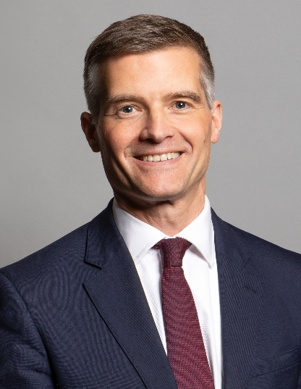
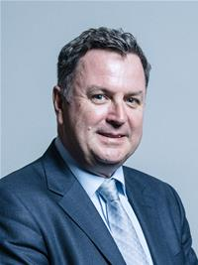
Government must …
Prioritise resources for WRRS
Raise awareness of MORR with employers
Publicise good practice/ facilitate benchmarking
Link WRRS and site transport safety agendas
Include work-related road injuries in RIDDOR
Ensure HSE/police liaison in crash investigations
Respond to worker/public complaints
Where necessary and appropriate, enforce /take high profile prosecutions
Focus on MORR in public procurement etc
Contribute to international initiatives
Lead the WRRS research agenda

Slide 52

Some useful websites
www.rospa.com
www.scorsa.org.uk
www.hse.gov.uk/roadsafety
https://www.arrm.org.uk/about
www.roadsafe.com
www.pacts.org.uk
www.brake.org.uk
https://roadsafetygb.org.uk
www.rospa.com/drivertraining
www.drivingforbetterbusiness.com
https://www.edriving.com

Slide 53
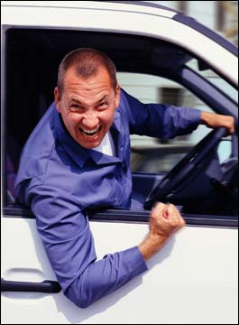
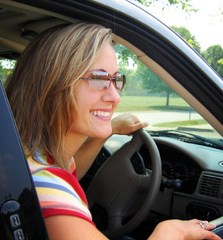
Avoid this, stay cool, relax…

Slide 54

Challenge everyone to ..

Slide 55
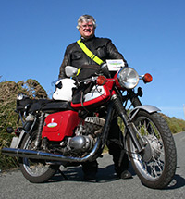
Thank you..
Roger Bibbings
Partnership Consultant
Royal Society for the Prevention of Accidents
RoSPA
28, Calthorpe Rd, Edgbaston, Birmingham B15 1RP
Email rogerbibbings@gmail.com
01684 540249

