Slide 1

An introduction to
PUWER & LOLER Regulations Update 2023
Wednesday 24th May 2023 at
Leominster Golf Club
Presented by Herefordshire Health & Safety Group

Slide 2

A little history

Slide 3

Health and safety at Work etc Act 1974. (The umbrella)
Manual
Handling Regs
The Management of health and safety at work Regs
Risk Assessment
PUWER
Provision and use of work equipment regs
LOLER
Lifting operations and lifting equipment regs
Work at Height Regs
First aid at Work regs

Slide 4
PUWER & LOLER
Provision and
Use of
Work
Equipment
Regulations 1998
Lifting
Operations &
Lifting
Equipment
Regulations 1998

Slide 5

Safe use of work equipment
Provision and Use of Work Equipment Regulations 1998
ACOP
Approved Code of Practice and guidance

Slide 6
The Approved Code of Practice and guidance is aimed at
employers, duty holders and anyone who has responsibility
for the safe use of work equipment, such as managers and
supervisors.
It sets out what is needed to comply with the Provision
and Use of Work Equipment Regulations 1998.
The Regulations, commonly known as PUWER, places duties
on people and companies who own, operate or have control over work equipment.
PUWER also places responsibilities on businesses and organisations whose employees use work equipment, whether owned by them or not.

Slide 7
What is work equipment?
Work equipment is any machinery, appliance, apparatus, tool or installation for use at work (whether exclusively or not). This includes equipment which employees provide for their own use at work. The scope of work equipment is therefore extremely wide.

Slide 8
The use of work equipment is also very widely interpreted and '...means any activity involving work equipment and includes starting, stopping, programming, setting, transporting, repairing, modifying, maintaining, servicing and cleaning'.

Slide 9

Health and safety legislation is put in place to ensure that employers are preventing injury and illness in the workplace, and that people can go to work without fear for their own health.

Slide 10
First and foremost it is the law
We also have a moral duty of care
And as good employers, we want to look after our employees and anyone who might be affected by what we do or don’t do! We want to prevent accidents, injuries and ill health.
At the end of the working day, everyone should go home safe

Slide 11

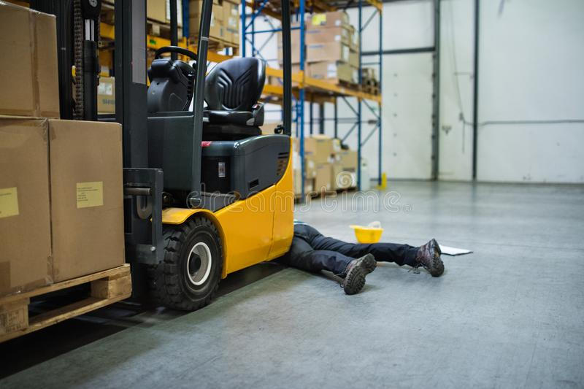
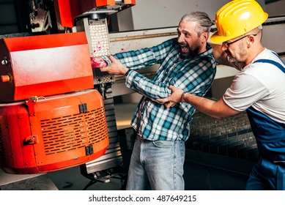

Slide 12
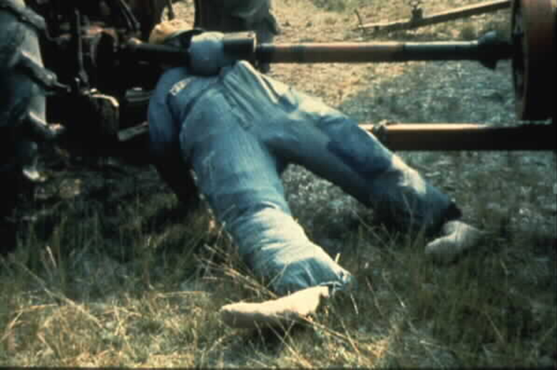
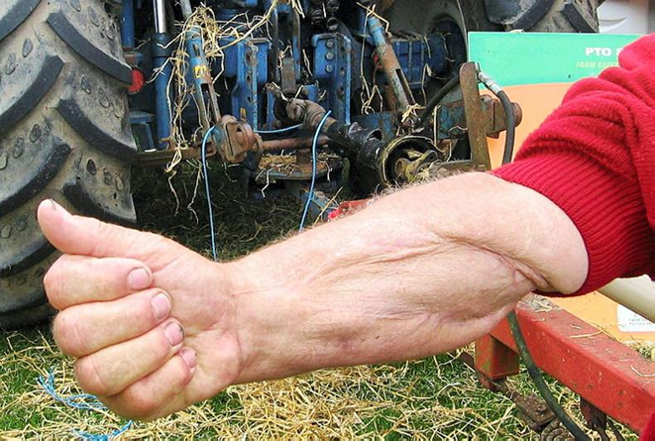

Slide 13
ACOP
The Approved Code of Practice and guidance is aimed at employers, duty holders and anyone who has responsibility for the safe use of work equipment, such as managers and supervisors.

Slide 14
ACOP
It sets out what is needed to comply with the Provision and Use of Work Equipment Regulations 1998.The Regulations, commonly known as PUWER, place duties on people and companies who own, operate or have control over work equipment.
PUWER also places responsibilities on businesses and organisations whose employees use work equipment, whether owned by them or not.

Slide 15
So, lets have a look at some of the PUWER regulations, and in particular the ACOPS.
The Approved Code of Practice (ACOP) text and associated guidance provide practical advice on how you can comply with the requirements of the Regulations.
If you follow the ACOPS, then you will be doing everything to comply with the regulations

Slide 16
What does PUWER apply to?
PUWER applies to the provision and use of all work equipment. It cannot be considered in isolation from other health and safety legislation. In particular, it needs to be considered with the requirements of the Health and Safety at Work etc Act 1974.
(‘the HASAWA). Revised 2003. Section 3 updated July 2015.

Slide 17
Health and safety at Work etc Act 1974.
Section 3
HSWA section 3 places general duties on employers and the self-employed to conduct their undertakings in such a way as to ensure, so far as is reasonably practicable, that persons other than themselves or their employees are not exposed to risks to their health or safety.

Slide 18
The ACOP material and guidance contained in the publication will highlight where this is the case.

Slide 19
There is also some overlap between PUWER
and other sets of regulations, for example:
The Lifting Operations and Lifting Equipment
Regulations (LOLER) apply over and above the general requirements of PUWER in dealing with specific hazards/risks associated with lifting equipment and lifting operations;

Slide 20
The Workplace (Health, Safety and Welfare) Regulations 1992 (‘the Workplace Regulations’)
Which cover workplace risks to pedestrians from vehicles;
The Health and Safety (Display Screen Equipment) Regulations 1992, for example, on lighting;

Slide 21
The Personal Protective Equipment at Work Regulations 1992 (‘the PPE Regulations’),regulation 5 for example, on maintenance;
Manual Handling Operations Regulations 1992
The noise at Work Regulations 1989

Slide 22
The Work at Height Regulations 2005 (‘the Work at Height Regulations’) (relating to inspection of work equipment for use when working at height);
The Management of Health and Safety at Work Regulations 1999 (‘the Management Regulations’) relating to risk assessments.

Slide 23
If you comply with the more specific regulations, it will normally be enough to comply with the more general requirements in PUWER.

Slide 24
PUWER
PUWER applies to all workplaces and work situations where the Health and safety at Work etc Act 1974, applies and extends beyond the mainland of Great Britain to specified offshore areas and activities.

Slide 25
ACOP text explains how to comply with the law in a specific way and has a special status in law.
If you do not follow the advice in ACOP text and you are prosecuted for a breach of the law, the court will take your breach of the law as proven, unless you can show that you have complied with the law in another equally effective way. If you follow the advice in an ACOP, you can be sure that you will be doing enough to comply with the law.
Guidance text is different – following it is not compulsory, unless specifically stated.

Slide 26
If you follow it, you will normally be doing enough to comply with the law, but you may use other methods.
The ACOP describes preferred or recommended
methods that can be used (or standards to be met) to comply with the Regulations and the duties imposed by the HSW Act. The accompanying guidance also provides advice on achieving compliance, or it may give
information of a general nature, including explanation of the requirements of the law, more specific technical information or references to further sources of
information.

Slide 27
Where PUWER applies
(a) to all sectors where the HSW Act applies, not only factories, offices and shops but also, for example schools, universities, hospitals, hotels, places of entertainment and offshore oil and gas installations;
(b) to work equipment used in the common parts of shared buildings (such as lifts), private roads and paths on industrial estates and business parks and temporary work sites, including construction sites;
(c) throughout Great Britain and has effect wherever work is done by the employed or the self-employed except for domestic work in a private household;
(d) to equipment used by homeworkers; and to hotels, nursing homes and similar establishments and to parts of workplaces where ‘domestic’ staff are employed, such as the kitchens of hostels or sheltered accommodation.

Slide 28
Who has duties under PUWER?
PUWER places duties on:
(a) employers;
(b) the self-employed;
(c) people who have control of work equipment.

Slide 29
Regulation 4 Suitability of work equipment
Summary of regulation 4
This regulation deals with the safety of work equipment from three aspects:
its initial integrity;
the place where it will be used;
the purpose for which it will be used.
There is no specific regulation requiring a risk assessment in PUWER. Instead the requirement to carry out a risk assessment is contained in the Management Regulations, which have general provisions relating to the safety of work equipment.

Slide 30
How risk assessment and the
Management Regulations link with PUWER
Risks to health and safety should be assessed taking into account the type of work equipment, substances and electrical
or mechanical hazards to which people may be exposed.
Action to eliminate/control any risk might include, for example, during maintenance:
(a) disconnecting the power supply to the work equipment;
(b) supporting parts of the work equipment which could fall;
(c) securing mobile work equipment so it cannot move;
(d) removing or isolating flammable or hazardous substances;
(e) depressurising pressurised equipment.

Slide 31
Regulation 5 Maintenance
Summary of regulation 5
This regulation builds on the general duty in the HSW Act which requires work equipment to be maintained so that it is safe.
It does not cover the maintenance process (that is covered by the general duties of the HSW Act) or the construction of work equipment, so that maintenance can be carried out without risk to health or safety (that is covered by regulations 10 and 22 of PUWER).

Slide 32
Regulation 10.
Regulation 10 states: (1) Every employer shall ensure that an item of work equipment conforms at all times with any essential requirements.
This regulation applies to items of work equipment provided for use in the premises or undertaking of the employer for the first time after 3 December 1992. Regulation 10 is about conforming to Community rules. The rules are covered by a number of existing regulations and are now being included within PUWER. So regulation 10 is about the rules that make equipment safe as it is designed, manufactured and provided for use. The regulation specifies the need to comply with the existing regulation, and thereby the Community requirements, for equipment of a certain age.

Slide 33
Regulation 22
Every employer shall take appropriate measures to ensure that work equipment is so constructed or adapted that, so far as is reasonably practicable, maintenance operations which involve a risk to health or safety can be carried out while the work equipment is shut down, or in other cases – (a) maintenance operations can be carried out without exposing the person carrying them out to a risk to his health or safety; or (b) appropriate measures can be taken for the protection of any person carrying out maintenance operations which involve a risk to his health or safety

Slide 34
Regulation 5 Maintenance
Every employer shall ensure that work equipment is maintained in an efficient state, in efficient working order and in good repair.
Every employer shall ensure that where any machinery has a maintenance log, the log is kept up to date.
You need to consider.
Noise, HAVs (Hand arm vibration) and Dust

Slide 35
Work equipment
PUWER. Daily, Weekly and Management checks.
Equipment doesn’t need to be mechanical, e.g. ladders, hand tools,
Daily checks on forklifts done by the operator.
Daily checks on machinery.

Slide 36
Regulation 6 Inspection
Summary of regulation 6
Regulation 6 covers the extent and nature of the inspection. It deals with:
the different situations where inspection of work equipment is required;
The purpose of the inspection in each case; e.g. Forklift
who should carry out the inspection; Operator
keeping records of inspections; Faults rectified
The work equipment that is not covered by regulation 6, and why. (Inspections)

Slide 37
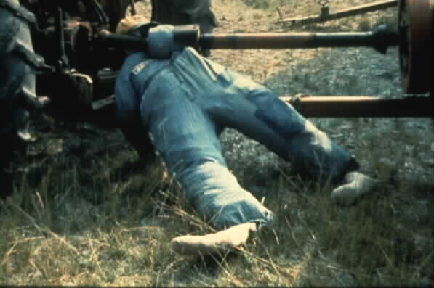
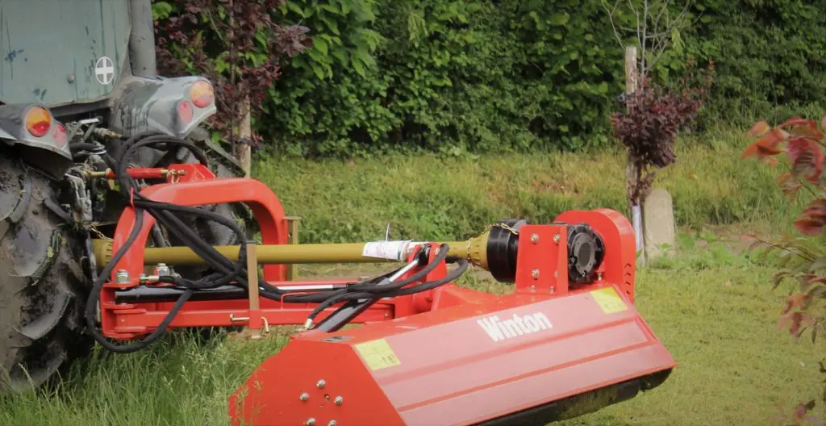
PUWER. Cont’d
PTO. (Power Take Off)
Inspections Regulation 6

Slide 38
Example
Irish farmer Peter Gohery sustained life-changing injuries in a farm accident involving an unguarded tractor PTO shaft – and now he wants British farmers to learn from his mistakes.
When Jean Gohery, an experienced nurse, was summoned outside by her distressed 10 year-old son, she found her husband Peter Gohery motionless on the floor of their farmyard in County Galway.
Lying close to his tractor, she could see that one leg was completely severed and his other foot very nearly severed. Jean assumed Peter was dead or close to it.
Fortunately for this Irish farming family, Peter survived, although his injuries that fateful day in 2009 were life-changing.
Every year, farmers lose lives and limbs in accidents that could have been preventable. A high proportion involve machinery and tractors and of these, many are connected with a PTO (Power Take-Off) or PTO drive shaft.
If this part of the tractor is always covered with an appropriately designed and maintained guard, the risk of injury or death can be greatly reduced.
https://www.youtube.com/watch?v=f7BVNqFi_So

Slide 39
Example
A self-employed agricultural contractor lost his arm on an unguarded PTO shaft attached to a tractor and a semi-mounted water tanker.
The contractor had been instructed to carry out several tasks including the emptying of an underground tank full of rain water prior to minor civil engineering work. However, during the process, another worker was not convinced that water was being extracted from the underground tank so he went to the rear of the tractor to check the discharge lever to the tanker was in the correct position. As he placed his hand over the exhaust outlet to feel for emissions, his clothing and high visibility tabard were caught on an exposed section of the rotating PTO shaft and torque limiter and his arm was ripped off.
Lack of maintenance and deficient guarding of the PTO shaft were major contributory factors. Replacing the damaged PTO guard with a new one would have prevented the accident. (Regulation 5 & 6 not carried out)(Regulation 5-Maintenance,
6-Inspection) Regulation 8 Information and Instruction & Regulation 9. Training

Slide 40
Action
The active partner in the farming business was prosecuted under regulation 11(1) of the Provision and Use of Work Equipment Regulations 1998 (PUWER). The farmer pleaded guilty and was fined £4,000 plus £2,500 towards the cost of bringing the prosecution.
Regulation 11(1) requires employers to take effective measures to prevent
access to dangerous parts of machinery or stop their movement before any
part of a person enters a danger zone. Regulation 11(2) specifies the measures which you should take to prevent access to the dangerous parts of the
machinery to achieve compliance with regulation 11(1). Regulation 11(3)
sets out various requirements for guards and protection devices. Regulation
11(4) sets out requirements for protection appliances.

Slide 41
Example
A 13 year old boy became entangled on an unguarded PTO shaft. He was one of two young people milling grain and shovelling it into bags. The farmer's son was looking
for some string to tie the bags and as he approached the machine he somehow became entangled and wrapped around the PTO shaft. The other boy realised what had happened and leant into the tractor to disengage the PTO. The child's left hand was amputated and he subsequently lost his left lower leg (below the knee). He also received trunk and head injuries.
Action
The farmer was prosecuted under Section 3(2) of the Health & Safety at Work Act 1974 for failing to ensure the health and safety of the two boys. He pleaded guilty.
The Magistrates awarded a conditional discharged but no costs; the Chair of the Bench emphasised that the penalty did not reflect the severity of crime but rather took account of the family's very restricted means.

Slide 42
Health and Safety at Work etc Act (1974)
Section 3
General duties of employers and self-employed
to persons other than their employees.
(1)It shall be the duty of every employer to conduct his undertaking in such a
way as to ensure, so far as is reasonably practicable, that persons not in his employment who may be affected thereby are not thereby exposed to risks to their health or safety.
(2)It shall be the duty of every self-employed person who conducts an undertaking
of a prescribed description] to conduct the undertaking]in such a way as to ensure,
so far as is reasonably practicable, that he and other persons (not being his
employees) who may be affected thereby are not thereby exposed to risks to their health or safety.

Slide 43
(2A)A description of undertaking included in regulations under subsection (2) may be framed by reference to—
(a)the type of activities carried out by the undertaking, where those activities are carried out or any other feature of the undertaking;
(b)whether persons who may be affected by the conduct of the undertaking, other than the self-employed person (or his employees), may thereby be exposed to risks to their health or safety.]
(3)In such cases as may be prescribed, it shall be the duty of every employer and every self-employed person, in the prescribed circumstances and in the prescribed manner, to give to persons (not being his employees) who may be affected by the way in which he conducts his undertaking the prescribed information about such aspects of the way in which he conducts his undertaking as might affect their health or safety.

Slide 44
Advice
Unguarded or inadequately guarded PTO shafts are a source of numerous serious accidents to children (and adults) on farms. All PTO shafts must be fully guarded to prevent any contact with the rotating parts. Young persons helping on the farm must be given adequate instruction and training and be properly supervised at all times.
Under the Provision and Use of Work Equipment Regulations 1998 (PUWER) equipment for use should be adequately guarded BEFORE being used. A simple system for checking over equipment before use would have identified the missing guard allowing the problem to be rectified.

Slide 45
Dangerous parts of machinery
11.—(1) Every employer shall ensure that measures are taken in accordance
with paragraph
(2) which are effective—
(a)to prevent access to any dangerous part of machinery or to any rotating stock-bar;
or
(b)to stop the movement of any dangerous part of machinery or rotating stock-bar before any part of a person enters a danger zone.
(2) The measures required by paragraph (1) shall consist of—
(a)the provision of fixed guards enclosing every dangerous part or rotating stock-bar where and to the extent that it is practicable to do so, but where or to the extent that it
is not, then
(b)the provision of other guards or protection devices where and to the extent that it is practicable to do so, but where or to the extent that it is not, then

Slide 46
Dangerous parts of machinery. Cont’d
2 (c)the provision of jigs, holders, push-sticks or similar protection appliances used in conjunction with the machinery where and to the extent that it is practicable to do so, but where or to the extent that it is not, then
(d)the provision of information, instruction, training and supervision.
(3) All guards and protection devices provided under sub-paragraphs (a) or (b) of paragraph (2) shall—
(a)be suitable for the purpose for which they are provided;
(b)be of good construction, sound material and adequate strength;
(c)be maintained in an efficient state, in efficient working order and in good repair;
(d)not give rise to any increased risk to health or safety;

Slide 47
Dangerous parts of machinery. Cont’d
3 (e)not be easily bypassed or disabled;
(f)be situated at sufficient distance from the danger zone;
(g)not unduly restrict the view of the operating cycle of the machinery, where such a view is necessary;
(h)be so constructed or adapted that they allow operations necessary to fit or replace parts and for maintenance work, restricting access so that it is allowed only to the area where the work is to be carried out and, if possible, without having to dismantle the guard or protection device.

Slide 48
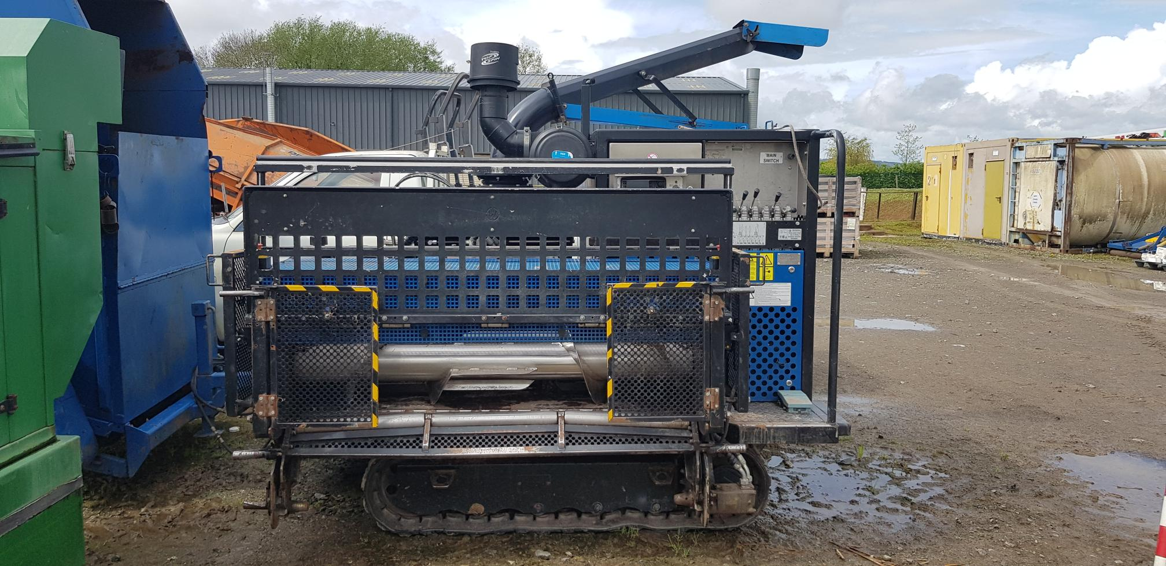
Pic 1. Bio Chopper
One operator stands on platform controlling the machine.
These side guards open up to prevent operators getting access to auger

Slide 49
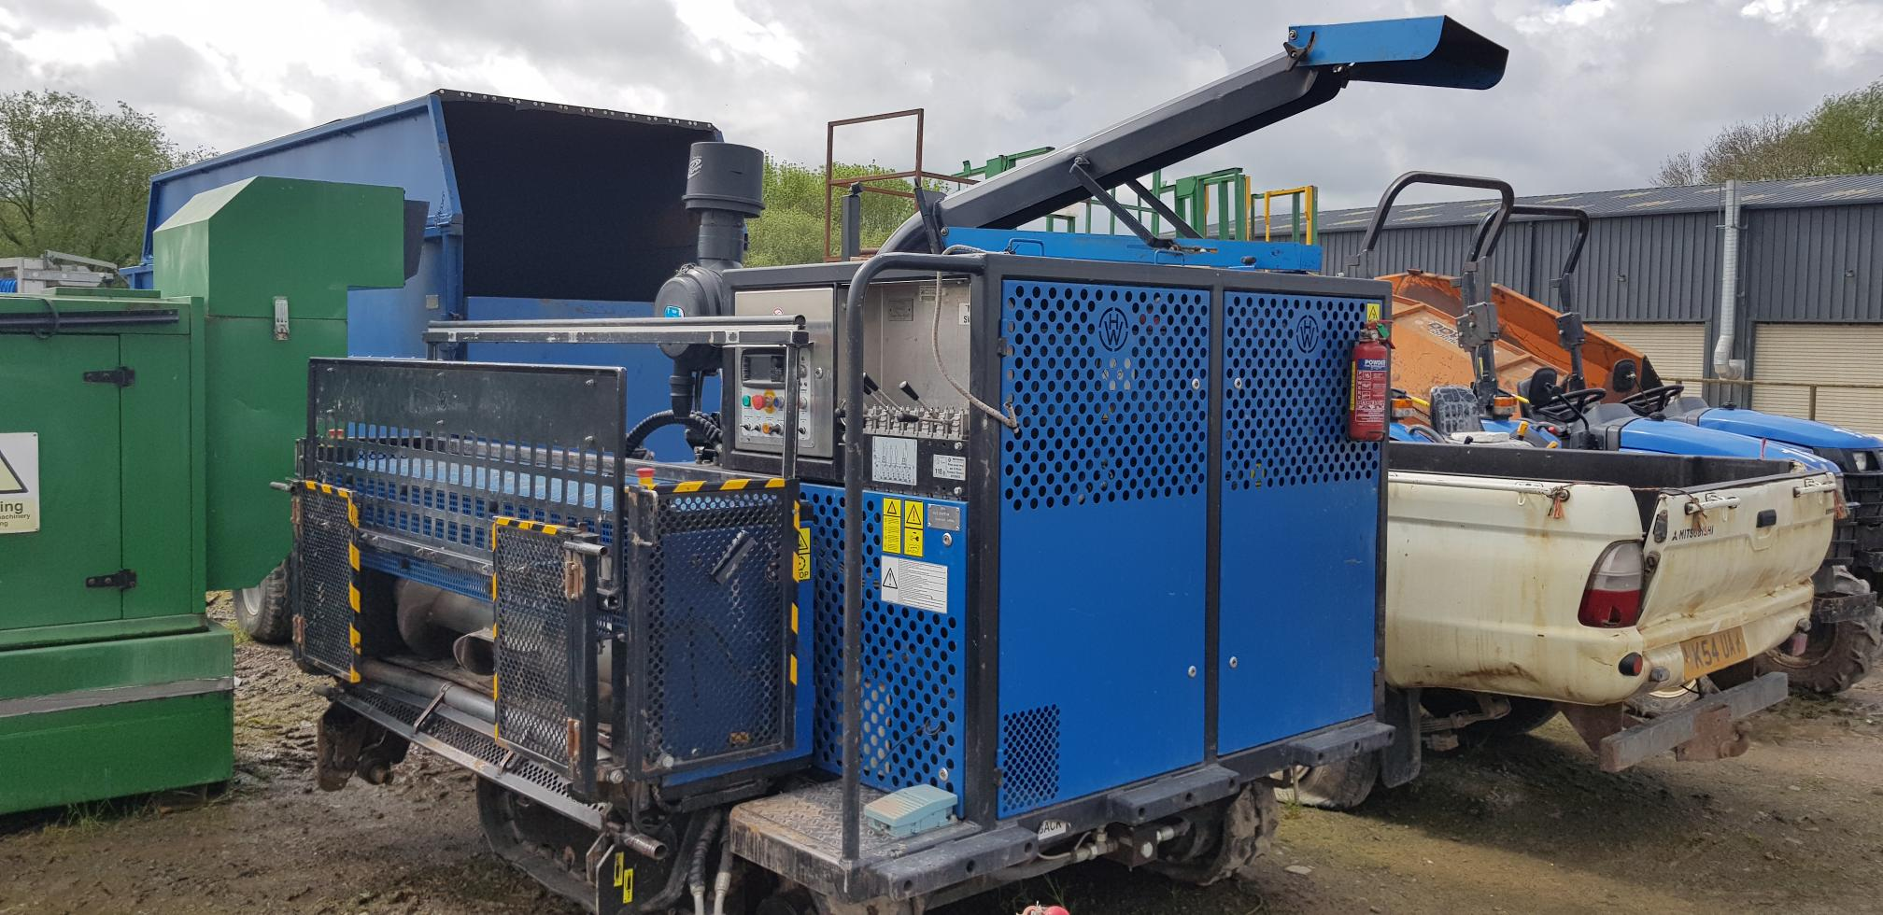
Pic 2. Bio chopper
Top bar drops down to prevent operators getting close to auger
These side guards open up to prevent operators getting access to auger

Slide 50

Pic 3. Bio chopper
Safety push bars
The operator of the machine stands on the platform with the controls, which has a blue foot pedal on it.
Two other operators stand at least 2 meters in front of the auger, feeding in the Mypex matting into the auger – the matting is wound into the Bio chopper machine using a rotating shaft. The safety push bar (rubber semicircle on the top of it) which comes down simultaneously with the one. They both lock into position while the machine is in operation.
aft.

Slide 51
123 workers killed in work-related accidents in 2021/22 (RIDDOR)

Slide 52
A 67-year-old self-employed farmer was killed when he was trapped between a tractor and topper while leaning out of the back window of the tractor. He died from crush injuries.
A 23-year-old farm worker was killed while assisting a farmer to fit a tractor tyre. They were in the process of inflating the tyre when it exploded causing serious head injuries to the worker. A 63-year-old self-employed farmer was killed while repairing a tractor. The tractor moved and rolled over his leg causing significant lacerations and blood loss.

Slide 53
A 54-year-old farm worker was killed when a seed drill that he was repairing collapsed on top of him. The seed drill was being supported by bottle jacks and an axle stand. It slipped from the supports killing him.
A 45-year-old worker was killed while using a log splitting machine. He was trapped by the mechanical arm that moved the logs along the machine. He sustained crush injuries to his chest and torso.
A 19-year-old worker was killed when he was struck by an HGV being driven across the yard.

Slide 54
HSE Deaths in Agriculture. April 2021 to March 2022.
A 21-year-old farm worker was killed when she attempted to climb onto a moving tractor. She missed her footing, fell and was drawn into the barley drill being towed by the tractor.
A 21-year-old farm worker was killed when she was trapped under an ATV quad bike. She went out to a field on the quad bike to locate a missing cow, but did not return. She was later found under the overturned quad bike

Slide 55
HSE Deaths in Agriculture. April 2021 to March 2022.
Number of deaths: Twenty-five (25) people were killed in agriculture: ● 16 fewer than last year and 7 fewer than the five-year average (32) ● The second lowest number of deaths recorded in the last 5 years
Age: ● The oldest farmer killed was aged 85 ● The youngest person killed was a 9-year-old child Main cause: While the number of deaths by each cause varies each year, the five most common remain as: ● Struck by moving vehicles ● Struck by an object ● Contact with machinery ● Fall from height ● Killed by animals

Slide 56
HSE Deaths in Agriculture. April 2021 to March 2022.
8 people Killed when struck by a moving vehicle Incidents involved tractors, all-terrain vehicles (ATVs), a 4x4 vehicle, an HGV vehicle and a telescopic handle
5 people Killed by contact with machinery Incidents involved a horse walker, a log splitting machine, a trailer tailgate, and a tractor/topper
4 people killed in contact with machinery

Slide 57
HSE Deaths in Agriculture. April 2021 to March 2022.
2 people killed. Fall from height
2 people killed. Injured by an animal
4 people killed. All other cause
Total of 25 people killed just going to work.
Main cause: While the number of deaths by each cause varies each year, the five most common remain as: ● Struck by moving vehicles ● Struck by an object ● Contact with machinery ● Fall from height ● Killed by animals

Slide 58
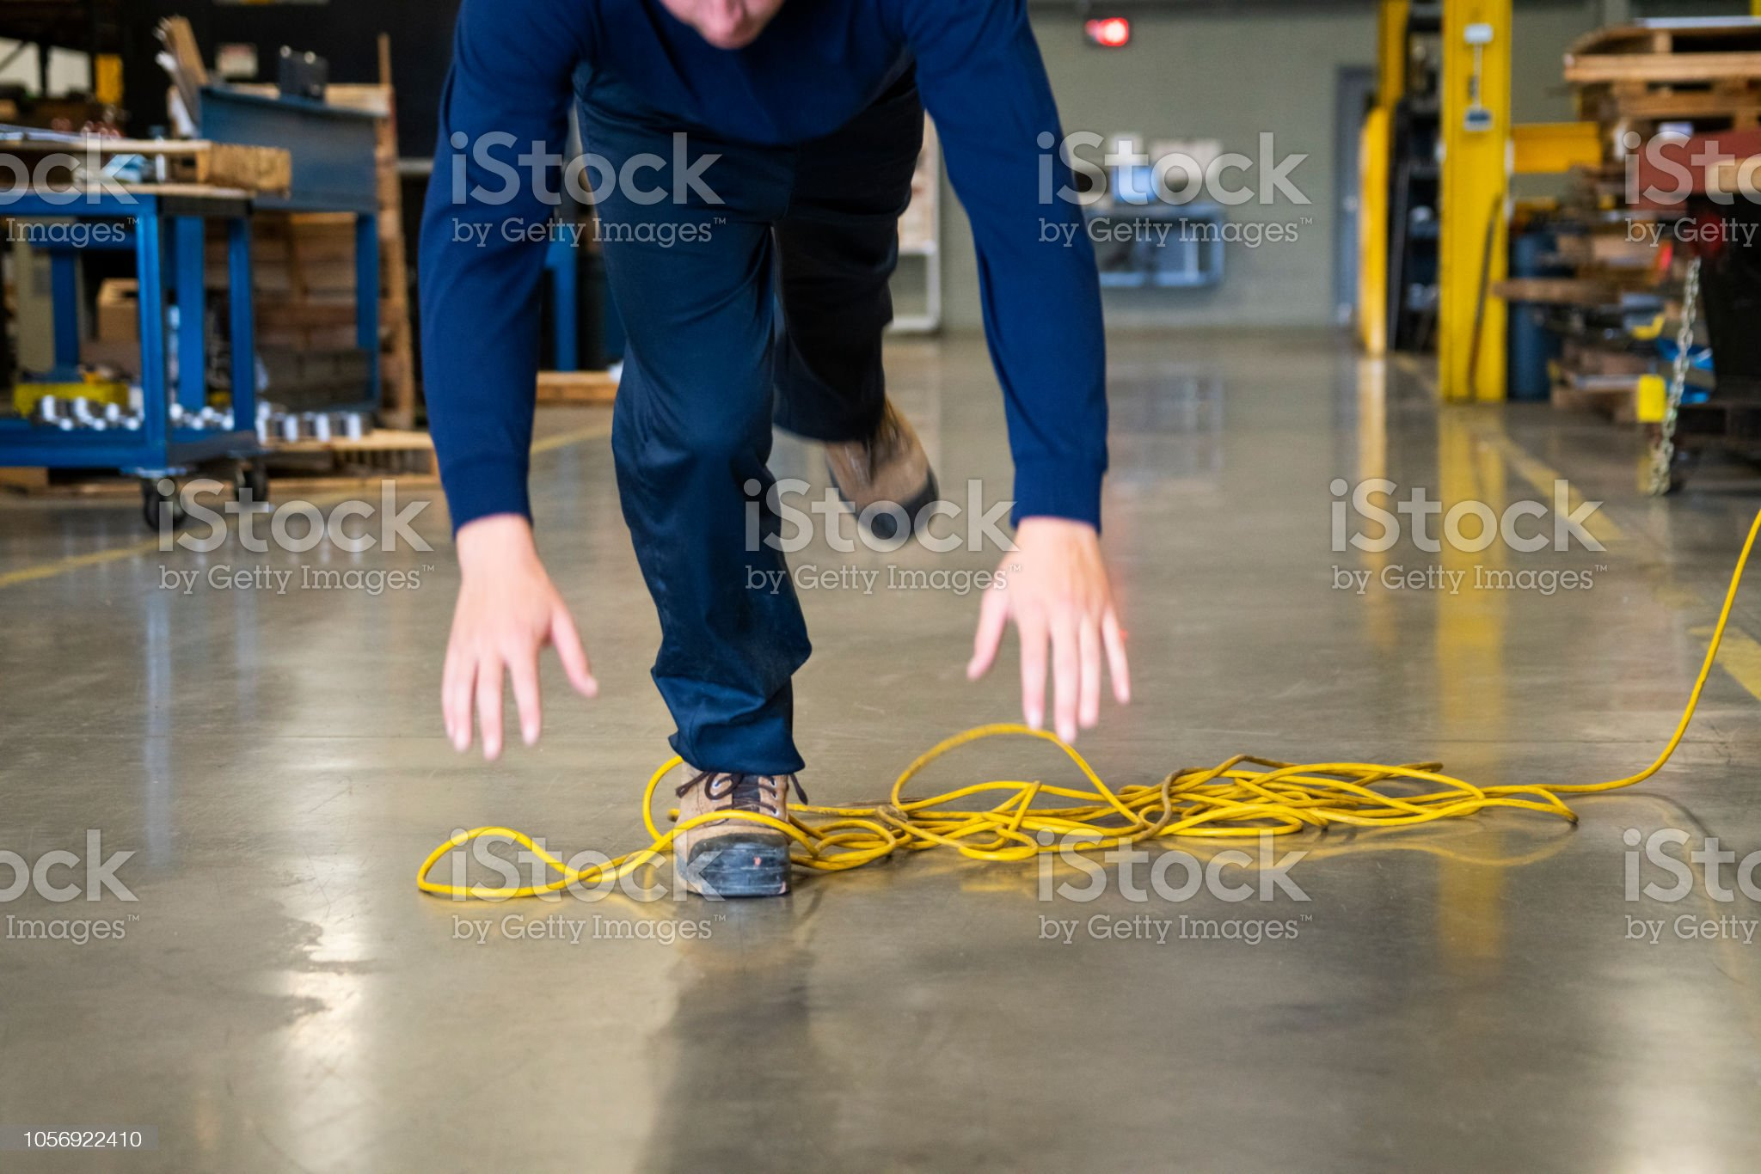
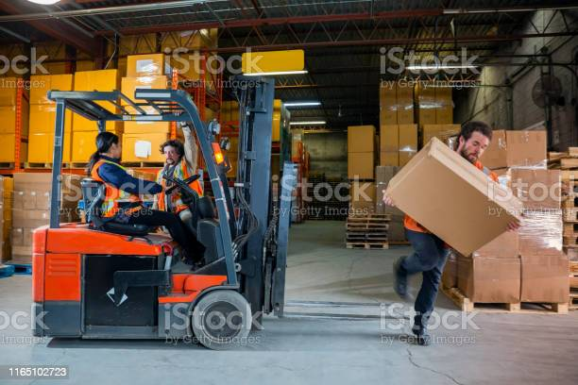
Remember, we do not go to
work to work to suffer ill health, Injuries or even death

Slide 59
https://youtu.be/EDT9G3W14wk
Advice
Unguarded or inadequately guarded machines continue to be a source of numerous serious accidents to adults (and children) on farms. All machines must be effectively guarded to prevent any contact with the dangerous parts.
Under PUWER, employers have to ensure that equipment for use at work is effectively guarded BEFORE being used. A simple system for checking over equipment before use would have identified any missing or damaged guards.

Slide 60
Information from the HSE
INDG241. Working safely with agricultural machinery
INDG229. Using work equipment safely
HSG270. Farmwise. Your essential guide to health and safety in agriculture
INDG185. Using tractors safely

Slide 61
Regulation 7 Specific risks
Summary of regulation 7
This regulation deals with restricting the use of some equipment to people who are trained in the use of that equipment and in the specific risks involved.
Having identified equipment that involves specific risk the employer also has to decide who can repair, modify, maintain or service it; and provide the appropriate training for those people.

Slide 62
Any Questions?
Revision 4. 16/05/23

Slide 63
Safe use of lifting equipment
Lifting Operations and Lifting Equipment Regulations 1998.
ACOP
Approved Code of Practice and guidance.

Slide 64
What does LOLER apply to?
LOLER applies to the use of lifting equipment provided as work equipment.
These Regulations implement the lifting provisions of the Amending Directive to the
Use of Work Equipment Directive (AUWED, 95/63/EC) and build on the
requirements of the Provision and Use of Work Equipment Regulations 1998
(PUWER) for which HSE has made available separate guidance

Slide 65
The Approved Code of Practice and guidance is for those that work with any lifting equipment provided at work or for the use of people at work, those who employ such people, those that represent them and those who act as a competent person in the examination of lifting equipment.

Slide 66
It sets out what you should do to comply with the Lifting Operations and Lifting Equipment Regulations.
Lifting Equipment Regulations 1998 (LOLER).
LOLER applies to lifting equipment and builds on the requirements of the Provision and Use of Work Equipment Regulations (PUWER).

Slide 67
Where does LOLER apply?
Subject to the provisions of regulation 3, LOLER applies to all workplaces and work situations where the Health and Safety at Work etc Act 1974 (HSW Act)
applies and extends beyond the mainland of Great Britain to specified offshore areas and activities.

Slide 68
Regulations 1–3 Setting the scene:
Citation and commencement; Interpretation; Application

Slide 69
Regulation 5 Lifting equipment for lifting persons
Regulation 5(1)
Summary
Regulation 5(1) details the additional safeguards that must be considered
When using lifting equipment to lift people.
(1) Every employer shall ensure that lifting equipment for lifting persons —
(a) subject to sub-paragraph (b), is such as to prevent a person using it
being crushed, trapped or struck or falling from the carrier;
(b) is such as to prevent so far as is reasonably practicable a person using
it, while carrying out activities from the carrier, being crushed trapped or
struck or falling from the carrier;
(c) subject to paragraph (2), has suitable devices to prevent the risk of a
carrier falling;
(d) is such that a person trapped in any carrier is not thereby exposed to
danger and can be freed.

Slide 70
Regulation 7 Marking of lifting equipment
Summary
Regulation 7 details the requirements for clearly labelling or, otherwise
Making available, details of the safe working load of each piece of
lifting equipment or accessory.
Every employer shall ensure that —
(a) subject to sub-paragraph (b), machinery and accessories for lifting loads
are clearly marked to indicate their safe working loads;
(b) where the safe working load of machinery for lifting loads depends on its
configuration —
(i) the machinery is clearly marked to indicate its safe working load for
each configuration; or

Slide 71
Regulation 7, Cont’d
(ii) information which clearly indicates its safe working load for each
configuration is kept with the machinery;
(c) accessories for lifting are also marked in such a way that it is possible to
identify the characteristics necessary for their safe use;
(d) lifting equipment which is designed for lifting persons is appropriately and
clearly marked to this effect; and
(e) lifting equipment which is not designed for lifting persons but which
might be so used in error is appropriately and clearly marked to the effect
that it is not designed for lifting persons.
184 Regulation 7 of LOLER builds upon the requirements of regulation 23 of PUWER
which states: ‘Every employer shall ensure that work equipment is marked in a clearly
visible manner with any markings appropriate for reasons of health and safety.’

Slide 72
Regulation 8 Organisation of lifting operations
Summary
Regulation 8(1) clarifies that each lifting operation needs to be planned,
supervised and carried out safely.
Regulation 8(2) defines a lifting operation.
(1) Every employer shall ensure that every lifting operation involving lifting
equipment is —
(a) properly planned by a competent person;
(b) appropriately supervised; and
(c) carried out in a safe manner.
(2) In this regulation “lifting operation” means an operation concerned with
the lifting or lowering of a load.
Regulation 8(1)(a)
209 The person planning the operation should have adequate practical and
theoretical knowledge and experience of planning lifting operations

Slide 73
Regulation 9 Thorough examination and inspection
Summary
Regulation 9 puts in place requirements for all lifting equipment to be subject to
‘thorough examination’ at various points.
Regulation 9(3) requires periodic thorough examination where equipment is
subject to deterioration due to use and where this deterioration could lead to a
dangerous situation.

Slide 74
The frequency depends on the type of equipment and the
purposes for which it is used, e.g. equipment used for lifting people requires more frequent examination. (6 Monthly) The periods stated are the maximum periods. (12 monthly for thorough examination)
Unless there is an examination scheme produced by
a competent person in place, which can specify longer or shorter periods
depending on the risk of defects arising.

Slide 75
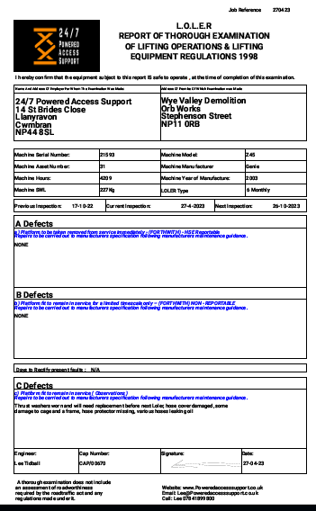
LOLER certificate of Through Examination

Slide 76
Regulation 9(4) requires that no lifting equipment leaves a business and/or is used, including when received from a third party, unless there is physical evidence that the required thorough examination has been completed.

Slide 77
When working with fork lifts, for example.
Under PUWER. Regulation 6 & LOLER, Regulation 8.
The operator, following training, needs to carry out the regular inspection

Slide 78
Types of LOLER equipment
What is lifting equipment?
'Lifting equipment' means work equipment for lifting and lowering loads. This includes lifting accessories and attachments used for anchoring, fixing or supporting the equipment

Slide 79
Types of LOLER equipment
Examples of lifting equipment include:
overhead cranes and their supporting runways
patient hoists
motor vehicle lifts
vehicle tail lifts and cranes fitted to vehicles
a building cleaning cradle and its suspension equipment
goods and passenger lifts
telehandlers and fork lifts
lifting accessories

Slide 80
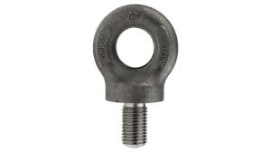
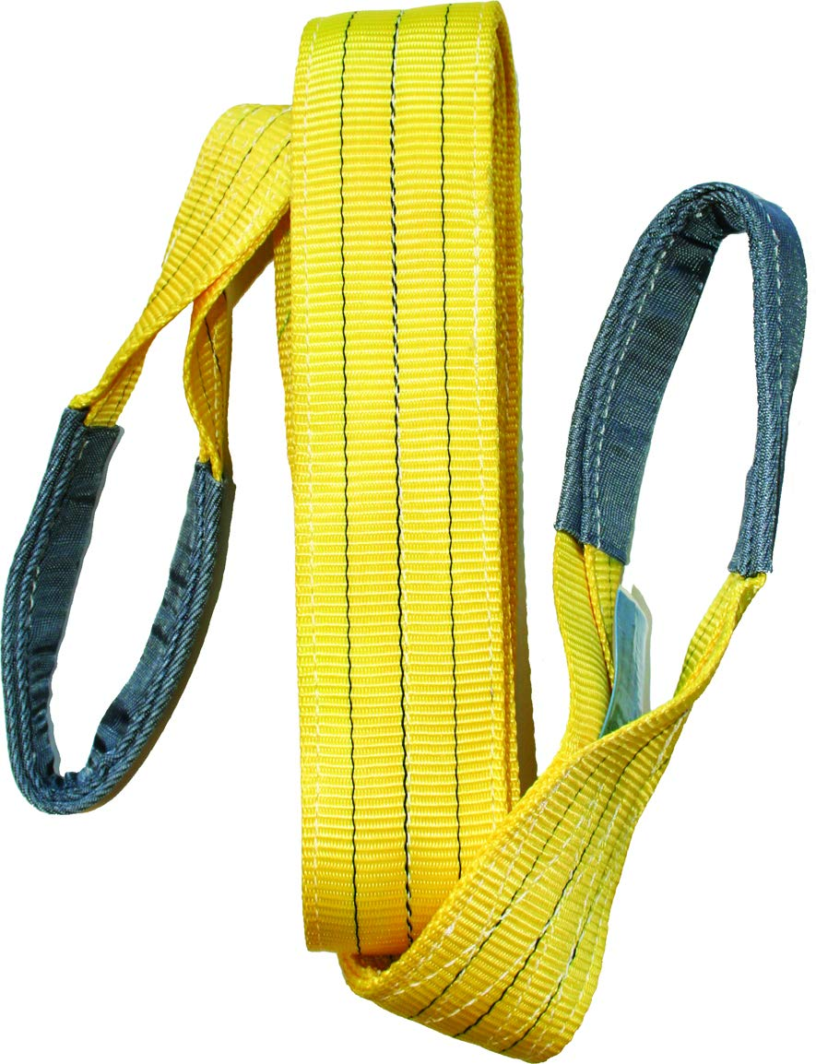
Types of LOLER equipment
Examples of lifting accessories include:
fibre or rope slings
chains (single or multiple leg)
hooks
eyebolts
spreader beams
magnetic and vacuum devices

Slide 81
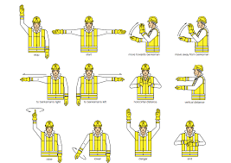
Dos and don'ts of lifting machinery safely
use only certified lifting equipment, marked with its safe working load, which is not overdue for examination
keep the reports of thorough examination as well as any declarations of conformity or test certificates
make sure the load is properly attached to the lifting equipment.
before lifting an unbalanced load, find out its centre of gravity.
have a responsible slinger or banksman and use a recognised signalling system

Slide 82
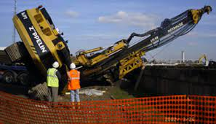
Dos and don'ts of lifting machinery safely

Slide 83
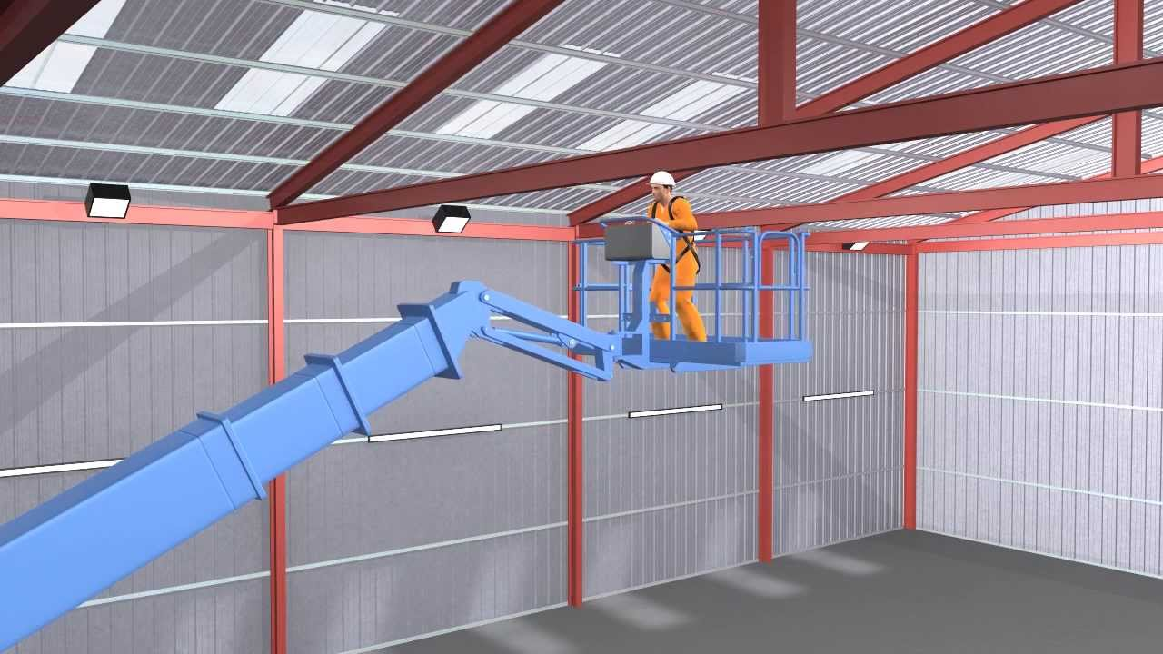
Dos and don'ts of lifting machinery safely

Slide 84
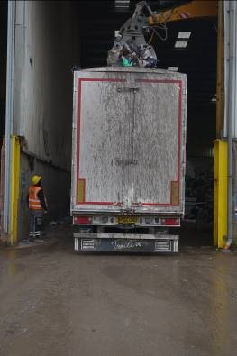
Dos and don'ts of lifting machinery safely

Slide 85
PUWER and LOLER are linked and should be read together.

Slide 86
Don’t forget employees who do not speak English as their first language.

Slide 87
Today, most company’s have a workforce from several different countries, and therefore, all staff, regardless of country of origin or training, have the same legal protection within the workplace.

Slide 88
Remember
HASAW etc Act 1974. Section 3. A duty of care
PUWER Regulation 8. Information and instruction
PUWER Regulation 9. Training

Slide 89
Check out the HSE website.
https://www.hse.gov.uk
Polish
Towe zdrowie, Twoje bezpieczeństwo
Krótki przewodnik dla pracowników (PDF)
Informacje dla osób z zagranicy pracujących w Wielkiej Brytanii
Ochrona zdrowia i bezpieczeństwa w pracy (PDF)
Przepisy dotyczące bezpieczeństwa i higieny pracy
Co należy wiedzieć (PDF)
English
Your health, your safety: A brief guide for workers
Working in the UK from overseas? Your health and safety at work in agriculture and food processing
Health and safety law
What you need to know

Slide 90
Think safe.
Work safe.
Be safe.

Slide 91
Healthandsafety@fdl.co.uk
www.herefordhsg.co.uk
info@herefordhsg.co.uk
https://www.hse.gov.uk
https://www.hse.gov.uk/languages/index.htm
https://www.hse.gov.uk/statistics/fatals.htm

Slide 92
Information from the HSE
INDG241. Working safely with agricultural machinery
INDG229. Using work equipment safely
INDG 291 (rev 1) Providing and using work equipment safely
HSG270. Farmwise. Your essential guide to health and safety in agriculture
INDG185. Using tractors safely
INDG290. Lifting equipment at work
L22. PUWER ACOP
L113. LOLER ACOP

Slide 93
Any Questions?
Revision 4. 16/05/23

