Slide 1
Become a better falls fighter!
Roger Bibbings MBE CFIOSH
Partnership Consultant , RoSPA

Slide 2

Whole person/whole life approach to prevention
Accidents and cases of occupational ill-health don’t need to happen
Freedom from harm is an important goal for Society
Safe and healthy work underpins business success
We all have a responsibility to adopt a balanced approach to health, safety and risk

Slide 3
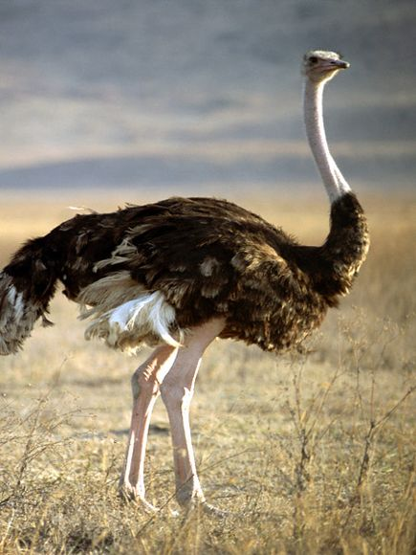
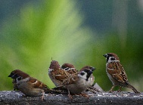
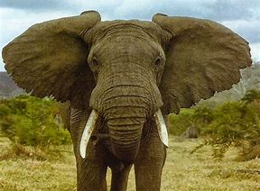


Slide 4
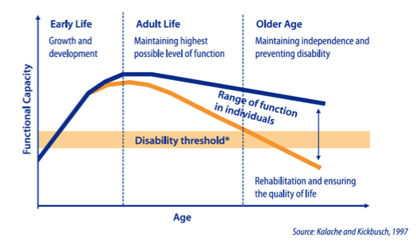
The role of the workplace in maintaining functional capacity?

Slide 5

Why 24/7 safety?
Home/leisure accidents and absence?
Impact on well-being?
Transferability of OS&H knowledge/skills?
Coverage in OS&H training?
Family focus?
Sharing experiences?
Attitudes and safety culture?

Slide 6
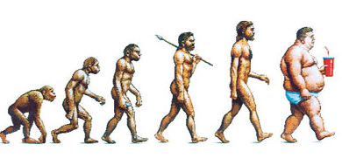
The curse of bipedalism?

Slide 7
Little wonder then?
Non-fatal injuries reported under RIDDOR 2021/22
(includes those accident kinds that account for 5% or more of the total)
Percentage of 565,000 injuries
30% Slips, trips or falls on same level
18% Handling, lifting or carrying
11% Struck by moving object
9% Acts of violence
8% Falls from a height

Slide 8
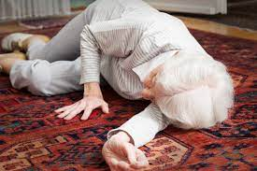
Falls of older people
Around 1 in 3 adults over 65 and half of people over 80 will have at least one fall a year
90,000 + hospital admissions p.a. related due to slipping, tripping and stumbling
Costs the NHS £435 million each year
Human cost includes distress, pain, injury, loss of confidence, loss of independence and mortality.

Slide 9
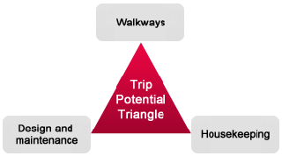
Workplace causation?
Slip potential model | Trip potential triangle
• Contamination • Cleaning • People • Flooring • Environment • Footwear

Slide 10
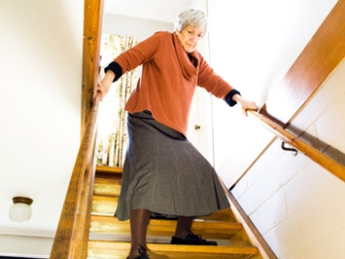
Falls of older people
Older people are more likely to have a fall because they may have:
balance problems
muscle weakness
vision loss
a long-term health condition leading to dizziness/loss of consciousness
combined with:
wet/polished floors
poor lighting
rugs/carpets not properly secured
over-reaching
going down stairs
rushing to get to door/phone/ toilet
falling from a steps/ladders

Slide 11
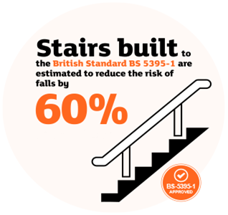
RoSPA stairs campaign
Falls on the stairs claim over 700 lives p.a.
Over 43,000 people hospitalised p.a. due to falls on stairs in the home.
BS 5395-1 covers dimensions of stairs, slip resistance and handrails
Would save the NHS up to £5 million p.a. through accident reduction.

Slide 12

RoSPA’s partnership with RSA
A long-term strategic partnership
Follows research into key areas
The initial priority – preventing falls in the home
https://www.rospa.com/media/documents/miscellaneous/Enabling-Safety-RSA-Report.pdf
“Most participants felt there was insufficient support and advice on accident prevention for older people and their carers”
“Two-thirds of people feel uncomfortable raising safety issues with their older relatives”

Slide 13
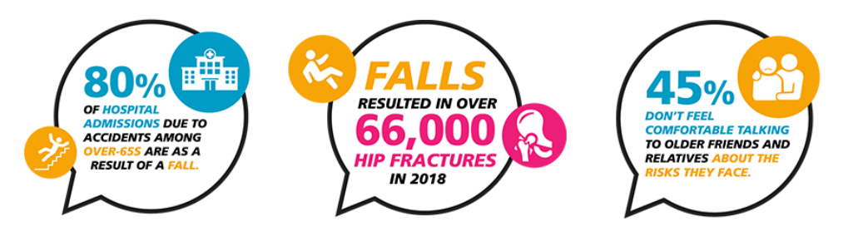
Project aims
Raise awareness of falls prevention, among older people and their families
Increase the uptake of strength and balance exercises among older people
Improve the safety and wellbeing of older people in the midst of the coronavirus pandemic.

Slide 14
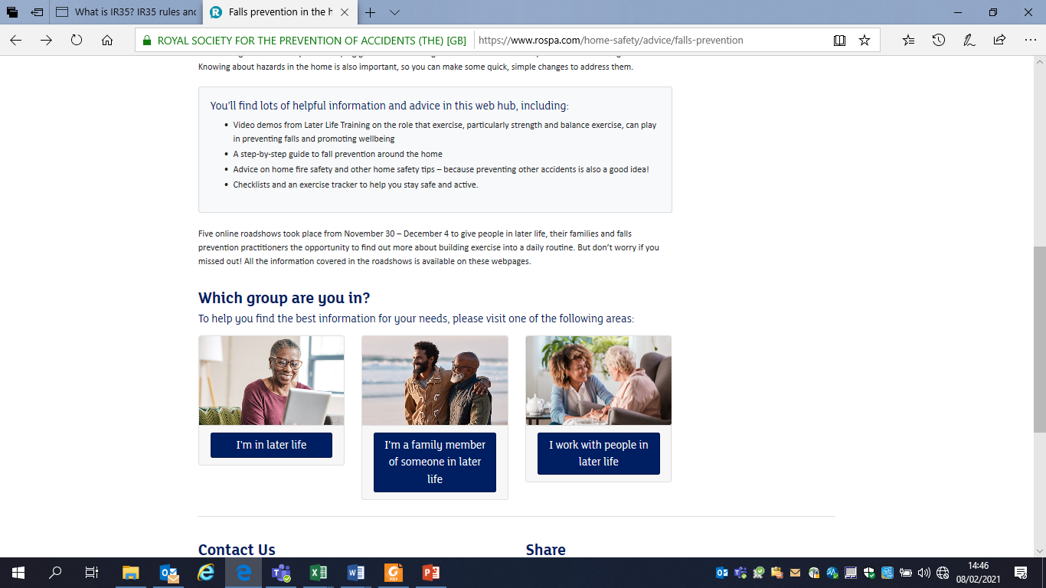
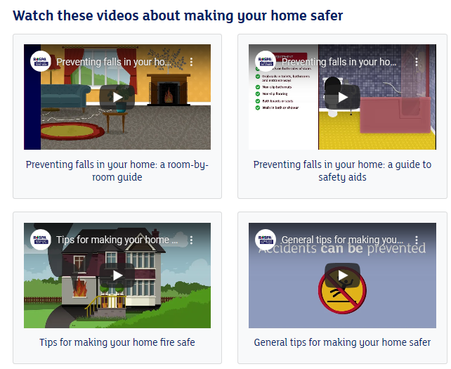
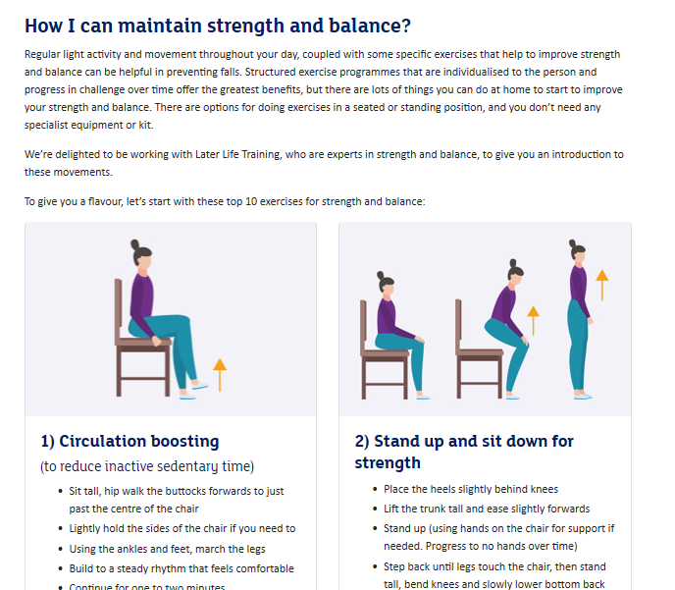
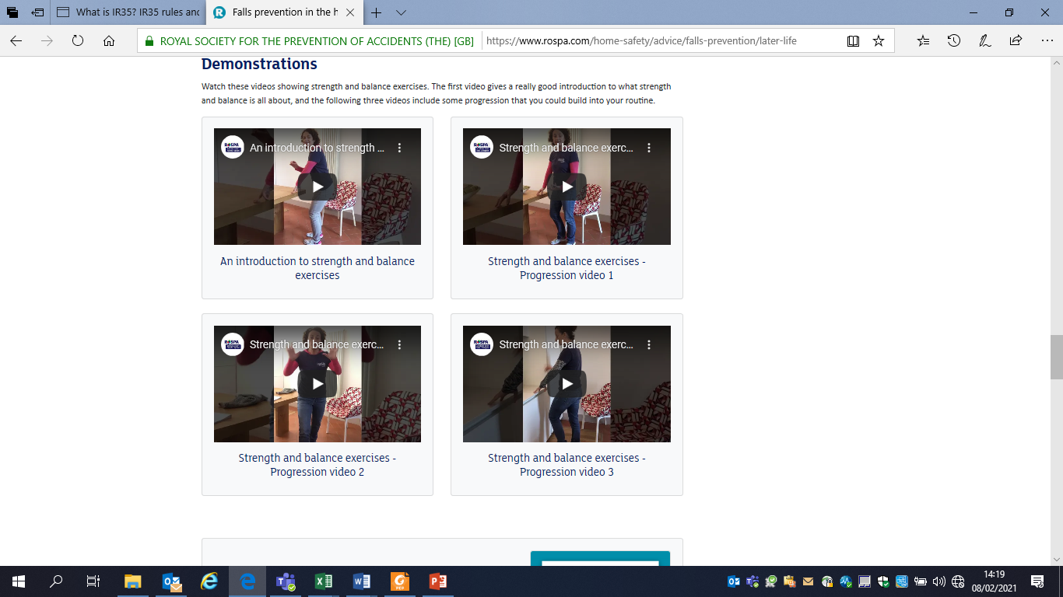
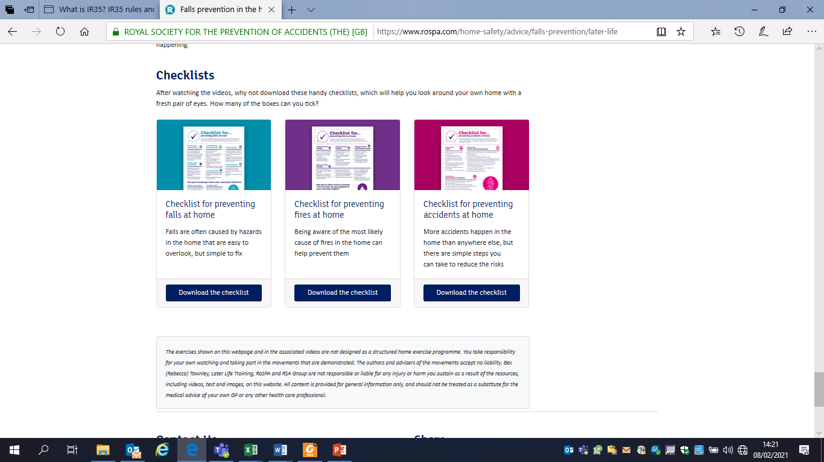
New web hub

Slide 15
Online Roadshows
Originally planned as face to face events but adapted as 1 hour online sessions
Included demonstrations of strength and balance exercise and Q&A led by Later Life Training
12 sessions delivered, targeting up to 20 participants per session.
257 attended (77 members of the public)

Slide 16
Online Roadshows
69% - the roadshow information would help them make their home safer
85% - the demonstration of strength and balance exercises would help them build movement more regularly into daily routine
Those agreeing that they felt comfortable to talk to family and friends about how to prevent falls rose by 6% after the roadshows
9% more felt comfortable to talk to family and friends about strength and balance

Slide 17
Online Roadshows
“Know what to do to prevent falls at home” - rose by 8% overall after the roadshows, and by 19% among people in later life
95% of practitioners said that they felt confident to talk to their clients about falls prevention (up from 78% pre-roadshow) and 92% about strength and balance exercises following the roadshows, (up from 74%)

Slide 18
The roadshows, web hub and Fall Fighters have
Supported people in later life, their families and practitioners by providing key advice and support
Demonstrated the potential of an online approach
Increased confidence to improve strength and balance
Increased confidence to make changes at home
Enabled participants to improve safety

Slide 19


Trent & Dove Housing

Slide 20


Sir George Earle Trophy Legacy Proposal
Trent & Dove committed to become exemplar ‘Fall Fighters’ within the Social Housing Sector.
There are 1500 social housing providers in England renting 4.4 million homes.
Our project approach has three keys strands
  Training staff & partners
  Offering fall prevention visits to our customers
  Measuring outcomes, demonstrating benefits and sharing our approach.

Slide 21
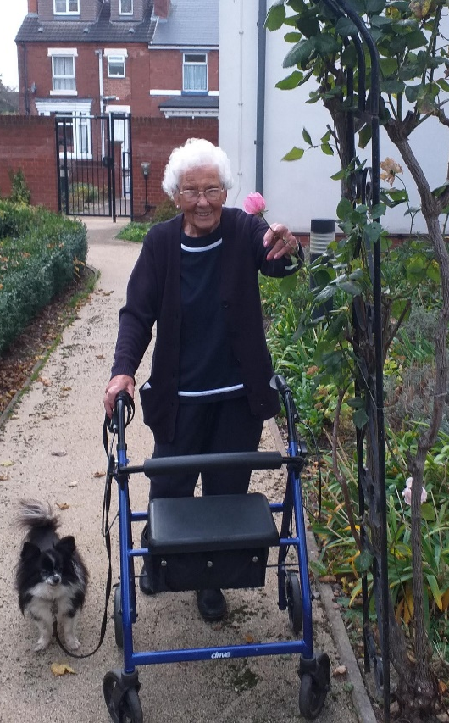

Fall Prevention for Social Housing Tenants
Raise awareness of risk and consequences of falls
Support to implement personal fall prevention measures
Approximately 2000 residents over-60 housed in flats, bungalows, houses and sheltered accommodation
Higher instance of vulnerabilities in social housing than national average

Slide 22
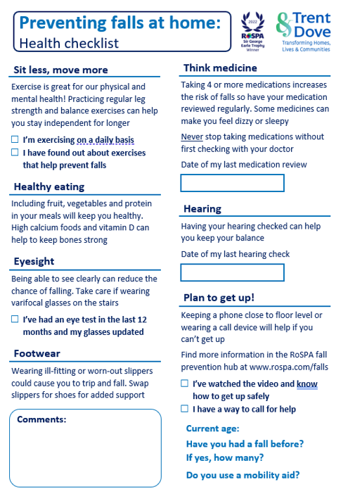
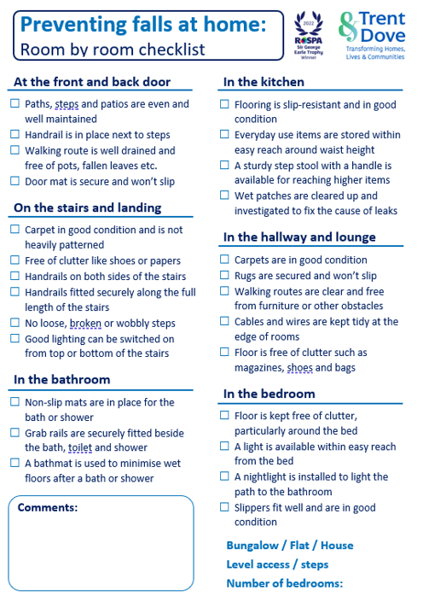






Fall Prevention Home Visits
Covers fall risk factors in health, lifestyle and home
Based on RSA checklist with project specific questions
Introduces an investigative line of thinking
Work alongside existing teams with a focus on preventative measures and resident-led change
Signposting to healthcare and local authority and charity partners
Follow-up to support resident with any barriers

Slide 23
Benefits
Better understanding of risk and mitigation of falls in the social housing context
Encouraging a curious mindset, empowering residents to find new services/groups which in turn combats loneliness etc.
Working with our partners and community groups to target fall prevention services better, both in terms of location and accessibility
Improved relationship between resident and Trent & Dove
Better engagement and participation by residents in initiatives and events

Slide 24
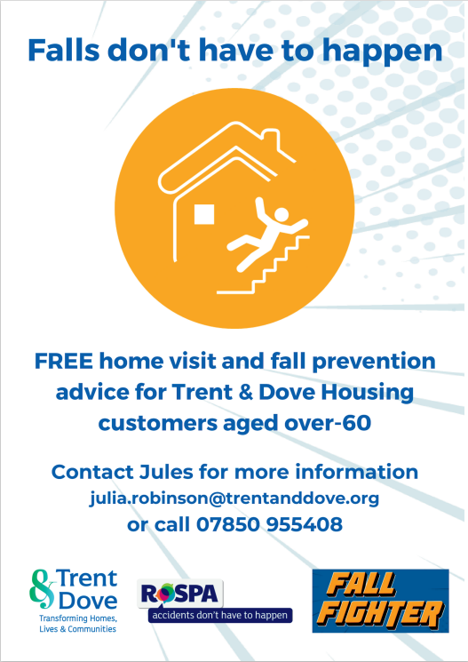

Challenges
Communication with a majority offline demographic: flyers, letters, newspaper and word of mouth
Marketing to attract those who have not yet had a fall
Measuring impact of project without falls data being reported
Avoiding duplication of NHS staff, carers and occupational therapists

Slide 25
Herefordshire Health & Safety Group
Time for a break….. Back in 15 minutes

Slide 26
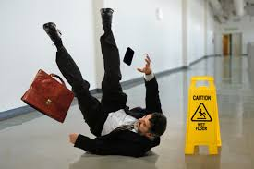
Workplace risk factors….
Slipperiness?
Changes in level?
Stairs?
Lighting?
Contamination?
Obstructions?
Footwear?

Slide 27
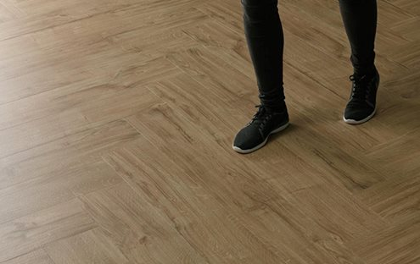
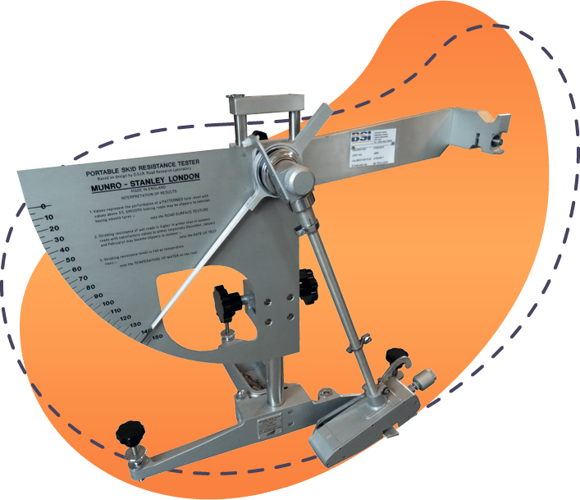
Understanding slip resistance
Factors that can contribute to slip accidents: location of floors, environmental surroundings, footwear, cleaning products used and the actual flooring material itself

Slide 28
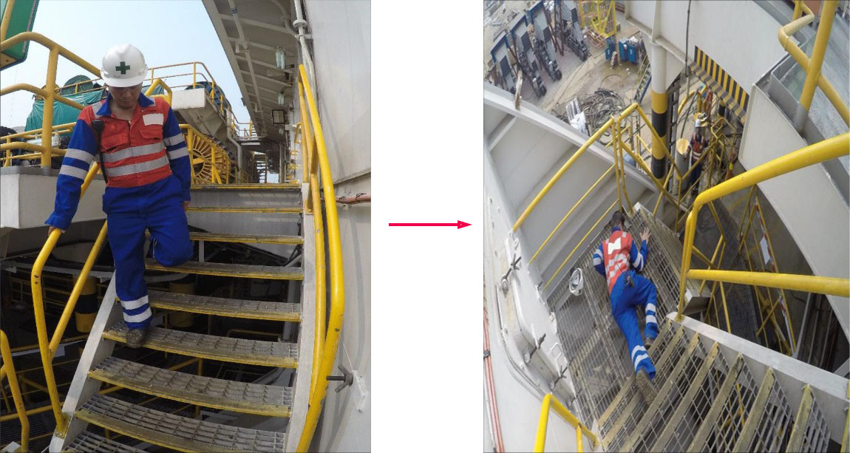
Hold on..

Slide 29

Clean up spills

Slide 30

What can you do?
Discuss with colleagues/form a team
Get training/make a plan
Study incidents
Carry out a survey
Make prioritised changes
Publicise/educate
Monitor/learn lessons
Feed back to managers regularly
Fine tune and keep at it!

Slide 31

Learning from investigation?
A member of staff in a food factory wearing inadequate footwear, running on a walkway, slips on a patch of oil and damages her knee.
‘Underlying causes’ of the event above might include:
• lack of supervisory resource;
• no policy for preventing contamination;
• no signage of slipping hazards;
^{• poor lighting;}
• no provision/use of suitable footwear;
• time pressure to get to a new location;
^{• no training;}
• personal problems with fitness, weight and balance;
^{• fatigue;}
^{• distraction; and so on}

Slide 32
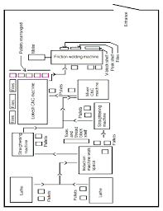
STF hazard surveying..
Draw a sketch map of the work area
Mark all the slips and trips reported in the last 12 months (or any relevant period) with crosses on the map
Talk to members to identify any ‘near misses’ and add them to the map
Find out from staff members what is causing people to slip or trip in that area

Slide 33
HSE resources
HSE’s website: www.hse.gov.uk/slips/
Guidance https://www.hse.gov.uk/pubns/indg225.pdf
Mapping tool https://www.hse.gov.uk/slips/mappingtool.pdf
Slips and Trips eLearning Package, referred to as ‘STEP’ (www.hse.gov.uk/slips/step/start.htm)
Research - https://www.hse.gov.uk/slips/research.htm

Slide 34

Be a safety winner?

Slide 35
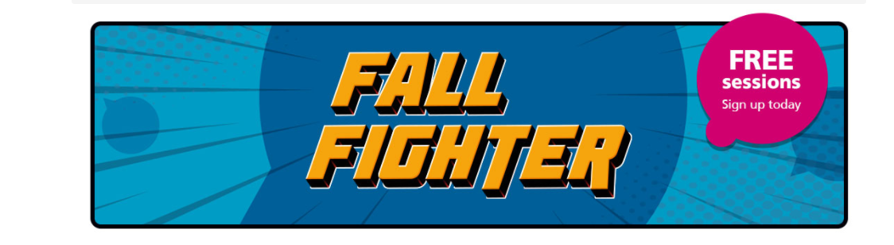
Make a real difference – become a RoSPA Falls Fighter
https://www.rospa.com/home-safety/advice/falls-prevention/fall-fighter

Slide 36
Thank you

