Slide 1
Health, Safety & Environmental Update 2023
Wednesday 22nd February 2023
at
Leominster Golf Club
Presented by Herefordshire Health & Safety Group

Slide 2
HSE Update 2023
A Look Back at 2022
Notes:
2021 has been a relatively quiet year for health and safety.
Despite there being post-Brexit promises of major overhauls to health and safety legislation, nothing has materialised or is slated for early 2022.
Nor has the HSE been particularly active when it comes to on-site enforcement. But is this pattern set to continue?

Slide 3
HSE Update 2023
Key figures for Great Britain (2021/22)
1.8 million working people suffering from a work-related illness, of which
914,000 workers suffering work-related stress, depression or anxiety
477,000 workers suffering from a work-related musculoskeletal disorder
123,000 workers suffering from COVID-19 which they believe may have been from exposure to coronavirus at work
2,544 mesothelioma deaths due to past asbestos exposures (2020)
123 workers killed in work-related accidents
565,000 working people sustained an injury at work according to the Labour Force Survey
61,713 injuries to employees reported under RIDDOR
36.8 million working days lost due to work-related illness and workplace injury
£18.8 billion estimated cost of injuries and ill health from current working conditions (2019/20)
https://www.hse.gov.uk/statistics/

Slide 4
HSE Update 2023
HIGHLIGHTS FROM THE 2022 REPORT
1. Stress, depression and anxiety are the leading types of work-related illness
The statistics suggest that stress, depression and anxiety are the predominant forms of work-related illness in Britain. 914,000 workers – just over half of the 1.8 million total suffering from work-related ill health – are estimated to have stress, depression or anxiety as a result of their work.
Of the 914,000, 372,000 workers are suffering from a new case of work-related stress, depression or anxiety in 2021/22.
An estimated 17 million working days were lost in the 12 months assessed due to these mental health issues – more than half of all working days lost due to work-related ill health.
These statistics highlight a growing crisis in work-related stress and mental health problems.

Slide 5
HSE Update 2023
HIGHLIGHTS (Cont’d)
2. Work-related musculoskeletal disorders
Musculoskeletal disorders make up the second-largest portion of work-related ill health, with 477,000 workers suffering from these in 2021/2022. Of these, 139,000 workers are suffering from a new disorder that began within the 12-month period.
An estimated 7.3 million working days were lost due to work-related musculoskeletal disorders in 2021/22.
3. Injuries sustained at work in 2021/22
There were 565,000 workers who sustained a non-fatal injury at work in 2021/22. Tragically, there were 123 workers killed in work-related accidents in the 12-month period too.
An estimated six million working days were lost due to non-fatal workplace injuries.

Slide 6
HSE Update 2023
HIGHLIGHTS (Cont’d)
4. The impact of Covid-19 on workplace health
123,000 workers suffering from Covid-19 in 2021/22 believe they were exposed to the virus at work. Roughly 40 per cent of these workers are in the human health and social work sectors.
5. Ill health from workplace exposure
There are an estimated 13,000 deaths each year linked to past exposure at work, primarily to chemicals, dust or asbestos. Of these, 12,000 deaths are due to occupational lung disease.
An additional 585,000 workers are suffering from a work-related illness caused or made worse by the effects of the coronavirus pandemic, both new and long-standing.

Slide 7
HSE Update 2023
HIGHLIGHTS (Cont’d)
6. The cost of workplace-related ill-health
Work-related injury and new cases of ill health cost Britain an estimated £18.8 billion in 2019/20. Of this, £7.6 billion was due to workplace injury and £11.2 billion was due to work-related ill health, excluding long latency illnesses such as cancer.
7. Top three industries with workplace injury in 2021/2022
Agriculture, forestry and fishing
Construction
Accommodation/food service activities
8. Top three industries with work-related ill health in 2021/2022
Human health/social work
Public administration/defence
Education

Slide 8
HSE Update 2023
So what’s changed during 2022
The Highway Code
Driving
Personal Protective Equipment
Building Regs
All discussed last year – presentation available if you require a refresher

Slide 9
HSE Update 2023
What’s planned for 2023
Two main developments:
1. Building Safety Act
2. Fire Safety Act

Slide 10
HSE Update 2023
Whilst the Building Safety Act 2022 (the Act) is now in force, only a limited amount of provisions have taken effect, with the remainder expected to become law during 2023.
The Act
The Act, which received Royal Assent in April this year, creates a new regulatory regime and a new Building Safety Regulator (BSR) for all building work of any kind on any building. It also creates a more stringent process for higher-risk buildings (HRBs), regulating these buildings throughout their operating life. It’s aim is to deliver a system that is fit for purpose and provides improved accountability, risk management and assurance of safety to those living in HRB’s.
There is still much to be determined regarding the operation of the Act, which is expected to be resolved through secondary legislation, some of which will not come into force for a further 6 to 12 months. A transition plan which seeks to provide a detailed timeline of the plans to implement the new building safety regime can be found on the UK Government’s website.

Slide 11
HSE Update 2023
Two New Roles
The most significant and immediate change is probably the establishment of two key roles, the Building Safety Regulator (BSR) and the Accountable Person (AP).
Central to the new regime is the creation of a national BSR - embedded within the Health and Safety Executive (HSE) with responsibilities for monitoring the safety of all buildings in England.
The BSR’s three main functions are:
To oversee safety and standards of all buildings.
Encourage increased competence within the industry and building control professionals; and
Lead the implementation of the new building control approval regime for the design, construction and major refurbishment of HRBs.
Wide-ranging powers have been given to the BSR to regulate standards for buildings and construction work, including powers to investigate and prosecute breaches. The BSR will also have the power to set insurance requirements, but cover will need to be obtained from the wider insurance market, rather than a limited number of government-approved schemes as originally proposed (S.48 of the Act removes the requirement for an approved inspector to obtain insurance from a government-approved scheme).

Slide 12
HSE Update 2023
The Accountable Person (AP)
Arguably the most significant change comes in the occupation phase with the advent of the AP. The Act identifies new duty holders known as APs (building owner, freeholder, or management company) who have an ongoing duty to assess building safety risk and provide a ‘safety case report’. The safety case report demonstrates how risks are being identified, mitigated, and managed on an ongoing basis.
In buildings where ownership structures are complex, there may be more than one AP, in which case there will be a Principal Accountable Person (PAP). The AP and PAP will be responsible for registering buildings under their control before they can be occupied, and have ongoing obligations to manage building safety risks during the entire occupation phase.

Slide 13
HSE Update 2023
Golden thread
A further key focus of the Act is maintaining the ‘golden thread’ of vital information to safeguard residents and others against risks, which include fire and structural safety issues. This obligation falls upon duty holders and the AP. The obligation includes a requirement to put measures in place to ensure that current information and documents relating to the design, build, and management of the building are easily accessible throughout its lifetime.
With information and documents in one centrally held digital record, the intention is to ensure that all parties involved will know where to find relevant information to ensure that they can limit risks and respond efficiently.
The golden thread of vital information is the core of the Act and is extremely critical.
Graham Cundy, Director of the Recovery Strategy Unit at the Department for Levelling Up, Housing and Communities said:
‘This principle will hopefully remove the risk of misidentifying the parties involved in the building process in the future and will benefit the whole sector; from the Insurer, all the way down to leaseholders’

Slide 14
HSE Update 2023
Gateway principle
The safe design and construction of these HRBs will now be underpinned by three mandatory gateways processes. These are to ensure early consideration is given to fire safety and comprise (a) managing change control, (b) to preserve the integrity of the building, and (c) fire safety information.
The gateway principle is intended to support the creation of the golden thread of vital information.
There are three stages to the new gateway regime:
Gateway one at the planning application stage;
Gateway two before construction begins; and
Gateway three at the completion stage of the works.
Gateway one deals with the planning permission phase and early consideration of fire safety; it will take effect through secondary legislation.
At gateway two, an application that includes the full design intention will have to be provided to, and approved by the BSR before construction work begins, providing a 'hard stop' point until that approval is received.
Gateway three includes handover of the relevant documents to both the BSR and the building owner. If approved, the BSR will issue a completion certificate and the HRRB will be registered on the regulatory system. A building cannot be occupied until the gateway three process has been completed satisfactorily.
Gateways two and three are likely to come into force following April 2023.

Slide 15
HSE Update 2023
Construction product regulations
S147 to 155 of the Act creates a new right of action, namely, the right to sue construction product manufacturers and suppliers for breach of the Construction Products Regulations that causes a building or dwelling to become unfit for habitation.
Liability also arises if a person marketing or supplying a product makes a misleading statement in relation to the product.
The relevance for liability insurers is that there is likely to be a tougher testing regime for construction products. We might expect, therefore, greater levels of in-built safety and hopefully less risk for insurers.

Slide 16
HSE Update 2023
What to expect in 2023?
Looking at the year ahead and before the end of October 2023, we expect to see the following come into force:
Establishment of a Building Advisory Committee, which will provide advice to the BSR on developing future building regulations;
Establishment of the Industry Competence Committee to publish public guidance on industry competence and advise the Building Safety Regulator on this issue;
Mandatory registration of building inspectors and building control approvers;
Mandatory registration of occupied high-risk residential buildings;
New duties on the Accountable Person with regard to managing safety risks in higher-risk buildings;
Gateways two and three to come into operation;
Commencement of mandatory occurrence reporting pertaining to fire and structural safety issues; and
New requirements for construction products.

Slide 17
HSE Update 2023
.
New Fire Safety Regulations are coming into effect in England from January 2023 which require residential buildings to update some of their fire safety equipment and procedures.
One key change to the Fire Safety Regulations 2022 is the new procedures around checking fire doors, including routine checks and inspections of fire doors.
What are fire doors?
Fire doors are constructed using specific materials and ironmongery that allow the door to prevent the spread of fire and smoke. Commonly, they suppress fire for 30-60 minutes and will have been through rigorous testing to gain certification for this.
They usually have a sticker on them saying ‘fire door keep shut’ but fire doors can also look like a standard front door. If you live in a block of flats or a HMO, your front door should be a fire-rated door.

Slide 18
HSE Update 2023
.
The Fire Safety (England) Regulations 2022 have come into effect as of 23 January 2023
The Building and Fire Safety legal arena has evolved considerably over the past few years especially following Grenfell.
The Fire Safety Act 2021 amended the Regulatory Reform (Fire Safety) Order 2005 (FSO) and clarified that external walls, flat entrance doors and structures of buildings are all covered by the FSO and must be accounted for in fire risk assessments for higher risk buildings.
The Building Safety Act 2022 reformed the building and fire safety regime during both the design and construction and in-occupation phase.
HSG168 Fire Safe in Construction 3rd Edition issued Jul 2022

Slide 19
HSE Update 2023
As of 23 January 2023, the Fire Safety (England) Regulations 2022 came into force and applies to all buildings in England comprising two or more domestic premises (including residential parts of mixed-use buildings and student accommodation).
The obligations do not apply within individual flats, other than where measures are installed inside for the safety of other residents (e.g. sprinklers).
The obligation on the responsible person differs depending on the height of the building:
under 11 meters;
Between 11 and 18 meters; or
Over 18 meters.

Slide 20
HSE Update 2023
The general obligations on the responsible persons in relation to all multi-occupied residential buildings are:
To display and provide residents with fire safety instructions including the evacuation strategy, information on how to report a fire and what to do if a fire occurs.
To provide residents with key information about the importance and operation of fire doors including; (i) fire doors should be kept shut when not in use (ii) residents and their guests should not tamper with self-closing devices and (iii) residents should report any fault or damage immediately to the responsible person.
Residents should be reminded about the key information annually.

Slide 21
HSE Update 2023
In residential buildings between 11 meters and 18 meters the responsible person is required to:
Undertake annual checks and complete remedial works on flat entrance doors. This is to be done on a “best endeavours basis” and “record the steps taken to comply with this obligation”.
Undertake checks and complete remedial works on communal area fire doors at least every 3 months.

Slide 22
HSE Update 2023
In high-rise residential buildings (over 18 meters) the responsible person is required to:
Floor and Building Plans - provide the local Fire and Rescue Service with up-to-date electronic building and floor plans and to place a hard copy in the secure information box.
External Wall Systems - provide to the local Fire and Rescue Service information about the design and materials of the external wall system including the level of risk the system gives rise to and mitigating steps taken. The record should be updated if there are significant changes to these walls.

Slide 23
HSE Update 2023
High Rise (cont’d)
Lifts and other Key Fire-Fighting Equipment
undertake monthly checks on any lifts intended for use by firefighters, and evacuation lifts in the building and check the functionality of other key pieces of firefighting equipment.
Any fault discovered must be rectified within 24 hours or it must be reported to the local Fire and Rescue Service electronically.
The outcome of checks must be recorded and made available to residents.

Slide 24
HSE Update 2023
High Rise (cont’d)
Information Boxes - install and maintain a secure information box containing the name and contact details of the Responsible Person and hard copies of the building and floor plans.
Wayfinding Signage - install signage visible in low light or smoky conditions that identifies flat and floor numbers in the stairwells of relevant buildings.

Slide 25
Environmental Update

Slide 26
Environmental Update
Summary of progress on Environmental Targets set out in the Environment Act
The Government remains committed to halting the decline in species by 2030 and bringing forward the wider suite of targets, which will help clean up our air, reduce pollution, keep our water clean and reduce waste.
The Environment Act will deliver the most ambitious environmental programme of any country and help support our international commitments to protect 30 per cent of land and ocean by 2030.

Slide 27
Environmental Update
Sitting at the heart of the government’s
Environment Act, the targets are:
Halt the decline in species populations by 2030, and then increase populations by at least 10% to exceed current levels by 2042
Restore precious water bodies to their natural state by cracking down on harmful pollution from sewers and abandoned mines and improving water usage in households
Deliver our net zero ambitions and boost nature recovery by increasing tree and woodland cover to 16.5% of total land area in England by 2050
Halve the waste per person that is sent to residual treatment by 2042
Cut exposure to the most harmful air pollutant to human health – PM2.5
Restore 70% of designated features in our Marine Protected Areas to a favourable condition by 2042, with the rest in a recovering condition.

Slide 28
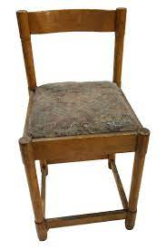
Environmental Update
Identify waste containing persistent organic pollutants (POPs)
Waste Upholstered Domestic Seating
Information to help you ensure you comply with the existing legal requirements for waste containing Persistent Organic Pollutants (POPs)
Persistent Organic Pollutants (POPs) remain intact in the environment for long periods, and if not disposed of properly become widely distributed geographically. They accumulate in the fatty tissue of humans and wildlife and have harmful impacts on human health and on the environment.
The Environment Agency has undertaken an investigation and confirmed the widespread presence of very large quantities of Persistent Organic Pollutants (POPs) and other hazardous chemicals in both the textiles and foam of waste upholstered domestic seating. These chemicals were used as flame retardants and are now banned.

Slide 29
Environmental Update
Identify waste containing persistent organic pollutants (POPs)
The law requires that POPs in waste are destroyed to prevent lasting environmental harm and impacts on the food chain. This means waste containing POPs must be incinerated and must not be re-used, recycled, or landfilled. Most treatment is also prohibited.
The Persistent Organic Pollutants Regulations 2007 (as amended) and Retained Regulation (EU) 2019/1021 on persistent organic pollutants as amended by the Persistent Organic Pollutants (Amendment) (EU Exit) Regulations 2020.
Your Duty of Care means you must make sure the waste you or your contractors handle is described and managed appropriately both by you, and by anyone the waste is transferred to.

Slide 30
Environmental Update
Identify waste containing persistent organic pollutants (POPs) What items are affected - waste upholstered domestic seating
Waste upholstered domestic seating includes any item of upholstered seating of a household type from households or businesses that is waste. For example sofas, sofa beds, armchairs, kitchen and dining room chairs, stools and foot stools, home office chairs, futons, bean bags, floor, and sofa cushions.
Upholstery includes any foam and fabric, for example textiles, leathers and synthetic leathers.
The following items are not considered ‘waste upholstered domestic seating’:
- Items that are not upholstered (for example a wooden chair without a cushioned or textile back, seat, or arms). These should not contain POPs.
- Deckchairs, mattresses, curtains, blinds, and beds
- Wastes from the manufacture of new domestic seating that are known not to contain POPs
You should assume that an item of waste upholstered domestic seating contains POPs unless the foam and fabric of that item has been tested to demonstrate otherwise.

Slide 31
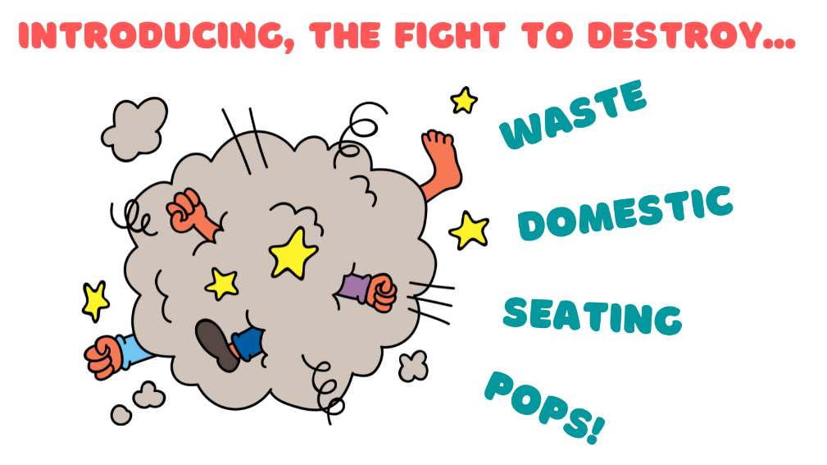
Environmental Update
Identify waste containing persistent organic pollutants (POPs)
What action must you take?
We expect you to review your procedures to make sure that waste upholstered domestic seating is:
Segregated from other waste
Described and classified correctly
Sent for destruction in a municipal or hazardous waste incinerator, or cement kiln.

Slide 32
Environmental Update
ANY

