Slide 1
Health and Wellbeing Journey

Slide 2
Introduction
Head of SHEQ – Green Frog Connect
Green Frog Connect - Independent Connections Provider for energy projects up to and including 132kV.
Founded in 2022 and since then we have connected in excess of 1800MW of power generation to the grid.
Design and build contractor.

Slide 3
Workforce
The workforce is made up of a significant number of engineers and project managers.
Until recently the team was mixed in age and predominantly male.
In more recent times we have had a influx of younger graduate design engineers
Disconnect between the number of Electrical Design Engineers in the industry and the number required.
Retaining employees has never been more vital. In the past we have lost staff to competitors

Slide 4
What are we doing?
Trying to become “Employer of Choice”.
Younger workforce is more inclined to appreciate a healthy workplace rather than just a good salary and other benefits
Ensuring that employees are thriving
Health Care / EAP system / Life insurance / Sick pay etc
Notes:
In order to retain and attract the right staff we need to be the “industry employer of choice”.
Our workforce is changing and requirements are not the same as they were when we first started.
We want to ensure that employees are thriving and that work does not present unhealthy amounts of stress.
We already provide a competive salary, bonuses, Health Care, EAP system, life insurance, sick pay etc but these tend to be viewed as fairly “standard” these days.

Slide 5
Consulting Employees
In the past - HSE Stress Management Standards and the stress survey
Difficulties with this
“Being Well Together” Employee Wellbeing survey
Demands – Risk to Employees
Notes:
HSE Stress Management Standards were difficult to use with small numbers and was hard to find the time to administer it.
Last year we utilised the “Being Well Together” Employee Wellbeing survey which was much easier and had the added benefit of the results interpreted by BWT and benchmarked against other companies.
We identified that as an employer we need to be particularly aware of the “demands” put on employees at work. Whilst many of the jobs are demanding they are also rewarding but this remains an area of risk to us.

Slide 6
Next Steps
Employee Committee Meeting
Working Groups
Notes:
Next month we are holding out Employee Committee meeting. The Health and Wellbeing programme will feature largely in this. We are looking at what data we have available and what we are monitoring in the future. We are planning to ask employees about what they want. Whether this be health checks, health and wellbeing guidance, training, volunteering opportunities then we are asking our employees to let us know. Obviously this is not a free for all but by asking the question we hope to be able to give employees at least some of their “wish list”. We aim to set up working groups across the business for topics which people are interested in exploring further, e.g. things like “women’s health” and “social events”. We are also looking to ask for volunteers to expand our current pool of MHF Aiders.

Slide 7
British Safety Council’s Approach to Health, Safety & Wellbeing
Jo Saines
Wellbeing Services Manager
British Safety Council
22nd March 2023
Notes:
Welcome & thank you’s
My name is Jo Saines and I am the Wellbeing Services Manager from British Safety Council.
A little bit of background as to why I’m here and you’re here…
As a charitable organisation, we’re passionate about fulfilling our vision that no one should be injured or made ill through their work. One of the ways we can do that is by providing workshops free of charge to organisations that want help with these strategies.
Rebecca got wind of our vision and asked if we could speak to you more about integrating health, safety & wellbeing.
To give you a little bit of context, as the Wellbeing Services Manager, my role is to oversee the support that we give organisations in developing their wellbeing strategies. I have been in the wellbeing sphere for about 10 years and I am truly passionate about making sure that people can be well.

Slide 8
What we’ll be talking about
What is wellbeing?
Link health, safety, and wellbeing
A strategic approach to wellbeing
The Being Well Together Programme
Interactive
Questions at end
Slides
Notes:
Over the next 55 minutes, we’re going to be discussing….
This is going to be an interactive session where I will be asking you for your insight throughout.
If you have any questions then we will have an opportunity to ask them at the end
If you would like the slides from the presentation then jot down our email address and/or phone number on the last slide and contact us to ask for them

Slide 9
Health, Safety & Wellbeing
“freedom from the occurrence or risk of injury, danger, or loss” (Dictionary.com 2022)
“Health is a state of complete physical, mental and social wellbeing and not merely the absence of disease or infirmity” (WHO, 2022)
Health
“is about stopping you getting hurt at work or ill through work” (HSE, 2022)
Safety
Health and
Safety
Wellbeing
“an individual’s ongoing state which enables a person to thrive” (British Safety Council 2020)
Notes:
Before we get into the nitty grittys, we thought it would be sensible to start with some basic definitions, so we’re all coming from the same starting point.
But of course, wellbeing is in fact more than that, it can be split into the separate components (lead on to next slide)….

Slide 10
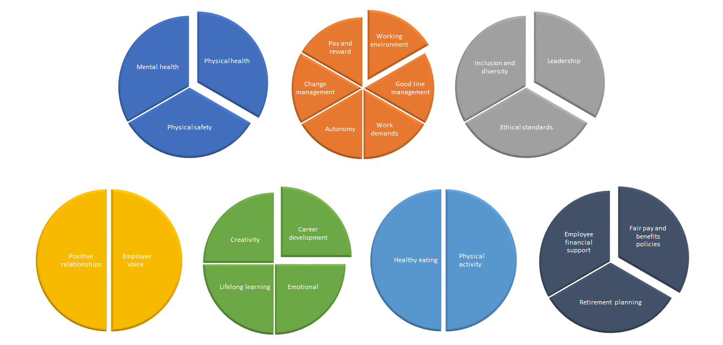
Domains of Wellbeing
Health
Good Work
Values / Principles
Collective / Social
Personal Growth
Good Lifestyle Choices
Financial Wellbeing
Notes:
We know that all of these domains matter:
Health – we’re talking about physical health, physical safety, and mental health:
According to HSE, in 2021/22 there were 1.8 million work-related ill health cases
Work – we know that good work is good for us and it of course directly correlates with our wellbeing. In 2022 Gallup released a publication informing us that “People with a bad manager have even worse wellbeing than those without jobs”
Values/principles – are we promoting ethical standards, and being fully inclusive in our workplace?
Collective/social – as Cary Cooper points out, for almost everyone, being at work involves some level of interaction with people. The quality of these interactions and the extent to which they’re supportive and rewarding is an important ingredient in how people feel at work.
Personal Growth – how are we helping our employees to grow and develop?
Audience participation: For those of you that are line managers, when was the last time you had a conversation with your direct report about training, career development or lifelong learning? Or if you’re not a line manager, have you had those conversations with yours
Good Lifestyle choices - are we and our employees getting enough physical activity or are we stuck at our desks, eating at our computers, and barely moving from 8-6?
Financial wellbeing – arguably, there’s never been a more important time than now to start talking about financial wellbeing. In fact, we’ve had a big increase in financial wellbeing enquiries just over the last week.
When we spend over 90,000 hours of our lives at work, you can see then that workplace wellbeing is quite a big subject isn’t it??

Slide 11
Thought Leadership
51%
“In 2021/22 stress, depression or anxiety accounted for 51% of all work-related ill health cases” (HSE, 2022)
Half
Almost half of employees loose sleep because they’re stressed at work (Perkbox 2020)
£56 billion
“poor mental health among employees costs UK employers £56bn” (Deloitte, 2022)
£5.30 ROI from £1
An average ROI of £5.30 for every £1 invested in staff mental health (Deloitte, 2022)
Notes:
Here’s just some of the research behind how our health is affecting us at work….
Click for stats
In 2021/22 stress, depression or anxiety accounted for 51% of all work-related ill health cases this equated to 55% of all working days lost due to work-related ill health
Audience participation
Have you ever lost sleep because you’re stressed at work?
According to Perkbox
“Almost half of employees loose sleep because they’re stressed at work, 55% experience anxiety as a result of work stress, while a third turn to comfort eating”
Poor mental health among employees costs UK employers £56billion
An average ROI of £5.30 for every £1 invested in staff mental health – for those of you keen statisticians that have been keeping an eye on the numbers over the years, you’ll know that this number has been steadily increasing over time.
We’re now going to look at mental health at work, and then physical health and how relevant they are to health and safety…

Slide 12
H&S; Mental Health
Poor mental health can affect concentration, information processing, decision making consistency
Stress can cause a diminished ability to control thoughts and actions
Workers experiencing high levels of stress may be more liable to commit errors - slips, mistakes or violations - which in turn can lead to accidents
Poor mental health often impacts sleep
Poor mental health can lead to drug use (alcohol etc)
Suicide in the workplace
“There is evidence of a link between mental ill health and higher rates of industrial accidents” (Mind/CIPD 2011)
“People who are stressed, anxious or depressed are more likely to be distracted by other thoughts and find it harder to focus on a task” (HSE, 2006)
Notes:
High levels of stress (whether caused by work or arising from other life stressing events such as bereavement, divorce or money worries) can lead not only to ill health but can adversely affect concentration, information processing and the consistency of decision making….READ REMAINDER OF BOX

Slide 13
H&S; Physical Health
Impaired hearing, eyesight, neurotic illness, diabetes, epilepsy
Diabetes can cause people to black out – 4.9 million have the condition in the UK
Poor physical health can create a distraction – can make sufferers careless
Poor physical health can affect sleep – can cause fatigue
Pre-existing MSK conditions
“Poor physical health increases the risk of accidents at work”(Palmer et al, 2016)
“Overweight and obese manufacturing workers are 25% - 68% more likely to experience injuries than normal weight workers” (National Institute of Health, 2012)
Notes:
So what about physical health and it’s link to H&S?
Audience participation
I’d love to hear from you how and why do you think poor physical health increases the risk of accidents at work?
Click for next bullet point:
According to a National Institute of Health study “Overweight…”
Click for image bullet points
Diabetes – read, then add “850,000 people are currently living with type 2 diabetes but are yet to be diagnosed”

Slide 14
Approaches to Health, Safety and Wellbeing
Notes:
First off, let’s talk about the current approaches to HSW in the workplace, what’s traditionally done and what the research says.
Based on your attendance at today’s meeting, I’m sure you have an interest in how health, safety, and wellbeing are interrelated
Question to the audience…
In your organisation is wellbeing, safety, or health tackled in tandem or in isolation?
o In tandem – health, safety & wellbeing
o As separate parts – health & safety, and wellbeing
So why are these subjects often treated in isolation?

Slide 15
Traditional Approach to Health, Safety & Wellbeing
Traditional focus of occupational H&S professionals
Extension in more progressive workplaces
In workplaces, safety programmes and wellbeing programmes have been far apart from each other. Departments have often been separated
Notes:
Traditionally the approach has been that health and safety has been the focus of occupational H&S professionals, of course, there has been an extension in more progressive workplace, but on the whole…. In many workplaces, safety programmes and wellbeing programmes have been kept far apart from each other. Departments have also often been separated

Slide 16
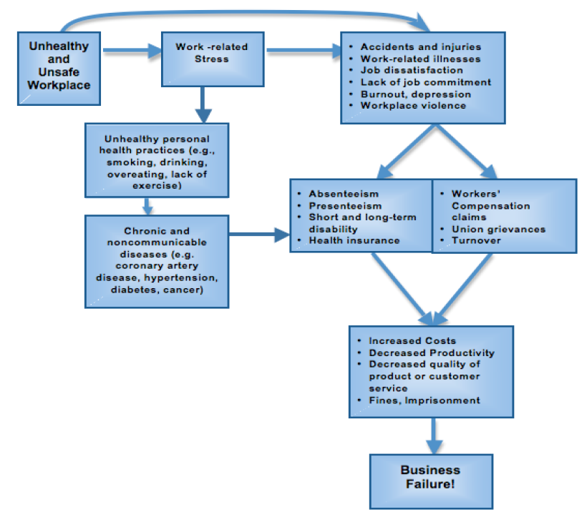
WHO Healthy Workplace Framework and Model
“Most private sector enterprises are in business to make money. Non-profit organizations and institutions are in business to be successful at achieving their missions. All these workplaces require workers in order to achieve their goals, and there is a strong business case to be made for ensuring that workers are mentally and physically healthy” (Burton, J, 2010)
Notes:
When we look at the World Health Organisation’s application of the Healthy Workplace Framework, we can see that there’s a relationship between unsafe and unhealthy workplace
Safety is something that’s obvious to us, but sometimes wellbeing isn’t so obvious but they both have implications to this framework
We’ll talk about two circumstances where an unsafe workplace has an impact on employees, it might not be exactly the same as your workplace but I wonder if you might be able to imagine yourself, a friend, family member or colleague in either of these situations?….
Look at diagram and tell the story
Imagine you’re a factory worker and sales have gone through the roof. Your organisation doesn’t want to hire more staff, instead, they want staff to be more efficient. As a very competent and diligent worker, you already work hard and are very efficient and proficient at what you do. So this news to you stresses you out. Click
You start trying to work harder, but actually what you’re doing is getting more stressed, in an attempt to do this so you start taking shortcuts. You don’t put your gloves on as it saves me 3 seconds. “They don’t care about my safety anyway, what’s the point, I’ve not needed gloves until now”. You go about your usual job without gloves and burn both of your hands – 3rd degree burns. Which you would not have had if you weren’t stressed, you weren’t rushing, and if you had your gloves on. Click
You take 3 weeks off of work. They get agency staff to cover you – there’s a 3 day delay in this, and the staff member takes 2 days to be inducted. Click
Your organisation looses your labour for a week, in addition to paying your sick pay Click
You return to work earlier than advised by the doctor because you need the money as the sick pay doesn’t cover your family needs. You’re still unwell, your productivity is at rock bottom, as is morale Click
When you return to work, you notice that nothing has changed, your colleagues are as stressed, workload still as high and accidents becoming more frequent. Eventually, there’s a fatality. The investigation into this fatality (which by the way cost ten’s of thousands of pounds) concluded that this fatality could have been prevented with proper health and safety training in addition to more staff and lower workloads. By this time, the whole cost of the situation has cost an unimaginable amount that could have been negated if my organisation had taken seriously it’s obligation to provide a healthy and safe workplace.
Or perhaps Click
Imagine you’re a Project Manager, Line Manager …..
Your organisation hasn’t listened to employees complaining of high workload over the last year or so. Workloads are through the roof, as are stress levels.
The only way you can cope with the stress of work is with 3 glasses of red wine in an evening. It calms you down and sends you off to sleep quicker than you would without it. Click
After 3 months of this, you notice a weight increase, your mood and quality of life decrease. You go to the doctors and get diagnosed with type 2 diabetes and depression. Click
Both of these stories outline how unsafe and unhealthy workplaces can have an effect on employees
Whilst one might be related to a factory setting, and the other more in an office setting, both can be applicable….
Often what we see is organisations try and avoid investing in opportunities to help their staff be well as it’s still seen as an optional extra, as WHO says though…Click
“Most private sector enterprises are in business to make money. Non-profit organizations and institutions are in business to be successful at achieving their missions. All these workplaces require workers in order to achieve their goals, and there is a strong business case to be made for ensuring that workers are mentally and physically healthy through health protection and promotion”

Slide 17
We need you…
HR Perspective
H&S Perspective
Sickness absence, stress, personal development
Compliance, risk, mitigation of accidents
Notes:
But you can change that…
Here at BSC, we spend lots of time speaking to smart H&S professionals like you about the importance of your role in wellbeing.
Historically, organisations deal with wellbeing from a HR Perspective – understandable given that HR deal with sickness absence, stress, performance, personal development and the like.
But that overlooks wellbeing when we think of it more broadly (as in the wellbeing domains that we discussed earlier).
If we think back to our slides about physical & MH affecting H&S, shouldn’t we consider these risks as part of h&s? For example, Diabetes is not traditionally thought of as a H&S issue, however, given than Diabetes could result in fainting & blackouts, this isn’t just wellbeing, it’s a risk to H&S.
You don’t need me to tell you, H&S teams oversee compliance; risk; managing and improving workplace h&s. They do this by collecting and analysing data, leading to positive action and - hopefully - mitigation. The role focuses on reducing incidents or near-miss rates, and, in turn, creating strong, proactive measures that nurture a more safety-engaged workforce, and keep people safe.
When it comes to wellbeing, we find that the value that H&S professionals add is worth it’s weight in gold.
We work with H&S professionals (and ideally in conjunction with HR professionals) to create systems that facilitate better working conditions, and therefore healthier workplaces. If good systems are in place, then the organisation has undergone its legal responsibility for keeping workers safe, mitigating issues like stress-induced poor decision-making. We work with H&S professionals in a proactive approach to wellbeing. We’re not waiting for sickness leave, we’re not waiting for absence due to stress, neither are we waiting for accidents due to high workloads and/or lack of sleep. We take a proactive approach so that less mistakes are made and we’re working towards healthier workplaces.

Slide 18
Integrated Approach; Research
“Research increasingly shows that compared to traditional programs, an integrated approach can lead to healthier and safer employees, as well as improved operating and financial outcomes for employers” (Harvard T.H. Chan School of Public Health, 2017)
“Overall, evidence from the 32 intervention studies included in the review demonstrated the positive impact of integrated approaches on worker health and safety outcomes” (Institute for Safety, Compensation and Recovery Research)
“A more multifaceted approach to worker wellbeing can lead to sustainable, and even increased, employee health” (Campbell Institute / National Safety Council)
Notes:
Not just WHO advising, based on research……….from the Campbell Institute, Harvard T.H Chan School of Public Health, and more Read stats

Slide 19
A clear strategy
The key to success is to have
one clear strategy
for the organisation, harnessing a
multi-disciplinary team
Notes:
The key to success in health, safety & wellbeing is having one clear strategy for your organisation and harnessing your multi-disciplinary team.
What we mean by this is considering Health, Safety, and Wellbeing as one, not separate entities, and involve all key stakeholders.
Cary Cooper, a world leading expert on wellbeing Successful management interventions said that “Successful management interventions are those that ensure that the context is evaluated and understood. One size rarely fits all, changes need to be crafted to the specific demands of the situation and good management practice recognises this”
Back in 2020, a study was undertaken to review of the evidence base of health and wellbeing interventions used in healthcare and their implications for wellbeing outcomes, which we think can be applied to all sectors and organisations, they suggest undertaking more “process evaluations, to understand if how the intervention was implemented could have an impact on its uptake and effectiveness. For example, were staff consulted as to what intervention they needed or would use, did the intervention have appropriate senior management support, was it resourced sufficiently and promoted across organisations”

Slide 20
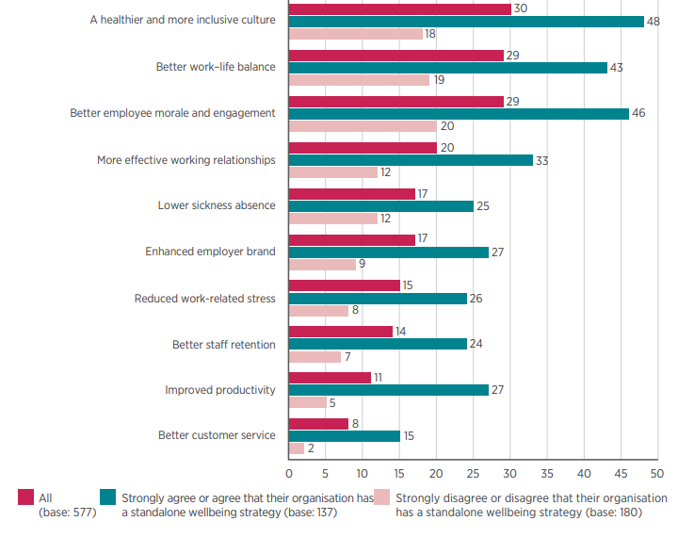
Why have strategy?
When asked:
"What has your organisation’s employee health and wellbeing activity achieved? (% with health and wellbeing activity)"(1)
(CIPD, April 2022)
Notes:
And just to remind you, here’s why:
When asked "What has your organisation’s employee health and wellbeing activity achieved? (% with health and wellbeing activity)“
You can see from this CIPD/Simply Health report that those with a wellbeing strategy are reporting:
A healthier and more inclusive culture
Better work-life balance
Better employee morale & engagement
More effective working relationships
Low sickness absence
Enhanced employer brand
Reduced work-related stress
Better staff retention
Improved productivity, and
Better customer service

Slide 21
How we do it…
Organisational Assessment Tool
Five Star Wellbeing Audit
Employee Wellbeing Survey
Bespoke Wellbeing Consultancy
Notes:
British Safety Council’s wellbeing offering comprehensively covers health, safety and wellbeing:
The Being Well Together Programme including the Organisation Assessment Tool, the Employee Wellbeing Survey, and all of the resources, cover all of the key aspects of health, safety and wellbeing
The Five Star Wellbeing Audit fully covers health, safety and wellbeing – indeed of the 213 detailed questions in Section 2 of the specification, 117 (55%) cover traditional H&S aspects

Slide 22
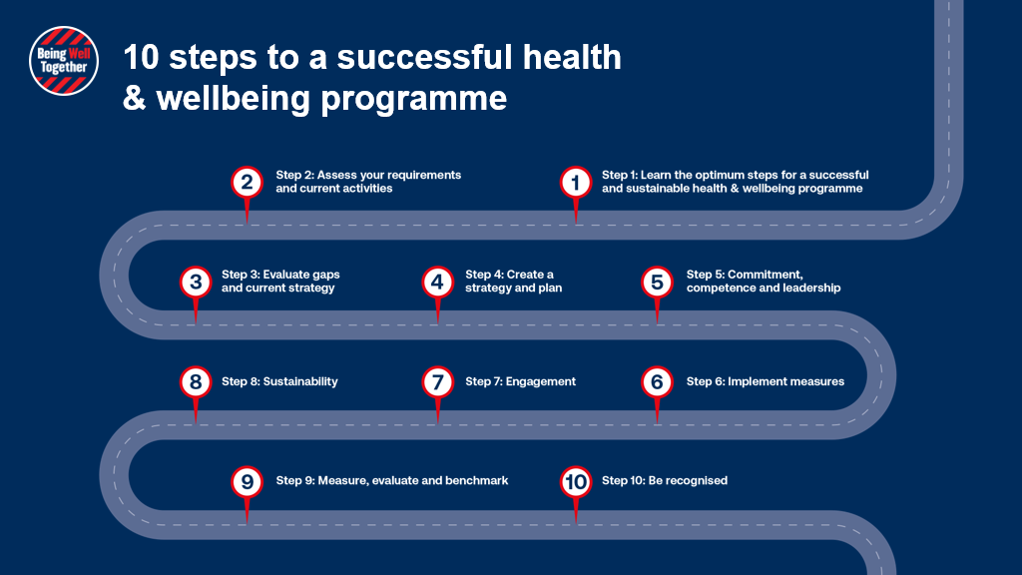
Strategic Approach to Wellbeing
Notes:
As Rebecca mentioned, Green Frog Connect joined our Being Well Together Programme last year and we’re working with them, and lots of other organisaions to put together a health, safety & wellbeing strategy with our 10 step approach.
Question to audience
If you were to put yourself on this roadmap, which step would you guess you’re at?

Slide 23
The foundation of our unique approach
Plan
Act
Do
Check
Notes:
We talked earlier about the domains of wellbeing:
Health
Good Work
Values & principles
Social & collective
Personal development
Good lifestyle choices
Financial wellbeing
As H&S experts, we also bring the Plan, Do, Check, Act Model into our approach to workplace wellbeing.
Audience participation
Hands up if you use, maybe even enjoy the PDCA approach?
As you know, this model is simple and easy to understand, yet it is a powerful driver for meaningful change and improvement while minimising waste and increasing efficiency.
And this, along with the holistic approach to Health, Safety, and Wellbeing are just two of the things that makes our Being Well Together Programme offering so different to the rest of the market.

Slide 24
The Being Well Together Programme
Organisation Assessment Tool & Employee Wellbeing Survey
Start the Conversation training materials
Employer access to template HR policies
Access to Croner-I HR 24/7 HR hotline
Being Well Together Certificate, logos & email footers
Dedicated Support Manager
Employer wellbeing guides & fact sheets
Employee wellbeing guides & fact sheets
Access to new live webinars and pre-recorded webinars
Wellbeing Campaign packs, posters, infographics
Discount access to Being Well Together partner services
Ongoing comms advice and support
Access to exclusive Roundtable Events
Access to the British Safety Council Awards
Notes:
So what is the Being Well Together Programme?
The Being Well Together Programme has the following...
Organisation Assessment Tool
Employee Wellbeing Survey
Dedicated Support Manager
Unlimited access to Start the Conversation training
Employer specific wellbeing guides and fact sheets
Employee specific wellbeing guides and fact sheets
Employer access to template HR policies
Unlimited access to the Croner-I HR 24/7 HR hotline
Being Well Together Certificate, logos and email footers
Wellbeing Campaign packs, posters, infographics
Access to new live webinars and pre-recorded webinars
Access to exclusive Roundtable Events
Discounted access to Being Well Together partner services
All of these tools give you the opportunity to do something that you haven’t done before and/or improve what you already have.
If we had another 3 hours, I’d take you through all of these incredible benefits, however, I know you’re busy and you want to know what’s going to make the real difference to your organisation…

Slide 25
Benchmarking
Organisation Assessment Tool
Find out what your organisation’s situation is and what’s needed to improve it
Covers wellbeing domains and PDCA model
Benchmark yourselves against a series of key measures
Use these as baselines to measure the impact of your wellbeing & strategies year on year
Identify gaps in your current approach and move along a continuum of best practice
Focus on prevention rather than cure
Notes:
One of the most important aspects of putting any wellbeing provision in place is knowing what your organisation's current situation is and what's needed to improve it.
Covering the domains of wellbeing, using the Plan, Do, Check, Act Model, our organisation health & wellbeing assessment tool allows you to undertake a thorough assessment (over 100 questions) of your health, safety and wellbeing provision.
The assessment draws on existing recognised and evidenced frameworks from within health and safety, clinical and Human Resources fields.
The assessment tool is intended to enable your organisation to:
Benchmark against a series of key measures in relation to the management of health, safety and wellbeing within your organisation and use this baseline to measure the impact of your wellbeing strategies and interventions year on year.
Identify gaps in your current approach to help map out a measurable plan of action towards best practice so that you can move along the continuum to ensure you are always moving forward.
Inform your decisions on the most suitable employee interventions for your organisation, focussing on prevention rather than cure.
The organisation assessment tool will provide a report containing detailed and prioritised recommendations to help your structure your wellbeing strategy in a holistic and integrated way.

Slide 26
Listen to your employees
Employee Wellbeing Survey
Your employees perspective of your health, safety & wellbeing efforts
Anonymous insights into what your people feel you are doing well as an organisation and areas they think can be improved
Your employee’s wellbeing
Works with the Being Well Together Organisation Assessment Tool
Can reassess in subsequent years
Notes:
Our unique employee wellbeing survey will provide you with your employees’ perspective of how well you are doing to improve their health, safety, and wellbeing. Using our survey you will have anonymous insights to and understand what your people feel you are doing well as an organisation, and areas for improvement need, as well as what is working for them.
The survey also asks your employees questions about their wellbeing – levels of activity, smoking, eating and drinking habits etc – to help you to build a picture of the health and wellbeing of your staff.
The Employee Wellbeing Survey is designed to work specifically with the Being Well Together Organisation Assessment Tool so that you can measure how your organisation is performing directly against employee perceptions. For example (make relevant to the organisation) You may think that your senior leadership promote a good culture of mental health and wellbeing, yet you might find out from your employees that only 24% of staff think that they do. Or perhaps you think you have a good handle on staff working outside of their contracted hours, you might find out from the survey that 67% of your staff work beyond their normal hours.
Having these two assessments side- by -side saves you spending hours trawling through data trying to determine the best use of your valuable resources. Instead you are given with a clear picture of your people’s needs so that you can match it with a suitable solution.
Our Being Well Together Supporters find the reassessments of incredible value. By completing both the Organisation Assessment Tool and Employee Wellbeing Survey a year later, we help organisations to see what’s worked well, what needs improvement, and what’s next.

Slide 27
Bespoke Support
Dedicated Support Manager
No more doing it on your own
Understanding of your organisation
Regular meetings
Expert guidance
Rooted in data
Meeting business and staff needs
Notes:
One of the common complaints that we hear from organisations is that they’re struggling to do it on their own.
With a dedicated Support Manager, you don’t have to! Our experienced Support Managers get to know you and your organisation so that they can help you to meet your organisational and people needs.
Your dedicated Support Manager will meet with you about once every 6-8 weeks to provide the guidance you need to get your health, safety and wellbeing strategy off the ground
They’ll help you to stay rooted in the data, making sure that what you put in place is what your business needs, and what your staff need
Your experienced Support Manager helps you to plan your wellbeing programme, making sure it’s rooted in this data to help you to identify and plan for appropriate change, not assumptions about what employees want.
As you saw a few slides ago, there’s tons more tools and resources that you will be able to access as a Being Well Together Supporter, if we went through them all this afternoon, we’d be here for another three hours and I know that you’re busy. Safe to say our Being Well Together Programme will give you the tools and resources you need to put together a health, safety and wellbeing strategy.

Slide 28
Recipe for success
Recap
Following the steps
Activities
Tools
Resources
Interventions
What you already have in place
Consistency
Notes:
Click
Following the 10 steps and recognising the
Activities
Tools
Resources
interventions and support available
together with what you already have in place, makes the journey clear and achievable, and in line with your business objectives.
And of course, we need repetition and consistency.
Your strategy may not be perfect straight away, it’s important to recognise that you’ll likely go through many iterations, to update and you’ll want to constantly improve it. It’s only when you go through the 10 steps a few times that you’ll get the desired long-term cultural change results that your organisation needs.
It’s this approach that will embed wellbeing into your policy, operation, brand, and culture and is the recipe for success

Slide 29
A ‘long term’ cultural change
Primary
Multiple data sets inform approach
Support services focus on proactive intervention
Demonstrable leadership ownership/ accountability
Wellbeing literacy throughout workplace
Managers equipped to manage wellbeing
Understanding
Reactive to issues/ events
Achieve minimum legal compliance
Support services focus at point of need
Policy/ies to develop (or update)
Plan/ strategy to be developed
Tertiary
Maturity
Notes:
By taking this strategic approach, we’re talking about a long-term cultural change within your organisation.
We help organisations to move from a Tertiary Intervention stage of:
Being reactive to sickness absence
Being ‘seen’ to do the right thing
Having policies for policy sake
To a place of Primary intervention where:
Multiple data sets inform your approach
You’re getting the right interventions in for the right people
The culture is coming from the top-down
Can you imagine if there was a culture of wellbeing where people would actively take care of their own wellbeing, and that of others. We’re starting to break down the mental health stigma, and we’ve got a way to go. We also want to break down the financial problems stigma too, right? A recent report from People Management explains that 81 per cent of employees don’t feel comfortable talking about money at work and 71 per cent of employees don’t feel comfortable asking for help with financial matters from their employer. Imagine what work would look like if people did feel comfortable talking about money, or any wellbeing matters, at work and requesting the help that they need from their employer.
Audience participation, show of hands, would a culture of wellbeing enhance your organisation?

Slide 30
Strategic Importance of Wellbeing
Our vision is: “no one should be injured or made ill through their work”
Putting wellbeing at the heart of our strategy means that we can broaden the delivery of our vision and have greater impact
Notes:
As you’ve probably gathered by now, here at British Safety Council, we believe that health, safety, and wellbeing is of utmost strategic importance and by putting wellbeing at the heart of our strategy means that we are broadening the delivery of our vision and having greater impact so that we reach a place where no one should be injured or made ill through their work

Slide 31
Closing Points
Wellbeing is multi-faceted
Organisations need to take a holistic approach to wellbeing so that all wellbeing domains are covered
Health, safety, and wellbeing are intrinsically linked
For optimal output, organisations should be taking a strategic approach to health safety & wellbeing.

Slide 32
How can you get involved
Webinar next Tuesday (28th March) – Leadership in Health, Safety & Wellbeing
Online Wellbeing Conference on 18th April:
Implementing an Authentic Organisational Wellbeing Strategy
Connecting workplace psychosocial hazards to unsafe behaviours: Insight from site
The real business case for workplace wellbeing
Wellbeing for human performance
The impact of indoor air quality on occupants’ cognitive function, productivity and wellbeing, and more!
2023 workplace wellbeing webinar series including:
@BritSafe
#KeepThriving
@BeingWellTogether
#KeepThriving
Notes:
2023 workplace wellbeing webinar series including:
Webinar next Tuesday (28th March) – Leadership in Health, Safety & Wellbeing presented by Phil Clarke, Head of Health and Safety, Care UK and Marcus Herbert: Head of Wellbeing, British Safety Council, and
Online wellbeing Conference on 18th April covering topics such as:
Implementing an Authentic Organisational Wellbeing Strategy
Connecting workplace psychosocial hazards to unsafe behaviours: Insight from site
The real business case for workplace wellbeing
Wellbeing for human performance
The impact of indoor air quality on occupants’ cognitive function, productivity and wellbeing, and more!

Slide 33
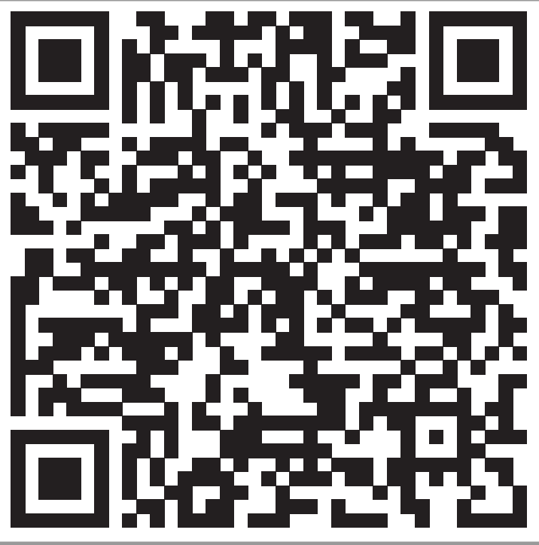
Other ways to get involved
30 Minute Complementary Consultation
Book your call with one of our experts:
Follow this QR code
020 8600 1000
support@beingwelltogether.org
@BritSafe
#KeepThriving
@BeingWellTogether
#KeepThriving
Notes:
2023 workplace wellbeing webinar series including:
Webinar next Tuesday (28th March) – Leadership in Health, Safety & Wellbeing presented by Phil Clarke, Head of Health and Safety, Care UK and Marcus Herbert: Head of Wellbeing, British Safety Council, and
Wellbeing Conference on 18th April

Slide 34
Questions and Answers
@BeingWellTogether
#KeepThriving
@BritSafe
#KeepThriving
support@beingwelltogether.org +44 (0)20 8600 1000

