Slide 1
Principles of Gas Safety
Wednesday 28th September 2022
at
Leominster Golf Club
Presented by Herefordshire Health & Safety Group

Slide 2
What is Gas?
The word 'gas' can be used to describe the physical state of many substances however, this presentation focuses specifically on the safe use of gas as a fuel in the workplace.
It is commonly used as a fuel for heating, cooking, welding, cutting and for processing products - anywhere a flame is needed.

Slide 3
1. Common gas related hazards
Gas can be supplied from the mains supply or a storage tank. It can also be supplied from smaller portable cylinders used close to the work site. Types of gas commonly used, include
natural gas
liquefied petroleum gas (LPG)
LPG autogas (LPGA)
medical gases
methane.

Slide 4
What are the risks?
There are a number of risks when using gas such as explosion from damaged, overheated or poorly maintained cylinders, pipes equipment or appliances.
There is also the risk of carbon monoxide poisoning and burns caused by contact with flame or hot surfaces.

Slide 5
Carbon monoxide poisoning (1)
When gas does not burn properly, or is used in an area without adequate ventilation, it produces excess carbon monoxide (CO) which is a colourless and odourless gas.
This can happen regardless of the type of gas being burned, whether from cylinders or a mains supply.

Slide 6
Carbon monoxide poisoning (2)
When inhaled, carbon monoxide binds with the haemoglobin in the blood and reduces the blood's ability to carry oxygen.
This can result in death.

Slide 7
Carbon monoxide poisoning (3)
The risk of carbon monoxide poisoning occurs where there is not adequate ventilation in the room where the appliance is located,
a flue or chimney is blocked and cannot vent the system properly
an appliance has not been fitted and regularly maintained by a competent person.
the Gas Safe Register site has information on the requirements of a competent person.​

Slide 8
Carbon monoxide poisoning (4)
Carbon monoxide poisoning can kill within a matter of hours so it is important to be aware of the risk and symptoms - these include
​​tiredness
drowsiness
headaches
​nausea
​

Slide 9
Gas leaks (1)
As pipes can be buried in the ground, located below floors or in wall and ceiling voids, poor maintenance can lead to leaks and build-up of gas.
This increases the risk of an explosion.

Slide 10
Gas leaks (2)
If you think you have a gas leak, you should:
remove everyone from the area
switch off the gas at the mains or supply – do not enter cellars or go below ground to do this
extinguish naked flames and sparks – but do not turn off lights as it can create a spark
.

Slide 11
Gas leaks (3)
open all windows and doors
​use a phone outside the property to contact the National Gas Emergency number on 0800 111999
contact your local gas supplier.
.

Slide 12
Carry out a risk assessment
Remember to include gas usage and storage in your risk assessment.
This will help you identify potential hazards and controls that need to be put in place

Slide 13
2. Gas safety precautions (1)
If your risk assessment has found hazards linked to the use of gas, then you need to put precautions in place.
There are a number of things you can do, such as the following:
Make sure your staff are trained to use equipment.
Store gas cylinders as per regulations.

Slide 14
2. Gas safety precautions (2)
Install and regularly test carbon monoxide (CO) detectors and alarm systems.
Perform regular inspections.
Schedule and record formal maintenance that is carried out by a competent person.
Make sure pipes, storage areas and vehicles carrying gas are suitably marked and signed.

Slide 15
2. Gas safety precautions (3)
You should also
keep areas around external flue outlets clear including from leaf and paper debris
make sure there is suitable airflow around gas appliances.
You can contact the HSE Gas Safety Advice Line free on 0800 300 363 for more advice.

Slide 16
Controls for liquefied petroleum gas LPG (1)
When using LPG extra care must be taken:
store as few gas cylinders as possible.
make sure there is suitable ventilation where the gas is being stored and used, particularly at low level.
This is because LPG is heavier than air so there is a risk of asphyxiation.

Slide 17
Controls for liquefied petroleum gas LPG (2)
The LPG Association guidance states that the storage area must
be secured against attack from vandals
have warning signs in place to show the hazards
allow for cylinders to be stored in an upright position, unless labelling states otherwise

Slide 18
Controls for liquefied petroleum gas LPG (3)
be easily accessible
be kept free of flammable sources and combustible materials, including vegetation
be located away from open drains.

Slide 19
Use a registered engineer (1)
It is important to have all gas equipment supplied, fitted and maintained by a Gas Safe registered engineer.
When selecting an engineer you should make sure that they are qualified to work on the correct equipment. You can do this by checking the back of their registration card.

Slide 20
Use a registered engineer (2)
The Gas Safe Register website also lists registered installers across the UK and their areas of expertise.

Slide 21
3. Gas safety legislation(1)
In addition to the duties placed on employers and those who control premises, under the Health and Safety at Work etc Act 1974 and associate legislation, there are a number of legal duties relating to the safe use of gas as a fuel in the workplace.

Slide 22
3. Gas safety legislation(2)
The​ Gas Safety (Installation and Use) Regulations 1998
These regulations place duties on
Employers
Gas users
Installers
Suppliers
Landlords

Slide 23
3. Gas safety legislation(3)
You can download a copy of the Approved Code of Practice (ACOP) and guidance that gives practical advice on these regulations on the Health and Safety Executive (HSE)​ site.

Slide 24
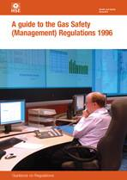
3. Gas safety legislation(4)
Gas Safety (Management) Regulations 1996
This states that detailed records should be kept of any maintenance work carried out on gas pipe work, appliances and flues.
Engineers will issue certificates for any work they carry out.

Slide 25
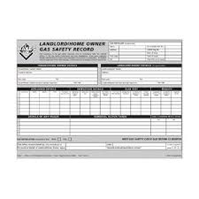
3. Gas safety legislation(5)
Landlords
Landlords have specific responsibilities for the safety of their tenants:
This includes making sure that all gas appliances, fittings and flues provided for tenants are safe.
As a landlord you are also responsible for regular maintenance and repair of new or existing flues, appliances and pipework.

Slide 26
3. Gas safety legislation(6)
Landlords
Any work and annual gas safety checks must be carried out by a Gas Safe engineer.
You must keep a record of annual safety checks for 2 years and issue a copy to each tenant within 28 days of the check.
You can find full details of landlords' responsibilities on the HSE website​ and the ​Gas Safe Register website​.

Slide 27
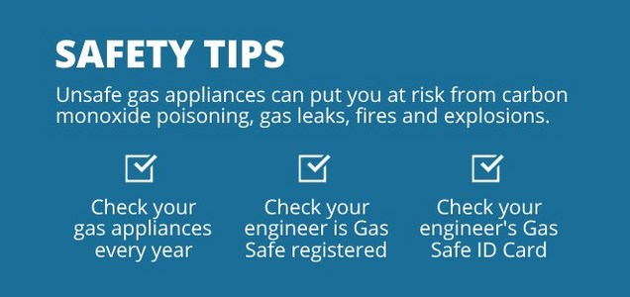
3. Gas safety legislation
Landlords REMEMBER

Slide 28
Gas in Cylinders
Relevant Legislation, ACOP’s, Guidance, etc
https://www.liquidgasuk.org/
Code of Practice 7 – The Storage of Full and Empty LPG Cylinders and Cartridges
CHIS4 Use of LPG in small bulk tanks
INDG297 Safety in gas welding, cutting and similar processes

Slide 29
Gas in Cylinders - Cont
INDG459 Oxygen use in the workplace
HSG139 The safe use of compressed gases in welding, flame cutting and allied processes
INDG327 Take care with acetylene

Slide 30
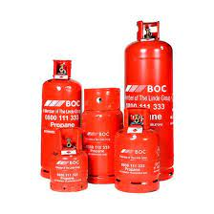
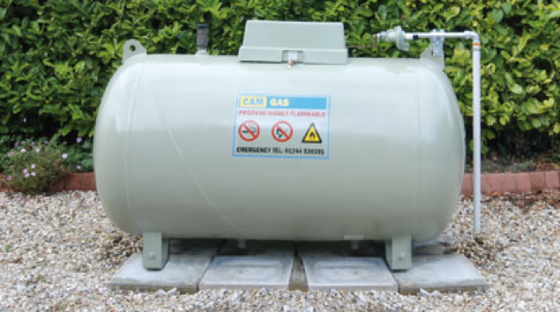
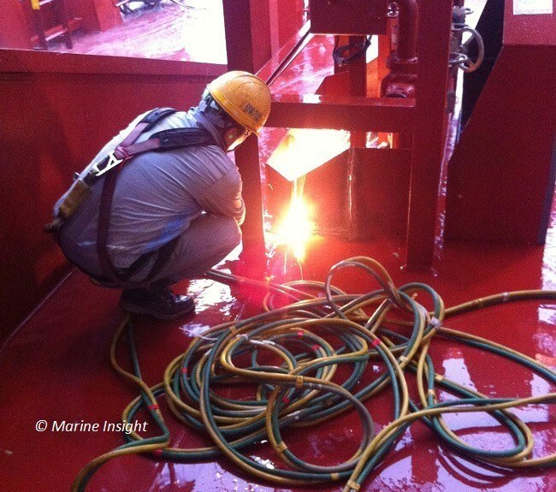
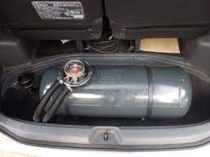
Gas in Cylinders
Forklift Trucks
Cookers; domestic, catering events
Car LPG fuel tanks
Contractors welding

Slide 31
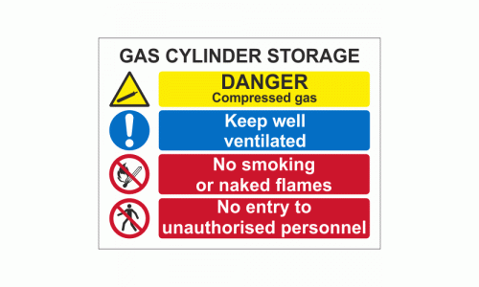
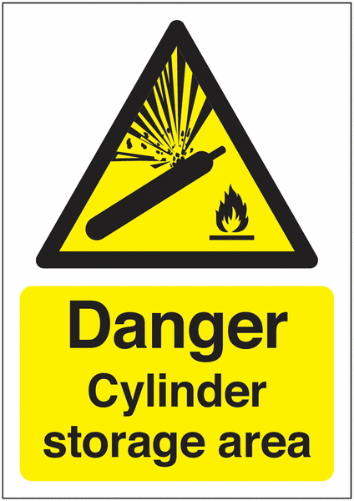
Gas in Cylinders
Signage required, explosive, flammable, no smoking

Slide 32
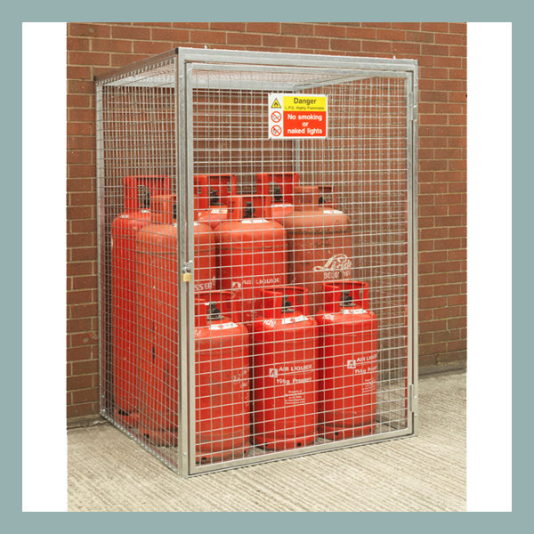
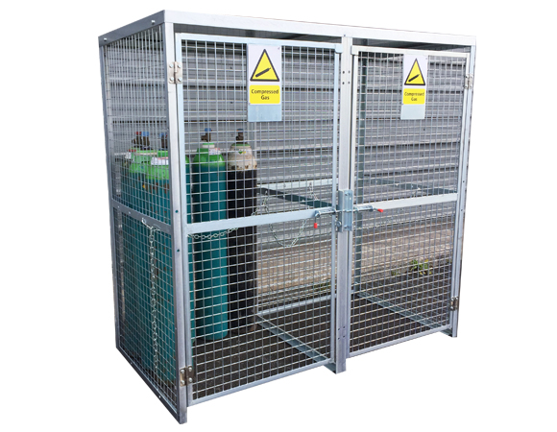
Gas in Cylinders
Fuel cylinders; LPG, Propane etc to be storage in cages or other secure environment at least 3 metres away from Oxygen cylinders

Slide 33
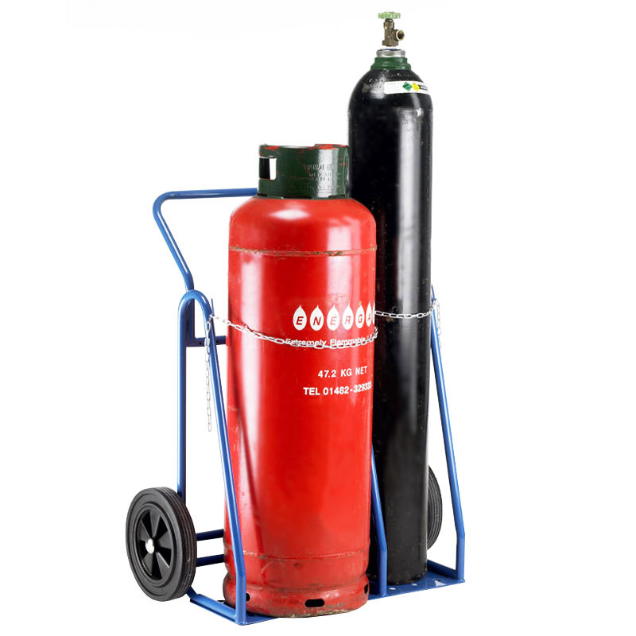
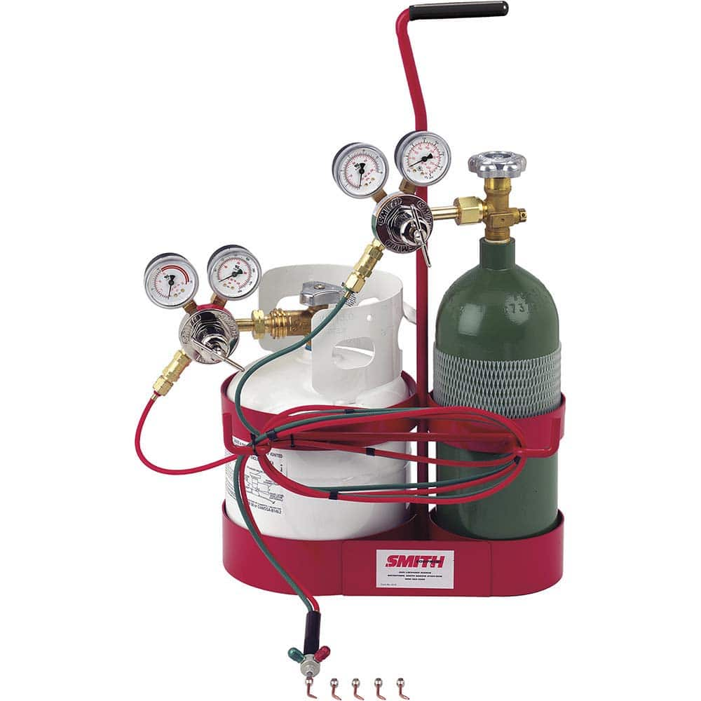
Gas in Cylinders
Transport; Upright and signage
Use of Trolleys
Use of regulators

Slide 34
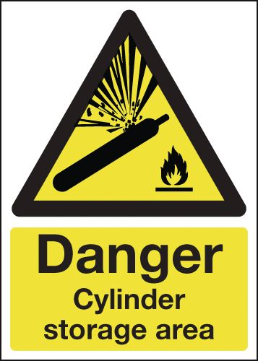
Gas in Cylinders
Disposal – cylinders owned by the supplier
Eg Calor, Liquidair, BOC
‘Empty’ cylinders are still an explosive risk

Slide 35
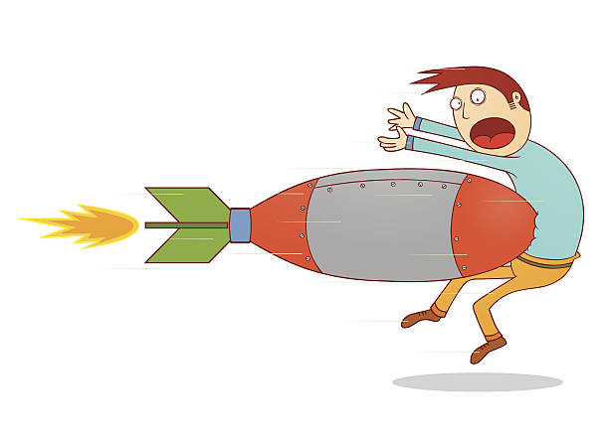
Gas in Cylinders
Transport & Storage; Upright & secure and signage
British Compressed Gases Association (BCGA) L1 The carriage of small quantities of gas cylinders. Revision 6: 2021
Cylinders lying down are ‘torpedoes’!

Slide 36
Principles of Gas Safety
Thanks for listening
Any Questions?

