Slide 1
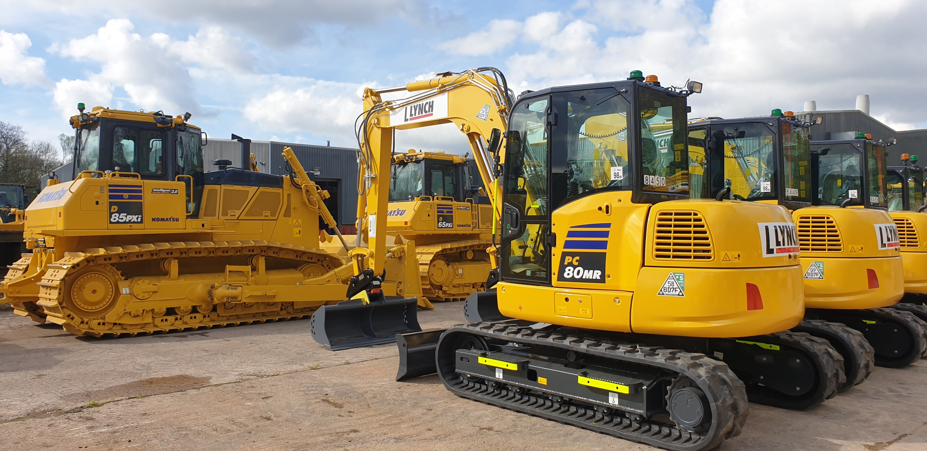
SAFETY BY DESIGN

Slide 2
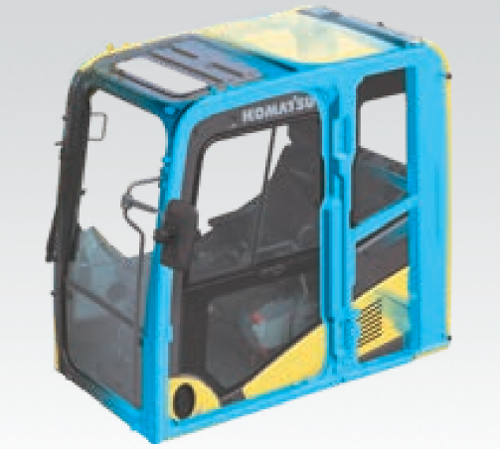
Reinforced Safety SpaceCab
The Roll Over Protective Structure (ROPS compliant to ISO 12117-2:2008) cab (up to 50t operating weight) has a tubular steel frame and provides high shock absorbency, impact resistance and durability. (The high reach machines (50t plus) have TOPS (Tip Over Protective Structure) as standard).

Slide 3
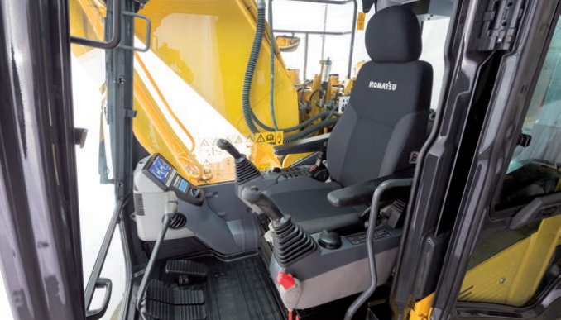
Reinforced Safety SpaceCab
A standard air-suspended high-back seat, heated for improved comfort and with fully adjustable armrests with lumbar support, is the centre of a comfortable and low-fatigue working environment. High visibility and ergonomic controls further assist to maximise the operator’s productivity.

Slide 4
Reinforced Safety SpaceCab

Slide 5
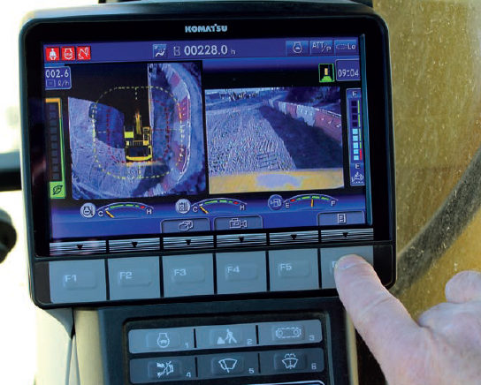
KomVision surround view system
With a series of high definition networked cameras fitted, KomVision provides a crystal clear, real-time bird’s eye view of the immediate surroundings on the widescreen cab monitor. The driver can quickly and easily check the machine’s surrounding area prior to making any movements, even in low light conditions.

Slide 6
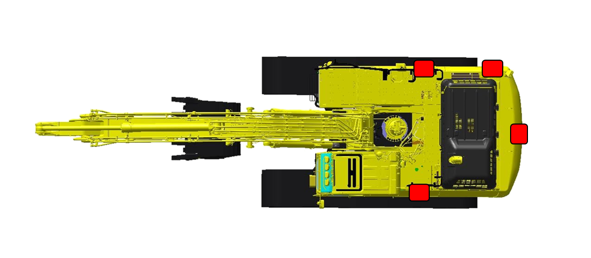
KomVision surround view system
1
2
3
3 or 4 Cameras (model dependant)
4

Slide 7
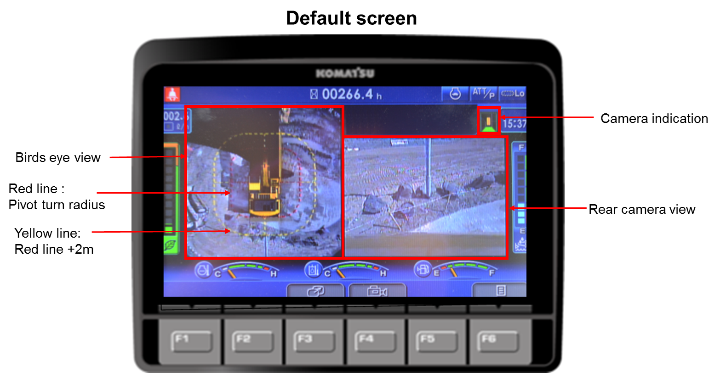
KomVision surround view system
Birds eye view incorporates input from all cameras and creates a bird’s eye view.
Default screen shows rear view camera image.

Slide 8
Demolition Models
Operator Protective Guards (ISO10262 Level 2 OPG)
Laminated high impact glass on front and roof windows (EN356 Grade P5A - tested with 4.11kg ball dropped from 9m (9 times total)
Demolition protection: 15mm bolted on side guards, Wrap around side protection, 9mm underguards, heavy duty bucket linkages.
Working range indication system with graphical display showing maximum limits of machine with stated attachment weight and real time movement, working through 360º.
Arm end camera
Lifting eyes for safe transportation
Parallel Action Wiper wide view
Tilt cab emergency down switch (internal & external)
LED Lamps Enhanced view of the jobsite

Slide 9
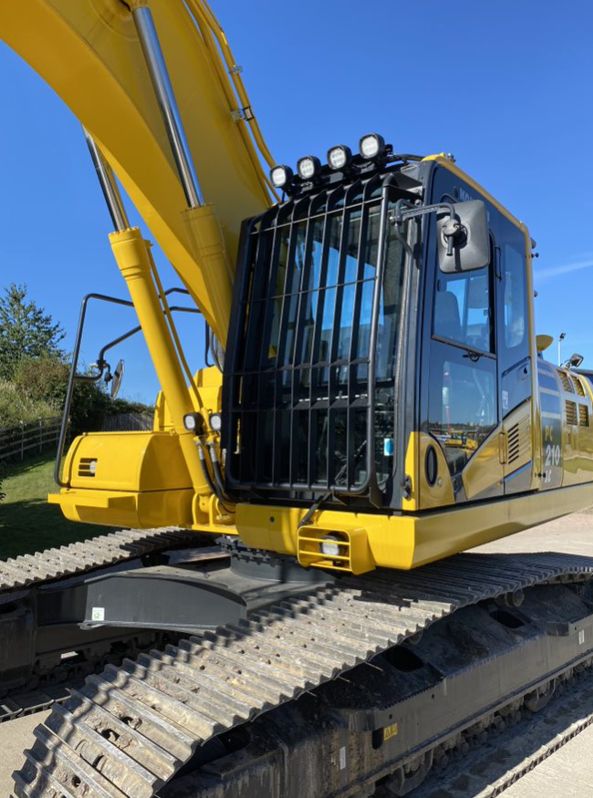
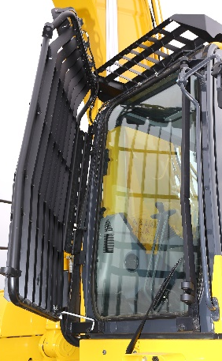
Demolition: Operator Protective Guards

Slide 10
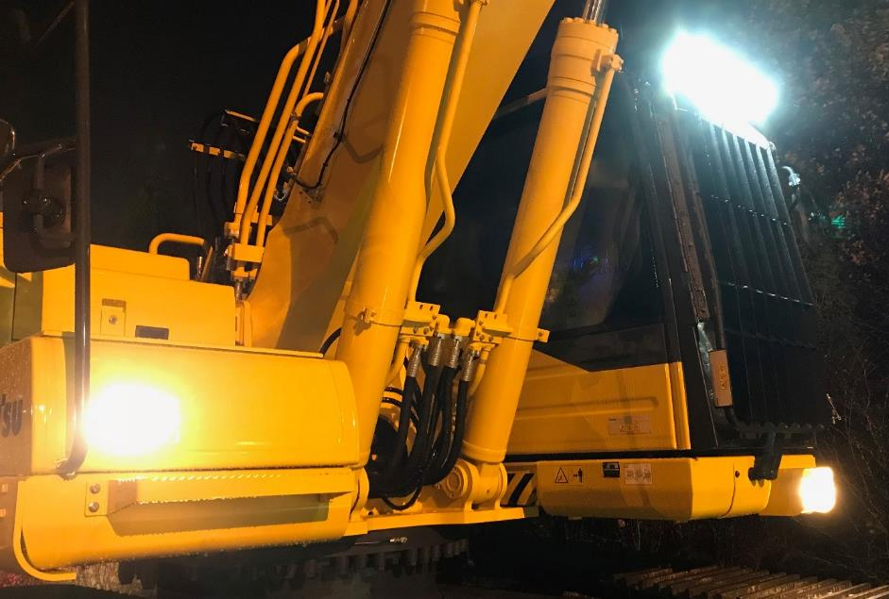
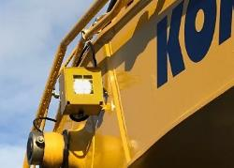
Demolition: LED Lamps

Slide 11
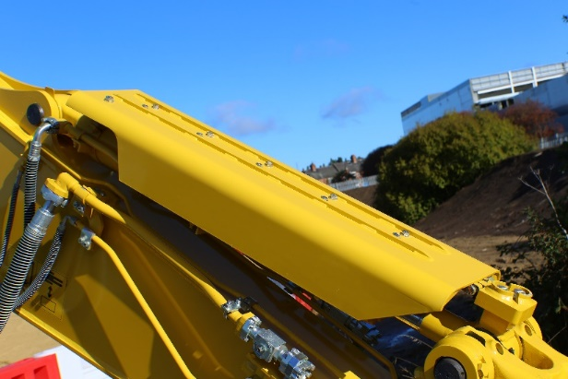
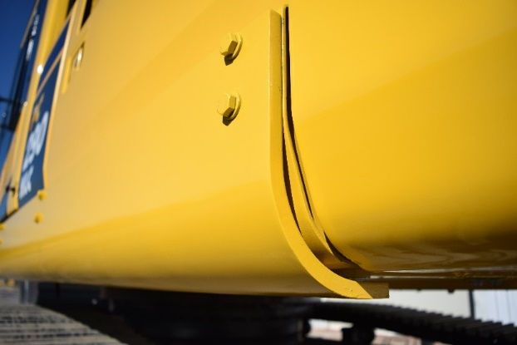
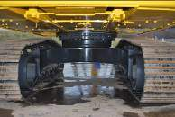
Demolition: Protection
15mm bolted on side guards
Wrap around side protection
9mm underguards

Slide 12
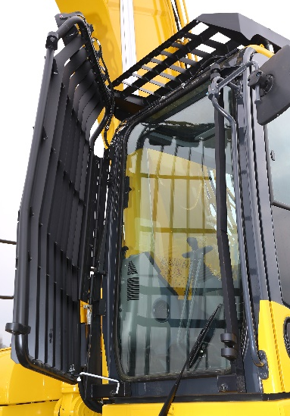
Demolition: Laminated High Impact Glass
Test requirement:
Impactor: steel sphere, diameter 100mm, 4.11 kg.
Drop type: P1A – P4A: Impactor dropped three times from the test height. The points of impact form an equilateral triangle with a side length of approx. 130mm. P5A: Same procedure as for P4A, but repeated 3 times, making a total of 9 impacts, 3 impacts on each of the three impact points.
The glass is intended to resist impact of heavy materials travelling at high speed.

Slide 13
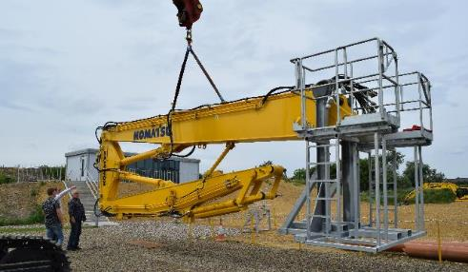
Demolition: Lifting Eyes

Slide 14
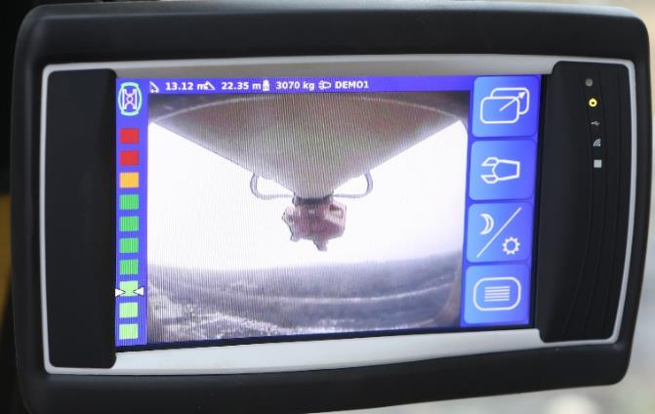
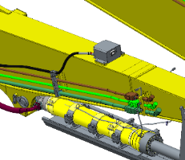
Demolition: Arm End Camera

Slide 15
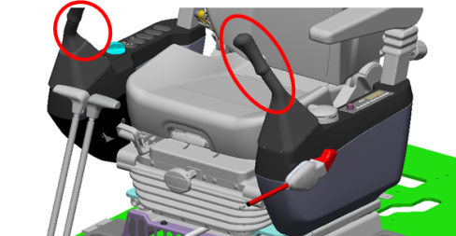
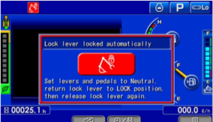
Neutral Position Detection System
If the work equipment levers are not in neutral when the lock lever is released, the machine is prevented from any movement.
The auto stop status is shown on the monitor panel.

Slide 16
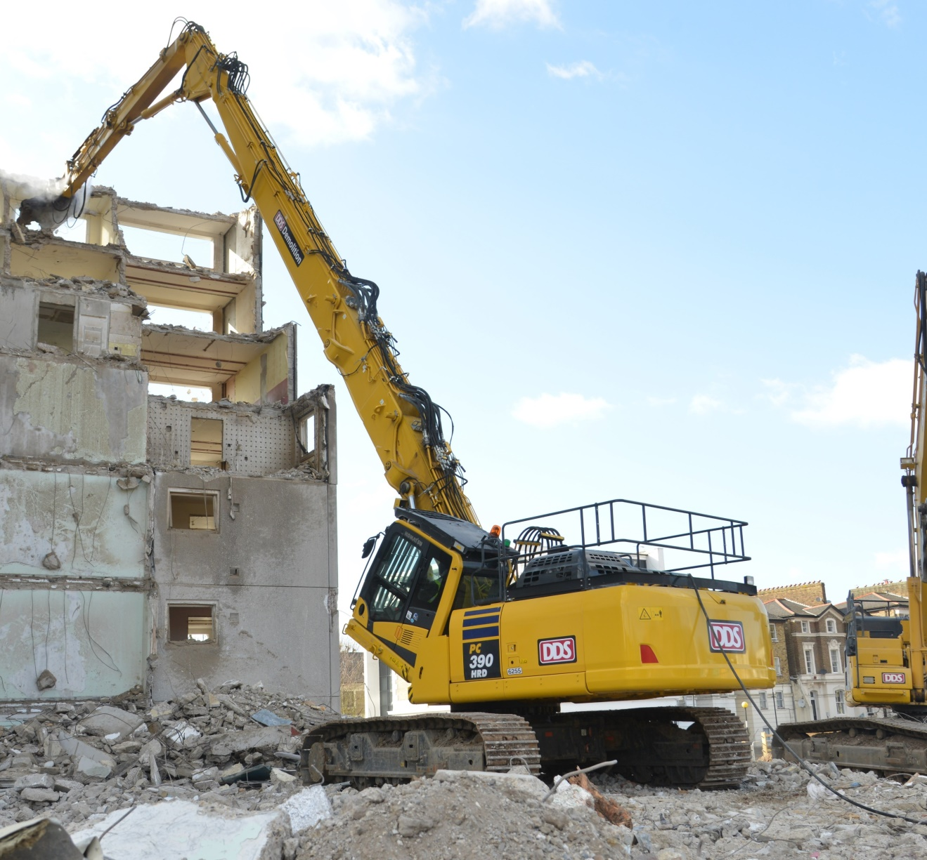
‘Boxing Ring’ Safety Rails
Safety rails added to higher risk areas of machines

Slide 17
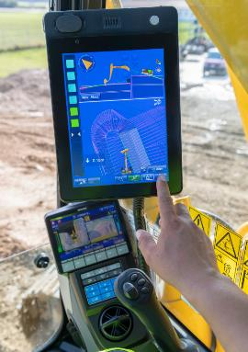
intelligent Machine Control
Less human interaction needed = less risk = higher safety levels.
Machine is fitted with sensors, monitor and antennae which then offer extremely fine control for the functions.

Slide 18
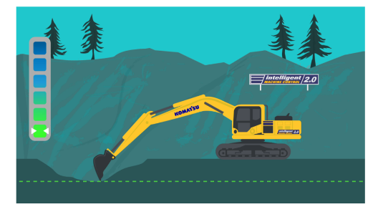
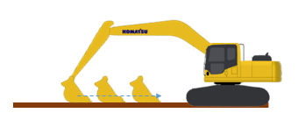
intelligent Machine Control
Auto Stop Control: Eliminates “over digging”
Auto Grade Assist: Ensures finished accuracy first time, in one pass
Auto Tilt Control: Makes delivering final grade quicker and easier
Bucket Angle Hold: Increased productivity and easier finished quality

Slide 19
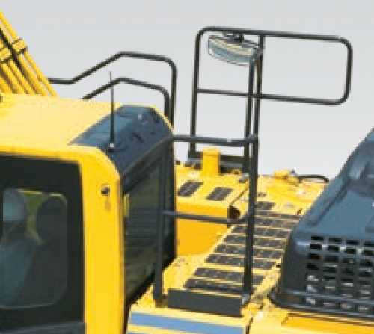
Standard Fit Safety Equipment
Electric horn
Overload warning device - operates when in lifting mode.
Audible travel alarm
Boom safety valves
Large handrails, rear-view mirrors
Battery main switch
Seat belt caution indicator
Boom and arm hose burst valves
Highly durable anti-slip plates – with additional high friction covering – maintain long term traction performance.

Slide 20
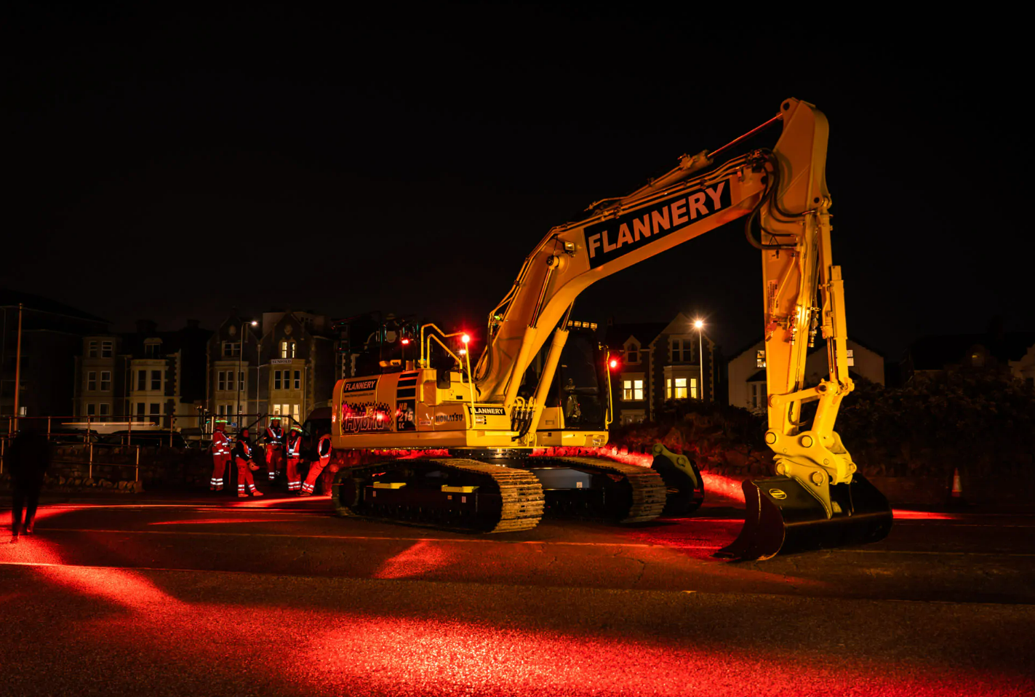
Aftermarket Safety Options
Halo lighting
Wheel Loader proximity reverse radar (Ogden Safety Systems)
Slew and height control (Prolec / Xwatch)
Hi vis tape on handrails and steps
RDS Bucket Weighing system
…plus many more options, application specific.

Slide 21
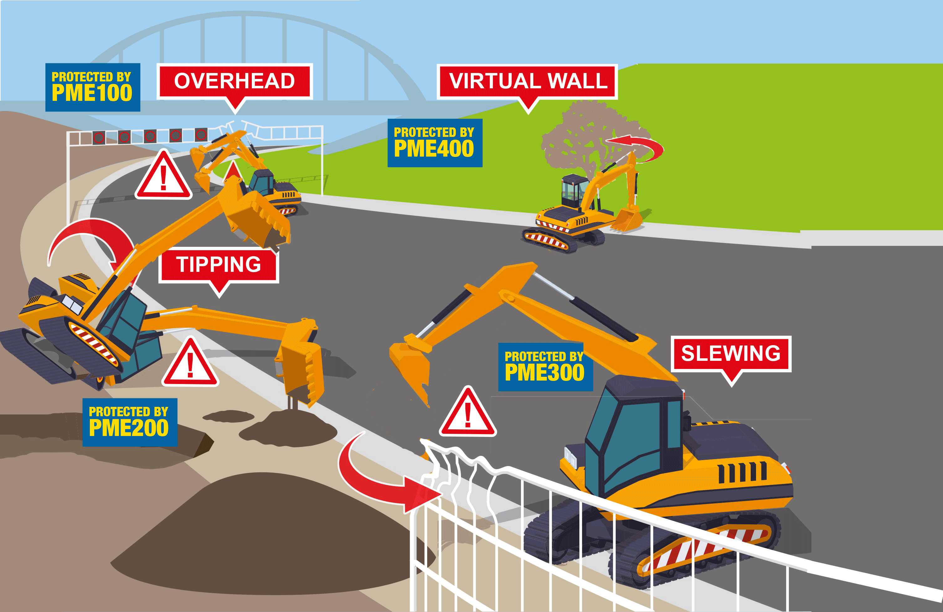
Aftermarket Safety Options

Slide 22
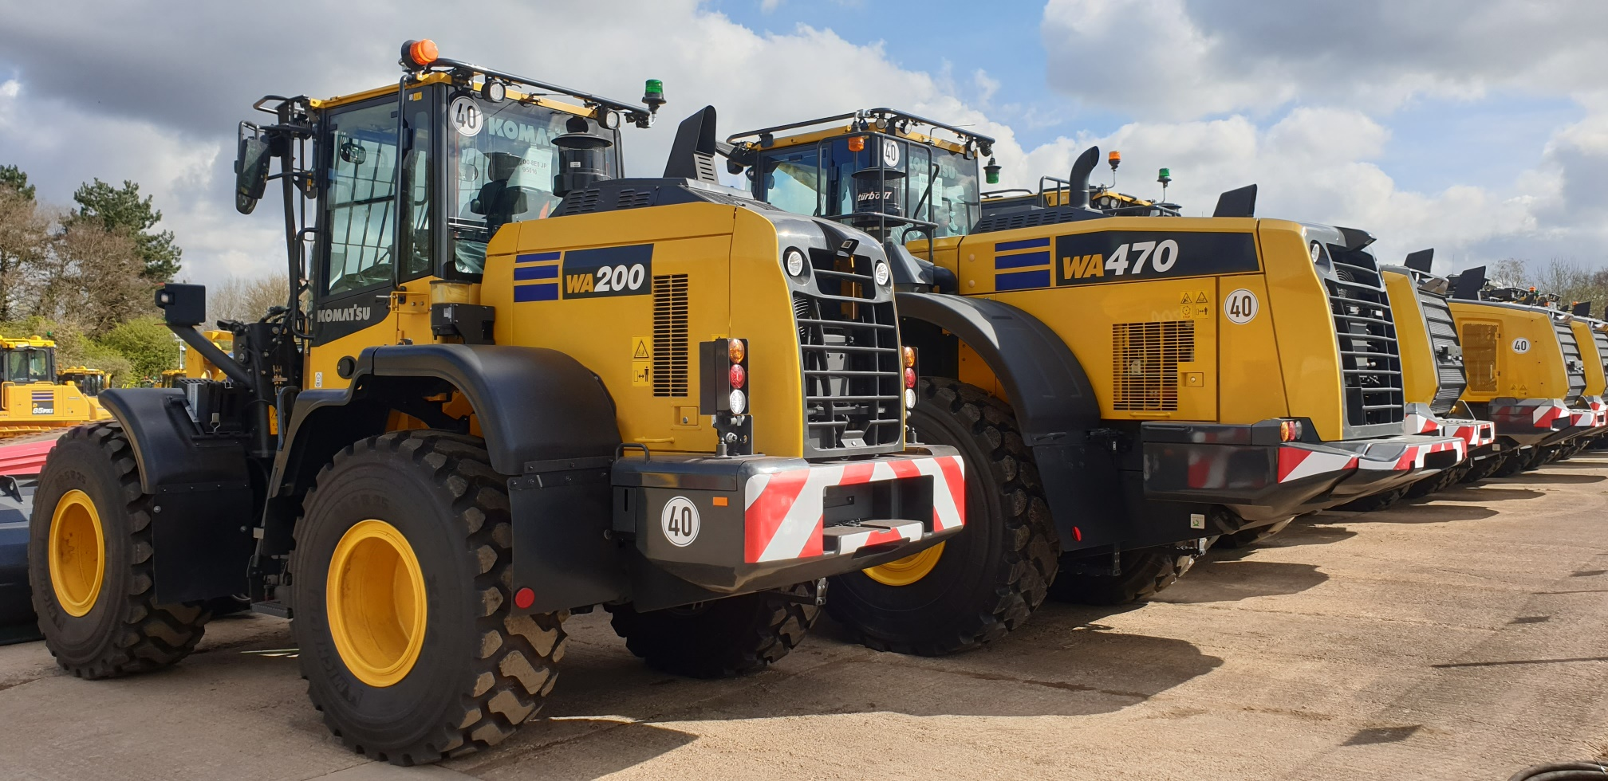
THANK YOU
Carole Nicholls
07867 552 195
Carole.Nicholls@mkl.co.uk

