Slide 1
Seasonal Safety 2022
Wednesday 23rd March 2022
at
Leominster Golf Club
Presented by Herefordshire Health & Safety Group

Slide 2
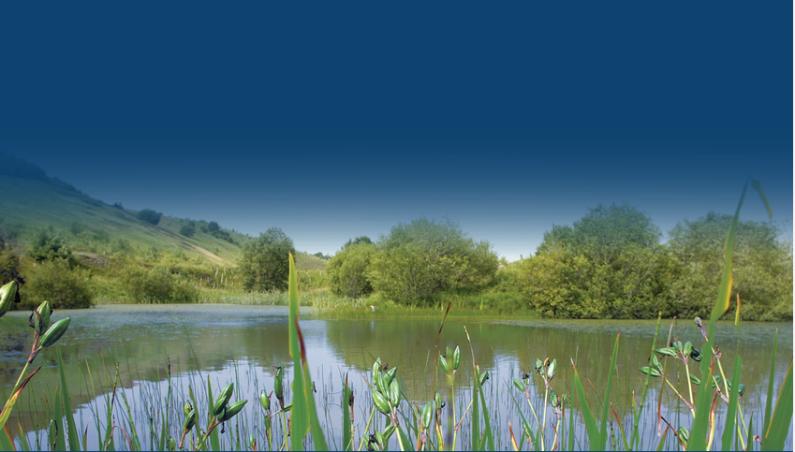
Keeping Communities Safe Around Water
The majority of deaths involving members of the public in quarries are water related.
Educating the public about the hazards associated with open water will help to minimise these avoidable and tragic incidents in quarry lakes and other types of inland water such as reservoirs, rivers and canals which are present in and around Herefordshire.
The briefing notes summarise key water safety messages being used by a wide range of organisations and guidance on what to do in an emergency.
These notes were originally developed by the Wales Water Safety Group and included input from RNLI, RoSPA, Swim Wales, the emergency services, MPA and the water utilities.

Slide 3
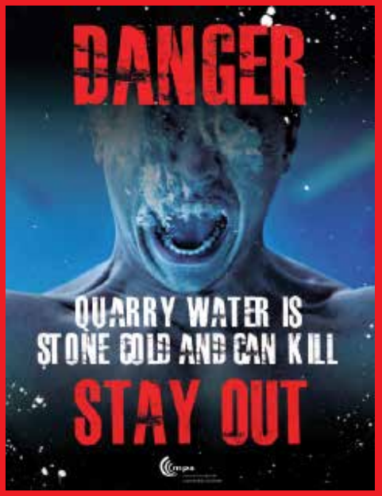
KEY MESSAGES – SAFETY IN AND AROUND WATER (1)
Whatever your activity and your ability, the water can always catch you out as it’s easy to underestimate its power.
Stay safe by spotting the dangers, you may swim well in a warm indoor swimming pool but that does not mean you will be able to swim in the cold water of the seas, rivers, quarries or reservoirs.
Don’t ignore safety advice, special flags and notices that warn you of any dangers. Know what each sign means and what they’re telling you to do.
https://www.safequarry.com/resources/MPA%20Community%20Water%20Safety.pdf

Slide 4
KEY MESSAGES – SAFETY IN AND AROUND WATER (2)
Never swim alone.
If you get into danger in open water, there will be someone who can get help. Children should always be accompanied by an adult.
You should never go in the water after drinking. Alcohol is a contributing factor in many water related incidents as it seriously impairs your judgement, reactions and ability to swim.
The effect on the body after entering cold water is often underestimated.
Cold water shock can be a precursor to drowning.
https://www.safequarry.com/resources/MPA%20Community%20Water%20Safety.pdf

Slide 5
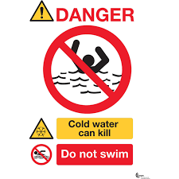
The dangers of water (1)
It is very cold and could cause cold water shock or hypothermia.
There may be hidden pumps or currents which could make it difficult to swim back to shore.
It can be difficult to get out e.g. steep, slimy or crumbling banks.
It can be deeper than it looks, there can be sudden changes in depth and it can be difficult to estimate how deep the water is.

Slide 6
The dangers of water (2)
In the water, there may be hidden rubbish or debris e.g. shopping trolleys, broken glass and underwater weeds can wrap around your legs.
If swimming in rivers, quarries or reservoirs there will be no lifeguards around to help.
The water may be polluted and cause illnesses.
Did you know the average UK sea temperature is just 12°C. Quarry lakes can be much colder than that, even in the summer, the risk of cold water shock is significant most of the year.
It only takes half a pint of water to enter the lungs for a fully grown person to start drowning.

Slide 7
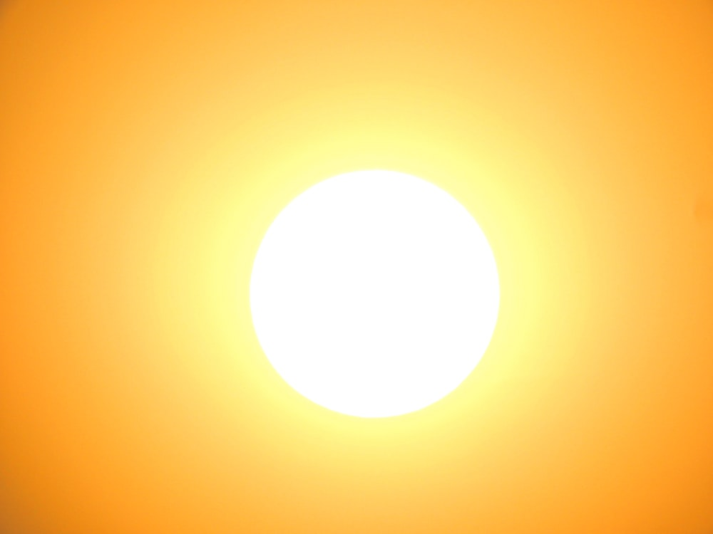
Outdoor working – Hot environments (1)
When working outdoors the effects of the weather in the UK environment can potentially have a serious impact on an employee's health if the risks have not been considered or properly managed. This impact may be immediate or it may occur over a long time period.
When working outdoors the weather can have influence an individual's effectiveness and this is not readily managed using just engineering controls. In these circumstances some of the most effective ways of managing these environments are to introduce some simple administrative controls, for example:
https://www.hse.gov.uk/temperature/outdoor.htm

Slide 8
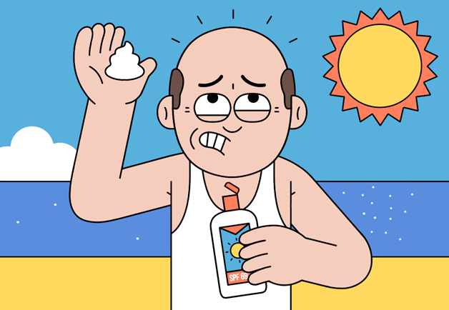
Outdoor working – Hot environments (2)
Some simple administrative controls:-
reschedule work to cooler times of the day
provide more frequent rest breaks and introduce shading to rest areas
provide free access to cool drinking water
introduce shading in areas where individuals are working
encourage the removal of personal protective equipment when resting to help encourage heat loss
educate workers about recognising the early symptoms of heat stress
Too much sunlight is harmful to your skin. It can cause skin damage including sunburn, blistering and skin ageing and in the long term can lead to an increased risk of skin cancer. Skin cancer is one of the most common forms of cancer in the UK with over 50,000 new cases every year.
A tan is a sign that the skin has been damaged. The damage is caused by ultraviolet (UV) rays in sunlight.

Slide 9
Outdoor working – Hot environments (3)
Who is at risk?
If work keeps you outdoors for a long time your skin could be exposed to more sun than is healthy for you. You should take particular care if you have:
fair or freckled skin that doesn't tan, or goes red or burns before it tans
red or fair hair and light coloured eyes
a large number of moles

Slide 10
Sun Safety - skin cancer (1)
At least 1,500 new cases of non-melanoma skin cancer (NMSC) and 240 new cases of malignant melanoma linked to solar ultraviolet radiation (UVR) exposure at work are diagnosed in Britain each year.
Skin cancer kills 60 workers a year, in Britain each year, but 90 per cent of all skin cancer deaths can be prevented. In Britain we love the sun and having a sun tan, but even a tan that has been built up gradually can be harmful to health. A tan is a sign that the skin has been damaged.
In the short term... sunburn can blister your skin and make it peel; mild reddening is a sign of skin damage.
In the long term... too much sun will speed up the ageing of your skin, making it leathery, mottled and wrinkled, and the most serious effect is an increased chance of developing skin cancer.
Abnormal reactions to sunlight
Some medicines, contact with some chemicals used at work (such as dyes, wood preservatives, coal-tar and pitch products), and contact with some plants, can make your skin more sensitive to sunlight.

Slide 11
Sun Safety - skin cancer (2)
Some Dos and Don’ts to avoid the dangers are:
■ Do try to avoid the mild reddening which is a sign of skin damage as well as being an early sign of burning.
■ Take your breaks in the shade if you can - this will reduce your risk of harming your skin and also help to keep you cool.
■ Cover up with suitable clothing and sunglasses
■ Do continue to take care when you go outside even in the garden - your skin remembers every exposure.
■ Don’t be complacent; get to know your skin’s most vulnerable areas (eg back of neck, head) and keep them covered.

Slide 12
Sun Safety - skin cancer (3)
Some Dos and Don’ts to avoid the dangers are:
Don’t try to get a tan - it’s not a healthy sign.
Do stay hydrated, drink plenty of water.
When buying sunscreen, the label should have a sun protection factor (SPF) of at least 30 to protect against UVB at least 4-star UVA protection
UVA protection can also be indicated by the letters "UVA" in a circle, which indicates that it meets the EU standard.
Make sure the sunscreen is not past its expiry date. Most sunscreens have a shelf life of 2 to 3 years.

Slide 13
Sun Safety - skin cancer (4)
Check your skin
The first warning sign is often a small scabby spot which does not clear after a few weeks. Look for changed or newly formed moles or any skin discolouration.
You should pay particular attention to any growths which appear on the face, especially around the nose and eyes, or on the backs of the hands; you should show your doctor any moles which change in size, colour, shape or start to bleed.
Fortunately most of these signs will be harmless, but medical checks may be needed to be sure. Even if a spot is cancerous, simple modern treatments can usually cure it and most don’t spread to other parts of the body. The smaller the spot the easier it is to cure.
Don’t delay. If you think something might be wrong get it looked at quickly.

Slide 14
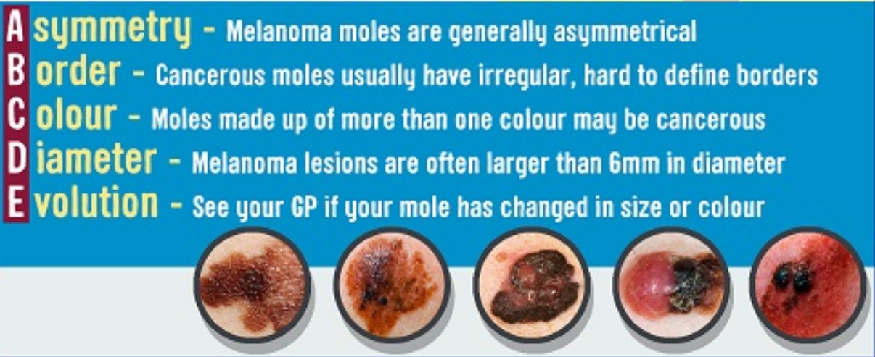
Sun Safety - skin cancer (5)

Slide 15
How does the body react to heat?
The body reacts to heat by increasing the blood flow to the skin's surface, and by sweating.
This results in cooling as sweat evaporates from the body's surface and heat is carried to the surface of the body from within by the increased blood flow.
Heat can also be lost by radiation and convection from the body's surface.

Slide 16
Typical example of a heat stress situation
Someone wearing protective clothing and performing heavy work in hot and humid conditions could be at risk of heat stress because:
sweat evaporation is restricted by the type of clothing and the humidity of the environment.
heat will be produced within the body due to the work rate and, if insufficient heat is lost, core body temperature will rise.
as core body temperature rises the body reacts by increasing the amount of sweat produced, which may lead to dehydration.
heart rate also increases which puts additional strain on the body.
if the body is gaining more heat than it can lose the deep body temperature will continue to rise.
eventually it reaches a point when the body's control mechanism itself starts to fail.
the symptoms will worsen the longer someone remains working in the same conditions.

Slide 17
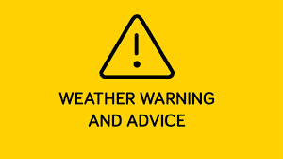
What are the effects of heat stress?
Heat stress can affect individuals in different ways, and some people are more susceptible to it than others.
Typical symptoms are:
an inability to concentrate
muscle cramps
heat rash
severe thirst - a late symptom of heat stress
fainting
heat exhaustion - fatigue, giddiness, nausea, headache, moist skin
heat stroke - hot dry skin, confusion, convulsions and eventual loss of consciousness. This is the most severe disorder and can result in death if not detected at an early stage

Slide 18
How to prevent heat stress
Action to take
MOST IMPORTANT - Prevent dehydration
Working in a hot environment causes sweating which helps keep people cool but means losing vital water that must be replaced.
Provide cool water in the workplace and encourage workers to drink it frequently in small amounts before, during and after working

Slide 19
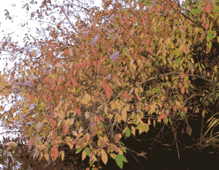
So that’s Spring & Summer but what about Autumn & Winter
Autumn
Get Your Flu Shot
Autumn is the start of flu season so if you are eligible get vaccinated against the flu.
Drive Safely as it gets Darker
When the clocks go back it starts to get darker earlier so more care is required whilst driving in darkness, remember even with high-beam headlights on, visibility is limited to about 500 feet (250 feet for normal headlights) creating less time to react to something in the road, especially when driving at higher speeds.
Make sure headlights are clean
Dim your dashboard
Look away from oncoming lights
If you wear glasses, make sure they're anti-reflective
Clean the windshield to eliminate streaks
Slow down to compensate for limited visibility and reduced stopping time

Slide 20
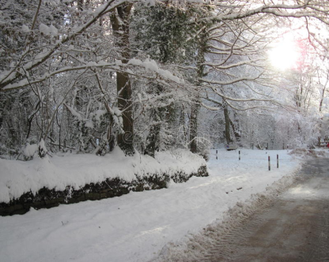
Winter
Drive Safely in winter road conditions
Driving in the winter means changes in the way you drive. Snow, sleet and ice can lead to hazardous road conditions.
Prevent Carbon Monoxide Poisoning
Carbon monoxide detectors save lives.
The most common symptoms of carbon monoxide poisoning are often described as “flu-like” – headache, dizziness, weakness, upset stomach, vomiting, chest pain and confusion.
Check your batteries
When you change your clocks, it's also a great time to check the batteries in your smoke alarms and carbon monoxide detectors.

Slide 21
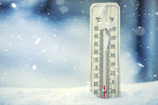
Working outside in cold conditions
There’s no minimum or maximum working temperature for working outdoors – but employers do have a duty of care to their employees.
Employers have to:
Ensure any protective equipment is appropriate
Provide any equipment for free and it must be properly maintained
Provide mobile facilities for employees warming up
Encourage the consumption of hot drinks such as soup or hot chocolate
Educate workers about the early symptoms of cold stress
Incorporate more frequent rest breaks into the day
Delay work until a warmer time of the year, so long as that doesn't compromise safety

Slide 22
What are the risks if you work outside?
Frostbite
This typically occurs if your skin is exposed to freezing temperatures.
It usually affects extremities, such as the hands, feet, ears, nose and lips, but can happen in any part of the body.
If your skin goes pale and numb, you should try to warm sufferers slowly indoors, but avoid putting them close to a heater or fire as this can make it worse.
Chilblains
This is when you get small, itchy swellings on your skin that happen as a reaction to cold temperatures.
Thankfully these normally heal within a few weeks if further exposure to the cold is avoided.
You should seek help if you have severe or recurring chilblains and if your chilblains don't improve within a few weeks.
Hypothermia
This serious condition takes place when your normal body temperature (37C) falls to below 35C.
It can be extremely dangerous if not treated quickly, so you should call 999 if you notice the signs and if temperatures slip to under 32C.
Symptoms of hypothermia include shivering, cold and pale skin, slurred speech and confusion.
To help treat someone, you need to move them indoors, remove wet clothing, wrap them in blankets, give them a warm non-alcoholic drink if they can swallow normally, and give energy food that contains sugar if they can swallow normally.

Slide 23
Thanks for listening
Any Questions?

