Slide 1
Health, Safety & Environmental Update 2022
Wednesday 23rd February 2022
at
Leominster Golf Club
Presented by Herefordshire Health & Safety Group

Slide 2
We Are glad you could make it to the HHSG first face to face meeting of the year

Slide 3
HSE Update 2022
A Look Back at 2021
Notes:
2021 has been a relatively quiet year for health and safety.
Despite there being post-Brexit promises of major overhauls to health and safety legislation, nothing has materialised or is slated for early 2022.
Nor has the HSE been particularly active when it comes to on-site enforcement. But is this pattern set to continue?

Slide 4
HSE Update 2022
Coronavirus.
Coronavirus & HSE
In line with national rules HSE has limited their visits
They have been concentrating on how organisations manage the virus and have been particularly active in Herefordshire
Notes:
The primary reason the HSE hasn’t followed through on new legislation and cut direct enforcement visits is coronavirus.
As new variants hit and rules are creeping back to what they were in the summer of 2021, it does appear that it will continue to have a major impact on the HSE.
On this basis, we shouldn’t expect a raft of post-Brexit legislation any time soon, or for inspectors to be as active they were pre-pandemic.

Slide 5
HSE Update 2022
Coronavirus – What do you need to do?
As part of your risk assessment to protect your workers and others from coronavirus (COVID-19), you should identify poorly ventilated work areas.
Notes:
But - be warned that as long as there are rules and restrictions on coronavirus, if an inspector calls, they will check that your arrangements meet the current requirements and it’s certainly worth keeping an eye on government guidance and the news to track what you should be doing.

Slide 6
HSE Update 2022
Insurance companies have been looking at companies’ H&S Arrangements. Again particularly how you are managing Covid-19 and it’s variants
Checking Paperwork
When PPE was issued
Method Statements/Risk Assessments signed etc
Training/Briefings attended
Keep records!
Notes:
During 2021 insurers have definitely been looking at the health and safety arrangements of the organisations they’ve insured in more detail.
In particular, they’ve been checking that paperwork trails are in place, for example that staff are signing for PPE when it is issued, they’ve been briefed on method statements, risk assessments, etc. This is a trend that is certain to continue in 2022.
Make sure that you keep records of any training and ask staff to sign to confirm they have attended and understood the messages. Evidence such as this will be incredibly valuable if it comes to fending off a potential personal injury claim.

Slide 7
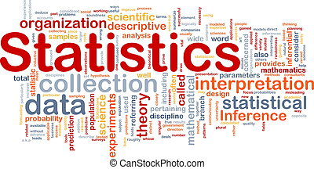
HSE Update 2022
HSE Annual Statistics 2020 – 2021
The HSE has released its annual health and safety statistics for 2020/2021. In summary these figures show:
142 workers were killed at work which represents a significant increase from 111 in 2019/20
441,000 workers sustained non-fatal injuries compared with 693,000 in 2019/20
185 cases were prosecuted which is a significant decrease from 325 cases in 2019/20
2,929 enforcement notices were issued representing less than half of the 7,7075 notices served in 2019/2020.

Slide 8
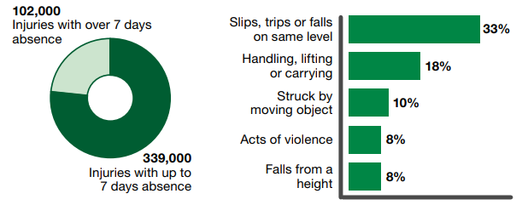
HSE Update 2022
The story behind the figures
Notes:
The story behind the figures (cont’d)
Drilling down into the figures, it is evident that slips, trips and falls continue to account for a high proportion of these injuries, with lifting, carrying and being struck by moving objects also being a common cause.
Furthermore, it is clear that it is not just the overall number of workplace incidents that is declining, but also the number of more serious cases which require reporting under the Reporting of Injuries, Diseases and Dangerous Occurrences Regulations. In 2020/2021 there were 51,211 reports, down from 65,427 reports made in 2019/20.
It is also hard to reconcile why the number of non-fatal incidents had dropped so markedly, which could perhaps be attributed to more people working from home, and yet the number of fatal workplace incidents has increased significantly.
These figures serve as a stark reminder to employers of the importance of continual improvement in safety at work and of looking at new ways of using technology to help drive towards the ultimate goal of zero fatal incidents. That said, the UK has only fallen slightly behind Germany in terms of being one of the safest EU countries to work in.

Slide 9
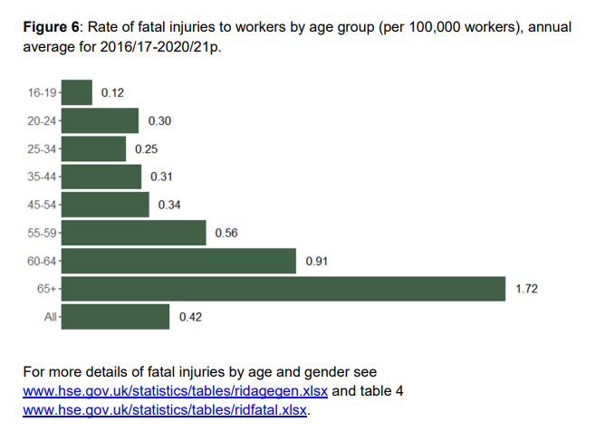
HSE Update 2022
Fatalities by age group

Slide 10
HSE Update 2022
The direct impact of COVID-19
Interestingly, the HSE has included figures concerning the numbers of workers impacted by COVID-19, with 93,000 workers attributing having caught the virus to exposure at work.
A further 645,000 workers have said that they have suffered from a work-related illness which has been caused or made worse by the effects of the pandemic.
The majority of such workers operate within the health and social care sectors and in public administration and defence with stress, depression and anxiety accounting for 70% of such illnesses, evidencing the strain directly felt by the workers at the sharp end of the fight to control the virus.

Slide 11
HSE Update 2022
It is noteworthy that these figures do not take into account prosecutions by local authorities for safety related offences.

Slide 12
HSE Update 2022
So what’s changing this year
The Highway Code
Driving
Personal Protective Equipment
Building Regs

Slide 13
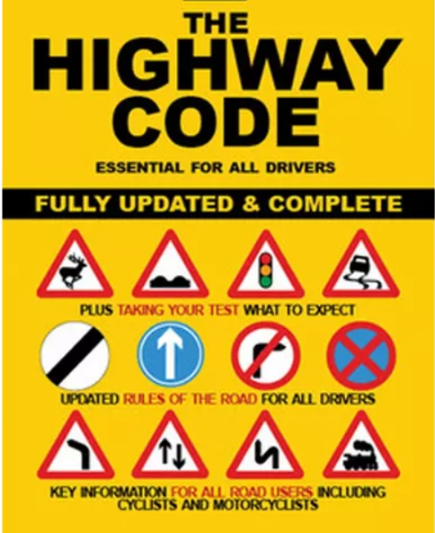
HSE Update 2022
The Highway Code – the major changes
Drivers of large passenger vehicles and HGVs now have ‘the greatest responsibility to reduce the danger posed to other road users’
Drivers at a junction should give way to pedestrians crossing or waiting to cross a road that they’re turning into
Drivers should give way to pedestrians waiting to cross a zebra crossing, and pedestrians and cyclists waiting to cross a parallel crossing
Cyclists should give way to pedestrians that are using shared-use cycle tracks
Drivers should not cut across cyclists going ahead when turning into or out of a junction or changing direction or lane
New ‘Dutch Reach’ technique tells road users how to open the door of their vehicle while looking over their shoulder

Slide 14
HSE Update 2022
Three new rules added to The Highway Code
Rule H1: hierarchy of road users
The first (and most significant) rule in the refreshed The Highway Code sets out the hierarchy of road users. Road users who can do the greatest harm (those driving large vehicles) have the greatest responsibility to reduce the danger they pose to other road users.
Pedestrians
Cyclists
Horse riders
Motorcyclists
Cars/taxis
Vans/minibuses
Large passenger vehicles/heavy goods vehicles
.

Slide 15
HSE Update 2022
Rule H2: clearer and stronger priorities for pedestrians
This rule is aimed at drivers, motorists, horse riders and cyclists.
The Highway Code now states clearly that, at a junction, you should give way to pedestrians crossing or waiting to cross a road that you’re turning into. Previously, vehicles had priority at a junction.
Drivers should also give way to pedestrians waiting to cross a zebra crossing, and pedestrians and cyclists waiting to cross a parallel crossing (a combined pedestrian and cycle crossing).
Meanwhile, cyclists should give way to pedestrians on shared-use cycle tracks, and are reminded that only pedestrians (including those using wheelchairs and mobility scooters) can use the pavement.
Pedestrians are allowed to use cycle tracks unless there’s a road sign nearby that says doing so is prohibited.

Slide 16
HSE Update 2022
Rule H3: drivers to give priority to cyclists in certain situations
The updated The Highway Code urges drivers and motorcyclists not to cut across cyclists when turning into or out of a junction or changing direction or lane.
This rule applies whether the cyclist ahead is using a cycle lane, a cycle track or simply riding on the road ahead.
Drivers are meant to stop and wait for a safe gap when cyclists are: Approaching, passing or moving away from a junction Moving past or waiting alongside still or slow-moving traffic Travelling on a roundabout

Slide 17
HSE Update 2022
Guidance on passing distances
The wording of rules regarding passing distances has been amended and now includes guidelines for overtaking pedestrians, cyclists and horses. It now advises motorists to:
Leave a minimum distance of 1.5m at speeds under 30mph;
Leave a minimum distance of two metres at speeds over 30mph;
Always leave a distance of at least two metres if driving a large vehicle;
Pass horses and horse-drawn vehicles at speeds under 15mph and at a minimum distance of two metres;
Allow two metres of distance when passing a pedestrian who is walking in the road;
Wait behind the motorcyclist, cyclist, horse rider, horse drawn vehicle or pedestrian and not overtake if it is unsafe or not possible to meet these clearances.
Leaving plenty of space when overtaking should be fairly obvious but the rule changes add much-needed clarity.

Slide 18
HSE Update 2022
Dutch reach
One of the slightly more obscure amendments involves the recommendation that motorists adopt a “Dutch reach” when opening their car doors into traffic.
This involves a driver opening their door with the opposite hand (the left hand in the case of right-hand-drive UK cars), forcing the driver to turn their body and head in such a way that they’re more likely to see any oncoming cyclists and not hit a cyclist by carelessly opening their door.

Slide 19
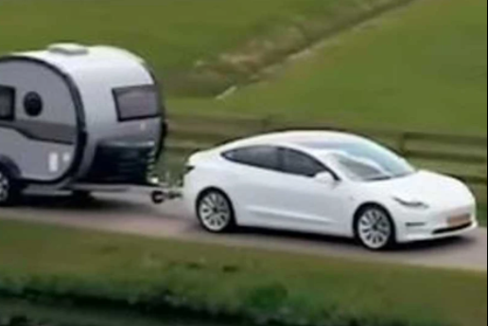
HSE Update 2022
Driving - What else is coming in 2022?
Changes to towing rules
As of December 2021, if you passed your driving test on or after 1 January 1997 you won’t have to take an additional test to tow trailers up to 3,500kg.
The government says that relaxing the rules could potentially help ease the HGV driver shortage as it would mean that roughly 30,000 more HGV driving tests could happen every year.

Slide 20
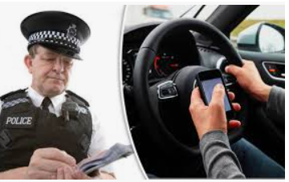
HSE Update 2022
Stricter use on mobile phone use in vehicles
At present, motorists can only be penalised for “communicating” with their mobile phones, i.e., making a call or sending a text.
Changes to the rules are due to be introduced end of March 2022, strengthening the wording making it so that drivers will not be allowed to touch their phones while driving except in cases where the phone is held in a cradle or when using it for contactless payments at motorway toll booths.
Apart from in these cases, drivers found touching their phone while driving will face six penalty points and a £200 fine.

Slide 21
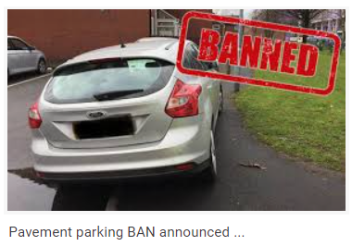
HSE Update 2022
Nationwide ban on pavement parking
London and Cardiff already have local laws banning parking on pavements.
An England- and Wales-wide ban on the practice could be on the cards this year too with local councils having the power to issue £70 fines to those caught parking on the pavement.
Scotland is also due to ban parking on footpaths in 2023.

Slide 22
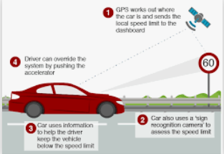
HSE Update 2022
Speed limiters mandatory in all new cars
Speed limiters will become mandatory in all new cars from July this year.
An Intelligent Speed Assistance system is capable of using cameras and GPS to recognise the speed limit in a given area and will alert the driver if it they are driving over that limit.

Slide 23
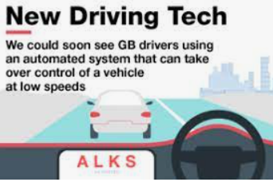
HSE Update 2022
Self-driving cars on UK motorways
Last year, the government announced that hands-free driving in cars with Automatic Lane Keeping Systems (ALKS) would be allowed on congested motorways at speeds of up to 37mph.
Although there are a number of cars on the market that are equipped with ALKS, its legal use in the UK will not be permitted until later this year.

Slide 24
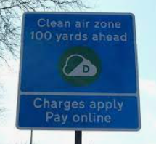
HSE Update 2022
Ban on red diesel
From April 1st 2022 it will no longer be legal to use red diesel for non-road mobile machinery such as bulldozers and cranes or to power mobile generators on construction sites. The change is meant to help the UK reach its climate targets by forcing those businesses to make the switch towards cleaner options such as electrification.
Clean air zone in Manchester
Several cities in the UK such as London, Bath, Birmingham and Portsmouth already have clean air zones meaning that high-emissions vehicles are charged a fee to enter.
Manchester is set to launch its own at the end of May 2022, charging certain HGVs, buses, coaches, vans and some other vehicles to enter the city centre.
Other cities also due to implement clean air zones in 2022 include Bradford and Oxford.

Slide 25
HSE Update 2022
PPE regulation changes from 6 April 2022
From 6 April 2022, existing PPE regulations are being amended, and the Personal Protective Equipment at Work (Amendment) Regulations 2022 will come into force.
They extend employers’ and employees’ duties regarding personal protective equipment (PPE).

Slide 26
HSE Update 2022
The PPE amendment
Existing regulations place a duty on every employer in Great Britain to ensure that suitable PPE is provided to ‘employees’ who may be exposed to a risk to their health or safety while at work.
The amended regulations define a “worker” as an individual who has entered into or works under:
(a) a contract of employment; or
(b) any other contract, whether express or implied and (if it is express) whether oral or in writing, whereby the individual undertakes to do or perform personally any work or services for another party…

Slide 27
HSE Update 2022
Generally, workers who come under definition (b):
carry out casual or irregular work for one or more organisations
after 1 month of continuous service, receive holiday pay but not other employment rights such as the minimum period of statutory notice
only carry out work if they choose to
have a contract or other arrangement to do work or services personally for a reward (the contract doesn’t have to be written) and only have a limited right to send someone else to do the work, for example swapping shifts with someone on a pre-approved list (subcontracting)
are not in business for themselves (they do not advertise services directly to customers who can then also book their services directly)
Please note: these changes do not apply to those who have a ‘self-employed’ status.

Slide 28
HSE Update 2022
What this means for employers
For employers with (a) and (b) workers:
By 6 April 2022, you need to ensure that there is no difference in the way PPE is provided to your workers
For employers with just (b) workers:
You need to ensure that your workers are provided with PPE free of charge, where required, by 6 April 2022. This means assessing the residual risk once all other measures (such as engineering controls) have been taken.
You then need to ensure suitable PPE is:
provided
compatible
maintained
correctly stored
used properly
You will also need to provide training and instruction in its use to all your workers.
You cannot charge workers for PPE they require to carry out their work.

Slide 29
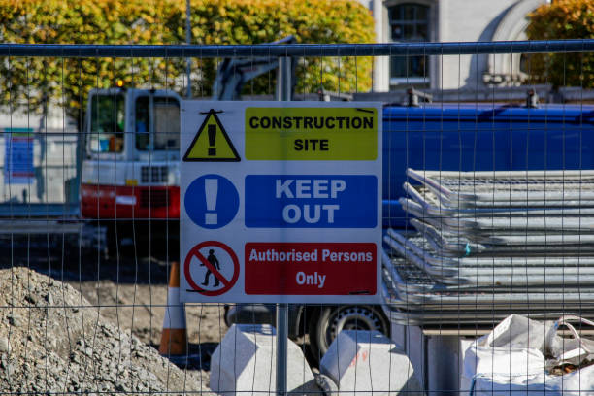
HSE Update 2022
Building Regulation changes in 2022
The Department for Levelling Up, Homes and Communities (DLUHC) announced a raft of changes to Building Regulations that will take effect from 15th June 2022.
Why are building regulations changing?
While uplifts around ventilation come from Public Health England data on indoor air pollution, the bulk of the building regulation changes in 2022 are part of the roadmap to the 2025 Future Homes Standard.
A key part of this Standard is that all new builds are zero carbon ready in support of the UK’s bid to deliver net zero carbon emissions by 2050. According to figures from the Department for Business, Energy & Industrial Strategy, heating and powering buildings currently accounts for 40% of the UK’s total energy usage.

Slide 30
HSE Update 2022
The new building regulations comprise uplifts to:
Approved Document L, Conservation of fuel and power and Approved Document F, and the creation of Approved Document O, Overheating, and Approved Document S, Infrastructure for charging electric vehicles. The following are the key changes to be aware of:

Slide 31
HSE Update 2022
Reduction of carbon emissions in domestic new builds by 31%
From 15th June 2022, new build homes will need to produce at least 31% less carbon emissions.
The government sees the installation of electric central heating systems as an enabler of this, particularly when combined with a renewable energy source such as solar.
Heat pumps are also getting strong support as part of the Future Homes Standard.

Slide 32
HSE Update 2022
Reduction of carbon emissions in non-domestic new builds by 27%
New non-domestic builds will need to produce at least 27% less carbon emissions.
Again, the installation of low-carbon heating technology is seen as the best route to achieve this.

Slide 33
HSE Update 2022
New metric for measuring energy efficiency
‘Primary energy’ will be used to measure the efficiency of a building’s heating, as well as the energy used to deliver fuel to the building, and even the efficiency of the power station supplying the electricity.

Slide 34
HSE Update 2022
New minimum efficiency standards
In new domestic builds, the new U-value for walls will be 0.18W/m², 1.4 (Window Energy Rating Band B) for windows and rooflights, and 1.4. for doors.
In non-domestic builds there’s a lowered U-value of 0.26W/m² K for walls and the majority of new windows and curtain walls must achieve 1.6.

Slide 35
HSE Update 2022
New maximum flow temperature
New and replacement heating systems in both domestic and non-domestic builds must have a max flow temperature of 55°C.
Heating and lighting system efficiency
Existing non-domestic buildings must improve the efficiency of heating and hot water boiler systems through the installation of new controls.
In new non-domestic buildings, the minimum lighting efficacy will be raised to 80 luminaire lumens per circuit watt for display lighting and 95 luminaire lumens for general lighting.

Slide 36
HSE Update 2022
Ventilation and indoor air pollutants
Background trickle ventilators will be recommended in non-domestic buildings, along with the requirement for installation of CO2 monitors in offices.
The new guidance will also stipulate a recommended minimum air supply rate of 0.5 l/s.m².

Slide 37
HSE Update 2022
Fabric Energy Efficiency Standard (FEES)
The FEES level in new homes will be set by a ‘full fabric specification’
Standard Assessment Procedure (SAP) compliance will now be applied to extensions built on existing properties.

Slide 38
HSE Update 2022
Prevention of overheating
The new Approved Document: Approved Document O introduces glazing limits in new build homes, care homes, schools and student accommodation to reduce unwanted solar heat.
It also stipulates new levels of cross-ventilation required to remove excess heat.

Slide 39
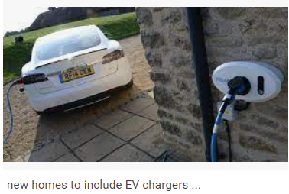
HSE Update 2022
Electric vehicle charging points
The new Approved Document S requires all domestic new builds to have the preparatory work completed for the future installation of an electric vehicle charge point.

Slide 40
HSE Update 2022
Transitional arrangements for new regs
While the amended regulations and accompanying Approved Documents will come into force on 15 June 2022, the government has stipulated transitional arrangements to support businesses and homeowners with compliance:
“The changes will not apply in relation to building work where a building notice or an initial notice has been given to, or full plans deposited with, a local authority before 15 June 2022 provided that the building work is started before 15 June 2023. In some cases, applications will be in respect of a number of buildings on a site, for example, a number of houses. In such cases, it is only those individual buildings for which work is commenced which can take advantage of the transitional provisions.” – Gov.uk

Slide 41
HSE Update 2022
ENVIRONMENTAL

Slide 42
HSE Update 2022
The long-awaited Environment Act was finally passed into law in November 2021, nearly three years after a bill was first proposed to govern environmental matters after the UK's departure from the EU.

Slide 43
HSE Update 2022
Environmental principles
The Act will enshrine into law 5 environmental principles which will underpin future government policy, contributing to the improvement of environmental protection and sustainable development. Mostly these principles are not new – polluter pays and the precautionary principle are both familiar concepts – but the need for ministers to have "due regard" to them when formulating non-environmental policy is new.

Slide 44
HSE Update 2022
Environmental principles (cont’d)
The integration principle is the principle which states that policy-makers should look for opportunities to embed environmental protection in other fields of policy that have impacts on the environment.
The prevention principle means that government policy should aim to prevent, reduce or mitigate harm.
The rectification at source principle means that if damage to the environment cannot be prevented it should be tackled at its origin.
The polluter pays principle is the principle that those who cause pollution or damage to the environment should be responsible for mitigation or compensation.
The precautionary principle states that where there are threats of serious or irreversible environmental damage, a lack of scientific certainty shall not be used as a reason for postponing cost-effective measures to prevent environmental degradation.

Slide 45
HSE Update 2022
New in 2022
Mandatory climate-related disclosures
For the first time premium listed UK PLCs will be obligated to state in their Annual Reports whether they have included climate-related financial disclosures consistent with the recommendations of the Task Force on Climate-related Financial Disclosures (TCFD) and if not to explain why. Many companies will currently be grappling with these requirements as they prepare their 2021 Annual Reports.
New regulations have recently been adopted to extend this obligation to certain public companies, large private companies and Limited Liability Partnerships. The Companies (Strategic Report) (Climate-related Financial Disclosure) Regulations 2022 and the Limited Liability Partnerships (Climate-related Financial Disclosure) Regulations 2022 come into force on 6 April 2022 and will apply to accounting periods starting on or after that date.

Slide 46
HSE Update 2022
New in 2022
Mandatory climate-related disclosures (cont’d)
The FCA has separately started discussions on introducing UK Sustainability Disclosure Requirements (SDR) and a UK sustainable product labelling system. Businesses should consider what strategy they intend to adopt in light of these new disclosure requirements and consider going beyond minimum reporting requirements
Greenhouse Gas Protocol is the most widely used accounting standard,
Scope 2 Guidance standardizes how corporations measure emissions from electricity, steam, heat and cooling.
Scope 3 emissions a company is responsible for outside of its own walls—from the goods it purchases to the disposal of the products it sells; value chain emissions.

Slide 47
HSE Update 2022
New in 2022
Plastic packaging tax
A new environmental tax on plastic packaging will come into effect from 1 April 2022.
The tax will apply to in-scope plastic packaging manufactured in or imported into the UK that contains less than 30% recycled plastic.
The rationale behind the tax is to incentivise businesses to incorporate recycled plastic into their packaging and increase levels of plastic waste collection and recycling.
The rate of tax will be £200 per metric tonne of relevant plastic packaging.

Slide 48
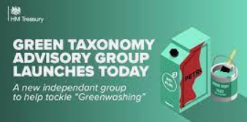
HSE Update 2022
New in 2022
UK Green Taxonomy
By the end of 2022, the government aims to establish a UK “Green Taxonomy” that will set out the criteria which specific economic activities must meet to be considered environmentally sustainable.
The green taxonomy is intended to help tackle ‘greenwashing’; improve understanding of environmental impact to help companies and investors make informed green choices, support investment in sustainable projects and boost efforts to tackle climate change

Slide 49
HSE Update 2022
New in 2022
UK ETS
The UK Emissions Trading Scheme (UK ETS) came into force in 2021 to replace the UK’s participation in EU ETS following Brexit.
The scheme aims to incentivise cost-effective greenhouse gas emissions reductions for certain sectors by putting a cost on carbon pollution.
Further consultations around UK ETS can be expected in 2022 including in relation to an emissions cap, the role of free allocation of allowances and a potential expansion of the scheme to cover additional sectors. Businesses affected by UK ETS are advised to follow developments in this area

Slide 50
HSE Update 2022
New in 2022
ESOS
The Energy Savings Opportunity Scheme (ESOS) requires large companies and non-public sector organisations that qualify for the scheme to carry out energy audits to assess their business’s total energy consumption with a view to identifying energy savings.
The government is considering improving and strengthening ESOS by potentially extending the scheme to medium sized companies and introducing a net zero element to the existing ESOS audit, which would require relevant companies to identify which energy-using processes and activities need to be addressed for the business to become carbon neutral or net zero by 2050.
Businesses should look out for the outcome of the consultation which will bring more clarity around the government’s proposals. Businesses should also start thinking about Phase 3 of ESOS – the qualification date is 31 December 2022.

Slide 51
HSE Update 2022
New in 2022
SECR
The Streamlined Energy and Carbon Reporting (SECR) framework requires large UK companies and large LLPs to make disclosures on energy use and emissions in their annual reports.
The government is considering making changes to the framework to better align it with the TCFD requirements by 2023.
Companies should prepare themselves for more ambitious requirements in the years to come and notably for Scope 3 value chain emissions reporting to become mandatory

Slide 52
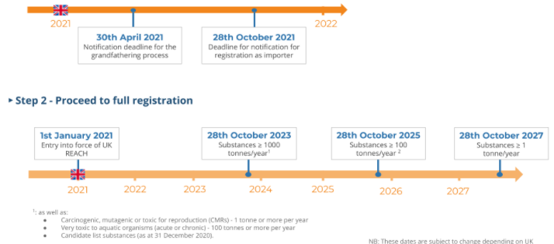
HSE Update 2022
New in 2022
UK REACH

Slide 53
HSE Update 2022
New in 2022
Chemicals strategy
The government is expected to publish its UK chemicals strategy at some point this year. Whilst we know very little about its proposed content, businesses should expect the strategy to address (amongst other things)
hazardous chemicals such as endocrine disruptors (EDCs), persistent, bioaccumulative and toxic substances (PBTs) and persistent, mobile and toxic chemicals (PMTs);
consider a phase-out of PFAS substances as a group;
and consider whether to introduce a UK equivalent of the EU’s SCIP database.

Slide 54
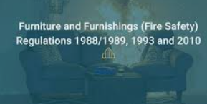
HSE Update 2022
New in 2022
Review of the Furniture and Furnishings (Fire Safety) Regulations 1988
The Furniture and Furnishings (Fire Safety) Regulations 1988 regulate the fire resistance of furniture products.
Several attempts have been made to review the regulations over the last few years on the basis that they allow toxic flame retardants to be used in everyday items such as sofas, mattresses and baby products.
The government is expected to consult on a proposed legislative reform and issue draft new legislation in 2022.

Slide 55
HSE Update 2022
New in 2022 – Open Consultations
Single Use Plastics (closes 12 February 2022):
The government is considering a ban on the supply of single-use plastic plates, cutlery, balloon sticks, and expanded and extruded polystyrene food and drink containers in England from April 2023.

Slide 56
HSE Update 2022
New in 2022 – Open Consultations
Forest Risk Commodities (closes 11 March 2022): the Environment Act 2021 introduces new obligations on businesses regarding the use of “forest risk commodities” and derived products in commercial activities in the UK.
Businesses will be expected to carry out due diligence to confirm that in-scope commodities and derived products have not been produced on land subject to deforestation since 31 December 2020.
The EU has already tabled a similar legislative proposal which proposes to target palm oil, soy, wood, cocoa, coffee and beef.

Slide 57
The Department for Environment, Food and Rural Affairs (DEFRA) have launched a consultation that will affect the way waste is managed, transported and tracked. This will affect waste carriers, brokers or dealers. There are 2 Defra consultations for the introduction of: 1. A digital waste tracking service; and 2. A new permitting regime for carriers, brokers and dealers that manage waste as a business.

Slide 58
HSE Update 2022
New in 2022 – Open Consultations
Biodiversity Net Gain (closes 5 April 2022):
The Environment Act 2021 requires new developments in England to achieve “biodiversity net gain”, which consists of leaving natural habitats in a better state than they were before the development.
The government is consulting on the practical and legal implementation details of this new requirement.

Slide 59
HSE Update 2022
Thanks for listening
Any Questions?

