Slide 1
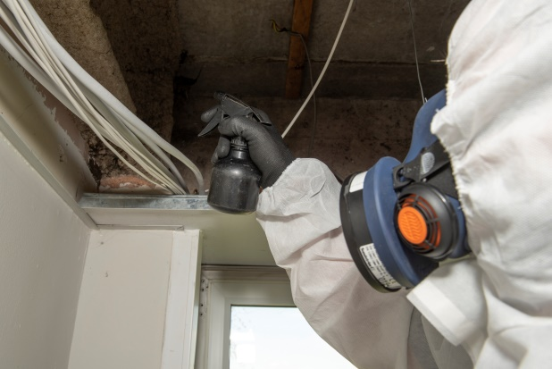
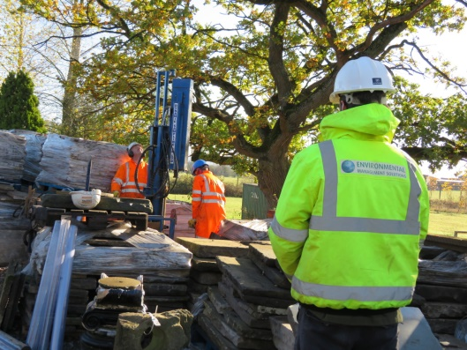
Asbestos Management
Hereford Health & Safety Group
November 2021

Slide 2
Introduction
Jamie Perkins-Best
Director of Environmental Management Solutions Ltd since 2003.
Over 25 years experience in the asbestos industry
EMS’s Head Office is in Hereford and we offer Asbestos, Water & Geotechnical services throughout UK & Europe.

Slide 3
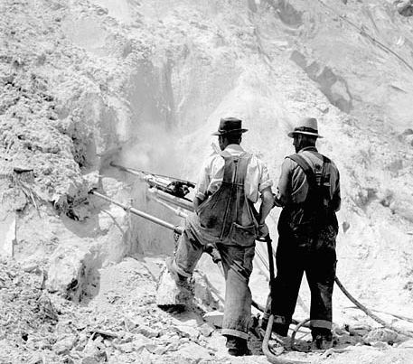
Asbestos Reminders
First commercially mined in around 1870 & used in the UK from 1890.
Still mined in many places around the world, still mined today in Russia, China, Brazil & Kazakhstan.
Use wasn’t banned in the UK until 1999. So all building pre-2000 should be presumed to contain asbestos.
UK has around 6million tons spread across 1.4million commercial buildings
Asbestos is still UK’s highest occupational killer. Although first signs of a decrease in No. of deaths.

Slide 4
Legislation
Control of Asbestos Regulations 2012 – Inc Regulation 4 – Duty to Manage
Health & Safety at Work Act 1974
CDM Regulations 2015
Hazard Waste Regulations
Relevant Guidance
Asbestos: The Analysts Guide
Asbestos: The Survey Guide
Asbestos: The Licensed Contractors Guide
CARSoil: CL:aire guidance document

Slide 5
The Duty to Manage
CAR2012 Regulation 4 places a legal duty, on the duty holder, to manage asbestos within any non-domestic premises constructed post-2000.
Who is the ‘Duty Holder’ or person responsible?
One or any of – Tenant, Building Owner, Employer or Management Agent
Usually the person(s) who is responsible for control of maintenance – where this is shared, the responsibility is shared accordingly unless contracted otherwise.
The Duty to Manage CAN NOT be delegated
Those nominated by the duty holder to assist with any work as a result of the regulations, must be clear on what is required; and-
The duty holder must ensure they are competent to undertake [that] task
But The Duty Holder remains responsible.

Slide 6
The Duty to Manage
What does ‘The Duty to Manage’ mean?
Maintaining your ACMs in a good condition to protect and prevent asbestos exposure to –
Those that occupy, visit and work within the building
Those who work on the fabric of the building
Where do we start?
Identify and risk assess all asbestos or potentially asbestos containing materials onsite
What type of asbestos survey is needed?
Management Survey – Everyday management & occupation
Having a survey undertaken does NOT make you compliant with the regulations

Slide 7
What is next?
What other steps can help us manage asbestos?
Consider and Implement any remedial recommendations made by the survey.
Assess the material in its environment – Priority Assessments
Distribution of the relevant information to relevant staff
Training of relevant staff that may come into contact with Asbestos or control tasks that may disturb asbestos.
Control maintenance tasks within the property – for example Permits or access restrictions.
Control external contractors – selecting competent contractors & employ controls on site
Labelling of materials – should only be used as part of a robust system.
Continue to monitor the condition of ACMs on a regular basis
All these should be set out in a written asbestos management plan.

Slide 8
Asbestos Management Plan
AMP Should contain -
A hierarchy of responsibilities – From CEO to Shop floor
A plan on how the assessment of the materials in their environment will be carried out – Priority Assessments
Management procedures on how materials will be controlled onsite to prevent disturbance
The AMP should be an up-to-date record of materials and a log of re-inspections and remedial or removal work to ensure continued integrity of the materials and relevance of plan.
The plan should contain details of company procedures, including emergency procedures.
The plan should be written and reviewed annually, by a competent person

Slide 9
Priority Assessments
AMP Should assess the materials in their environment -
The asbestos survey should help identify materials of high risk – the comments should draw attentions to vulnerabilities and not just report Material Risk Assessment.
Priority Assessment is a HSE tool for assessing priorities for maintenance.
Materials in good condition score 1
The scoring matrix will then consider –
Material condition
Likelihood of disturbance
No. of people affected if disturbed
Location of material and how confined a fibre release maybe
The matrix will then produce an arbitrary number to help prioritise.

Slide 10
Reinspections
Asbestos containing materials should be reinspected no less than once every 12 months.
The inspection should be carried out by a competent person.
The reinspection should evaluate the condition of the material. Any damage or deterioration may lead to further actions.
Digital photographs are a good way to monitor the materials
Up-to-date records should be kept
The environment should also be evaluated as any changes may require the priority assessment to be re-evaluated
UKAS accreditation has been extended from surveys to reinspections.

Slide 11
Training
Levels of Training & Competence
Asbestos Awareness Training
Mandatory for those that may encounter asbestos during their work or control such projects.
AAT is not sufficient for operatives to undertake work with asbestos
Work with Non-Licensed materials
Normally required for anyone undertaking work which is likely to disturb asbestos.
P405:Management of Asbestos in Buildings
Recommended for those responsible for day to day management of asbestos in buildings.
Course covers management options and removal process’
Tool Box Talks /Task Specific Training
Recommended for those using buildings with asbestos present.
Groundworkers dealing with contaminated Soils
Those undertaking reinspections?

Slide 12
Contractor Selection
Asbestos Contractors-
Surveyors
The survey company must have a suitable quality system
Surveyors must be P402 qualified with 2yrs relevant experience.
UKAS accreditation (ISO17020) STRONGLY recommended by HSE.
Laboratories & analysts must be UKAS accredited.
Removal Contractors
Current HSE license (if licensable work)
Should be able to demonstrate competence and relevant experience
Asbestos Removal Contractors Association (ARCA)
Non-Asbestos Contractors
All contractors that disturb the fabric of the buildings or equipment should have AAT
This includes construction trades, pipe fitters, IT & Phone cable installers, Alarm engineers and machine/equipment engineers.

Slide 13
HSE Prosecutions / FFI
‘Fee for Intervention’ applies to breaches of CAR – charged at £160/hr with a typical letter costing around £800
HSE have again reiterated that Asbestos is high on their agenda.
West Midlands Case - Property Company fined £9k in May 2018 for failures when selecting a surveying company
Balfour Beatty & Subcontractors fined a total of £1.27m for failing to review details in a survey correctly ie undertaking works without an appropriate survey
2019 HSE Prosecutions – 11 for having no AAT & 15 for having incorrect level of surveys.

Slide 14
HSE Prosecutions / FFI
Godfrey-Syrett Limited Case Study
Godfrey-Syrett Ltd. A furniture making company.
They had an annual turnover of around £26m
Commissioned an asbestos survey in 2003
Took no action to address issues raised by the survey
2017 – member of staff reported them to HSE over H&S concerns
HSE Investigation showed the asbestos issues had not been addressed in the 14 years since they were identified and a prosecution was brought.
GSL were fined £800,000 for breach of asbestos regulations.
Fine reduced to £1 as GSL are now in administration.

Slide 15
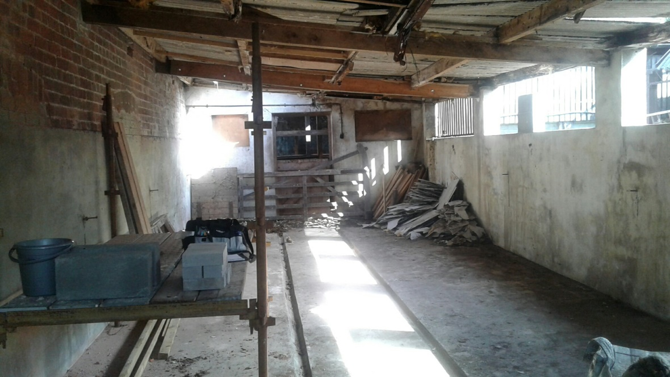
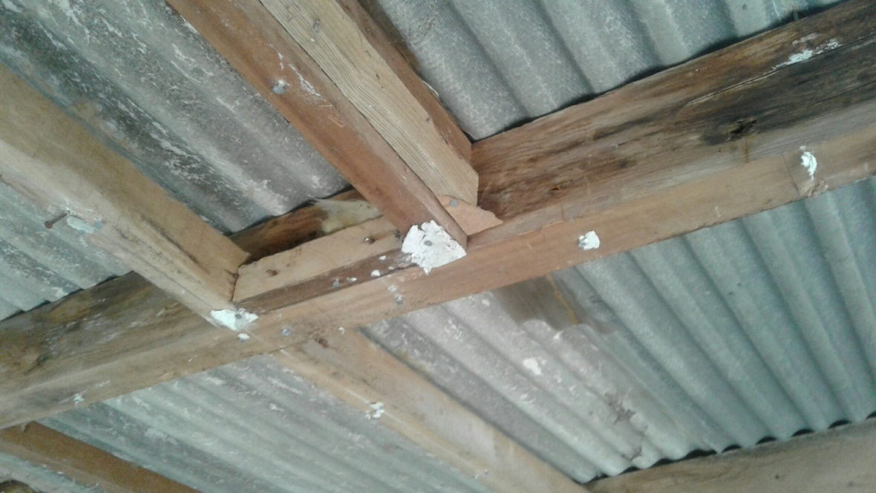
DIY Asbestos Removal/Poor Management

Slide 16
HSE Prosecutions / FFI
Summary of responsibilities
Locate & Risk Assess Asbestos Materials
Evaluate the materials in the their environment
Consider & implement recommendations of survey
Cascade information to relevant people
Produce a written AMP for all properties
Ensure all staff / contractors have the correct training
Implement controls on maintenance
Review materials & AMP annually.

Slide 17
Jamie Perkins-Best
Asbestos Surveys & Management
Asbestos Bulk Analysis
Asbestos Air Testing
Consultancy & Project Supervision
Geotechnical & Contaminated Land Investigations
Legionella Assessments & Water Risk Assessments
info@emsgroupuk.com
08003581100

Slide 18
Asbestos Update – HSG248: The Analysts Guide
Hereford Health & Safety Group
November 2021

Slide 19
HSG248: The Analysts Guide
What is HSG248?
The HSE’s guidance for asbestos ‘laboratories’ covering –
Sampling of asbestos materials
Bulk analysis of asbestos samples
Air sampling & fibre counting
Clearances following asbestos removal
A document mostly used by specialists in the asbestos industry.

Slide 20
HSG248: The Analysts Guide
Background Behind the update -
Edition 1 was long overdue an update; the draft version of Ed.2 was optimistically dated 2016. The draft was released for review in 2015. but it has taken until now to get it agreed and released.
One of the drivers for the overhaul was a study carried out by the HSE into the standard of asbestos analysts and by association Asbestos Removal Contractors.
The paper produced found many areas that require significant improvement.
Analysts asked to implement the new guidance from 1st December 2021

Slide 21
HSG248: The Analysts Guide
How does this effect me? or my clients?
Edition 2 attempts to bring responsibilities in line with CDM regs – Giving the client more responsibility.
Additional procedures related to air monitoring.
Significant change to laboratory process’ which may affect sample costs and turnaround times.
Changes to sampling protocols could effect survey prices.

Slide 22
HSG248: The Analysts Guide
The Client is responsible!
The analyst should be appointed by the client not the removal contractor. Clause 1.22, states –
It is strongly recommended that the analyst for site clearance certification is independently sourced and employed by the building owner or occupier (ie building client) in control of the premises. This arrangement should:
create a clearer and healthier contractual situation on site;
help avoid any potential conflict of interest (perceived or real) that may arise should the analyst be employed by the removal contractor;
give added assurance that the inspection process is undertaken impartially and objectively, as required by International Organisation for Standardisation (ISO) 17025;
enable the independent analyst to be involved in resolving any problems (between the building client and contractor) that may arise.

Slide 23
HSG248: The Analysts Guide
The Client is responsible!
The analyst should be involved from early in the process to help design the project and agree the outcome. The process should be client/consultant led – not contractor led.
The client [building owner] will receive copies of the paperwork, regardless of who employs the analyst.
Will it happen? What are the practicalities? What About personal monitoring records?

Slide 24
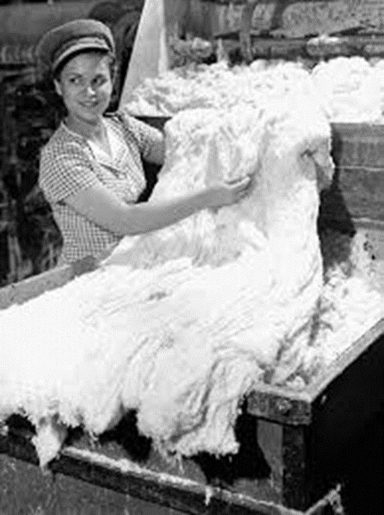
HSG248: The Analysts Guide
Changes for the Analyst onsite -
Handover forms [from removal contractor to analyst] are now mandatory.
They must estimate the time for the clearance and explain why, should the time differ by more than 20%
More photographs are required, these must be date/time stamped.
Actual results will be reported and not just the ‘less than clearance limit’

Slide 25
HSG248: The Analysts Guide
Changes for the Analyst onsite -
Significant increase in quality control with witness and revisit audits.
Audits increased from 4/yr to 5% of all projects – who pays for the extra time?
Additional desk top audits of paperwork required.

Slide 26
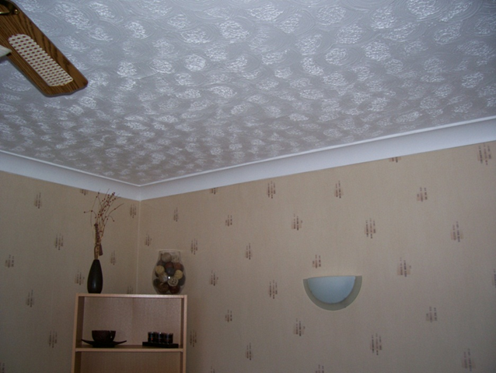
HSG248: The Analysts Guide
Textured Coating -
The new guidance states that when surveying, a minimum of two samples of textured coating should be taken from EACH surface.
Current guidance states 1 sample every 25m²
Also a suggestion that larger samples should be taken.

Slide 27
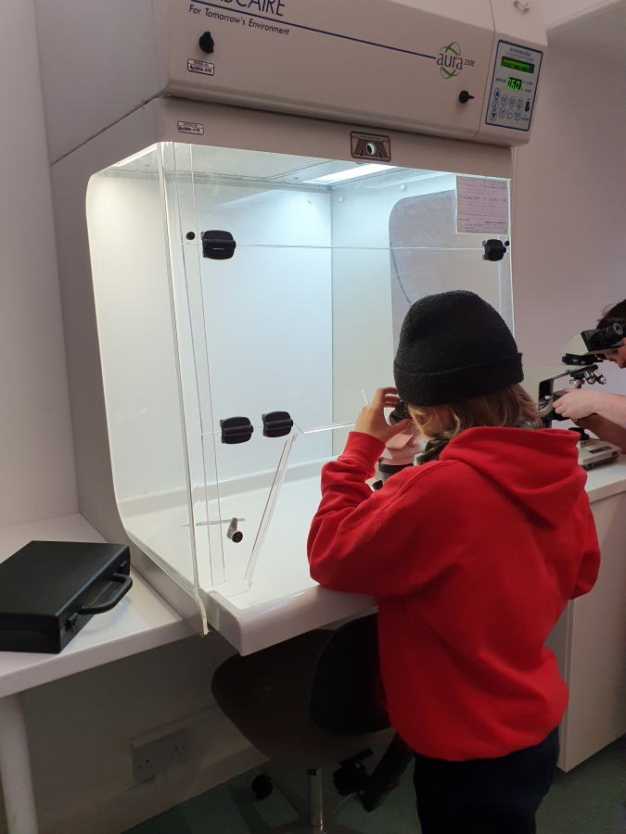
HSG248: The Analysts Guide
Other Laboratory changes -
Reduction on maximum number of samples an analyst can test per day.
Negative results count double!
Increased record keeping
Will we see an increase in costs?

Slide 28
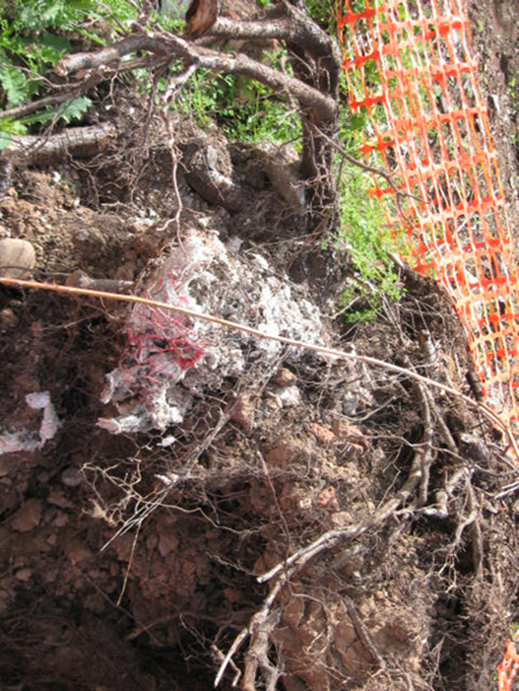
HSG248: The Analysts Guide
What else is new?
DUST – don’t sample as standard practise
Asbestos in soils – The first official guidance on the presence of asbestos in soils.
Lots of technical changes which will hopefully improve the quality of the analysts and in turn the quality of asbestos removal.

Slide 29
Jamie Perkins-Best
Asbestos Surveys & Management
Asbestos Bulk Analysis
Asbestos Air Testing
Consultancy & Project Supervision
Geotechnical & Contaminated Land Investigations
Legionella Assessments & Water Risk Assessments
info@emsgroupuk.com
08003581100

