Slide 1
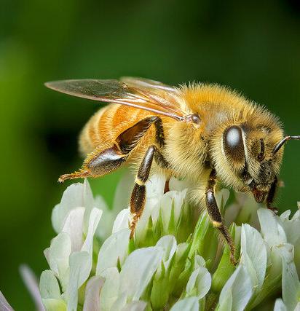
Earth Protectors
Phil Hughes MBE
Notes:
Wake Up!! Wake Up!!
Over the last year The Guardian has had over 3000 articles on the Environmental emergency and Climate Change. In the run up to COP 26 I checked IOSH's Magazine
one article on Environment on page 62 which talks about Environmental issues how we would have done in the 1990/2000's
This is challenging to us all including myself in particular. But if we wait until we are perfect nothing will get done.

Slide 2
I try to be green!
Hardly ever fly
Well insulated home with solar panels & efficient lighting
Use an electric car
Grow some of our food and committed to bio-diversity and rewilding in our garden,
Use forest garden method including no dig, harvest rainwater.
Shop locally
Actively encourage and sometimes protest for the environment
Notes:
Perhaps many of you do much the same. But this is just to show that I try but have masses more to do

Slide 3
Is this going to keep the world to 1.5℃ above pre-industrial levels?
NO
Not nearly enough
Governments across the World must get serious
Notes:
This is not nearly enough and although important for us all to take peronal action unless we get Governments to take it seriously and urgently we will soon not be able to live in our home.

Slide 4
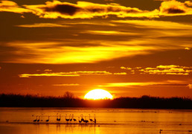
Records broken in 2021
2nd fastest rise in CO2 levels on tract for 16% rise by 2030
CO2 level 414.31ppm highest level for over 800,000 years
Largest gathering of World leaders ever
Notes:
CO@ levels are going in the wrong direction as Governments urge their economies to bounce back from the pandemic.
An opportunity thrown away by our politicians
COP 26 the largest ever gathering of World leaders is so so important as we have a fast disappearing window to take action to avoid catastrophy.

Slide 5
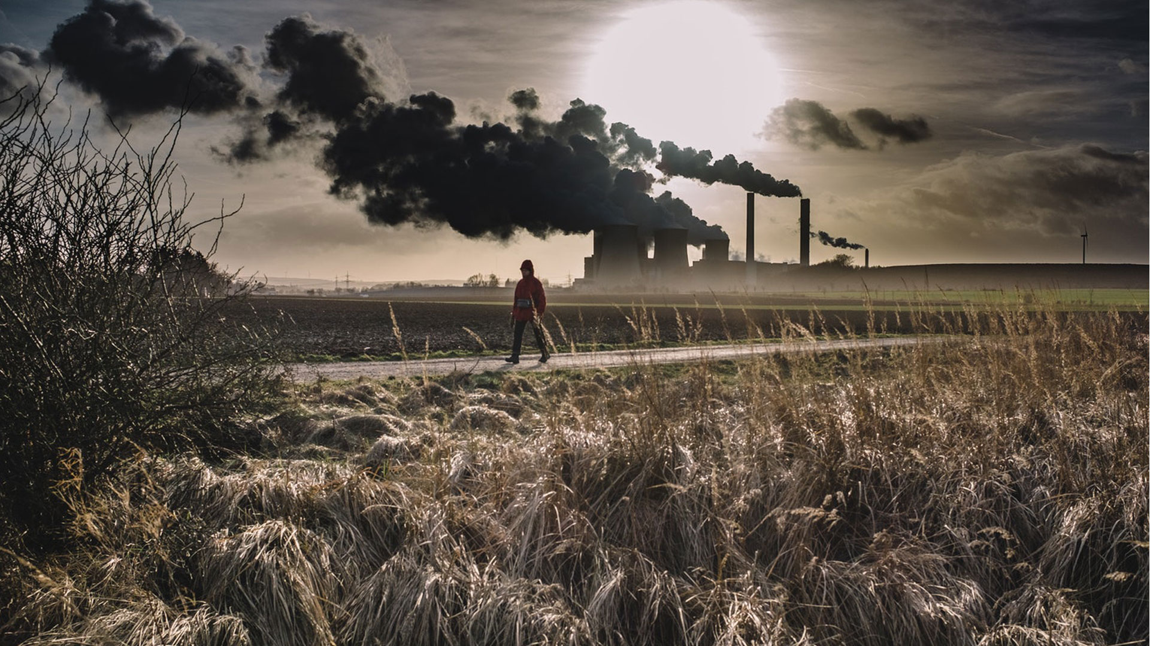
Without the unusual stability of the Holocene Interglacial epoch, agriculture and the complex entity of human civilisation could never have arisen
Notes:
We have experienced a remarkable stable climate for thousands of years in this Holocene Interglacial epoch.
Wew are currently intent on destroying this stability and making the world unihabiitable for humans, animal life and plants. Can you be more stupidthan this??

Slide 6
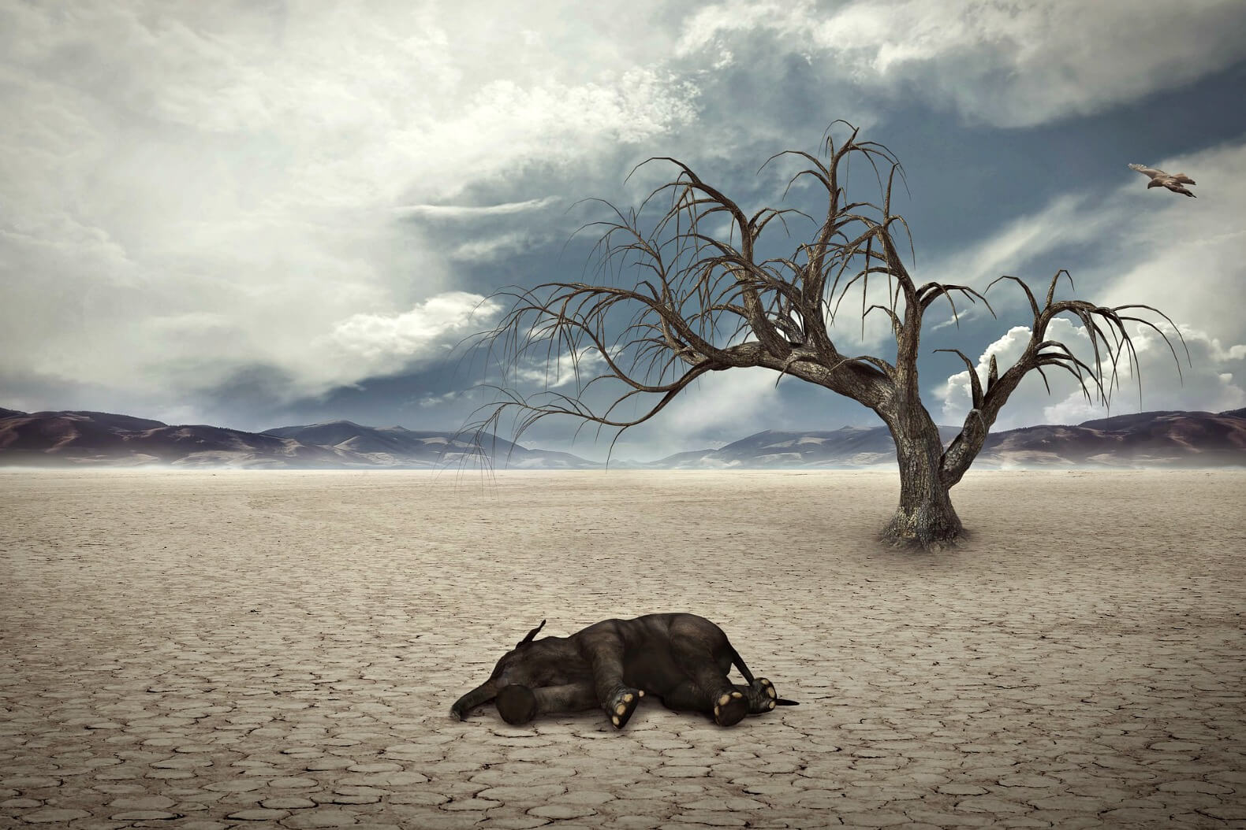
The End Holocene Extinction
In the 700 million year history of complex life on Earth the current climate and biodiversity disruption represents:
The fastest ever rate of extinction (200 species a day)
The fastest ever rise in atmospheric CO2 levels by at least a factor of 10
Likely to be the fastest ever rise in temperatures
The fastest ever acidification of oceans
At current rates we will lose 75% of all species and see a temperature increase of up to 7 Celsius by 2100)
Notes:
There is no easy way to face the facts

Slide 7
International Energy Agency October 2021 annual World Energy Outlook
We are witnessing an unsustainable recovery from the pandemic,” IEA’s director Fatih Birol said, pointing to sections of the report that show coal use growing strongly, contributing to the second-largest increase in CO₂ emissions in history.
Carbon emissions ‘will drop just 40% by 2050 with countries’ current pledges’
International Energy Agency says $4tn investment needed over decade to reach net zero target
Notes:
We don't learn any lessons it seems on our journey.
Only how to get richer and have a better more comfortable life.
Our chancellor said over Covid finances "whatever it takes"
The Climate crisis is a much bigger threat to humanity and our living world but we are not saying the same.

Slide 8
World now likely to hit watershed 1.5°C rise in next five years, warns UN weather agency
Odds are increasing that the annual average global temperature will rise beyond 1.5°C above pre-industrial levels, in at least one of the next five years, the UN weather agency warns in a new report. Issued on 26 May 2021
EU calls for oil, coal and gas to stay in the ground The Guardian 14 October 2021
Notes:
It seems that 1.5 degrees rise is locked in and we are now needing to take action to avoid much higher levels of 2 degrees or more.
Fossel fuels must stay in the ground.
Even the Brazillian rain forest is now a net emitter of CO2 because of deforestation and fires.

Slide 9
CODE RED FOR HUMANITY
Climate change widespread, rapid and intensyfying. August 2021
By year 2100 without drastic change to emissions 70% of world will be unihabitable. Prof Phil Jones
99.9% of scientists agree climate emergency caused by humans based on a survey of 90,000 studies
The Guardian 19th Oct 2021
Notes:
In 2021 to allow air time or publishing space to deniers is completely agianst the interest of
humanity and the world we live in. it is difficult to nearer to 100% than 99.9% from 90,000
published studies.

Slide 10
We now have to choose: Guardian 21 October 2021
Between saving the living planet or saving our unsustainable way of life.
We have left it too late to have both – this uncomfortable reality is what our leaders have chosen by their decades of inaction.
We need immediate, drastic, annual emission reductions unlike anything the world has ever seen.
There is no technology to achieve this alone so we have to make fundamental changes to our society.
Notes:
a stark choice

Slide 11
The Challenge
To Reduce our CO2 Equivalent footprint by 40 billion tons per annum and remove at least 200 Billion tons of CO2 back out of the atmosphere

Slide 12
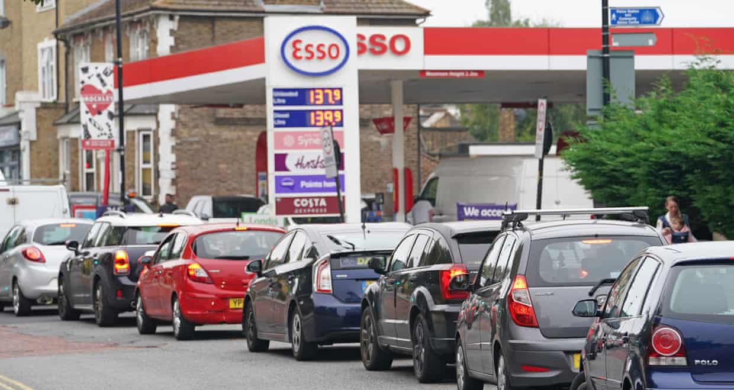
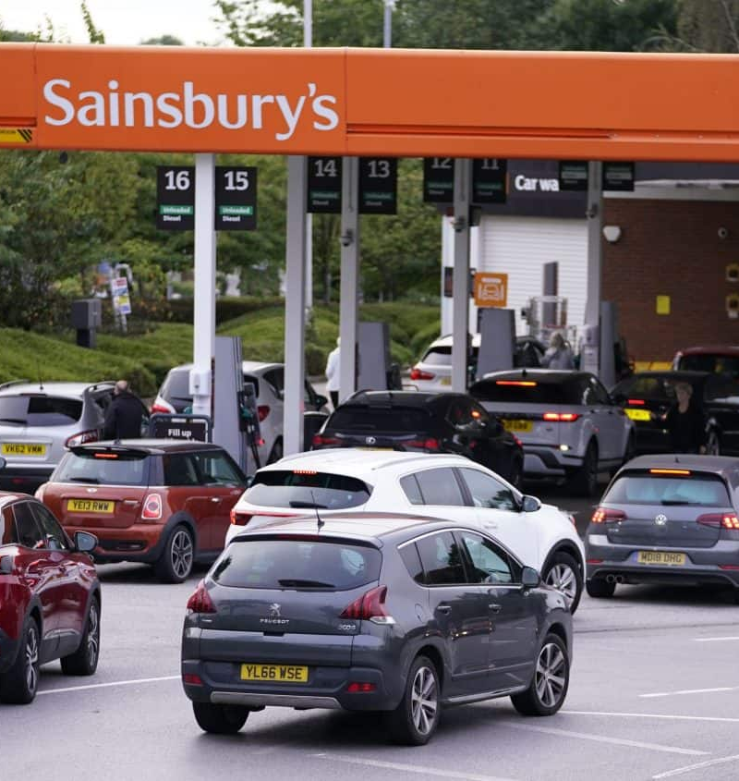
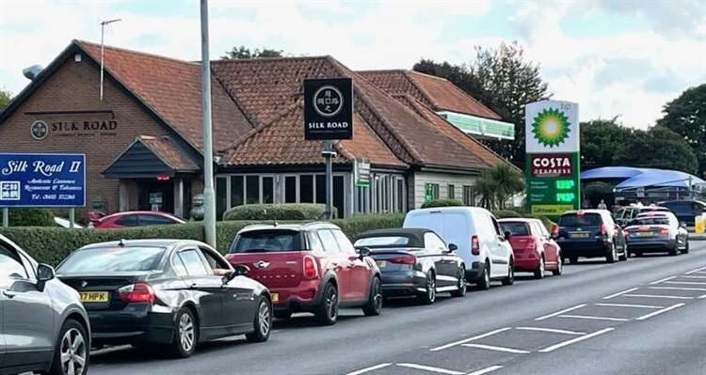
Notes:
Chaos recently caused by empty fuel pumps around the Country.
There wasn't even a shortage only a lack of qualified drivers.
If that was considered to be a crisis was are real shortages going to involve

Slide 13
Should People Protectors evolve to Earth Protectors ?
We Protect People at Work - 3 Bn total with 2.3million deaths per year
At current 1.2℃ rise climate heat/cold variations cause at least 5 million deaths per year. Energy and Science July 2021. Causing Kidney failure in large numbers Guardian 21 October 2021
1.5℃ rise would have much more severe consequences for people, + fauna and flora
2℃ rise considered by the IPCC to have catastrophic consequences for people, fauna and flora. With 100s of millions of people displaced and many 10s of millions dying through heat/floods/ starvation/conflict.
Notes:
Should H&S people evolve from People protectors to Earth Protectors
Traditionally ILO figures are about 2.3 million deaths from a global working force of 3 billion
But heat and cold also cause at least 5 million deaths plus Kidney failure in large numbers of people working long hours outside in high temperatures without shade or protection from ground radiated heat.
1.5degree rise much more severe consequences for people fauna and flora
2 degrees rise would have catastrophic consequences with 100's millions of people displaced and many 10s millions dying
But the rise in temperature goes on and on very rapidly to near extinction in the lifetime of children living today

Slide 14
H&S has adopted the idea of Zero Harm
Apply this to:
Zero emissions of GHG’s
Zero pollution air/water/land
Zero waste
Zero unsafe and/or single use plastics
Massively more biodiversity
Companies measured on achiement of these goals
Notes:
this seminar was planned on the theme of Environmental safety and zero harm
so lets take that and apply zero harm to climate change

Slide 15
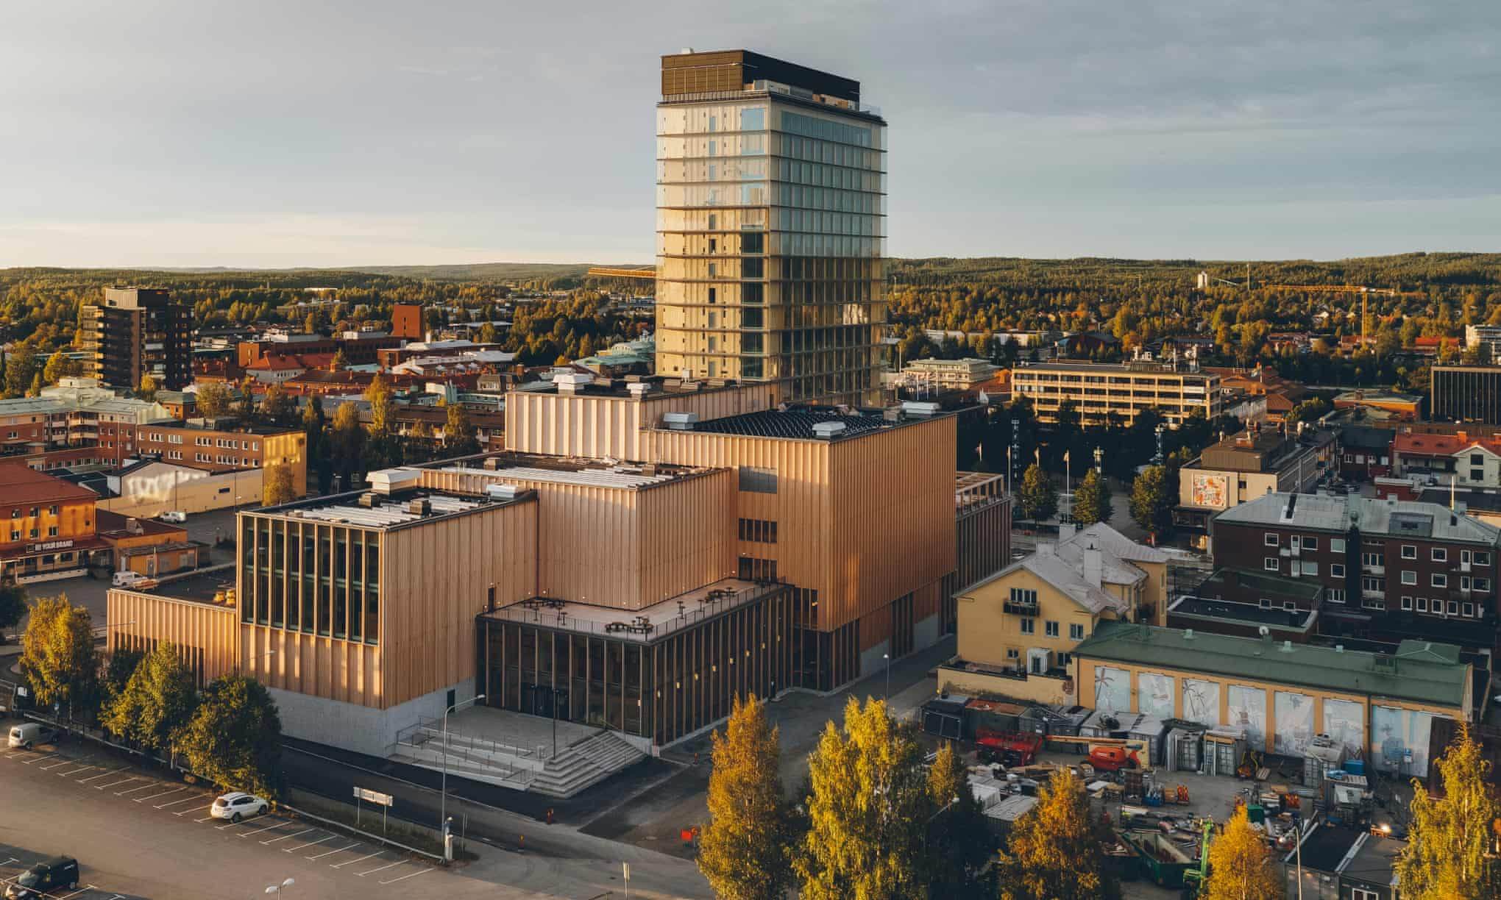
We already have some of the solutions…
We have the money and finances
We have the money and finances
We have the engineering and technology solutions and they are getting cheaper, quickly
We know what policies, legislation and taxation is needed
We know how long we have got to do it
To do it will improve food security, energy security and geopolitical stability
human health, happiness and economic prosperity will dramatically improve
We have the engineering and technology solutions and they are getting cheaper, quickly
We know what policies, legislation and taxation is needed
We know how long we have got to do it
To do it will improve food security, energy security and geopolitical stability
human health, happiness and economic prosperity will dramatically improve
We have the money and finances
We have the engineering and technology solutions and they are getting cheaper, quickly
We know what policies, legislation and taxation is needed
We know how long we have got to do it
To do it will improve food security, energy security and geopolitical stability
Human health, happiness and economic prosperity will dramatically improve
Notes:
why don't we get on and get it done and save humanity??
One way to help would be to up the consequences for individuals running organisations and companies
Currently Bolsonaro has been accused of crimes against humanity by his own legislators for the reckless way he managed Covid.

Slide 16
Ecocide to increase accountability
“ecocide” means unlawful or wanton acts committed with knowledge that there is a substantial likelihood of severe and either widespread or long-term damage to the environment being caused by those acts.
Notes:
Should introduce Ecocide as a crime worthy of trial at the Hague

Slide 17
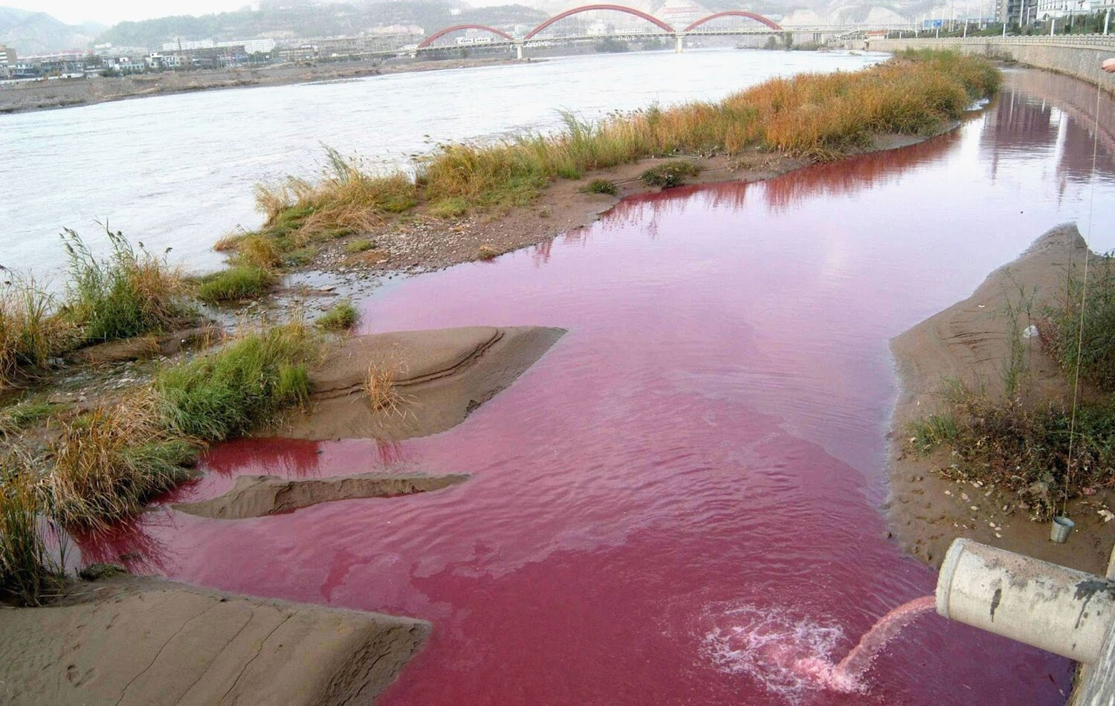
Notes:
water pollution

Slide 18
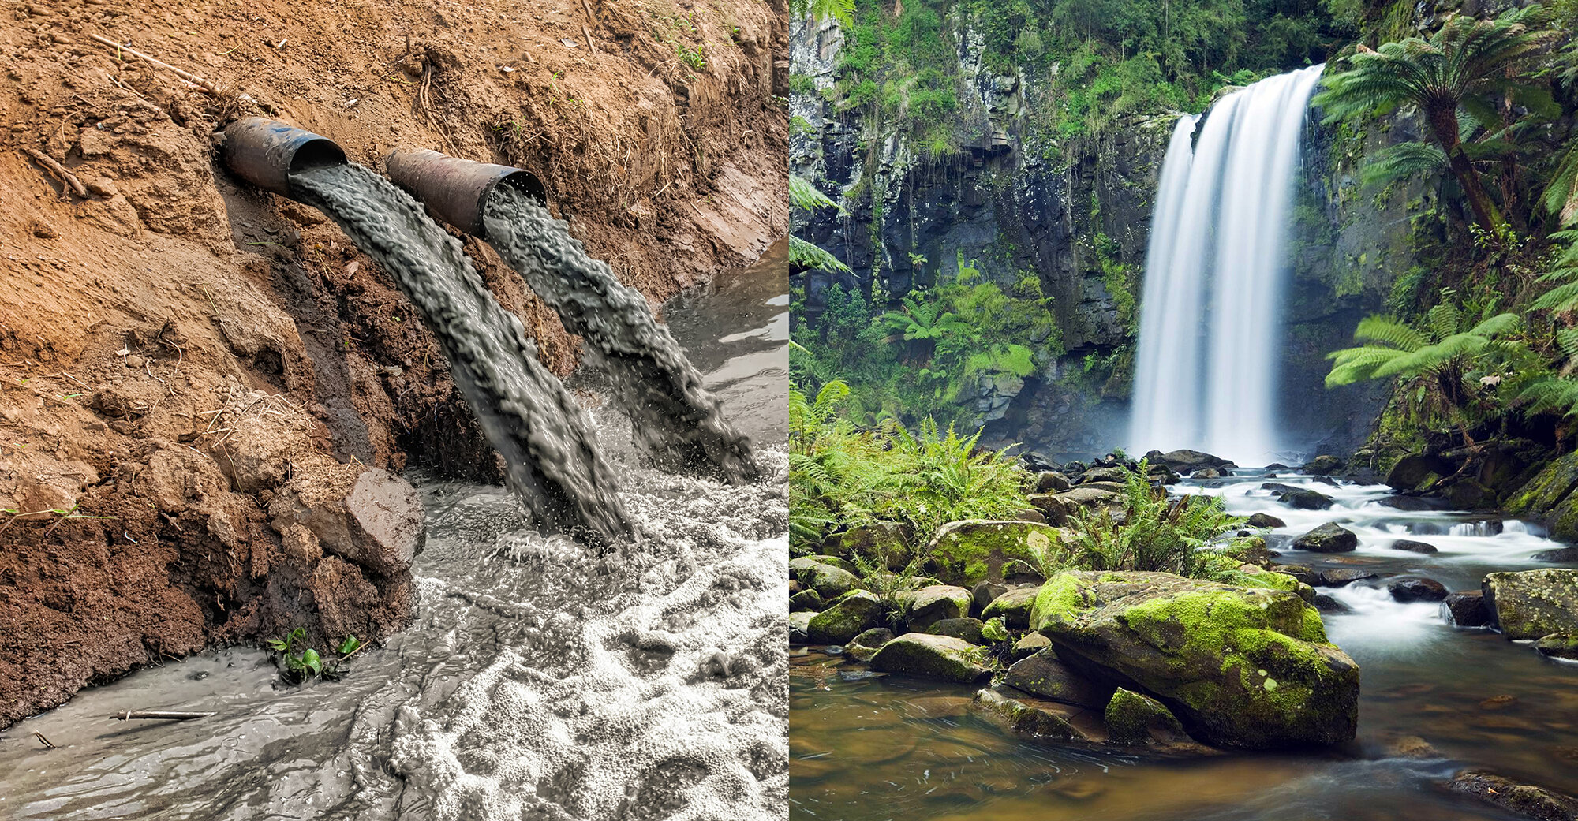
Notes:
River pollution

Slide 19
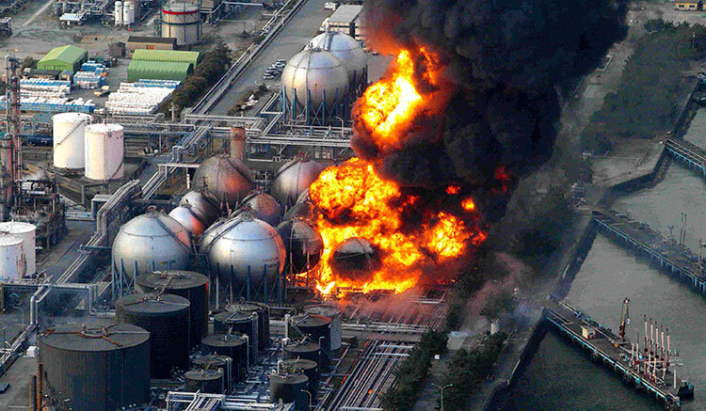
Notes:
Nuclear accidents at Fukashima or Chernobyl

Slide 20
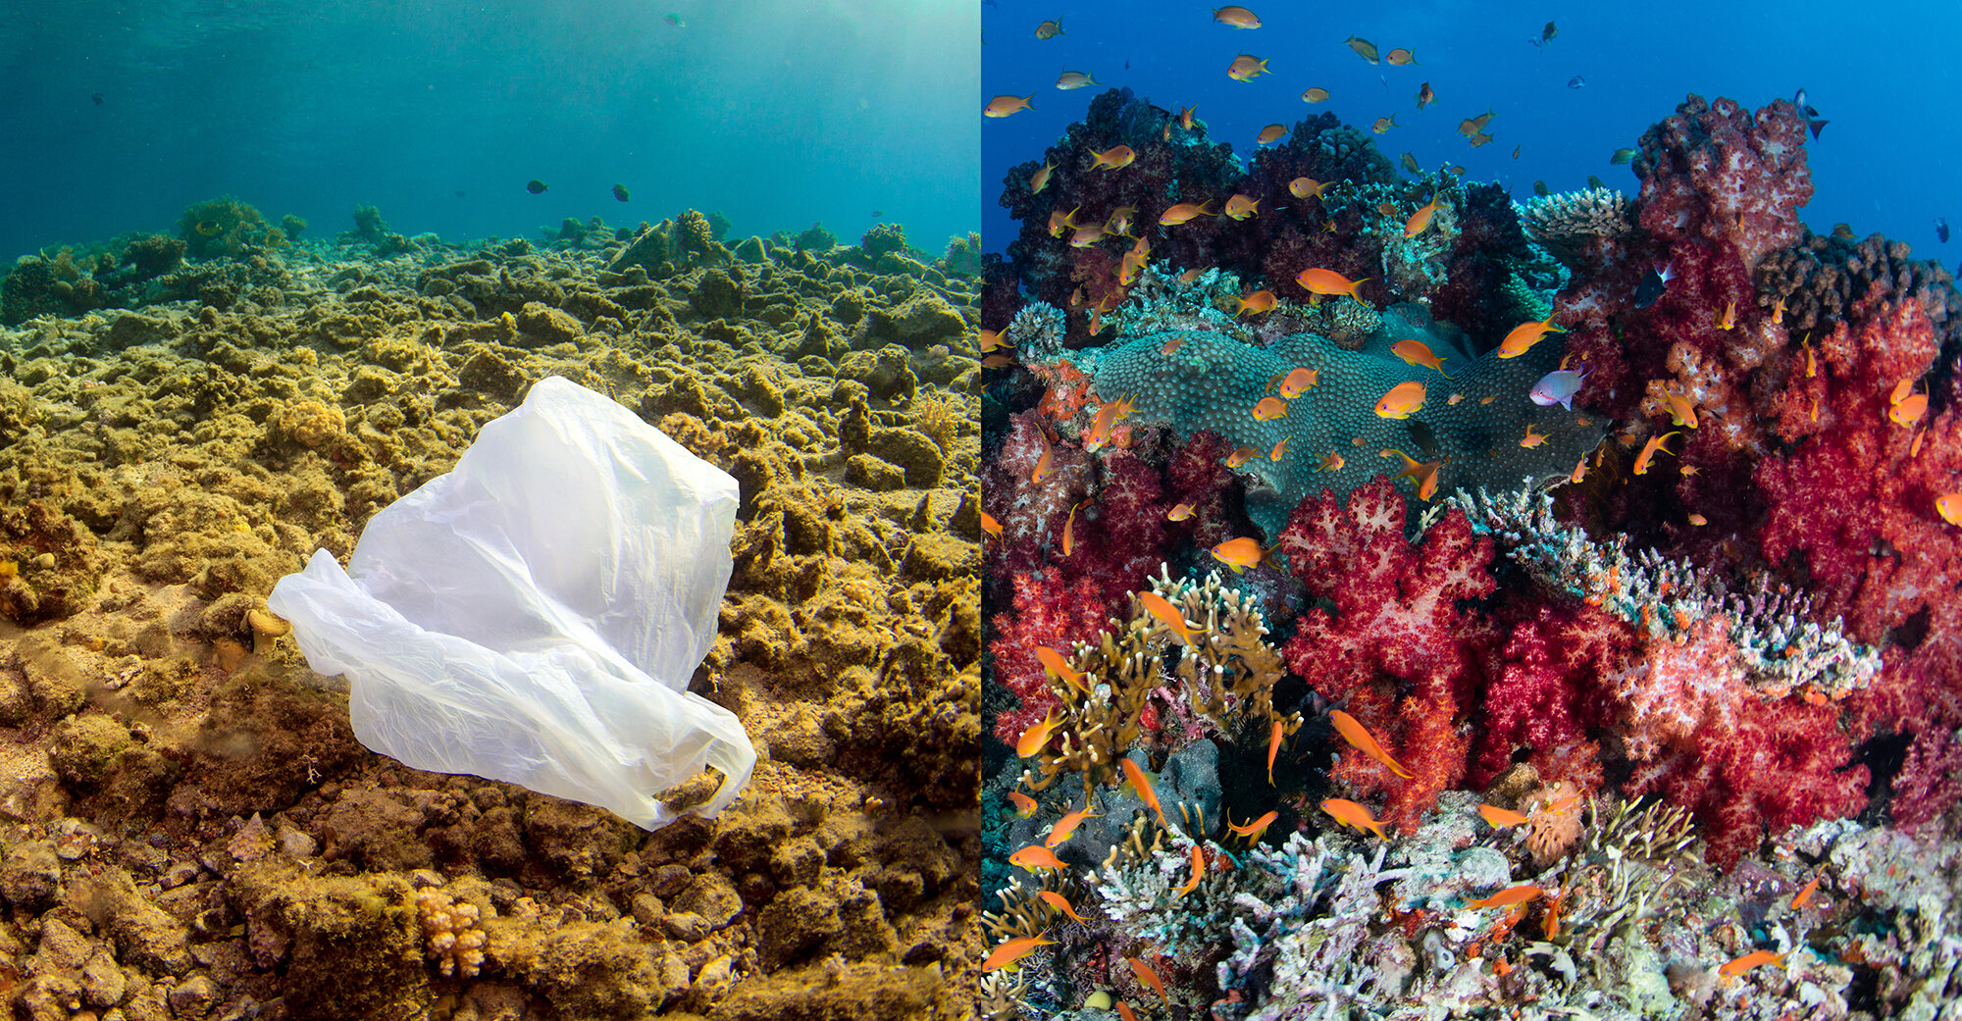
Notes:
Destroying coral reefs

Slide 21
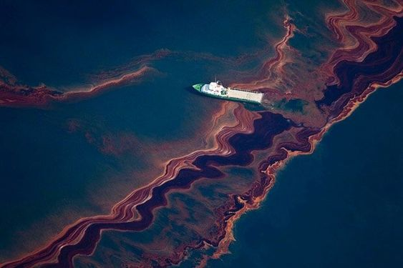
Notes:
Deepwater Horizon Oil spill

Slide 22
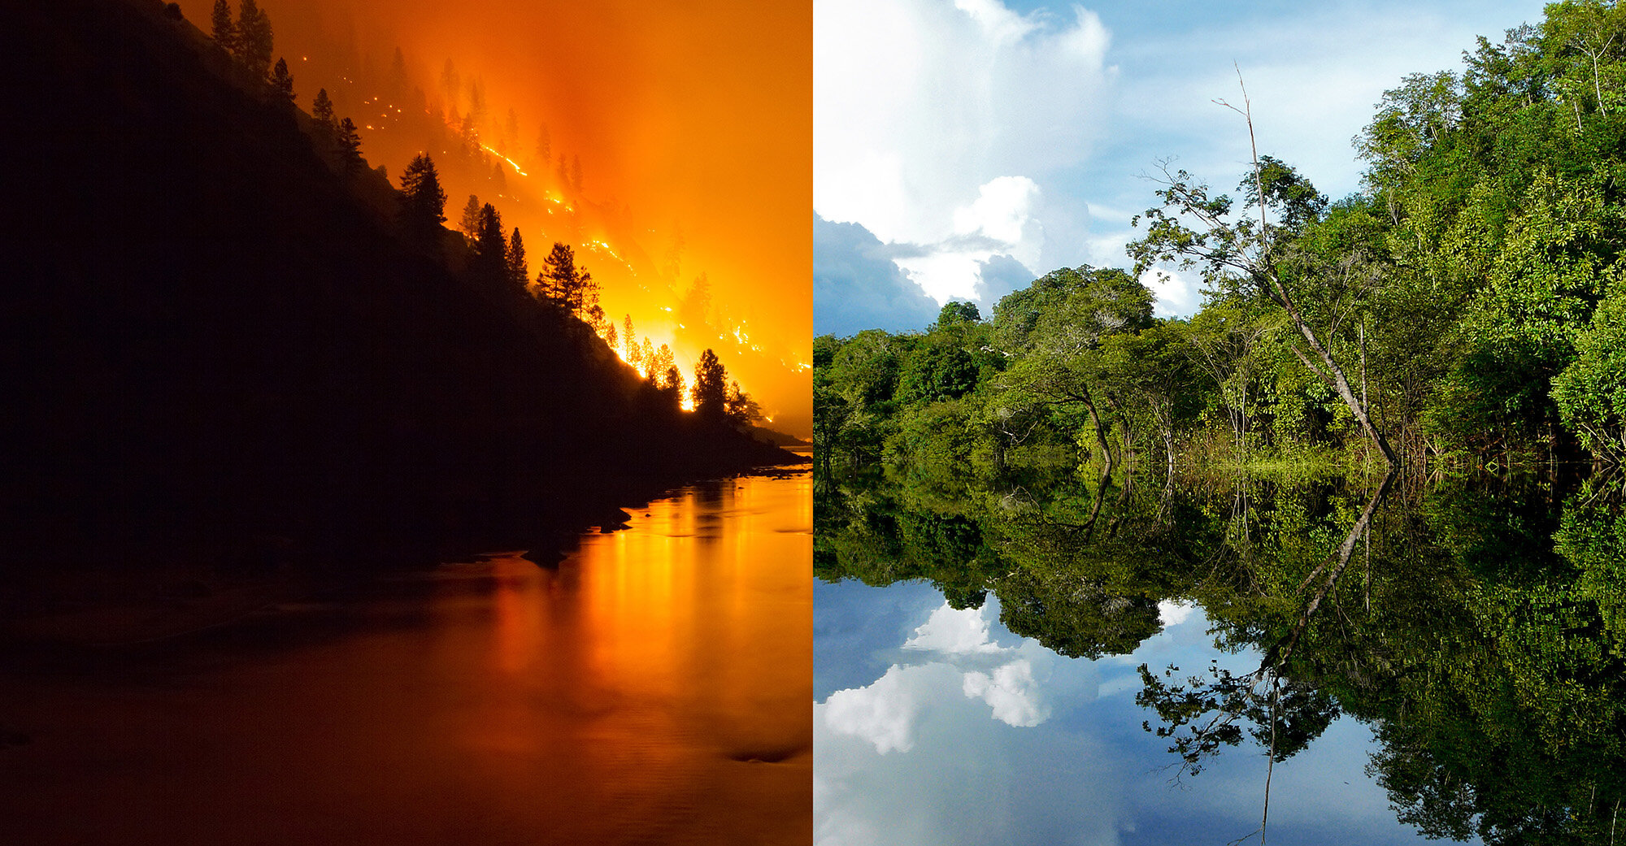
Notes:
Massive forest fires

Slide 23
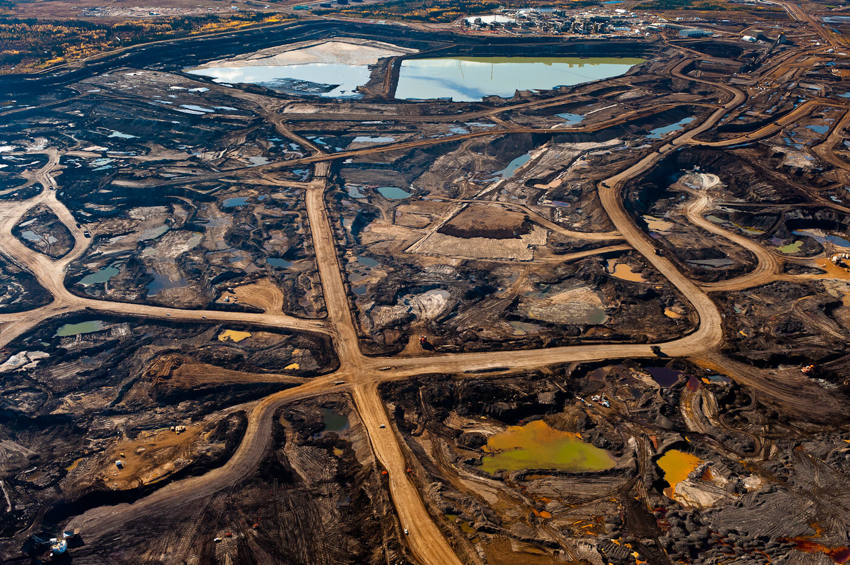
Notes:
Tar Sands oil extraction in Alberta

Slide 24
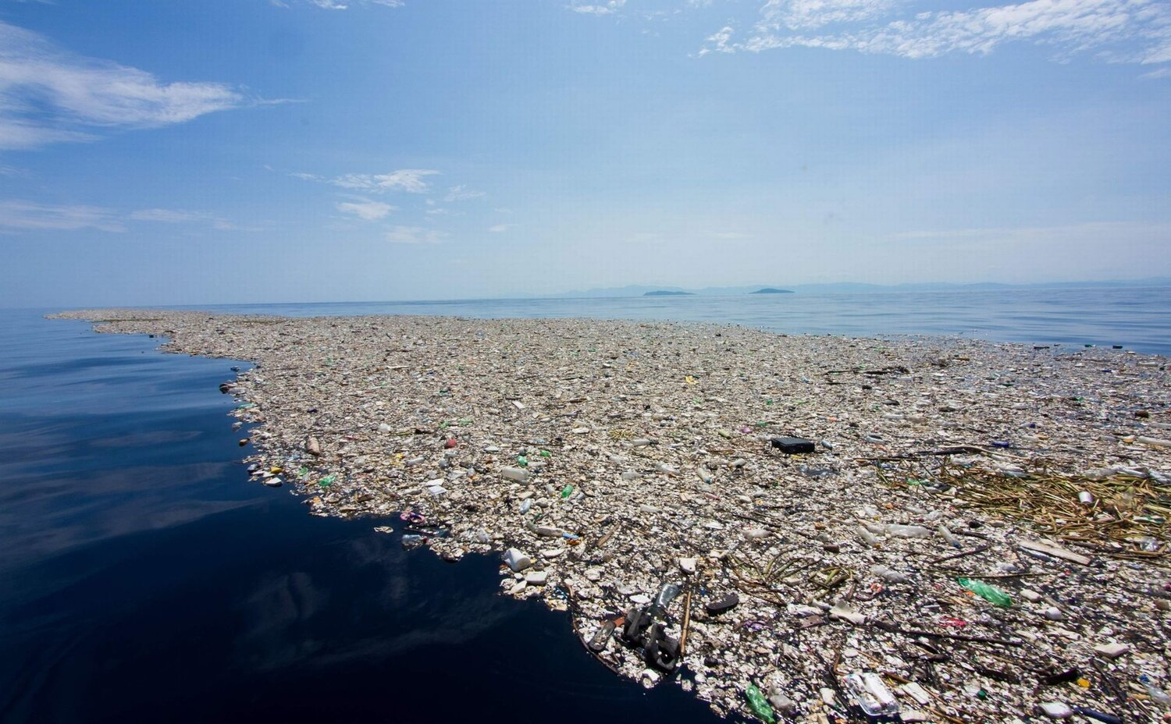
Notes:
plastic waste now more numerous than sharks and killing many birds and sea mammals and fish

Slide 25
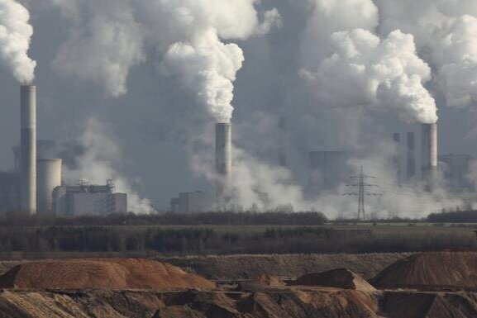
Notes:
Cement production

Slide 26
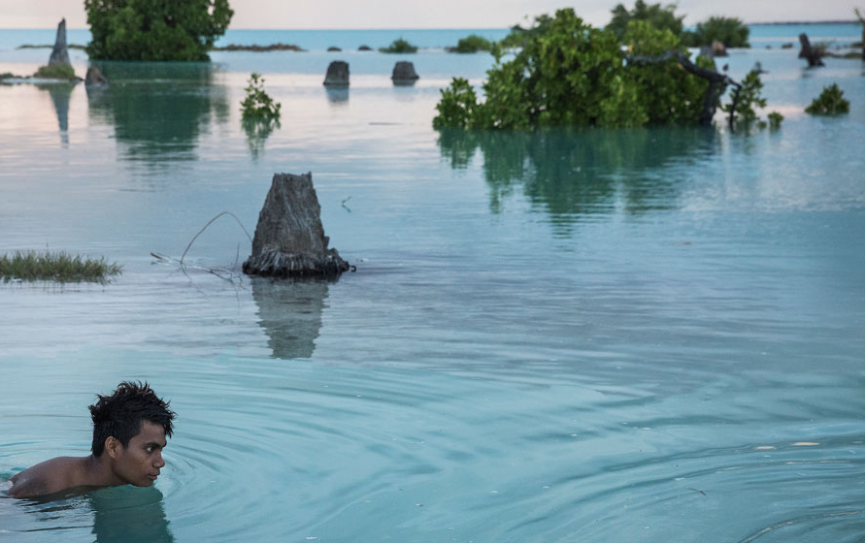
Notes:
flooding from excessive rain and sea level rises

Slide 27
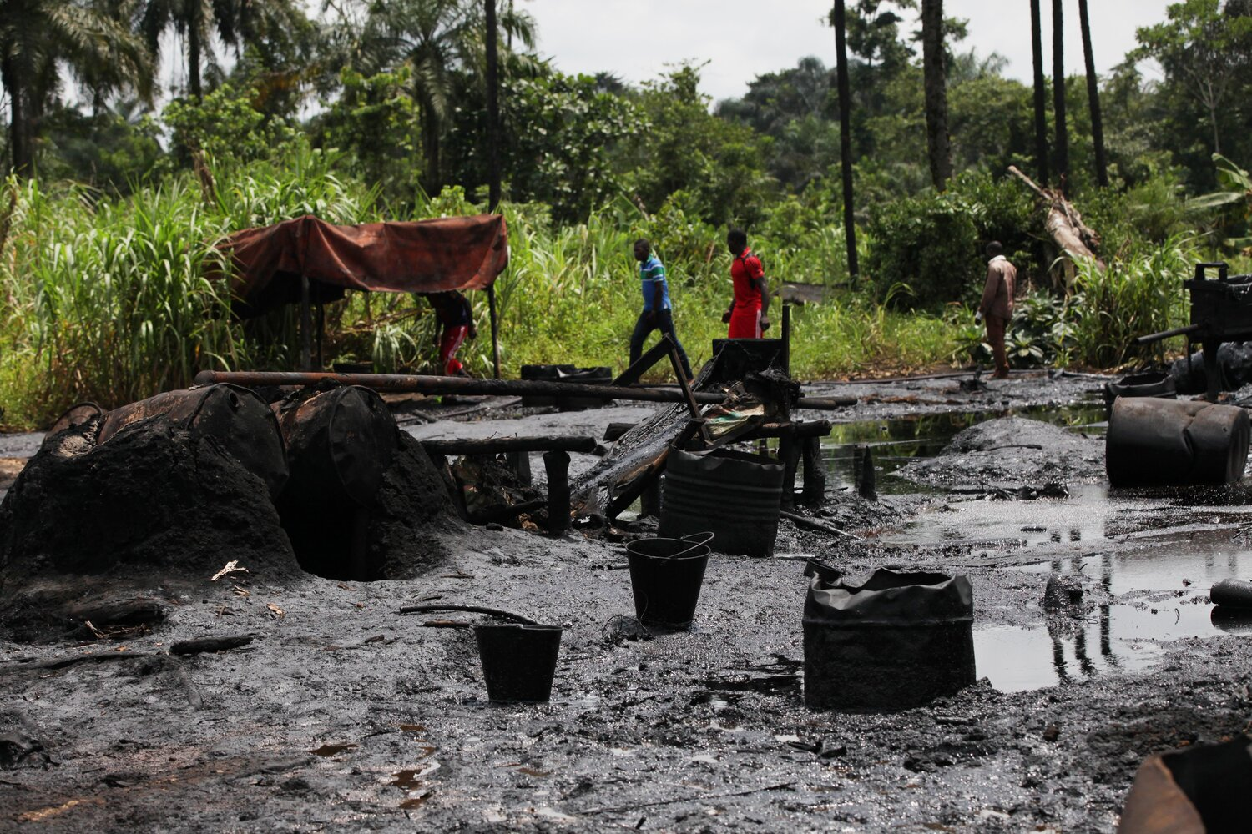
Notes:
OIl leaks on land

Slide 28
International Criminal Court already deals with:
Genocide
Crimes against humanity
War Crimes
Crime of Agression

Slide 29
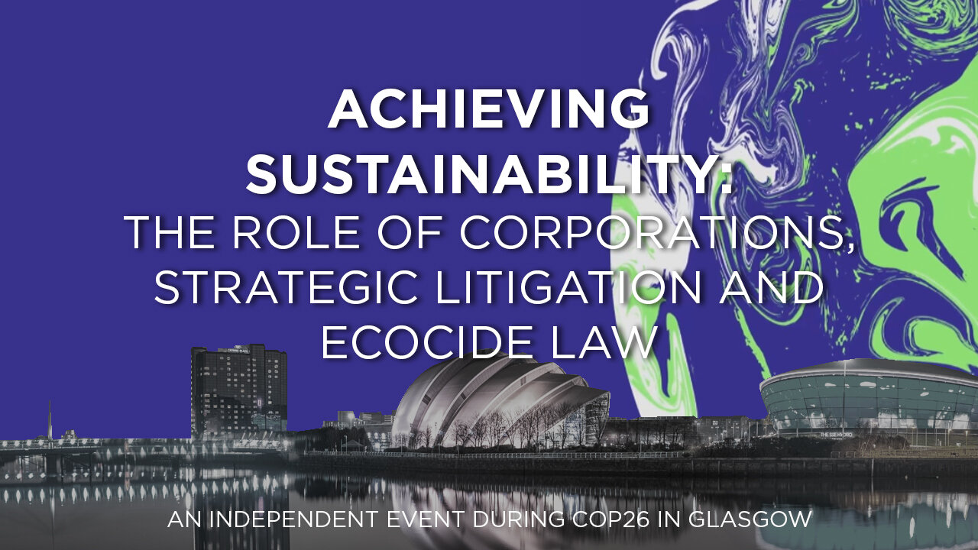
Ecocide expected to be added in about 4-5 years to increase individual accountability
Official Partner event at COP26
Wednesday, November 3, 2021, 5:30 PM 6:30 PM
+ An event every day until 10th November
ACTIVATING A LAW TO PROTECT THE EARTH
It’s time to change the rules. It’s time to protect our home

Slide 30
