Slide 1
Environmental Liability
Dougie Spencer ACII
Regional Director – Chartered Insurance Broker
Thomas Carroll Group plc
October 2021

Slide 2
Objectives
What is Environmental Liability and how can it arise?
How can an Environmental Liability claim be brought?
What are the consequences?
Risk Mitigations
What does the future hold?

Slide 3
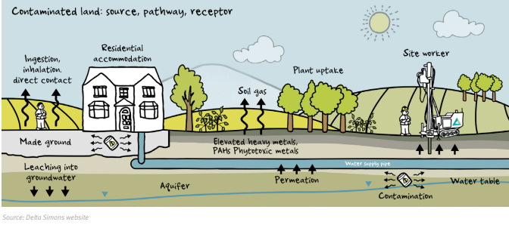
What is Environmental Liability?
According to the Association of British Insurers:
“The cost of restoring damage caused by environmental accidents such as pollution of land, water, air and biodiversity damage”

Slide 4
How Can Environmental Harm Arise?
There are many ways that organisations can cause or contribute to environmental harm
Suddenly and visibly following an incident:
Explosion
Spill
Deep Water Horizon Oil Spill leaked 200 Million gallons of Oil into the Gulf of Mexico in 2010
Gradually and Surreptitiously:
Leaking underground tank
Run Off from agricultural land
In many cases the full extent of a more gradual incident only becomes clear well after the event (Occasionally many years)

Slide 5
What Risks Do You Have?
Historic contamination issues taken on by contract
Mobilisation and/or exacerbation of historical pollution
Tenant actions resulting in landlord being liable for clean up costs
Hazardous Goods – Transportation
Inadequate raw material storage
Waste water discharges
Impact of business activities on infrastructure (utilities or sewerage)
Air emissions – odour/fumes/dusts
Fire

Slide 6
How Can Claims Be Brought?
The law of Tort has traditionally been used to rectify environmental harm with the most common torts being:
Negligence
Nuisance
The rule in Rylands vs Fletcher – Strict Liability for persons who handle hazardous materials
Trespass
In more recent years though, the law of tort has not been so effective, and with a growing sense of responsibility towards the environment so have followed a number of pieces of legislation from UK and EU
The introduction of this statutory legislation increases the chance of action by regulators as it is no longer simply third party damage which must be considered.

Slide 7
What Other Legislation Is In Place?
Water Pollution – Section 161A of The Water Resources Act 1991
Contaminated Land – Part 2A of The Environmental Protection Act 1990
Waste – Section 59 of The Environmental Protection Act 1990
Statutory Nuisance – Part III of the Environment Protection Act 1990
Environmental Damage – Environmental Damage Regulations 2015
European Liability Directive (ELD) 2009 – Businesses must investigate the cause of any contamination, and pay for any remedial action. If brought to court, an offence under this directive can result in up to two years imprisonment and an unlimited fine

Slide 8
What Costs Can be Incurred Following an Environmental Liability Incident?
Third party property damage and bodily injury
Statutory remediation (clean up costs required by regulator)
Emergency response costs (clean up costs incurred by the regulator)
First party clean up costs (own site)
Biodiversity damage
First party business interruption costs
Mitigation costs to respond to an imminent threat

Slide 9
What is The True Cost of An Environmental Liability Loss?
A UK water company was fined £15,000 for polluting a river.
They also had to cover costs for:
Tankering away the chemical - £32,600
Plugging the leak - £8,300
An initial fish survey - £6,000
Installing leak detection equipment - £60,000
Charge for Environment Agency officers - £2,270
Further fish surveys - £20,000
Restocking of the river - £63,500
​TOTALING: £192,670

Slide 10
What Other Consequences Are There?
Fines
December 2015 – 3 men and a haulage company were ordered to pay more than £262,000 in fines, confiscation and costs for illegally dumping more than 60,000 tons of waste on two farms in Cornwall. The amount of material deposited was way in excess of the prescribed limit of 1,000 tons, some of which was tipped on a raised field and slipped into a nearby stream.
April 2016 - two company directors and their company were ordered to pay £25,450 fines for illegally exporting 187 tons of hazardous electronic waste to six African countries between 2011 and 2015. The prosecution was brought by the Environment Agency after their officers found 11 shipping containers full of electrical waste destined for Nigeria, Ghana and Tanzania.
Imprisonment
In June 2014, an offender convicted of illegally exporting 46 tonnes of hazardous electrical waste to Nigeria, Ghana, the Ivory Coast and the Congo was sentenced to a term of 16 months by Snaresbrook Crown Court. He had a previous conviction for this offence.

Slide 11
What Other Consequences Are There? (Continued)
Reputation
Coming into disrepute, through being found guilty of an environmental crime or even simply being publically named brings added issues and you can expect:
Media Interest
Negative Public Opinion
Attention from Pressure Groups
Slump in Sales
Imagine the impact of this on:
Southern Water – Sewage Dumping 2021 (Together with £90m fine)
BP – Deep Water Horizon ($18.7bn fine)
Enforcement / Clean Up Notices
Regulators can enforce closure or suspension of business until a breach has been rectified. Breaching such a notice is a criminal offence

Slide 12
Surely My Insurance Policies Provides Protection?
In most cases a standard insurance policy providing cover for property damage or public liability will be inadequate with exclusions applying.
Property Insurance
Does not cover any third party liabilities
Soil/ground water are not considered as having a value
Pollution is not an insured peril
Does not cover gradual events
Public Liability
Does provide some cover if incident is sudden and unforeseen, but only for injury or damage to third party property.
Authority costs are not “damages”
Requires a claim to be brought against the policyholder
Only covers damage to third parties (excludes flora/fauna)

Slide 13
Bartoline Ltd vs Royal Sun Alliance 2006
Bartoline carries out the manufacturing and packaging of solvents and wood preservatives
A fire at the factory led to fire fighting foam (and chemicals) washing into two local water courses.
Acting under its statutory powers the Environment Agency carried out the clean-up process and invoiced the cost to Bartoline pursuant to the Water Resources Act 1991. This amounted to £770,000
Bartoline sought to recover these costs from their public liability insurers – RSA, who rejected the claim.
The judge commented that the “Agency’s statutory powers and the laws of tort seek to protect very different interests.” (Public Interest vs Private Interest) and subsequently ruled that these costs were authority costs and as a result not damages.
The result of this case essentially shuts the door for policyholders to reclaim environmental costs under a public liability insurance policy.

Slide 14
Case Study 1 – Food Manufacturer
Failure to conduct appropriate checks on pipes and valves led to 23,000 litres of diesel leaking from bunded tanks.
The Environment Agency had issued notices to remove the pipes from a decommissioned fuel storage facility.
With faulty valves, the fuel escaped to a local water course.
The company was fined £140,000
Clean Up Costs were in the region of £500,000.

Slide 15
Case Study 2 – Waste Recycling Centre
The business in question had a licence to recycle waste wood into chippings for burning fuel. The licence was for 10,000 tons.
A fire broke out as a result of thermal activity and burned for a number of days despite firefighters best efforts.
The water run-off contained heavy metal, oils, and chemicals.
Despite there being no escape of contaminants from the business’ own land and no fine being issued the remediation costs were £5,000,000 and a number of subsequent claims were received from neighbours for smoke nuisance

Slide 16
Case Study 3 – Groundworker / Construction
Allegations received that construction of a road through a brownfield site resulted in discharge of historic hydrocarbon and chlorinated solvents which polluted third party property via groundwater.
Environment Agency requested formal investigation, with costs running to £670,000 to include third party damages, compensation and legal defence. No fine was issued.

Slide 17
Case Study 4 – Farming
Imported aggregate for surfacing of the yard was contaminated with asbestos.
Regulatory demand to clean-up due to the potential human health exposure
£125,000 paid in investigation and clean-up requirements with a further £15,000 donation to a local wildlife charity was also paid.

Slide 18
Case Study 5 – Property Owner
An Industrial unit was leased by a small powder coating firm from a large property fund at a site near Southampton.
After a couple of years, the operators went into liquidation and contractors were employed to refurbish the unit.
During the refurbishment it came to light that there had been large process tanks which had been poorly maintained and resulted in leakage of chlorinated solvents.
Cracks in the concrete floor had allowed chemicals to escape causing groundwater and soil contamination.
Investigation and clean-up costs amounted to £180,000. This bill remained with the property owner.

Slide 19
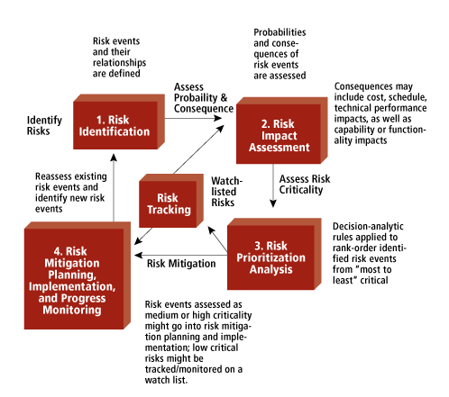
How Can We Mitigate Environmental Risks?
Understand and investigate the risks that you have.

Slide 20
How Can We Mitigate Environmental Risks?
Be proactive – don’t wait for an incident to occur!
Implement an Environmental Management element into your risk management processes.
Ensure that licences and training are kept up to date, particularly for higher risk activities such as removal of asbestos or storage of chemicals.
Maintain plant, machinery and equipment regularly
Conduct regular reviews of processes and continually evaluate the risks that you have.
Purchase environmental liability insurance
Engage with colleagues/employees to understand the importance of both preventative and corrective practices. (Training)
Quality Management
The Value of The Environment
Understand the Product Life Cycle

Slide 21
What Does the Future Hold?
How will public/political opinion change?
Will there be extra legislation?
Extra/additional powers for the regulator?
Additional funding for the regulators to undertake more visits and investigations.
A greener world? – A move away from certain materials, or substances?

Slide 22
Questions?

