Slide 1
HAV Exposure Monitoring vs Measurement Herefordshire Health and Safety Group

Slide 2
HAVS The Issue Section One | 03
HAV Risk Assessment Challenges Section Two | 05
HAV Exposure Management Section Three | 11
Reactec Approach Section Four | 13
In Summary Section Five | 16

Slide 3
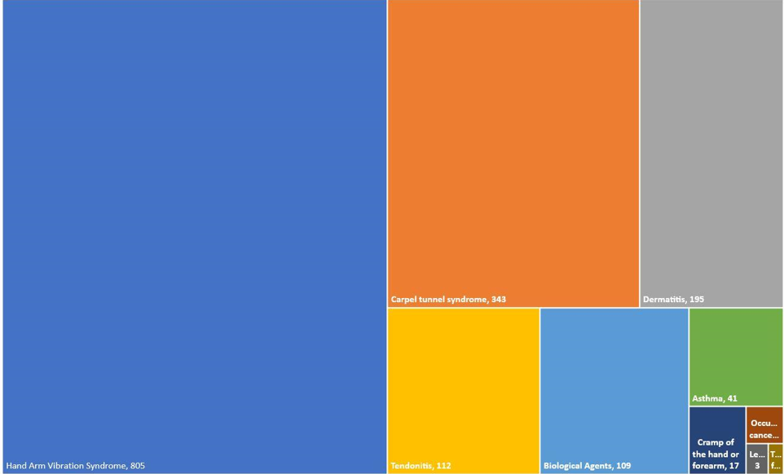
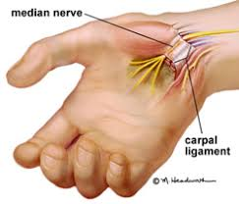
2018 Industrial Disease RIDDORS
How likely are you to develop havs?
CTS
HAVS
Established correlation between time to vascular damage (white finger) and average daily exposure

Slide 4
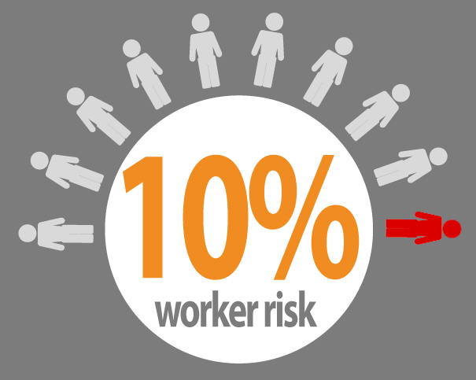
How likely are you to develop havs?
10% of employees exposed at the exposure action level will contract HAVS within 12 years or within 6 years if exposed to the exposure limit level. (HSE)
“Exposure below the Action Value cannot be considered safe...” (HSE)
D_{y}, years | 4 | 8 | 12 | 15
A(8), m/s² | 7 | 3.7 | 2.5 | 2.0
Daily Exposure Pts | 784 | 219 | 100 | 64
Established correlation between time to vascular damage (white finger) and average daily exposure

Slide 5
Legal obligations
The Control of Vibration at Work Regulations 2005 and associated guidance requires the following;
Elimination or control of vibration exposure risk to As Low As Reasonably Practicable (ALARP).
An assessment of the risks to employees from exposure to vibration, including assessment of employees’ daily exposure to vibration.
Information, instruction and training to tool users and their managers.
A suitable and sufficient assessment of HAV exposure risk requires a determination of;
duration of exposure and;
probable vibration magnitude during exposure.

Slide 6
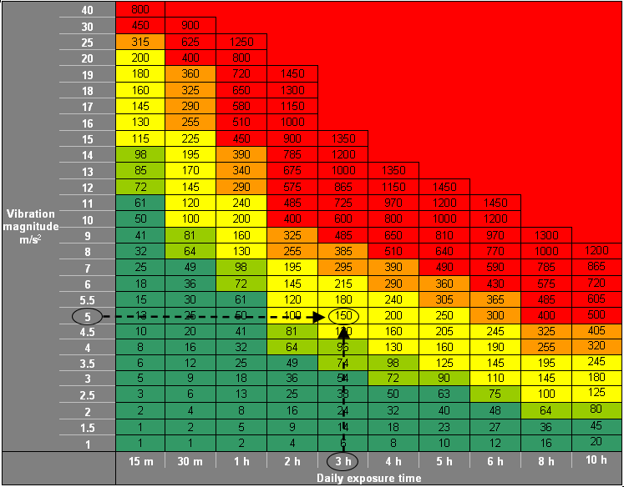
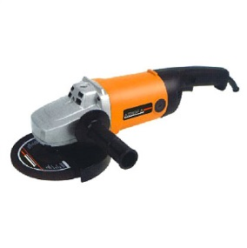
Assessing HAV Exposure
Angle grinder
Vibration magnitude 5m/s²
Trigger time: 3 hours
150 EXPOSURE POINTS
*HSE Website: www.hse.gov.uk/vibration

Slide 7
01
Does the risk assessment match the real tool use
Why does HAVS still dominate RIDDORS?
02
How representative is vibration data used for risk assessments
03
Inadequate or ineffective controls.
04
Operator competency
05
Is the right tool being used for the job

Slide 8
01
30
Chipping hammer A
Condition of tool
25
rock drill
20
Vibration Magnitude (m/s²)
Impact drill
02
Condition of tool accessory
15
10
03
Operator competency
5
0
04
Material being worked
Key
Range of vibration in intended use
declared
emission
mean vibration in intended use

Slide 9
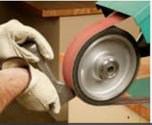
HSE Appendix 3
7 to 13m/s²
Drills Imact: Can give very high vibrations if operators push too hard. Maintaining sharp drill bits is important.
7 to 11m/s²
Impact wrench: Measured vibration levels are dependent upon rates of use. It can be difficult to assess exposure times correctly.
3 to 10m/s²
Angle grinders: Vibration values will depend on force being applied and different materials being worked. Selecting the right grade of abrasive and applying the right forces can help to minimise exposures.
4 to 12m/s²
Orbital sander: Vibration magnitudes are very dependent upon applied force. Lower vibration magnitudes can be achieved by applying the correct forces and using the appropriate abrasives.
7 to 27m/s²
Reciprocating saw: Operator training and work organisation is important. Lower vibrations can be achieved by keeping the tool’s nose against the workpiece.
Linishing: Vibration magnitudes vary greatly with applied force and condition of linishing belt.

Slide 10
How good are your risk assessments?
Even with the right training, it’s hard to know just how closely everyone is following health and safety protocols. Individuals taking more risk than you want, and unchecked exposure could damage your organisaton down the line.
Immediate and long-term gains require a shift towards prevention rather than simply compliance. Measure what’s happening, tailor your controls faster, engineer out risk and actively protect your workers health in the workplace.

Slide 11
Approximately right or exactly wrong
Assessment / Monitoring
Measurement
Can be suitable for monitoring HAV exposure all day from multiple tool use and assess exposure as required by “The Control of Vibrations at Work Regulations 2005”.

A grip mounted vibration magnitude measurement which can be compliant to ISO5349...

A wrist or tool mounted HAV monitor* does not measure in full compliance to ISO5349.
X
… will not be suitable for monitoring HAV exposure all day from multiple tool use.
X

Slide 12
Risk assessment should be a continuous process
PLAN, DO, CHECK, ACT Management method for the control & continuous improvement of risk
Initial risk assessments of employees exposed to vibration are required to establish an appropriate set of controls and determine if occupational health screening is required.
4
1
ACT
Improve controls & revise risk assessments
PLAN
Plan Initial Risk Assessment
Review the performance of controls and identify improvements to reduce risk ALARP.
3
2
Are monitored risk levels in keeping with initial assessment
Have control measures resulted in risk levels desired
CHECK
Review controls effectiveness
DO
Monitor Exposure Levels
Monitoring can help validate risk assessments.
Tool mounted and wearable on the wrist devices can be used to monitor HAV exposure.

Slide 13
HAVS prevention
HAVWEAR is a wearable device giving unique insight into individual exposure levels to Hand Arm Vibration and personal alarms to directly influence behaviour.
More powerfully, combining the HAVWEAR with automatic data capture to the rich environment of the Reactec Analytics, all levels of management have enabling information to effectively manage the HAV exposure of their workforce at their finger tips

Slide 14
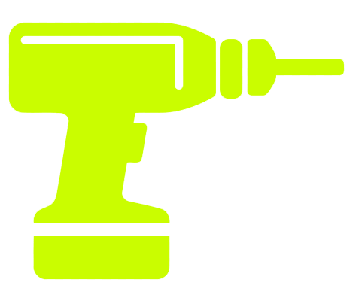
HAVWEAR
2 Concurrent Assessments
x
=
Tool Exposure Points (TEP)
COMPLIANT with HSE Guidance
2
Pre-determined expected vibration magnitude
Trigger time of Tool Use
x
=
Sensed Exposure Points (SEP)
Independently validated by the IOM
2
Real use sensed vibration magnitude
Trigger time of Tool Use

Slide 15
Reactec Credentials
Clients +900
Employees protected +75,000
Tool records +20M
Software users +9,000

Slide 16
In Summary
HAVS damage is irreversible with a latency which can lead to complacency. However HAVS is preventable.
01
HAV risk assessments are a legal requirement
02
Risk assessments do not require precision measurements
03
They do need to be representative enough to implement effective controls

