Slide 1
Herefordshire Health & Safety Group
ZOOM SEMINAR
10:00am Wednesday 28th April 2021
‘Health and Wellbeing – in the new normal’
Housekeeping:
Please keep microphones ‘muted’ unless you wish to speak (this keeps down background noise).
Please ask questions though the ‘chat’ button.
Technical issues, please email info@herefordhsg.co.uk
Please note the Seminar will be recorded and may be used for supporting the communication of H&S advice.

Slide 2
AGENDA
Today we are going to cover:
Working from home
Display Screen equipment
Fatigue and Work
Stress Awareness Month - HSE

Slide 3
What happens now?
Fifty of the biggest UK employers questioned by the BBC have said they have no plans to return all staff to the office full-time in the near future.
24 companies have no plans to return staff to the office yet;
20 firms have gradual plans to reopen office space;
3 firms have brought back staff with no plans for more;
20 have opened offices for staff unable to work at home

Slide 4
Working from Home
Employers have the same health and safety responsibilities for employees working from home as for any other employees
While there is no increased risk from DSE work for those working at home temporarily, a basic risk assessment should still be undertaken
For long term home workers a full risk assessment will be required

Slide 5
Reduce the risks from display screen work
break up long spells of DSE work with rest breaks (at least 5 minutes every hour) or changes in activity
avoid awkward, static postures by regularly changing position
get up and move or do stretching exercises
avoid eye fatigue by changing focus or blinking from time to time

Slide 6
Look out for …
Staff suffering aches, pains or discomfort related to their temporary DSE arrangements
The adverse effects for staff due to working in isolation, on remote IT systems, or unable to access usual support systems
Staff working longer hours without adequate rest and recovery breaks

Slide 7
Eyes and eyesight testing
The law says employers must arrange an eye test for display screen equipment (DSE) users if they ask for one, and provide glasses if an employee needs them only for DSE use.
DSE work does not cause permanent damage to eyes. But long spells of DSE work can lead to:
tired eyes
discomfort
temporary short-sightedness
headaches

Slide 8
Workstations and Assessment
If workers use display screen equipment (DSE) daily, as part of their normal work, continuously for an hour or more, employers must do a workstation assessment.
Employers should look at:
the whole workstation, including equipment, furniture, and work conditions
the job being done
any special requirements of a member of staff, for example a user with a disability
Where there are risks, they should take steps to reduce them.

Slide 9
Getting the message across

Slide 10
Fatigue and Work
RoSPA have recently issued some new guidance on fatigue – their key point is:
"Fatigue is a major but under-recognised hazard in the workplace, adversely affecting workers’ health, safety and wellbeing as well as overall organisational effectiveness."

Slide 11
Fatigue and Work
Many causes..
Some workers more susceptible to excessive fatigue than others (EDS, OSA etc,)
Fatigue can contribute to accidents and unplanned events by adversely affecting motivation, vigilance/monitoring, reaction times, sustained attention, visual tracking, logical reasoning and calculation, encoding and decoding of information, memory, communication, multi-tasking and complex decision-making.

Slide 12
Fatigue and Work
Many causes.. (cont’d)
Sufferers from extreme and prolonged mental and physical exhaustion are more likely to develop persistent insomnia, sleepiness, mood disturbance, relationship difficulties, substance abuse, absenteeism and disciplinary problems as well as long-term health detriments such as stomach upsets and cardiovascular disease.
Employers have legal duties (SFAIRP) to assess and control tiredness in the workplace

Slide 13
Fatigue and Work
Many causes.. (cont’d)
Cumulative fatigue is a significant risk factor not only in front-line safety critical work but also in many other tasks, which, if performed poorly, can result in latent safety problems.

Slide 14
Fatigue and Work
Key objectives
Avoid stigmatisation! (ensuring fatigue is not wrongly described as indolence or laziness)
Assess and reduce potential for fatigue
Manage shiftwork safely (HSG 256)
Enough time between shifts to commute, wash, eat, socialise and carry out domestic duties, as well as sleep;

Slide 15
Fatigue and Work
Key objectives (cont’d)
Restrict consecutive night shifts to a maximum of two to three or two 12-hour shifts; and allowing at least two days off after the last night shift in a string of such shifts.
Shifts rotated forwards (early shifts changing to afternoons and afternoons changing to nights).
Long shifts and too much over-time to be avoided.
Quality breaks and scope for “power napping” (with caution!)
Self-selection of shift patterns.

Slide 16
Fatigue and Work
Further general steps..
Fully consulting the workforce and their representatives
Communicating a clear policy that destigmatises fatigue
Delivering workplace awareness-raising, including steps to improve and maintain good health and good sleep hygiene
Training line and middle managers in interpersonal skills to engage sensitively with workers about fatigue
Taking account of fatigue in all risk assessment processes, particularly for safety critical work

Slide 17
Fatigue and Work
Further general steps..(cont’d)
Reviewing fatigue as a possible causal factor in all accidents and incidents
Consider any difficulties in travel to and from work that may contribute to fatigue
Avoiding workers driving when dangerously tired, both when driving for work and driving to and from work
Engaging outside experts to help
Ensuring appropriate occupational health support

Slide 18
Fatigue and Work
Final thought..
"Against a background of austerity in society generally, increasing demands for “leanness” and unremitting expectations for ever higher personal achievement in the workplace, business leaders need to commit to creating an intelligent and humane culture in their organisations which recognises the corrosive and potentially harmful effects of fatigue and exhaustion and the importance of addressing this problem both sympathetically and systematically."

Slide 19
Fatigue and Work
For more information follow the link:
RoSPA - Fatigue and work
Position statement
https://www.rospa.com/media/documents/occupational-safety/fatigue-and-work-position-statement.pdf

Slide 20
Work-related health
Campaign resources
Stress Awareness Month
April 2021

Slide 21
Introduction
The following pack contains information and resources which you may wish to use to help raise awareness of work-related health through your own channels.
Our aim is to improve capability and understanding of basic risk management and prevention of ill health at work.
Generally, HSE’s primary focus areas for health include coronavirus and the top three causations of workplace ill health. These are:
work-related stress
lung health
and musculoskeletal issues.
This month the focus will be on Stress Awareness.
If you have any questions, please contact natalie.dunn@hse.gov.uk or jennie.atkins@hse.gov.uk

Slide 22
Audiences
Generally, we will target workers and business duty holders, particularly in areas where social-demographics show vulnerabilities to workplace health inequalities associated with sector and work activity. Including:
employers in small and micro businesses
employees in identified vulnerable sector based communities
new employees / young workers who have recently joined or are expected to join the world of work
Citizens of England, Scotland and Wales.
Findings for stress specifically…
Stress, depression or anxiety is more prevalent in public service industries, such as education; health and social care; and public administration and defence. By occupation, professional occupations that are common across public service industries (such as healthcare workers; teaching professionals and public service professionals) show higher levels of stress as compared to all jobs.
Compared to all workers females overall had statistically significantly higher rates of work-related stress depression or anxiety and males significantly lower. Females in age groups 25 to 34, and 35 to 44 had significantly higher rates of work-related stress, depression or anxiety.
Large workplaces had a statistically significantly higher rate.

Slide 23
HSE’s key messages
Employers are being urged to review stress-causing factors in the workplace as part of their risk assessments.
Stress, depression or anxiety account for 51% of all work-related ill health cases and 55% of all working days lost due to work-related ill health.
Stress impacts on all sectors and businesses of all sizes and employers have a legal duty to protect employees from stress at work by doing a risk assessment and acting on it.
Evidence shows that there are six key focus areas to manage stress in the workplace. If not properly managed, they are associated with poor health, lower productivity and increased accident and sickness absence rates. These are:
Demands: workload, work patterns and the work environment
Control: how much say the person has in the way they do their work
Support: encouragement, sponsorship and resources available to workers
Relationships: promoting positive working to avoid conflict and dealing with unacceptable behaviour
Role: whether people understand their role within the organisation and whether the organisation ensures that they do not have conflicting roles
Change: how change (large or small) is managed and communicated.
HSE has a range of practical support and guidance available including risk assessment templates, a talking toolkit, workbooks, posters, a new mobile app and an new automated stress indicator tool (SIT) that is free for businesses with up to 50 employees.

Slide 24
Resources available
 | Link
Main page - stress | https://bit.ly/3sljMYU
What to do | https://bit.ly/2NUeYL2
Risk Assessment | https://bit.ly/3tNapkS
Stress Standards (6 main causes) | https://bit.ly/3rnsp3A
Mobile app | https://bit.ly/2QFUKWn
Stress Indicator Tool | https://bit.ly/3tO14sY

Slide 25
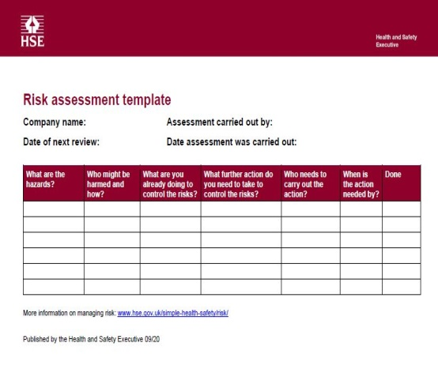
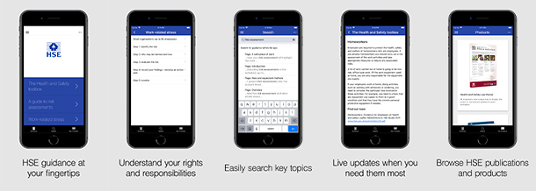
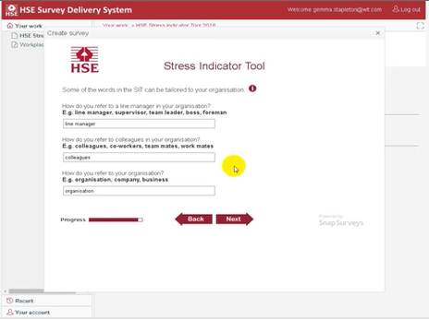
Outline plan
The themes will be primarily social, however there will also be targeted e-bulletins to those who have subscribed and a press release.
Week 1: soft launch with social (note: Easter weekend).
Week 2: six main causes of stress at work (change, support, role, demands, control, relationships).
Week 3: stress risk assessment.
Week 4: more on what stress is, signs, prevention and case studies.
Week 5: resources (templates, talking toolkits, workbooks, posters, mobile app and stress indicator tool).

Slide 26
Herefordshire Health & Safety Group
Thanks for listening
Any Questions?

