Slide 1
Herefordshire Health & Safety Group
ZOOM SEMINAR
10:00am Wednesday 25th November 2020
Workplace Transport
Housekeeping:
Please keep microphones ‘muted’ unless you wish to speak (this keeps down background noise).
Please ask questions though the ‘chat’ button.
Technical issues, please email info@herefordhsg.co.uk
Please note the Seminar will be recorded and may be used for supporting the communication of H&S advice.

Slide 2
Workplace Transport Safety

Slide 3
When the I nspector Calls
Is there a traffic management system in place?
Has all the workplace transport been assessed?
Is the risk assessment documented?
Are there documented policies, safe systems of work, site rules?
Are people aware of them & are they adhered to?
Is there evidence that traffic is managed?

Slide 4
What the I nspector finds..
No/inadequate Workplace Transport RA
Individual hazards only
Entire Workplace Transport set up not assessed

Slide 5
Employer must…
Ensure that the movement of people & vehicles is directed & controlled
Establish roles &
responsibilities - Appoint a competent person
Monitor changes, sub-contractors doing CDM work?

Slide 6
Transport - Key messages – In equal measures
Safe SITE
Safe VEHICLE
Safe DRIVER
Notes:
6
Transport consistently = 25-33% of fatalities each year.
Good topic to link these together
“Safe on Road – Safe Off Road” theme

Slide 7
Traffic Management Syste m
Combination of physical measures & formal traffic management procedures
Based on RA
Details responsible people
Safe SITE

Slide 8
Traffic Management Syste m
Traffic Management Plan:
ID the traffic routes
Includes a map/site plan
Workplace / Site Rules:
Instructions: what people can or cannot do

Slide 9
Risk Assessment
WHAT COULD GO WRONG?
Person:
Be hit by a vehicle?
Fall from a vehicle?
Be crushed between a vehicle & another vehicle or stationary object?
Be hit by a falling load?
Make a mistake?
Pedestrians paying attention to their phones, not what's around them!
Vehicle:
Be used inappropriately?
Overturn/topple over?
Drive away prematurely?
Touch an overhead obstruction?

Slide 10
Risk Assessment
Who can be harmed?
Employees
Visitors,customers
Members of the public
Visiting drivers
Contractors
Maintenance personnel
Cleaners
Security staff
Employees of other companies
Vulnerable people

Slide 11
Risk Assessment
Evaluate/assess the level of risk
Are existing precautions good enough?
Look at:
The workplace/the route The vehicle
The driver
Previous incidents/accidents?
Safe Driver
Safe Vehicle
Safe Workplace

Slide 12
Hierarchy of Control
Eliminate
Substitute Isolate
Engineering Controls
Administrative Controls PPE

Slide 13
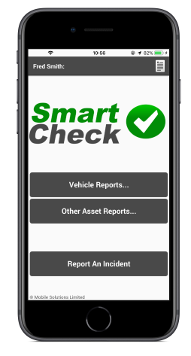
Safe Vehicle
Safe VEHICLE
Appropriate
For the task
For the loads being carried
Safe (throughout working life including driver wellbeing)
Regularly inspected, repaired & maintained
Access & egress
Driven safely - competence
Specify what safety requirements are for contract owner drivers

Slide 14
Safe Driver
Safe DRIVER
Employers must ensure that :
Drivers are fit & competent to operate all Workplace Transport & attachments
Medical requirements satisfied
Licences checked
Company Procedures implemented
Recruitment
Training, authorisation & supervision
Contractor vetting
Managing visiting drivers

Slide 15
Driver Safety Process
Safe DRIVER
New driver check; licence, health, eyesight
Driving for anyone else?; Driving hours / Driver Fatigue
Can he carry passengers; children during holidays!
Learn company polices; How to check a vehicle, Reporting of incidents and defects, Action in the event of a RTA’s.
On the road assessments
Awareness of Load heights, Low Bridges, Overhead powerlines

Slide 16
Continuous Management
Review & monitor effectiveness of the system
Review RA annually & particularly if you introduce:
New vehicles or equipment
Changes in the number of vehicles
New work practices / Changes to traffic routes / New personnel
OR Other changes that may affect traffic flow & management

Slide 17
Jane Gurney
'Tilly The Trailer'

Slide 18
Will Salkeld
Area Manager

Slide 19
Local Issues - Herefordshire
Things to consider:
Rural area
Agricultural with lot of seasonal work
Tractors and farm machinery on the roads transporting apples and potatoes etc.
Getting crops off the fields leads to road contamination
Congestion on main routes at certain times of the day
All of these issues present specific problems to the area in which we live and should be considered in any transport assessment

Slide 20
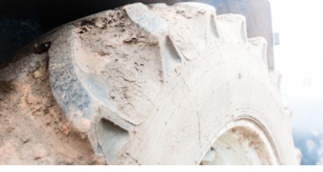
Local Issues - Herefordshire
Mud on Roads
Requirements:
Farmers and contractors are legally obliged to clean up any deposits left on the road.
There is also a legal requirement to place out signs compliant with the Traffic Signs Regulation 2016 to warn motorists of the conditions on the road.
If they don't, they could be liable for a number of offences under the Highways Act 1980 and the Road Traffic Act 1988.
Keep to low-speeds to help retain mud on the vehicle, especially when only travelling a short distance
Be prepared to keep a written record of your decisions on whether or not to deploy signs and/or to clean the road

Slide 21
HSE & DVLA Guidance
Drivers’ welfare at delivery and collection sites during the coronavirus (COVID-19) pandemic – Updated Nov 2020

Slide 22
Driving and Covid 19
1) Comply with the UK Government’s advice on Covid-19 – see: www.gov.uk/coronavirus
2) Keep at least 2 metres away from others where possible
3) Touch as little as possible.
4) Follow the washing hands guide. If possible, ensure hand sanitiser or soap is available in the cab.
5) Drivers should use gloves where possible and follow guidance on how to remove them without contamination.
6) At both the start and end of your shift, wipe down all cab surfaces. This includes steering wheel, gearstick, dashboard, handles, any other surfaces where the virus could make contact with a person. Dedicate vehicles if possible.
7) Ensure drivers have food and water as back-up in case of low supplies in food stores and/or motorway service areas.

Slide 23
Driving and Covid 19
Refuelling
8) When refuelling, use disposable or other gloves (paper towels if there are no gloves).
9) If possible wash your hands immediately after refuelling, otherwise use hand sanitiser.
Documentation
10) If the customer agrees, instead of signing documents, consider asking the customer to send you/your company an email confirming delivery or using your mobile phone to provide photographic evidence of delivery
11) Use your own pen to sign documentation. Do not share your pen with anyone. Ask the customer to use their own pen.
12) Ensure minimal contact with any piece of paper.
Please do all you can to keep yourself, your family and others safe from contact with Covid-19
Sites
Destinations / site legally obliged to provide welfare facilities for visiting drivers.

Slide 24
Driving and Covid 19
Advice for Drivers at Work
Ideally there should be only one person in the vehicle
Where this is not possible, workers should keep the window open for ventilation and should be careful to avoid touching their face at all times & Wear face coverings.
Facing away from each other may help to reduce the risk of transmission. Where face-to-face contact is essential, this should be kept to 15 minutes or less wherever possible.
Drivers should wash their hands with soap and water for 20 seconds or longer before getting into or after getting out of the vehicle, or use hand sanitiser.
Remember to catch coughs and sneezes in tissues
Employers should hand sanitiser and tissues and encourage staff to use them where staff are split into teams, organise these in such a way that where contact is unavoidable, it happens between the same individuals.
Keep teams as small as possible (In bubbles). Spread out standard processes, so that only one team is needed to complete a task at a given time.
Staff should still be advised to maintain a two-metre distance from each other as much as possible even in teams.

Slide 25
Transport - Key messages
Safe SITE
Safe VEHICLE
Safe DRIVER

Slide 26
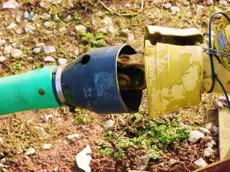
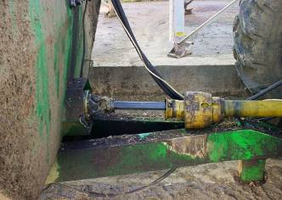
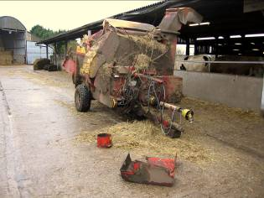
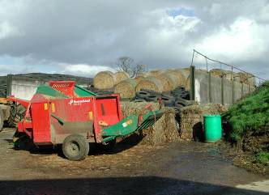
Machinery & PTO Shafts

Slide 27
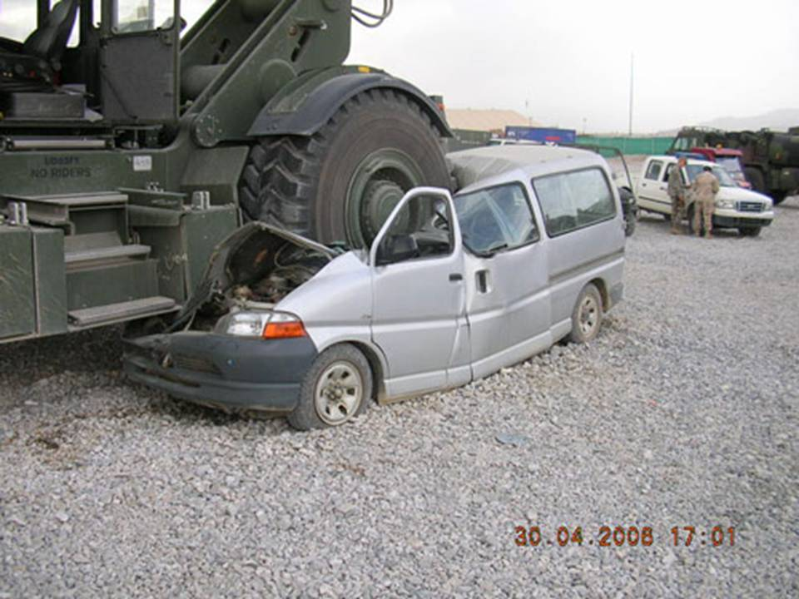
Big Vehicle vs Small Car

Slide 28
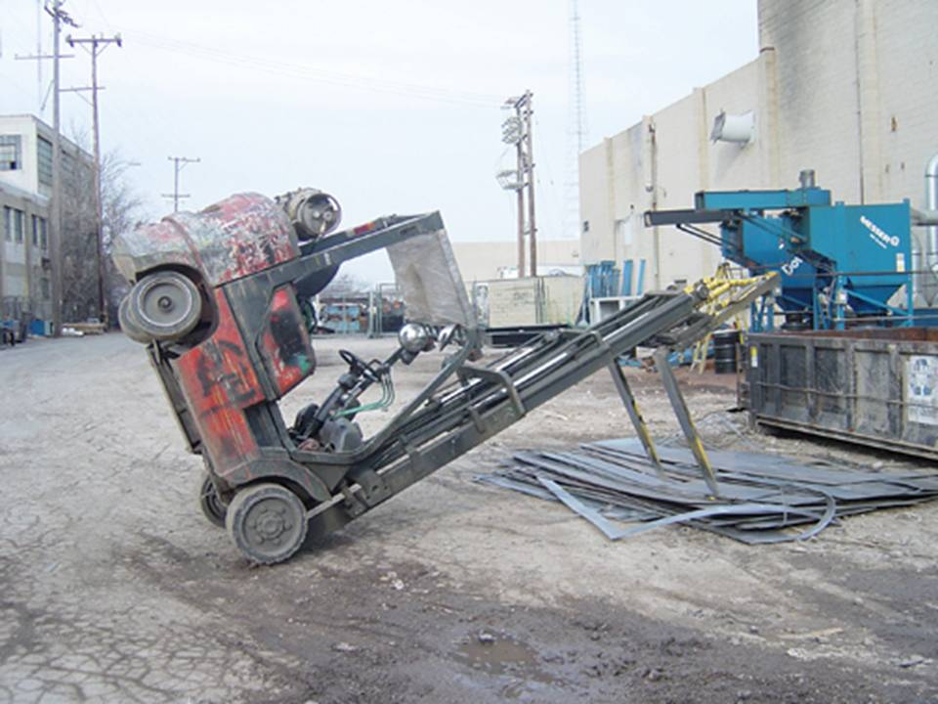
Forklift training required?

Slide 29
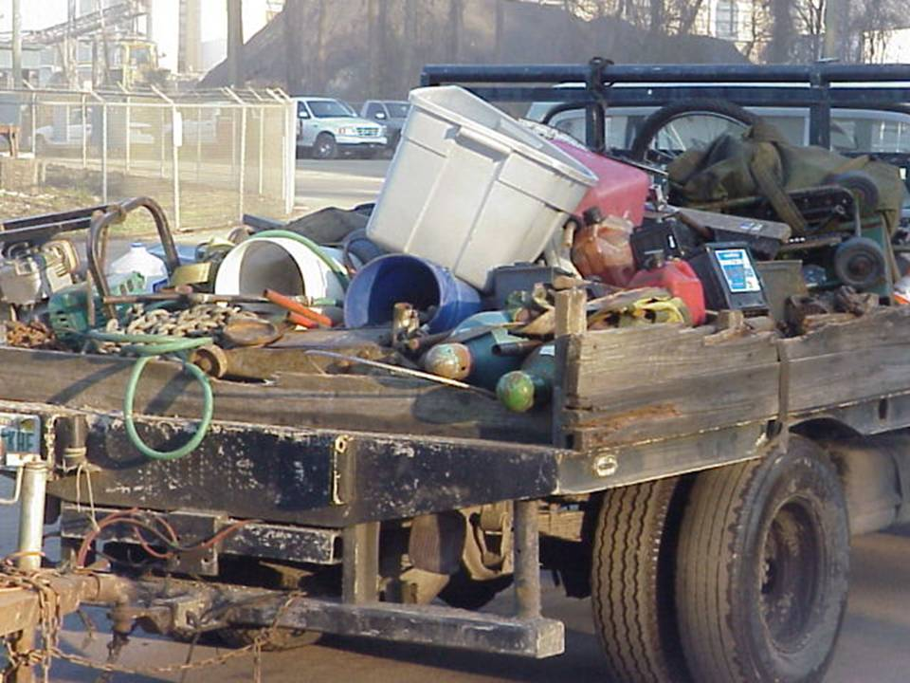
Ready for the road?

Slide 30
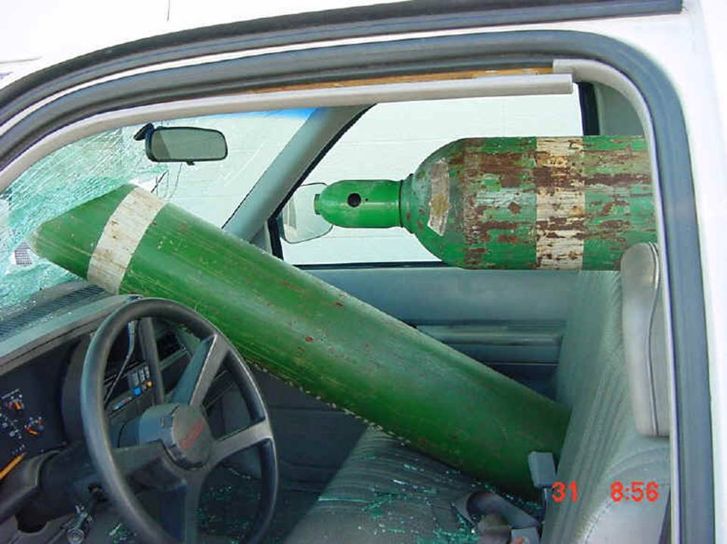
Rocket launching??

Slide 31
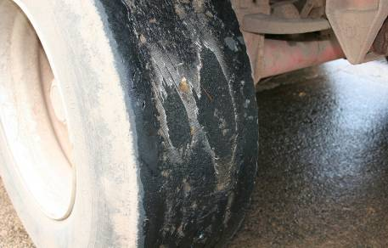
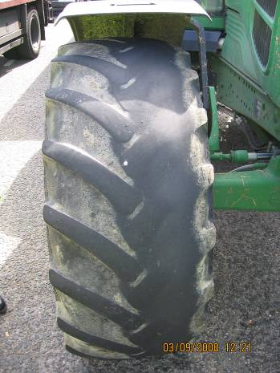
Fit for the road??

Slide 32
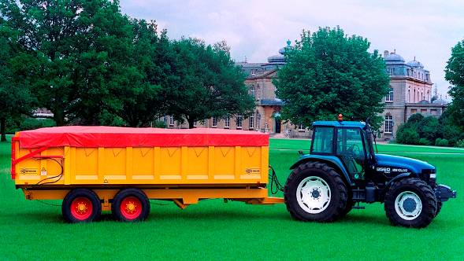
Tractor brake and stop
UK max. permissible gross train weight = 24390 kg
Trailer max weight = 18290 kg
Tractor max weight therefore = 6190 kg (typical 100 – 150hp 4wd)
Up to 75% of combination kinetic energy comes from the trailer
Max UK road speed = 20 mph (32 km/h) – despite EC Type Approval to 40 km/h
UK requires suspended axles and Commercial Vehicle braking performance above 20 mph

Slide 33
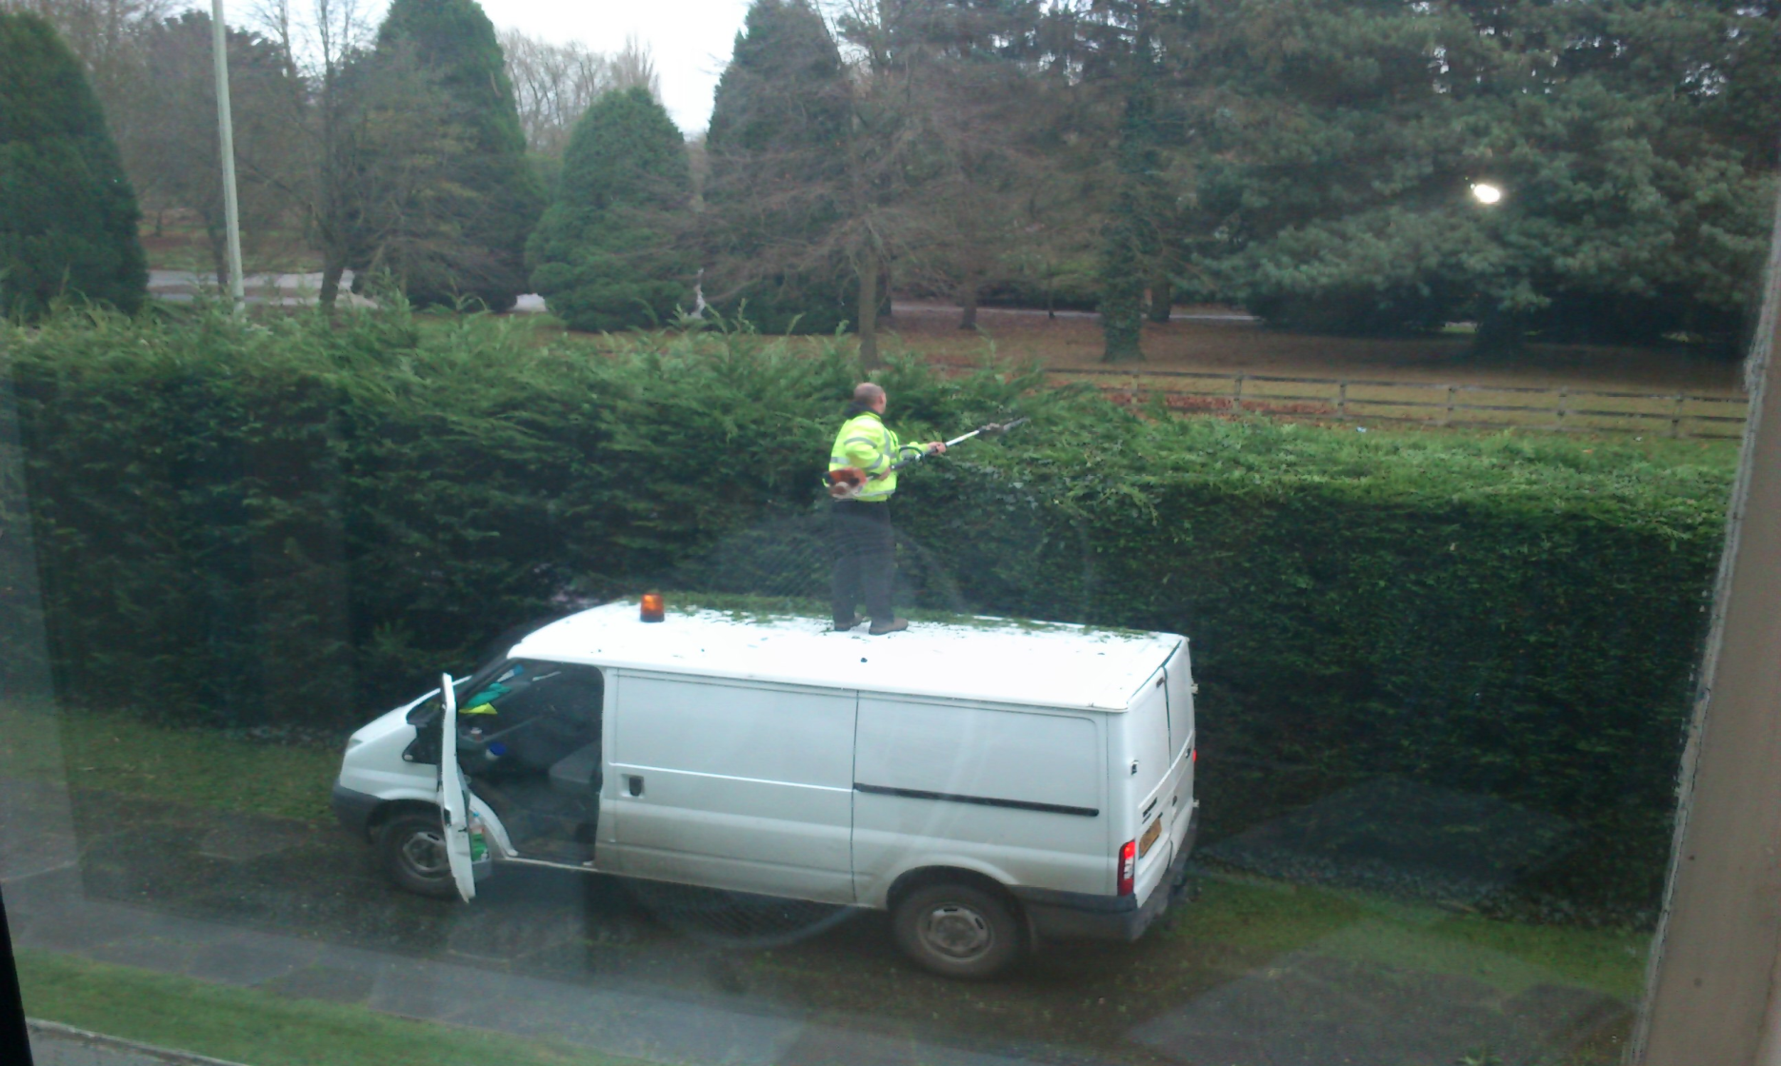
Hedge cutting the wrong way

Slide 34
Key message - Manage
Safe SITE
Safe VEHICLE
Safe DRIVER

Slide 35
References regarding Mud on Roads:- a) NFU - https://www.nfuonline.com/cross-sector/farm-business/transport/ and Health and safety pages: b) NFU -https://www.nfuonline.com/cross-sector/farm-business/health-safety-and-wellbeing/) c) Leaving mud on the road is against the law : -https://www.nottinghamshire.police.uk/advice/mud?fbclid=IwAR0-0TqEgz3JUivh-rXgQQUj2sbN0EtbSY_2EzqLVTecfpUZeZ_A3h2zChw). d) The Staffordshire Road Safety Partnership http://www.staffsbiker.co.uk/cleanersaferhighway. These are only a very small sample of the numerous guides to the responsibilities of farmers and construction companies.

Slide 36
Thank you for listening Any Questions??

Slide 37
Questions asked / Reponses
https://www.drivingforbetterbusiness.com/calmdriver/ The above link is to free(!) resources developed by Highways England and Driving for Better Business and CALM to promote mental health and stress management and also provide pointers on where to seek help for commercial drivers, but could equally be of use to less frequent drivers or those purely who use vehicles for SD&P.
Don't forget that delivery drivers should have access to welfare facilities (WC / Washing etc) when delivering to all premises, not just construction sites. This is being enforced especially as a result of COVID
The CITB free online course about COVID site safety is excellent it includes workplace transport as one of the areas covered
One of the issues with workplace transport on farms is driver 'fatigue', I worked on a farm for many years and during harvest time, farmers are working 80+ hours a week!
https://www.citb.co.uk/about-citb/news-events-and-blogs/uk/2020/11/free-online-covid-19-e-course-launched-by-citb/

Slide 38
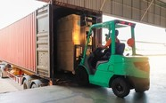
In the run up to the festive period, HSE is working with local authorities to inspect businesses in the transport and logistics industry to ensure they are managing the risk of coronavirus. HSE inspectors and local authority officers will be visiting warehouses and distribution centres across the country to make sure workplaces are COVID-secure and following the relevant guidance. They will ensure that businesses have suitable toilet and handwashing facilities for all workers, including visiting drivers. They will also check other health and safety matters if required. Our website has a range of advice and guidance on making your workplace COVID-secure. This press release has more details about the checks.
Just in from HSE
HSE is checking businesses in the transport sector are COVID-secure
HHSG ahead of the game...........

