Slide 1
Environmental Health Update
Herefordshire Health & Safety Group
21 February 2018

Slide 2
Environmental Health Update
EH Update
Housing and Risk Assessment
Housing and Planning Act 2016
HMO Reforms
MEES & Tenant Fees

Slide 3
Introduction
Scope of Environmental Health

Slide 4





Introduction
Scope of Environmental Health

Slide 5

Health & Safety
LA Regulatory Priorities - LAC 67/2 rev6 2017/18
Construction
Falls from height – work on/adjacent to fragile roofs/materials
Health risks - respirable silica dust
Duty to manage asbestos
Visitor attractions to prevent or control ill health arising from animal contact
Beverage gases in the hospitality industry
Gas safety in commercial catering premises
Welfare provision for delivery drivers
Investigation of incidents and complaints

Slide 6

Health & Safety
Myth Busters Challenge Panel
HSE Chair Martin Temple + 11 independent members with a wide range of interests
Each case considered by HSE – advice given to panel to make decision
All outcomes published
413 cases since 2012
Within 6 months 35% reduction in negative H&S media stories
Journalists recognise the difference
Public have more confidence to challenge

Slide 7

Health & Safety
Case 408 - Supermarket deli refused to leave plastic wrapping on liver sausage stating that it was a ‘choking hazard’
Issue
Supermarket deli refused to leave plastic wrapping on liver sausage stating that it was a ‘choking hazard’
Panel opinion
There is no health and safety reason for refusing to leave the original plastic wrapping on fresh liver sausage. The decision to remove the plastic wrapping from the fresh food at point of sale makes no sense, especially as the product is likely to be wrapped in some other form of plastic bag before being handed to the customer. Claiming removal of the product’s original wrapping was necessary for health and safety reasons is indeed a myth!
Notes:
Health and safety law doesn't stop graduates having fun and celebrating their success in the time-honoured fashion!
The chance of being injured by a flying mortar board is incredibly small, and when the concern is actually about the hats being returned in good condition, it's time to stop blaming health and safety.

Slide 8

Health & Safety
Case 409 - Store stopped providing customer with empty ‘tester’ perfume bottles to customer for health and safety reasons
Issue
Store stopped providing customer with empty ‘tester’ perfume bottles to customer for health and safety reasons
Panel opinion
Retailers are not prohibited under health and safety at work legislation from providing empty perfume bottles to customers upon request. In this case the store assistant was correctly following company policy on the destruction/recycling of waste. The company should have been more transparent about the real reason for refusal rather than use the excuse of ‘health & safety’.
Notes:
Health and safety law doesn't stop graduates having fun and celebrating their success in the time-honoured fashion!
The chance of being injured by a flying mortar board is incredibly small, and when the concern is actually about the hats being returned in good condition, it's time to stop blaming health and safety.

Slide 9

Health & Safety
Case 410 - Children at school have been banned from eating pack lunches outside allegedly due to health and safety
Issue
Children at a school have been banned from eating pack lunches outside allegedly due to health and safety
Panel opinion
This appears to be a specific approach put in place by this school, perhaps as part of a wider food policy. It is not a requirement of health and safety regulation and central government guidelines on food hygiene or healthy eating do not cover this. It might be helpful to explain the thinking behind it more clearly therefore.
Notes:
Health and safety law doesn't stop graduates having fun and celebrating their success in the time-honoured fashion!
The chance of being injured by a flying mortar board is incredibly small, and when the concern is actually about the hats being returned in good condition, it's time to stop blaming health and safety.

Slide 10

Health & Safety
Case 411 - Safety pins on swimming pool locker keys
Issue
A swimming pool operator has removed safety pins from their locker keys on H&S grounds
Panel opinion
Other than the general duties under the HSW Act there is no specific H&S legislation or guidance applying to this. Safety pins have been widely used as a means to secure locker keys and should not present significant risks, however use of safety pins is outdated and has gradually been replaced by either clips or wrist bands. This appears to be a specific policy at this leisure centre, so a fuller explanation would be helpful, beyond the simple ‘health and safety’ line.
Notes:
Health and safety law doesn't stop graduates having fun and celebrating their success in the time-honoured fashion!
The chance of being injured by a flying mortar board is incredibly small, and when the concern is actually about the hats being returned in good condition, it's time to stop blaming health and safety.

Slide 11

Health & Safety
Case 413 - Re-freezing ice packs at campsites’
Issue
Campsite refuses to provide freezer facility to campers for re-freezing thawed ice packs on health and safety grounds
Panel opinion
This was a health and safety myth. There are no health and safety concerns that prevent the freezing of ice packs.
Health and safety at work legislation does not prohibit the re-freezing of ice packs. The customer should have been told that this facility was not available due to the limited space within the freezer.
It would have been helpful for the site to have been clearer about the reasons for refusal rather than quoting general health and safety.
Notes:
Health and safety law doesn't stop graduates having fun and celebrating their success in the time-honoured fashion!
The chance of being injured by a flying mortar board is incredibly small, and when the concern is actually about the hats being returned in good condition, it's time to stop blaming health and safety.

Slide 12
Environmental Protection
Air quality
Contaminated land
Industrial pollution
Noise
Statutory nuisance
Notes:
Health and safety law doesn't stop graduates having fun and celebrating their success in the time-honoured fashion!
The chance of being injured by a flying mortar board is incredibly small, and when the concern is actually about the hats being returned in good condition, it's time to stop blaming health and safety.

Slide 13
Food Safety
Notes:
Health and safety law doesn't stop graduates having fun and celebrating their success in the time-honoured fashion!
The chance of being injured by a flying mortar board is incredibly small, and when the concern is actually about the hats being returned in good condition, it's time to stop blaming health and safety.

Slide 14
Food Safety
Notes:
Health and safety law doesn't stop graduates having fun and celebrating their success in the time-honoured fashion!
The chance of being injured by a flying mortar board is incredibly small, and when the concern is actually about the hats being returned in good condition, it's time to stop blaming health and safety.

Slide 15


Public Health
National Clean Air Day 2017
Smoking ban: 10 years on
World Environmental Health Day 2017
Notes:
Health and safety law doesn't stop graduates having fun and celebrating their success in the time-honoured fashion!
The chance of being injured by a flying mortar board is incredibly small, and when the concern is actually about the hats being returned in good condition, it's time to stop blaming health and safety.

Slide 16

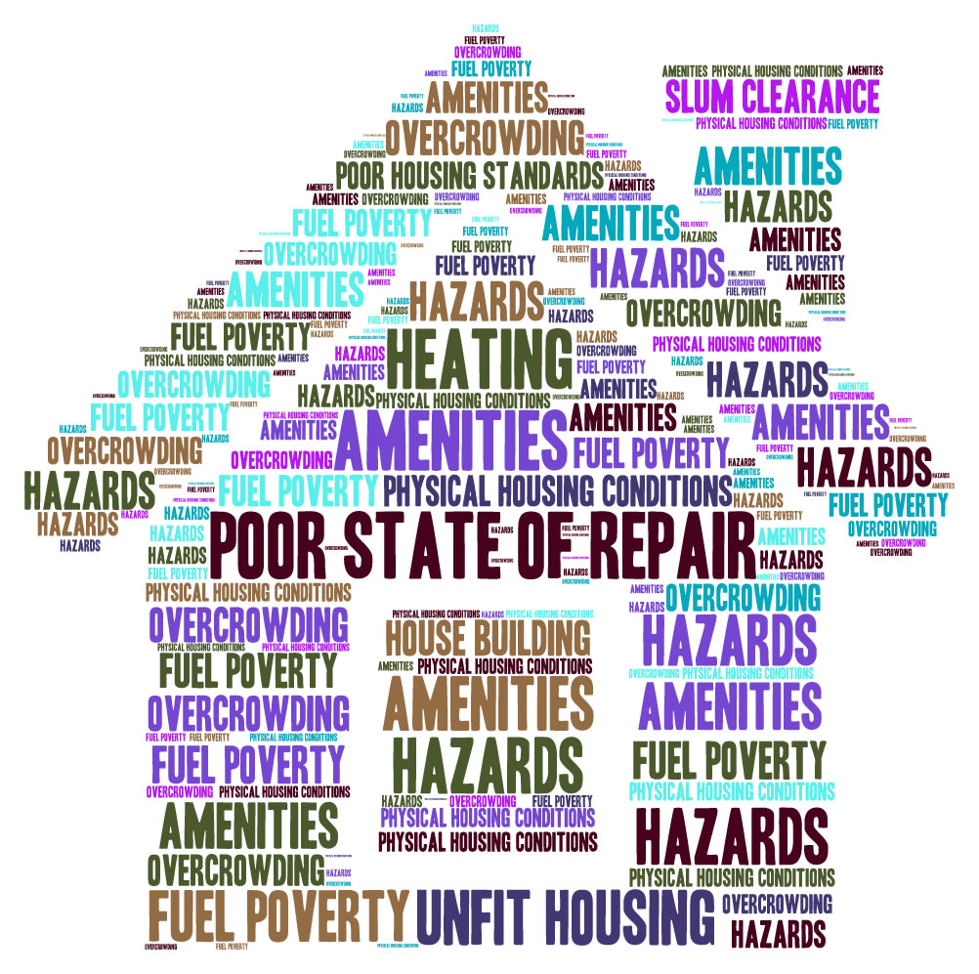
Housing

Slide 17
Housing
Development of housing legislation
Nuisance Removal Act 1855
  made overcrowded housing illegal and introduced statutory nuisance i.e. “any premises in such a state as to be a nuisance or injurious to health”
Housing Act 1957 & 1985 (unfitness)
Local Government and Housing Act 1989 (fitness standard)
  Amended S604 of the Housing Act 1985
  Supported by Department of the Environment Circular (DoE) 6/90, and subsequently DoE Circular 17/96 (DoE, 1996)
Notes:
1875 Public Health Act required local authorities to implement building regulations: each house had to be self-contained, with its own sanitation (usually a backyard privy) and water. New standards in window size, door height, materials and street layout were set, and the terrace was born.

Slide 18
Housing
Development of housing legislation
S. 604 Fitness for human habitation.
(1) Subject to subsection (2) below, a dwelling-house is fit for human habitation for the purposes of this Act unless, in the opinion of the local housing authority, it fails to meet one or more of the requirements in paragraphs (a) to (i) below and, by reason of that failure, is not reasonably suitable for occupation,—
  (a) it is structurally stable;
  (b) it is free from serious disrepair;
  (c) it is free from dampness prejudicial to the health of the occupants (if any);
  (d) it has adequate provision for lighting, heating and ventilation;
  (e) it has an adequate piped supply of wholesome water;
  (f) there are satisfactory facilities in the dwelling-house for the preparation and cooking of food, including a sink with a satisfactory supply of hot and cold water;
  (g) it has a suitably located water-closet for the exclusive use of the occupants (if any);
  (h) it has, for the exclusive use of the occupants (if any), a suitably located fixed bath or shower and wash-hand basin each of which is provided with a satisfactory supply of hot and cold water; and
  (i) it has an effective system for the draining of foul, waste and surface water;
and any reference to a dwelling-house being unfit for human habitation shall be construed accordingly.
Notes:
1875 Public Health Act required local authorities to implement building regulations: each house had to be self-contained, with its own sanitation (usually a backyard privy) and water. New standards in window size, door height, materials and street layout were set, and the terrace was born.

Slide 19
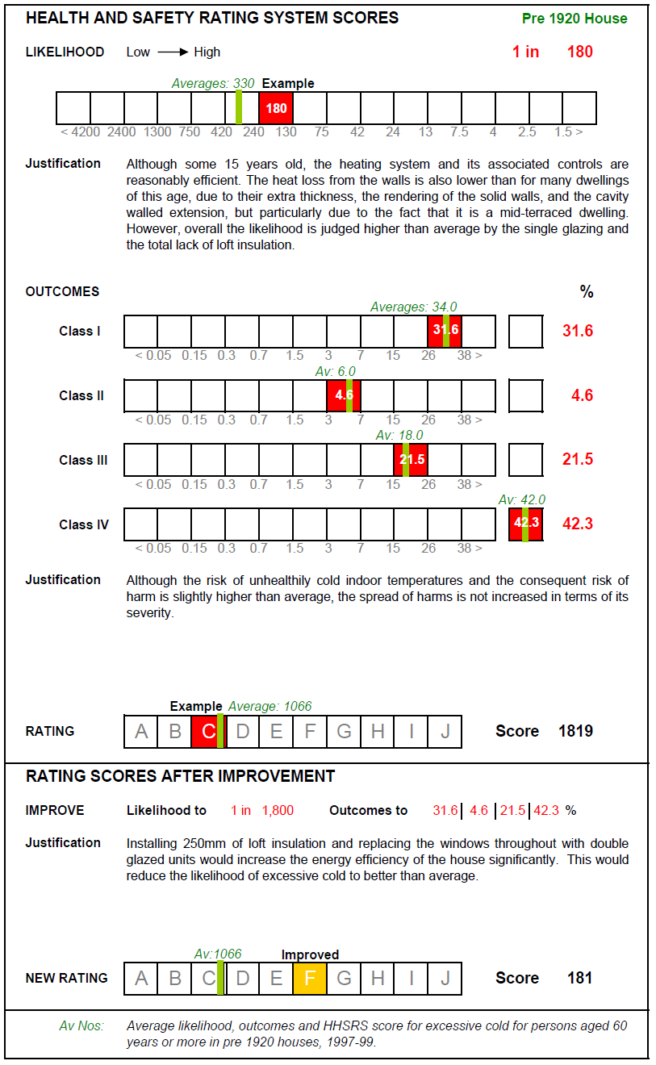
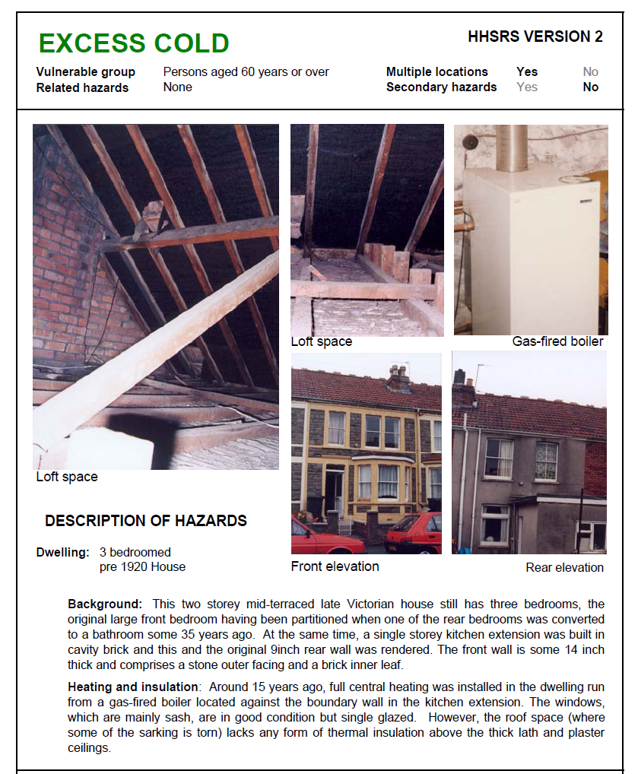
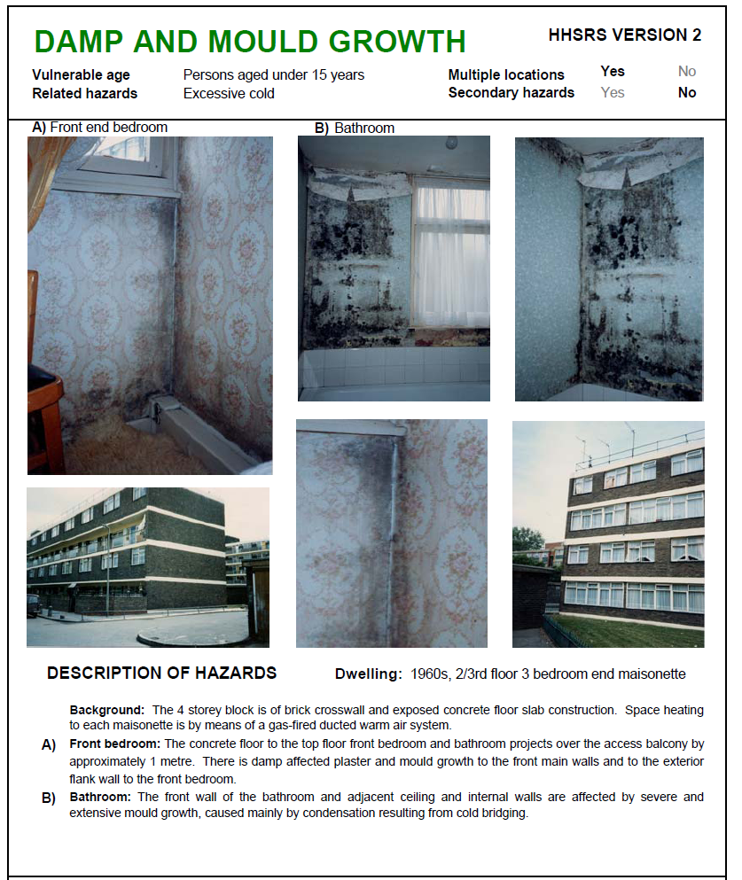
Housing
Housing Act 2004 and the HHSRS
Notes:
1875 Public Health Act required local authorities to implement building regulations: each house had to be self-contained, with its own sanitation (usually a backyard privy) and water. New standards in window size, door height, materials and street layout were set, and the terrace was born.

Slide 20
Housing
Housing Act 2004 and the HHSRS
The HHSRS was introduced by Part 1 of the Housing Act 2004 and the Housing Health and Safety Rating System (England) Regulations 2005 (SI 2005 No 3208) which came into force on 6 April 2006.
England and Wales has the first evidence based system of housing assessment in the developed world.
Notes:
1875 Public Health Act required local authorities to implement building regulations: each house had to be self-contained, with its own sanitation (usually a backyard privy) and water. New standards in window size, door height, materials and street layout were set, and the terrace was born.

Slide 21
Housing
Housing Act 2004 and the HHSRS
WHAT IS HHSRS?
  A method for identifying and assessing the seriousness of hazards arising from property defects and deficiencies, either through poor design, something that is missing, or lack of repair

Slide 22
Housing
Housing Act 2004 and the HHSRS
The principle underlying the HHSRS is that:
“A dwelling, including the structure and associated outbuildings and garden, yard and/or other amenity space, should provide a safe and healthy environment for the occupants and any visitors”
(HHSRS Operating Guidance)

Slide 23
Housing
Housing Act 2004 and the HHSRS
29 Pre-determined hazards (4 categories)
Hazards 1 – 10 (Physiological Requirements)
Hazards 11 – 14 (Psychological Requirements)
Hazards 15 – 18 (Protection against Infection)
Hazards 19 – 29 (Protection against accidents)

Slide 24
Housing
Housing Act 2004 and the HHSRS
Physiological requirements
Damp and mould growth
Excess cold
Excess heat
Asbestos (and MMF)
Biocides
Carbon Monoxide and fuel combustion products
Lead
Radiation
Uncombusted fuel gas
Volatile Organic Compounds

Slide 25
Housing
Housing Act 2004 and the HHSRS
Psychological requirements
Crowding and space
Entry by intruders
Lighting
Noise

Slide 26
Housing
Housing Act 2004 and the HHSRS
Protection against infection
Domestic hygiene, Pests and Refuse
Food safety
Personal hygiene, Sanitation and Drainage
Water supply

Slide 27
Housing
Housing Act 2004 and the HHSRS
Protection against accidents
Falls associated with baths etc
Falling on level surfaces etc
Falling on stairs etc
Falling between levels
Electrical Hazards
Fire
Flames, hot surfaces etc
Collision and entrapment
Explosions
Position and operability of amenities etc
Structural collapse and falling elements

Slide 28
Housing
Housing Act 2004 and the HHSRS
The likelihood of a harmful occurrence over the next 12 months
The probable severity of the outcomes of such an occurrence
The 2 judgements generate a numerical score
The higher the score, the greater the risk

Slide 29
Housing
Housing Act 2004 and the HHSRS

Slide 30
Housing
Housing Act 2004 and the HHSRS
HAZARD BANDS
10 Hazard bands (A – J)
Bands A – C = Category 1 hazards
Bands D – J = Category 2 hazards
Category 1 hazards = Duty to act (Mandatory)
Category 2 hazards = Power to act (Discretion)

Slide 31
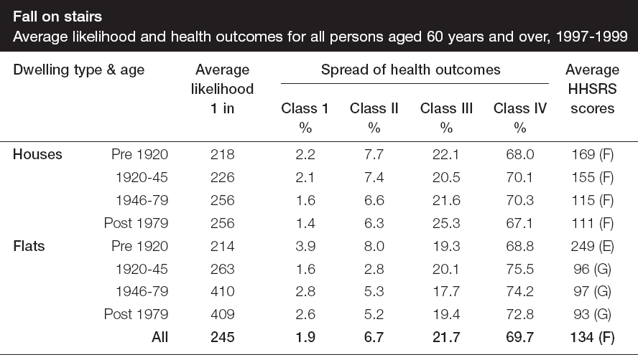
Housing
Housing Act 2004 and the HHSRS

Slide 32
Housing
Housing Act 2004 and the HHSRS

Slide 33
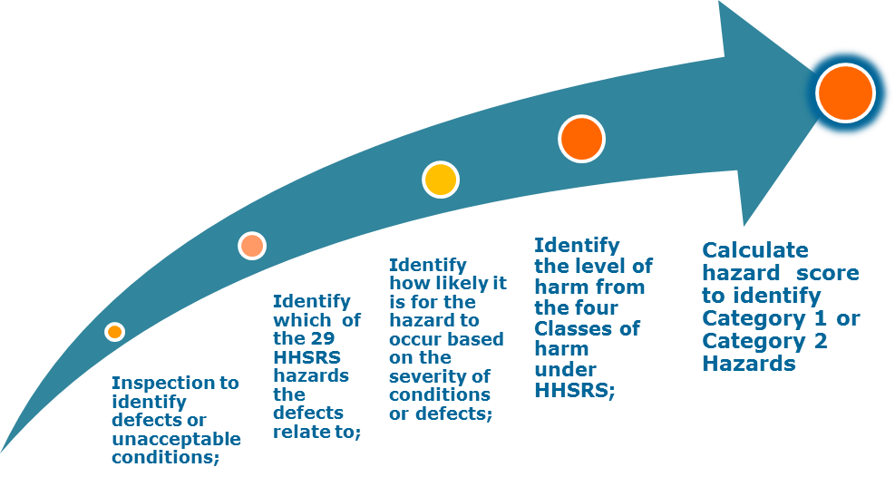
Housing
Housing Act 2004 and the HHSRS

Slide 34
Housing
Housing Act 2004 and the HHSRS
Inspector notes defects/deficiencies
  uneven steps/landing (allow water to collect)
  poor friction quality (covering of moss)
  leaking waste pipes (water on to steps)
  no external light
  loose handrail
  insufficient guarding (large opening in guarding)
  uneven yard surface
What hazard(s) may this give rise to?
  Falls on stairs, falls on level
Is the likelihood of a harmful occurrence over the next 12 months increased? Yes
If there is an occurrence will the harm outcomes be increased? Yes

Slide 35
Housing
Housing Act 2004 and the HHSRS
Matters relevant to the likelihood of an occurrence include:
Variation in tread or riser – dimensional variation producing an uneven pitch.
Poor friction quality – of treads and nosings.
Length of flight – long flights may increase the likelihood of a fall.
Construction/disrepair – inadequate construction or disrepair to any element of the stairs.

Slide 36
Housing
Housing Act 2004 and the HHSRS
Matters relevant to the severity of an occurrence include:
Length of flight – long flights increase the severity of the outcome.
Projections etc – the presence of sharp edges, heating installations, or glass, to the stairs or at the foot of the flight.
Construction/disrepair – inadequate construction of, or disrepair to, any element of the stairs.

Slide 37
Housing
Housing Act 2004 and the HHSRS

Slide 38
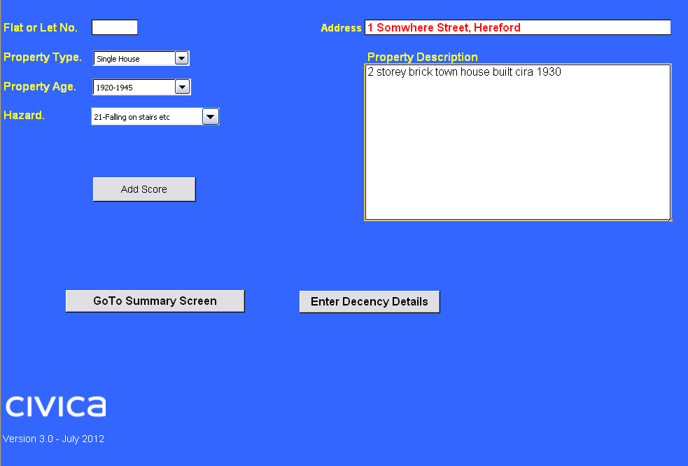
Housing
Housing Act 2004 and the HHSRS

Slide 39
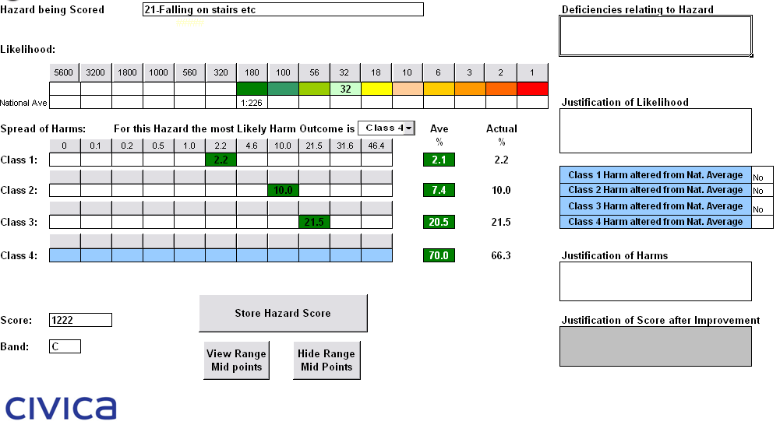
Housing
Housing Act 2004 and the HHSRS

Slide 40
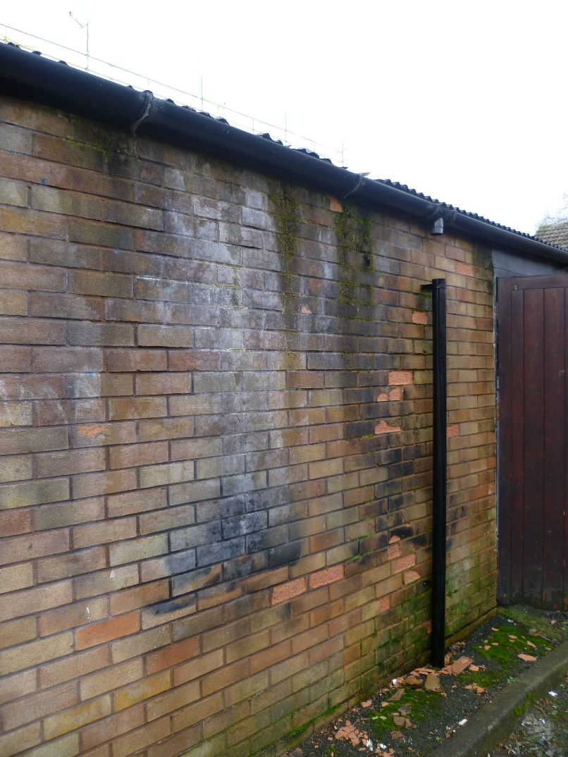
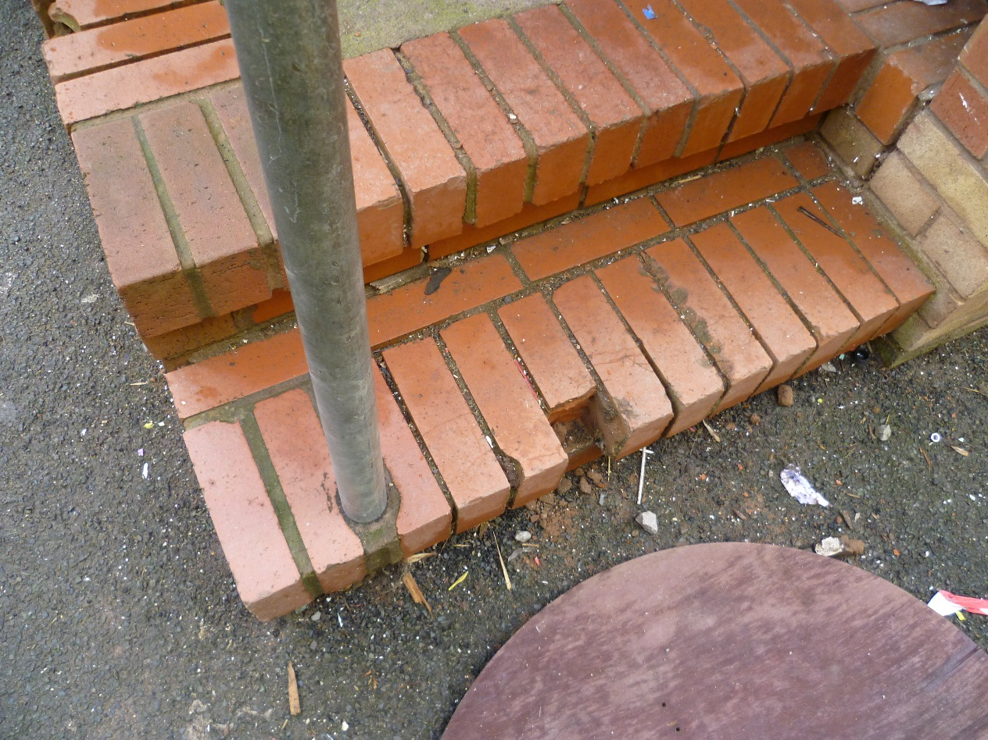
Housing
Housing Act 2004 and the HHSRS

Slide 41
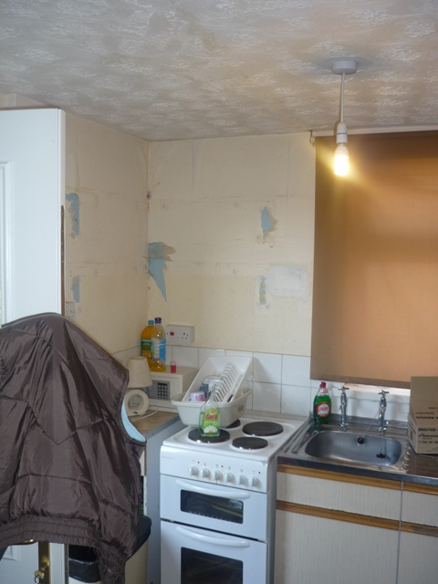
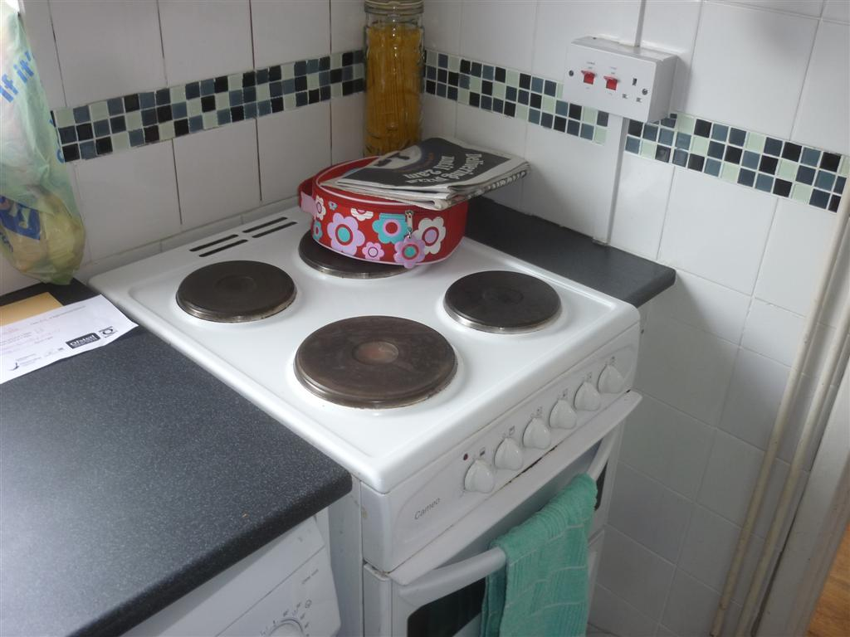
Housing
Housing Act 2004 and the HHSRS

Slide 42
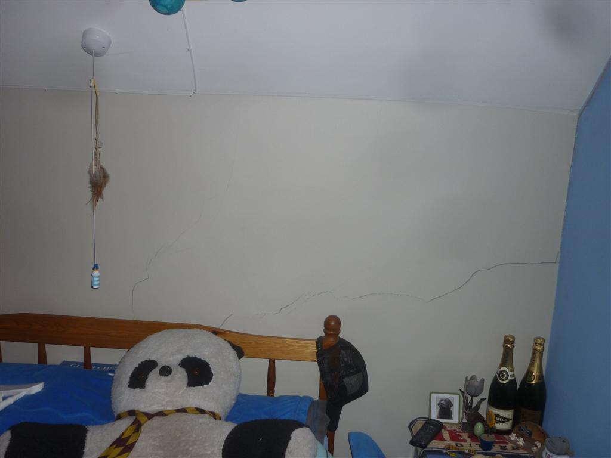
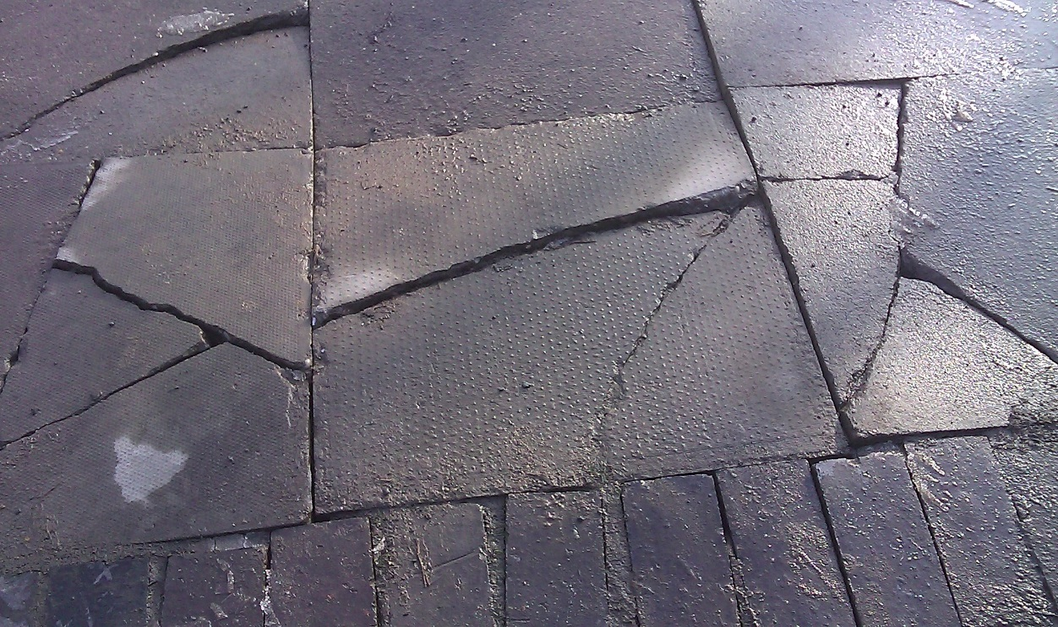
Housing
Housing Act 2004 and the HHSRS

Slide 43
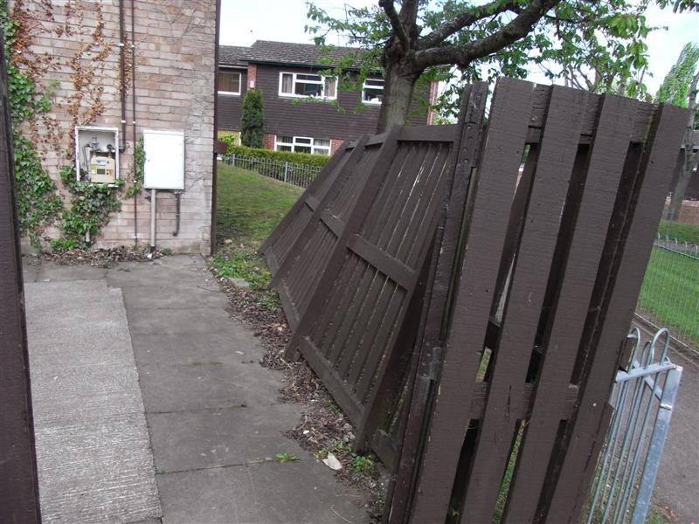
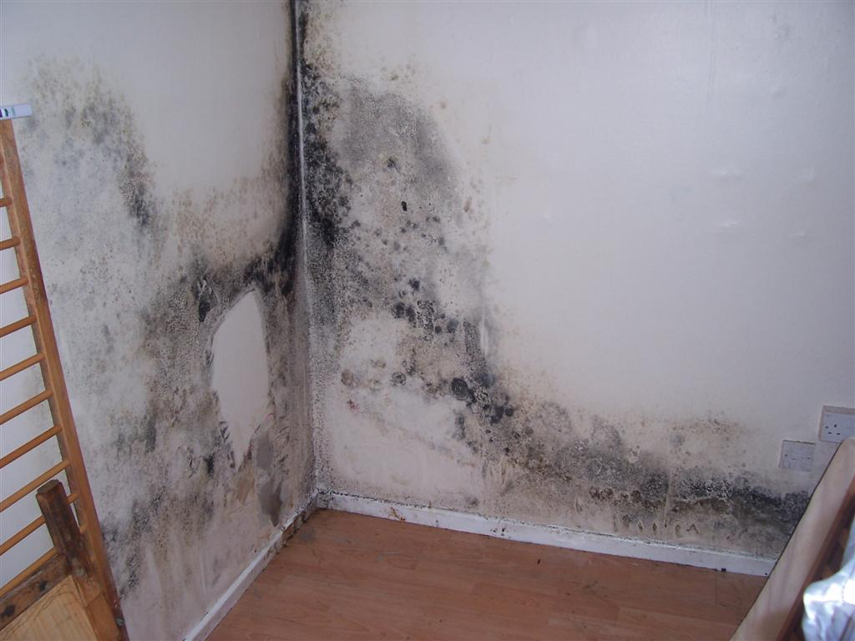
Housing
Housing Act 2004 and the HHSRS

Slide 44
Housing
Fire Safety in Flats and Houses
Grenfell Tower Fire, Wednesday 14 June 2017

Slide 45
Housing
Fire Safety in Flats and Houses

Slide 46
Housing
Fire Safety in Flats and Houses

Slide 47
Housing
Fire Safety in Flats and Houses
LACORS Fire Safety Guide: applies to houses converted to flats

Slide 48
Housing
Provide informal advice
Serve a hazard awareness notice
Serve an improvement notice requiring remedial works
Make a prohibition order, which closes the whole or part of a dwelling or restricts the number of permitted occupants
Take emergency action
Apply for an Empty Dwelling Management Order (EDMO)
Make a demolition order or declare a clearance area
Enforcement Options

Slide 49
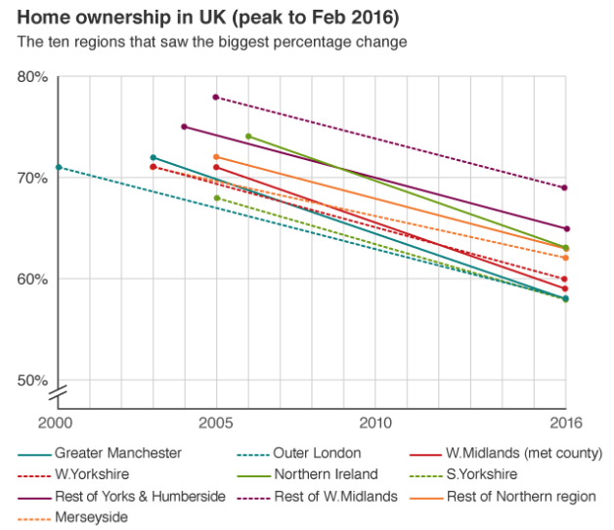
Housing
Housing and Planning Act 2016
Rapidly expanding sector - over 9m. renters; 4.4m households¹
Proportion of households living in the PRS has risen by 80% since 2000; second only now to owner occupier sector¹
Worse conditions; Govt “determined to tackle rogue landlords”
DCLG response to consultation on PRS measures
DCLG, English Housing Survey 2014-15
The Resolution Foundation

Slide 50
Housing
Housing and Planning Act 2016
May 2015 Transparency of fees introduced
PM speech on immigration [rogue landlords & HMOs]
Oct 2015 Mandatory smoke & CO alarms plus retaliatory evictions
Oct 2015 Housing & Planning Bill published with PRS package
Feb 2016 Right to rent checks
May 2016 Housing & Planning Act received Royal Assent

Slide 51
Housing
Housing and Planning Act 2016
5 measures designed to tackle criminal landlords/property agents
Civil penalties of up to £30,000
Extension of Rent Repayment Orders
Banning orders for most prolific offenders
Database of rogue landlords/property agents
Tougher fit and proper person test for landlords of licensed properties
HPA 2016 also introduces
New mechanism allowing landlords to legally recover abandoned properties without needing to go to court; and
Powers on electrical safety and client money protection

Slide 52
Housing
Housing and Planning Act 2016
Civil Penalties and Rent Repayment Orders
March 2017 Guidance published
6 April 2017 Implementation
West Midlands Housing Enforcement Practioners Group (WMHEPG) Civil Penalty matrix

Slide 53
Housing
Housing and Planning Act 2016
Civil Penalty Notices
came into force on 6 April 2017
allow local authority fine of up to £30,000, to be kept by authority for investment in enforcement
one penalty per offence
choice of penalty or prosecution, one precludes the other
incentive to enforce / cost of enforcement
penalty allowed for most HA 2004 offences

Slide 54
Housing
Housing and Planning Act 2016
Civil Penalty Notices
Intention notice within 6 months of last day of conduct
Representations allowed on notice: at least 28 days
Final notice: Decision (28 days to pay)
Appeal to First Tier Tribunal (within 28 days)
Enforcement via County Court

Slide 55
Housing
Housing and Planning Act 2016
Civil Penalty Notices
Failure to comply with improvement notice (Housing Act 2004 Section 30)
Failure to comply with an Improvement Notice (Section 30) | £
1st offence (note 1) | 5,000
2nd subsequent offence by same person/company (note 2) | 15,000
Subsequent offences by same person/company (note 7) | 25,000
Premiums (use all that apply)
Acts or omissions demonstrating high culpability (note 8) | +2,500
Large housing portfolio (10+ units of accommodation) (note 3) | +2,500
Multiple Category 1 or high Category 2 Hazards (note 4) | +2,500
Vulnerable occupant and/or significant harm occurred as result of housing conditions (note 5) | +2,500
Perpetrator demonstrates Income to be less than £440/week (note 6) | -50%
West Midlands Housing Enforcement Practitioners Group (WMHEPG)

Slide 56
Housing
Housing and Planning Act 2016
Civil Penalty Notices
Licensing of HMOs under Housing Act 2004 Part 2 (Housing Act 2004 Section 72)
Offences in relation to licensing of HMOs (note1) under Part 2 of the Act (Section 72) | £
Failure to obtain property Licence (section 72(1)) (note 1) | 10,000
2nd subsequent offence by same person/company (note 2) | 30,000
Perpetrator demonstrates Income to be less than £440/week (note 6) | -50%
Breach of Licence conditions (Section 72(2) and (3)) - Per licence breach | 5,000
Perpetrator demonstrates Income to be less than £440/week (note 6) | -50%
West Midlands Housing Enforcement Practitioners Group (WMHEPG)

Slide 57
Housing
Housing and Planning Act 2016
Civil Penalty Notices
Failure to comply with overcrowding notice, (Housing Act 2004 Section 139(7))
Offences of contravention of an overcrowding notice (section 139) | £
1st relevant offences (note 1) | 5,000
2nd subsequent offence by same person/company (note 2) | 15,000
Premiums (use all that apply)
Acts or omissions demonstrating high culpability (note 8) | +2500
Vulnerable occupant and/or significant harm occurred as result of overcrowding (note 3) | +2500
Perpetrator demonstrates Income to be less than £440/week (note 6) | -50%
West Midlands Housing Enforcement Practitioners Group (WMHEPG)

Slide 58
Housing
Housing and Planning Act 2016
Civil Penalty Notices
Management regulations in respect of HMOs. (Housing Act 2004 Section 234)
Failure to comply with management regulations in respect of HMOs (Section 234) | £
1st relevant offences (note1) | 1000 per offence
Second subsequent offences by same person/company for the same offence | 3000 per offence
Premiums (use all that apply)
Acts or omissions demonstrating high culpability (note 8) | +2500
Large housing portfolio (10+ units of accommodation) (note 3) | +2500
Vulnerable occupant and/or significant harm occurred as result of housing conditions (note 5) | +2500
Perpetrator demonstrates Income to be less than £440/week (note 6) | -50%
West Midlands Housing Enforcement Practitioners Group (WMHEPG)

Slide 59
Housing
Housing and Planning Act 2016
Civil Penalty Notices
Relevant HA2004 Offence
28 days for representation
28 days for appeal to FTT
County Court Order for Payment
Served within 6 months of LHA becoming aware of the offence
West Midlands Housing Enforcement Practitioners Group (WMHEPG)

Slide 60
Housing
Housing and Planning Act 2016
Rent Repayment Orders
Already exist for Housing Act licensing offences, although used neither well nor widely
Extended to cover:
  Improvement Notices HA 2014 S.30
  Prohibition Orders HA 2014 S.32
  Breach of banning order HPA 2016 S.21
  Violence to secure entry to property
  (Criminal Law Act 1977 S.6)
  Illegal eviction or harassment
  (Protection from Eviction Act 1977 S.1)

Slide 61
Housing
Housing and Planning Act 2016
Rent Repayment Orders
As before does not require conviction first for LA application
Tenants can also make order, but need conviction or RRO by LA
Max penalty where conviction occurred or financial penalty levied (Housing Benefit where paid can be recovered)

Slide 62
Housing
Housing and Planning Act 2016
Banning Orders and RL Database
Banning Orders
6 April 2018 Regulations come into force
“Rogue” landlords database
6 April 2018 Implementation with above

Slide 63
Housing
Housing and Planning Act 2016
Banning Orders
Link between the property and “banning order offence” – housing, immigration, serious crime and other criminal offences
Local Authorities:
  must give notice and consider representations
  have to apply to First Tier Tribunal for the Order
Banning order is for minimum of 12 months
Applications to First Tier Tribunal to revoke or vary
Ban means person cannot act as landlord or agent
Is an offence to breach
Allows for management orders for properties
Information on other properties can be sought to aid enforcement

Slide 64
Housing
Housing and Planning Act 2016
Banning Orders
Housing Related Offences
Illegally evicting or harassing a residential occupier in contravention of the Protection from Eviction Act 1977
Using violence to secure entry under the Criminal Law Act 1977
An offence under section 36 of the Gas Safety (Installation and Use) Regulations 1998;
An offence under section 32 of the Regulatory Reform (Fire Safety) Order 2005

Slide 65
Housing
Housing and Planning Act 2016
Banning Orders
Housing Act 2004 Offences
Failure to comply with an improvement notice (section 30);
Failure to comply with a prohibition order (section 32)
Offences in relation to licensing of Houses in Multiple Occupation (HMOs) (section 72);
Offences in relation to licensing of houses under Part 3 of the Act (section 95);
Contravention of an overcrowding notice (Section 139)
Failure to comply with management regulations in respect of HMOs (section 234).
Providing false or misleading information (section 238)

Slide 66
Housing
Housing and Planning Act 2016
Banning Orders
Immigration Offences
Letting to someone disqualified from renting because of their immigration status, whether as a landlord or agent.
Serious Criminal Offences
Offences where
the offence was committed against or in collusion with a tenant occupying any housing (or another person occupying that housing with the tenant) or the offence was committed at or in relation to that housing;
at the time the offence was committed, the offender was the residential landlord or property agent of that housing or an officer of a body corporate who was the residential landlord or property agent of that housing; and
the offender was sentenced for the offence in the Crown Court

Slide 67
Housing
Housing and Planning Act 2016
Banning Orders
Serious Criminal Offences
a range of fraud offences under the Fraud Act 2006
any specified violent and sexual offence under Schedule 15 of the Criminal Justice Act 2003
Offences under the Misuse of Drugs Act
Concealing criminal property and related offences under the Proceeds of Crime Act 2002
Harassment and stalking under the Protection from Harassment Act 1997
Offences under the Anti-social Behaviour, Crime and Policing Act 2014
Offences of criminal damage under the Criminal Damage Act 1971
Theft, burglary, blackmail and handing stolen goods under the Theft Act 1968.

Slide 68
Housing
Housing and Planning Act 2016
“Rogue” landlords database
Similar to banning order but less severe
Must include banned persons, but may include convicted persons without a banning order
May include people with two financial penalties in 12 months
LA power to seek information to help enforcement
Does not automatically trigger a negative fit and proper person test, but relevant
Database accessible to DCLG, HMRC and local authorities
Process:
  21 days notice
  Appeal to First Tier Tribunal
  Entry stays on database for minimum of 2 years

Slide 69
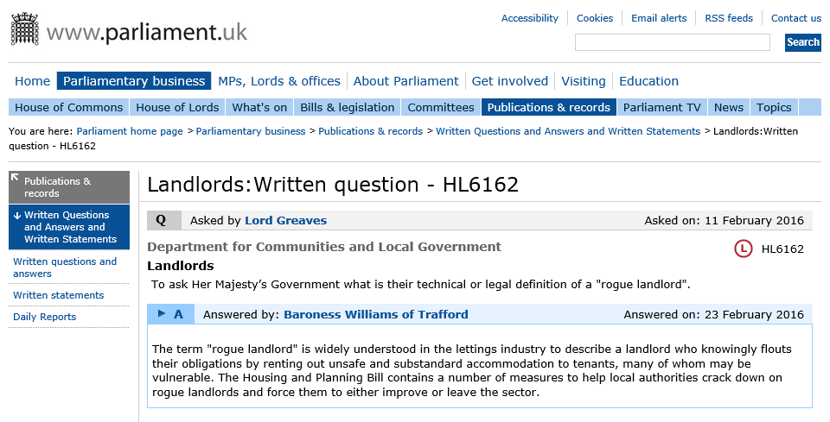
Housing
Housing and Planning Act 2016
“Rogue” landlord definition

Slide 70
Housing
HMO Reforms
HMOs are dwellings that house more than one family.
Exemptions include where there are only two occupiers / lodgers
HMOs that houses 5 or more people over 3 or more floors require a licence

Slide 71
Housing
HMO Reforms
Extension of mandatory licensing of HMOs
National minimum room size
Revised Fit and Proper Person test
October 2016 Consultation
December 2017 DHCLG response
http://services.parliament.uk/bills/2016-17/rentersrights.html

Slide 72
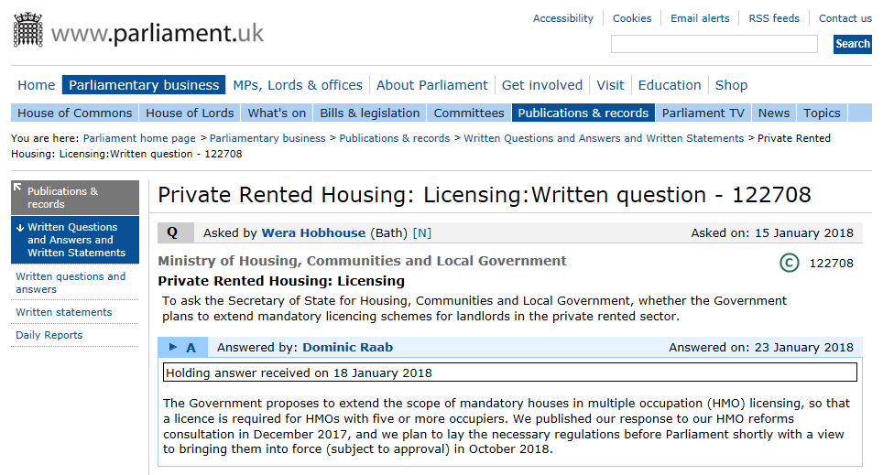
Housing
HMO Reforms
Extension of mandatory licensing of HMOs

Slide 73
Housing
HMO Reforms
Extending Mandatory Licensing
The Government will extend the scope of mandatory HMO licensing.
It will apply where certain HMOs are occupied by five persons or more in two or more households, regardless of the number of storeys.
This includes any HMO which is a building or a converted flat where such householders lack or share basic amenities such as a toilet, personal washing facilities or cooking facilities.
It also applies to purpose built flats where there are up to two flats in the block and one or both are occupied as an HMO.
The new rules will be introduced in two phases.

Slide 74
Housing
HMO Reforms
Extending Mandatory Licensing
First phase will last six months
During that period local authorities‘ general duties to promote licensing, process applications received and issue licences will remain in force
A landlord of an HMO (subject to the new mandatory regime) may not be prosecuted for not licensing the property within that period and no rent repayment order may be made in respect of such an HMO
During the first phase it is expected landlords will apply for a licence. At the end of the six month grace period landlords who have still not applied for a licence may be prosecuted and / or subject to rent repayment orders

Slide 75
Housing
HMO Reforms
National Minimum Room Size
Introduction of mandatory conditions in licences to regulate the size and use of rooms as sleeping accommodation in licensed HMOs:
By prescribing the absolute minimum sizes of rooms that may be used for sleeping
By introducing a mandatory licencing condition requiring local authorities to specify which rooms in an HMO are suitable for sleeping accommodation, and by how many adults and children
Where a room does not meet these conditions, the local authority will be required to give the landlord a reasonable period of time (18 months) to remedy the failure and during this period they will not face any sanctions for a breach of the condition (unless the breach of condition was deliberate, in which case sanctions apply)

Slide 76
Housing
HMO Reforms
Revised Fit and Proper Person Test
2016 proposal was for:
a more stringent fit and proper person test for landlords of licensable properties, involving:
  Disclosure and Barring Service check so local authority has information about any criminal convictions
  Checking whether landlord:
    Has received a penalty for not carrying out a Right to Rent check
    Has leave to remain in the UK
    Is bankrupt or insolvent, or
    Managing agent has an office in the UK

Slide 77
Housing
HMO Reforms
Revised Fit and Proper Person Test
MHCLG has concluded that they will not introduce legislation to mandate criminal record certificates to be provided in connection with applications for licences under the Housing Act 2004.
Local authorities already have discretion to do this should they so choose and the new powers being introduced through the Housing and Planning Act on banning orders and a rogue landlord database will help strengthen this provision.
This is however, an area which MHCLG will keep under review.

Slide 78
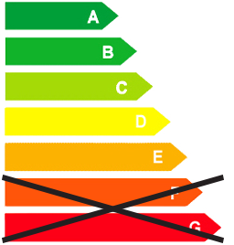
Housing
https://www.gov.uk/government/publications/the-private-rented-property-minimum-standard-landlord-guidance-documents
Minimum Energy Efficiency Standard (MEES)
From 1 April 2018, any building which is to be rented on a new tenancy or a renewal, must have a minimum energy rating of “E”
From 1 April 2020, the minimum level “E” applies to all tenancies – including existing
There are a number of exemptions available and if one of those exemptions apply, the property must be registered on the National PRS Exemptions Register.
The Energy Efficiency (Private Rented Property) (England and Wales) Regulations 2015 (Principal Regulations) as amended by The Energy Efficiency (Private Rented Property) (England and Wales) (Amendment) Regulations 2016 enforce the MEES Standard

Slide 79
Housing
Tenant Fees Bill
Consumer Rights Act requires agent fees to be published in office and on website
Still being widely ignored by sector (and by LAs); can be housing/EH or Trading Standards enforcement
Open goal: Allows for LA to enforce by fine of up to £5,000; LA can keep fines obtained and use for any purpose
Levying fees on tenants to be outlawed: draft Tenants' Fees Bill being scrutinised by Communities & Local Government Committee
https://www.parliament.uk/business/committees/committees-a-z/commons-select/communities-and-local-government-committee/inquiries/parliament-2017/draft-tenant-fees-17-19/

Slide 80
Contact Details
  Charles Yarnold B.Sc.(Hons), M.Sc., CMCIEH
  Environmental Health Service Manager
  Tel: 01432 260765
  Fax: 01432 260357
  Mail: cyarnold@herefordshire.gov.uk
  Gcsx: cyarnold@herefordhire.gcsx.gov.uk
  Web: www.herefordshire.gov.uk/psh

