Slide 1
Is Waste Crime the New Narcotics?
Lyndon Essex and Steve Cawthorne
Environment Officers:
Waste Regulation, West Midlands Area
21st February 2018

Slide 2
Aims & Objectives
What is waste crime?
What is its effect?
Examples
What can you do to prevent it?

Slide 3
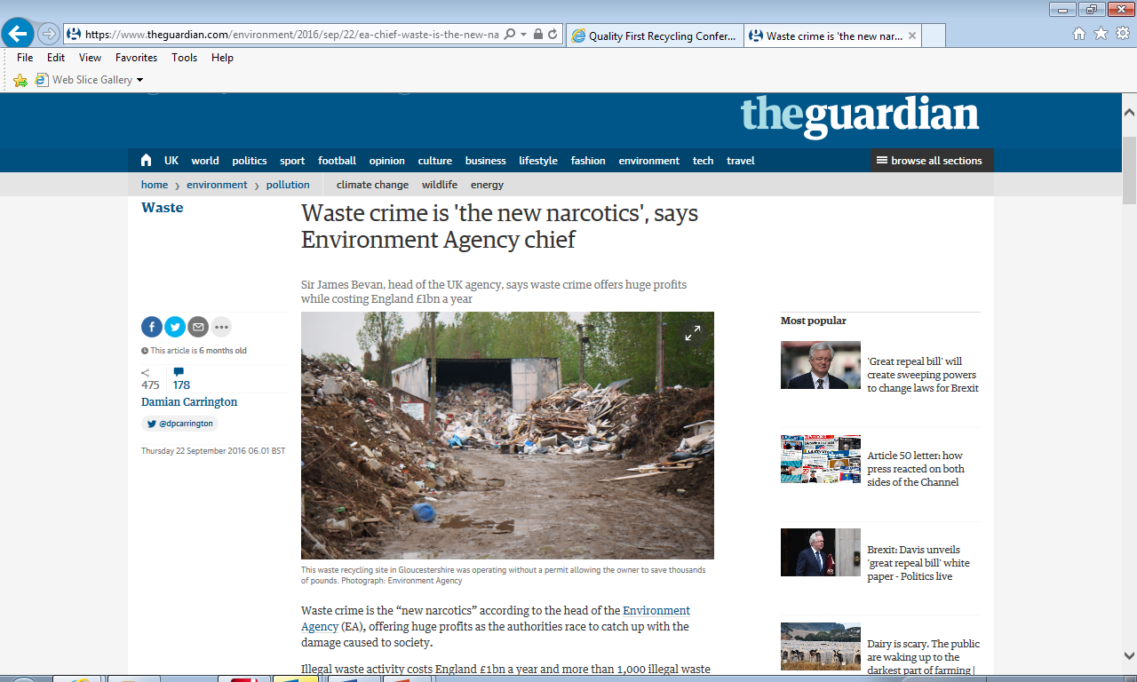
Notes:
Mention crime money moving into waste management due to various reasons

Slide 4
What is waste crime?
Poorly performing Permitted sites
Illegal waste sites
Illegal waste exports
Mis-description of waste
Fraudulent management of recovered wastes
Notes:
The EA regulate waste management facilities throughout England under a Permitting system of Environmental Permits which aim to minimise harm to human health and pollution of the Environment
IWS – operating outside the Permitting regime
Exports – WEEE and hazardous wastes going to West Africa and other locations
Mis-description – where wastes are describe as “inert” but are actually contaminated – used for construction or disposed of avoiding landfill tax
ProRes work – Packaging recovery – example of moped scooter transporting 10’s of thousands of tonnes

Slide 5
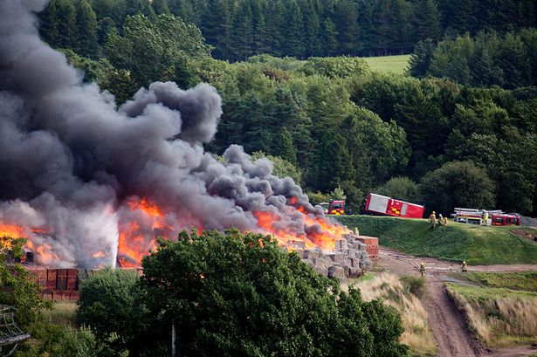
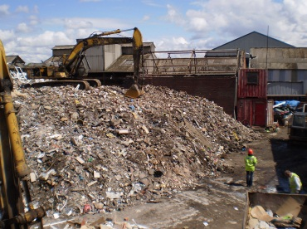
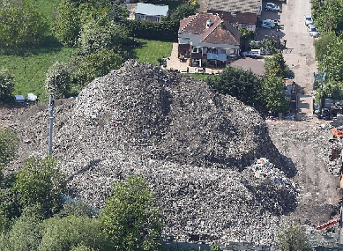
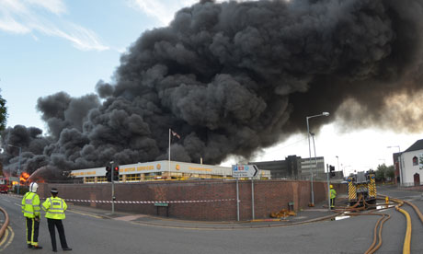
Notes:
This is what poor performance and crime in the waste sector looks like!
The problems (symptoms) we see range from:
Poorly run waste sites which impact on communities and the environment (ignorance to deliberate non-compliance)
Waste crime, including mis-description, illegal exports and illegal disposal (deliberate criminality).
When not properly managed, waste:
Smells, attracts vermin and can catch fire, which poses risks to local communities
Can leach hazardous chemicals into the environment
We find 1000 illegal waste sites a year – and whilst we are increasing the speed at which we close them down, new ones appear at the same rate because waste continues to be produced and criminals continue to act within the sector. Apart from the environmental impacts, poor performance and criminality undercuts legitimate operators who are trying to do the right thing.
Why do we see this in the waste sector?
Waste management responsibilities are split across the public and private sector, leading to a system which is fragmented and which sees waste as a problem rather than a resource
The waste sector is populated by SMEs with low levels of corporate and social responsibility and professionalism
Profit margins are small and subject to market fluctuations, leading to low investment

Slide 6
We take waste crime seriously
Waste crime can cause serious pollution to the environment, put communities at risk and undermines legitimate business, and the investment and economic growth that go with it.
Waste crime diverts as much as £1 billion per year from legitimate business and Treasury.

Slide 7
It’s not all bad - Waste crime is at the extreme end of a spectrum
The vast majority (96%) of waste sites are well run and provide a much needed service
Notes:
This is a household waste facility operated for a Local Authority

Slide 8
Performance at permitted waste sites
Of 11,500 permitted sites, and between 2014 and 2015:
  Serious pollution incidents decreased by 36%
  Poorly performing sites fell by 20%
  Persistent poorly performing sites fell by 6%.
Notes:
… and since these stats were gathered performance has continued to improve
We target resources at the worse performing sites

Slide 9
BUT ……
During 2015/16, we:
  Found over 1,000 new illegal waste sites;
  Identified over 630,000 tonnes of mis-described waste;
  Referred over 60 sites to HMRC for tax investigations – a potential landfill tax revenue value of £18 million.
Notes:
2015 to 2016, we:
found over 1,000 new illegal waste sites (~240 currently active)
stopped 989 illegal waste sites
stopped more than 50% of new illegal waste sites < 90 days
Between 2014 and 2016:
we estimate illegal exports of WEEE and household waste fell by 17%
we identified > 600k tonnes of mis-described waste and referred over 60 sites to HMRC

Slide 10
AND ……
There are major economic incentives to commit waste crime;
There is a lack of waste producer compliance with Duty of Care responsibilities;
Barriers to entering the waste management sector are perceived as being low;
There is a perceived low risk of detection and protracted enforcement.

Slide 11
Our Vision for Waste
Waste is minimised, and waste that is produced is managed in the right place, by the right people.
Notes:
A bit of “Corporate Messaging”

Slide 12
Our Vision for Waste
Regulated customers take greater responsibility for their environmental performance;
We reduce crime and tackle poor performance in the waste management sector;
We work with industry to ensure that waste is correctly described, treated and managed to safeguard healthy communities and the environment and contribute to economic growth.
Notes:
This is what we want to see
So how are we going to go about it?

Slide 13

Our approach (1)
We take tough regulatory action
Notes:
A firm but fair regulator treating the customers in the sector it regulates proportionally to the risk they present.
This means:
Expect full compliance
Use our full range of powers‎ - Site & Regime
Recover debt
High priority crime types:
- illegal waste sites
- poorly performing permitted sites
- non-compliant exemptions
- deliberate mis-description of waste
- illegal waste exports
High priority waste types:
- Transfer Stations Fines
- Construction, Demolition & Excavation waste
- RDF
- Wood

Slide 14
Our approach (2)
We evolve our regulatory approach
Notes:
General move towards prevention and disruption
- national team developing and promoting interventions
- routine evaluation of the effectiveness of interventions
- developing a waste crime prevention toolkit with College of Policing
Raising the barrier to entry into the waste industry
- 2nd Defra waste crime consultation will cover technical competence, financial provision and landowner checks

Slide 15


Our approach (3)
We support legitimate business
Notes:
- campaign with industry to improve compliance with Duty of Care

Slide 16



Our approach (4)
We work in partnership with other regulators
Notes:
We’ve got much better at this in recent years
Defra/EA/HMRC review of interventions and enforcement options
Pushing waste crime with NCA and Regional Organised Crime Units

Slide 17
Local examples:

Slide 18
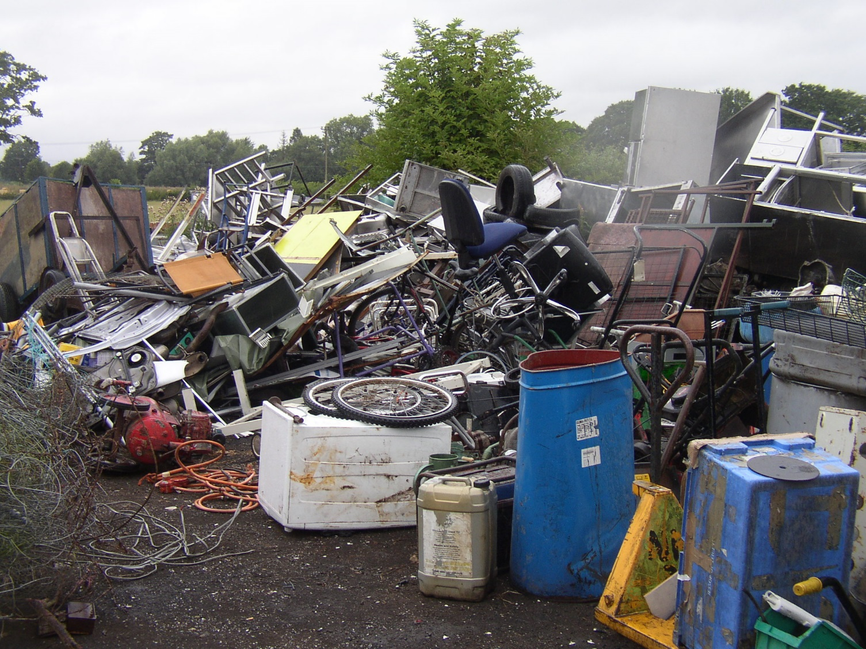
1. Leominster Scrap Metals
Notes:
An individual operating an unauthorised scrap metal and ELV site
Legitimate Permitted sites operating in the area – unfair financial advantage
Very sensitive location near a SSSI and in a groundwater protection zone
No pollution prevention infrastructure
Offered advice and guidance – not followed
Notices served to remove the wastes – not complied with
Interviewed under caution
This was in court on Friday 02 Feb – fines and costs >£12,000

Slide 19
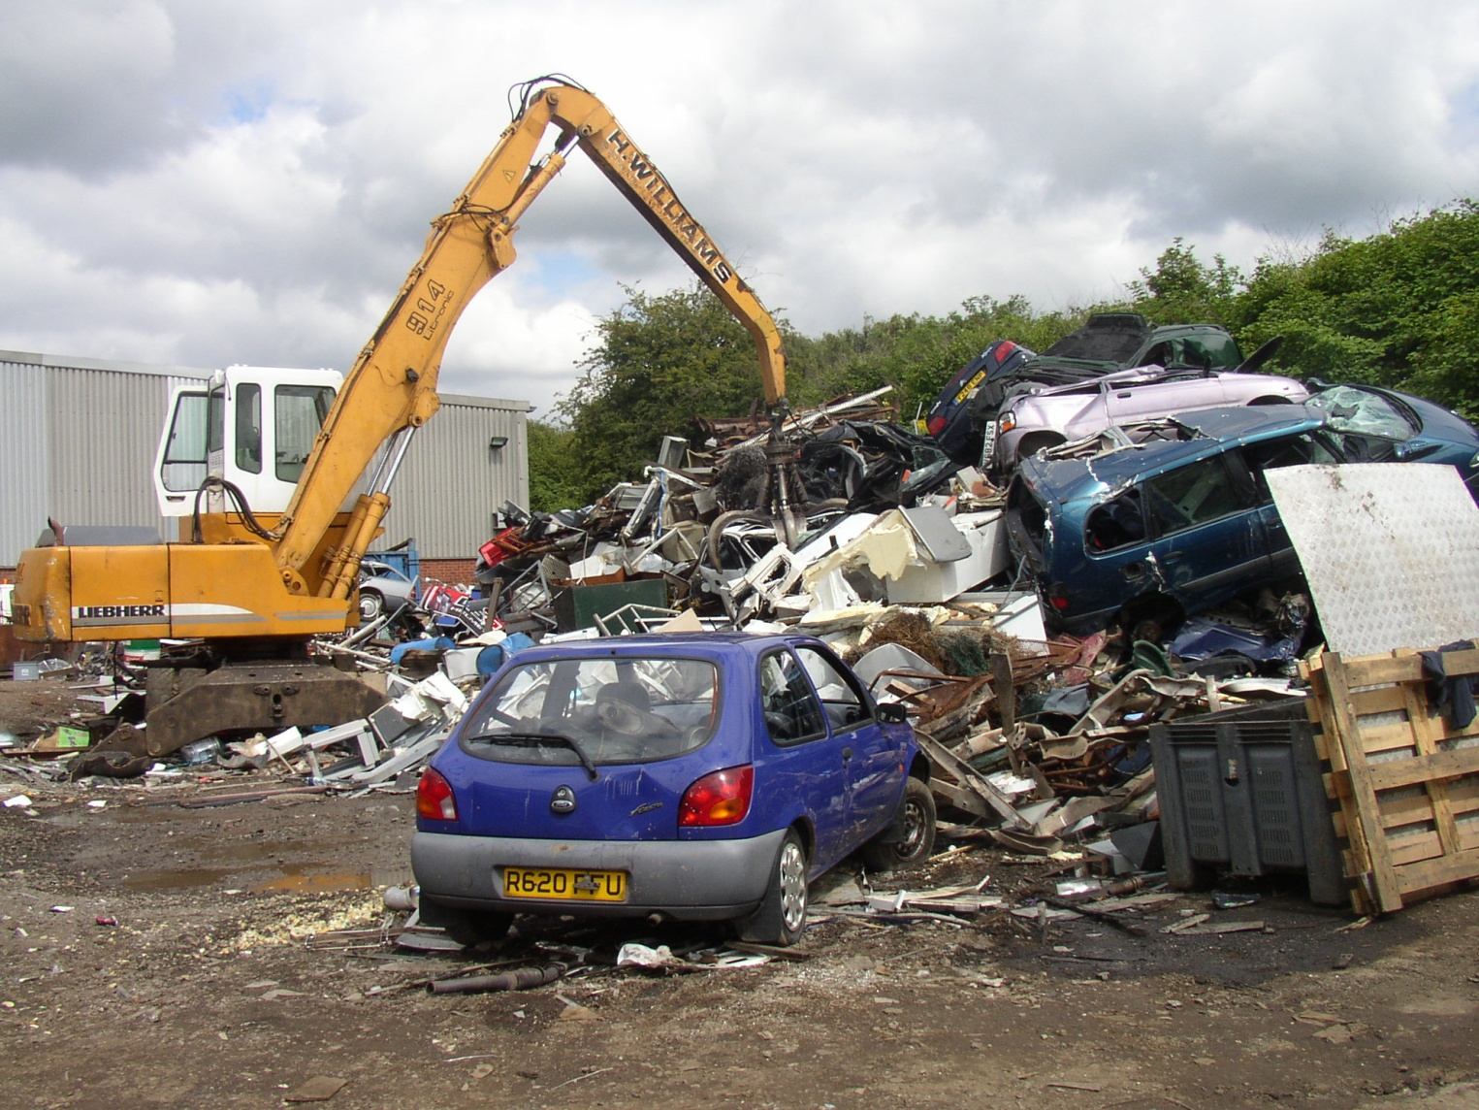
2. C&D Metals
Notes:
A similar but more serious case involving two individuals on an Industrial Estate in Worcester
More of the “organised crime” variety
Again, IWS taking scrap metal and ELVs
Next to a main railway line, so a fire at the site could have been very distuptive
Significant oil pollution of local water course
Both defendants had previous offences for waste cries and violence
The land owner also a known waste criminal
Went to Worcester Crown Court and resulted in custodial sentences for the two operators and hefty fines for the owner.
Then owner is subject of an ongoing investigation into another IWS in Worcestershire and has already received two custodial sentences for waste offences

Slide 20
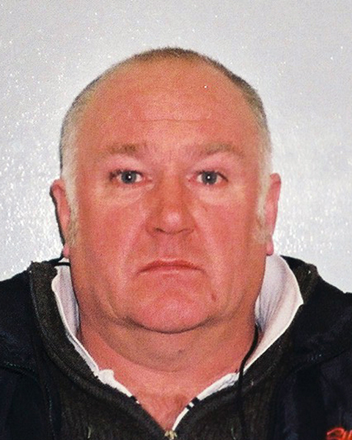
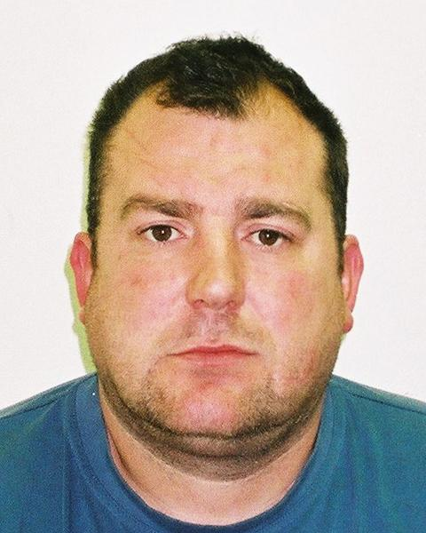
11 Months 6 months
Ronald Calder Giles Detheridge

Slide 21
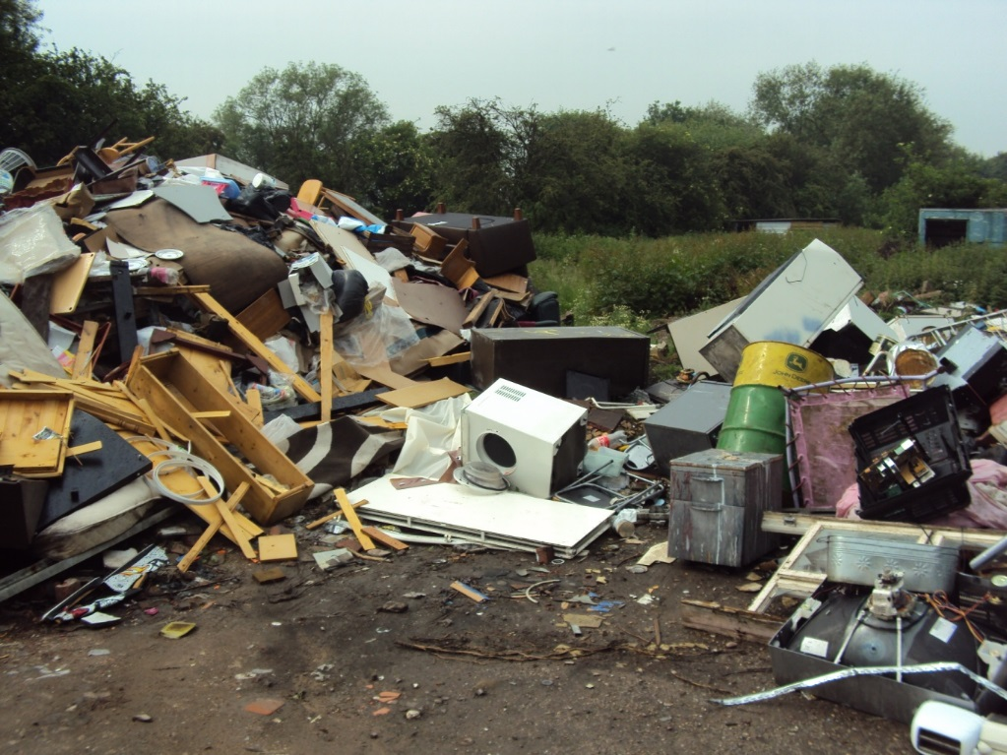
Tackling waste crime in court (1)
Case example:
Mr M.
Notes:
On 7 January 2016, Mr Robert Murphy, 48, of Carver Road Burton-upon-Trent Staffordshire appeared before Birmingham Magistrates court and was sentenced to 12 months imprisonment for failing to make any contribution towards the Proceeds of Crime Order imposed previously, in order to compensate the victims of his previous offending.
Murphy was jailed on 30 April 2015 for 7 months for the illegal operation of a waste facility over a 15 month period on land off the A38 near Burton-upon-Trent. Murphy was required to pay £20,793.20 towards clean up costs.
As Murphy has not made any attempt to pay any of the costs, the court was left with no choice but to activate the default period of imprisonment of 12 months. The outstanding amount payable, including interest, currently stands at £21,331.38.

Slide 22
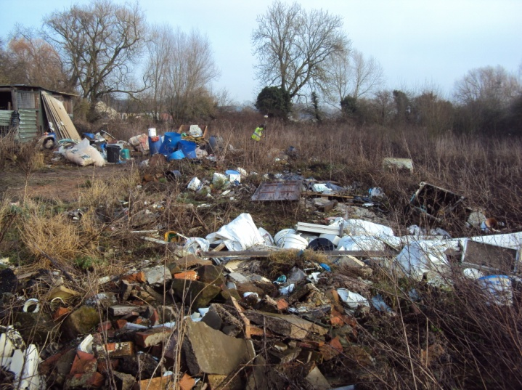
Tackling waste crime in court (2)
We saw repeated offending and a worsening attitude following warnings to stop;
We had to deploy a concrete
block at the site entrance to stop
Mr. M from dumping more waste;
Involvement of the police for
breaking locks installed by EA and landowner did not deter Mr M.
Notes:
He is currently in prison. When he comes out he will still owe the monies due under the compensation order. We are trying to sell his house.
This is under the proceeds of crime legislation
We now have financial investigators that look into assets held by environmental criminals and go after these

Slide 23
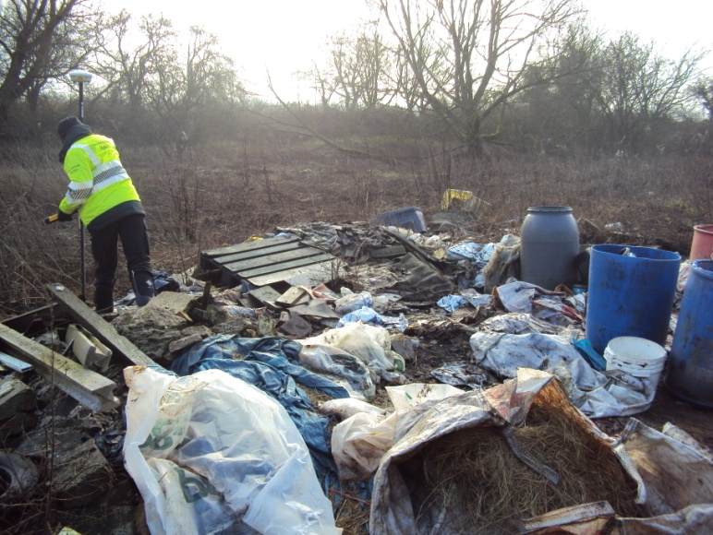
Tackling waste crime in court (3)
There was a human victim - a confiscation order has been made in favour of the landowner for clean up of the site;
There was environmental
harm - confiscation
proceedings
have been used to remove
123 tonnes of waste from the
site.
Notes:
There was a Special Measures application for an elderly and vulnerable landowner who gave evidence behind a screen in Stafford Crown Court.
A default prison sentence of twelve months has recently been activated for non payment of the confiscation order. We are inviting the Court to appoint an enforcement receiver for the first time to sell the defendants home to pay the confiscation order.

Slide 24
Just think ……
If any of these three sites had no customers how would they have been able to operate?

Slide 25
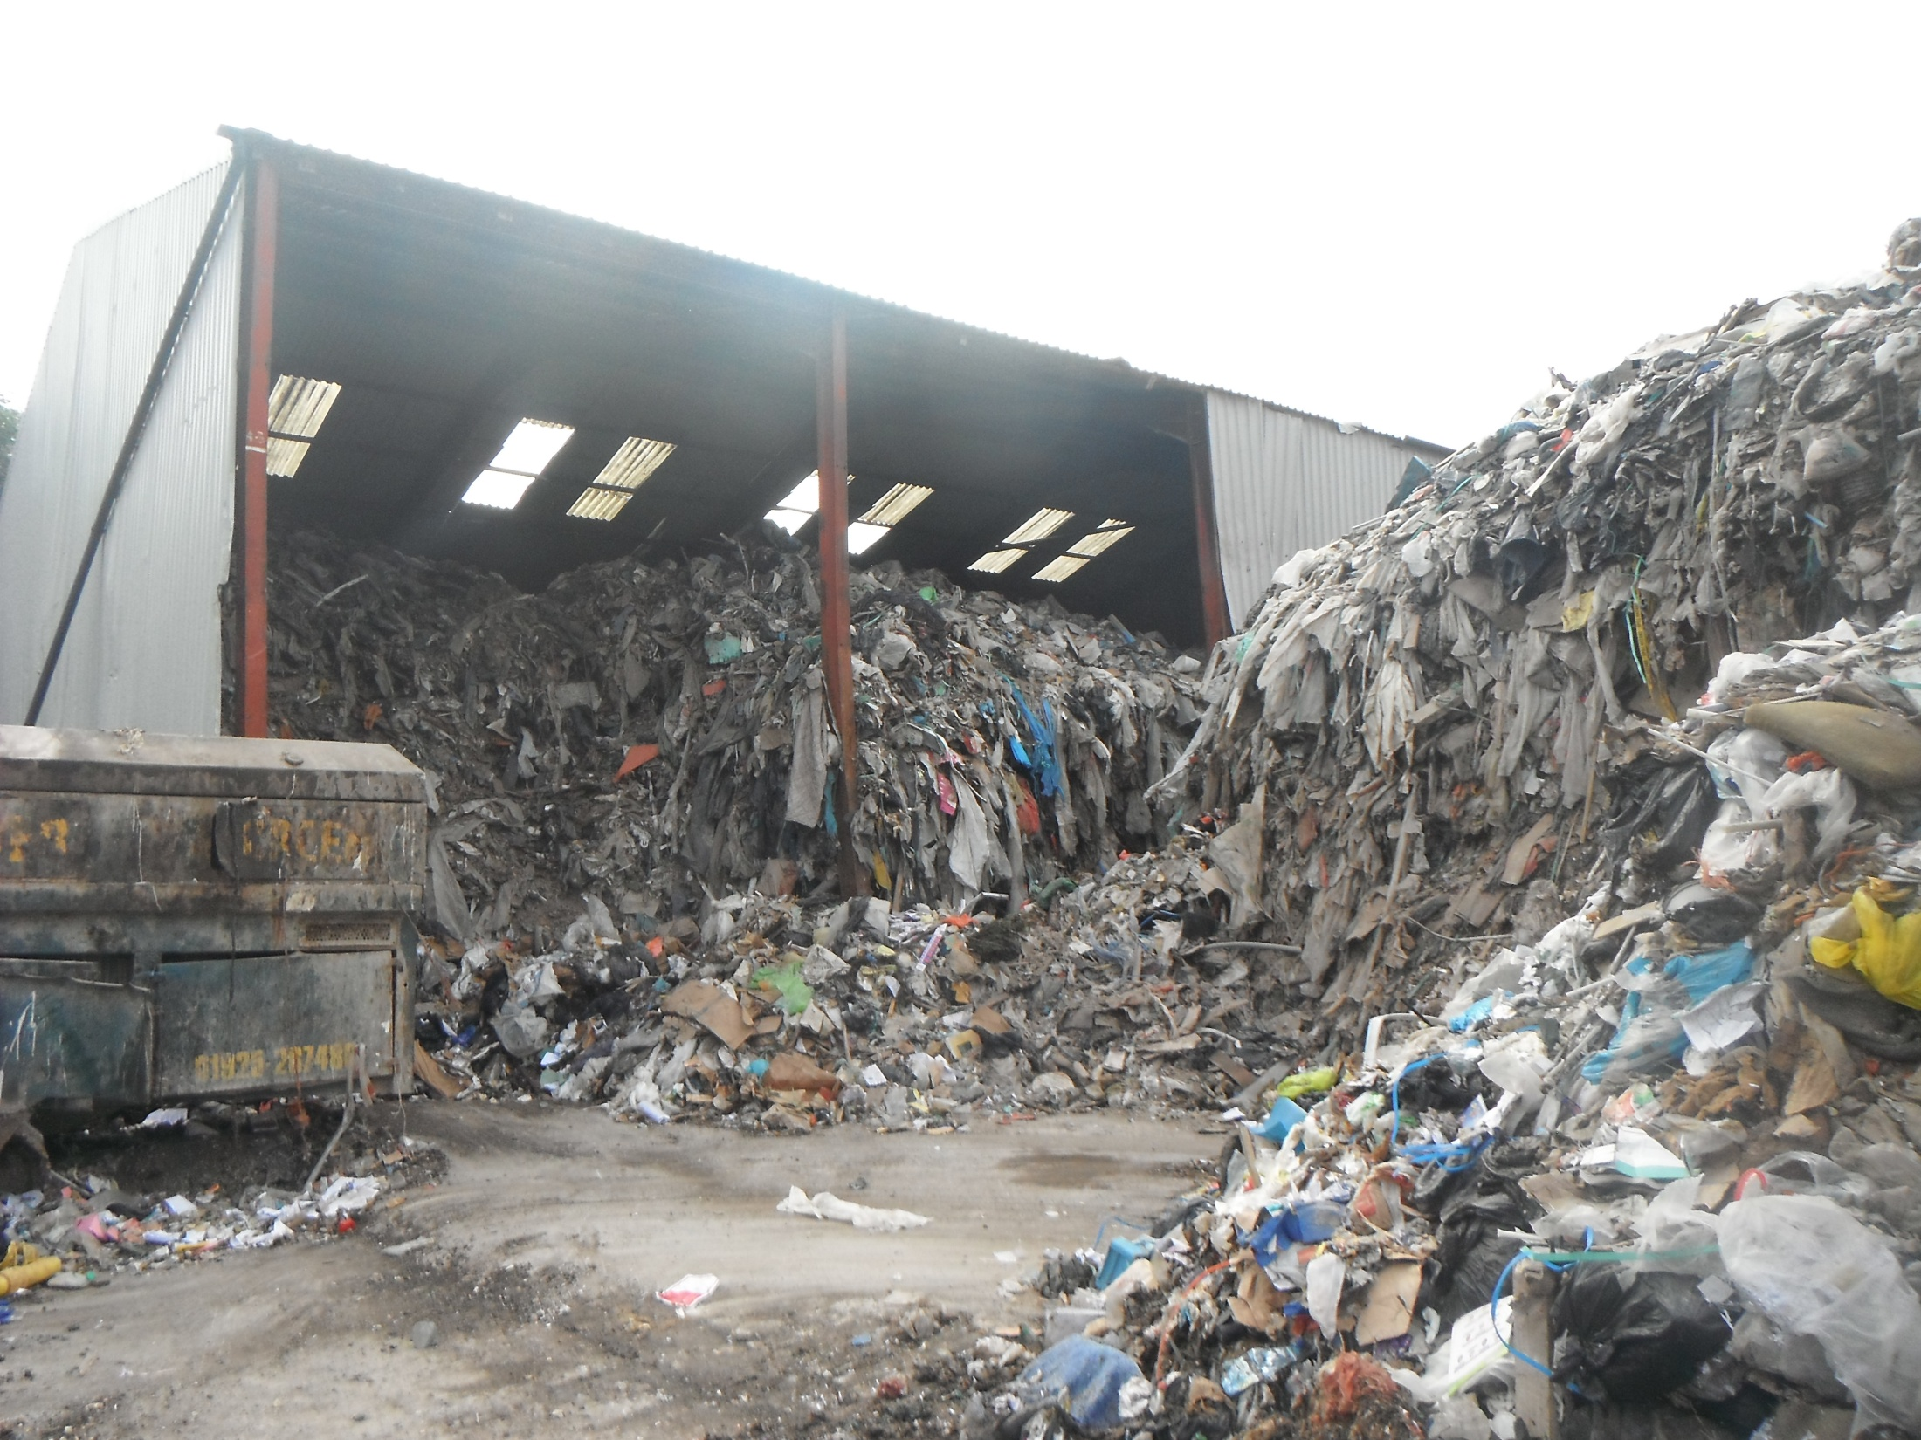
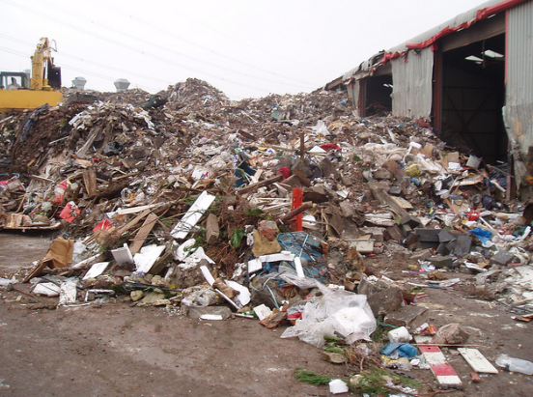
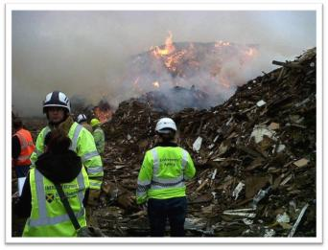
Take a look and consider
Would I want my company’s waste going here ?
Are the sites we use like this?
How do we know ?
Duty of Care compliance?
Notes:
- So consider where the wastes produced in the course of your business are currently going

Slide 26
Notes:
For example – this is what “zero” waste to landfill can look like!
Is your waste going to a site like this?
Or worse …..?

Slide 28
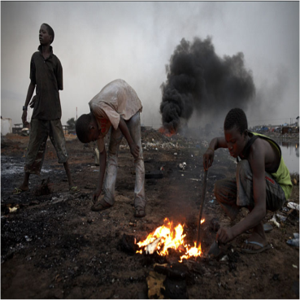
Notes:
Or abroad where people are exploited processing it in a dangerous manner?

Slide 29
Ask Yourself / Consider
Would I want my company’s waste going here
Do we know it isn’t?
How?
Can we improve Duty of Care compliance?
Notes:
Just to reiterate the point ….

Slide 30
How you can help prevent this happening?
EA hotline number 0800 807060
Alternatively - Crimestoppers
Notes:
If you come across illegal operators or illegal waste sites etc – report it.
It will be investigated.

Slide 31
How else can you help?
Check who you send your waste to
Educate your supply chain on their Duty of Care responsibilities
Spread the ‘right waste, right place, right people’ message
Promote the website: www.rightwasterightplace.com/

Slide 32
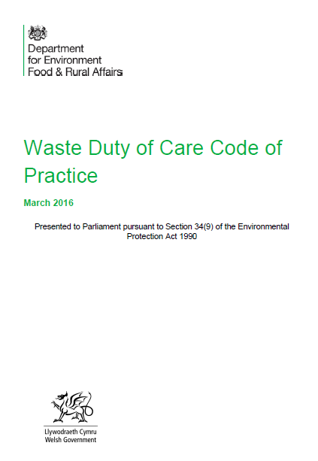
Revised – DOC Code of Practice
Clearer description of obligations
MUST NOT give waste to unauthorised or non compliant sites
MUST use accurate written description with sufficient detail…

Slide 33
Sources of information
Duty of Care
- Code of Practice:
https://www.gov.uk/government/publications/wa ste-duty-of-care-code-of-practice
- Environment Agency (EA):
https://www.gov.uk/managing-your-waste-an- overview
EA Public Register information:
https://www.gov.uk/guidance/access-the-public- register-for-environmental-information

Slide 34


Slide 35
Contact details:
General enquiries
National Customer Contact Centre
PO Box 544
Rotherham S60 1BY
Email enquiries@environment-agency.gov.uk
Telephone 03708 506 506
Minicom (for the hard of hearing) 03702 422 549
Monday to Friday, 8am to 6pm
Environment incident hotline
Telephone (24 hour service) 0800 80 70 60
Floodline
Telephone (24 hour service) 0345 988 1188
Type talk (for the hard of hearing) 0345 602 6340

