Slide 1
Business Continuity and Emergency Planning Seminar The 5 R’s

Slide 2
Todays Agenda
09:00 to 09:30 - The 5 R's - Xris Middleton (Herefordshire Council Resilience Team)
09:30 to 10:00 - Emergency Planning - John Forsyth (Symbiosis)
10:00 to 10:15 - Tea & Coffee.
10:15 to 11:00 - Crisis Management - David Helme (Kerry Foods)
11:00 to 11:45 - Building Resilience – Xris Middleton (Herefordshire Council Resilience Team).
11:45 to 12:00 - Questions and End

Slide 3
The 5 R’s: Risk, Resilience, Response, Recovery and Reassurance
Xris Middleton – Herefordshire Council

Slide 4
What is Business Continuity?
…..loosely defined as the capability of the organisation to continue delivery of products or services at acceptable predefined levels following a disruptive incident.
(Source: ISO 22301:2012)

Slide 5
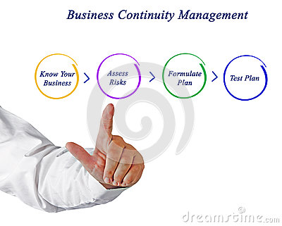
Principle of BCM
To identify the risks that could impact a business ability to maintain its customer offer
To understand and prioritise key business activities and processes
Build protection by implementing:
Measures that minimise the likelihood of unplanned event/disruption occurring
Response structures to react effectively when risks become reality
Capabilities that mitigate the impact should the unplanned event occur.

Slide 6
Business Continuity Management System
Exercise
Test
Continuous Improvement
Conduct Healthcheck
Business Impact Analysis
Risk Assessment
Document BC Plans
Implement Strategy
Training/Awareness
Incident Mgnt Structure
Agree BC Framework
Draft BC Plan(s)

Slide 7
The Risks to Business
TYPES
SOURCES
EFFECT
IMPACT
Political
Economic
Social
Technological
Legislative
Environmental
Operational
Reputational
Minimum Pay Levels
BREXIT
Industrial action
IT failure
Product safety failure
Flooding
Machinery failure
Tax avoidance
Customers
Brand
Stakeholders
People
Property
Process
Performance
Profit

Slide 8
Possible Situations
Denial of Access
Loss of Power
Loss of Key Delivery Partner / Critical 3rd Party Contractor
Loss of Key Product Supplier
Loss of Key Customer
Core ICT Failure / data loss
Major Product Safety Issue
Public Data Security Breach (Website)
Fatality On Site (other than due to natural causes)
Viral Pandemic
Threat to or Loss of Key Personnel
Terrorist Attack

Slide 9
Understanding Risk

Slide 10
The Risk Cake

Slide 11
What is Business Continuity Management?
A key component in the risk management tool box
A management process that contributes towards the mitigation of business risks
Aim to safeguard the 5 Ps’:
People; Property; Processes; Performance; Profit
Designed to protect:
the brand, its customers, and its key stakeholders
Aligns with other activities that support effective management:
Strong financial controls
Insurance cover
Procurement policies
Buildings/site security
Health and safety practices
HR policies

Slide 12
The RM & BC Overlap

Slide 13
Business Impact Analysis
A systematic process to determine and evaluate the potential effects of an interruption to critical business operations.
Key Questions:
What are the daily activities conducted in each area of my business?
What are the long-term or ongoing activities performed by each area of my business?
What are the potential losses if these business activities could not be provided?
How long could each business activity be unavailable for (either completely or partially) before my business would suffer?
Do these activities depend on any outside services or products?
How important are the activities to my business? Rank?

Slide 15
Strategies - People
List of back up skilled specialists
Multi-skill training of staff and contractors
Separation of core skills
Use of third parties
Succession planning
Documenting processes

Slide 16
Strategies – ICT
Install a high quality, frequently updated anti-virus software suite that removes and prevents viruses and cleans spyware.
Review security of passwords and check security of Wi-Fi and router.
Cloud based systems.
Review flexibility of software and applications (e.g. Office 365).
Protect against loss of power and loss of access.
Holding older equipment as emergency replacement or spares
Contracted provision of equipment or recovery services.

Slide 17
Strategies – Information & Data
If you don’t have copies of your data then you are prepared to lose it!
Including Hardcopy & Electronic Data
Confidentiality (i.e. Password Protected, Locked Away)
Availability (replicated, can be accessed remotely)
Currency (up-to-date)

Slide 18
Strategies – Buildings / Utilities
Alternative premises within the organisation
Alternative premises provided by other organisations (whether or not these are reciprocal arrangements)
Alternative premises provided by third-party specialists
Working from home or at remote sites
Back-up power (Generator / UPS)
Bottled water
Access to facilities at other premises or hiring portaloos
Portable gas appliances (i.e. Calor)

Slide 19
Strategies – Equipment & Consumables
Storage of additional supplies at another location
Diversion of just-in-time deliveries to other locations
Arrangements with third parties for delivery of stock at short notice
Identification of alternative/substitute supplies

Slide 20
Strategies – Transportation
Identifying possible scenarios of logistic disruptions which may be caused directly by an incident
Securing alternative logistic means and routes by taking account of traffic conditions and alternative means of transportation
Arrangements with transport providers

Slide 21
Strategies – Finance
Arrangements for providing funds for emergency purchases, such as, food, accommodation, facilities, consumables and transport
Reimbursement of staff expenses
Major expenditure on, for example, rental or purchase of buildings and equipment
Reviewing insurance arrangements

Slide 22
Strategies – Suppliers / Partners
Availability of alternative suppliers
Streamlining procurement procedures when necessary
Encouraging key suppliers to have Business Continuity
Include suppliers in Business Continuity exercises

Slide 23
Business Continuity Buddy
People you can call onto help to maintain continuity drawn from your business and personal networks.
Suppliers, customers, competitors, trade associates, employees, neighbouring businesses, friends and family.
Formal/informal arrangements to provide mutual assistance, pool resources

Slide 24
Building Resilience
Xris Middleton – Herefordshire Council

Slide 25
Civil Contingencies Act 2004
“An event or a situation which threatens serious damage to human welfare in a place in the UK, the environment of a place in the UK, or war or terrorism which threatens serious damage to the security of the UK”

Slide 26
Our Duties

Slide 27
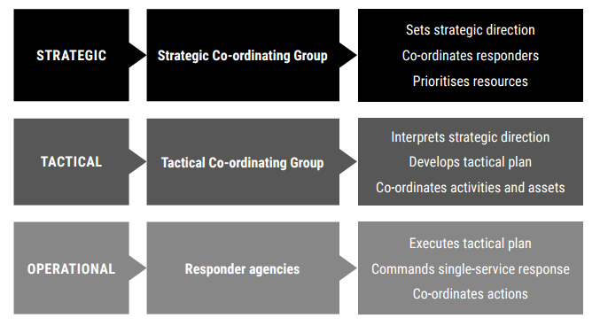
A Multi-Agency Response

Slide 28
Working Together
Notes:
Go to insert > duplicate slide to add more slides

Slide 30
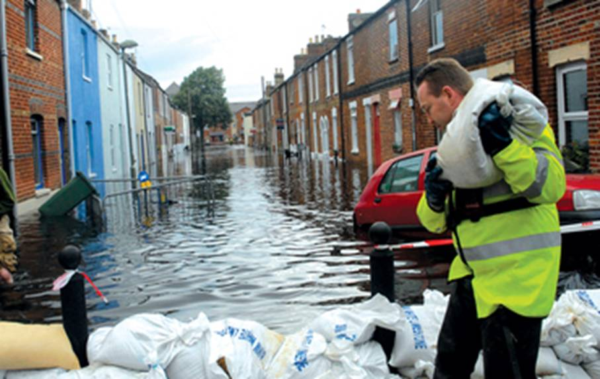
Recovery Phase
Local Authority Lead
Recovery Co-ordinating Group
Community
Health and Welfare
Environment and Infrastructure
Business and Economy

Slide 31
Training
All staff
Emergency procedures e.g. Evacuation
What to do during a disruption.
Response staff
Invoking BC arrangements
Crisis Management
Communications
Inductions / E-learning / Team Meetings
Seminars / Workshops

Slide 32
Testing & Exercising
Periodic Testing
Business Continuity Plan
IT Disaster Recovery Plan
Desk Top / Walk-Through Exercise
Role Play Exercise

Slide 34
Reassurance
Embedding programme to raise awareness of Business Continuity for all staff
Senior level buy-in
Internal business continuity management audits
Supplier business continuity capability reviews
3rd party specialist business continuity management gap analysis

Slide 35
Why BCM?
“Business Continuity is a bit like cleaning the carpets, we only do it if we have to, and we don’t need to clean these carpets”
MD of Major UK Retailer
Why let your customers down?
How loyal are they
Will they go somewhere else?
How long would it take to get them back?
Will they ever come back?
What about your staff?
Why lose what has taken so long to develop?

Slide 36
Todays Challenges
Global sourcing
Increase in outsourcing
Drive for efficiency
Reliance upon technology
Cyber crime
Demand for e-trading
Procurement strategy
BREXIT
Severe Weather
Terrorism
Energy shortages
Global warming
Recruitment
Transport

Slide 37
Who Does It?
Major Corporations and Listed Companies (Corporate Governance)
FSA regulated organisations
Central Government (Procurement Policies)
Local Government (Community Resilience initiatives)
Retailers – (Supply Chain management)

Slide 38
Benefits of having a BCMS
Maintaining continuity of operations / service delivery
Helps build customer confidence
Builds confidence within the organisation
Provides a competitive advantage
Help build Resilient Communities

Slide 39
Useful Information Sites

