Slide 1
A Brief Guide to Emergency Planning and Preparedness

Slide 2
Emergency planning can be defined as the process of preparing systematically for future contingencies, including major incidents and disasters.

Slide 3
Emergency: An unexpected event or set of circumstance which will require immediate intervention.

Slide 4
Levels of Emergency
Emergencies, major emergencies, crises, disasters, catastrophes.

Slide 5
Levels of Emergency
Emergencies, major emergencies, crises, disasters, catastrophes.
Energy, weather, equipment, data breach, server down time, fire etc.

Slide 6
Legislation & Planning
RRFSO 2005, HASAWA, other H&S regulations, environmental regulations, (COMAH regs).

Slide 7
Legislation & Planning
RRFSO 2005, HASAWA, other H&S regulations, environmental regulations, (COMAH regs).
Why plan for emergencies?

Slide 8
Legislation & Planning
RRFSO 2005, HASAWA, other H&S regulations, environmental regulations, (COMAH regs).
Why plan for emergencies?
Seven Ps.

Slide 9
Legislation & Planning
Policy.

Slide 10
Legislation & Planning
Policy.
Formation and meeting of EP Team.

Slide 11
Legislation & Planning
Policy.
Formation and meeting of EP Team:
Policy;
Allocate tasks;
Schedule.

Slide 12
Vulnerability Survey

Slide 13
Vulnerability Survey
Survey:
Possibly by departments/areas.

Slide 14
Vulnerability Survey
Survey:
Possibly by departments/areas;
Identifying risks (consider all).

Slide 15
Vulnerability Survey
Survey:
Possibly by departments/areas;
Identifying risks (consider all);
Grading the risks, (likelihood & severity, FTA, FMA).

Slide 16
Vulnerability Survey
Survey:
Possibly by departments/areas;
Identifying risks (consider all);
Grading the risks, (likelihood & severity, FTA, FMA);
Geographical or other factors.

Slide 17
Vulnerability Survey
Survey:
Possibly by departments/areas;
Identifying risks (consider all);
Grading the risks, (likelihood & severity, FTA, FMA);
Geographical or other factors;
Team review of identified risks.

Slide 18
Vulnerability Survey
Survey:
Possibly by departments/areas;
Identifying risks (consider all);
Grading the risks, (likelihood & severity, FTA, FMA);
Geographical or other factors;
Team review of identified risks;
Prioritised list of risks to the organisation.
(temporary measures may be necessary)

Slide 19
Emergency Plan
Preparing the plan (be meticulous).

Slide 20
Emergency Plan
Preparing the plan (be meticulous)
Contingency measure/control measures:
Before event;
During event (CMT);
After event.

Slide 21
Emergency Plan
Preparing the plan (be meticulous).
Contingency measure/control measures:
Before event;
During event (CMT);
After event;
Write the plan.

Slide 22
Crisis Management Team

Slide 23
Crisis Management Team
Form CMT (content of plan).

Slide 24
Crisis Management Team
Form CMT (content of plan).
Ensure where possible CMT has the assets it needs.

Slide 25
Crisis Management Team
Form CMT (content of plan).
Ensure where possible CMT has the assets it needs.
Practice CMT (changes to team).

Slide 26
Crisis Management Log

Slide 27
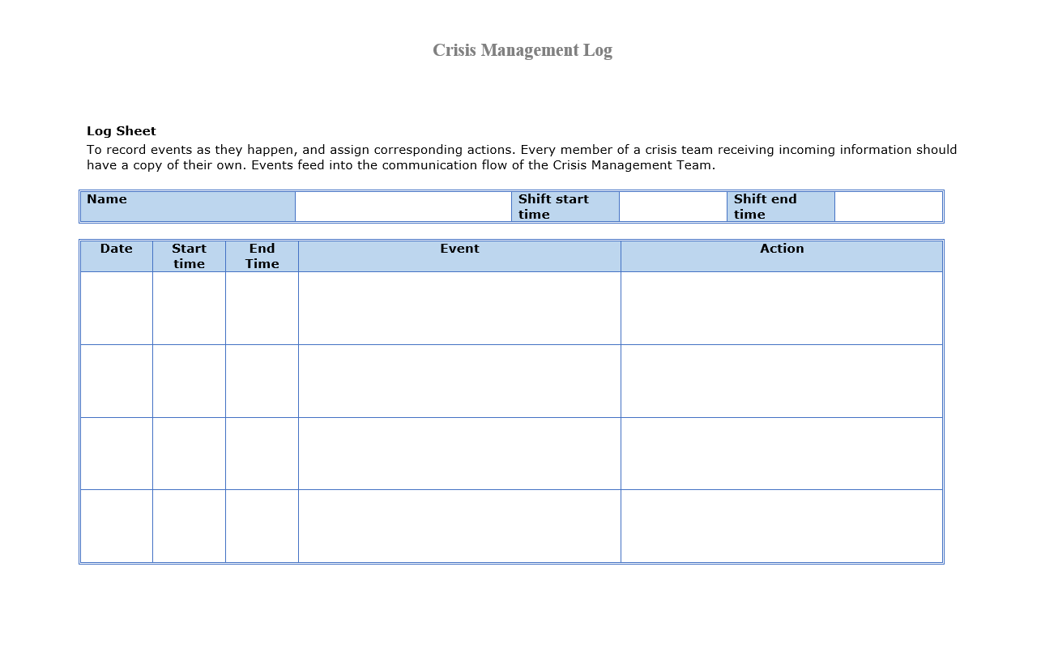
Crisis Management Log

Slide 28
Post Crisis Events

Slide 29
Post Crisis Events
Wash up.

Slide 30
Post Crisis Events
Wash up.
Where necessary, amend the plan.

Slide 31
Summary
Policy.
Vulnerability study (don’t discount things early on).
Prepare the plan ( be meticulous).
Practice the CMT.
Keep a log during event.
Wash-up after the event, amend plan where necessary.

Slide 32
Don’t Forget

Slide 33
The Seven Ps

Slide 34
Think in terms of a risk assessment.

