Slide 1
Crisis Management
David Helme – Kerry Foods

Slide 2
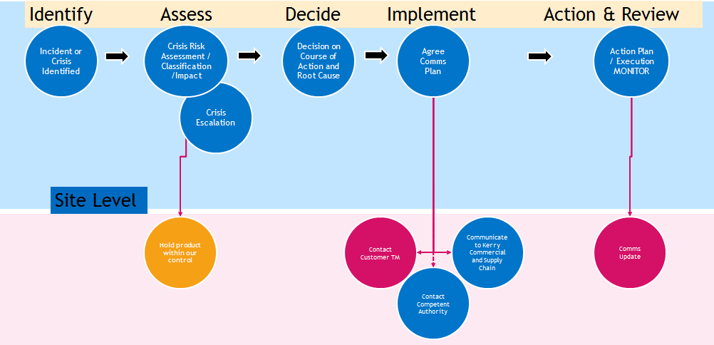
Crisis Management

Slide 3
Crisis Management
Policy
Purpose and Responsibility
Crisis Management Objectives
Site Crisis Management Team (SCMT)
Responsibilities
Managing a Potential Crisis, Information Collation and Assessment
Convening of TCMT
Membership of the Technology Crisis Management Team (TCMT)
Crisis Management Organisation
Communication
Site Action, Review and Shared Learnings
Contact Lists must be maintained by all roles detailed in documents

