Slide 1
Work Equipment & Machinery
Notes:
We will now consider how to control the hazards created by equipment used at work. This is a vast topic area, as it covers almost everything used at work, from a stapler in an office to an enormous earth moving machine on a construction site, and just about everything in between!

Slide 2
Topics covered
Basic principles of work equipment and machinery safety
Machinery hazards
Guarding and safety devices
Legislation and conformity
Lifting equipment
Conclusion and questions

Slide 3
Basic principles

Slide 4
Work Equipment
Varies from simple to complex
Even simple equipment may be a risk!
Simple but hazardous equipment in the workplace?
However simple or complex
Safe ways and unsafe ways to use
Safe way – known as ‘Safe System of Work’
Always use equipment in the safe manner
Examples of unsafe ways of using equipment?
Employer to ensure competence before authorising first using
Notes:
Note that even ‘simple equipment’ can be hazardous. A good example of this is the use of fixed bladed ‘Stanley’ type knives in an unpacking department. These can, and have, caused some horrific injuries, and resulted in many compensation payouts.
Can delegates think of any other examples?
...no matter what type of equipment, there should be a safe way of using it, and users should be aware of this. Of course the level of detail required will vary according to the complexity of the equipment, and the degree of risk arising from it.

Slide 5
Employer’s responsibilities
All work equipment
Select workplace precautions
Train users in workplace precautions
Devise and maintain Safe System of Work
Additional requirements for machinery
Identify need for guards, emergency stops, etc.
Select, fit and maintain guards
Check guards are used properly
What’s a machine?
…Equipment consisting of an interconnected system of components used to apply or modify force in order to perform useful work. Usually (but not always) power driven.
Notes:
What is ‘a machine?’ - ...’Equipment consisting of an interconnected system of components used to apply or modify force in order to perform useful work. Usually (but not always) power driven.
What additional hazards are created by moving parts of machinery?...ask delegates to suggest a few examples then see if they can identify them on the next slide...

Slide 6
Machinery hazards

Slide 7
Moving machinery hazards
Need to protect personnel from following hazards:
Traps
Impact
Contact
Entanglement
Cutting/shearing
Stabbing/puncture
Ejection
Notes:
The hazards arising from moving parts can be summarised into these broad categories.
...now, let’s consider the different types of guarding systems...

Slide 8
Bench Grinder

Slide 9
Pillar drill

Slide 10
Circular saw – small one

Slide 11
Circular saw – big one!

Slide 12
‘In running nips’

Slide 13
Access to moving parts... ...not always obvious!

Slide 14
Unexpected movements – trapping points

Slide 15
Guarding and safety devices

Slide 16
Types of Guards
Fixed –
fully enclosing
difficult to remove
not suitable where access is required
Interlocking –
simple interlocks
guard locking
trapped key system
can be overridden!
Adjustable -
manually adjustable
relies on operative adjusting correctly
may be removable!
Automatic -
mechanically activated by machine
effective, but limited in application
movement of guard may cause hazard!
Notes:
Can anyone think of examples of where these type of guards could be found? (either in the home, a workplace, or sometimes in a public place)
Fixed guards are very common – any type of permanent cover or grille is a fixed guard. Most people will have seen a metal cover over a desk fan.
Interlocking guard – how many people have used a microwave this morning. Why will it not work until the door is closed? - to prevent danger, the door is ‘interlocked’ to the power control of the machine. It won’t operate until the door is closed, as it would not be safe to do so!
Adjustable guards are necessary where a certain portion of the dangerous parts have to be exposed for the machine to work. Most people will have used or seen a strimmer which has a partial guard around the rapidly rotating head. This can be adjusted to deflect the flying particles of debris away from the user.
Automatic guards operate in conjunction with the machinery mechanism, and are also known as ‘mechanical’ guards. Lift doors are a common example.
Now let’s have a look at some common workplace examples of guards from a range of industry applications…

Slide 17
Good example of fixed and interlocked guarding

Slide 18
Adjustable drill chuck guards

Slide 19
Automatic guard fitted to power press

Slide 20
Machinery Guards - Possible Issues
All guards have weaknesses!
Operators must not attempt to defeat guards
Bad practice and illegal!
Who is responsible if operator is injured through defeating guard?
If guards make work difficult, then not effective, and temptation to defeat
Do not allow anyone to defeat the guard!
Notes:
The guard may not be sufficient to cover or protect the dangerous parts, and they could still be exposed
Guards can ‘get in the way’ and make operation more difficult. They can slow down the process – the operator may be on ‘piece work’ rate, and so this would affect their bonus!
Some people are ‘devious’ and ‘bloody minded’ and may be tempted to ‘get one over on their employer’ by deliberately removing the guard!
The guard may become damaged or loose etc. Or it may fail to work correctly.
Think back to module 3. What section of the legislation we discussed covers the tampering with, or removal of guards? – s.8 HSW Act.
..are there any other types of protection devices which may be used?...

Slide 21
Access to enclosure... ...Good or bad?

Slide 22
Trip Devices etc.
Where effective guarding not possible
Typically telescopic probe on drill, light guard on press etc.
Must
Stop machine in sufficient time and in safe position
Be checked regularly
Trip bars, wires etc. are similar devices
Two handed controls sometimes used
Must meet certain criteria to prevent misuse
Notes:
These devices leave the dangerous parts exposed, but are designed to stop the movement before the operator can reach them. They may protect against contact or entanglement with moving parts, but not against other hazards such as ejection of components, contact with hot surfaces etc.
They are often easier to over ride or misuse.
Therefore they are not usually as effective as guarding, and should only be used where conventional guarding is not practicable.
...now, let’s summarise the key action points for machinery safety...

Slide 23
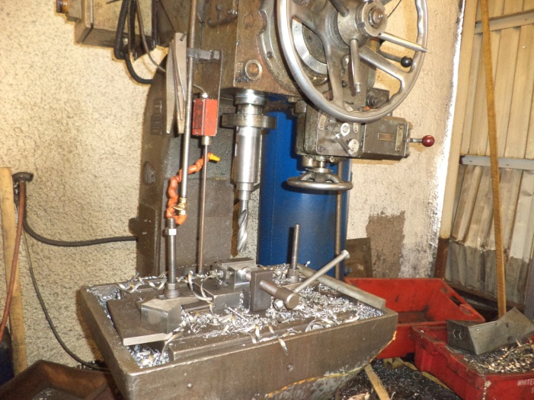
Trip guard on radial arm drill

Slide 24
PE ‘Light Guard’ on hydraulic punching machine

Slide 25
‘Trip wire’ emergency stop along overhead conveyor

Slide 26
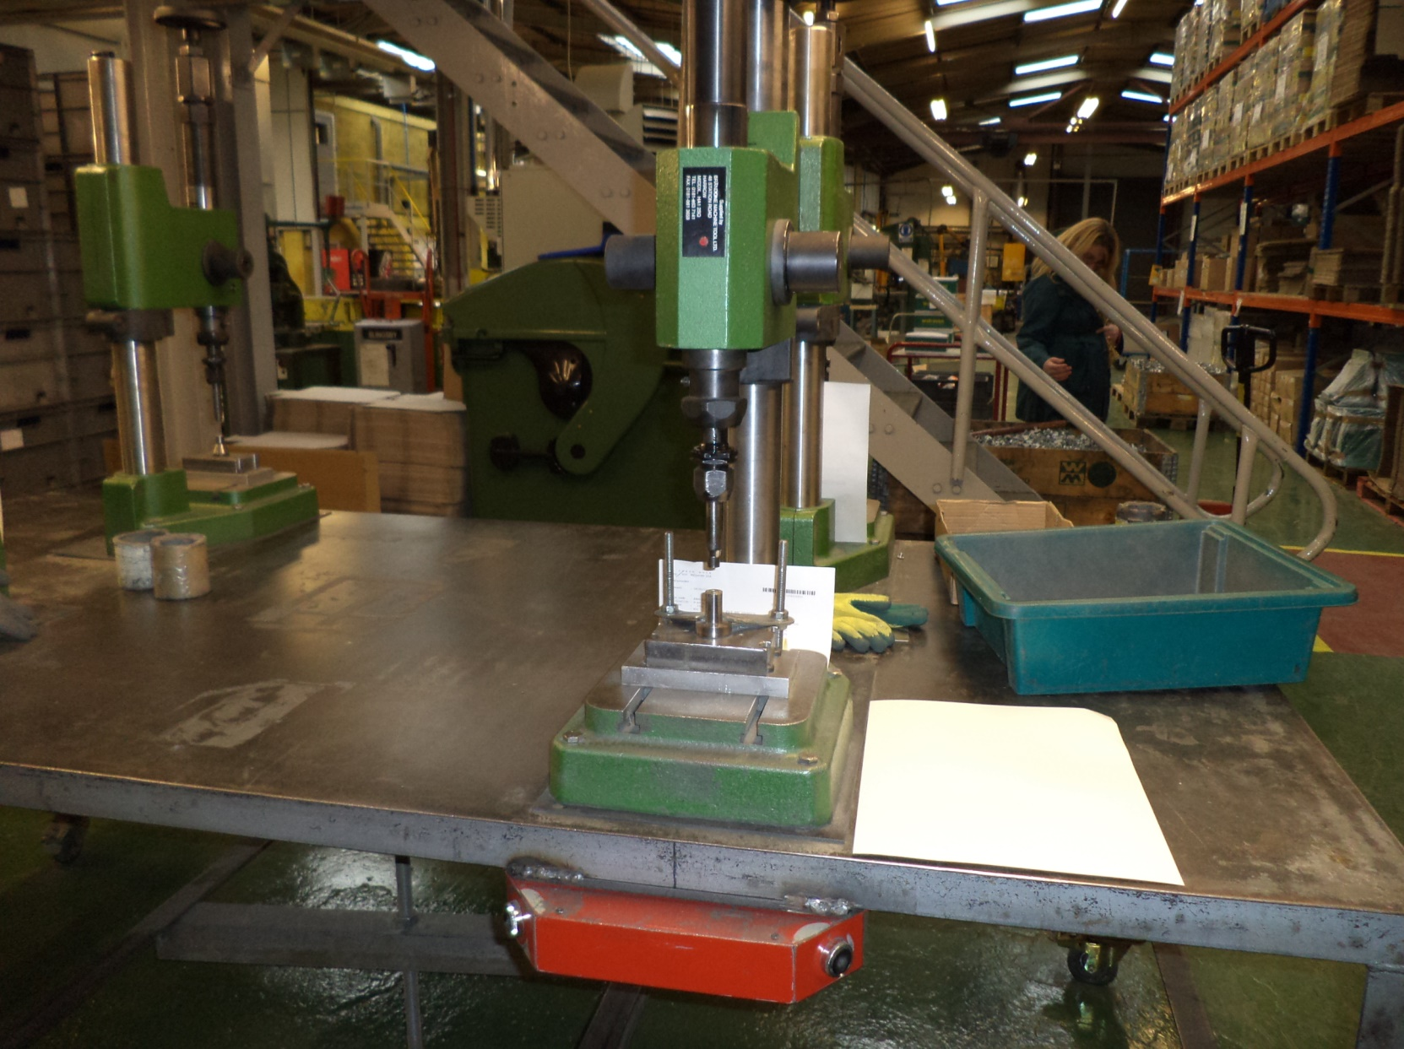
Two handed control systems

Slide 27
Key Activities for Machinery
Prepare and implement effective safe system of work
Make sure users are competent
Safe system of work to be followed at all times
Find out about emergency stop, is one fitted?
If so, does it work effectively?
Find out if machine should have guard
If machine does have a guard, ensure users:
Never operate machine without guard
Never try to defeat the guard
Now look at legislation…
Notes:
Emergency stops should not be used as an alternative to guarding. They are intended as a ‘last resort’ emergency measure
They must be easily accessible, and clearly identifiable (red ‘mushroom’ button with yellow background)
They must stop the machine effectively, and in a safe position. (in some cases eg woodwork machinery, within a prescribed time limit)
They must of course work effectively!! (believe it or not, many don’t!!!) – so they should be subject to regular testing and maintenance.
They are not always fitted – in some cases eg on lathes or abrasive wheels, they would not be appropriate.
Now we will quickly summarise the legal requirements regarding work equipment...

Slide 28
Legislation and conformity

Slide 29
Legislation Summary
HEALTH AND SAFETY AT WORK ACT 1974 (HSW)
SECTION 6 HSW
MACHINERY DIRECTIVE
SUPPLY OF MACHINERY (SAFETY) REGULATIONS 2008
SECTION 2 HSW
USE OF EQUIPMENT BY WORKERS AT WORK DIRECTIVE
PROVISION AND USE OF WORK EQUIPMENT REGULATIONS 1998
ALL MACHINERY USED AT WORK
NEW MACHINERY
(or first used in EEA)
INCLUDES RECONDITIONED EQUIPMENT

Slide 30
Legislation
Main legislation is
Supply of Machinery (Safety) Regulations 2008
Provision and Use of Work Equipment (PUWER) 1998
Work equipment is defined in regulations.
Requirements imposed on designers, manufacturers, importers, suppliers, installers as well as employers
Typical examples of ‘work equipment’?
But there are exceptions – what is not work equipment?
Livestock, substances not defined as ‘equipment’
Notes:
As we said earlier ‘work equipment’ covers just about everything used for work purposes...the vending machine in the office is work equipment!...a ‘company car’ is work equipment!...computers are also work equipment, but they are also covered by additional specific regulations.
There are very few exceptions – the slide shows just about the only two!!

Slide 31
Supply of Machinery (Safety) Regulations – main requirements imposed on ‘supplier’
Applies to new/reconditioned equipment, or that first supplied in EEA
Requirement to design hazards out, rather than control measures in where possible
All equipment to be of sufficient strength, stability and to ‘fail safe’
Declaration of conformance to relevant regulations and standards and ‘CE’ mark required
Evidence of conformity (Technical File)
Suitable information, instructions for safe installation, commissioning, operation, maintenance, decommissioning and disposal to be provided

Slide 32
Classification of Harmonised European Standards (CEN’s)
Three main classifications of standards relating to machinery:
Type A standards – General requirements applying to all types of machines
Type B standards – of which there are two sub groups:
B1 – relating to safety and ergonomic aspects
B2 – relating to safety components and devices
Type C standards – Apply to specific types or groups of machines

Slide 33
PUWER – Main requirements imposed on employer
Detailed, and technical guidance on machinery
Following are key requirements of regulations:
Work equipment must be suitable
Certification and technical file required
Work equipment must be inspected and maintained
Inspection and maintenance records required
Users must be given information, etc
Training and authorisation records required
Machinery must be guarded if ‘practicable’
Must be adequate start / stop controls
Let’s look at some of the main regulations concerning the above…
Notes:
The employer must provide equipment which is ‘suitable and sufficient’ and ‘fit for purpose’
It must be maintained in a safe condition
Note that guards should be fitted where ‘practicable’ NOT ‘reasonably practicable’!
Start/stop controls covers emergency stops where appropriate.

Slide 34
Maintenance requirements (regulation 5)
Regulation requires that equipment must be maintained in efficient state, efficient working order and good repair.
Suggested schedule includes:
Pre use, weekly, or monthly inspections
By users
By supervisors
Fault reporting and prioritisation system required
Regular testing of safety devices
Guarding/protective devices
Interlocks
Emergency stops
By Competent Person
Documented maintenance schedule
Breakdown/running repairs/replacement
Opportunistic
Planned preventative maintenance
Planned shutdowns

Slide 35
Inspection requirements (regulation 6)
Where the safety of the equipment depends on installation conditions, it must be inspected:
After initial installation and before being put into service for first time
After re assembly at new location
Where exposure conditions may cause deterioration liable to result in a dangerous situation:
At suitable intervals
Occurrence of exceptional circumstances liable to jeopardise health and safety
Prior to leaving undertaking
To ensure that health and safety conditions are maintained and deterioration can be detected and remedied in good time.
Inspections must be carried out by suitably competent person and recorded (note these inspections are additional to pre use checks and ‘normal’ maintenance activities)

Slide 36
Specific risks (regulation 7)
Where use of the equipment is likely to involve a specific risk to health and safety, employer to ensure that:
Use of the equipment is restricted to those persons specifically authorised to do so, and
Repairs, maintenance, servicing is restricted to specifically designated persons.
Employer to ensure that all such persons have received adequate training relevant to the operations for which they have been authorised or designated.

Slide 37
Dangerous parts of machinery (regulation 11)
Employer shall ensure that effective measures are taken to either:
Prevent access to dangerous parts, or
Stop movement of dangerous parts before any part of person enters ‘danger zone’
Measures required shall consist of:
Fixed guarding, where and to the extent that it is practicable, where it is not, then
Other guards or protection devices where and to the extent that it is practicable, where it is not,
Provision of jigs, push sticks, or similar protection appliances used in conjunction with machine, where practicable, but where it is not, then
Appropriate information, instruction, training and supervision

Slide 38
Protection against ‘specified hazards’ (regulation 12)
Prevent exposure, or where not reasonably practicable control exposure to hazards arising from:
Articles/substances falling or ejected from work equipment
Rupture or disintegration of parts of work equipment
Equipment overheating/catching fire
Unintended discharge of gas, vapour, liquid, dust, produced or stored in equipment
Unintended or premature explosion of equipment or anything produced by it
Control measures where reasonably practicable to be other than provision of personal protective equipment, or information, instruction, training and supervision.

Slide 39
Emergency stops (regulation 16)
Not an alternative to guarding
To be used in emergency only, not for routine stops
Must be clear and unambiguous (red ‘mushroom’/yellow background)
Easily accessible
Should lock in on operation
Equipment should not restart without resetting
Trip wires must be bi-directional
Must override all other control functions
Must stop machine in a safe position

Slide 40
Machinery assessment process (the ‘PUWER assessment’)
Still recommended, despite certificate of conformity!
Some factors to consider:
Routine and non routine operating modes/tasks
Installation, setting/adjustment, cleaning, maintenance, repair decommissioning
Accessibility for operation, cleaning, maintenance etc.
ergonomic requirements
Any unprotected hazards?
Security of guarding/protection devices
Potential to ‘fail to danger’
Fault detection
Inspection and maintenance requirements
Existing control measures
Other potential hazards

Slide 41
LIFTING EQUIPMENT

Slide 42
Lifting Equipment – – Lifting Operations/Lifting Equipment Regulations (LOLER) 1998
Defined as any equipment for lifting/lowering load and accessories for attaching or supporting it. PUWER requirements still apply! Additional requirements:
Equipment to be marked with Safe Working Load (SWL)
Indicator for SWL Limit where appropriate
Statutory inspections to be carried out - annual for equipment - 6 monthly for accessories or equipment for lifting persons
Records to be retained
Detailed lift plan required
Operators to be competent
All lifts to be adequately controlled
Notes:
Before opening the slide ask...what exactly is meant by ‘lifting equipment’?...show definition, and ask delegates to suggest examples.
Note that all ‘lifting equipment’ is also ‘work equipment’ therefore the PUWER still apply. The following requirements are additional and not alternative to the legal requirements we have just discussed.
This completes the module on ‘Work Equipment’ - a few questions to test understanding:
Give an example of an unsafe way of using simple work equipment?...hand in front of blade when using knife, using chisel as screwdriver etc...many examples could be quoted!
What are the main categories of hazard arising from moving machinery?... Trapping, impact, contact, entanglement, stabbing /puncture, ejection.
What different types of guard are there?.. Fixed, interlocking, adjustable, automatic/mechanical (possibly ask delegates to give example of where each could be found)
What are limitations of guards?...may not offer complete protection, may break down, fail, drop off etc. Operator may remove, over ride or tamper with them.
What colour should emergency stops be?...red ‘mushroom’ on yellow background.
What are some additional requirements for lifting equipment?...SWL’s to be marked, statutory inspections, detailed lifting plan to be in place etc...
...now let’s consider hazards which may be caused by the movement of people within the workplace...

Slide 43
conclusions

Slide 44
In conclusion
Although legal requirements and standards may change, good practices do not! Therefore:
Buy carefully
Assess and control risks
Inspect and maintain
Inform, instruct, train and authorise
Keep up to date documented records
Keep an eye on things!

Slide 45
Thank you
Any Questions?
Notes:
45

