Slide 1
ComPliance Essentials LTD
Paul Johnson
07949576178
compliance.essentials@btinternet.com

Slide 2
The Regulatory Reform (Fire Safety) Order 2005
BS9999: 2017 Fire Safety in the Management, Design and use of Buildings. Code of practice.
BS7974: Application of fire safety engineered principles to the design of buildings. Code of practice.
Building Regulations Approved Document B – Fire Safety – Amended 2013
- Volume 1 – Dwellinghouses
- Volume 2 – Buildings other than Dwellinghouses

Slide 3
Legislation and Regulation Problems?
RRO is self-regulatory and open to interpretation
The criticism of the regulations are that they are confusing, too open to interpretation, and at times contradictory

Slide 4
2009 Lakanal House fire.
Following her inquest into that fire, coroner Frances Kirkham wrote to then communities secretary Eric Pickles in March 2013, recommending that the government review Approved Document B. This sets out how to meet the Building Regulations on fire safety, but she described it as a ‘most difficult document to use’.
She argued that it needed to provide ‘clear guidance’, in particular to the ‘spread of fire over the external envelope of the building’. Kirkham urged these regulations be ‘expressed in words and adopt a format … intelligible to the wide range of people and bodies engaged in construction, maintenance and refurbishment of buildings’.

Slide 5
The Regulatory Reform (Fire Safety) Order 2005
FIRE SAFETY DUTIES
9. Risk assessment

Slide 6
Question
Does Fire Risk Assessment drive your organisational approach to fire risk management?
Should it?

Slide 7
FIRE RISK ASSESSMENT
When do you undertake assessments?
When do you undertake reviews?
How do you determine competency?
How intrusive are your assessments?
How do you make decisions on risk treatment?
How do you communicate risk acceptance?
Do you audit the FRA program?
What’s your methodology for auditing FRA’s?

Slide 8
Fire Risk Assessments are a means to an end but not the end in themselves.
The value of a fire risk assessment is highly dependent on the organisations ability to management the outcomes.
Fire Risk Management within our built environment is a broader discipline.

Slide 9
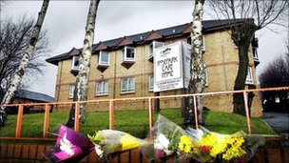
WHY MANAGEMENT?
“The deficiencies in the management of fire safety at Rosepark contributed to the deaths in that a number of key circumstances would have been quite different if there had been AN ADEQUATE SYSTEM OF FIRE SAFETY MANAGEMENT”

Slide 10
WHY MANAGEMENT? WHY MANAGEMENT? WHY MANAGEMENT?
Increase in the proliferation of fire engineered buildings;
Fire Engineered Building MAY require enhanced management;
Emergence of modern methods of construction;
Building design freedoms based on assumptions;

Slide 11
WHY MANAGEMENT?
Most non-domestic multi-fatality fires have management failings as their root cause.
Fire risk is often governed more by the quality of management than the level of fire protection.
A building with first rate fire precautions yet poor management, may pose a greater risk than a building with limited fire precautions and good management.
Management must be considered as of equal importance to fire protection measures.

Slide 12
PAS 7 : 2013
“An integrated or holistic approach to understanding and managing the risks posed by the threat of fire which enables an organization to optimize it’s underlying processes and achieve more efficient results”.

Slide 13
COMPREHENSIVE COMPLIANCE
Article 9
Article 10
Article 11
Article 12
Article 13
Article 14
Article 15
Article 16
Article 17
Article 18
Article 19
Article 20
Article 21
Article 22
Strategic Fire Risk Management
Fire Risk Assessment
Fire Safety Training
Work Control
Resources & Authority
Maintenance & Testing
Communication
Emergency Planning

Slide 14
FRMS PROCEDURES
FRM STRATEGY
FIRE POLICY

Slide 15
DOCUMENTATION LEVEL?
Strategic fire risk management at ORGANIZATIONAL level
Organisation wide policy and objectives;
Organisation wide fire risk management strategy;
Organisation wide procedures.
Operational fire risk management at PREMISES level
As built fire strategy
Premises specific policies and procedures
Fire Risk Assessments
Fire safety manual
PEEPS
Hot Work Permits
Maintenance and Testing Records

Slide 16
FIRE POLICY
It’s the “what and why” statement of intent.
Provides a framework for setting objectives.
Responsibility for defining & authorizing rests with top management.
Should consider life, property, mission continuity and socio environmental considerations.

Slide 17
WHY DOCUMENT STRATEGY?
To provide a framework for operational fire risk management throughout the organisation;
To formalise the fire safety managers role;
To set objectives;
To communicate responsibilities of all duty holders;
Identify areas for business process improvement;
Inspire confidence within stakeholders;
To ensure a holistic approach to legislative compliance;

Slide 18
WHAT SHOULD YOUR ORGANISATIONS STRATEGY CONSIDER?
Fire Risk Assessment
Resources and Authority
Fire Safety Training
Work Control
Maintenance and Testing
Communication
Document Control
Auditing
Emergency Planning

Slide 19
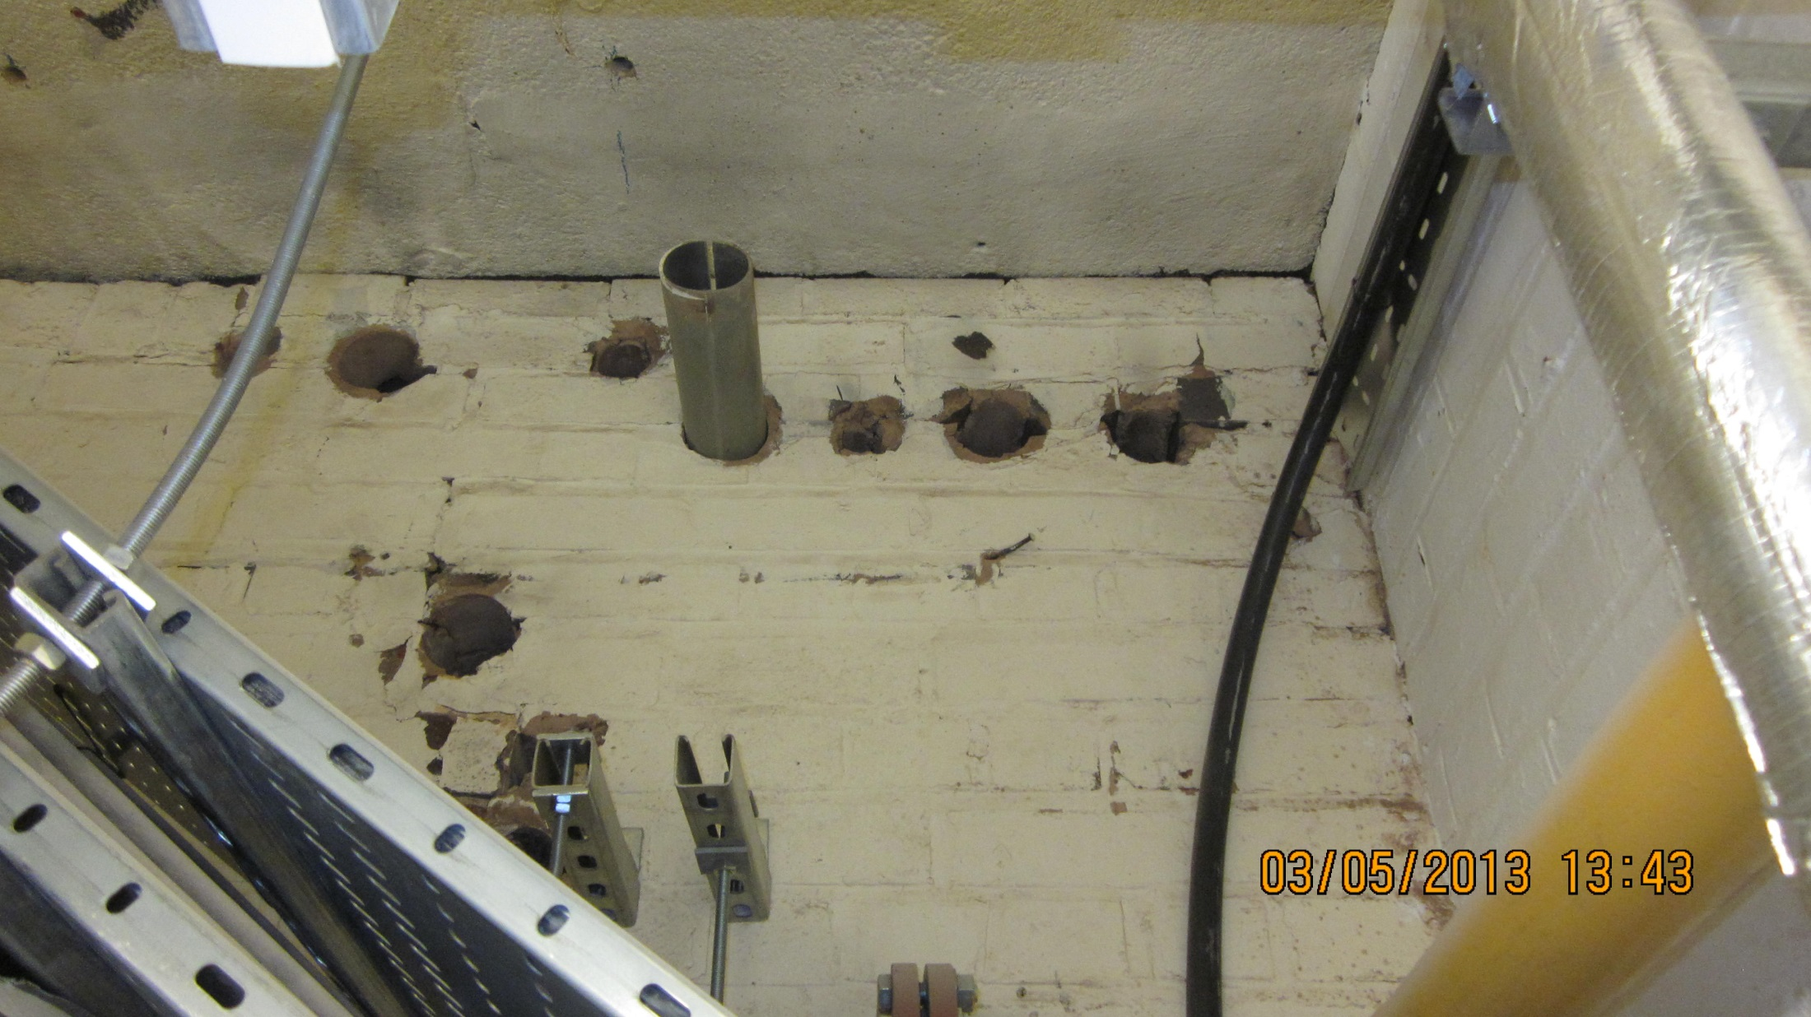
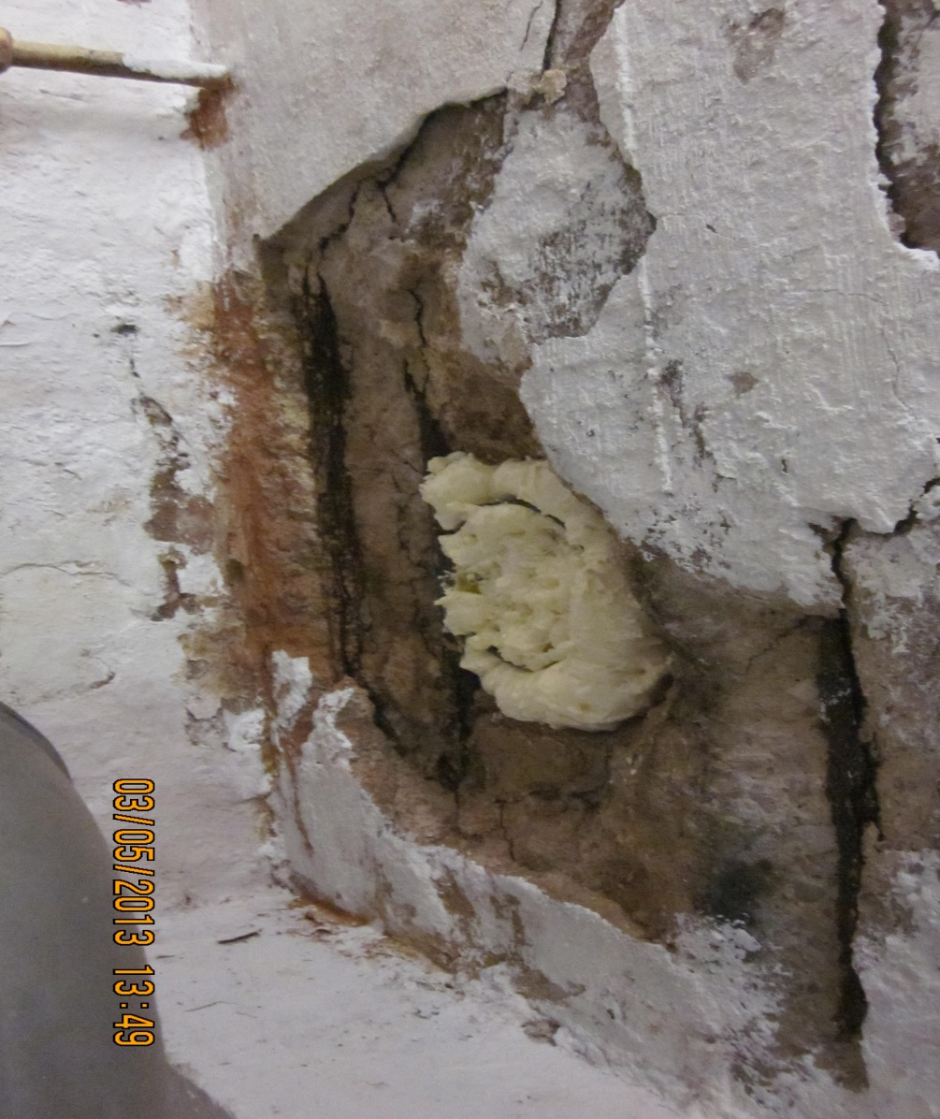
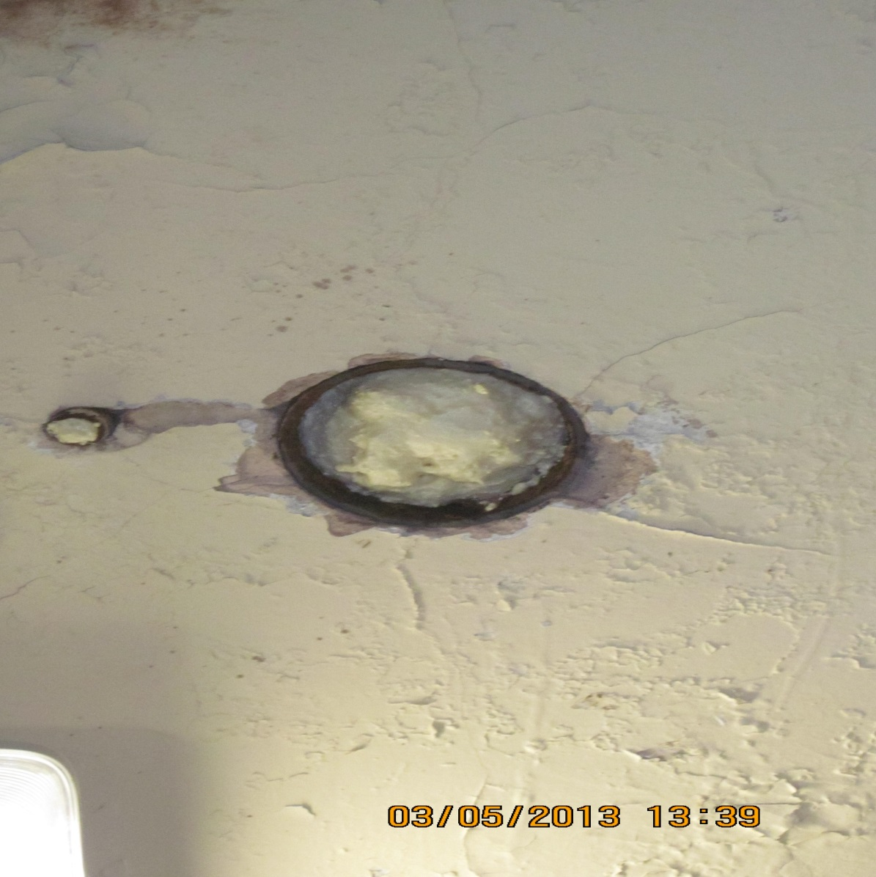
Compartmentation Issues

Slide 20
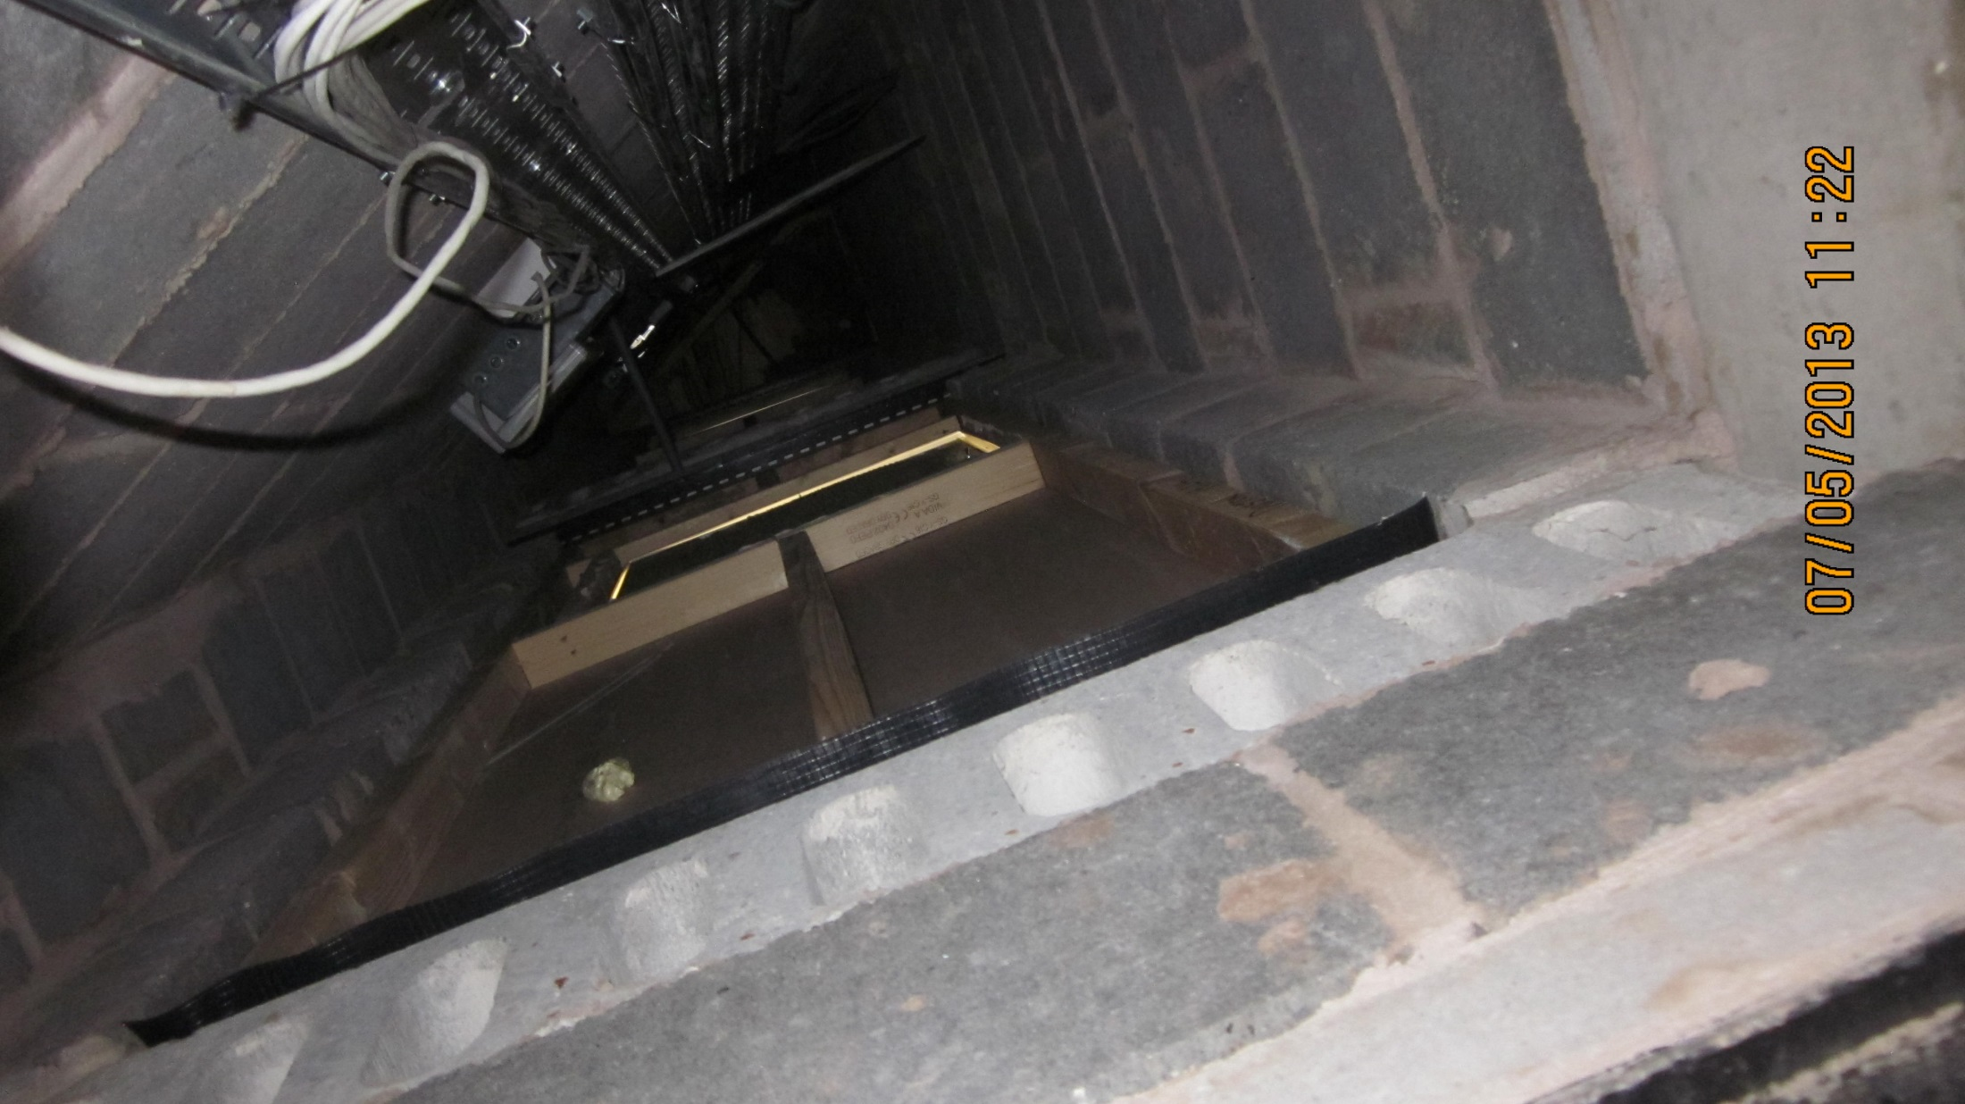
The Chimney Effect

Slide 21
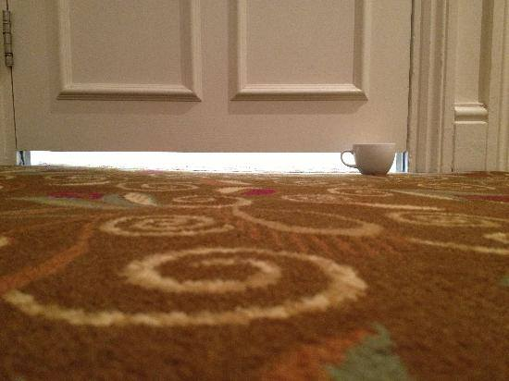
Fire Doors

Slide 22
Standard Practice?

Slide 23
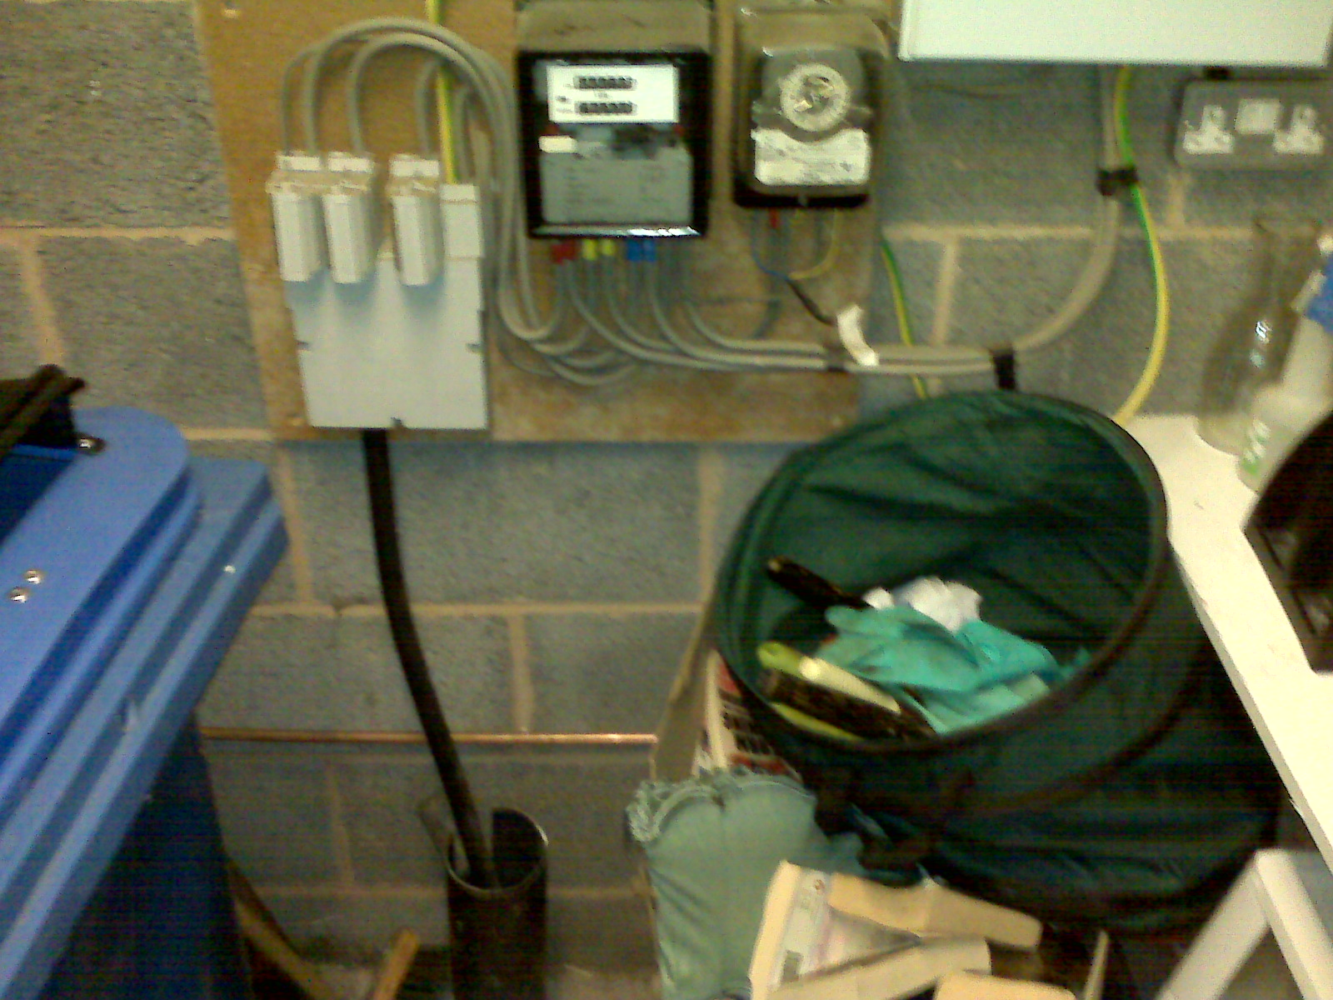
Clutter

