Slide 1
Promoting Health & Safety at Work
April 2017

Slide 2
Agenda
Sean Austin – a brief biography
World Class Manufacturing
Change Management
Paterson Arran at a glance
Safety Improvement @ Paterson Arran – a case study
Critical Success Factors & Common Mistakes – Dos & Don’ts
Questions

Slide 3
Sean Austin – a brief biography

Slide 4
Sean Austin – a brief biography
Experience:
Senior operations, supply chain, change management and program management roles in food, pharma and personal care in the UK, Mainland Europe and North America.
Education:
BSc (Chemistry with Management Science): Stirling
MBA: Loughborough
Career History:
Current:
Paterson Arran Ltd - Operations Director
Sean Austin Consulting – Manufacturing Consultancy
Queen Margaret University – Guest lecturer & MBA student mentor
Previous:
Kerry Ingredients – VP Operations (EMEA)
Budelpack International – Group Supply Chain & IT Director
Boots:
Manufacturing Supply Chain Director
Manufacturing Business Improvement Director
ERP Programme Director
Manufacturing Director (North America)

Slide 5
World Class Manufacturing

Slide 6
World Class Manufacturing

Slide 7
World Class Manufacturing
DELIVERABLES
Service
Quality
Cost
Working Capital

Slide 8
World Class Manufacturing
ENABLERS
Process Capability
Information Capability
People Capability
DELIVERABLES
Service
Quality
Cost
Working Capital

Slide 9
World Class Manufacturing
PREREQUISITES
Product Safety Excellence
Health & Safety Excellence
Environmental Excellence
HR Compliance
ENABLERS
Process Capability
Information Capability
People Capability
DELIVERABLES
Service
Quality
Cost
Working Capital

Slide 10
Change Management

Slide 11
Change Management

Slide 12
Change Management
Change Management is about delivering change!
Change is about PEOPLE!

Slide 13
Change Management
Change Management is about delivering change!
Want to
(Motivation)
Allowed to
(Empowerment)
Can do
(Capability)
Change Management is about PEOPLE!

Slide 14
Change Management
Change Management is about delivering change!
Want to
(Motivation)
Allowed to
(Empowerment)
Can do
(Capability)
ENGAGEMENT
Change Management is about PEOPLE!

Slide 15
Change Management
Change Management is about delivering change!
Want to
(Motivation)
Allowed to
(Empowerment)
Can do
(Capability)
ENGAGEMENT
TRAINING
Change Management is about PEOPLE!

Slide 16
Change Management
Change Management is about delivering change!
Want to
(Motivation)
Allowed to
(Empowerment)
Can do
(Capability)
ENGAGEMENT
TRAINING
PERMISSION
Change Management is about PEOPLE!

Slide 17
Change Management
Change Management is about delivering change!
Want to
(Motivation)
Allowed to
(Empowerment)
Can do
(Capability)
WILL DO
Change Management is about PEOPLE!

Slide 18
Change Management
Change Management is about delivering change!
Want to
(Motivation)
Allowed to
(Empowerment)
Can do
(Capability)
OWNERSHIP
WILL DO
Change Management is about PEOPLE!

Slide 19
Change Management
LEADERSHIP
Want to
(Motivation)
Allowed to
(Empowerment)
Can do
(Capability)
WILL DO

Slide 20
Paterson Arran at a glance

Slide 21
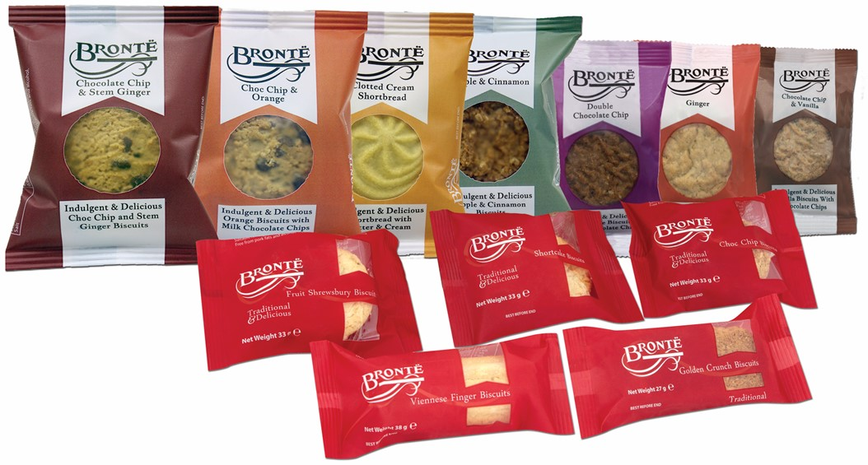
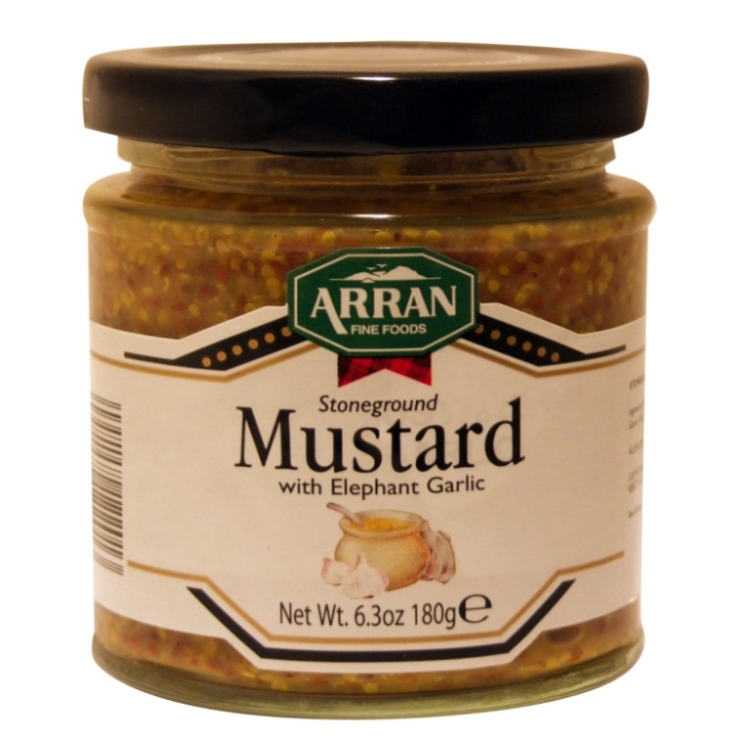
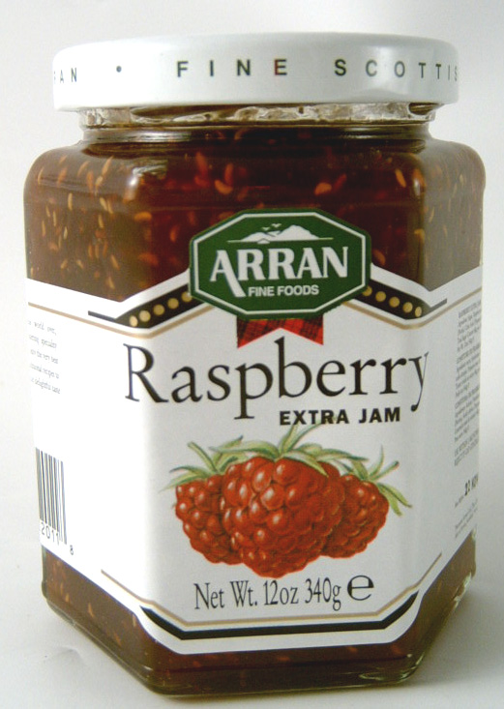
Paterson Arran At A Glance
Sales: £30M
Profit: £3M
Products:
Brands
Locations: Livingston & Isle of Arran
Employees: 250

Slide 22
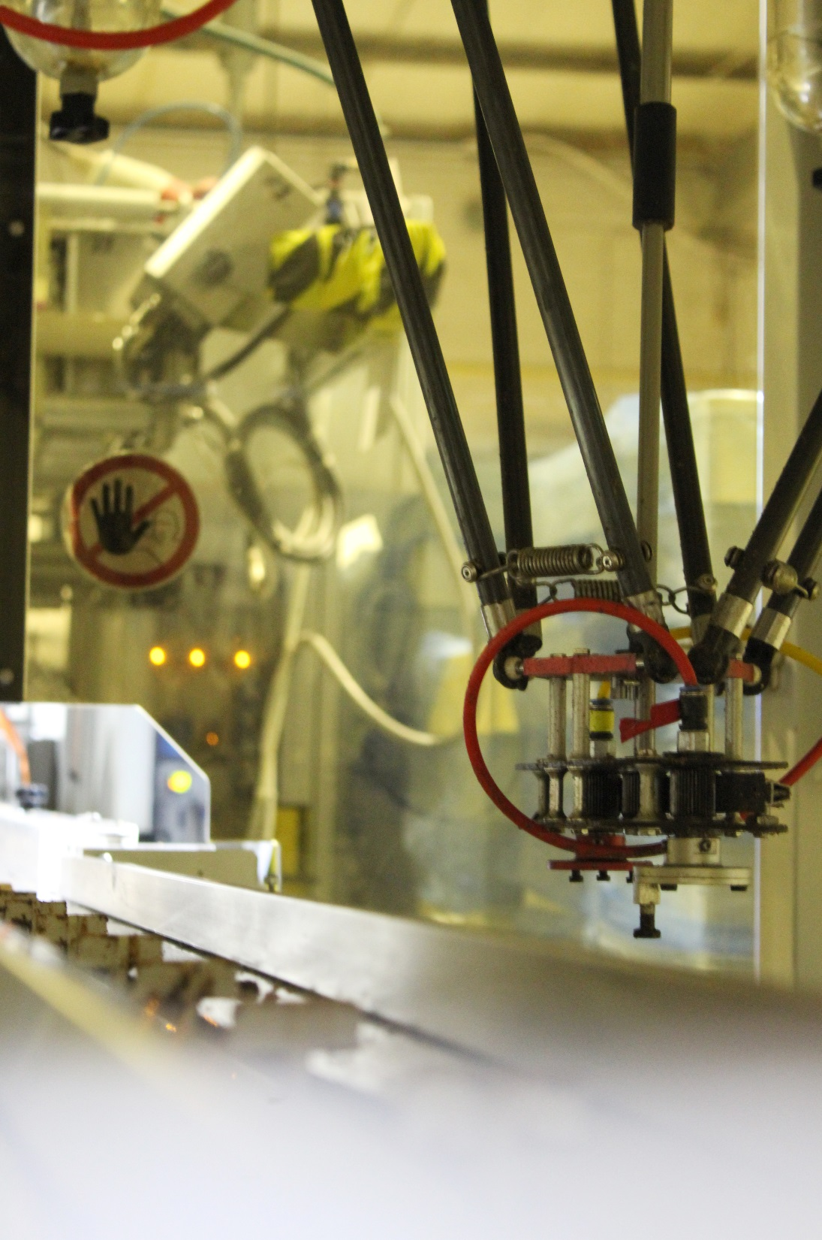
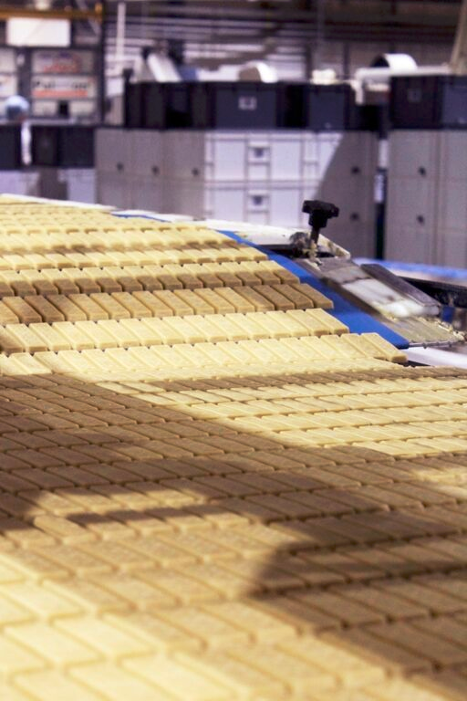
Livingston Bakery
Livingston Bakery
Factory footprint: 9,100m²
Site area: 32,000m²
Products:
Shortbread
Oatcakes
Biscuits
Cookies
Configured for flexible efficiency:
7 x dough mixers
4 x 50 – 80m travelling ovens
4 x pick & place multi-arm robots
Chocolate enrobing
Jam depositing
Flow wrapping & over-wrapping
Output: >8,000T
People: ca 220
Notes:
Accreditations
The Livingston bakery has held BRC highest level since the system was established, and currently holds BRC A on an unannounced basis.
The most recent audit dated 7 January 2016 resulted in an A+ audit grade.
The factory is also certified under ISO 14001 Environmental Standard, awarded since 2009.
Arran is also BRC grade A
Will be unannounced from 2017.
Also targeting ISO 14001 in 2017.

Slide 23
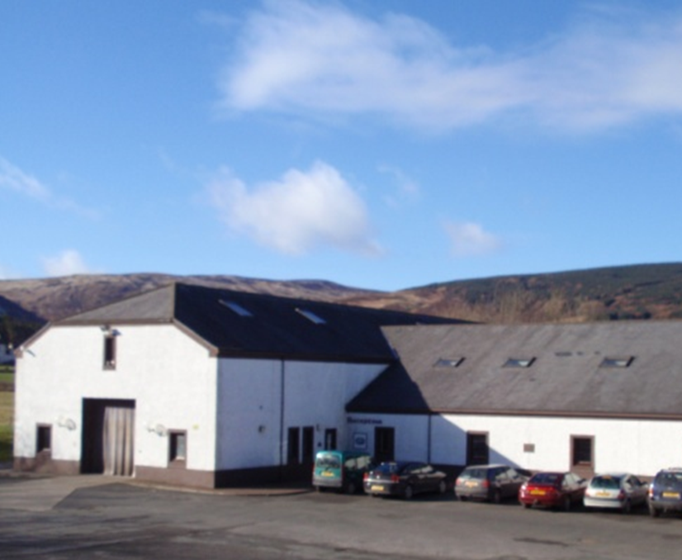
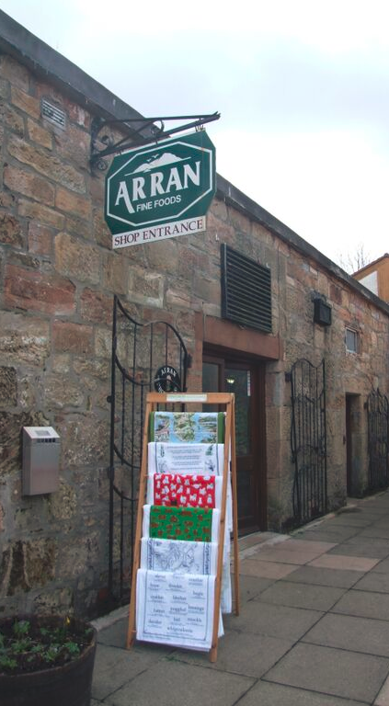
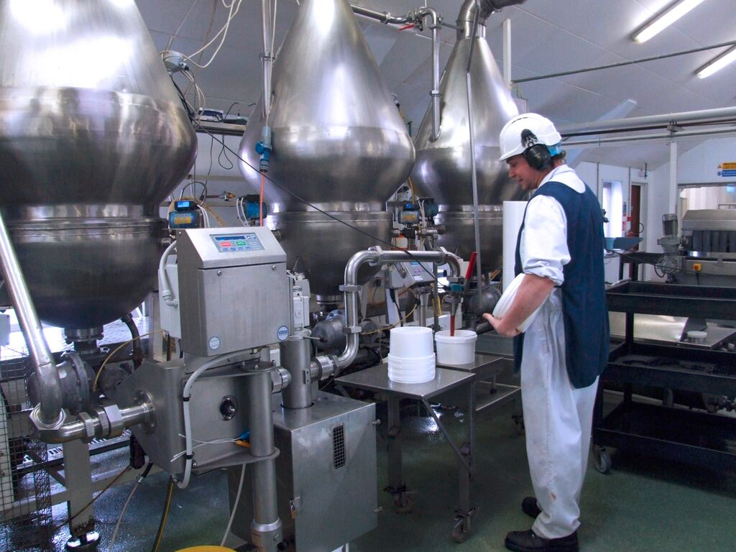
Arran Factory
Arran Factory
Factory footprint: 1,730m²
Site area: 12,000m²
Products:
Chutneys
Mustards
Preserves
Production Capability:
2 low tech, flexible filling lines
Retail jars
Tubs & sapphire jars
2 x 500L contra mixers
3 x jam boiling pans
[Portion pot line]
Output: ca 800T
Source: Management information

Slide 24
Strategic Framework
Goal
Maximise
Company Value
Objectives
Long term
income growth
Strong
balance sheet
Brands
growth
Own
manufacturing
Strategy
Diverse
customer base
Investment in organisational capability
Solutions for consumers’
& customers’ needs
Key business
partnerships
Flexible
efficiency
Tactics
Category innovation
Private label
Technical capability
Trial &
exploration
Speed to
market
Decision support
& IT capability
Process capability
Execution
Marketing plan
Trading plan
Financial
plan
Organisational Development
plan
QSHE
Improvement
plan
Regulatory
Compliance
plan
Operations
Improvement
plan
Values
Customer first
Strive for Excellence
Act with Integrity
Demonstrate ownership & teamwork
Respect for people
Health, Safety & Environment

Slide 25
Our Values
Customer First
We recognise that our customers have a choice and we work hard to win their confidence and trust.
We seek to fully understand our customers’ requirements and strive to exceed their expectations.
We ask for feedback on our performance and act on it.
Strive for Excellence
We strive for excellence in everything we do.
We constantly try to improve our products, our processes and our personal and collective performance.
Act with Integrity
We always do the right thing – even when it is difficult to do so.
We are honest, open and timely in our communications.
We comply with all relevant legislation.
Demonstrate Ownership and Teamwork
We are action and solution oriented and we take personal responsibility for our actions.
We encourage teamwork and aim to bring out the best in each individual.
We work together with our colleagues, customers and suppliers to exceed customers’ expectations.
Health, Safety and the Environment
We are committed to our responsibilities for the health, safety and well-being of our colleagues.
We are committed to minimising the impact of our business activities on the environment.
Respect for People
We recognise that everyone is an important individual.
We treat everyone with respect and value their contribution.
We support and enable our colleagues through coaching, guiding, training and constructive challenge.
We recognise and celebrate success.

Slide 26
Our Values
Customer First
We recognise that our customers have a choice and we work hard to win their confidence and trust.
We seek to fully understand our customers’ requirements and strive to exceed their expectations.
We ask for feedback on our performance and act on it.
Strive for Excellence
We strive for excellence in everything we do.
We constantly try to improve our products, our processes and our personal and collective performance.
Act with Integrity
We always do the right thing – even when it is difficult to do so.
We are honest, open and timely in our communications.
We comply with all relevant legislation.
Demonstrate Ownership and Teamwork
We are action and solution oriented and we take personal responsibility for our actions.
We encourage teamwork and aim to bring out the best in each individual.
We work together with our colleagues, customers and suppliers to exceed customers’ expectations.
Health, Safety and the Environment
We are committed to our responsibilities for the health, safety and well-being of our colleagues.
We are committed to minimising the impact of our business activities on the environment.
Respect for People
We recognise that everyone is an important individual.
We treat everyone with respect and value their contribution.
We support and enable our colleagues through coaching, guiding, training and constructive challenge.
We recognise and celebrate success.

Slide 27
Our Values
Customer First
We recognise that our customers have a choice and we work hard to win their confidence and trust.
We seek to fully understand our customers’ requirements and strive to exceed their expectations.
We ask for feedback on our performance and act on it.
Strive for Excellence
We strive for excellence in everything we do.
We constantly try to improve our products, our processes and our personal and collective performance.
Act with Integrity
We always do the right thing – even when it is difficult to do so.
We are honest, open and timely in our communications.
We comply with all relevant legislation.
Demonstrate Ownership and Teamwork
We are action and solution oriented and we take personal responsibility for our actions.
We encourage teamwork and aim to bring out the best in each individual.
We work together with our colleagues, customers and suppliers to exceed customers’ expectations.
Health, Safety and the Environment
We are committed to our responsibilities for the health, safety and well-being of our colleagues.
We are committed to minimising the impact of our business activities on the environment.
Respect for People
We recognise that everyone is an important individual.
We treat everyone with respect and value their contribution.
We support and enable our colleagues through coaching, guiding, training and constructive challenge.
We recognise and celebrate success.

Slide 28
Safety Improvement @ Paterson Arran: A Case Study

Slide 29
Safety @ Paterson Arran – August 2014
Very poor safety culture – production first
No real senior management commitment
Frequent accidents
Superficial accident investigation and no follow up
Minimal reporting of near misses and dangerous occurrences
Apparently comprehensive safety management system
Tick box approach
Lots of poor practices, behaviours and “duck tape engineering” etc
Poor/missing guarding
No maintenance manager (Technicians reported to production)
Serious accident August 2014 – amputation of tip of thumb

Slide 30
Safety Improvement – The start of the journey
Month | Action
August | Sean Austin appointed (mid-August)
September | All accidents in previous 3 years reviewed, root caused and preventive actions implemented
 | Health & Safety added to all regular management meetings inc: - Daily production meeting - Weekly operations meeting - Monthly Board meeting
October | Health & Safety Officer appointed
 | New H&S Committees established (chaired by Ops Director)
 | New H&S Steering Group established (Chaired by MD)
 | HSE unannounced visit - Notice of Contravention issued
November | External consultant (Adrian Gale) engaged
 | Comprehensive safety audit of both sites: Scores: Livingston = 63%; Arran = 71% (Good = 85%; World Class = 95%)
 | Results of audits fed back to all managers, the H&S Committee and all staff
December | Phase 1 plan agreed
 | Comprehensive Safety Management System designed

Slide 31
Safety Improvement – The journey continues
Year | Action
2015 | Comprehensive Safety Management System created from scratch: H&S Policy re-written and approved by MD & Board ?? Policies & procedures written and trained out 49 Safe Systems of Work developed and trained out Permit to work system implemented Working at Height, Confined Space, Lone Working controls etc implemented Control of Contractors system implemented – all contractors trained Home working and driving for work procedures implemented Guarding and interlock integrity check integrated into PM system New equipment H&S requirements integrated into capex process ATEX/DSEAR, Asbestos, LOLER & electrical safety management systems implemented Accident investigation process re-invigorated 98 tasks risk assessed Internal and external transport reviews conducted and recommendations implemented in full etc, etc etc.

Slide 32
Safety Improvement – The journey continues
Year | Action
2015 | Training & Engagement: NEBOSH General Certificate (H&S Officer) Line Managers’ safety responsibilities and behaviours [ALL line managers (inc MD)] IOSH Managing Safely (Site Production Managers, Project Engineer) COSHH Responsibilities (NPD Manager & H&S Officer) DSEAR Responsibilities (Arran Production Manager, Project Engineer & H&S Officer) FLT Refresher training (All FLT drivers) Permits to Work (All relevant personnel) Principles of Risk Assessment (Arran Production Manager, H&S Officer) Risk Assessments (Selected Operators) H&S Refresher (ALL employees) H&S information, stats and trends displayed on TVs & noticeboards Health surveillance – hearing, lung function & skin (Relevant staff) Monthly safety focus campaigns Monthly briefings ongoing etc, etc, etc

Slide 33
Safety Improvement – The journey continues
Year | Action
2016 | Safety Management System: All policies, procedures, SSOWs and controls reviewed and updated as required Machine guarding review repeated New emergency evacuation procedure implemented Comprehensive ATEX/DSEAR reassessment completed and action plan developed Manual handling & repetitive task risk assessments completed and actioned Noise & dust surveys completed - new equipment purchased and machinery modifications and recipe changes implemented etc, etc, etc

Slide 34
Safety Improvement – The journey continues
Year | Action
2016 | Training & Engagement: New QSHE DVD filmed on site (Shown to ALL staff) IOSH Managing Safely (Shift Managers) Legionella Responsible Person (Ops Director) Legionella Awareness (All relevant staff) Abrasive Wheel Safety (All Technicians) Electrical Safety (All Technicians)

Slide 35
Safety Improvement – The journey continues
Year | Action
2016 | Training & Engagement: New QSHE DVD filmed on site (Shown to ALL staff) IOSH Managing Safely (Shift Managers) Legionella Responsible Person (Ops Director) Legionella Awareness (All relevant staff) Abrasive Wheel Safety (All Technicians) Electrical Safety (All Technicians) Behavioural Safety Training (ALL staff) Ken Woodward (ALL staff) Behavioural Safety Observation Programme H&S Committee refreshed

Slide 36
Safety Improvement – The journey continues
Year | Action
2016 | Training & Engagement: New QSHE DVD filmed on site (Shown to ALL staff) IOSH Managing Safely (Shift Managers) Legionella Responsible Person (Ops Director) Legionella Awareness (All relevant staff) Abrasive Wheel Safety (All Technicians) Electrical Safety (All Technicians) Behavioural Safety Training (ALL staff) Ken Woodward (ALL staff) Behavioural Safety Observation Programme H&S Committee refreshed New strategic agenda process introduced PAL Values published etc, etc, etc

Slide 37
Safety Improvement – Put your money where your mouth is!
Year | Action
2015-2016 | Revenue Costs: Headcount - £40k p.a. Internal training - £10k p.a. External training - £20k p.a. Repairs & maintenance - £200k Capital Investment: Oven roof guard rails - £30k Roof safety system - £10k New equipment - £50k Transport risk reduction - £10k

Slide 38
Safety Improvement – The results so far
Site | Livingston |  |  |  | Arran
Year | 2013 | 2014 | 2015 | 2016 | 2013 | 2014 | 2015 | 2016
All Accidents (No.) | 35 | 39 | 41 | 35 | 14 | 11 | 23 | 15
LTAs (No.) | 3 | 8 | 5 | 0 | ? | ? | 3 | 2
RIDDORS (No.) | 3 | 4 | 2 | 0 | 1 | 0 | 0 | 1
Days Lost (Days) | 48 | 44 | 67 | 0 | ? | ? | 3 | 20
AIR | 1363 | 1895 | 970 | 0 | 3333 | 0 | 0 | 3333
Annual Audit Score (%) | N/A | 63 | 85 | 93 | N/A | 71 | 85 | 94
Note: Data prior to 2015 is not very robust and accidents were almost certainly under-reported.

Slide 39
Safety Improvement – The results so far
Site | Livingston |  |  |  | Arran
Year | 2013 | 2014 | 2015 | 2016 | 2013 | 2014 | 2015 | 2016
All Accidents (No.) | 35 | 39 | 41 | 35 | 14 | 11 | 23 | 15
LTAs (No.) | 3 | 8 | 5 | 0 | ? | ? | 3 | 2
RIDDORS (No.) | 3 | 4 | 2 | 0 | 1 | 0 | 0 | 1
Days Lost (Days) | 48 | 44 | 67 | 0 | ? | ? | 3 | 20
AIR | 1363 | 1895 | 970 | 0 | 3333 | 0 | 0 | 3333
Annual Audit Score (%) | N/A | 63 | 85 | 93 | N/A | 71 | 85 | 94
Note: Data prior to 2015 is not very robust and accidents were almost certainly under-reported.

Slide 40
DOs & DON’Ts

Slide 41
DOs & DON’Ts
DOs | DON’T's
Include Health & Safety in your core values | Waste time on the few people who won’t engage
Build Health & Safety into the strategic plan | Remove accountability from line managers
Fix the basics first | Forget the offices and office staff
Focus on the vital few initially | Forget the night shift or dedicated weekend shifts
Be consistent with your values - ALWAYS | Forget overtime shifts
Communicate, communicate, communicate | Forget contract cleaners etc
Get snr management commitment & involvement | Forget any stakeholders (RACI)
Manage by fact | Tell someone they are empowered (Until they “want to”, can do”, are “allowed to” - they are not empowered!)
Catch people doing something right
Top down and bottom up | Ignore non-compliance (especially by managers)
Set challenging goals and achievable milestones | Don’t confuse briefing with communication or communication with engagement
Articulate the vision
Listen, listen, listen (and then listen some more!) | Confuse project management with change management
Manage by walking about (MBWA)
Remember change is a doing word | STOP!
Include safety objectives in everyone’s targets
Publish the good, the bad & the ugly
Say thank you and celebrate success

Slide 42
Key Message
Safety improvement must be integrated into the organisation’s objectives and strategy.
(You must start with the top team!)
AND
Sustainable improvement is only achieved through effective change management and real employee engagement.
(You must involve everyone!)

Slide 43
Promoting Health & Safety at Work
April 2017

