Slide 1
Musculoskeletal Disorders
by
Jane Stevenson
Workplace Wellbeing

Slide 2
Occupational Health
A medical discipline that considers the impact of the work environment on an individuals health, and also the impact of the individuals health on the work environment

Slide 4
A Few Statistics…
2015-16
8.8 million working days lost to musculoskeletal disorders, equating to 34% of all working days lost due to work related ill health.
WRMSDs cases made up 41% of all work related illnesses, 539,000 out of a total of 1,311,000.
Notes:
A sensible employer will consider how to reduce WRMSD’s.

Slide 5
Work Related MusculoSkeletal Disorders
Musculoskeletal disorders (MSD) are injuries or disorders of the muscles, nerves, tendons, joints, cartilage, and spinal discs.
Work-related musculoskeletal disorders (WMSD) are conditions in which:
The work environment and performance of work contribute significantly to the condition; and/or
The condition is made worse or persists longer due to work conditions
Centers for Disease Control and Prevention’s (CDC)

Slide 6
Work Related MusculoSkeletal Disorders
WRMSDs are often associated with work patterns that include:
Fixed or constrained body positions
Continual repetition of movements
Force concentrated on small parts of the body, such as the hand or wrist
A pace of work that does not allow sufficient recovery between movements
Notes:
Musculoskeletal disorders can affect muscles, joints and tendons in all parts of the body
They can be episodic or chronic in duration

Slide 7
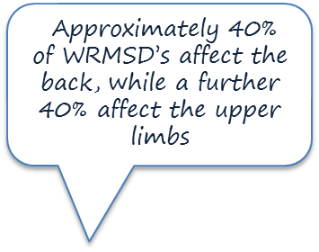
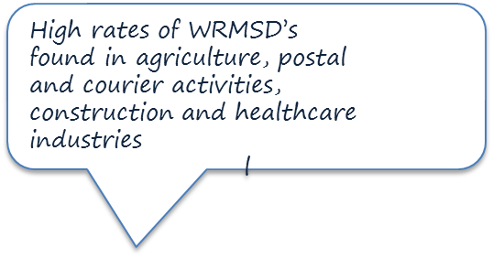
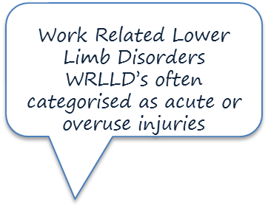
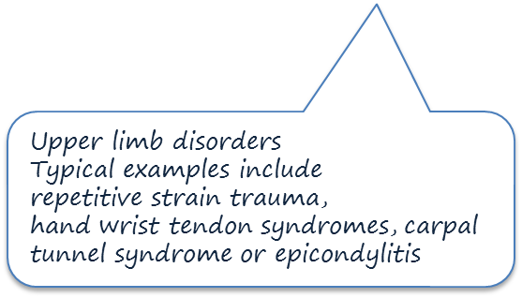
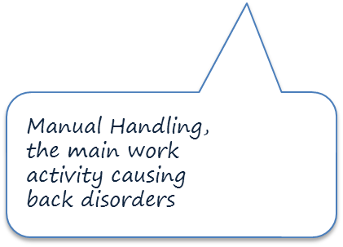
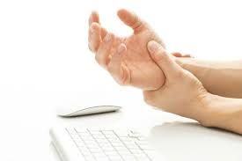
“Task and Movement” heavy lifting, and loading on the spine, main cause of back problems
Notes:
Not causing death but can have a severe impact on the individuals health ,wellbeing, and ability to work. Lateral epicondylitis, commonly known as tennis elbow, is a painful condition involving the tendons that attach to the bone on the outside (lateral) part of the elbow.

Slide 8
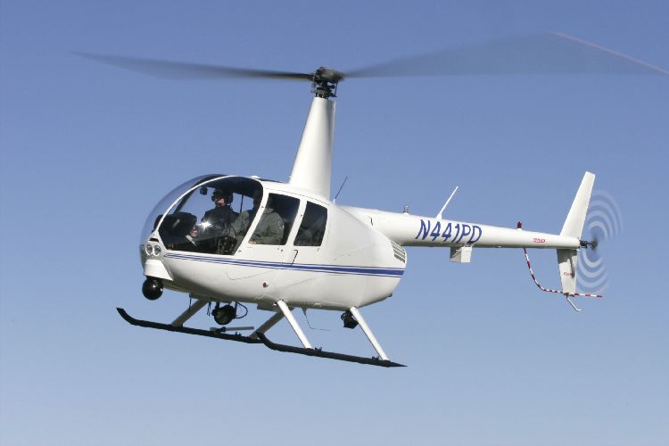
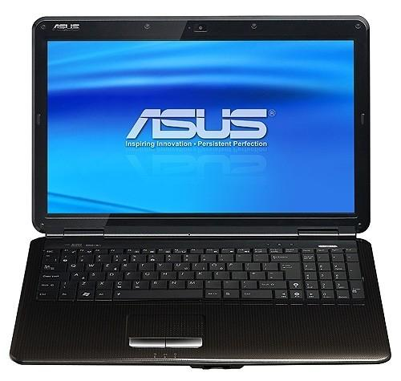
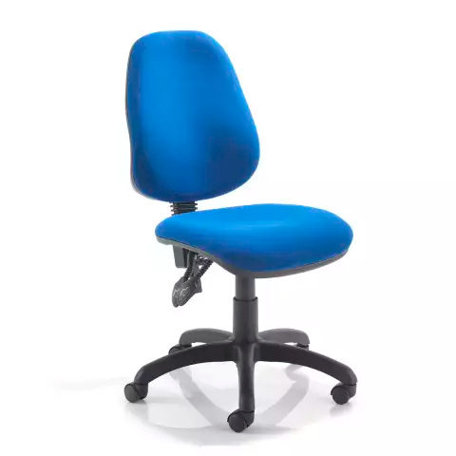
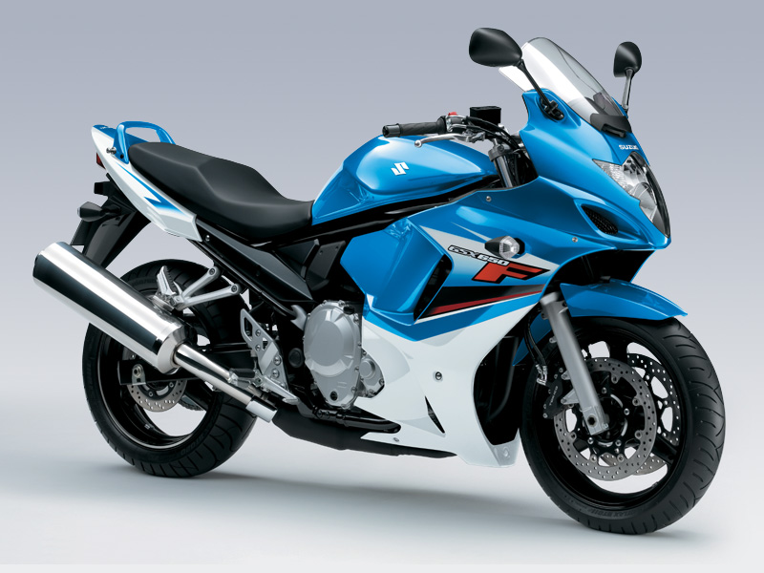
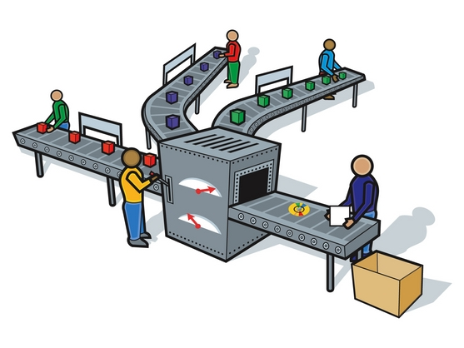
WRMSD for Workplace Wellbeing

Slide 9
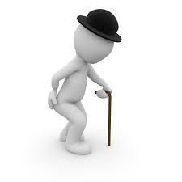
Additional Considerations
The Ageing Workforce
Age ranges 45-54 and 55+ have the highest rates of WRMSD for both genders.
By 2020 it is expected that one in three workers will be aged over 50

Slide 10
Recreational Activities
May include DIY, Gaming, Physical Sports, Hazardous Sports, Sofa Surfing
All/any of the above may impact on musculoskeletal wellbeing at work

Slide 11
Responding to WRMSD’s
Consider:
The Environment
The Role
The Equipment
….and discuss with the Individual
Notes:
GP
Physiotherapist
Manufacturer
The Individual

Slide 12
Help, Advice, Support.
GP
Ergonomist
Physiotherapist
Manufacturers/Designers
AbilityNet https://www.abilitynet.org.uk/
.…and discuss with the Individual

Slide 13
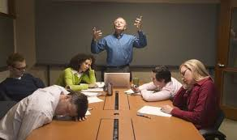
Training
Relevant
Informative
Interesting

Slide 14
Guidance for lifting and lowering
Notes:
Do not go to next slides until next module Controlling Risks: Discuss practical aspects of control: Task, Load etc Complete Exercise 2 then show Power Points 7, 8, 9, 10

Slide 15
Training

Slide 17
Thank you

