Slide 1
Herefordshire Health & Safety Group AGM
Wednesday 26th January 2022
Via
ZOOM at 10.00am

Slide 2
HHSG AGM
AGENDA
Welcome from the Chair
President’s Address
3. Treasurer’s Report
4. Election of Officers.
5. Election of Committee:
6. Any Other Business
7. Close of AGM (Chair)
8. OPEN FORUM
a) Seminar topics for 2022
b) Change of name to include Environment

Slide 3
HHSG AGM
Welcome from the Chair:
Phil Chandler

Slide 4
Intro & Impact of Covid 19
As we all know we are living through difficult times. The Covid - 19 pandemic has left no one untouched. The virus is not only claiming human lives, putting a strain on people’s health and wellbeing, but damaging the economy
Due to this we have decided to hold this meeting on line
A quote from Circero – “Any man can make mistakes, but only an idiot persists in his error.”
So unlike the present government, we are looking as to how we can reach more members and be more innovative. This is where you can help

Slide 5
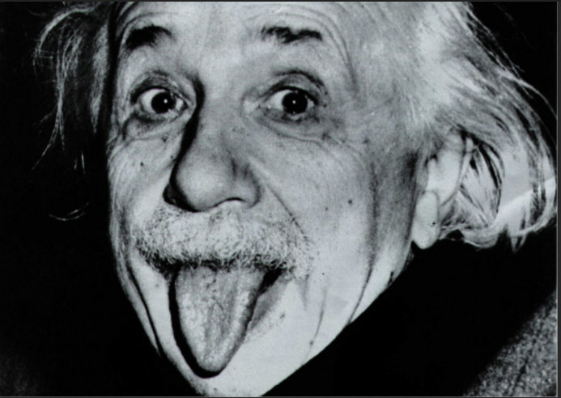
Before I introduce our president
One final quote from me, well Einstein actually
“Insanity is doing the same thing over and over again and expecting different results”.

Slide 6
HHSG AGM
Presidents Address:
Roger Bibbings MBE

Slide 7
President's address
After another year of living under COVID restrictions, the necessary constraints that have had to be imposed on business and on daily life are not just being accepted - and coped with fairly well (apart from in some parts of Whitehall!) - but they seem to have become the norm. 'Keep calm and carry on' really has been everyone's watchword. And in that context I want to say a big thank you to all members of the Group and to all Group Committee members for keeping the flag of health and safety flying. We have managed to maintain an interesting and informative seminar programme, facilitated mainly via Zoom, reminding everyone that while COVID never sleeps, neither do all the other hazards. Keeping everyone focused on accident and disease prevention has been as important as ever, and in some ways it might have been a wee bit easier because many of the basic ideas we have been drumming into everyone for the past five decades (this year marks the 50 anniversary of the Robens Report) have come in very handy when developing COVID secure working arrangements. Those companies who have got their heads around their hazards, around their risk assessments and have got robust safe working procedures in place have found it much easier to adapt to the COVID way of working life - compared say with those firms for whom health and safety wasn't really part of their business DNA. When the whole COVID experience is eventually reviewed (we're obviously going to be living with SARS COV 2 and/or its cousins for many years yet) health and safety - which many have accused of being a brake on business - will actually turn out to have been a great enabler.

Slide 8
This Group is your Group, a means to share knowledge and to help one another. Too many firms locally are still not taking part. Please try to recruit them if you can. Health and safety are things that require cooperation and sharing so it is vital that Group members tell the Committee about the topics that they'd like to see covered - and we may also need to find space in our meetings - and on Social Media too - to share problems as well as successes that members have had in tackling difficult health and safety issues.
One of the important features of Robens, from which the HSW Act sprang, was that it extended the scope of health safety law from factories, mines, quarries, docks and industrial settings to all workplaces, taking in whole new areas such as Local Government, the voluntary sector, the NHS and so on. And with that extension of scope came a consequential extension of scope of health and safety, moving on from things like machinery safety and so on to also cover health issues, including MSDs, stress, ergonomics generally - and even problems such as violence to staff - and latterly work related road safety. (More people are killed at work on the roads than in fixed workplaces.)

Slide 9
Many of the things called for in Robens never quite came to pass - or at least not in the way he and his Committee envisioned. But one thing is clear. The changes he set in motion changed the way we look at risk as a society (something, as I believe, that has helped massively with COVID). But risk literacy is still not universal and is still not understood sufficiently by those who do not want to use their judgment but insist on sticking to prescriptive rules, even when these are not appropriate or 'over-the-top'. This 'jobsworth's' approach to safety (or what is fashionably called 'safetyism') is not actually as prevalent as people might think but where it crops up it seems to help to fuel the silly stories about 'elf and safety gorn mad' - which sadly we continue to see from time to time in the popular Press.
There's no doubt that the HSW Act changed 'things safety', not just in Britain but across the World. (We actually exported a lot or our technical health and safety knowledge to developing economies and to the EU.) But what is not so well understood is the extent to which what people learn about health and safety at work, they then take away with them to help prevent safety failures cropping up at home or in their sporting and leisure pursuits. (The truly safety conscious firm needs to be mindful of the safety, health and welfare of its people 24/7.)

Slide 10
Now the agenda is going even wider. Health and safety folk have always had to be focused on tackling pollution - but now that with COP 26 the whole environmental agenda has expanded to encompass the much bigger idea of sustainability, there is a huge challenge here for us. Sustainability is not just about limiting emissions or managing wastes but focusing on energy use, sourcing, product life cycles, ethical issues even.
Do we in our Group need to reflect this by making our links to this agenda clearer? We have always had environmental topics in our programmes but should this angle now be reflected in our title too? Views please.
Just to close. I hope these thoughts are of value. Let us know how we can continue to improve. (We need to show this to go on winning in the SGUK Awards for Excellence, for example.) Do we need more member sharing sessions? More workplace visits? More project group perhaps? It's your Group. The Committee will endeavour to deliver what you say you need.

Slide 11
A big thank you again to everyone - and to the Committee especially. You might not want to become a Committee member but if you feel you could help, for example, with a one-off contribution, your arm will probably be taken off at the elbow!
Safety never stops. We all of us have to go on learning. And learning about safety and passing this knowledge on can and does save lives. Making sure the right preventive and protective measures are always in place and are working is not so glamorous maybe as pulling people out of burning buildings, but we know it works. Let's all commit to go on being lifesavers, falls fighters, health promoters, welfare warriors, Planet protectors.
Here's to keeping up the good work in 2022.
Best wishes,
Roger Bibbings MBE BA CFIOSH
President, Hereford Health and Safety Group
14th January 2022

Slide 12
HHSG AGM
Treasurers Report:
Adrian Gale

Slide 13
Financial Presentation
ACCOUNT SUMMARY FOR FINANCIAL YEAR 2021
 | Income |  |  |  | Expenditure
 | Opening Balances 01/01/2021 |  |  |  | Seminars | 698.96
 | Business a/c | 7906.57 |  |  | Post | 296.62
 | Current a/c | 3774.50 |  |  | Web Host | 184.99
 |  |  |  |  | AGM | 171.80
 |  |  |  |  | Face Masks | 458.00
 | 54 paying members for 2021 | 2160.00 |  |  | Social Evening | 229.20
 | 16 paying members for 2022 | 640.00 |  |  | Other | 87.38
 | Business a/c Interest | 0.80
 |  |  |  | 31/12/2021 | Current a/c Closing Balance | 4447.55
 |  |  |  |  | Business a/c Closing Balance | 7907.37
 |  | 14481.87 |  |  |  | 14481.87

Slide 14
Financial Presentation

Slide 15
Financial Presentation

Slide 16
HHSG AGM
Election of Officers
President – Roger Bibbings MBE
Chairman – Phil Chandler
Secretary – Peter Smith
Treasurer – Adrian Gale

Slide 17
HHSG AGM
5. Election of Committee
Ron Aston, Mike Burge, Les Coultas, Rebecca Lewis, Gavin Pettegrew, Simon Rosser, Jane Stevenson
Any other business
Close of AGM

Slide 18
HHSG AGM/ZOOM MEETING
Open forum
a) Seminar Topics
Possible topics for this year
Feb - Legal Update
March - Seasonal Safety (deep water, hot weather etc)
April – Personal Safety at Work
May – Site Visit
June – Social Evening
Sept – Behavioural Safety and Understanding
Oct – TBA
Nov – TBA

Slide 19
HHSG AGM/ZOOM MEETING
8. b)
Change of name to include ‘Environmental’

