Slide 1
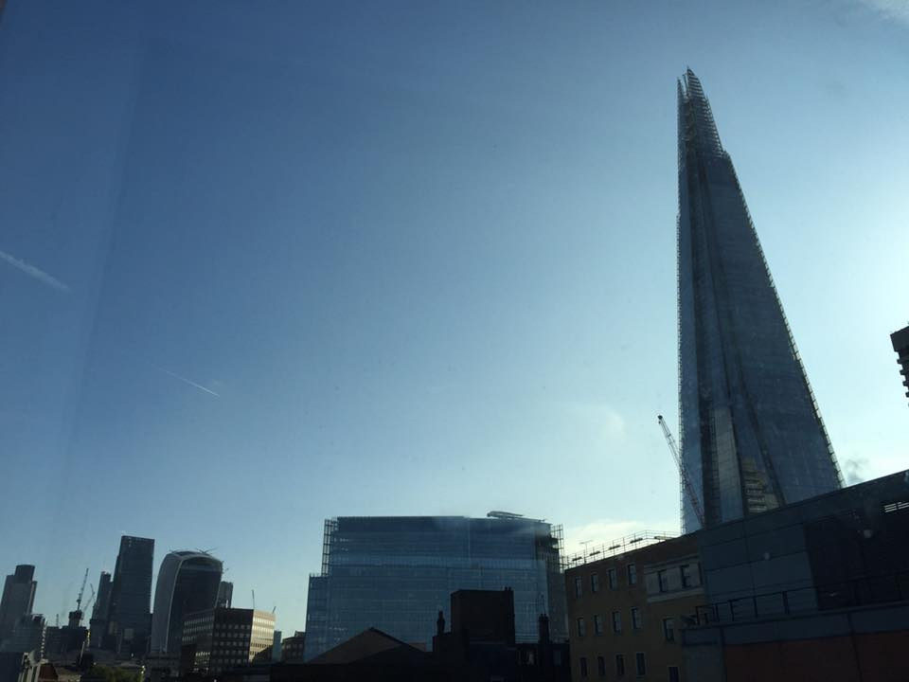
[Tall building] fire safety
Julia Cotton
Lead Safety Auditor
Imperial College London
Notes:
NAME –
I work for Imperial College London, and have worked for over 30 years advising UK universities on H&S in research and teaching, facilities management, and support services such as catering and residences.
Two weeks before Grenfell Tower, I attended a five day long, tall building-specific fire safety course, held at the Shard (95 storeys)
I’m not a fire safety expert, so what I want to share with you today, was all new to me –
However, it was also new to the other attendees, including the fire management teams from the Shard, Canary Wharf, and the London Fire Brigade!
But much of it is also relevant to ALL buildings regardless of their height.
Why did I attend the course?
My employer, Imperial College London, is one of the ten best universities in the world, and operates 24/7/365 – both are risk increasing factors to maintain that status, people take risks and work long hours, often in old buildings (1851 Great Exhibition)
It need to replace buildings and to expand, but in London, due to limited space, the only way to build is upwards.
It already has a 19 storey accommodation block and part use of a rented 16 storey block. Now building a 43 and planning a 34 storey accommodation block (A40).
However, recent audits of existing buildings showed a lack of understanding of fire safety management in tall buildings, so I was keen to attend this particular course, the only one of its kind.

Slide 2
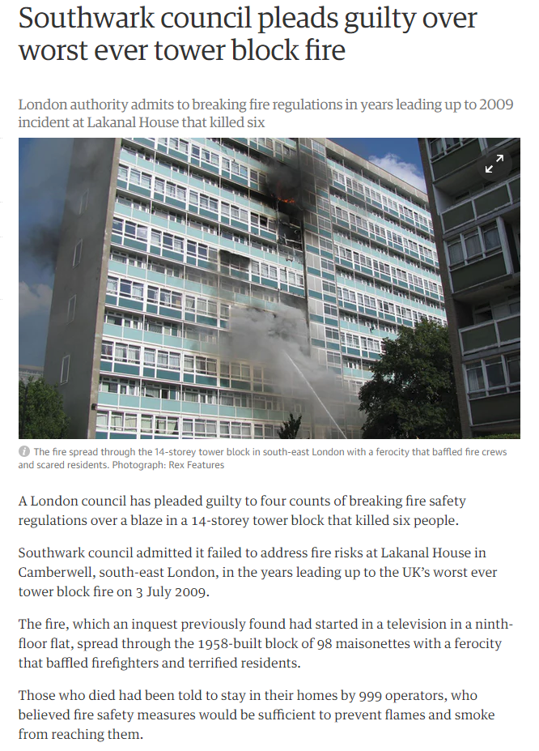
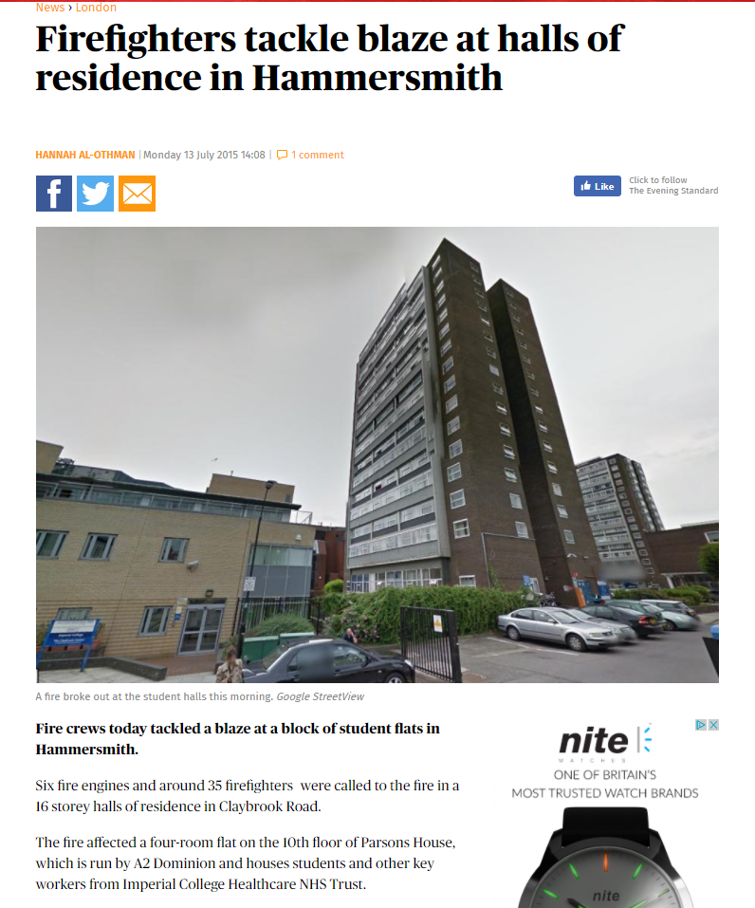
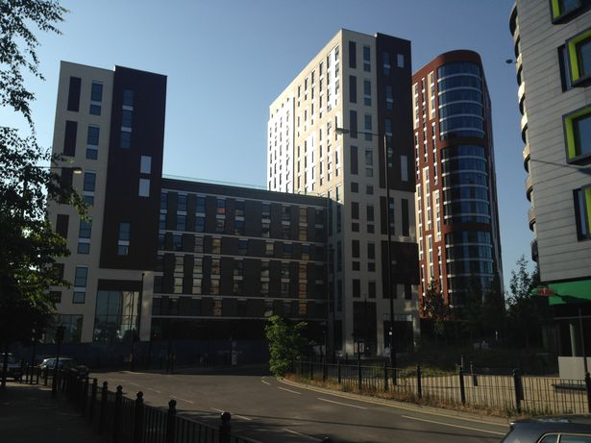
Notes:
Lakenal House (14 storeys), was the most infamous tower fire before Grenfell (24 storeys).
Nothing to do with the College, except that its a similar age to the 16 storey building on the right which the College rents from the NHS and where there was a fire on 11th floor two years ago, no casualties.
Not caused by our students who only occupy the first few floors, but credited to us so a reputational loss.
The central photos are both College buildings - a 43 storey block being built as we speak and an existing 19 storey accommodation block.

Slide 3
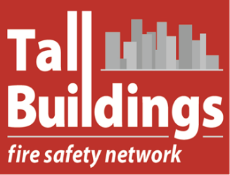
Tall buildings fire safety management course
Russ Timpson, Horizonscan
Held in Shard / Borough Market – 5 days
Attended – Shard Fire Safety Team, Canary Wharf 1, LFB, Dubai FB
My training already put to good use . . .
Follow-up audits of College accommodation and other buildings found a number of concerns all now being addressed
Notes:
Russ Timpson from Horizonscan
Russ is the leading tall building fire safety expert in the world, and a fireman with over thirty years’ service. He was involved in the investigations for the various Dubai fires for example, Munich Airport fire, etc. Risk management specialist.
Other attendees: Shard fire safety team, No1 Canary Wharf, LFB and a fire safety expert from Dubai. We got to go to the very top of the shard, about twenty floors above the public viewing floor
The two weeks after the course finished, when I was writing my exam essays, Grenfell Tower, Borough Market where I lived for 5 days while doing the course, Putney Bridge, Exhibition Road
My training has already been put to good use – see some of the images later.
Tall buildings present specific and different challenges to ordinary building fire safety management, but it’s the common concerns that I want to share.

Slide 4
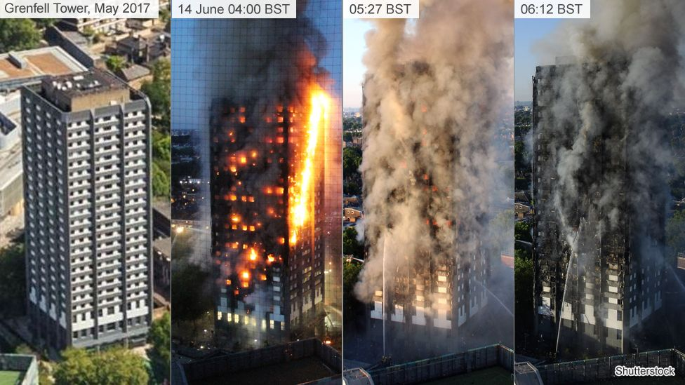
What did the course teach?
Relevant to all premises regardless of height . . . .
Definition of tall building
Prevention and planning
Detection and alarm
Means of Escape
Containment
Fire fighting
Aftermath
Business continuity
Everything we learnt on that course came horribly true two weeks later
Notes:
High-rise building – defined as
The number of storeys means occupants need to use a lift to reach their destination,
The height is beyond the reach of available fire-fighting equipment.
The height can have a serious impact on evacuation.
Typically this is considered to include buildings of more than 7 to 10 storeys or 23m to 30m, but also mid-rise buildings of five to ten storeys, equipped with lifts.
I was asked to give a talk on fire prevention, but am also happy to talk about Grenfell . .. Everything we learned came true that night.
24 storey building – built in 1974, stay put policy, no sprinklers. Supporting beams not fire-strengthened as for modern buildings.
Recently refurbished with cladding (but only of standard suitable for 3-storey high buildings).
Hot night so everybody’s windows were open.
Fire started in a fridge on the 4th floor. There are no PAT tests on person items in private housing.
People not trained to act or on implications of fire – many could not even speak English and were asylum seekers, so newly arrived.
Human behaviour – people will go to extraordinary lengths to save their children, pets, possessions.
Occupant reported as having packed suitcases before exiting flat and knocking on other residents’ doors.
A smouldering fire – once the flat door was opened, the fire almost certainly went out of control at that point.
“Alarms did not go off” – implications for those who hire incompetent contractors – “Lakehouse” and “Polytek” the alarm maintenance and testing company – arrested and now being investigated for fraud – installations in hundreds of properties.
No forced extraction at top of stairwell. So hot smoke rose up the single stair well, but not far as it was a hot night – it met hot air at the top of the stairwell causing a “reverse stack effect” where hot smoke falls instead of rising, straight back down into the stairwell, and onto the evacuating occupants.
Wind speeds in tall buildings are much greater than on the ground and in any case fire creates its own wind as it seeks oxygen. Phenomena of tall buildings – Wind-driven fires, either into the building and out of the flat door, or out of the building.
The fire was blown or sucked out of the kitchen window. Fire loves vertical surfaces, and it immediately started to spread up the cladding, and was then sucked into the open windows of other flats.
Could even cladding of the correct specification have withstood these flame-thrower effect of high wind speed and temperatures of possibly over 2000 degrees? Note that fake cladding has been found in the UK. Even laminated windows can delaminated at these temperatures and fall from buildings.
The housing association had made repeated complaints about lack of access to the building in the event of a fire.
The fire brigade did not have or did not send their tallest ladders for 30 minutes; but in any case they only reached to the 10th floor.
Could this happen again?

Slide 5
1 Prevention and planning
Building Regs: not retrospective, legacy of unknown risks
Fire Risk Assessments: look only at visible, superficial
Causes of fire: electrical, catering, arson, hot works
Taller buildings: wind-driven fires, reverse stack effects
Compartments – maintaining /checking part of works contract/process?
Compartments - only as good as a shut window, the sealant installer and your checks
PU foam – certificated installer and product (e.g. Hilte)
Vertical penetrations - intumescent collars fixed to slabs; crush collars for pipes
Notes:
Building Regs not retrospective – a 1960’s building can be like a fire safety museum. Significant changes may not have been recorded anywhere. Building may have been to a low or illegal standard. You may have a legacy of unknown risks.
The influence of the activities on the outcome of the FRA can be underestimated by the risk assessor, who in most cases will only look at what is clearly visible - and who may not be competent to assess the particular building type or building occupants or different fire safety management systems.
The main causes of fires –
electrical fires, who brings items in? Gang sockets and extension cables, cables running across floors/under carpets; turning off after use/out of hours; vending machines, water coolers, portable AC, cable management under desks, heating/cooling common cause of fire;
Catering – over-used oils have a lower ignition point; deep fat fires, ducts filled with fat (250um wet film test) – check along length via the access panels; cooker circuits may be overloaded or faulty; leaving cooking or toasters unattended; switching off hot plates and appliances so don’t come back on automatically;
arson, securing LPG in locked cages, bins, skips close to building groups of 12-14 years olds hanging round; is illicit smoking arson? YES, arson can be deliberate or reckless, corporate manslaughter if cigarette stub bins not emptied and fire results; investigate doors wedged open (50% caused by disgruntled ex-employees, often Security Guards “hero fixation”), key audits for sacked employees piles of combustibles, signs of forced entry, several seats of fire; empty buildings or floors – mothball them, secure them and monitor them.
hot works how well are they controlled? RAMS and Permits, Fire watcher with two extinguishers? 10 M clearance for combustibles; conduction risks on metal beams or electrical cables (cutting through concrete slabs heating up cable caused the Munich Airport fire). Only isolating local detectors – number them before issuing them to contractors – count them in and out, check work at end of day. Inspect together at end of job (before they disappear off site). Thermal imaging camera. FLIR1 for iPhone or Android (£219).
Less common causes of fires include candles, Christmas trees lights, cars . . including basement garages – current building regs are based on old data for cars with much smaller petrol tanks, so current loading does not reflect current petrol tank sizes. There are no checks to see what condition cars are in when they enter basement carparks. Fires in confined spaces are extremely serious – car will give a 16MegaWatt fire (4 MW if sprinklered). Use Jet fans to remove smoke in basements otherwise almost impossible to see. HOARDING – particularly where there are mental health issues.
Tall buildings have specific unusual effects caused by their height – wind-driven fires stack effect, smoke rising up a stair well if door left open; even if vented at top, on a hot night, a reverse stack effect arises in stair well, where cold smoke rises initially but then sinks back into the stair well, rather than rising; wind-driven fires; balconies with peoples possessions. AHUs, AC generally designed to turn off when an alarm is activated; but what happens to any forced ventilation in the stairwell? They all need to be commissioned “in use” to check for unintended consequences and interface failures.
More about compartments on next slide.

Slide 6
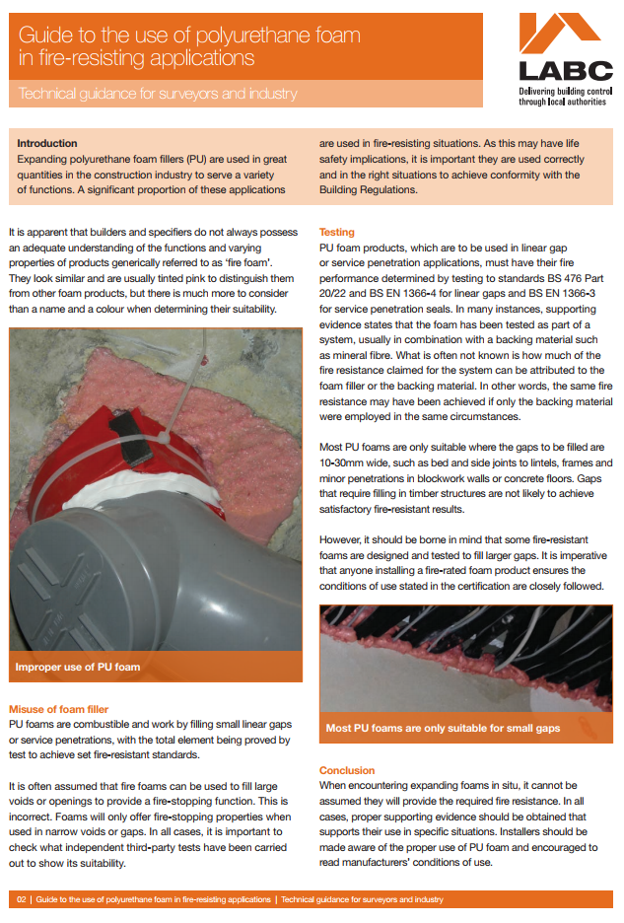
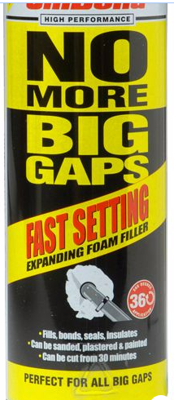
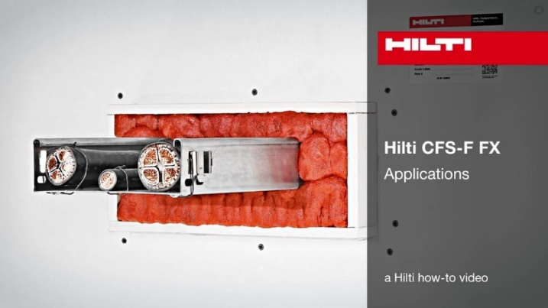
Fire retardant stopping – how good is yours?
https://www.allerdale.gov.uk/downloads/labcpd0715_techg_firefoam_0.pdf
Notes:
Self-explanatory – cheap PU foam may be sufficient for some but not all applications; it’s a complex set of requirements, and a certificated expert will be able to advise, use the correct foam for the correct application.
Does your fire risk assessment include checks of fire compartments? Are your compartments numbered so you can locate and check integrity after contractors have finished?
Compartments are only as good as the glass in the window or door, or the fire-retardant foam. If the foam has been put to the wrong use, or is not of correct specification, or has not been used at all, or the glass breaks or the intumescent seals are missing damaged or the fire door is of poor quality . . window integrity fails at high temperatures. Fire can flash out or be sucked into buildings. WINDOWS are left open when its hot weather . . .
PU Foam – 4 hours on EN1366 but not if a thin coating; only designed for long, deep, narrow gaps. Anyone who is installing a fire stopping must be certificated and use a certificated product. “Fire Stop Selector” Third party inspections. Contractor liability – include in contract. HILTE product selector, app, recording system, document management. Building Regs Part B: products must be tested and fit for purpose – tested for the particular use of the product.
Where there are vertical penetrations, are intumescent collars fixed to the ceiling slab? Plastic pipes melt creating a huge compartment breach – require fire proof cement and crush collars.
Excellent LABC guide to the use of PU foam (link at end)

Slide 7
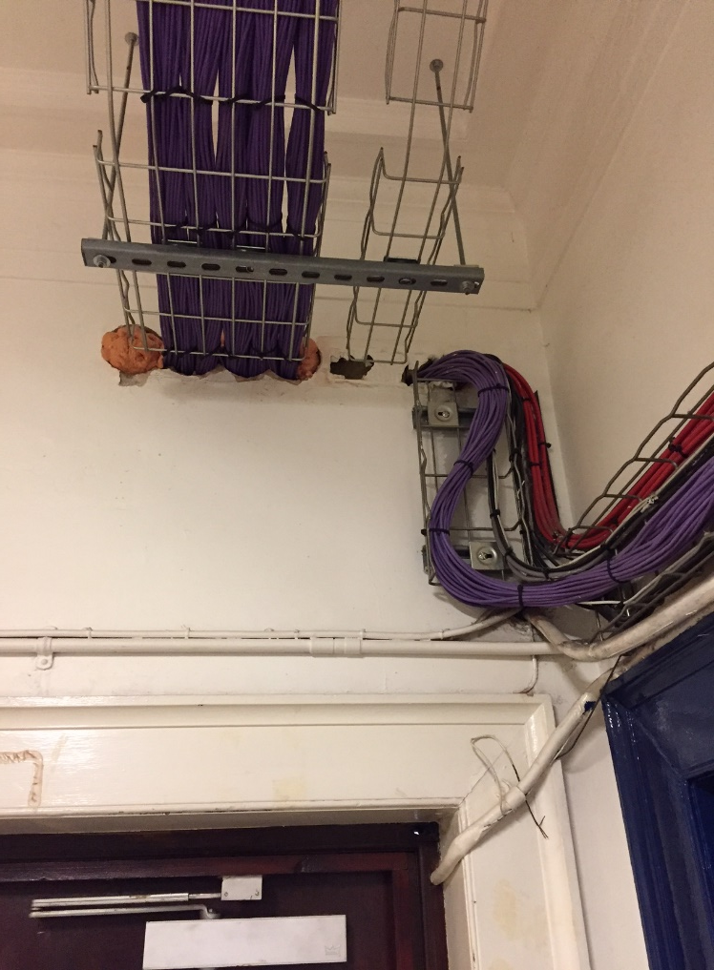
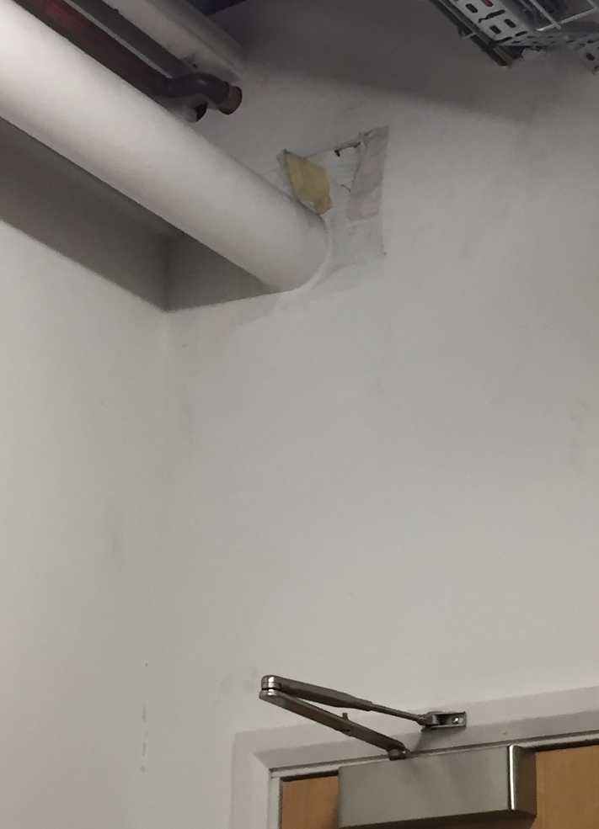
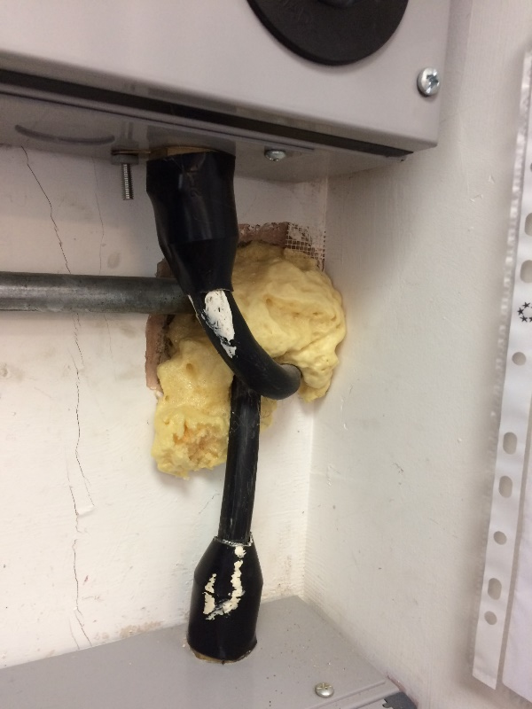
Compartments and PU foam
Notes:
Improper use of PU foam – a large hole penetrated by a high voltage supply for a lift.
Good that a cable tray has been used, but the cables are held on with plastic cable ties which will quickly melt in a fire.
Only part of it has been fire-stopped with foam – there are still large holes (some of it around the newly installed fire-alarm system cabling as well as the data cables)

Slide 8
2 Detection and alarm
Fire panel goes down – inform insurer immediately
Detectors in ceiling voids - not tested if unseen
Only one detector in room – is it a false alarm?
First responders trained what to do – and not to do?
All your staff trained to sound the alarm?
Personal Announcement Voice Activated systems (PAVA) – complex buildings
Degraded systems matrix – what if part of system fails?
Notes:
If your addressable panel goes down, it’s a major business risk – tell your insurer immediately.
Detectors in ceiling voids may not get tested as difficult for contractors to access.
Is it really a false alarm (one detector sounds in a room where there is only one detector)?
What should and shouldn’t alarm responders do? – must not go to the fire floor by lift – but two floors below and walk up; train responders to listen and smell and look for smoke and blackening, and to test doors and handles for heat, before opening them. Flashovers must be avoided at all costs.
Are all your staff trained to sound the alarm? Royal Jomtien Fire, Thailand – gas cylinder opened in error in ground floor coffee shop, but staff did not sound alarm as untrained. 100 died in the fire; fire exits were locked. Sprinklers were turned off. The Automatic alarm was in fault. Nobody called the fire brigade. Ladders were too short when they did arrive.
Personal Announcement Voice activated (PAVA) alarms - give clear instructions reduce reaction time very effectively – complex buildings.
Establish a degraded systems matrix – what to do if fire alarm panel fails – check with insurer what their requirement are; it might be to evacuate building, or stop all hot work; or if specific parts of your fire management system fail – eg emergency lights not working, only allow occupation during daylight hours.

Slide 9
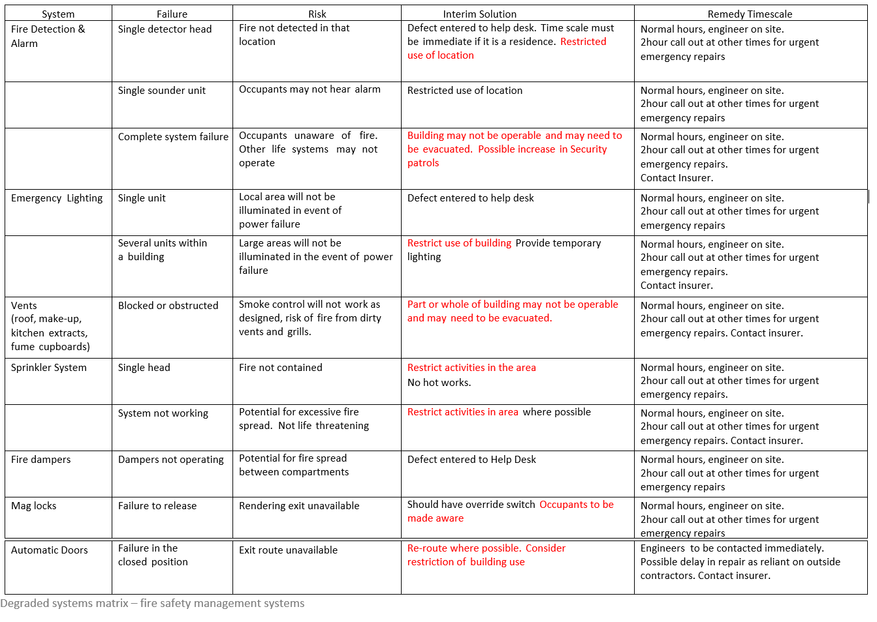

Slide 10
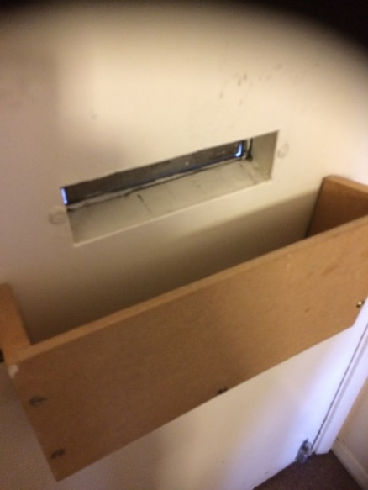
3 Means of Escape – false assurance?
Is it really a fire door?
Refurbishment to lower standard, suspended ceiling . . .
Where is your smoke really going to go? Hot smoke testing will tell you
Cladding, composite insulated panels – hidden legacy risk?
Are your fire wardens trained to manage evacuation?
Who/how are you going to evacuate disabled persons?
Human behaviour – ignore fire, habituated, re-entry
Evacuation policy may fail – stay put, simultaneous or phased – social media . . . .
Does your assembly point compromise Brigade access or is it too close (1.5x building height – not always possible in built up area)
Dispersal policy more appropriate?
Notes:
Are your Means of Escape properly constructed? Is it really a fire door? Has there been a refurbishment to a lower standard? Is the ceiling fire resisting? If there is a suspended ceiling, what’s going on above? What’s hidden is not inspected.
Where is your smoke really going to go? Hot smoke test of your premises before occupation?
Composite panels – legacy risk as may be hidden – good thermal insulation but full of styrene, may be in floors, walls or ceilings; rapid growth of fire, fumes, flashover, and floating burning styrene starts fresh fires. Facades: How are thermal floor panels fixed to façade? If the gap between the slab and façade is not properly filled with rockwool, fire will spread up the inside and outside of the façade. (Burj Khalifer, Dubai, 141 storeys).
Ensure your fire wardens are trained to manage evacuations - .
Disabled egress – obvious temporary or permanent disability, hidden disabilities – heart, asthma, hearing, poor sight. PEEPs; your responsibility to get people out, not the Brigade. What plans and training do you have in place?
Misconceptions about human behaviour in fires – habituated exit choice behaviour; main routes congested, hampering fire brigade, reaction time to alarm if source of alarm cannot be seen- pre-movement period filled with other activities such as: seeking the cause, warning others, collecting pets and belongs, re-entering buildings to collect possessions/children. People don’t always see the fire evacuation signs; illuminated ones are best in a smoky atmosphere or if the lights have failed.
Different types of evacuation policy but your evacuation policy is always likely to fail whether simultaneous, stay put (if designed with compartments for this purpose as in sleeping accommodation), or phased – a combination (preferred for multi-occupancy types with business and accommodation to reduce business down time).
Is a stay put evacuation policy appropriate for tall buildings if the fire compartment is breached or is breached because windows are open? Or if the building is covered in cladding. Or fake cladding; or the wrong specification cladding for the height of the building. In any case, people will IGNORE stay put policies – either because they don’t know about them or don’t trust them.
Where is your fire assembly point? Guidance is assembly point must be 1.5x height of building away, not always achievable in cityscape.
Will assembled people hinder the Brigade’s access? Is dispersal a better policy?
Tall buildings should ideally have more than one staircase and/or horizontal compartments (skylobbies) to allow for phased evacuation. But business pressure – the need to rent out or use every square inch often precludes this.

Slide 11
4 Containment
Fire loves vertical surfaces and corners – inside / out regardless of height
Rolling black smoke – high energy, full of carbon, flash over
Ceiling vents let smoke out – help prevent flash over
Sprinklers damp fires down –domestic or commercial
Retrofit portable mist sprinklers for £2K (kitchens)*
Sprinklers - good idea in ceiling voids
Sprinklers - not too high or water evaporates
Review sprinkler strategy if hazards or layout changes
If sprinkler system fails, inform insurer immediately
Only one sprinkler activates, not all
http://www.mistek.co.uk/?gclid=EAIaIQobChMIo56fwsX11gIVxZ3tCh10zQB1EAAYAiAAEgKIZvD_BwE *
Notes:
Fire likes vertical surfaces and loves corners, inside or outside of a building regardless of height.
Rolling smoke = high energy and full of carbon particles (fuel); a little more oxygen = flashover.
Ceiling vents let out heat, helping to prevent flashover.
Sprinklers are brilliant at keeping fires damped down – only one goes off not all; individual, portable sprinklers can be retro-fitted into domestic or commercial properties.
Mist sprinklers use less water and cause less water damage. If too high will evaporate before cooling. Do you have them in ceiling voids? Over deep fat fryers? Can they be isolated locally rather than taking out entire system? Hydraulic calculations must be reviewed if refurbishment undertaken. Discuss with your insurer premiums versus cost of installation. Low pressure systems can be refilled by the fire brigade.
If you have a sprinkler system and it goes down, tell your insurer immediately.

Slide 12
5 Fire fighting
Annual wet riser test for flow [not pressure]
Way-finding signage for fire fighters - level indicator/plan per floor
Staff trained to use extinguishers
Know where your isolations are
Clear access for the Fire Brigade vehicles
Daily checks on accessibility of fire hydrants
Familiarisation visit from Brigade – up to date floor plans
Competent person to meet Brigade if called out
Stairwell lobbies big enough for Brigade to establish bridgehead in tall buildings
Electrical cables held in trays with metal cable ties
Notes:
Wet riser testing annually for flow rather than pressure (flow rate more important).
Are your way findings signs for your occupants or for the Fire Brigade as well? Put a floor indicator and floor plan map on every stairwell.
Are your staff trained to use extinguishers? Legal requirement to provide extinguishers. 7/10 fires are extinguished in this way. For higher risk areas, COBRA water pressure gun, back-pack foam fire extinguisher P50.
Do you know where your isolations are – gas, electricity, water.
Can the Fire Brigade access your building – to park outside, so if the area is filled with skips or other peoples cars. . . do you know where the hydrants are and are they accessible, and checked daily?
Have you requested a familiarisation visits from the Brigade – Do you have a grab-pack of up-to-date floor plans, and information on any known hazards in the building that may affect the brigade Is there a competent person who fully understands the building layout and isolations to meet the brigade if a fire occurs?
There is less and less common space for people to escape while the Brigade are accessing buildings, trying to establish a bridgehead and somewhere to dump BA and change and rest (a tiny lobby is all they get in most building stairwells).
Electrical cables that are not properly suspended in cable trays can kill firemen when they melt and fall across corridors.

Slide 13
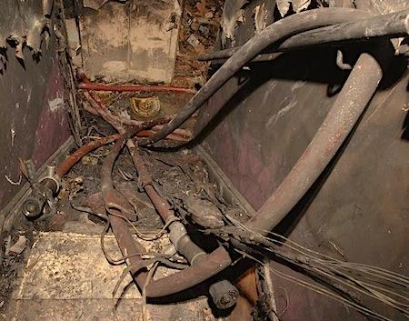
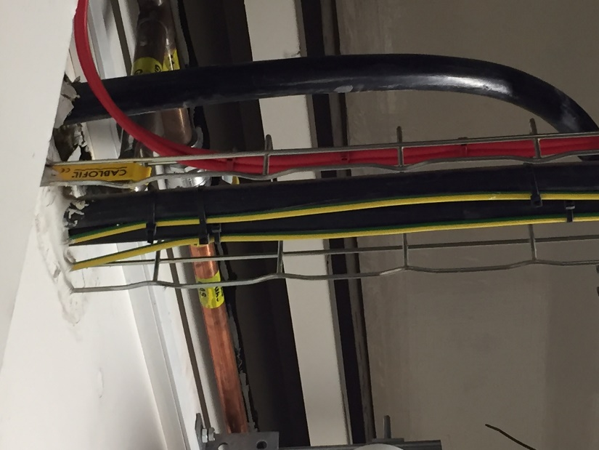
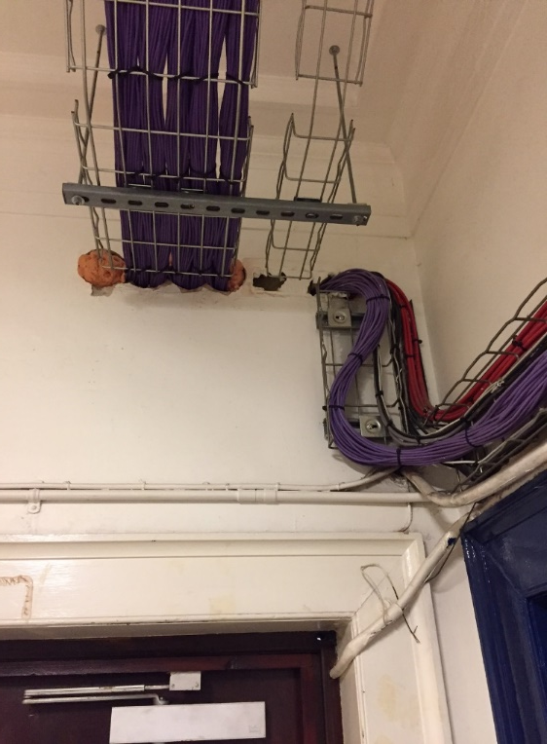
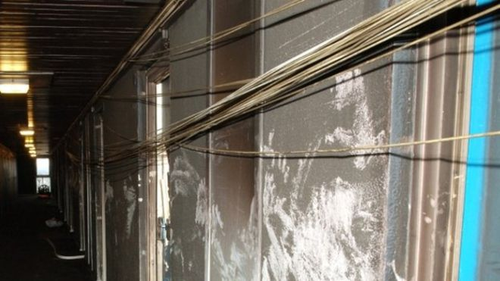
Unsecured cables melt and trap firemen
Shirley Towers fire 2010 – changed BS 7671
Notes:
Shirley Towers -firemen died when got entangled in melted fallen cables. BS 7671 was amended as a result to require cabling trays, but their installation not always checked, so plastic cable ties get used, and even worse, the cable trays are sometimes installed upside down.

Slide 14
6 Aftermath
The aftermath of a fire is a crime scene and you must preserve evidence.
If there is a resulting pollution incident – you may be fined by EA.

Slide 15
7 Business continuity
Do you have business continuity and disaster recovery plans?
How are you going to get your staff home if they can’t re-enter the building?
https://www.sungardas.com/en-GB/resources/articles/disruption-planning-business-continuity-disaster-recovery/

Slide 16
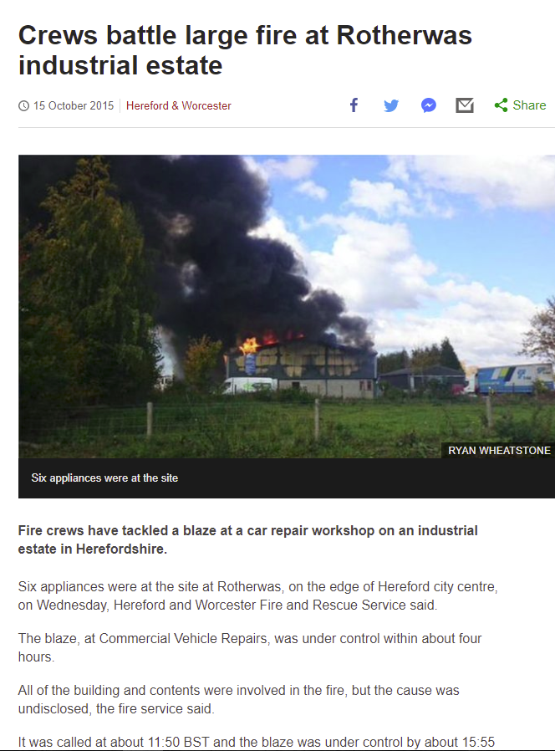
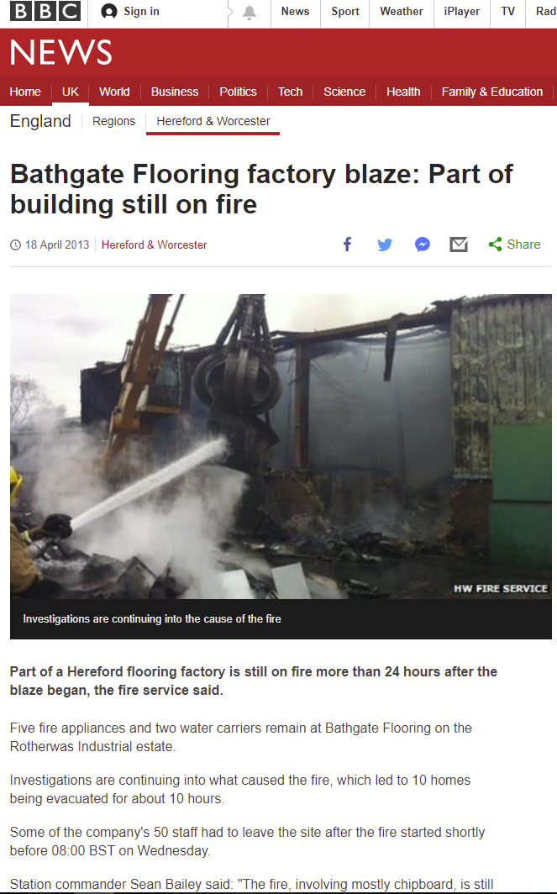
Could this apply to you?
Notes:
SUMMARY:
We may think that controls are in place and are effective, but in reality, they may have been compromised over time or by human behaviour, with compartments damaged, or windows left open on a hot day.
It’s a lot of work to make all of these checks, but in the long run its better to challenge controls, and have known risks.
Then you can decide on whether or not to accept or do something about them – risk management

Slide 17
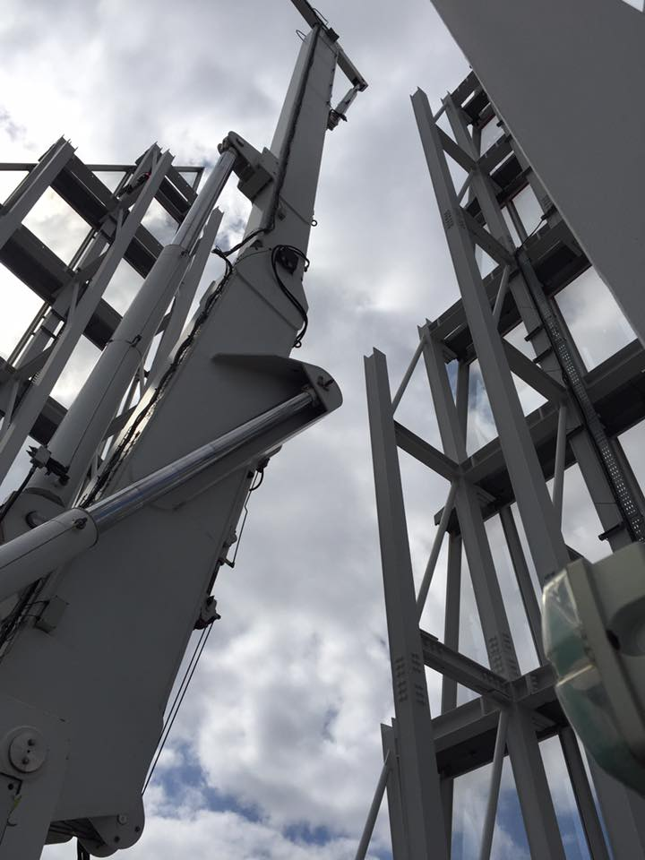
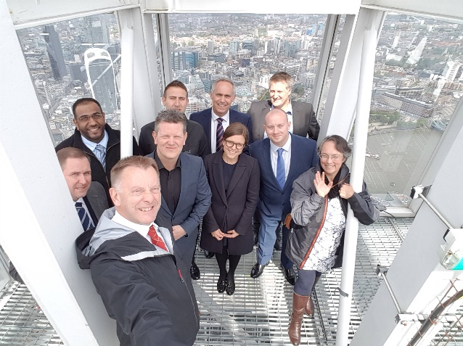
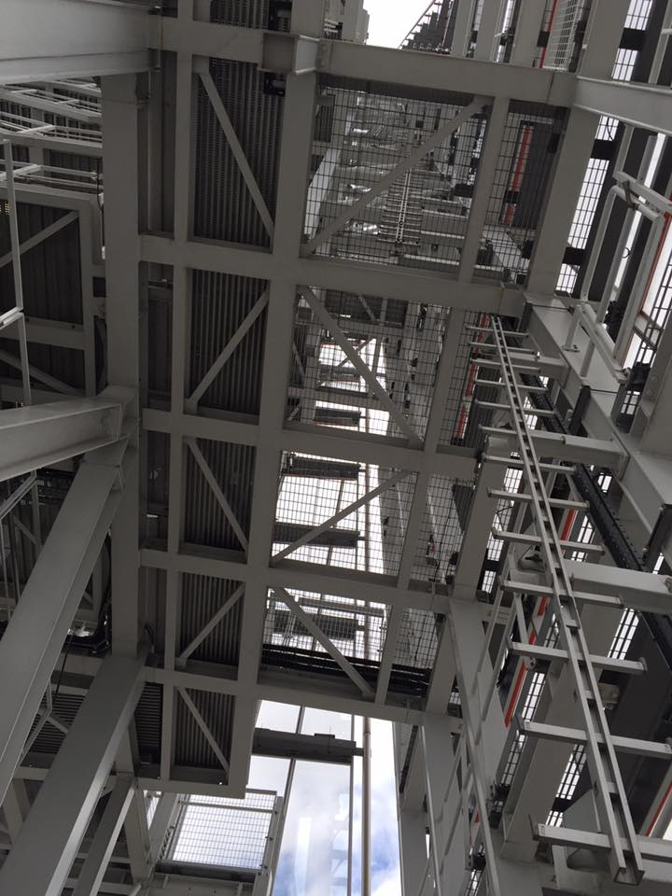
Any questions?
Thank you for listening

Slide 18
references
https://www.designingbuildings.co.uk/wiki/High-rise_building - what is a high rise building?
https://www.designingbuildings.co.uk/wiki/Building_regulations_completion_certificate - what is a completion certificate?
https://www.hilti.co.uk/firestop-and-fire-protection-systems/firestop-foams/r26040#documents-videos Hilte – how to video
https://youtu.be/djB4dmfHhQk fire blocking foam differences
https://www.allerdale.gov.uk/downloads/labcpd0715_techg_firefoam_0.pdf
https://nationwidefiresprinklers.co.uk/wp-content/uploads/2017/08/BAFSA-Water-Mist.pdf
http://www.mistek.co.uk/?gclid=EAIaIQobChMIo56fwsX11gIVxZ3tCh10zQB1EAAYAiAAEgKIZvD_BwE
Notes:
High-rise building
A high-rise building is defined variously as a building in which:
The number of storeys means occupants need to use a lift to reach their destination,
The height is beyond the reach of available fire-fighting equipment.
The height can have a serious impact on evacuation.
Typically this is considered to include buildings of more than 7 to 10 storeys or 23m to 30m.
A low-rise building is one which is not tall enough to be classified as high-rise.
Other definitions of buildings in relation to their height include:
Mid-rise buildings of five to ten storeys, equipped with lifts.
Skyscraper of 40 storeys or more.
Supertall buildings exceeding 300m.
Megatall buildings exceeding 600m.
Groundscrapers that extend horizontally over a large distance while only being of a low to medium height.
Super-slender buildings which are pencil-thin and of 50-90+ storeys.

